Slide 1

Computational Methods for Quantum Many-Body Systems (CMQMS) -
from artificial atoms to high-temperature superconductors
Lecture 23 – Random Phase Approximation
Prof. Dr. Thomas Schäfer Università degli studi di Trieste (UniTS), Winter Semester 2025

Slide 2
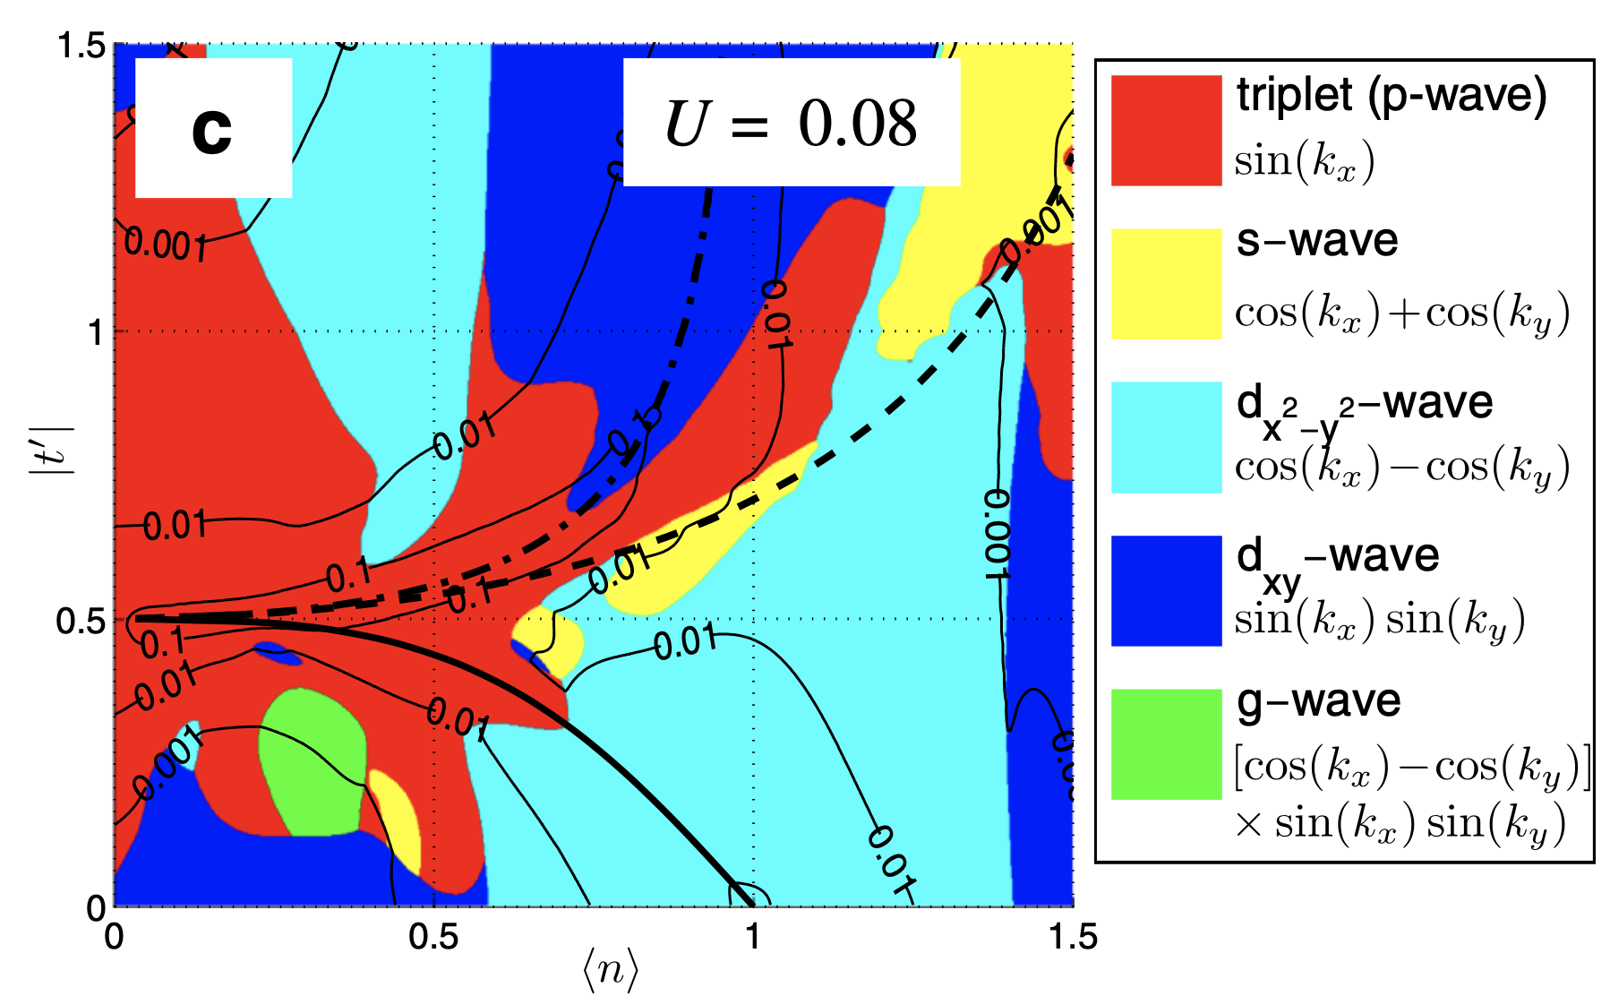
Random phase approximation for the Hubbard model
Superconductivity: linearized gap equation has a solution with $Δ\left(\vec{k}\right)≠0$ if $λ≥1:$
$$λΔ(\vec{k})=−\sum_{{\vec{k}}^{′}}{Γ_{pp}(\vec{k},{\vec{k}}^{′})\frac{1}{2ε_{{\vec{k}}^{′}}}Δ({\vec{k}}^{′})}$$
Leading instabilities in RPA as a function of filling $n$ and next-nearest neighbor hopping $t^{′}$:
Large area around
half-filling with
d-wave symmetry
A. Kreisel, et al., J. Supercond. Nov. Magn. 30, 85-89 (2017)
see also A. T. Rømer, et al., Phys. Rev. Research 2, 013108 (2020)

