Slide 1
Bank Loan Data Prediction Using Machine Learning
Team 05
Shang-Yi Cheng, Marcel Reitzle, Tobias Michael Schäfer, Karan Sharma, Yen-Chun Tseng

Slide 2
Overview
Kaggle dataset about bank loans (Source: World bank)
Data was unbalanced (8:2)
Various features about loan recipient e.g.
Current Loan Amount
Credit Score
Annual Income
Years in current job
Current Credit Balance
Target: Loan Status
Charged Off or Fully Paid

Slide 3
Preprocessing
Handling missing values
Data Exploration
Converting categorical values to numeric (low freq. to others category )
Outlier Removal (IQR, DBSCAN) , domain knowledge (eg. Credit Score)
Re-sampling (imbalanced dataset) on training dataset
Feature generation to improve source data
PCA decomposition
Usage of featuretools
Polynomial feature generation

Slide 4
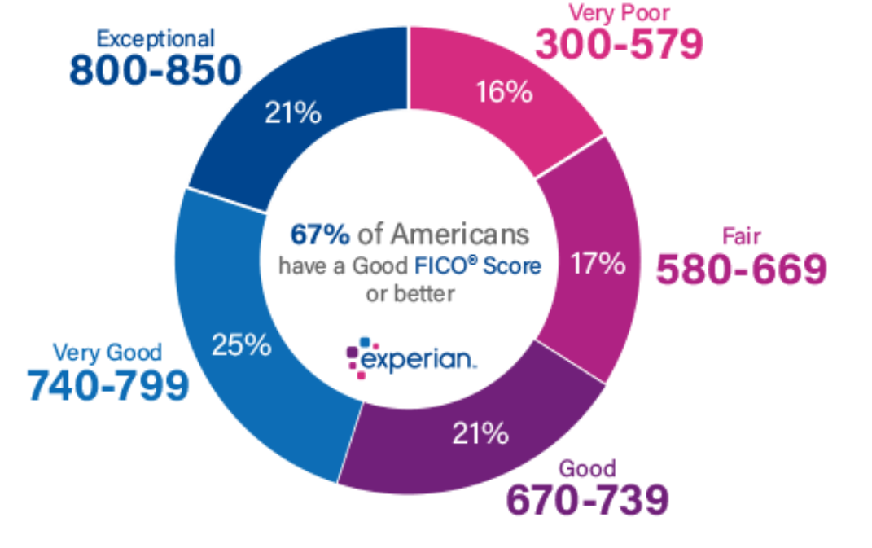
19 Variables → 17 Relevant Variables
Credit Score is highly interesting
Score between 300 and 850
Except for two (around 80%) all are filled at nearly 100%

Slide 5
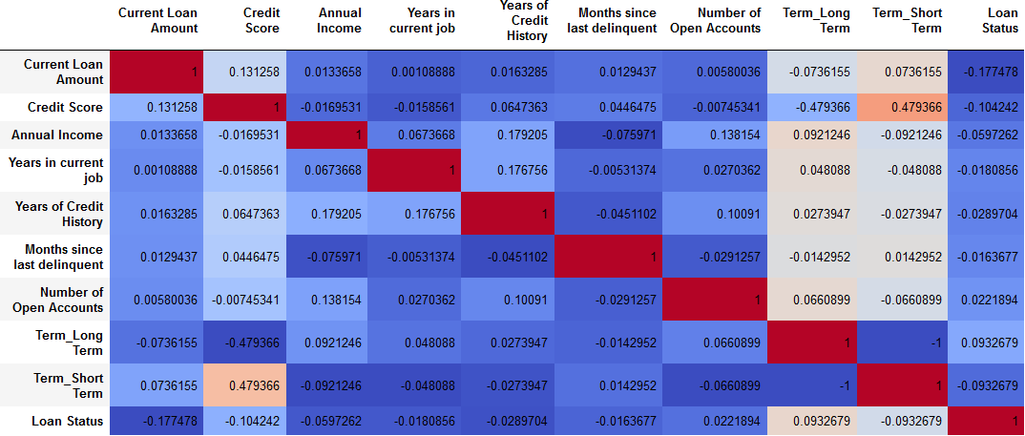

Slide 6
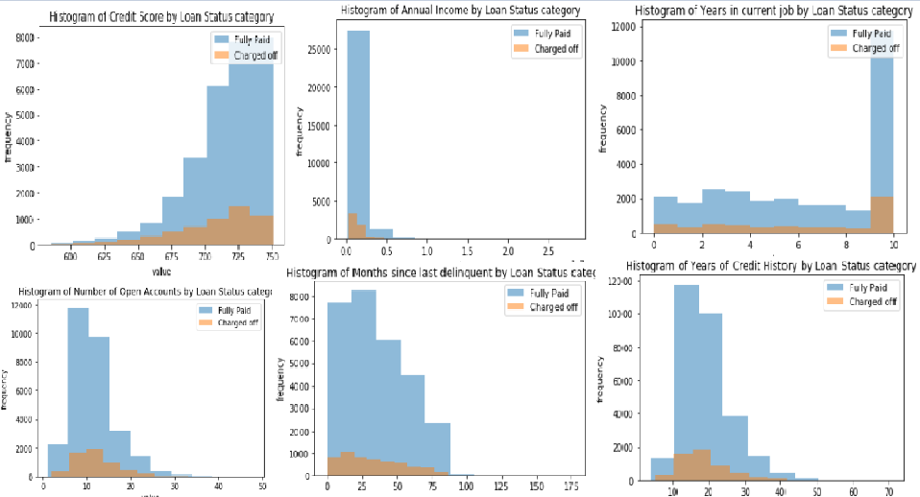

Slide 7
Used algorithms
To select the best estimator we used different approaches:
K-nearest Neighbor
Decision trees
Naïve Bayes
Support Vector Machines
Ensemble - RandomForest
Boosting – XGBoost, AdaBoost

Slide 8
Results
Evaluation performed on F1 score due to the unbalanced data
Incremental approach during processing
Trail and error approach for finding the best dataset and best estimator
Algorithm | Score on data after preprocessing | Best score
K-Nearest-Neighbors | Accuracy: 0.74 – F1: 0.35 | F1: 0.996 (PCA dataset)
Naïve Bayes | Accuracy: 0.84 – F1: 0.001 | F1: 0.91 (PCA dataset)
Decision Trees | Accuracy: 0.73 – F1: 0.31 | F1: ~1.0 (PCA dataset)
Random Forest | Accuracy: 0.92 – F1: 0.90 | F1: 0.99 (PCA dataset)
Support Vector Machines | Accuracy: 0.57 – F1: 0.29 | F1: 0.33 (resampled dataset)
XGBoostClassifier | Accuracy: 0.81 – F1: 0.21 | F1: 0.30 (resampled dataset)
AdaBoostClassifier | Accuracy: 0.81 – F1: 0.21 | F1: 0.27 (resampled dataset)
Accuracy also presented to show difference

Slide 9
Conclusion
Decision Trees and Random Forests work best on the given data
Random Forest also archives are score > 0.84 on the default set
PCA decomposition produces a more predictable dataset
The possibility of overfitting was considered, but with a strict train-test split this was kept under control

Slide 10

Questions?

Slide 11
Details (Best scores (F1) per data source
Algorithm | Default data | Outlier removal | PCA | Featuretools | Polynomial
K-Nearest Neighbor | 0.35 | 0.32 | 0.99 | 0.01 | 0.03
Decision Tree | 0.31 | 0.32 | ~1.0 | 0.0 | 0.003
Naïve Bayes | 0.001 | 0.001 | 0.91 | 0.001 | 0.001
Random Forests | 0.9 | 0.9 | 0.99 | 0.88 | 0.9

