Slide 1

Thorsten Scherf
Trier, April 2016

Slide 2

Me
Global Support Engineering Product Lead for Red Hats Identity Management solution
Principal Software Maintenance Engineer
Primarily working on LDAP, Kerberos and PKI

Slide 3
Acronyms
SSL (Secure Sockets Layer) – old security layer for TCP
TLS (Transport Layer Security) – the new security layer for TCP
HTTPS (HTTP Secure) – HTTP over TLS
X.509 – the format used by TLS certs
PKI (Public Key Infrastructure) – an infrastructure for distributing X.509 certificates
CA (Certificate Authority) – an entity that issues X.509 certificates in a PKI

Slide 4
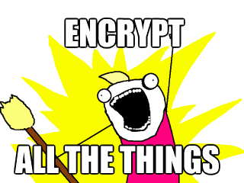
Why encrypt?
Snowden says, “encryption works”
Networks are untrustworthy and communications need to be protected…
...not only for financial data or user logins

Slide 5
Why is not everybody using TLS by default?
Whole topic is difficult to understand. Fedora has > 200 CA certificates included
Even a skilled person who understands PKI conceptually may take ~1 hour to get and deploy a certificate
Difficult integrating into some server and data center designs
Cost and effort of obtaining and managing PKI certificates
Performance

Slide 6
TLS and performance
TLS has exactly one performance problem: it is not used widely enough.
  Everything else can be optimized.
On our production frontend machines, SSL/TLS accounts for less than 1% of the CPU load, less than 10 KB of memory per connection and less than 2% of network overhead. Many people believe that SSL/TLS takes a lot of CPU time and we hope the preceding numbers will help to dispel that.
- Adam Langley, Google
https://istlsfastyet.com/

Slide 7
TLS configuration & tuning
Optimize TCP first
Server Name Indication (SNI)
Disable old protocols
Select right ciphers
HTTP Strict Transport Security (HTST)
Forward secrecy
Session Caching and Resumption
OCSP stapling

Slide 8
What is actually needed then?
We need a solution for Usability
We also need a solution for Security
Crypto on the Internet should be for free

Slide 9
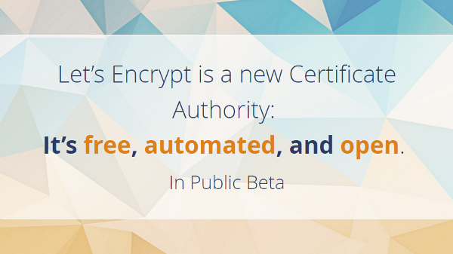

Slide 10
Let's Encrypt
Initially, a collaboration among EFF, University of Michigan and Mozilla
  to create a fully automated CA to issue certificates to any site for any purpose, quickly and at no charge
  aiming to be cheaper and more easier to implement
Now owned by the Internet Security Research Group (ISRG)
Thanks to partners including Akamai, Cisco, and IdenTrust, we now have publicly trusted certificates accepted by all major browsers

Slide 11

Current status
Private Beta started Nov 2015
Entered public beta Dec 2015
Issued its millionth certificate March 2016
Growth rate 100.000 certificates / week
High adoption at ISPs

Slide 12
Cross-signing
Root CAs can and do delegate their authority to intermediate CAs — currently hundreds of named entities
Browsers then automatically trust these intermediates
  end-entity certs are almost always signed by intermediates, not roots
Let's Encrypt CA is cross-signed by IdenTrust
  mainstream browsers trust immediately
  browser users won't have to install Let's encrypt CA's root certificate manually

Slide 13
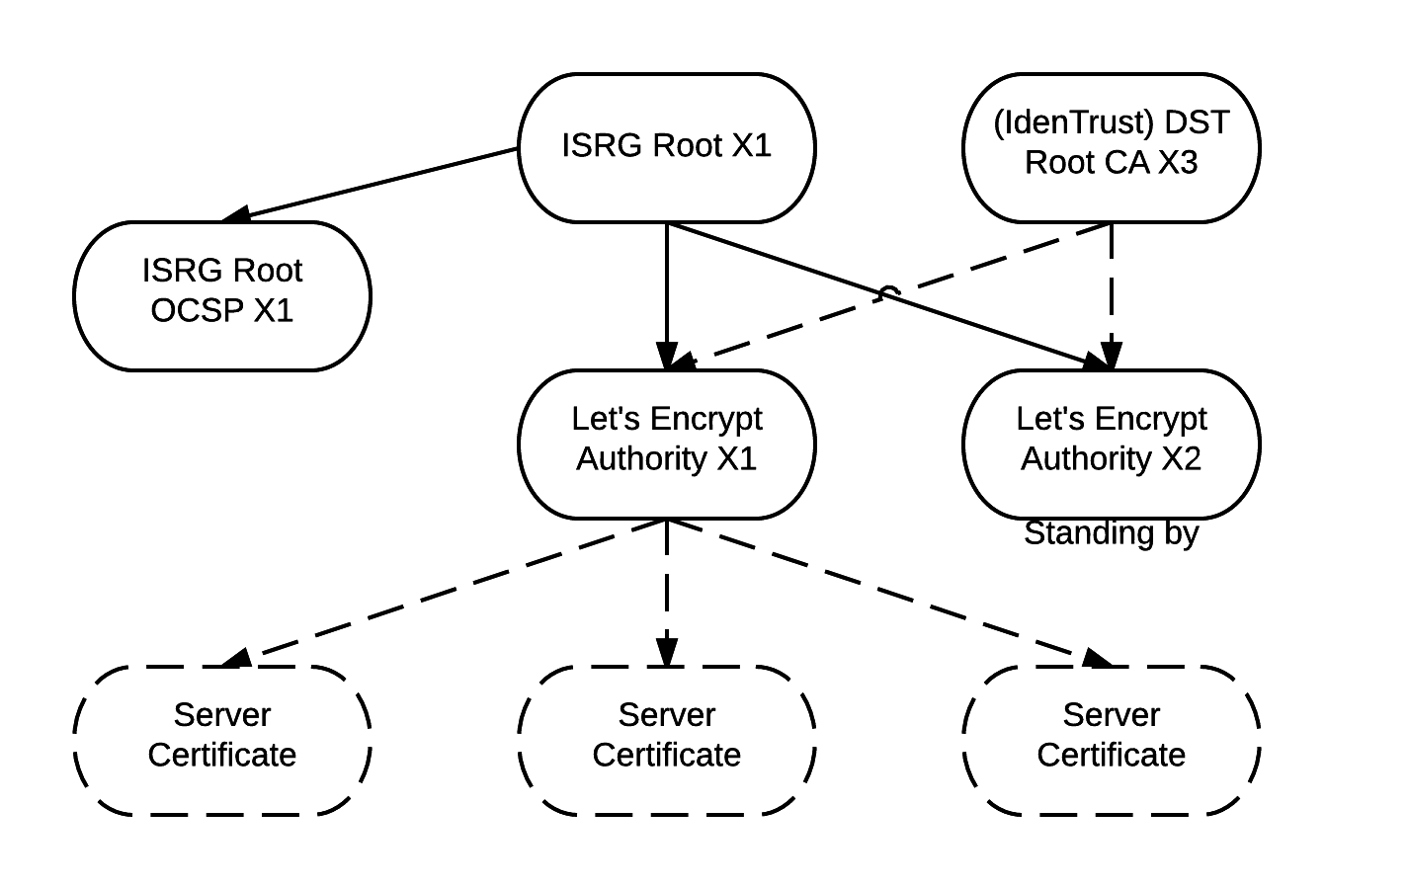
Cross-signing

Slide 14
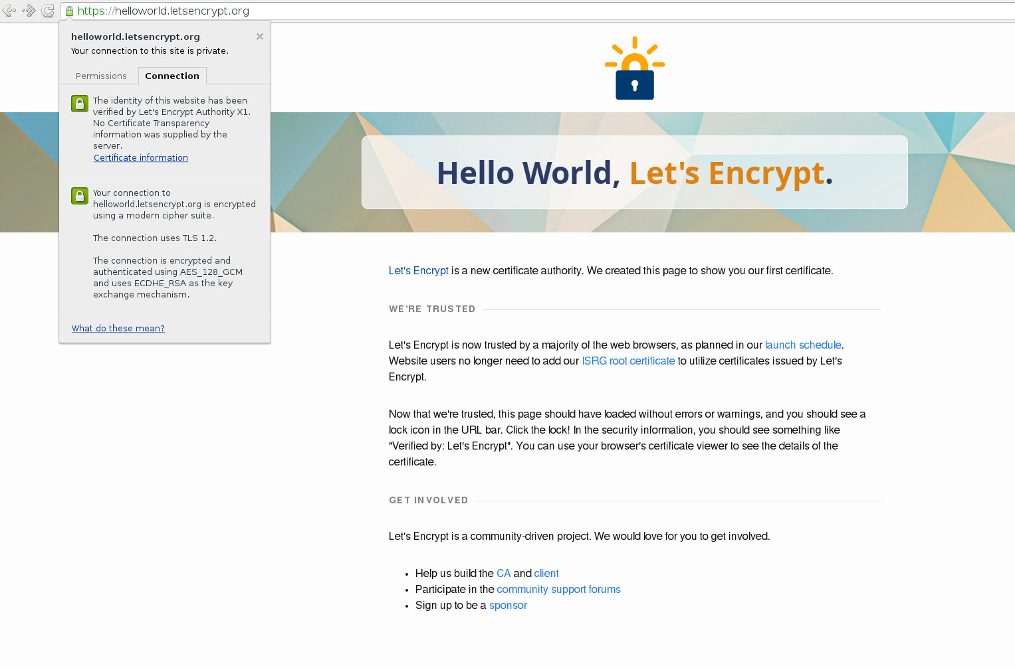

Slide 15
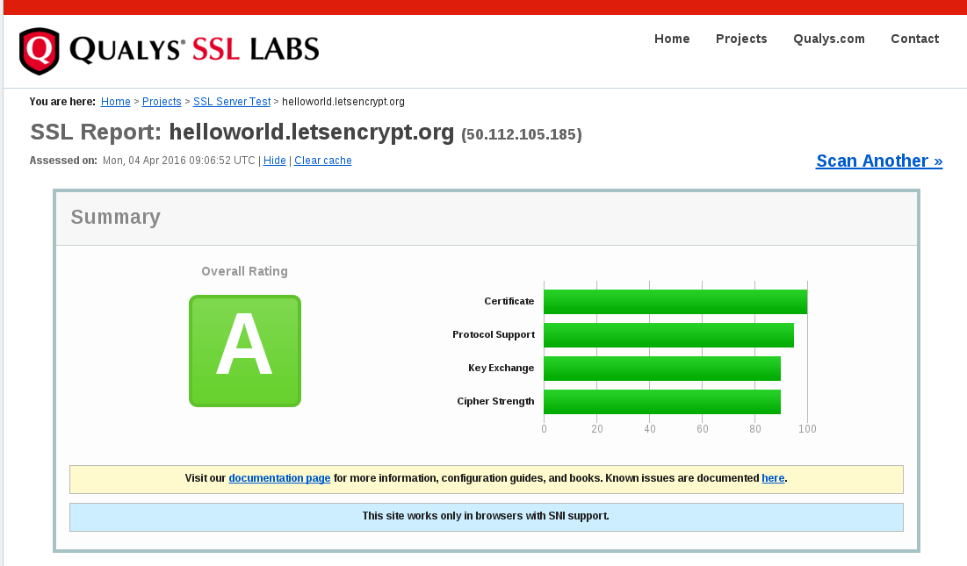

Slide 16
Connection details
# openssl s_client -connect archlinux.org:443
CONNECTED(00000003)
depth=2 O = Digital Signature Trust Co., CN = DST Root CA X3
verify return:1
depth=1 C = US, O = Let's Encrypt, CN = Let's Encrypt Authority X1
verify return:1
depth=0 CN = archlinux.org
verify return:1
---
Certificate chain
0 s:/CN=archlinux.org
i:/C=US/O=Let's Encrypt/CN=Let's Encrypt Authority X1
1 s:/C=US/O=Let's Encrypt/CN=Let's Encrypt Authority X1
i:/O=Digital Signature Trust Co./CN=DST Root CA X3
---
[…]
SSL-Session:
Protocol : TLSv1.2
Cipher : ECDHE-RSA-AES256-GCM-SHA384

Slide 17
Let's Encrypt validation
Uses DV (Domain Validation)
  No organizational (OV) or extended (EV) validation
  Verification by the CA that the applicant controls the domain name (or a server that the domain name is pointed at)
No certificates for
  code signing
  .mil domains
  ip addresses
No wildcard certificates
No S/MIME

Slide 18
Let's Encrypt concept
Client claims to control a particular name or names, and asks for a cert for them
Server issues one or more challenges to ask the client to prove its control (and/or possibly prove control of other cryptographic keys)
Client satisfies these challenges and server verifies this automatically, then issues cert and sends it over
Certificate is valid for 90 days
Can be renewed automatically

Slide 19
Software
Server-side CA Software
Boulder is the primary Let’s Encrypt CA implementation. It’s based on the ACME protocol, and written primarily in Go
https://github.com/letsencrypt/boulder
https://github.com/ietf-wg-acme/acme/

Slide 20
Software
Client Software
Let's Encrypt is a Python-based utility that works alongside Apache to automatically obtain a certificate and automatically convert a website to HTTPS
The client can configure your web server in the most secure way. But it's optional and can be a manual task.

Slide 21
Clients
Default client is based on ncurses
Sources are available on github
Requires a public IP address and port 80/443 open
Lot's of different client implementations are available
https://github.com/letsencrypt/letsencrypt/wiki/Links
https://github.com/letsencrypt/letsencrypt

Slide 22
Usage limits
100 names / certificate
20 certificates / domain per week
  Doesn't apply for renewals
5 certificates / fqdn per week
  For testing either use staging environment or –test-cert option

Slide 23
Request a certificate
# dnf install letsencrypt
# letsencrypt --text --renew-by-default --email recovery@example.com \
--domains www.example.com,example.com,foo.example.com \
--agree-tos --webroot --webroot-path /var/www/html certonly
# ln -s /etc/letsencrypt/live/www.example.com/cert.pem /etc/pki/tls/certs/www.example.com.crt
# ln -s /etc/letsencrypt/live/www.example.com/chain.pem /etc/pki/tls/certs/www.example.com.chain.crt
# ln -s /etc/letsencrypt/live/www.example.com/privkey.pem /etc/pki/tls/private/www.example.com.key
# Configure and restart your web server

Slide 24
Renew certificate
# cat > www-example-com-renewal.service <<EOF
[Unit]
Description=Automatically renew the www.example.com certificate
[Service]
Type=oneshot
ExecStart=/usr/bin/letsencrypt -d www.example.com --renew-by-default \
-m recovery@example.com --agree-tos -t --webroot -w /var/www/html certonly
ExecStart=/usr/sbin/systemctl reload httpd
EOF
# cat > www-example-com-renewal.timer <<EOF
[Unit]
Description=Trigger an automatic renewal every month
[Timer]
OnCalendar=monthly
Persistent=true
[Install]
WantedBy=multi-user.target
EOF

Slide 25
Revoke a certificate
# letsencrypt revoke --cert-path /etc/letsencrypt/archive/www.example.com/cert1.pem

Slide 26
THANK YOU
Questions?
tscherf@redhat.com

