Slide 1
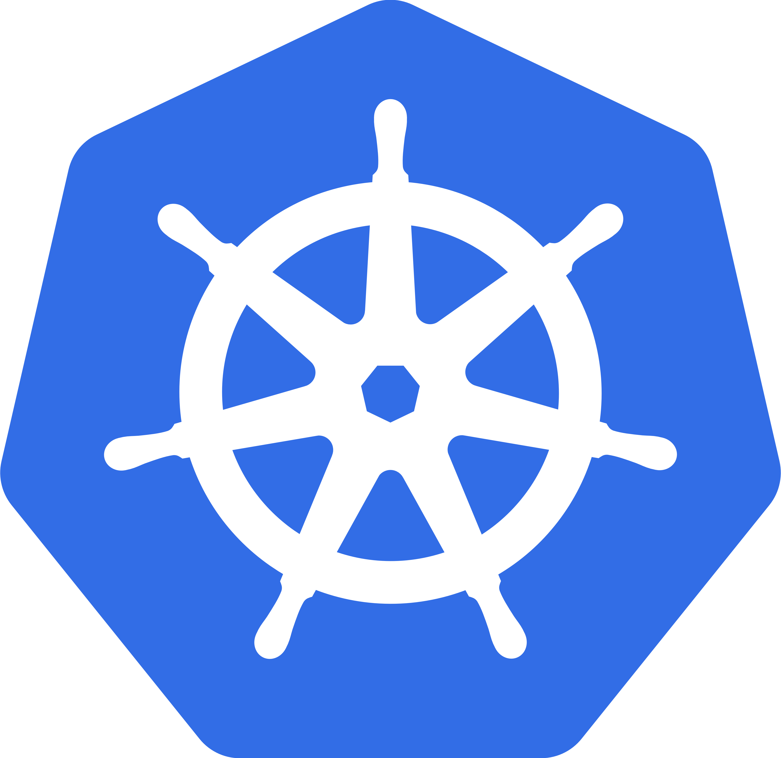
Kubernetes
Thorsten Scherf
Red Hat
SLAC, Berlin 2015

Slide 2
Agenda
What is Kubernetes
Kubernetes Primitives
Configuration and Cluster Setup Pointers

Slide 3
DOCKER PROS AND CONS
Pros
  Standardized interface for a container
  Ease of use, makes Linux containers consumable
  Very easy to create and work with derivative images
  Fast boot on containers
Cons
  Host centric solution, not aware of anything else
  Cannot handle networking between containers on separate hosts
  No higher level provisioning to connect related containers
Notes:
Docker is starting to grow into the cluster space. We believe that working with a company who has many many of experience working with containerized clusters is a wise choice.
As with all things docker it looks so simple and easy on the surface, but the devil is in the details. We also do not want to be too beholden to a single corporation's interests.
Kubernetes is very good working with an taking patches from the community, and got to clustering first.
All discussed on a later slide.

Slide 4
What is Kubernetes?
A declarative language for launching containers.
Notes:
Such a simple thing!
It allows you to define how you want the world to look and then it attempts to make the world look that way.
It uses json and yaml files as inputs and outputs for most REST apis. We describe what the cluster should do in this declarative language and let kube do the work.
The definition of these json files is currently version v1beta1. In the first update of atomic it is likely that v1beta3 will be available. It is a much cleaner API and all customers will need to port all pod/service/rc defitions to v1beta3. Sorry :-(
Not all of the docker command line can be expressed in kubernetes. But is you actually NEED that we may expose it.

Slide 5
What is Kubernetes?
A highly collaborative open source project originally conceived by Google
  Google has 10+ years experience w/ containerized apps
Sometimes called:
  kube
  k8s (that's 'k' + 8 letters + 's')
Start, stop, update, and manage a cluster of machines running containers in a consistent and maintainable way.
Notes:
Very very active. Much much younger than docker.
As of Feb 26, 2015
3968 non-merge commits in kube
8500 non-merge commits in docker

Slide 6
WHAT IS KUBERNETES
Kubernetes is a container cluster manager
Manages containerized applications in a clustered environment
It provides discovery across the cluster
Kubelet
  Kubelet (daemon on the worker node)
  Pods (collection of containers)
  Services (discovery mechanism between pods)
  Replication Controllers (replicated and monitored pods)
Pod 1
Pod 2
C1
C2
C3
Notes:
Obviously details on what these things are follow in later slides.

Slide 7
What is Kubernetes?
Particularly suited for horizontally scaleable, stateless, or 'microservices' application architectures.
  Does not mean others will not work or are ignored
Additional functionality to make containers easier to use in a cluster (reachability and discovery).
Kubernetes does NOT and will not expose all of the 'features' of the docker command line.
Notes:
The upstream kube project is generally of the mindset that 'applications and machines are replaceable.' This means that it might not be best suited for applications which cannot handle downtime. Kube is based on systems with replicas instead of a single huge system with extremely high uptime.
In general, I say, if you are going to pay a person full time to keep an application running (like you hired a db admin specifically for that purpose) that application may not gain much benefit moving to kube. (but maybe some!)

Slide 8
Kubernetes Primitives and Key Words
Master
Node/Minion
---------------------
Pod
Replication Controller
Service
----------------------
Label
Namespace
Notes:
Minion is being phased out, instead upstream is using the word “node”
We'll go over each one in detail.

Slide 9
Master
Typically consists of:
  kube-apiserver
  kube-scheduler
  kube-controller-manager
  etcd
Might contain:
  a network management utility
Notes:
These are all daemons.
Supposed to be composable parts. They communicate via a REST api. So it is 'possible' to completely swap out the scheduler.
The apiserver is obvious, as is the scheduler. The 'controller-manager' is a daemon that try to 'control' 'things.' On clouds with support it controls the addition and removal of nodes. It controls the addition and removal of pods based on replication controllers, etc.
Etcd is a storage 'DB' for kubernetes. That might change someday. Only the apiserver needs to talk to it (and flannel, but that's a later slide)

Slide 10
Node - Minion
Typically consists of:
  kubelet
  kube-proxy
  cAdvisor
Might contain:
  a network management utility
Notes:
The kubelet is what gets pods from the apiserver and launches the containers on the host. It is the real worker.
The proxy is how services work. Pods send traffic to a service IP address. The proxy intercepts the traffic and forwards it where-ever it needs to go.
cAdvisor is a container resource usage monitoring tool. It is provided although little used today. The scheduler may make more use of this knowledge in the future.
Network management will be discussed later.

Slide 11
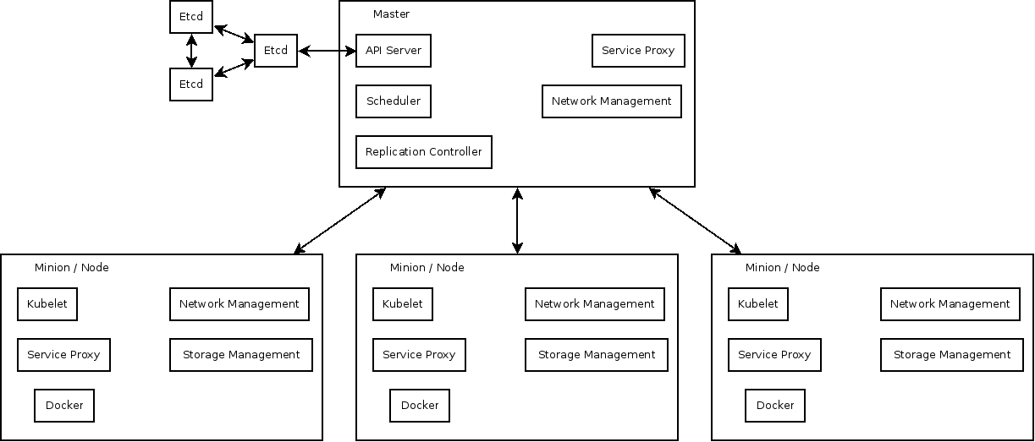
Systems and Binaries
Notes:
Side note: while this is accurate from a kubernetes PoV, flannel, the overlay networking tool we ship, talks directly to etcd from each minion.

Slide 12
Pod
Single schedulable unit of work
  Can not move between machines
One or more containers
  Shared network namespace
Metadata about the container(s)
Env vars – configuration for the container
Every pod gets an unique IP
  Assigned by the container engine, not kube!
Notes:
A pod is the SMALLEST thing kube knows about. Period, full stop. One pod can NOT be on 2 machines (although you might have 2 copies of the same pod)
There is often only a single container in a pod. But there could be 2. You might have a webserver container and a and DB container in the same pod. They may be pre-configured to talk via 127.0.0.1 and it would just work!!

Slide 13
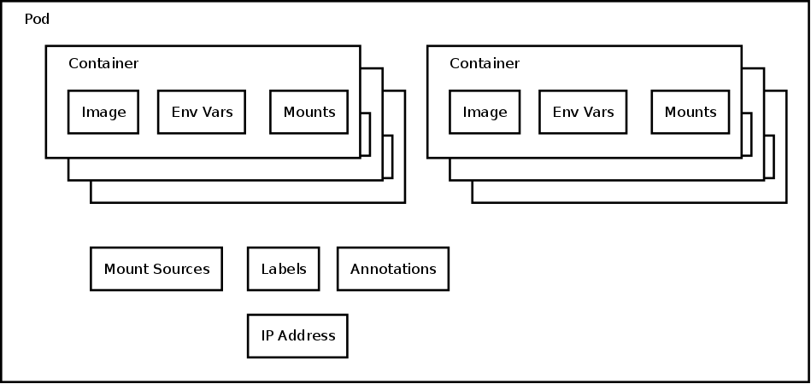
Pod
Notes:
Pods are collections of containers. This shows the main objects of a pod.
Each POD has an IP address. Pods may have labels or annotations (later in slides).
Containers state what image should be run, what env variable you want to inject.
Containers inside pods may also have liveness checks (very basic). Policy on when to pull from the repo, etc...
Storage is in flux. It will change soon. Today you define all of the sources of storage in the pod and you define where the sources get mounted in each container. The source information will move out of the pod definition entirely soon.
Slide on storage later.

Slide 14
Replication Controller
Consists of
  Pod template
  Count
  Label Selector
Kube will try to keep $count copies of pods matching the label selector running
If too few copies are running the replication controller will start a new pod somewhere in the cluster
Notes:
This is “High Availability” only so far as you can have multiple copies running at once. This is not necessarily a replacement for a “true” HA solution. Although its a LOT better than nothing if you application can scale horizontally.

Slide 15
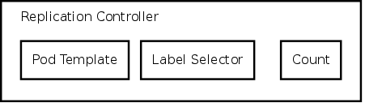
Replication Controller
Notes:
Pretty simple.
The “pod template” is how the rc knows what pods to launch if it needs to launch more.
The count is how many the system should be running.
The 'label selector' matches labels on pods to count how many are running.
If a replication controller is defined with the label selector == name=apache and count == 5 and there were already 10 pods running with name=apache, it will stop 5 pods!!

Slide 16
Services
Most every pod/replication controller will need a service. What's the point of a pod that doesn't provide some sort of service/useful work?
How 'stuff' finds pods which could be anywhere
Define:
  What port in the container
  Labels on pods which should respond to this type of request
Notes:
Services are available inside all pods started after the service created as environment variables.
There exist patches to dynamically manage DNS entries for services, but not available on atomic. Thus containers would be able to just use a DNS name rather than an ENV variable. Someday, maybe.
Services are implemented as a combination of iptables NAT rules and the kube-proxy binary.
Packets are sent to the service ip, iptables redirects them to the proxy, the proxy proxies them to the pod IP backing the service

Slide 17
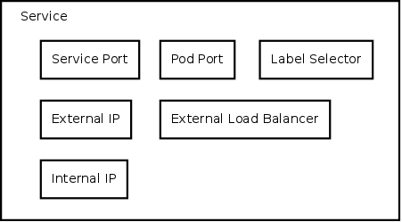
Services
Notes:
Most of these can be defined by the user. But realistically only the 'label selector', 'pod port,' and sometimes the 'external ip' should be.
Label selector is how the service knows what pods respond for this 'service'. Same as on the rc. Labels discussed a bit more below.
Pod port is obvious.
The external IP isn't so obvious to people. This needs to be an ip address that a computer responds to which is running the kube-proxy (and probably the sdn solution). This means it needs to show up in “ip addr” on some machine! For setups like OS1 or amazon AWS where VMs have a 'public' and 'private' IP. This needs to be the private ip. Kube doesn't know anything about those system's 'public' IPs.
The internal IP is ABSOLUTELY meaningless. These ip addresses (defined as the –portal_net= on the apiserver) NEVER hit a wire. They NEVER leave the box. Just pick and IP address range not in use anywhere and ignore them.
External IP addresses need to be that of a machine which responds to the IP and is running the kube-proxy (and likely the network controller)
External Load Balancer only available on GCE

Slide 18
Labels
List of key=value pairs
Attached to all objects
Currently used in 2 main places
  Matching pods to replication controllers
  Matching pods to services
Objects can be queried from the API server by label
Notes:
Current label selector language is simplistic (&&). But they envision a much richer language.
You can create a rc which matches on name=apache && release=prod. Another rc could control pods with name=apache && release=canary.
But you might have a service which only have name=apache. So the service would load balance across both the prod and canary releases!

Slide 19
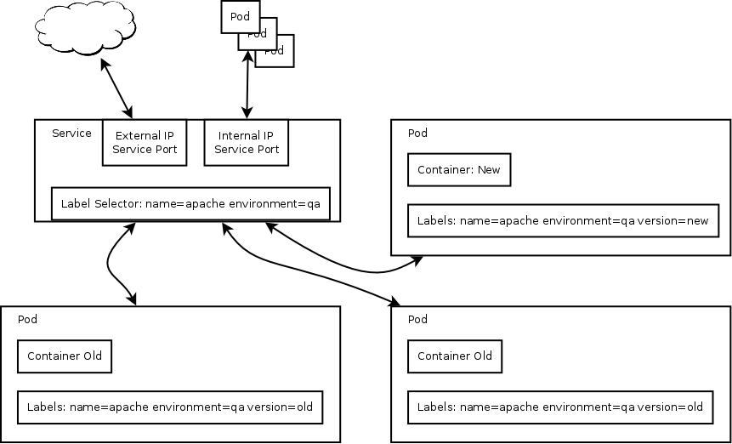
Services and Labels
Notes:
Other pods, which use a service, would use the “internal ip” which is provided via an environment variable.
Things outside the cluster can use the external ip.
The service proxy will use the label selector to find what pods it should load balance to. In this case the service label selector only matches on “name” and “environment” so traffic would be load balanced between the version=old and version=new pods.

Slide 20
Namespace
Attached to every object
Pods in ns1 will not get service variable from ns2
Users with permission to CRUD (create, read, update, delete) objects in ns1 may not have permissions to CRUD object in ns2
The network is not segregated.
Some people consider using a namespace per application. Some say a namespace per team.
Notes:
In atomic today namespaces are not a first class objects like pods, services, and replicationControllers in atomic. Instead they are just an annotation on the command line when you run kubectl.
They are upstream and will need to be created/deleted/managed similarly in future atomic releases. Soon you will not be able to use the –namespace= option to kubectl is you haven't already created the namespace!

Slide 21
Networking Setup
Networking is a docker problem – not kube
  Kube makes those problems apparent!
  If any two docker containers on any two hosts can talk over IP, kube will just work.
Docker looks so easy
  2 containers on one host can easily talk.
  How to get to those containers from outside?
  How to get to from one conainer on one host to a container on another?
Networking is really hard!
Notes:
Docker has a terrible networking model. Everyone who looks at it knows that. They plan to make a networking plugin model that will solve everyone's problem for everything. But that does not exist today and its does not seem likely to land any time soon.
Kubernetes is working on a plugin model as well. The upstream community seems more receptive. As the orchestration layer is the one best suited to knowing about network requirements, it makes sense to have something in kube. It will likely one day use the docker plugin model. But today we have to work around docker to get containers on 2 hosts to be able to talk.
We use flannel in atomic. There is something very very similar to flannel call openshift-sdn. Same idea. It configures the docker0 bridge before docker comes up to make things work. With the plugin model inside kube we may be able to have much more complex network solutions like programming your infrastructure network fabric automatically or building network connections on demand between pods, but this is a ways out.
The network requirement is SIMPLE. If a pod on machine 1 can talk via IP to a pod on machine 2, things are good!

Slide 22
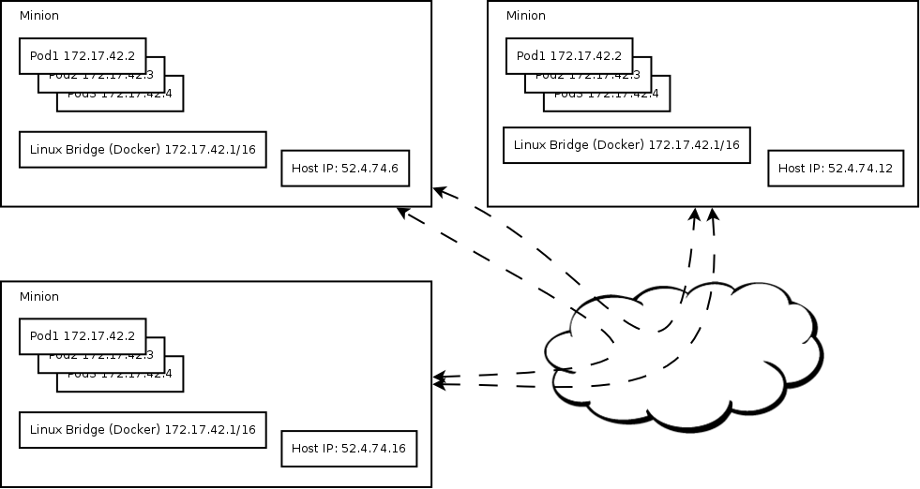
Networking Docker Out Of The Box
Notes:
See how docker containers on 2 hosts have the same IP? How is that supposed to work?!
Sure docker is simple as long as it's just running on your laptop, but how does that work in production?

Slide 23
Networking Setup – Available in Fedora
Flannel
  Super super easy configuration
  Can create a vxlan overlay network
  Can configure docker to launch pods in this overlay
  Pods just work!
There are many other solutions.
  This one is easy.
Notes:
This may be replaced with openshift-sdn in the future. Openshift-sdn is a LOT like flannel, but is tied more closely to kubernetes and uses OVS instead of the linux bridge for a (small) performance improvement.
Flannel must run before docker starts. It determines a subnet of addresses that should be used on 'this' machine. It also determines the entire address space of the whole overlay network. When docker starts it creates the docker0 linux bridge so addresses are correct.
Flannel tunnels traffic to other pods over the real network using vxlan. On the wire, traffic is only seen between hosts, you wouldn't see the pod IPs.

Slide 24
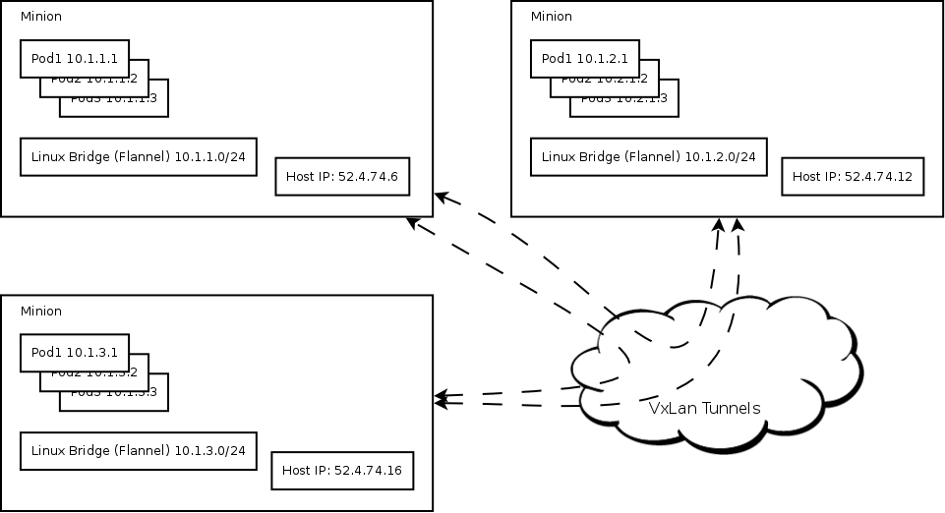
Networking with an overlay network
Notes:
Notice how with flannel containers all have their own Ips? That's because flannel configured the network before docker started. It also set up the tunnels so those container IPs are not visible while they are on the wire. No network infrastructure changes are needed to support flannel.

Slide 25
THANKS FOR LISTENING !!
Questions:
<tscherf@redhat.com>
Notes:
Today, the replication controller takes a list of nodes. In the next version of atomic nodes will need to be created via kubectl just like pods, services, rc.
Today how each daemon finds the apiserver is a command line mess. This is likely to be cleaned up (hopefully it will be backwards compatible) mess means that the controller-manager, scheduler and proxy all take –master, the kubelet takes –api_servers and kubectl takes –server.
We really really want to make the client almost configurationless. But we aren't there.
We know that that v1beta1 kube api stinks. v1beta3 is coming soon. Everyone be prepared to redo json object definitions.

