Slide 1
US School Violence
(2010-2018)
Investigation by Tyler Schmalz

Slide 2
Motivation
US has most school shootings
Substantially higher than similar nations
Student safety
Impact on student learning
Notes:
288 school shootings in the US, since only 2009!!!
That is 57 times the number of school shootings than all other industrialized nations COMBINED
50% of all incidents worldwide from 2000 to 2010 with 2 or more victims occurred in the US
Studies show that students standardized math and english scores drop substantially following the year or two after a school shooting

Slide 3
Investigating
Features with strongest relationship
Predictability of casualty rate
Likely times/areas of occurrence
Impact of overall county health
Notes:
These are the main topics/questions I set out with when beginning this investigation.

Slide 4
Data Source
School violence since Columbine from The Washington Post
County health characteristics from the Robert Wood Johnson Foundation Program
Notes:
School violence dataset contains information specific to the incident (time, date, shooter information), demographics of the school (ethnicity, size, staffing, etc.).
County health had a wide variety of characteristics to select from. Decided upon average mentally unhealthy days per week, percent who report binge drinking, teen birth rate, percent uninsured, high school graduation rate, percent of adults with some college education, unemployment rate, percent of children living in poverty, percent of single-parent households, and the primary care physician ratio to the county’s population
Selected because of their hypothesized connection to school violence and them being included from 2010-2018.

Slide 5
Exploring the Data

Slide 6
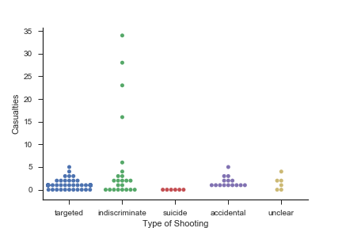
Targeted vs. Indiscriminate
Targeted shooting most common
Indiscriminate shooting most tragic

Slide 7
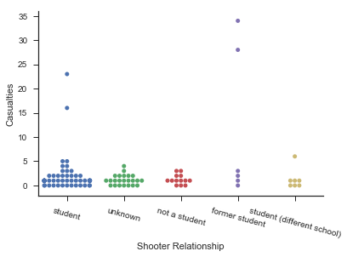
Shooter Relationship
Most common from current or former student of school

Slide 8
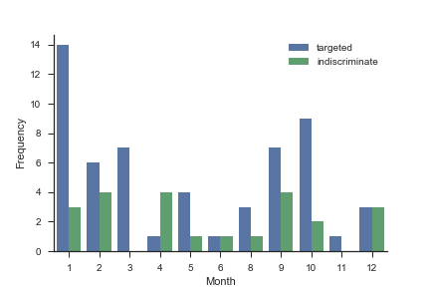
Shooter Relationship
18% of school shootings occur in January!

Slide 9
County Health
Higher teen birth rates and children in poverty in targeted/indiscriminate shooting areas
Higher rates of excessive drinking in higher casualty shooting areas

Slide 10
Future Recommendations

Slide 11
Future Studies
Include more health characteristics from county dataset
Find county health dataset that goes back further than 2010

