Slide 1



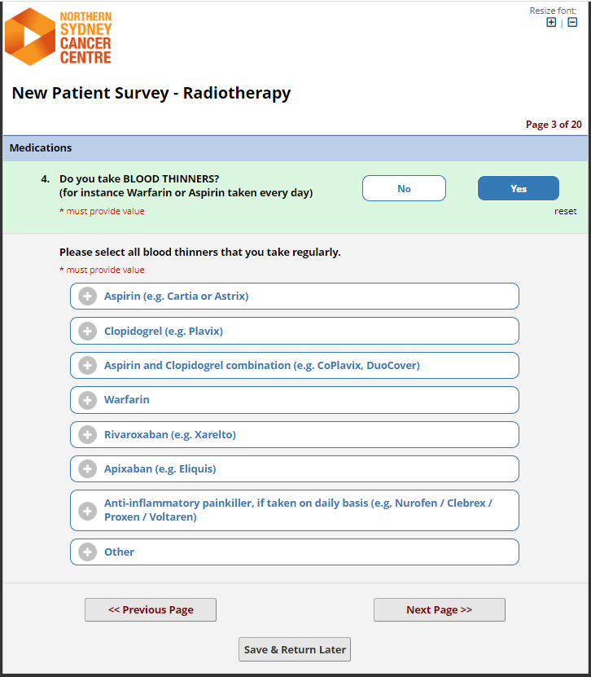


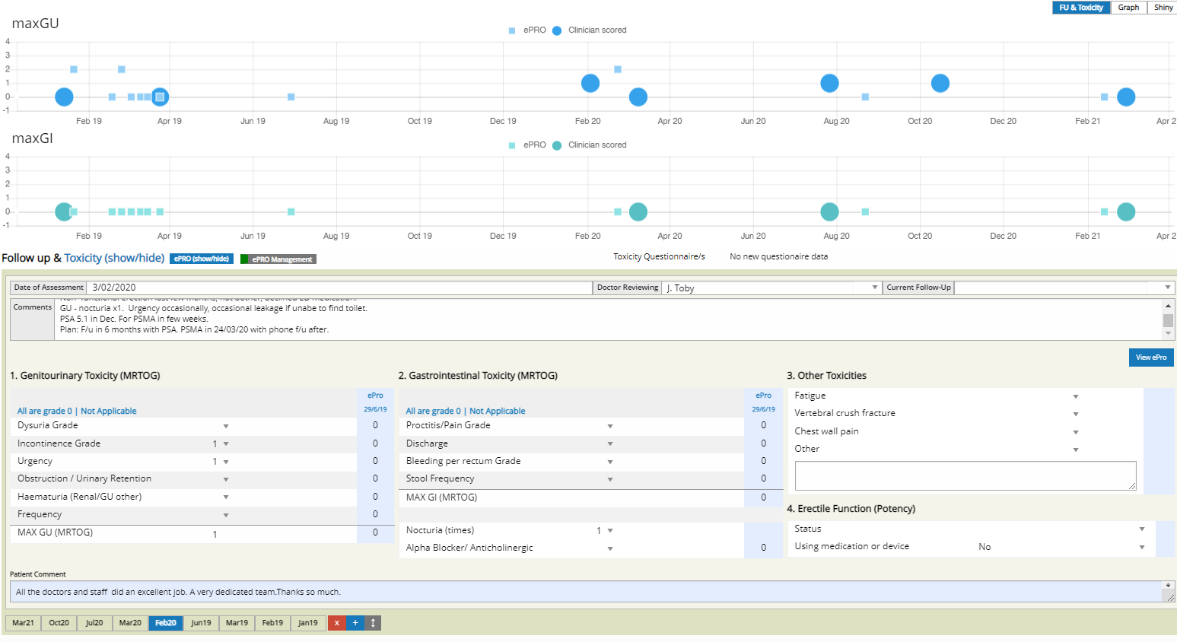


1. Onboarding
by ePRO team
2. Automated invitation
Via SMS or Email
+/- 1-2 reminders
4c. Regular scanning of freetext response and clinical escalation if any doubt
4a. Clinical system integration
Available in clinic or for remote RV
3. Completion on own device
Typically in comfort of own home
Carer/family can help if needed
Onsite iPad as fallback
4b. Email alert if potentially severe ePRO finding

Slide 2
1. Onboarding
by ePRO team
2. Automated invitation
Via personalized SMS or Email link
+/- 1-2 reminders
4c. Regular scanning of freetext response and clinical escalation if any doubt
4a. Clinical system integration
Routine availability in clinic or for remote review
3. Completion on own device
Typically in comfort of own home
Carer/family can help if needed
Onsite iPad as fallback
4b. Email alert if potentially severe ePRO finding

Slide 3
4c. Regular scanning of freetext response and clinical escalation if any doubt
1. Onboarding
by ePRO team
2. Automated invitation
Via personalized SMS or Email link
+/- 1-2 reminders
3. Completion on own device
Typically in comfort of own home
Carer/family can help if needed
Onsite iPad as fallback
4a. Clinical system integration
Routine availability in clinic or for remote review
4b. Automated email alert if potentially severe ePRO finding

