Slide 1
Human resources slide 1
DDS 6306
Case Study 2
Thad Schwebke

Slide 2

Human resources slide 8
Introduction
DDSAnalytics – Employee Attrition
DDSAnalytics is an analytics company that specializes in talent management solutions for Fortune 100 companies.
Talent management is the iterative process of developing and retaining employees. It includes:
workforce planning
employee training programs
identifying high-potential employees
reducing/preventing voluntary employee turnover (attrition)
DDSAnalytics is planning to leverage data science for talent management to gain a competitive edge over its competition. Executive leadership has identified predicting employee turnover as its first application of data science for talent management.
The DDSAnalytics data science team will conduct an analysis of existing employee data as a first step.

Slide 3
Human resources slide 2
AGENDA
Employee Demographics
Three factors leading to attrition
Job role trends
Employee attrition predictions
Employee salary predictions

Slide 4

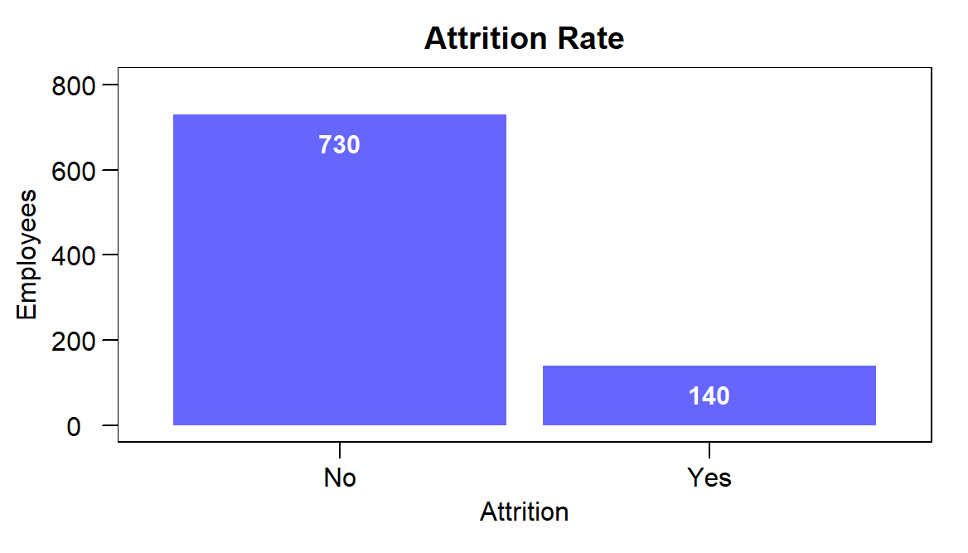
Human resources slide 3
Individuals
Employees: 870
Avg age: 36.8 years
Gender
Male: 59.3%
Female: 40.7%
Avg years working: 11.05 years
16%
Employee Health Ratings
* Rating Scale is 1 to 4. Four the highest and one the lowest.
Work environment
Compensation
Avg yearly income: $76,683
Avg salary increase: 15.2%
Employees overtime: 29%
Attrition Rate
2.7
Job involvement
Performance
Avg performance rating: 3.2
Avg years in current role: 4.2 years
Avg years since last promotion: 2.2 years
2.7
Overall job satisfaction
Roles
Avg years at company: 7 years
Avg years with current manager: 4.14 years
Departments (3)
Sales: 31.38%
Research & Development: 64.6%
Human Resources: 4.02%
Roles (9)
Sales Executive: 22.99%
Research Director: 5.86%
Manufacturing Director: 10%
Research Scientist: 19.77%
Sales Representative: 6.09%
Healthcare Representative: 8.74%
Manager: 5.86%
Human Resources: 3.1%
Laboratory Technician: 17.59%
2.7
Relationship rating
2.7
Work life balance
2.8
Attrition is the gradual reduction of a workforce by employees' leaving.

Slide 5

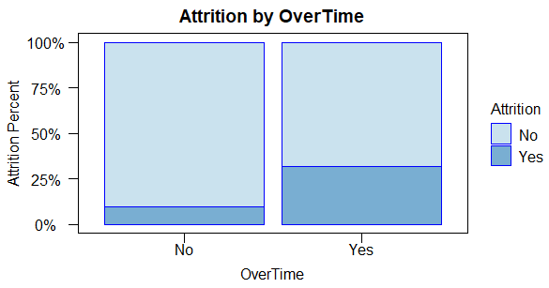


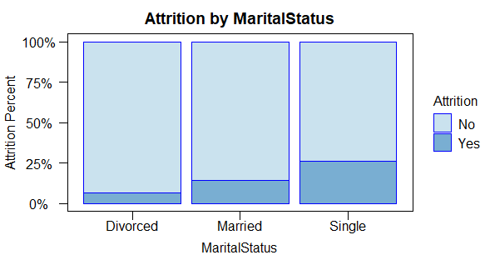




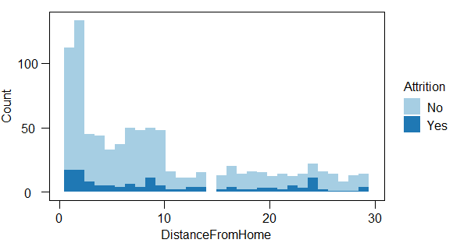
Human resources slide 5
Attrition Factors
Overtime
Overtime is a big contributor to attrition. Employee attrition rating is 3 times higher (31% vs 10%) when employees work overtime.
The top three factors that contribute to attrition:
Employees that work overtime.
Employees that are single or married.
Single employees have a high rate of attrition (26%). Likely due to not having a spouse or child to consider when leaving a job. Divorcee's only have a 6% attrition rate.
Commute Distance
Attrition
Marital Status
Distance from home shows that the proportion of employees with high attrition rates have longer commutes (12+ miles).
Employees with long commutes.

Slide 6
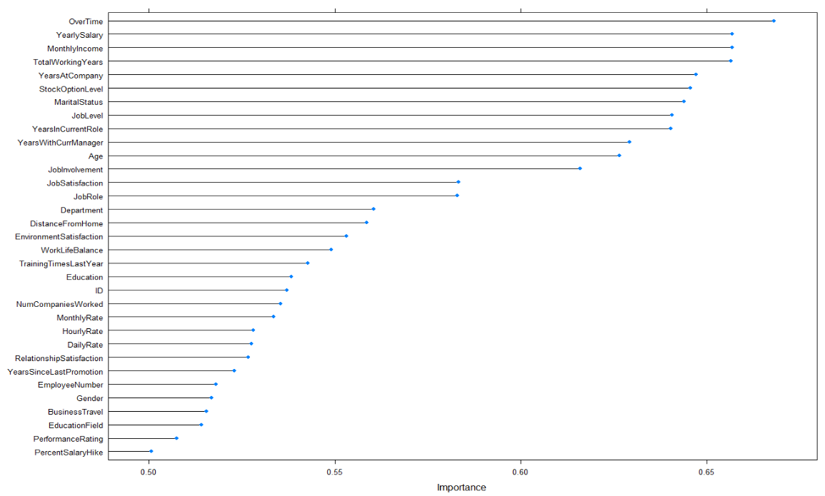
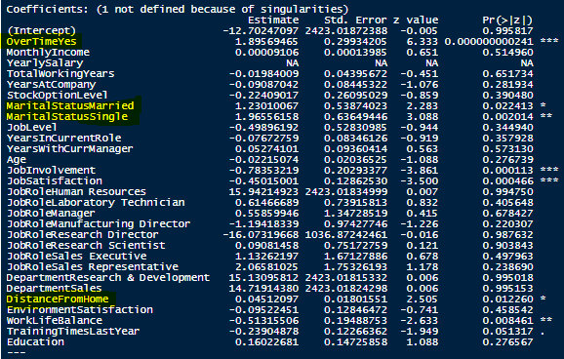
Human resources slide 9
Variable Importance
These are the variables that will be used in predicting attrition.
Top 3 attrition factors

Slide 7
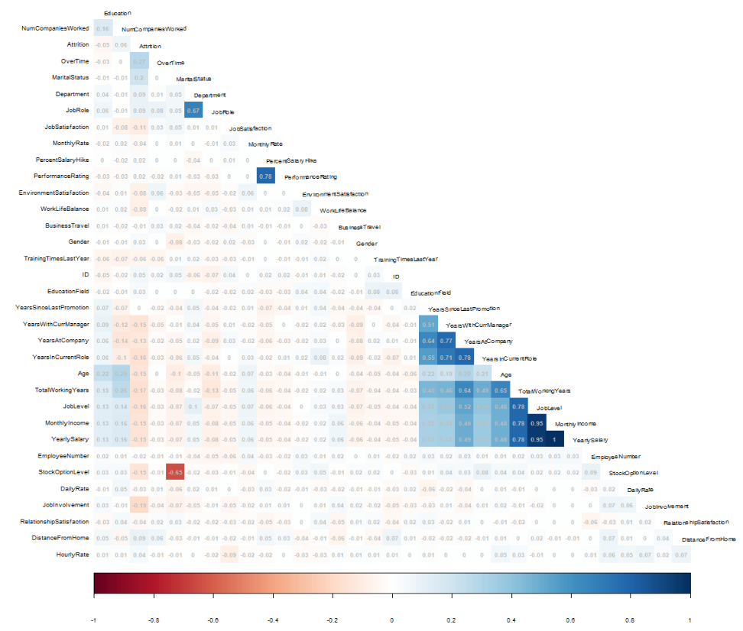
Human resources slide 9
Correlation with Attrition
Overtime and marital status have a moderate-level of positive correlation
XXXXXXXX
Department and JobeRole have a low-level of positive correlation
JobSatisfaction, EnvironmentSatisfaction, WorkLifeBalance, YearsWithCurrManager, YearsAtCompany, YearsInCurrentRole, Age, TotalWorkingYears, JobLevel, MonthlyIncome, StockOptionLevel, and JobInvolvement all have low-levels of negative correlation
DistanceFromHome has a low-level of positive correlation

Slide 8
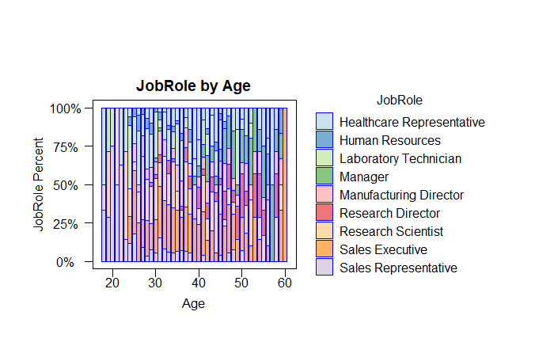
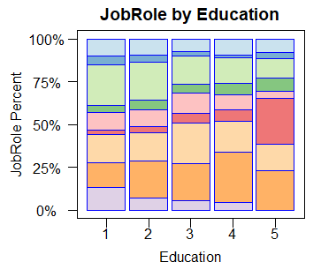
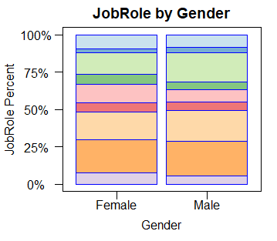
Human resources slide 9
Job Role Trends
Its surprising to see sales executives with a higher percentage of high-level education than researches. However, research directors clearly have the highest level of education.
Sales reps start in their early 20’s, but quickly move up to sales executives by their late 20’s. Salespeople have the highest average age.
This is a very diverse company. The split between men and women across all the roles is great to see.

Slide 9
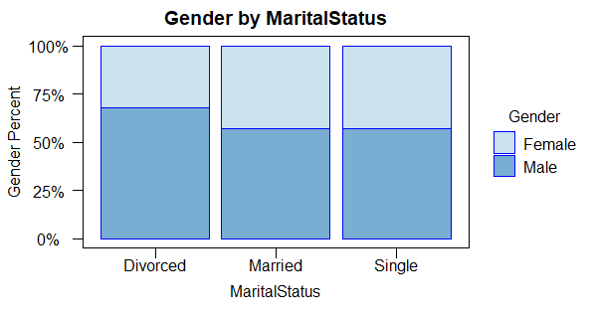
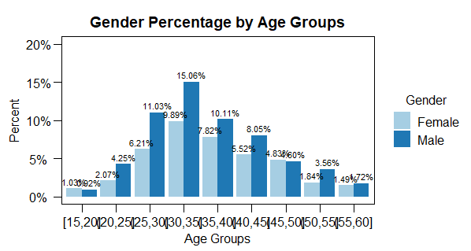
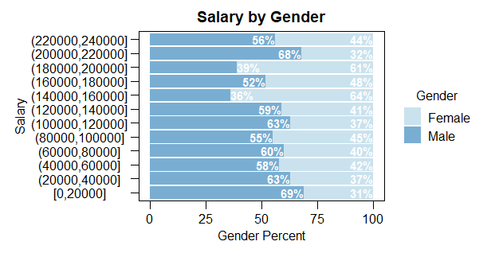
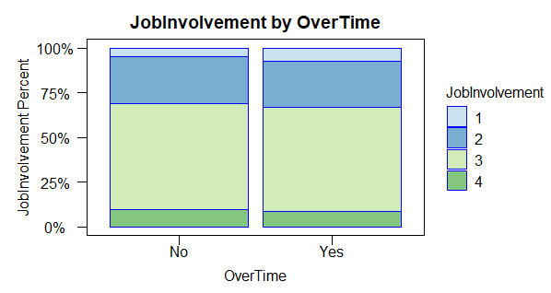
Human resources slide 9
Other Notable Trends
Married and single are very similar in mix between male and female. But it looks like there are far more divorced men than there are women.
Other than ages 15-20 males out number the percentage of women.
Men tend to outnumber the woman at all salary bins, except in the 14-16k and 18-20k ranges.
Overtime may be a factor when it comes to attrition, but it doesn’t have much of an impact on Job Involvement.

Slide 10
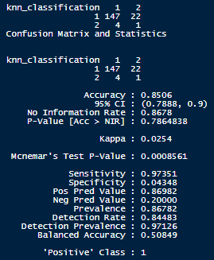
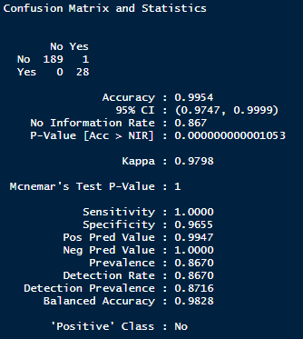
Human resources slide 8
Attrition Predictions
KNN and Naive Bayes models were used to predict attrition. The Naive Bayes model was chosen for the final prediction model because it had the highest accuracy (99.54%), sensitivity (100%), and specificity (96.55%).
KNN
Naive Bayes
Predictor | Accuracy | Sensitivity | Specificity
KNN | 0.8506 | 0.97351 | 0.04348
Naive Bayes | 0.9954 | 1.0 | 0.9655

Slide 11
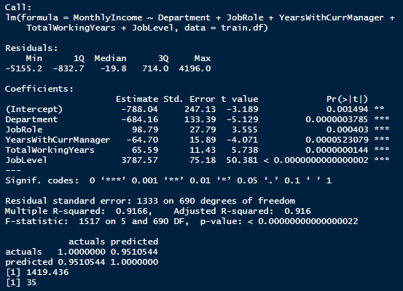
Human resources slide 8
Salary Prediction
The Linear Regression model was tested and used for salary predictions achieving a Root Mean Squared Error (RMSE) of $1,419, which is below the evaluation criteria of < $3,000.
Adjusted R-squared says that 91.3% of the variation in the response variable is explained by the predictor variables. The F-statistic value is 1213 which leads to a p-value of < 0.0000000000000002, which is highly significant.

Slide 12
Human resources slide 6
Conclusions
Statistically the top three factors contributing to Attrition are: Distance from Home, Marital Status, and Overtime.
There is an opportunity to explore work from home arrangements for employees that have longer commutes.
There is an opportunity to explore why single and married employees have higher attrition rates than divorced employees.
There is an opportunity to explore why overtime-eligible employees have higher attrition. Is the overtime pay not competitive? Or is it just too many additional hours?

Slide 13
Human resources slide 10
Thank You

Slide 14
Human resources slide 9
Appendix

Slide 15
Human resources slide 9
References
GitHub Link
https://github.com/tschwebke/DDS-6306-Case-Study-2
YouTube Link
https://youtu.be/ TBD
GitHub Pages Link
https://tschwebke.github.io/

