Slide 1


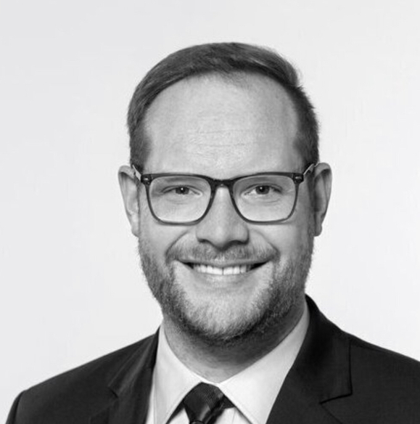
Student Project / Thesis
[TITLE]
[FIELDS OF STUDY]
Are you looking for an exciting topic for your Bachelor’s / Master’s Thesis or course project?
Are you interested in [#MAINTOPICS]?
Then join our project at the [Chronobiology & Health / Translational Sensory & Circadian Neuroscience] Lab! We are a young team at the [TUM Faculty for Sports & Health Sciences / Max Planck Institute for Biological Cybernetics], led by Prof. Dr. Manuel Spitschan, studying the effects of light on circadian and sleep health (https://tscnlab.org/).
What is the project about?
[PROJECT DESCRIPTION, INCL. METHODS AND GOALS]
When & where?
[PROJECT PERIOD; DATA COLLECTION SITE]
What’s in it for you?
By helping to [...], you will learn how to [...]. You will contribute to a study on [...], following Open Science practices.
We are flexible and happy to supervise you in line with your course timeframe and personal interests / skills.
Interested? Get in touch!
Send an email with your name, field of study, thesis timeline and CV
to [YOUR EMAIL]; applications accepted until [DEADLINE]!
YOUR PHOTO
[YOUR NAME & ROLE]
Prof. Dr. Manuel
Spitschan, PI

