Slide 1
Willson Financial Case Study Project
Trenten Coffman
Wade Eckert

Slide 2
The Case Study
Small town business partners Jake and Ned Willson want to analyze their customer base
They are considering changes to the company’s billing structure
To aid their decision process they want these questions answered
How many clients have they gained each month for the last six months?
What is the average dollar amount invested by the customers?
How many clients engage in more than ten transactions per month?
To help the company answer these questions we’ve created a database and generated reports for the owners to review

Slide 3
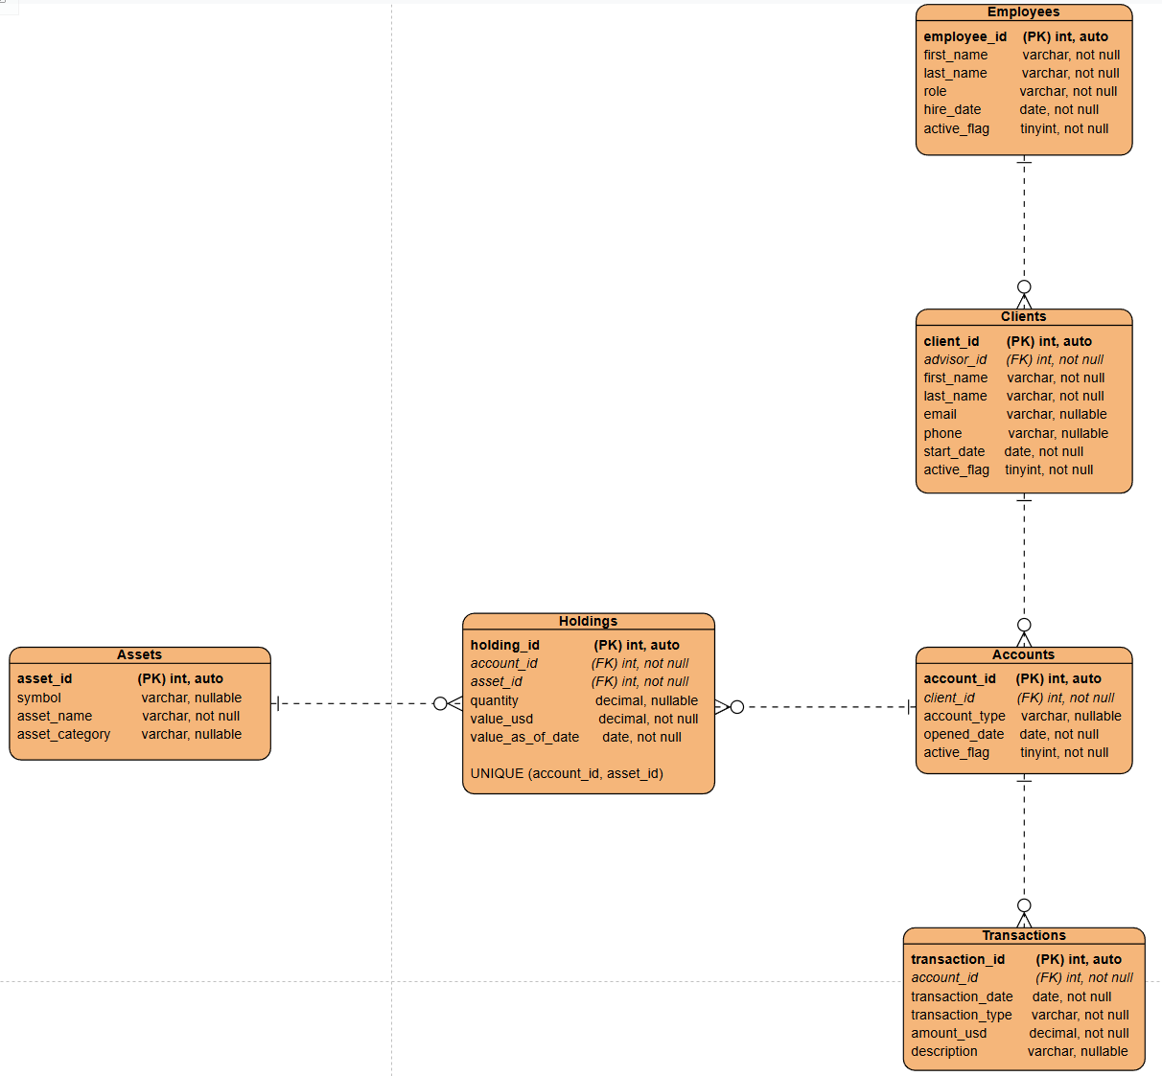
Entity Relationship Diagram

Slide 4
Case Study Assumptions
Clients have only one advisor
Clients have one or more accounts
Clients may hold a wide variety of assets

Slide 5
The Reports
Shows which months had new clients and how many joined for the last six months
Shows total clients, accounts, and dollar amount of assets held as well as the average dollar amount invested per client and account
Shows all clients who exceeded ten transactions in a single month and which months they exceeded that amount

Slide 6
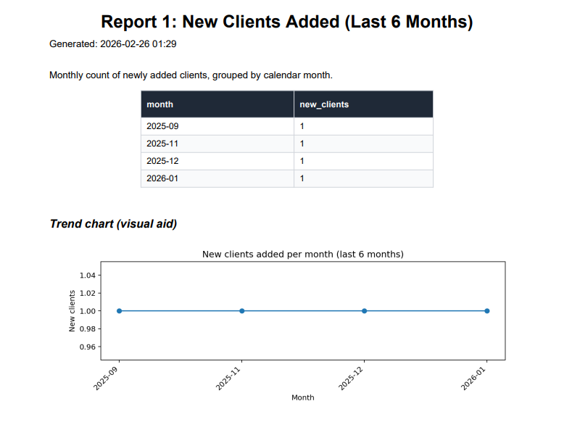

Slide 7
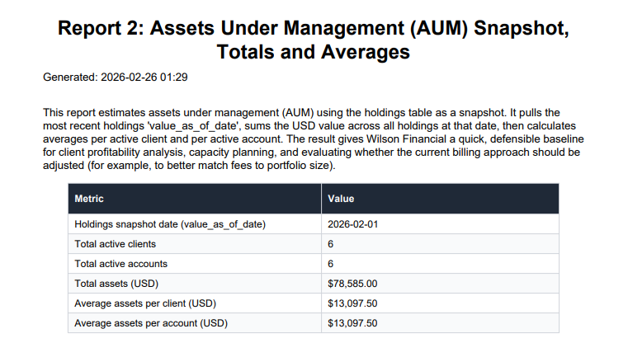

Slide 8
