Slide 1



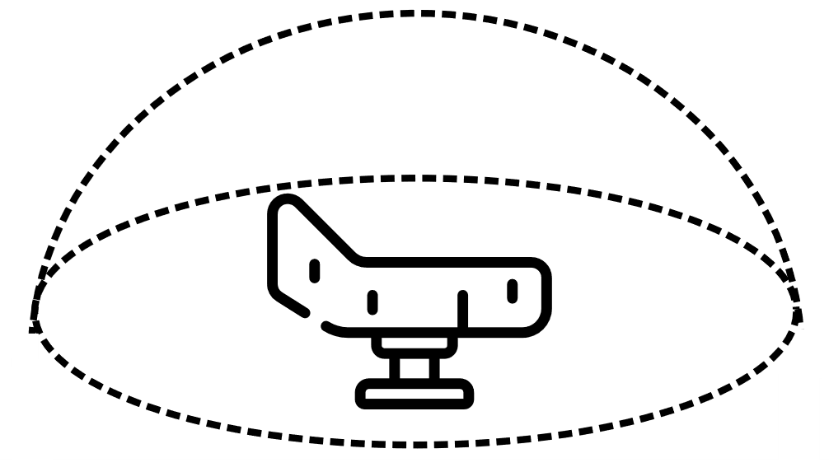


Server
Networks
Holographic Conference
Real Scene Streaming
Fire Fighter &
Military Training
Remote Surgery

