Slide 1
Cyclistic
Maximizing the number of Annual Memberships in Bike-Sharing
Presented by: Tsedey Tadesse
Project: Google Data Analytics Capstone Project
Last Updated: August 9th, 2023

Slide 2
Summary of Contents
Business task
Data source and structure
Processing and analyzing the data
Data overview and key takeaways
Recommendations and conclusion
Appendix

Slide 3
What is our business task?

Slide 4
Objective
Analyze how members and casual riders use Cyclistic bikes and recommend marketing strategies to convert casual riders into annual members.

Slide 5
The Data

Slide 6
The Data
Source: Divvy-tripdata (https://divvy-tripdata.s3.amazonaws.com/index.html)
Data organization
Each ride has a rider ID along with whether or not the rider is a member or a casual
The table contains the time, location name, location id, and geographic location of the starting and ending of each ride
Each ride has the type of cyclistic bikes (classic and electric)
The table also contains data about bikes stationed (excluded in the analysis)
Data used
Data for one year period (June, 2022 - April, 2023)
Rider ID, member vs. casual, rideable type ,and trip starting and ending time

Slide 7
The Process

Slide 8
Analysis
Members vs. Casual
Number of rides per month
Average ride length per month
Number of rides by day of the week
Average ride length by day of the week
Trends and connections
Tools used for analysis (SQL, Google Sheets)

Slide 9
Summary of Analysis

Slide 10
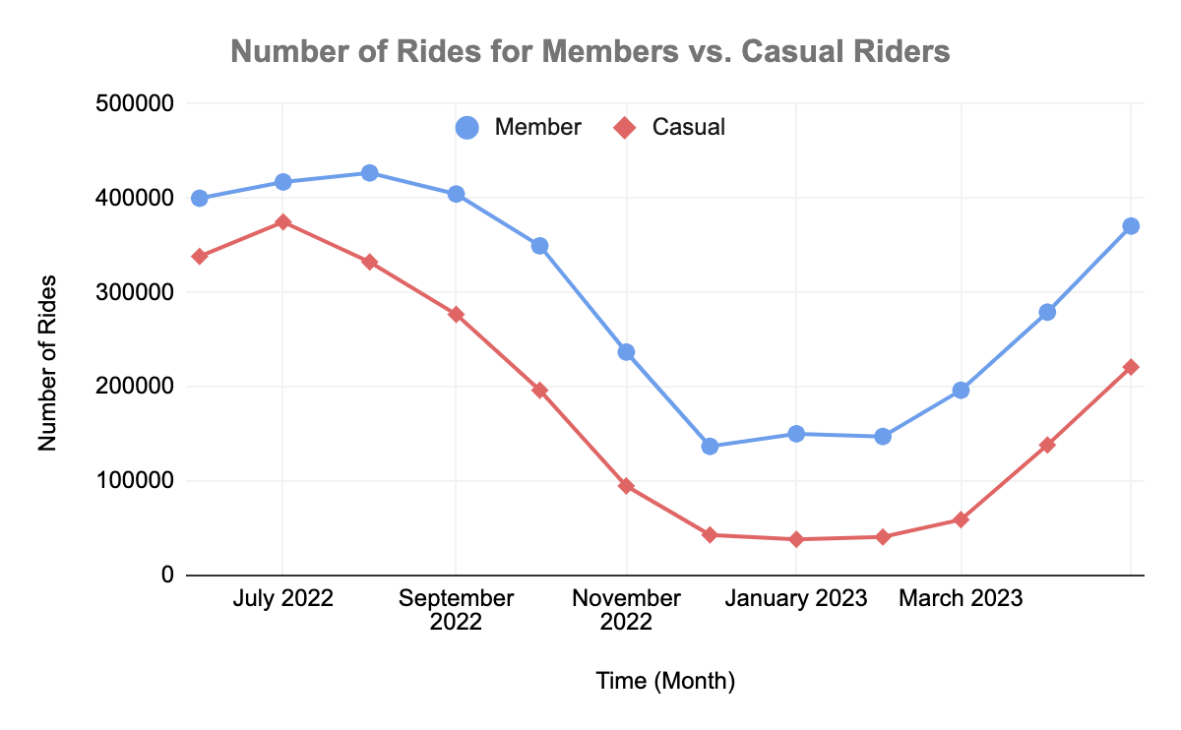
Number of Rides per Month
Data Overview:
There are 38.7% more member riders than casual riders.
Both rider groups have similar trends throughout the year (high during summer and low during winter)

Slide 11
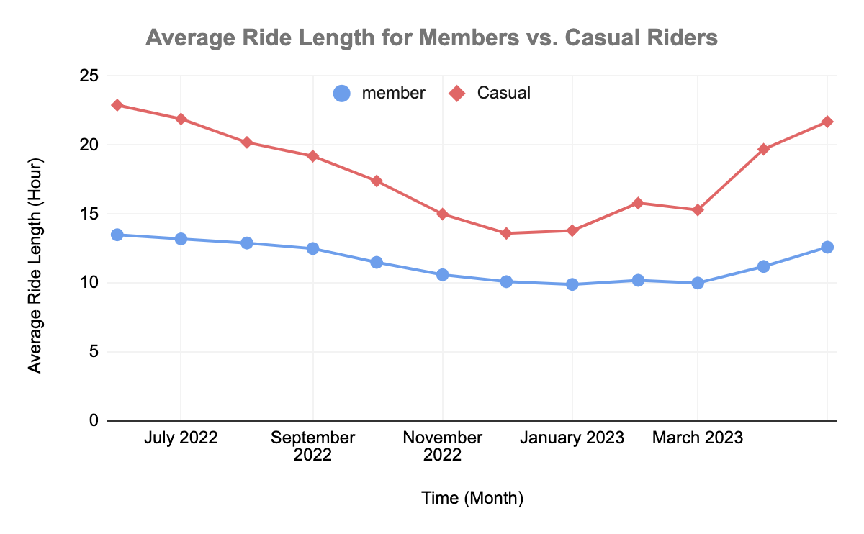
Average Ride Length per Month
Data Overview:
Casual riders ride 36% longer than casual rider throughout the year.
Both rider groups have their maximum average ride length during summer time.

Slide 12
Key Takeaways:
More people use the services and they ride for a longer duration during summer time.
Casual riders ride the bikes for a longer commute.
Member riders’ average ride length is almost constant throughout the year (riders use the bikes to travel to and from work).

Slide 13
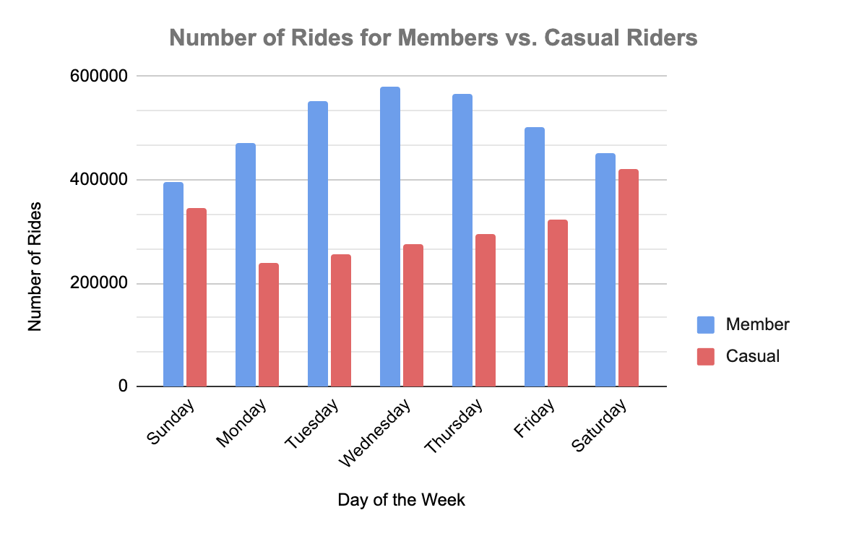
Number of Rides per Day of the Week
Data Overview:
Members ride the most during weekdays (peaking on Wednesdays).
Casual riders ride the most during the weekends.

Slide 14
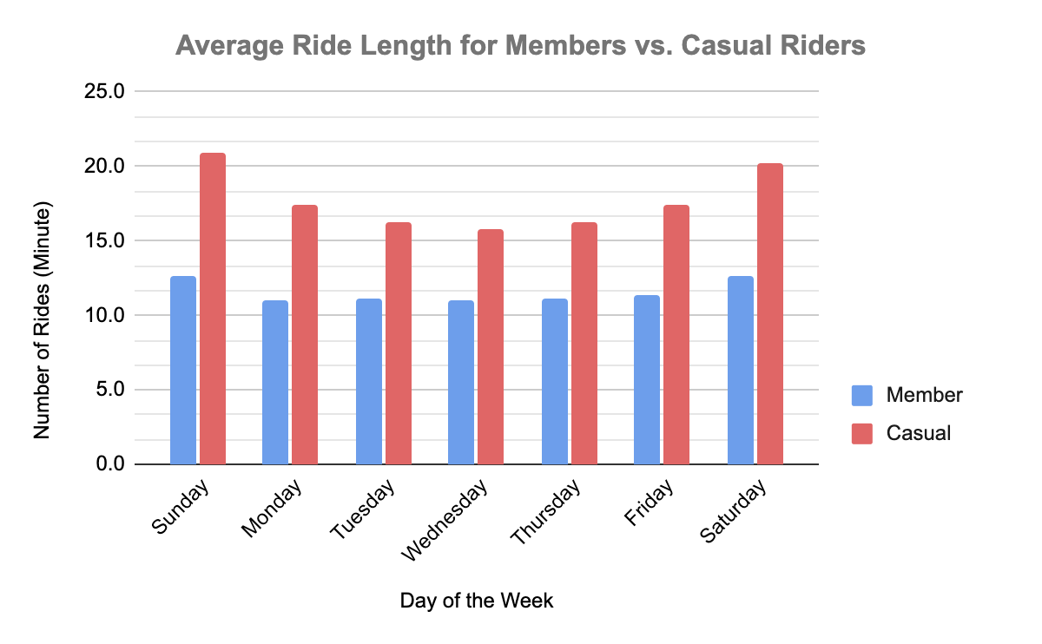
Average Ride Length per Day of the Week
Data Overview:
Both rider groups have similar trends: higher during weekends and lower during weekdays.
Wednesday is the day with the shortest average ride length

Slide 15
Key Takeaways:
Members tend to ride the bike during the weekdays, meaning that they use they to go to and from work.
Casual riders tend to ride the bikes more during weekends and they tend to ride they for longer period of time.
Member riders’ average ride length is almost constant throughout the weeks, meaning that they use the bike at a regular start and end locations more often.

Slide 16
Recommendations

Slide 17
Top Three Recommendations
To have casual riders switch to being annual members:
Free Trial: offer casual riders a limited-time free subscription trial.
Bike station relocation and redistribution: Assign more bikes to stations where members regularly use and where there are more offices. Relocate bikes from least used stations to most used stations.
Easy sign-up Process: Design an easy and user friendly sign-up process

Slide 18
Conclusion

Slide 19
The Take:
Casual users tend to ride 36% longer than members, generating a proportional amount of revenue for Cyclistic.
Weekends seems to be the most popular days of the week for both groups, meaning that rider use the bikes more for tour and activities rather than work commute.
Cyclistic can increase the number of subscribed members by using different marketing strategies such as offering free trials, assessing bike stations trends, and redesigning the sign-up process.

Slide 20
Thank you!

Slide 21
Appendix

Slide 22
Link to the data source:
https://divvy-tripdata.s3.amazonaws.com/index.html

Slide 23
--The query below counts the number of trips taken by casual riders and members,
--it calculates the average trip length for each month,
--and it calculates the maximum ride length taken each month by casual and member riders
--The query filters out the data where the bikes are stationary and analyzes only for
--classic and electric bikes, and aggregates the data for casual vs. member riders.
SELECT a1.member_casual,a1.m202206,a2.m202207,a3.m202208,
a4.m202209,a5.m202210,a6.m202211,a7.m202212,a8.m202301,
a9.m202302,a10.m202303,a11.m202304,a12.m202305,a1.avg202206,
a2.avg202207,a3.avg202208,a4.avg202209,a5.avg202210,a6.avg202211,
a7.avg202212,a8.avg202301,a9.avg202302,a10.avg202303,a11.avg202304,
a12.avg202305,a1.max202206,a2.max202207,a3.max202208,a4.max202209,
a5.max202210,a6.max202211,a7.max202212,a8.max202301,a9.max202302,
a10.max202303,a11.max202304,a12.max202305
FROM (
SELECT member_casual, count(ride_id) AS m202206, ROUND(avg(timestamp_diff(ended_at, started_at, MINUTE)),1) as avg202206,
ROUND(max(timestamp_diff(ended_at,started_at, HOUR)),1) AS max202206
FROM `prefab-list-392521.capstone_project_cyclistic.202206-divvy-tripdata`
WHERE
rideable_type = "electric_bike" OR rideable_type = "classic_bike"
group by
member_casual
) as a1

Slide 24
OIN (
SELECT member_casual, count(ride_id) AS m202207, ROUND(avg(timestamp_diff(ended_at, started_at, MINUTE)),1) as avg202207,
ROUND(max(timestamp_diff(ended_at,started_at, HOUR)),1) AS max202207
FROM `prefab-list-392521.capstone_project_cyclistic.202207-divvy-tripdata`
WHERE
rideable_type = "electric_bike" OR rideable_type = "classic_bike"
group by
member_casual
) as a2
ON a1.member_casual = a2.member_casual
JOIN (
SELECT member_casual, count(ride_id) AS m202208, ROUND(avg(timestamp_diff(ended_at, started_at, MINUTE)),1) as avg202208,
ROUND(max(timestamp_diff(ended_at,started_at, HOUR)),1) AS max202208
FROM `prefab-list-392521.capstone_project_cyclistic.202208-divvy-tripdata`
WHERE
rideable_type = "electric_bike" OR rideable_type = "classic_bike"
group by
member_casual
) as a3
ON a2.member_casual = a3.member_casual

Slide 25
JOIN (
SELECT member_casual, count(ride_id) AS m202209, ROUND(avg(timestamp_diff(ended_at, started_at, MINUTE)),1) as avg202209,
ROUND(max(timestamp_diff(ended_at,started_at, HOUR)),1) AS max202209
FROM `prefab-list-392521.capstone_project_cyclistic.202209-divvy-tripdata`
WHERE
rideable_type = "electric_bike" OR rideable_type = "classic_bike"
group by
member_casual
) as a4
ON a3.member_casual = a4.member_casual
JOIN (
SELECT member_casual, count(ride_id) AS m202210, ROUND(avg(timestamp_diff(ended_at, started_at, MINUTE)),1) as avg202210,
ROUND(max(timestamp_diff(ended_at,started_at, HOUR)),1) AS max202210
FROM `prefab-list-392521.capstone_project_cyclistic.202210-divvy-tripdata`
WHERE
rideable_type = "electric_bike" OR rideable_type = "classic_bike"
group by
member_casual
) as a5
ON a4.member_casual = a5.member_casual

Slide 26
JOIN (
SELECT member_casual, count(ride_id) AS m202211, ROUND(avg(timestamp_diff(ended_at, started_at, MINUTE)),1) as avg202211,
ROUND(max(timestamp_diff(ended_at,started_at, HOUR)),1) AS max202211
FROM `prefab-list-392521.capstone_project_cyclistic.202211-divvy-tripdata`
WHERE
rideable_type = "electric_bike" OR rideable_type = "classic_bike"
group by
member_casual
) as a6
ON a5.member_casual = a6.member_casual
JOIN (
SELECT member_casual, count(ride_id) AS m202212, ROUND(avg(timestamp_diff(ended_at, started_at, MINUTE)),1) as avg202212,
ROUND(max(timestamp_diff(ended_at,started_at, HOUR)),1) AS max202212
FROM `prefab-list-392521.capstone_project_cyclistic.202212-divvy-tripdata`
WHERE
rideable_type = "electric_bike" OR rideable_type = "classic_bike"
group by
member_casual
) as a7
ON a6.member_casual = a7.member_casual

Slide 27
JOIN (
SELECT member_casual, count(ride_id) AS m202301, ROUND(avg(timestamp_diff(ended_at, started_at, MINUTE)),1) as avg202301,
ROUND(max(timestamp_diff(ended_at,started_at, HOUR)),1) AS max202301
FROM `prefab-list-392521.capstone_project_cyclistic.202301-divvy-tripdata`
WHERE
rideable_type = "electric_bike" OR rideable_type = "classic_bike"
group by
member_casual
) as a8
ON a7.member_casual = a8.member_casual
JOIN (
SELECT member_casual, count(ride_id) AS m202302, ROUND(avg(timestamp_diff(ended_at, started_at, MINUTE)),1) as avg202302,
ROUND(max(timestamp_diff(ended_at,started_at, HOUR)),1) AS max202302
FROM `prefab-list-392521.capstone_project_cyclistic.202302-divvy-tripdata`
WHERE
rideable_type = "electric_bike" OR rideable_type = "classic_bike"
group by
member_casual
) as a9
ON a8.member_casual = a9.member_casual

Slide 28
JOIN (
SELECT member_casual, count(ride_id) AS m202303, ROUND(avg(timestamp_diff(ended_at, started_at, MINUTE)),1) as avg202303,
ROUND(max(timestamp_diff(ended_at,started_at, HOUR)),1) AS max202303
FROM `prefab-list-392521.capstone_project_cyclistic.202303-divvy-tripdata`
WHERE
rideable_type = "electric_bike" OR rideable_type = "classic_bike"
group by
member_casual
) as a10
ON a9.member_casual = a10.member_casual
JOIN (
SELECT member_casual, count(ride_id) AS m202304, ROUND(avg(timestamp_diff(ended_at, started_at, MINUTE)),1) as avg202304,
ROUND(max(timestamp_diff(ended_at,started_at, HOUR)),1) AS max202304
FROM `prefab-list-392521.capstone_project_cyclistic.202304-divvy-tripdata`
WHERE
rideable_type = "electric_bike" OR rideable_type = "classic_bike"
group by
member_casual
) as a11
ON a10.member_casual = a11.member_casual

Slide 29
JOIN (
SELECT member_casual, count(ride_id) AS m202305, ROUND(avg(timestamp_diff(ended_at, started_at, MINUTE)),1) as avg202305,
ROUND(max(timestamp_diff(ended_at,started_at, HOUR)),1) AS max202305
FROM `prefab-list-392521.capstone_project_cyclistic.202305-divvy-tripdata`
WHERE
rideable_type = "electric_bike" OR rideable_type = "classic_bike"
group by
member_casual
) as a12
ON a11.member_casual = a12.member_casual

Slide 30
--The query below counts the number of trips taken by casual riders and members,
--it calculates the average trip length for each month,
--and it calculates the maximum ride length taken each month by casual and member riders
--The query filters out the data where the bikes are stationary and analyzes only for
--classic and electric bikes, and aggregates the data for casual vs. member riders.
SELECT a1.member_casual,a1.day_of_week,a1.m202206,a2.m202207,a3.m202208,
a4.m202209,a5.m202210,a6.m202211,a7.m202212,a8.m202301,
a9.m202302,a10.m202303,a11.m202304,a12.m202305,a1.avg202206,
a2.avg202207,a3.avg202208,a4.avg202209,a5.avg202210,a6.avg202211,
a7.avg202212,a8.avg202301,a9.avg202302,a10.avg202303,a11.avg202304,
a12.avg202305,a1.max202206,a2.max202207,a3.max202208,a4.max202209,
a5.max202210,a6.max202211,a7.max202212,a8.max202301,a9.max202302,
a10.max202303,a11.max202304,a12.max202305
FROM (
SELECT EXTRACT(DAYOFWEEK FROM started_at) AS day_of_week, member_casual, count(ride_id) AS m202206,
ROUND(avg(timestamp_diff(ended_at, started_at, MINUTE)),1) as avg202206,
ROUND(max(timestamp_diff(ended_at,started_at, HOUR)),1) AS max202206
FROM `prefab-list-392521.capstone_project_cyclistic.202206-divvy-tripdata`
WHERE
rideable_type = "electric_bike" OR rideable_type = "classic_bike"
group by
day_of_week, member_casual
) as a1

Slide 31
JOIN (
SELECT EXTRACT(DAYOFWEEK FROM started_at) AS day_of_week,member_casual, count(ride_id) AS m202207,
ROUND(avg(timestamp_diff(ended_at, started_at, MINUTE)),1) as avg202207,
ROUND(max(timestamp_diff(ended_at,started_at, HOUR)),1) AS max202207
FROM `prefab-list-392521.capstone_project_cyclistic.202207-divvy-tripdata`
WHERE
rideable_type = "electric_bike" OR rideable_type = "classic_bike"
group by
day_of_week, member_casual
) as a2
ON a1.member_casual = a2.member_casual AND a1.day_of_week = a2.day_of_week
JOIN (
SELECT EXTRACT(DAYOFWEEK FROM started_at) AS day_of_week,member_casual, count(ride_id) AS m202208,
ROUND(avg(timestamp_diff(ended_at, started_at, MINUTE)),1) as avg202208,
ROUND(max(timestamp_diff(ended_at,started_at, HOUR)),1) AS max202208
FROM `prefab-list-392521.capstone_project_cyclistic.202208-divvy-tripdata`
WHERE
rideable_type = "electric_bike" OR rideable_type = "classic_bike"
group by
day_of_week, member_casual
) as a3
ON a2.member_casual = a3.member_casual AND a2.day_of_week = a3.day_of_week

Slide 32
JOIN (
SELECT EXTRACT(DAYOFWEEK FROM started_at) AS day_of_week, member_casual, count(ride_id) AS m202209,
ROUND(avg(timestamp_diff(ended_at, started_at, MINUTE)),1) as avg202209,
ROUND(max(timestamp_diff(ended_at,started_at, HOUR)),1) AS max202209
FROM `prefab-list-392521.capstone_project_cyclistic.202209-divvy-tripdata`
WHERE
rideable_type = "electric_bike" OR rideable_type = "classic_bike"
group by
day_of_week, member_casual
) as a4
ON a3.member_casual = a4.member_casual AND a3.day_of_week = a4.day_of_week
JOIN (
SELECT EXTRACT(DAYOFWEEK FROM started_at) AS day_of_week, member_casual, count(ride_id) AS m202210,
ROUND(avg(timestamp_diff(ended_at, started_at, MINUTE)),1) as avg202210,
ROUND(max(timestamp_diff(ended_at,started_at, HOUR)),1) AS max202210
FROM `prefab-list-392521.capstone_project_cyclistic.202210-divvy-tripdata`
WHERE
rideable_type = "electric_bike" OR rideable_type = "classic_bike"
group by
day_of_week, member_casual
) as a5
ON a4.member_casual = a5.member_casual AND a4.day_of_week = a5.day_of_week

Slide 33
JOIN (
SELECT EXTRACT(DAYOFWEEK FROM started_at) AS day_of_week, member_casual, count(ride_id) AS m202211,
ROUND(avg(timestamp_diff(ended_at, started_at, MINUTE)),1) as avg202211,
ROUND(max(timestamp_diff(ended_at,started_at, HOUR)),1) AS max202211
FROM `prefab-list-392521.capstone_project_cyclistic.202211-divvy-tripdata`
WHERE
rideable_type = "electric_bike" OR rideable_type = "classic_bike"
group by
day_of_week, member_casual
) as a6
ON a5.member_casual = a6.member_casual AND a5.day_of_week = a6.day_of_week
JOIN (
SELECT EXTRACT(DAYOFWEEK FROM started_at) AS day_of_week, member_casual, count(ride_id) AS m202212,
ROUND(avg(timestamp_diff(ended_at, started_at, MINUTE)),1) as avg202212,
ROUND(max(timestamp_diff(ended_at,started_at, HOUR)),1) AS max202212
FROM `prefab-list-392521.capstone_project_cyclistic.202212-divvy-tripdata`
WHERE
rideable_type = "electric_bike" OR rideable_type = "classic_bike"
group by
day_of_week, member_casual
) as a7
ON a6.member_casual = a7.member_casual AND a6.day_of_week = a7.day_of_week

Slide 34
JOIN (
SELECT EXTRACT(DAYOFWEEK FROM started_at) AS day_of_week, member_casual, count(ride_id) AS m202301,
ROUND(avg(timestamp_diff(ended_at, started_at, MINUTE)),1) as avg202301,
ROUND(max(timestamp_diff(ended_at,started_at, HOUR)),1) AS max202301
FROM `prefab-list-392521.capstone_project_cyclistic.202301-divvy-tripdata`
WHERE
rideable_type = "electric_bike" OR rideable_type = "classic_bike"
group by
day_of_week, member_casual
) as a8
ON a7.member_casual = a8.member_casual AND a7.day_of_week = a8.day_of_week
JOIN (
SELECT EXTRACT(DAYOFWEEK FROM started_at) AS day_of_week, member_casual, count(ride_id) AS m202302,
ROUND(avg(timestamp_diff(ended_at, started_at, MINUTE)),1) as avg202302,
ROUND(max(timestamp_diff(ended_at,started_at, HOUR)),1) AS max202302
FROM `prefab-list-392521.capstone_project_cyclistic.202302-divvy-tripdata`
WHERE
rideable_type = "electric_bike" OR rideable_type = "classic_bike"
group by
day_of_week, member_casual
) as a9
ON a8.member_casual = a9.member_casual AND a8.day_of_week = a9.day_of_week

Slide 35
JOIN (
SELECT EXTRACT(DAYOFWEEK FROM started_at) AS day_of_week, member_casual, count(ride_id) AS m202303,
ROUND(avg(timestamp_diff(ended_at, started_at, MINUTE)),1) as avg202303,
ROUND(max(timestamp_diff(ended_at,started_at, HOUR)),1) AS max202303
FROM `prefab-list-392521.capstone_project_cyclistic.202303-divvy-tripdata`
WHERE
rideable_type = "electric_bike" OR rideable_type = "classic_bike"
group by
day_of_week, member_casual
) as a10
ON a9.member_casual = a10.member_casual AND a9.day_of_week = a10.day_of_week
JOIN (
SELECT EXTRACT(DAYOFWEEK FROM started_at) AS day_of_week, member_casual, count(ride_id) AS m202304,
ROUND(avg(timestamp_diff(ended_at, started_at, MINUTE)),1) as avg202304,
ROUND(max(timestamp_diff(ended_at,started_at, HOUR)),1) AS max202304
FROM `prefab-list-392521.capstone_project_cyclistic.202304-divvy-tripdata`
WHERE
rideable_type = "electric_bike" OR rideable_type = "classic_bike"
group by
day_of_week, member_casual
) as a11
ON a10.member_casual = a11.member_casual AND a10.day_of_week = a11.day_of_week

Slide 36
JOIN (
SELECT EXTRACT(DAYOFWEEK FROM started_at) AS day_of_week, member_casual, count(ride_id) AS m202305,
ROUND(avg(timestamp_diff(ended_at, started_at, MINUTE)),1) as avg202305,
ROUND(max(timestamp_diff(ended_at,started_at, HOUR)),1) AS max202305
FROM `prefab-list-392521.capstone_project_cyclistic.202305-divvy-tripdata`
WHERE
rideable_type = "electric_bike" OR rideable_type = "classic_bike"
group by
day_of_week, member_casual
) as a12
ON a11.member_casual = a12.member_casual AND a11.day_of_week = a12.day_of_week

