Slide 1
HyperGCN
B. Tseesuren
2024/08/30

Slide 2
Motivation (I)
Collaborative filtering relies on identifying similar users and items to make predictions. Traditionally, there are two primary approaches: user-based CF and item-based CF.
Recently, Graph Convolutional Networks (GCNs) have emerged as a key model for collaborative filtering. However, GCN-based CF does not explicitly model user-user or item-item similarities. Instead, it primarily leverages the user-item interaction graph as the core structure.
We argue that this approach leads to suboptimal performance. Therefore, in this work, we propose constructing explicit user-user and item-item graphs based on similarity scores to enhance the model's predictive power.

Slide 3
HyperGCN in brief
i₁
Adjacency Matrix (AM)
u₁
 | 0 | 1 | 2 | 3 | 4 | 5 | 6 | 7 | 8
0 | 0 | s₀₁ | s₀₂ | s₀₃ | 0 | 0 | 0 | 0 | 0
1 | s₁₀ | 0 | s₁₂ | s₁₃ | 0 | 0 | 0 | 0 | 0
2 | s₂₀ | s₂₁ | 0 | s₂₃ | 0 | 0 | 0 | 0 | 0
3 | s₃₀ | s₃₁ | s₃₂ | 0 | 0 | 0 | 0 | 0 | 0
4 | 0 | 0 | 0 | 0 | 0 | s₄₅ | s₄₆ | s₄₆ | s₄₆
5 | 0 | 0 | 0 | 0 | s₅₄ | 0 | s₅₆ | s₄₆ | s₄₆
6 | 0 | 0 | 0 | 0 | s₆₄ | s₆₅ | 0 | s₄₆ | s₄₆
7 | 0 | 0 | 0 | 0 | s₄₆ | s₄₆ | s₄₆ | 0 | s₄₆
8 | 0 | 0 | 0 | 0 | s₄₆ | s₄₆ | s₄₆ | s₄₆ | 0
COO (edge_index)
i₂
u₂
The edge weight is
similarity S.
i₃
Similarity Matrix (SM)
u₃
src | dst | weight
0 | 1 | s₀₁
0 | 2 | s₀₂
1 | 0 | s₁₀
1 | 2 | s₁₂
2 | 0 | s₂₀
2 | 3 | s₂₃
3 | 1 | s₃₁
3 | 2 | s₃₂
4 | 6 | s₄₆
4 | 7 | s₄₇
4 | 8 | s₄₈
5 | 4 | s₅₄
… | … | …
7 | 8 | s₇₈
8 | 4 | s₈₄
8 | 6 | s₈₆
8 | 7 | s₈₇
hyperGCN for Collaborative Filtering
i₄
u_ID | u_ID | S
1 | 2 | s₁₂
1 | 3 | s₁₃
1 | 4 | s₁₄
2 | 3 | s₂₃
2 | 4 | s₂₄
3 | 4 | s₃₄
User & Item embeddings for collaborative signals
u₄
e₁
e₅
i₅
Layer 3
Layer 3
Calculate
similarities
between users
Layer 2
Layer 2
Layer 1
Layer 1
u_ID | i_ID
1 | 1
1 | 2
1 | 4
2 | 1
2 | 3
3 | 1
3 | 3
3 | 4
3 | 5
4 | 4
4 | 5
Neighbors e₁ of (u₂)
Neighbors e₅ of (i₂)
exp(s₁₀)
exp(s₁₂)
e₄
exp(s₅₄)
exp(s₅₇)
e₇
threshold by top-K (e.g., top-2 for users, top-3 for items)
e₀
e₂
…
i_ID | i_ID | S
1 | 2 | s₁₂
1 | 3 | s₁₃
1 | 4 | s₁₄
1 | 5 | S₁₅
2 | 3 | s₂₃
2 | 4 | s_{s4}
2 | 5 | s₁₄
3 | 4 | s₁₄
3 | 5 | S₁₄
4 | 5 | s₄₅
 | 0 | 1 | 2 | 3 | 4 | 5 | 6 | 7 | 8
0 | 0 | s₀₁ | s₀₂ | 0 | 0 | 0 | 0 | 0 | 0
1 | s₁₀ | 0 | s₁₂ | 0 | 0 | 0 | 0 | 0 | 0
2 | s₂₀ | 0 | 0 | s₂₃ | 0 | 0 | 0 | 0 | 0
3 | 0 | s₃₁ | s₃₂ | 0 | 0 | 0 | 0 | 0 | 0
4 | 0 | 0 | 0 | 0 | 0 | 0 | s₄₆ | s₄₇ | s₄₈
5 | 0 | 0 | 0 | 0 | s₅₄ | 0 | s₅₆ | s₅₇ | 0
6 | 0 | 0 | 0 | 0 | s₆₄ | 0 | 0 | s₆₇ | s₆₈
7 | 0 | 0 | 0 | 0 | s₇₄ | 0 | s₇₆ | 0 | s₇₈
8 | 0 | 0 | 0 | 0 | s₈₄ | 0 | s₈₆ | s₈₇ | 0
Normalized Sum
Normalized Sum
Calculate
similarities
between items
Interaction log
Prediction
Input
Pre-process
Embedding & Optimization & Prediction

Slide 4
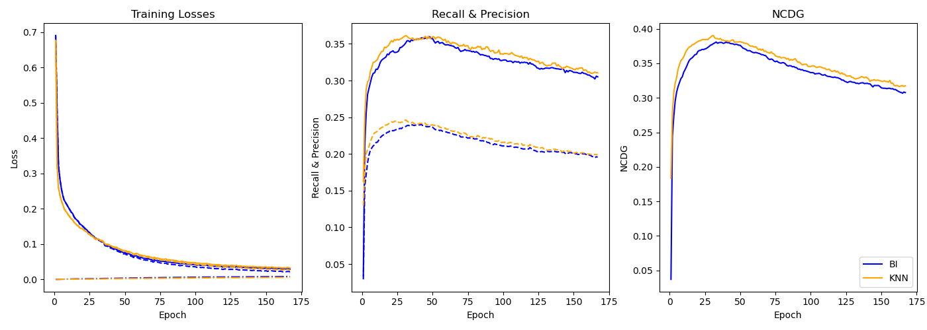
Some initial experimental results.
Quite positive.
BI – LightGCN, KNN- is hyperGCN.
Dataset: ml-100k | #User: 1,682 | #Items: 943 | #Interaction: 100,000 | Sparsity: 93.7%

Slide 5
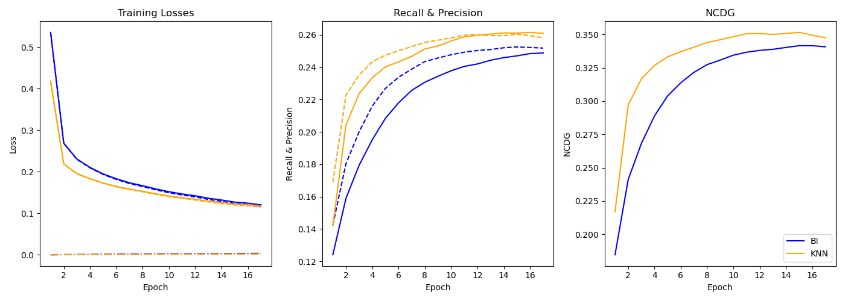
Some initial experimental results.
Quite positive.
BI – LightGCN, KNN- is hyperGCN.
Dataset: ml-1m | #User: 3,952 | #Items: 6,040 | #Interaction: 1,000,209 | Sparsity: 95.81%

Slide 6
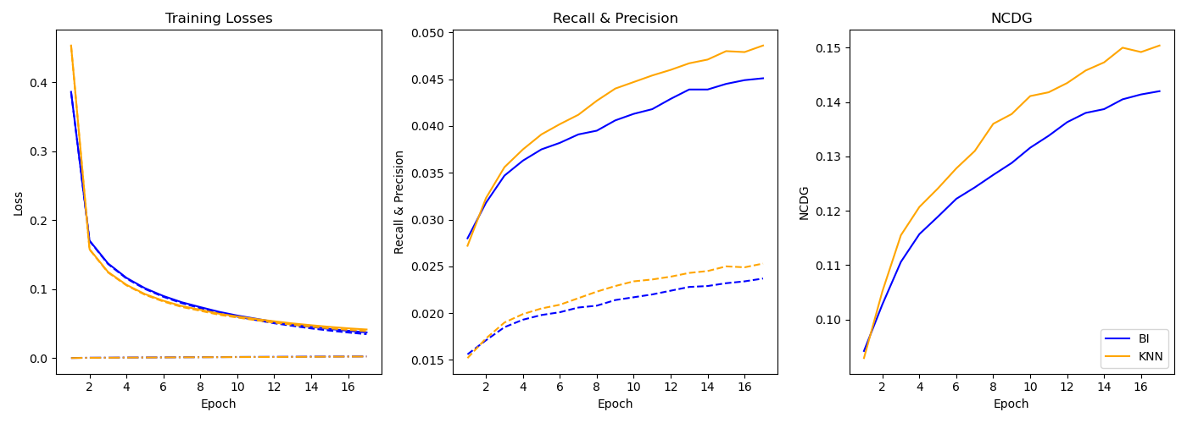
Some initial experimental results.
Quite positive.
KNN- is hyperGCN.
Dataset: Yelp2018 | #User: 31,668 | #Items: 38,048 | #Interaction: 1,561,406 | Sparsity: 99.87%

Slide 7
Paper structure
Abstract
Introduction
Related work
Methodology
Similarity matrices
Message construction
Message propagation & aggregation
Prediction
BPR learning & optimization
Regularization (dropout)
Experiment
Experimental Settings
Datasets: Yelp2018, ml-100k, ml-1m, Douban
Metrics
Performance comparison to LightGCN
Performance comparison to baselines: LightGCN, ItemKNN, userKNN, NCGF, MCGF, GHRS, GraphRec
Hyperparameter studies
Conclusion
Reference

