Slide 1
Research update
B. Tseesuren
2025/06/10

Slide 2
CF evolution and recent paper review
MF & various (before 2017) => GCN (2017 - 2021) => Spectral models (after 2021)
Graph Spectral models:
GF-CF (2021, CIKM)
LCFN (2022, AAAI)
ultraGCN (2023, CIKM)
JGCF (2023, KDD)
BSPM (spectral + diffusion based model, SIGIR 2023)
polyCF (2024)
2024, 2025?

Slide 3
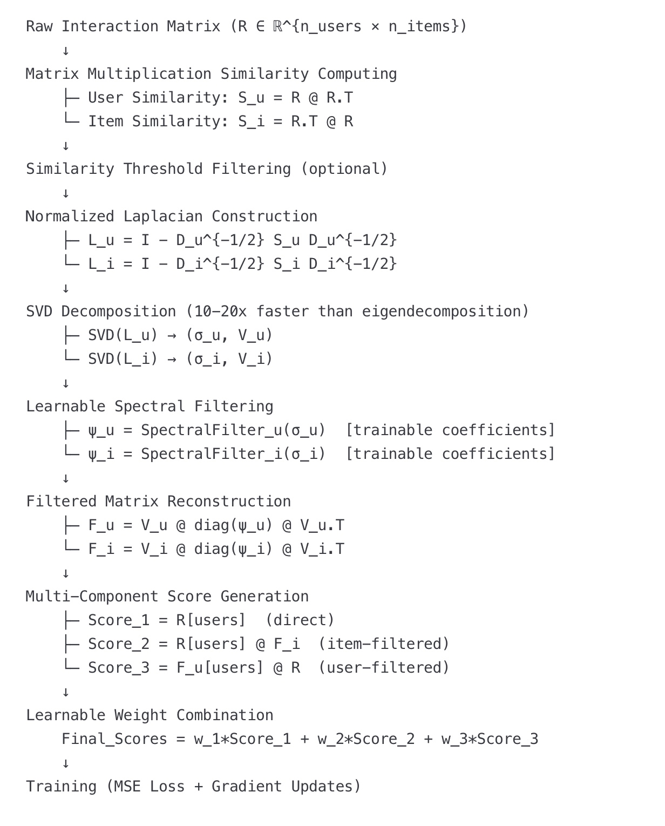
Universal Spectral CF (uSpecCF)
Problem Definition
The Challenge: Current spectral CF methods suffer from several critical limitations:
Fixed Spectral Processing: Existing spectral methods (like GF-CF) use fixed, hand-crafted polynomial filters that cannot adapt to different datasets or learn optimal frequency responses
Single-Component Limitations: Existing approaches typically use either user OR item similarities, missing the complementary information from both
Adaptive eigen number selection and adaptive thresholding based on dataset characteristic (fewer hyperparameters) ?
What Our Model Addresses: We propose Universal Spectral Collaborative Filtering (uSpec) that fundamentally transforms spectral collaborative filtering by introducing learnable, adaptive spectral filters with efficient SVD-based computation.

Slide 4
Timeline
The basic model development is done.
Experimenting & fine tuning on various datasets
Paper writing: initial draft is planned to be by 1st of July.
Finish reviewing and polishing for submission by 1st of August.

Slide 5
Conferences aiming
AAAI 2026 (Abstract 25th of July, full paper 1st of August)
KDD 2026 (August)
WSDM 2026
WWW 2026
SIGIR 2026
ICML 2026
RecSys 2026

