Slide 1
COVID19 Global Forecasting
05/05/20

Slide 2
Agenda
Introduction
Data Visualization
Linear Regression
Sigmoid
Random Forest Regression
SIR Model
RNN

Slide 3
Introduction
Project:
COVID19 Global Forecasting (Link)
Purpose:
Forecast daily COVID-19 spread in regions around world
Dataset:
  Id
  Province State
  Country Region
  Date
  Confirmed Cases
  Fatalities

Slide 4
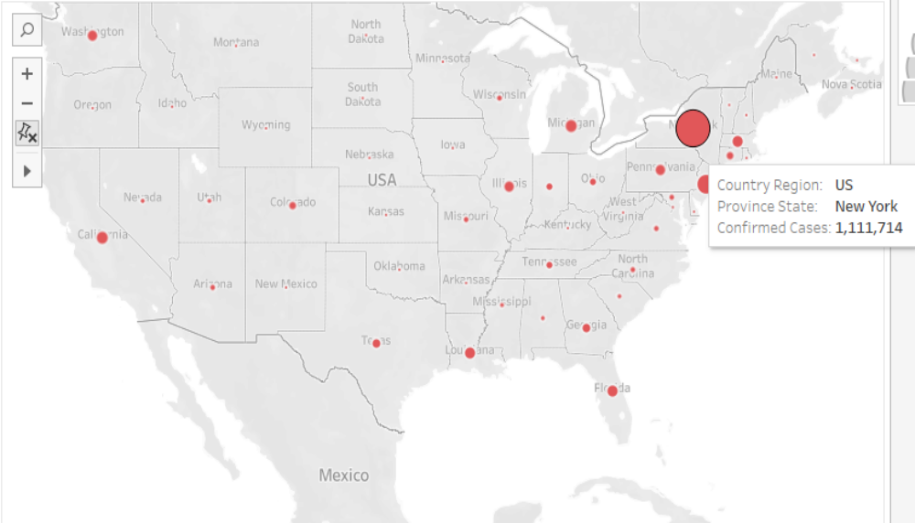
DataVisualization
Data visualized by world map

Slide 5
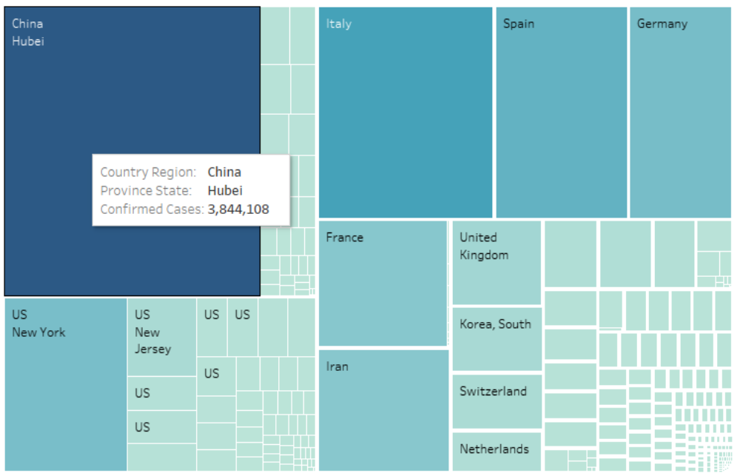
DataVisualization
Data visualized by tree map

Slide 6
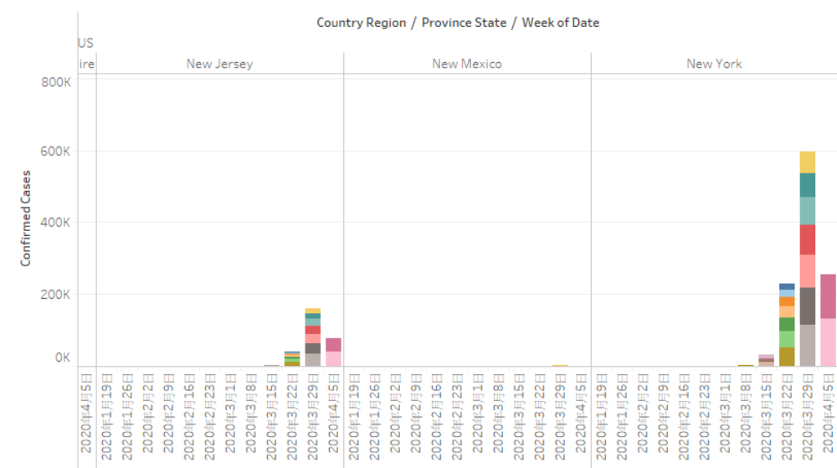
DataVisualization
Data visualized by side-by-side bars

Slide 7
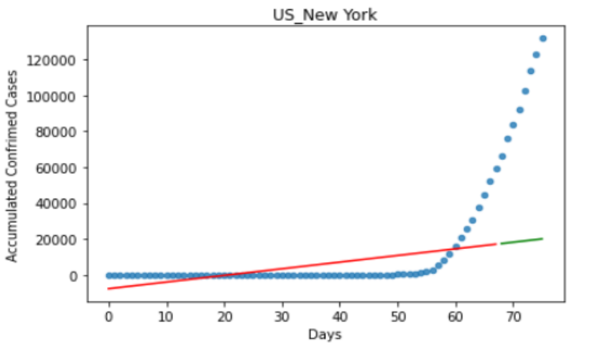
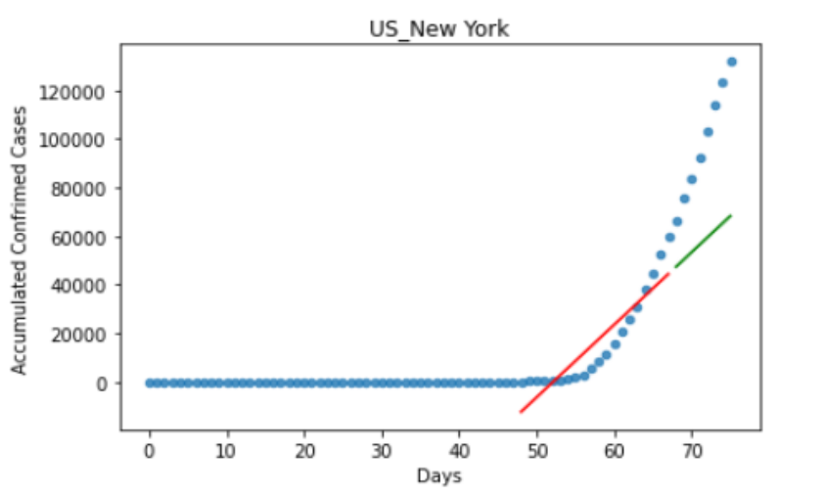
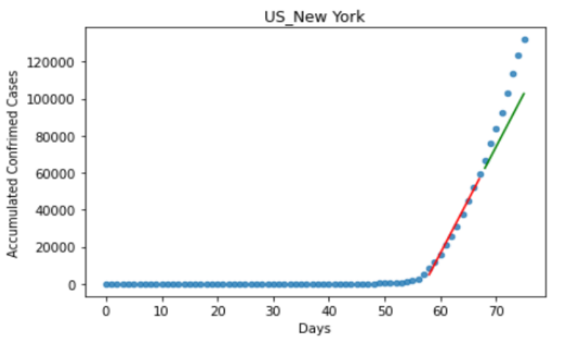
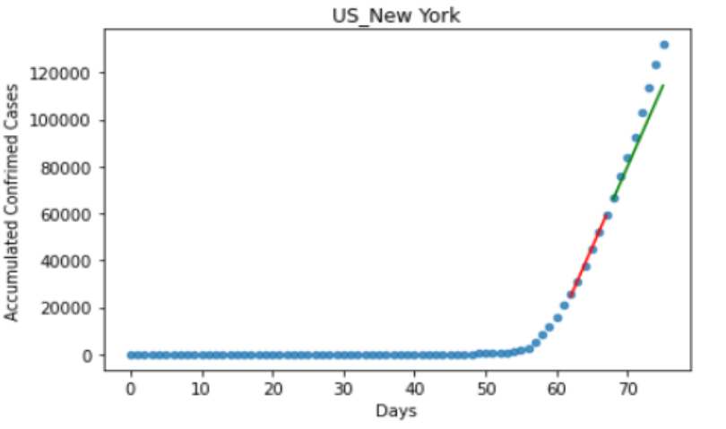
Linear Regression
Example:
score_train: 0.33
score_test : -13.6
score_train: 0.82
score_test :-3.05
Day 0
Day 48
score_train: 0.98
score_test : 0.27
score_train: 0.99
score_test : 0.76
Day 58
Day 62
score = 1 - (((y_true - y_pred) ** 2).sum() )/((y_true - y_true.mean()) ** 2).sum()

Slide 8
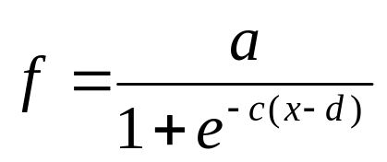
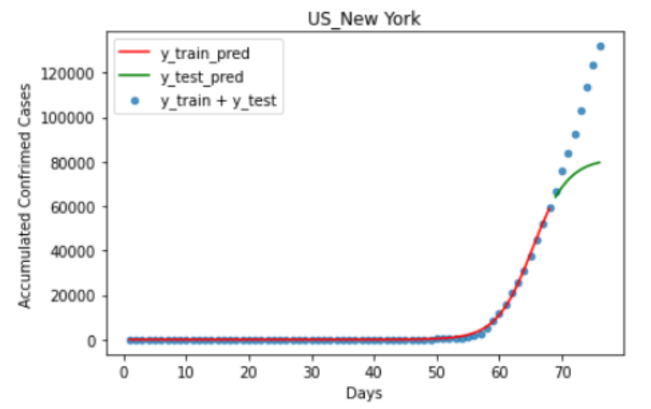
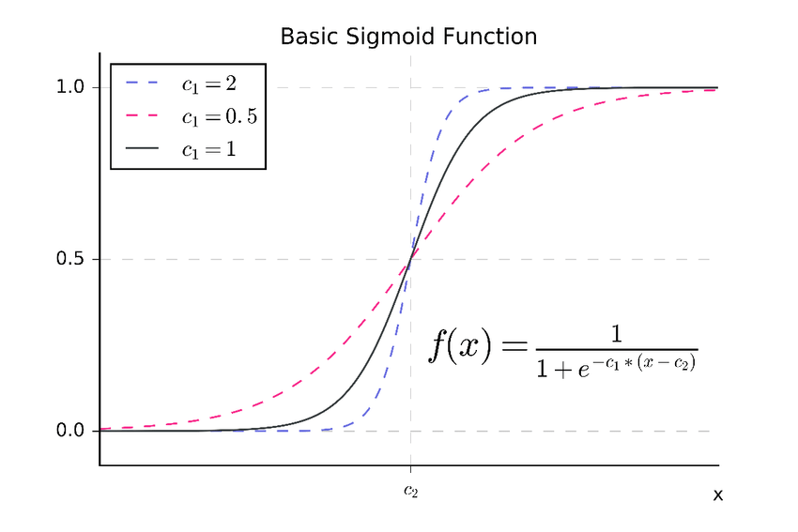
Sigmoid Function
Example:
a: the maximal number of cases
c: the growth parameter
d: the number of days of half max(ConfirmedCases)
score_train: 0.99
score_test: -0.93
https://www.researchgate.net/figure/A-Basic-sigmoid-function-with-two-parameters-c1-and-c2-as-commonly-used-for-subitizing_fig2_325868989

Slide 9
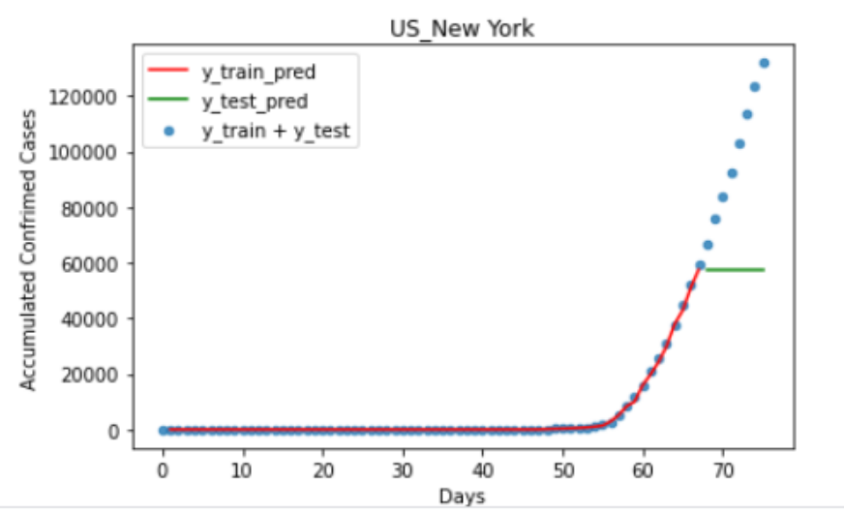
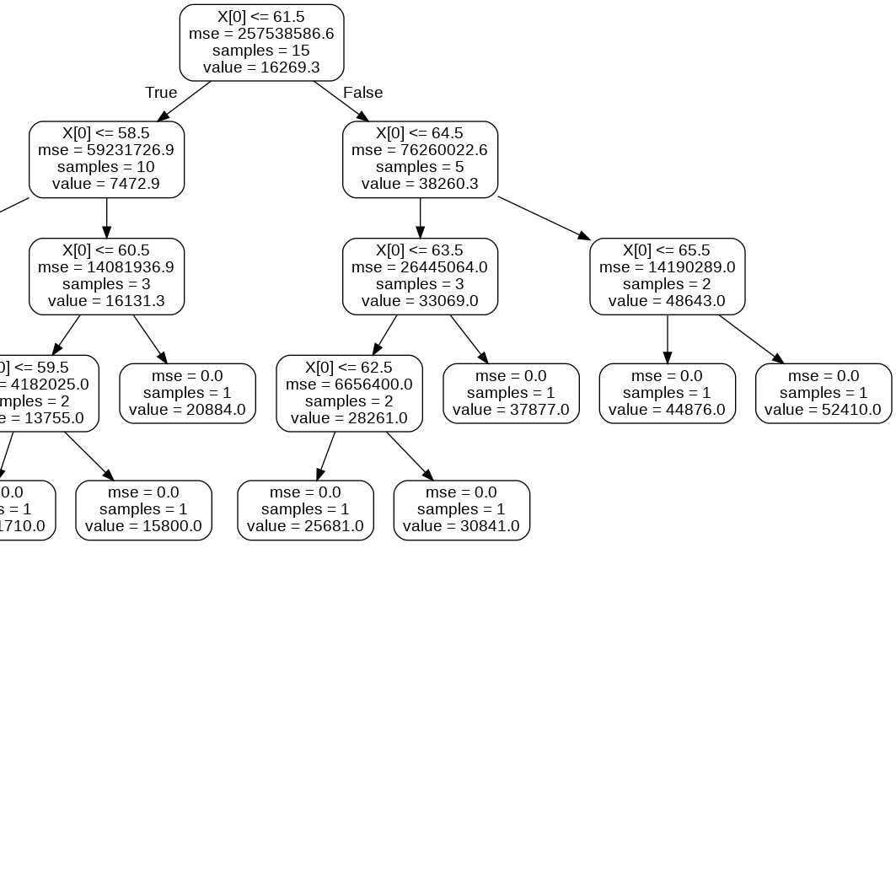
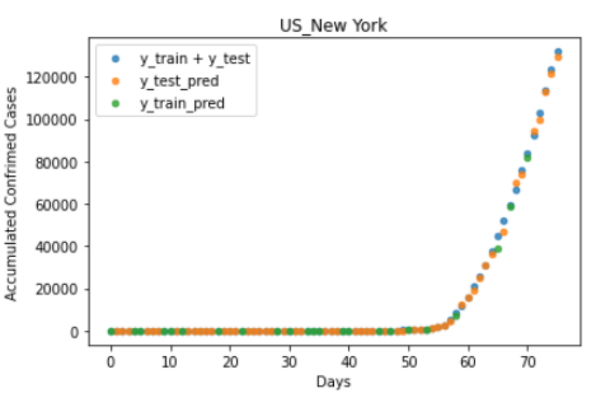
Random Forest Regression
Example
score_train: 0.99
score_test: -4.05
Splite last n days as y_test
score_train: 0.99
score_test: 0.99
random split

Slide 10
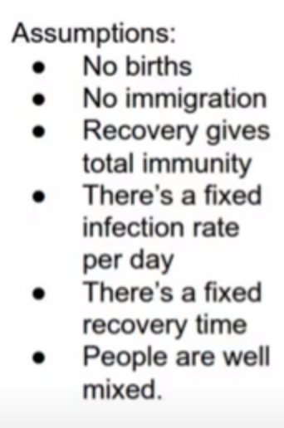
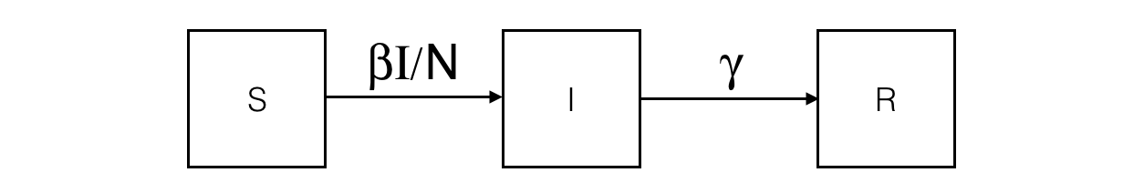
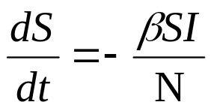
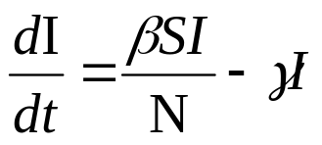
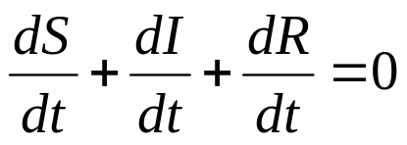
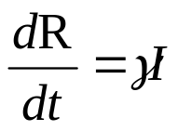
SIR
S: susceptible; I: infected; R: recovered
β = contacts per infected per day
N = total number of population
γ = recoveries per person per day

Slide 11
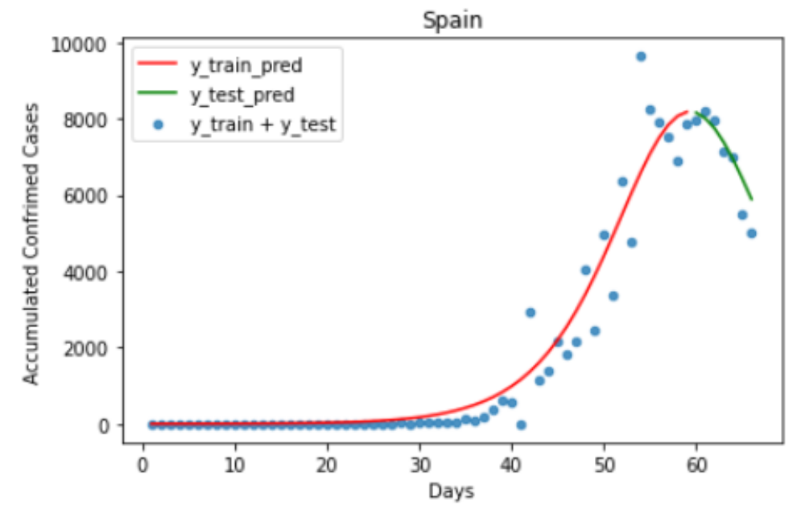
SIR
Example
score_train: 0.93
score_test: 0.80

Slide 12
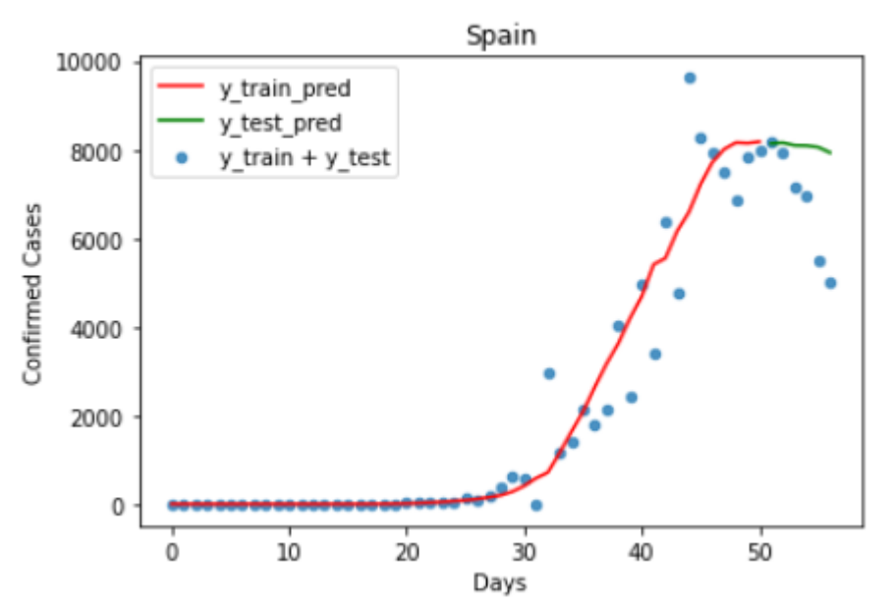
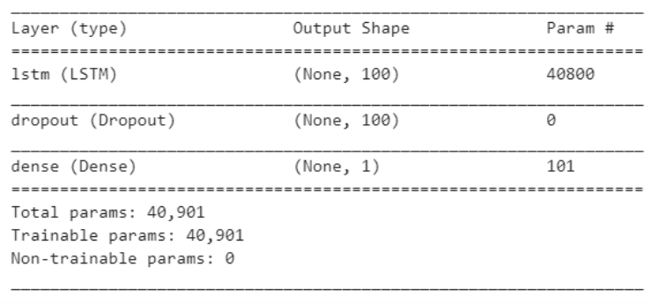
RNN
Sampling 10 days as 1 set (first 9 days as x, last day as y). For example:
row1 = [day1, day2, day3, day4, day5, day6, day7, day8, day9, day10]
row2 = [day2, day3, day4, day5, day6, day7, day8, day9, day10, day11]
row3 = [day3, day4, day5, day6, day7, day8, day9, day10, day11, day12]
...

