Slide 1
Memory and Resource Efficient Implementation of Information Bottleneck Method for LDPC Decoders

Slide 2
Overview: BRAM based Lookup Tables
CNU-IB RAM
CNU-IB ROM
CNU-IB Map
256-entry
32x4-bit
1st 9-entry page
2nd 9-entry page
Entry
Indexing
Func.
Page Data
Address
Map
256-entry
Address
32x4-bit
Data
5th connected
variable node
114th 9-entry page
256-entry
36-bit
(4-bit for each entry)
32x4-bit
256-entry
32x4-bit

Slide 3
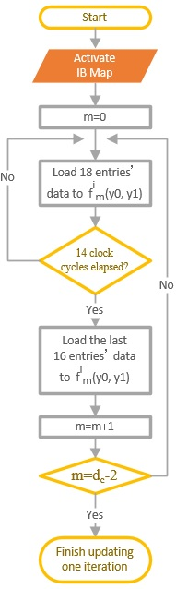
CNU-IB ROM Accesses
CNU-IB ROM
36
CNU-IB Map
32
Port A
ram_portA[0:7]
Port A
32
ram_portB[0:7]
Port B
32
ram_portC[0:7]
36
Addr_A
Addr_B
32
ram_portD[0:7]
7
7
Q=4
bank0_portA
Q=4
bank1_portA
Q=4
bank2_portA
ram_portA[0:7]
Qx8=32
Q=4
bank3_portA
Q=4
bank4_portA
Q=4
bank5_portA
Q=4
bank6_portA
Q=4
bank7_portA

