Slide 1
Memory and Resource Efficient Implementation of Information Bottleneck Method for LDPC Decoders

Slide 2
Overview: BRAM based Lookup Tables
CNU-IB RAM
CNU-IB ROM
CNU-IB Map
256-entry
32x4-bit
1st 9-entry page
2nd 9-entry page
Entry
Indexing
Func.
Page Data
Address
Map
256-entry
Address
32x4-bit
Data
5th connected
variable node
114th 9-entry page
256-entry
36-bit
(4-bit for each entry)
32x4-bit
256-entry
32x4-bit

Slide 3
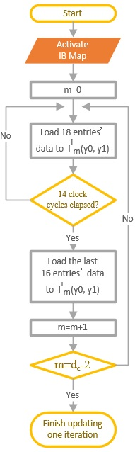
CNU-IB ROM Accesses
Specification of BRAM
  Page size: 36-bit
  Depth: 114
  Dual read ports
    Read latency: 1 clock cycle
(3,6)-regular code configuration
  Quantised message of 4-bit
  (d_{c}-2) number of decomposed LUTs
    2⁴x2⁴=256 entries, i.e., 1024-bit
    Memory utilisation: 15 pages
  Total memory utilisation: 114 pages
CNU-IB ROM
36
CNU-IB Map
32
Port A
ram_portA[0:7]
Port A
32
ram_portB[0:7]
Port B
32
ram_portC[0:7]
36
Addr_A
Addr_B
32
ram_portD[0:7]
7
7
Q=4
bank0_portA
Q=4
bank1_portA
Q=4
bank2_portA
ram_portA[0:7]
Qx8=32
Q=4
bank3_portA
Q=4
bank4_portA
Q=4
bank5_portA
Q=4
bank6_portA
Q=4
bank7_portA

Slide 4
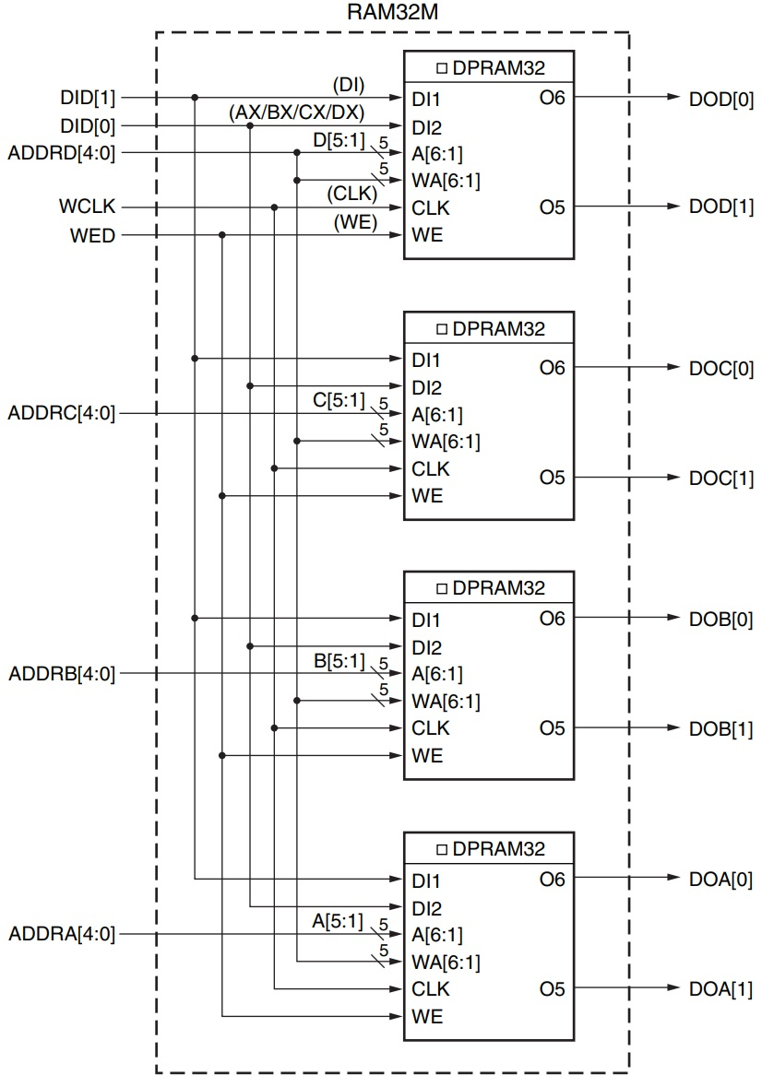
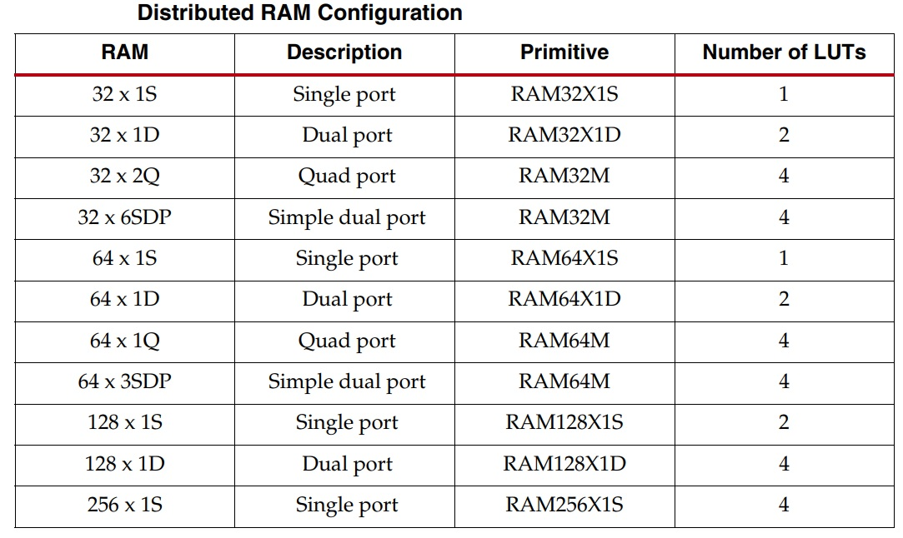
Structure of Information Bottleneck LUTs
32x2 Quad Port Distributed RAM (RAM32M) [1]
[1] Guide, User. "Series FPGAs configurable logic block." Xilinx, San Jose, CA 1.7 (7).
[1] Lewandowsky, Jan, and Gerhard Bauch. "Information-optimum LDPC decoders based on the information bottleneck method."Â IEEE AccessÂ 6 (2018): 4054-4071.

Slide 5
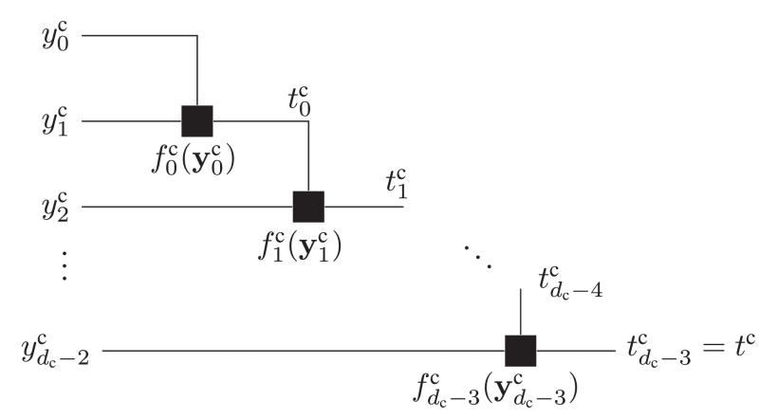
Structure of Information Bottleneck LUTs
Specification of distributed RAM (Xilinx FPGAs)
  Quad-Port 32 x 2-bit RAM (four number of 6-LUTs)
    Four duplicated 32x2b RAMs, i.e., port A, B, C and D
  One port for synchronous write and asynchronous reads
  Three ports for asynchronous reads
Structure of CNU-IB RAM
  Concatenation of two RAM32Ms: 4-bit of data bus width
    To match size of one quantised message
Construction of one mutual information maximising LUT
  2^{2Q} entries for each decomposed 2-input LUT, i.e., 256 entries
  d_{c}-2 number of decomposed 2-input LUTs
  Eight RAM banks to partition 256 entries
Bank 7
Bank 6
2
Figure 1. Illustration of IB LUTs decomposition [1]
32
depth
Bank 5
2
32
depth
Q=4
Bank 4
2
4
bank0_portA
32
depth
Bank 3
2
32
depth
2-bit
2
4
bank1_portA
Q=4
Bank 2
2
32
depth
2-bit
2
4
Q=4
Bank 1
2
bank2_portA
2-bit
4
32
depth
32
depth
2
Q=4
Bank 0
2
bank3_portA
MUX
2-bit
4
32
depth
32
depth
2
4
t^{C}₀ of portA
2
Q=4
2-bit
4
32
depth
32
depth
2
2-bit
bank4_portA
2-bit
4
32
depth
2
2-bit
bank5_portA
Q=4
2-bit
4
32
depth
2
2-bit
Q=4
2-bit
bank6_portA
32
depth
2
2-bit
32
depth
2-bit
bank7_portA
Q=4
32
depth
2-bit
3
2-bit
ram_bank_address
2-bit
[1] Lewandowsky, Jan, and Gerhard Bauch. "Information-optimum LDPC decoders based on the information bottleneck method."Â IEEE AccessÂ 6 (2018): 4054-4071.

Slide 6
CNU-IB Map: Bank Interleaving
CNU-IB ROM
36
CNU-IB Map
32
Port A
ram_portA[0:7]
Port A
32
ram_portB[0:7]
Port B
32
ram_portC[0:7]
36
Addr_A
Addr_B
32
ram_portD[0:7]
7
7
Q=4
bank0_portA
Q=4
bank1_portA
Q=4
bank2_portA
ram_portA[0:7]
Qx8=32
Q=4
bank3_portA
Q=4
bank4_portA
Q=4
bank5_portA
Q=4
bank6_portA
Q=4
bank7_portA

Slide 7
Entry Indexing Function: IB LUT Access Address
Entry address transalation for one decomposed 2-input LUT
  Concatenate two input signals as address
Address bus of RAM32_4bit x 8 banks
  RAM bank address: 3-bit
  RAM page address: 5-bit
  All banks share the same page address
Address Mapping:
Bank0
Bank1
Bank2
Bank7
Entry 0
Entry 1
Entry 2
Entry 7
y₀
y₁
Entry 8
Entry 9
Entry 10
Entry 15
Address
32
depth
Page address
Bank address
Entry 248
Entry 249
Entry 250
Entry 255
4-bit

Slide 8
System Architecture
CNU-IB RAM
CNU-IB ROM
CNU-IB Map
256-entry
32x4-bit
1st 9-entry page
2nd 9-entry page
Entry
Indexing
Func.
Page Data
Address
Map
256-entry
Address
32x4-bit
Data
5th connected
variable node
114th 9-entry page
256-entry
36-bit
(4-bit for each entry)
32x4-bit
256-entry
32x4-bit

Slide 9
Block Diagrams and Interfaces: Write
Page Address Gate
CNU-IB RAM 0
5
addr0
interBank_data
m
5
addr1
addr0
write_addr
ram_sel
selector
5
addr2
ram_clk
5
write_en
‘1’
addr3
addr1
CNU-IB RAM 1
CNU-IB ROM
36
CNU-IB Map
interBank_data
Port A
In_0
ram_portA
32
32
write_addr
ram_portB
32
32
32
write_en
‘1’
Port B
In_1
ram_portC
32
MUX
DEMUX
32
36
32
32
CNU-IB RAM 2
Addr_0
Addr_1
ram_portD
7
interBank_data
Counter
2-bit
2
m
addr2
write_addr
7
rom_clk
write_en
‘1’
Counter
m-bit
CNU-IB RAM 3
Decomposition Clock Generator
ram_sel
interBank_data
rom_clk
m_clk
addr3
write_addr
ram_clk
write_en
‘1’
0
1
2
3
4
5
...
13
14
0
ram_clk
Clock Source | Clock Rate
ram_clk | 300 MHz
rom_clk | 100 MHz
m_clk | 20 MHz
0
1
2
3
rom_clk
0
1
m_clk

Slide 10
Block Diagrams and Interfaces: Read
Entry
Indexing Function
4
y₀
page_addr
5
4
y₁
bank_addr
3
Entry
Indexing Function
CNU-IB RAM 0
5
page_addr
t
4
y₀
page_addr
bank_addr
y₁
bank_addr
3
Entry
Indexing Function
‘0’
write_en
CNU-IB RAM 1
ram_clk
page_addr
t
4
y₀
bank_addr
5
bank_addr
y₁
page_addr
3
4
‘0’
write_en
ram_clk
4
Entry
Indexing Function
CNU-IB RAM 2
CNU-IB RAM 3
5
4
page_addr
4
t
page_addr
page_addr
y₀
t
bank_addr
3
bank_addr
y₁
4
bank_addr
write_en
‘0’
write_en
‘0’
ram_clk
ram_clk

Slide 11
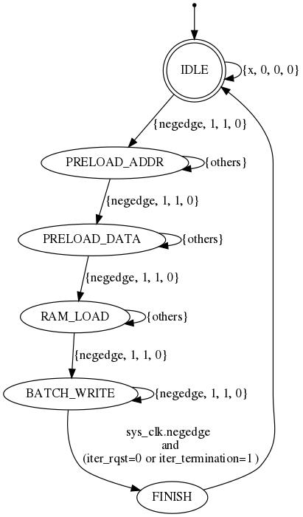
CNU-IB Control Unit
Finite State Machine
  Input
    sys_clk
    Rstn
    iter_rqst
    iter_termination
  Output
    ram_write_en
    iter_update
    c6ib_rom_rst
State 0: IDLE
  Output: {0, 0, 1}
State 1: PRELOAD_ADDR
  Output: {0, 1, 0}
State 2: PRELOAD_DATA
  Output: {1, 1, 0}
State 3: RAM_LOAD
  Output: {1, 1, 0}
State 4: BATCH_WRITE
  Output: {1, 1, 0}
State 5: FINISH
  Output: {0, 0, 1}
Notes:
CNU6IB Control Unit
a) Output:
(1) ram_write_en
(2) iter_update
(3) c6ib_rom_rst
b) Input:
(1) sys_clk
(2) rstn
(3) iter_rqst
(4) iter_terminate
Finite State
State 0. IDLE
input: {sys_clk, rstn, iter_rqst, iter_terminate} == {x, 0, 0, 0}
output: {ram_write_en, iter_update, c6ib_rom_rst} == {0, 0, 1}
next step:
{negedge, 1, 1, 1} -> State 1
others -> suspension
State 1. PRELOAD ADDR
input (from State 0): {sys_clk, rstn, iter_rqst, iter_terminate} == {negedge, 1, 1, 0}
output: {ram_write_en, iter_update, c6ib_rom_rst} = {0, 1, 0}
operation:
To give ROM dual-port's corresponding read addresses, i.e., 0x00 and 0x01, at half clock cycle ahead of
ROM-Data-Fetch timing (rising edge of rom_clk).
next step:
{posedge, 1, 1, 0} -> State 2
others -> suspension
State 2. PRELOAD DATA
input (from State 1): {sys_clk, rstn, iter_rqst, iter_terminate} == {posedge, 1, 1, 0}
output: {write_en, iter_update, c6ib_rom_rst} = {0, 1, 0}
operation:
To fetch first two pages' data from ROM, i.e., first 18 entries for RAM.
Then the data will be latched on dual read ports, each of which contributes 36-bit or 9 entries of data.
next step:
{negedge, 1, 1, 0} -> State 3
others -> suspension
State 3. RAM LOAD
input (from State 2): {sys_clk, rstn, iter_rqst, iter_terminate} == {negedge, 1, 1, 0}
output: {write_en, iter_update, c6ib_rom_rst} = {1, 1, 0}
operation:
The CNU-IB Map will partition and latch the first given 72-bit or 18 entries of data in a bank-interleaving
manner, at its three read ports of 32-bit width for each.
next step:
{negedge, 1, 1, 0} -> State 4
others -> suspension
State 4. BATCH WRITE
input (from State 3): {sys_clk, rstn, iter_rqst, iter_terminate} == {negedge, 1, 1, 0}
output {write_en, iter_update, c6ib_rom_rst} = {1, 1, 0}
operation:
Iteratively writing the data into CNU-IB RAMs
next step:
sys_clk in posedge && (iter_rqst == 0 || iter_terminate == 1) -> State 5
{sys_clk, rstn, iter_rqst, iter_terminate} == {negedge, 1, 1, 0} -> State 4
others -> suspension
State 5. FINISH
input (from State 4): {sys_clk, rstn, iter_rqst || iter_terminate} == {posedge, 0, 1}
output: {write_en, iter_update, c6ib_rom_rst} = {0, 0, 1}
operation:
Completing the update of next iteration's data set, then coming back to IDLE status again.
next step:
x -> State 0

Slide 12
Evaluation Metrics

