Slide 1
Optimization

Slide 2
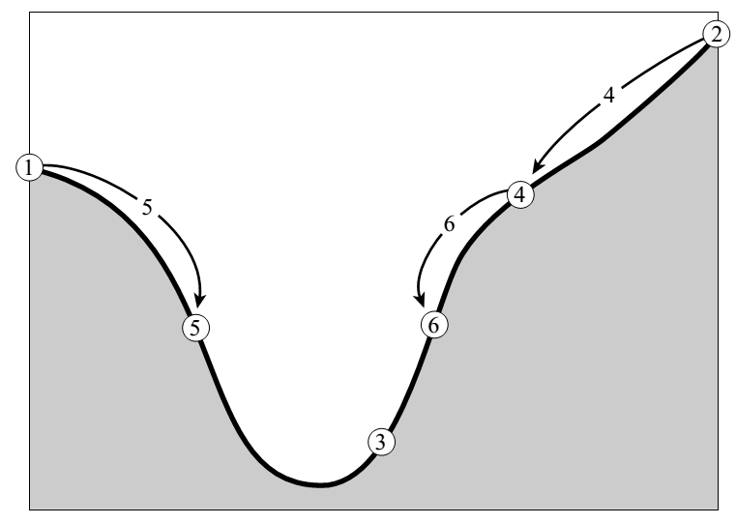
Golden Section Search
a
b
c

Slide 3



Golden section search in 1D
a
b
x
c
0
w
w+z
1
The next bracket may be (a, b, x) or (b, x , c), to minimize the worst case possibility, we set w+z = 1-w, such that

Slide 4

Golden section search in 1D
a
b
x
c
0
w
w+z
1
Where did the value of w itself come from?
If z is chosen to be optimal, so was w before it. This scale similarity implies that x should be the same fraction of the way from b to c. In other words,

Slide 5

Golden section search in 1D
a
b
x
c
0
w
w+z
1
In other word, the optimal bracketing interval (a , b , c) has its middle point b a fractional distance 0.38197 from one end , and 0.61803 from the other end.

Slide 6
Golden section search in 1D
At each stage, the next point to be tried is that which is a fraction 0.38197 into the larger of the two intervals
The golden section guarantees that each new function evaluation will bracket the minimum to an interval just 0.61803 times the size of the preceding interval
Bisection achieves 0.5 times the size if lucky

Slide 7
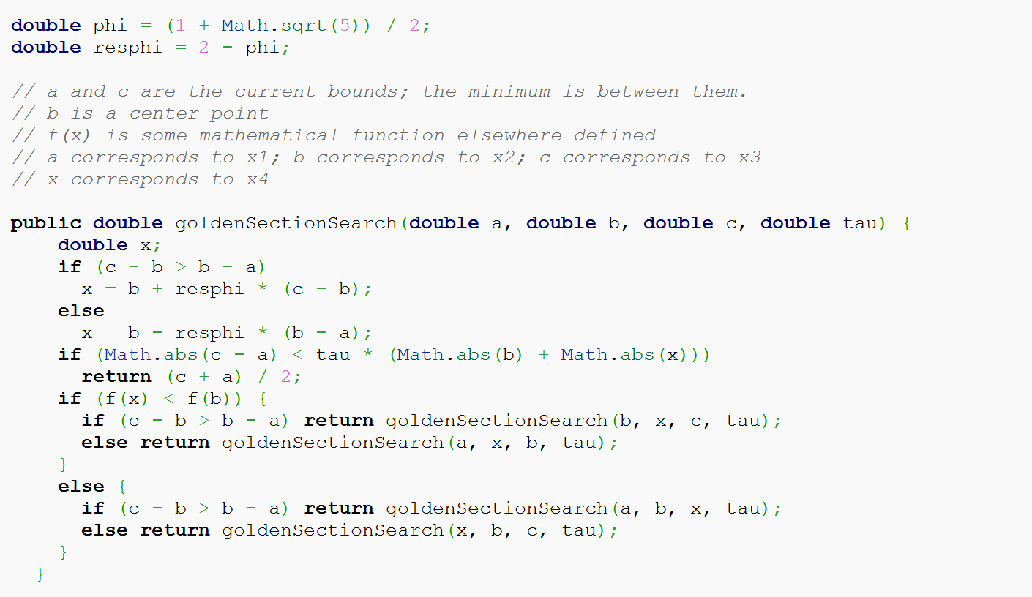
Golden Section Algorithm

Slide 8
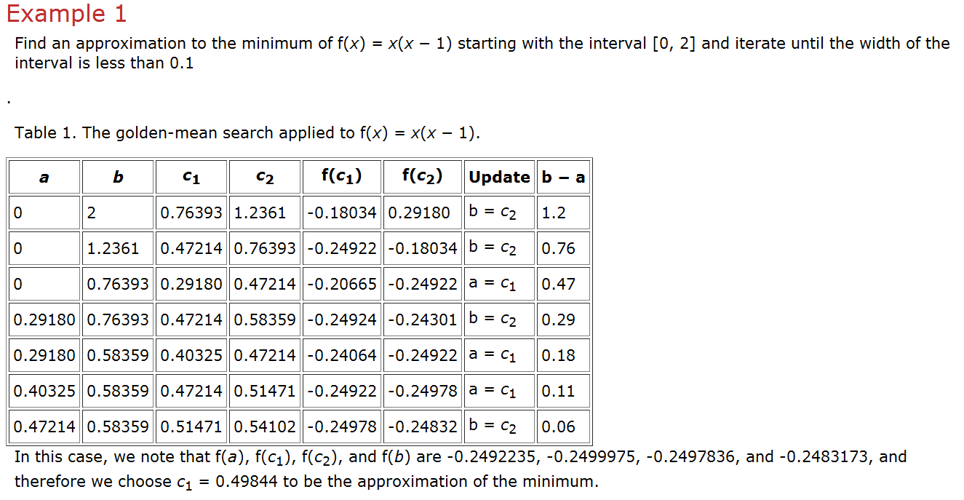
Golden Section = 0.618

Slide 9
Powell’s method in multi-dimensions
The function of N variables f(P) can be minimized by a sequence of 1D minimization methods.
Take the unit vectors e₁, e₂, … e_{N} as a set of directions. Then iteratively move along each direction to its minimum.
Generally, e₁ = (1, 0, 0, 0, 0,…0), e₂ = (0, 1, 0, 0, 0, … 0), … e_{N} = (0, 0, 0, 0, 0,…1), etc.

Slide 10
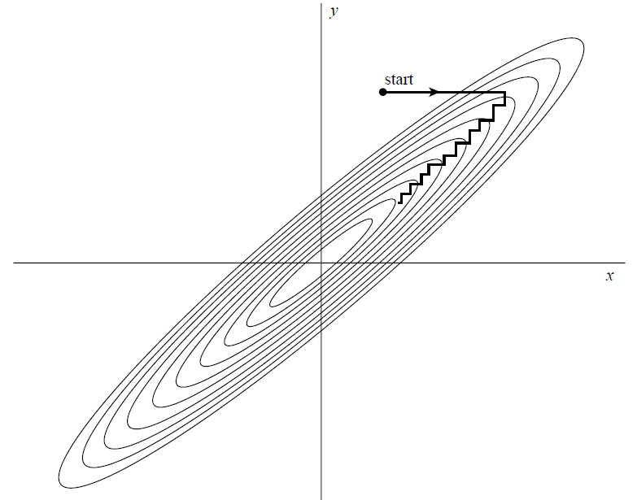
Powell’s method in multi-dimensions
What if minimizing the function with a long, narrow valley at some angle to the coordinate basis vectors?

Slide 11

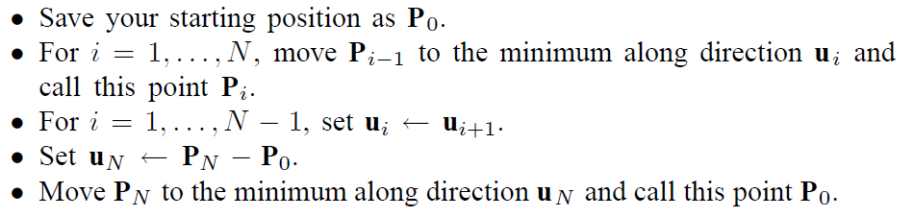
Powell’s quadratically convergent method

Slide 12
Powell’s quadratically convergent method
At each stage, u₁ in favor of P_{N}-P₀ tends to produce sets of directions that “fold up on each other” and become linearly dependent.
To remedy this,
Reinitialize the set of directions u_{i} after N iterations
Discard the old direction along which the function f made its largest decrease.

Slide 13

Example
Minimize
ƒ $\left(X\right)$ = ƒ$\left(x1,x2\right)$ = 3 + $\left(x1 −1.5x2\right)$² + $\left(X2 −2\right)2$
Side Constraints
$$0≤x1≤5$$
$$0≤x2≤5$$

Slide 14
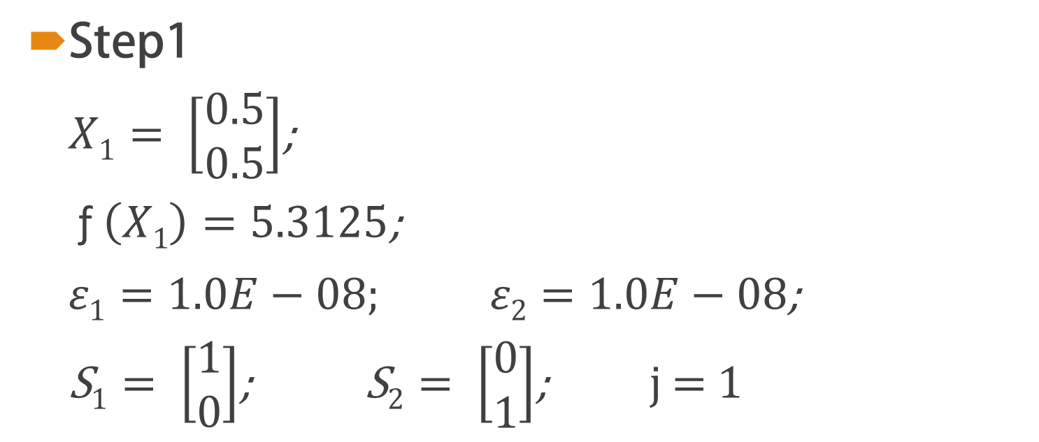
Solution
Step1
$X1= \left[\begin{aligned}0.5 \\ 0.5\end{aligned}\right]$;
ƒ $\left(X1\right)=5.3125$;
$ε1=1.0E−08; ε2=1.0E−08$;
S$1= \left[\begin{aligned}1 \\ 0\end{aligned}\right]$; S$2= \left[\begin{aligned}0 \\ 1\end{aligned}\right]$; j = 1

Slide 15
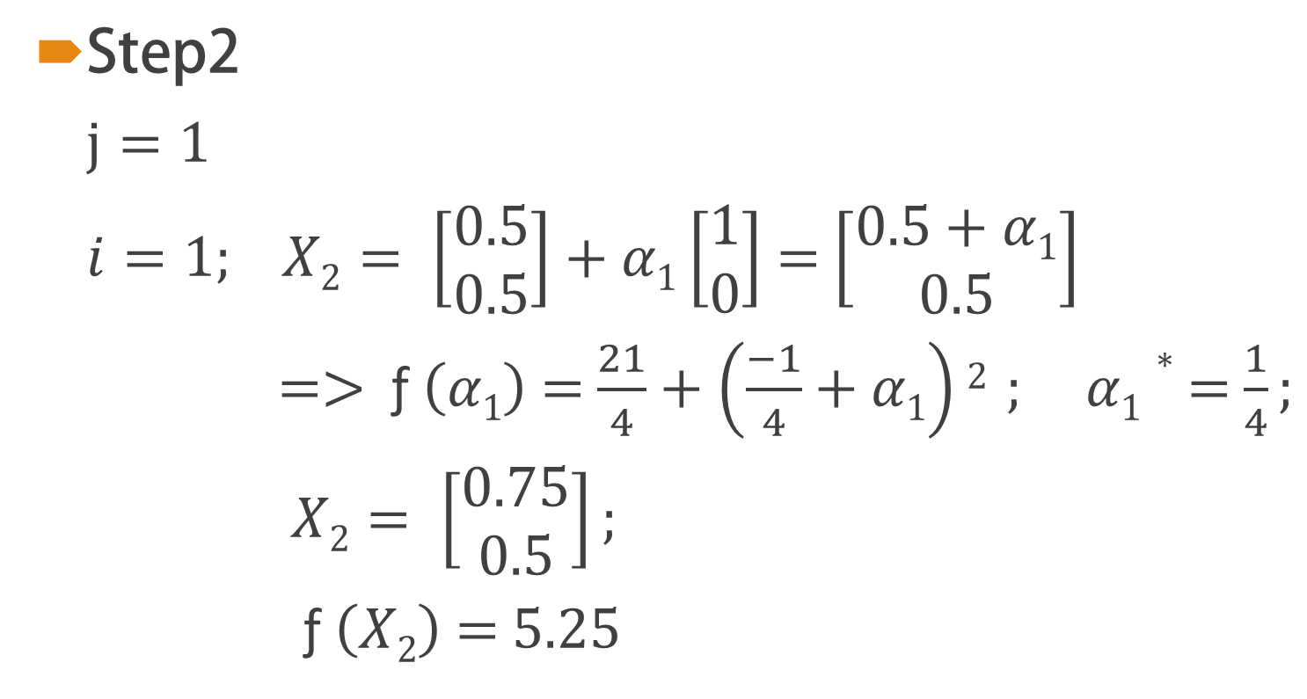
Solution
Step2
$j=1$
$i=1$; $X2= \left[\begin{aligned}0.5 \\ 0.5\end{aligned}\right]$ + $α1\left[\begin{aligned}1 \\ 0\end{aligned}\right]$ = $\left[\begin{aligned}0.5+α1 \\ 0.5\end{aligned}\right]$
=> ƒ $\left(α1\right)$ = $\frac{21}{4}+\left(\frac{−1}{4}+α1\right)2$ ; $α1∗$ = $\frac{1}{4};$
$X2= \left[\begin{aligned}0.75 \\ 0.5\end{aligned}\right];$
ƒ $\left(X2\right)$ = 5.25

Slide 16
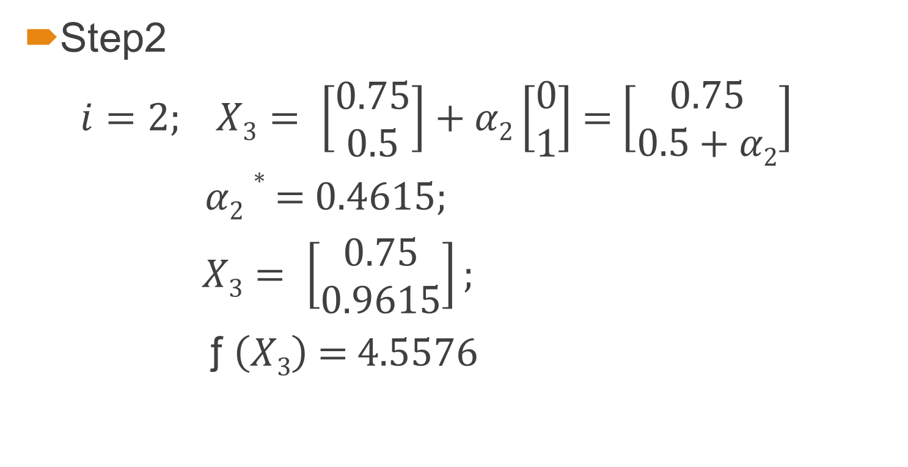
Solution
Step2
$i=2$; $X3= \left[\begin{aligned}0.75 \\ 0.5\end{aligned}\right]$ + $α2\left[\begin{aligned}0 \\ 1\end{aligned}\right]$ = $\left[\begin{aligned}0.75 \\ 0.5+α2\end{aligned}\right]$
$α2∗$ = 0.4615$;$
$X3= \left[\begin{aligned}0.75 \\ 0.9615\end{aligned}\right];$
ƒ $\left(X3\right)$ = 4.5576

Slide 17
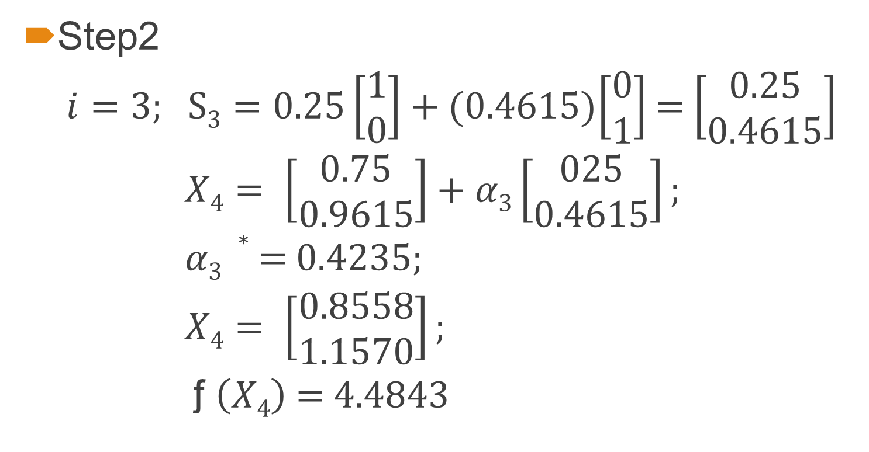
Solution
Step2
$i=3$; S$3=0.25\left[\begin{aligned}1 \\ 0\end{aligned}\right]$ + (0.4615)$\left[\begin{aligned}0 \\ 1\end{aligned}\right]$ = $\left[\begin{aligned}0.25 \\ 0.4615\end{aligned}\right]$
$X4= \left[\begin{aligned}0.75 \\ 0.9615\end{aligned}\right]+α3\left[\begin{aligned}025 \\ 0.4615\end{aligned}\right];$
$α3 ∗$ = 0.4235$;$
$X4= \left[\begin{aligned}0.8558 \\ 1.1570\end{aligned}\right];$
ƒ $\left(X4\right)$ = 4.4843

Slide 18
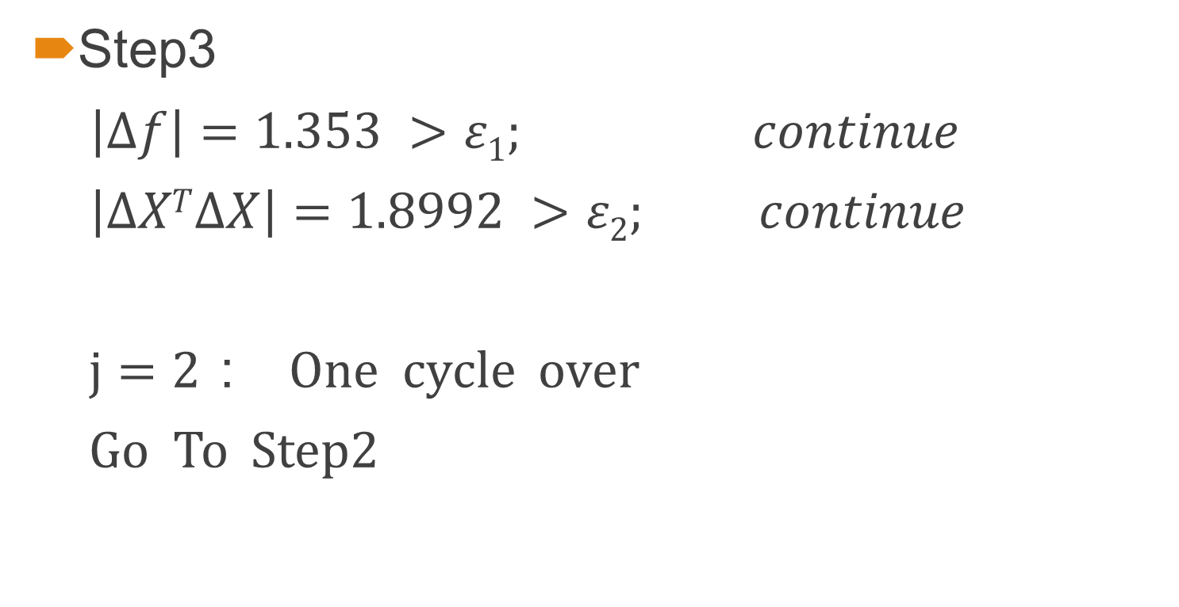
Solution
Step3
$\left|∆f\right|=1.353 >ε1$; $continue$
$\left|∆XT∆X\right|=1.8992 >ε2$; $continue$
$j=2：$ One cycle over
Go To Step2

Slide 19
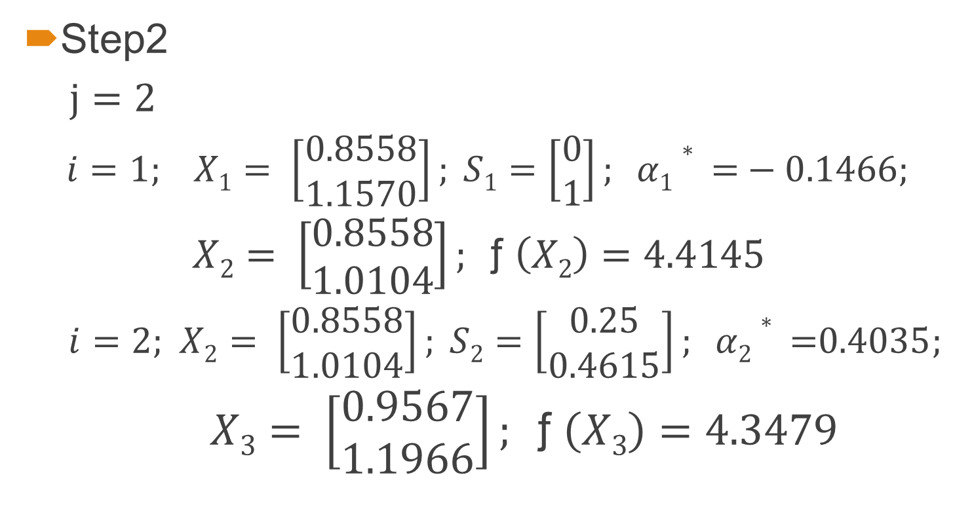
Solution
Step2
$j=2$
$i=1$; $X1= \left[\begin{aligned}0.8558 \\ 1.1570\end{aligned}\right]; S1=\left[\begin{aligned}0 \\ 1\end{aligned}\right]; α1∗\text{ =}−0.1466;$
$X2= \left[\begin{aligned}0.8558 \\ 1.0104\end{aligned}\right]; \text{ƒ }\left(X2\right)=4.4145$
$i=2$; $X2= \left[\begin{aligned}0.8558 \\ 1.0104\end{aligned}\right]; S2=\left[\begin{aligned}0.25 \\ 0.4615\end{aligned}\right]; α2∗\text{ =}0.4035;$
$X3= \left[\begin{aligned}0.9567 \\ 1.1966\end{aligned}\right]; \text{ƒ }\left(X3\right)=4.3479$

Slide 20

Solution
Step2
$i=3$; $X3= \left[\begin{aligned}0.9567 \\ 1.1966\end{aligned}\right]; S3=\left[\begin{aligned}0.1009 \\ 0.0396\end{aligned}\right]; α3∗\text{ =}20.25;$
$X4= \left[\begin{aligned}3 \\ 2\end{aligned}\right]; \text{ƒ }\left(X4\right)=3$

Slide 21
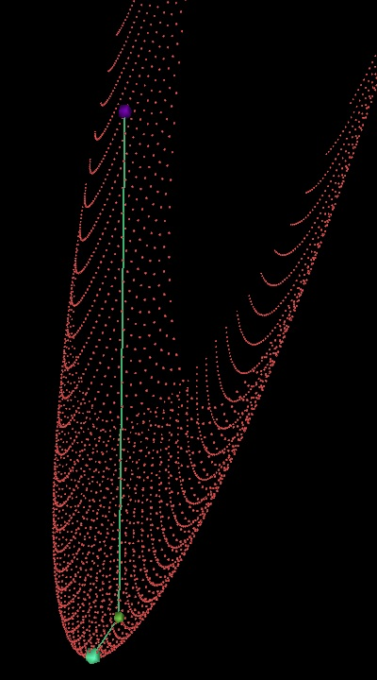
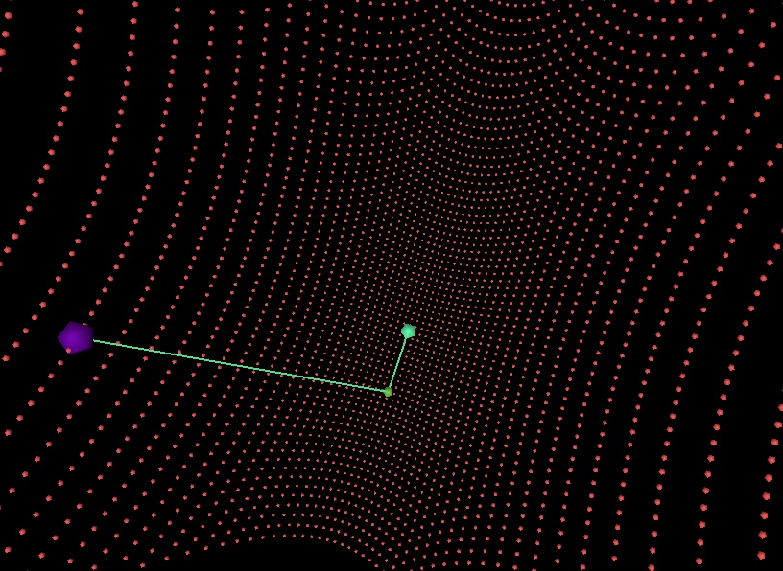
Powell’s Methods
Initial point : (50,30)
The minimum value of f is -1.6 at point (6,10)

Slide 22
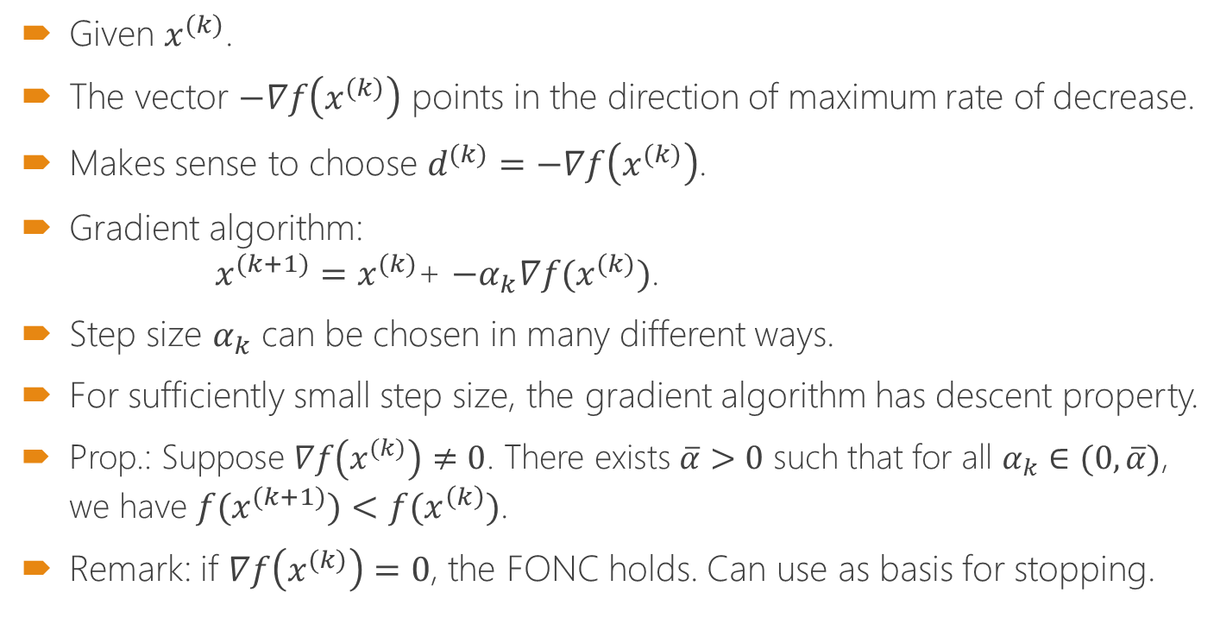
Gradient Methods (6.1)
Given $x^{(k)}$.
The vector $−∇f\left(x^{(k)}\right)$ points in the direction of maximum rate of decrease.
Makes sense to choose $d^{(k)}=−∇f\left(x^{(k)}\right)$.
Gradient algorithm: $x^{(k+1)}=x^{(k)}$+ ${{−α}_{k}∇f(x}^{(k)})$.
Step size $α_{k}$ can be chosen in many different ways.
For sufficiently small step size, the gradient algorithm has descent property.
Prop.: Suppose $∇f\left(x^{(k)}\right)≠0$. There exists $\overline{α}>0$ such that for all $α_{k}∈(0,\overline{α})$, we have ${f(x}^{(k+1)})<f(x^{\left(k\right)})$.
Remark: if $∇f\left(x^{(k)}\right)=0$, the FONC holds. Can use as basis for stopping.

Slide 23
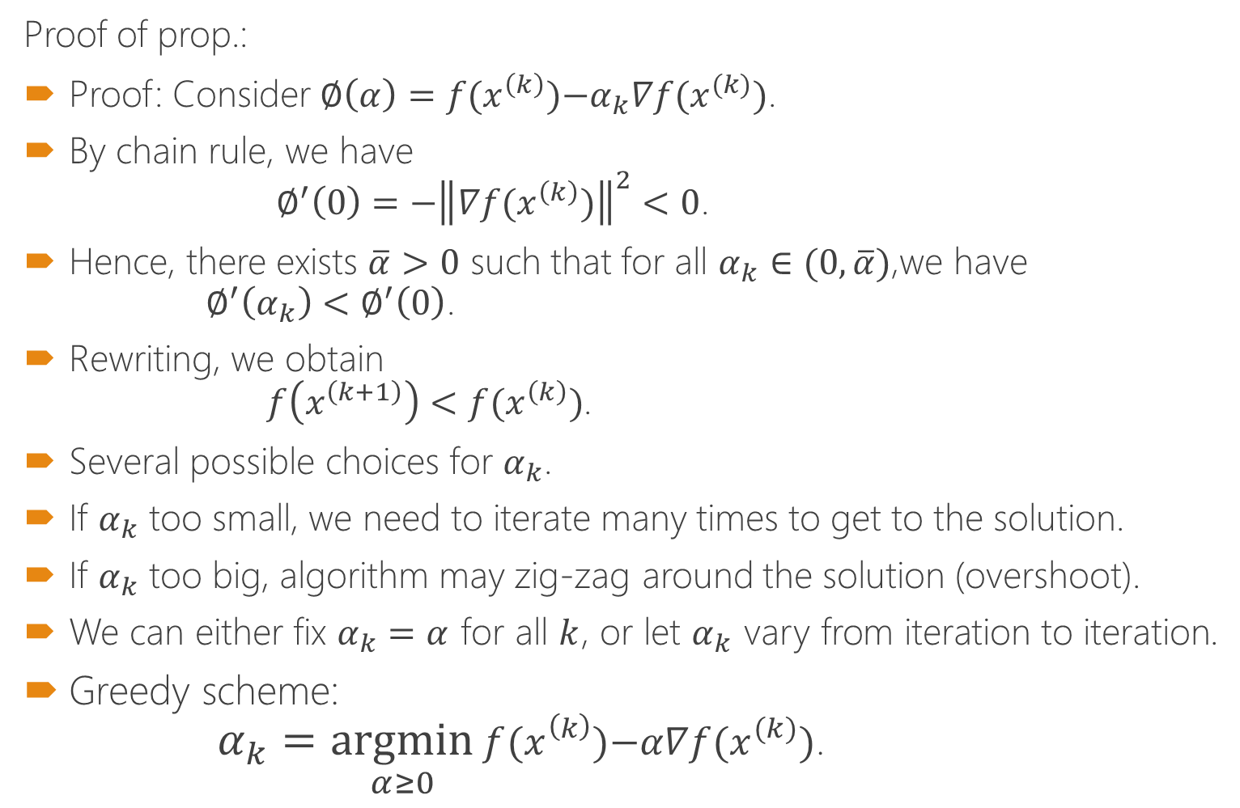
Gradient Methods(cont)
Proof of prop.:
Proof: Consider $∅\left(α\right)=f(x^{\left(k\right)}){{−α}_{k}∇f(x}^{(k)})$.
By chain rule, we have $∅^{′}\left(0\right)=−{\left\|{∇f(x}^{\left(k\right)})\right\|}^{2}<0$.
Hence, there exists $\overline{α}>0$ such that for all $α_{k}∈(0,\overline{α})$,we have $∅^{′}\left(α_{k}\right)<∅^{′}\left(0\right)$.
Rewriting, we obtain $f\left(x^{\left(k+1\right)}\right)<f(x^{\left(k\right)})$.
Several possible choices for $α_{k}$.
If $α_{k}$ too small, we need to iterate many times to get to the solution.
If $α_{k}$ too big, algorithm may zig-zag around the solution (overshoot).
We can either fix $α_{k}=α$ for all $k$, or let $α_{k}$ vary from iteration to iteration.
Greedy scheme: $α_{k}=\underset{α≥0}{argmin}{f(x^{\left(k\right)}){−α∇f(x}^{(k)})}$.

Slide 24
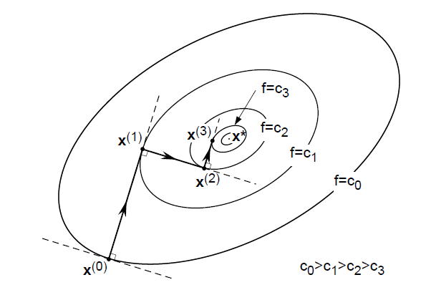
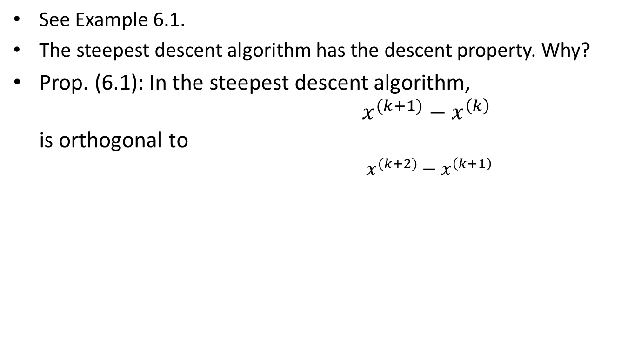
Steepest descent algorithm (6.2)
See Example 6.1.
The steepest descent algorithm has the descent property. Why?
Prop. (6.1): In the steepest descent algorithm, $x^{(k+1)}−x^{\left(k\right)}$ is orthogonal to $x^{(k+2)}−x^{\left(k+1\right)}$

Slide 25
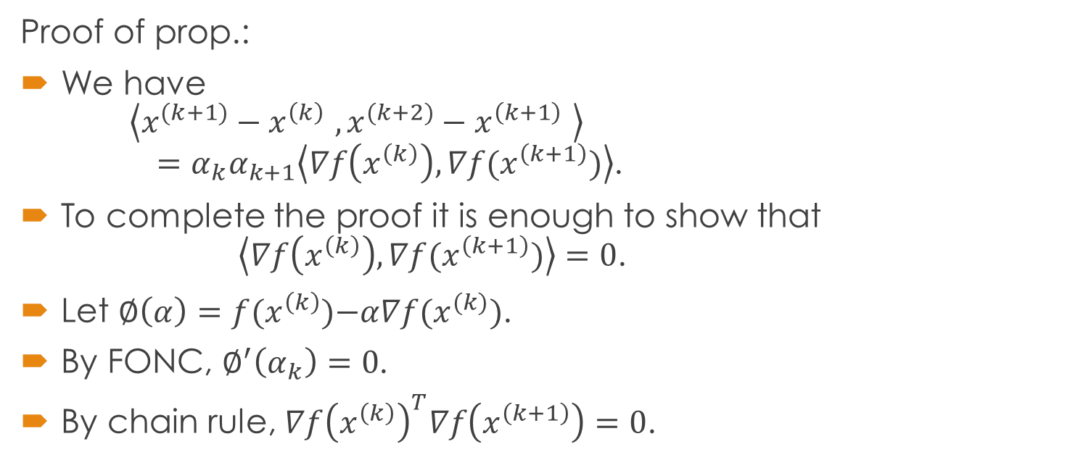
Steepest descent algorithm(cont)
Proof of prop.:
We have $\left\langle x^{(k+1)}−x^{\left(k\right)} ,x^{(k+2)}−x^{\left(k+1\right)} \right\rangle$ $=α_{k}α_{k+1}\left\langle ∇f\left(x^{\left(k\right)}\right),∇f(x^{\left(k+1\right)})\right\rangle$.
To complete the proof it is enough to show that $\left\langle ∇f\left(x^{\left(k\right)}\right),∇f(x^{\left(k+1\right)})\right\rangle =0$.
Let $∅\left(α\right)=f(x^{\left(k\right)}){−α∇f(x}^{(k)})$.
By FONC, $∅^{′}\left(α_{k}\right)=0$.
By chain rule, ${∇f\left(x^{\left(k\right)}\right)}^{T}∇f\left(x^{\left(k+1\right)}\right)=0$.

Slide 26
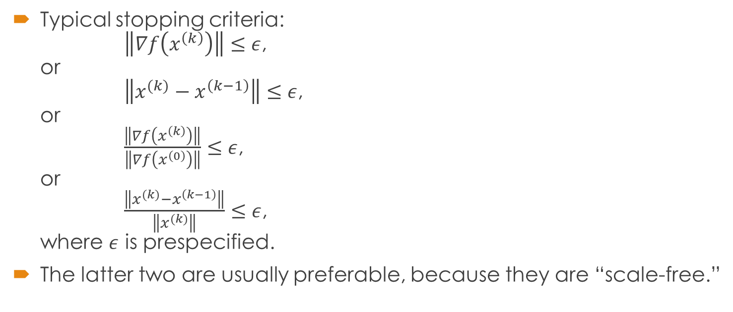
Steepest descent algorithm(cont)
Typical stopping criteria: $\left\|∇f\left(x^{\left(k\right)}\right)\right\|≤ε$, or $\left\|x^{(k)}−x^{\left(k−1\right)}\right\|≤ε$, or $\frac{\left\|∇f\left(x^{\left(k\right)}\right)\right\|}{\left\|∇f\left(x^{\left(0\right)}\right)\right\|}≤ε$, or $\frac{\left\|x^{(k)}−x^{\left(k−1\right)}\right\|}{\left\|x^{(k)}\right\|}≤ε$, where $ε$ is prespecified.
The latter two are usually preferable, because they are “scale-free.”

Slide 27
Steep descent algorithm
Data:
Step 0: set i=0
Step 1: if stop,
else, compute search direction
Step 2: compute the step-size
Step 3: set go to step 1

Slide 28
Steep descent method
The objective function can be represented using the Taylor expansion

Slide 29
Analysis of optimization algorithms
Rely heavily on mathematical tools.
“Do we really have to go through this?”
Analysis provides insight into:
Range of applicability of an algorithm.
Appropriate choice of algorithm for a given problem.
Qualitative behavior of an algorithm.
We must be able to answer:
Does the method work?
When does it work?
How well does it work?
Not good enough to superficially use commercial optimization software package.

Slide 30
Analysis of optimization algorithms(cont)
Globally convergent: starting from any initial point, the algorithm converges to a “solution.”
Usually, by “solution” we mean a point satisfying the FONC.
Locally convergent: starting from an initial point that is close enough to a solution, the algorithm converges to the solution.
Rate of convergence: how fast an algorithm converges.

Slide 31
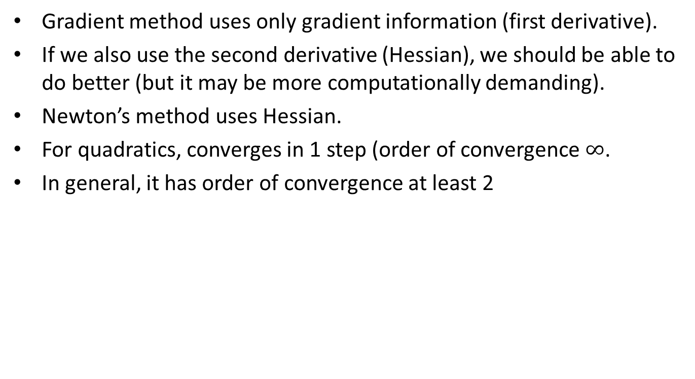
Newton’s Method
Gradient method uses only gradient information (first derivative).
If we also use the second derivative (Hessian), we should be able to do better (but it may be more computationally demanding).
Newton’s method uses Hessian.
For quadratics, converges in 1 step (order of convergence $∞$.
In general, it has order of convergence at least 2

Slide 32
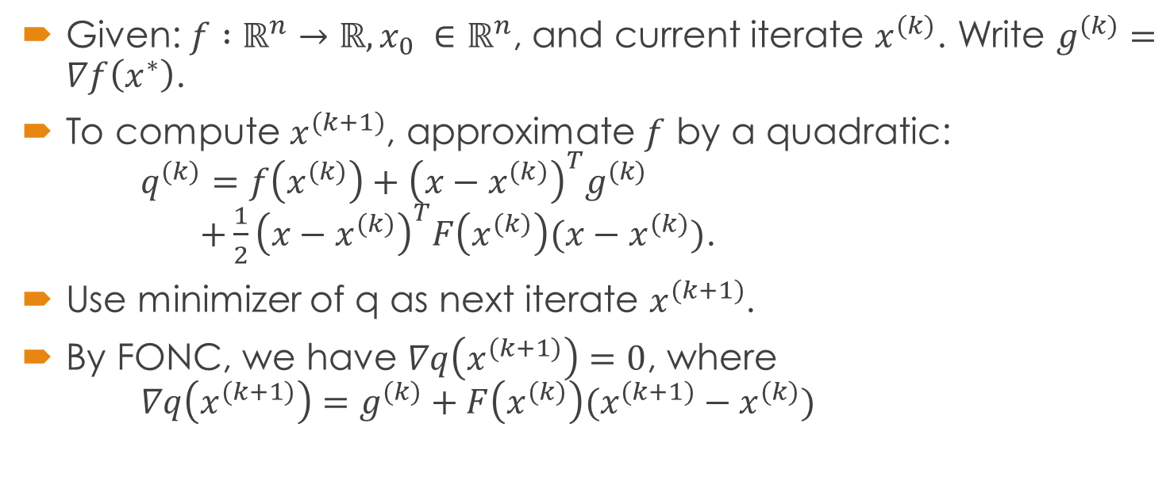
Underlying idea (9.1)
Given:${f :ℝ}^{n}→ℝ, x_{0} ∈ℝ^{n}$, and current iterate $x^{(k)}$. Write $g^{(k)}=∇f\left(x^{∗}\right)$.
To compute $x^{(k+1)}$, approximate $f$ by a quadratic: $q^{(k)}=f\left(x^{(k)}\right)+{\left(x−x^{(k)}\right)}^{T}g^{(k)}$ $+\frac{1}{2}{\left(x−x^{(k)}\right)}^{T}F\left(x^{(k)}\right)(x−x^{(k)})$.
Use minimizer of q as next iterate $x^{(k+1)}$.
By FONC, we have $∇q\left(x^{(k+1)}\right)=0$, where $∇q\left(x^{(k+1)}\right)=g^{(k)}+F\left(x^{(k)}\right)(x^{(k+1)}−x^{(k)})$

Slide 33
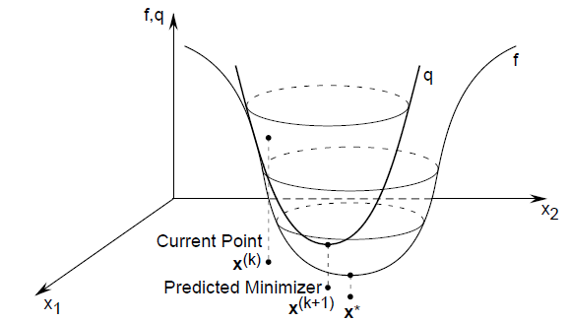
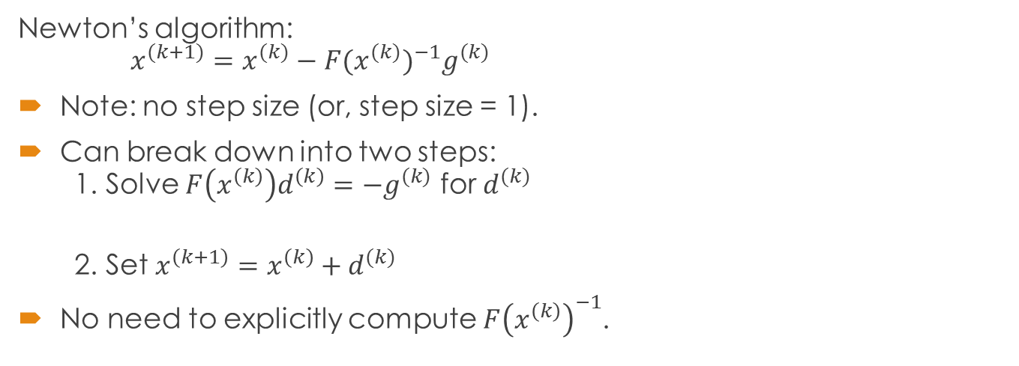
Newton’s algorithm: $x^{(k+1)}=x^{(k)}−F{(x^{(k)})}^{−1}g^{(k)}$
Note: no step size (or, step size = 1).
Can break down into two steps: 1. Solve $F\left(x^{\left(k\right)}\right)d^{\left(k\right)}=−g^{(k)}$ for $d^{(k)}$
2. Set $x^{\left(k+1\right)}=x^{\left(k\right)}+d^{(k)}$
No need to explicitly compute $F{\left(x^{\left(k\right)}\right)}^{−1}$.

Slide 34
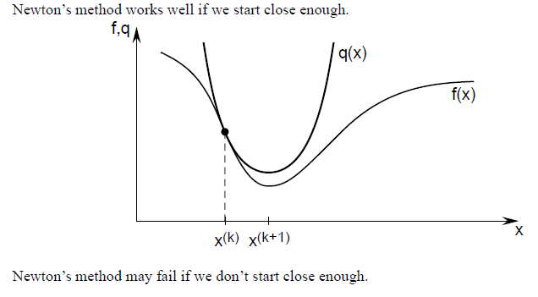

Slide 35
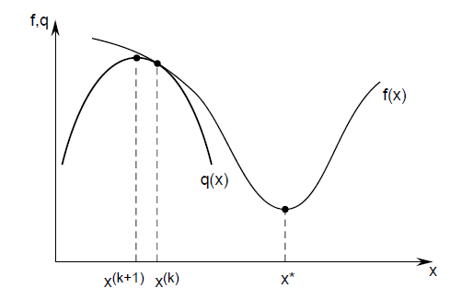
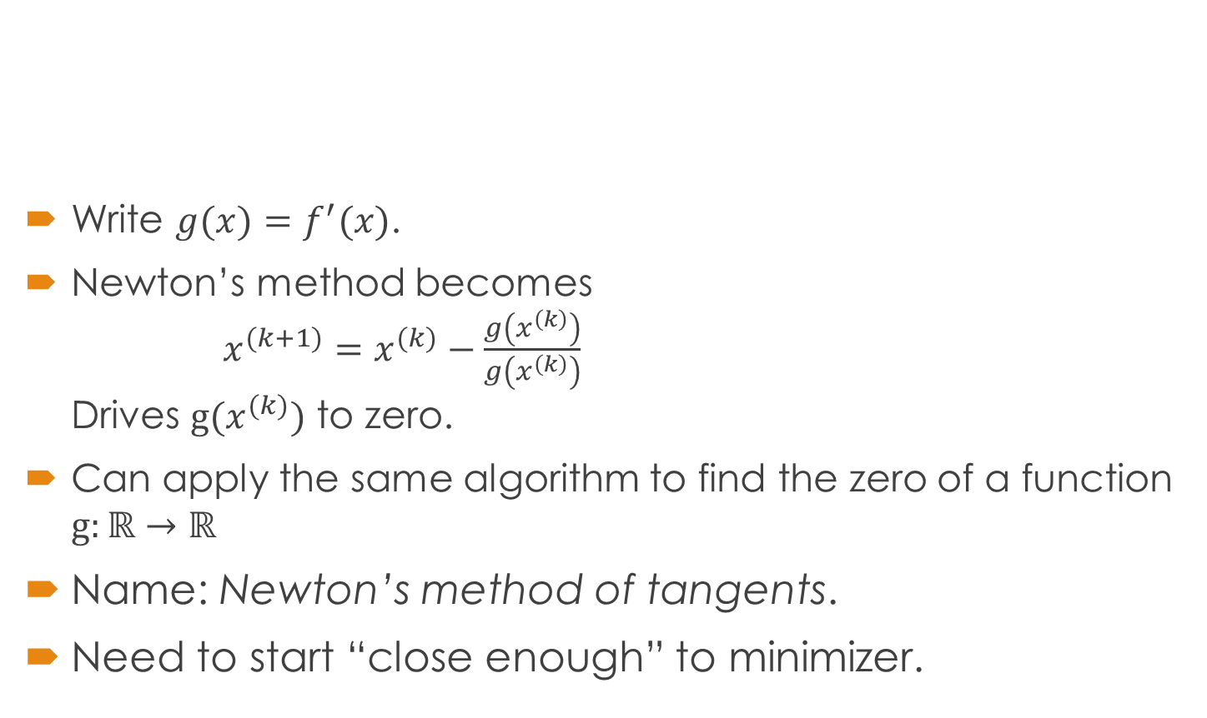
Write $g(x)=f^{′}(x)$.
Newton’s method becomes $x^{(k+1)}=x^{(k)}−\frac{g\left(x^{\left(k\right)}\right)}{g\left(x^{\left(k\right)}\right)}$ Drives $g(x^{(k)})$ to zero.
Can apply the same algorithm to find the zero of a function $g:ℝ→ℝ$
Name: Newton’s method of tangents.
Need to start “close enough” to minimizer.

Slide 36
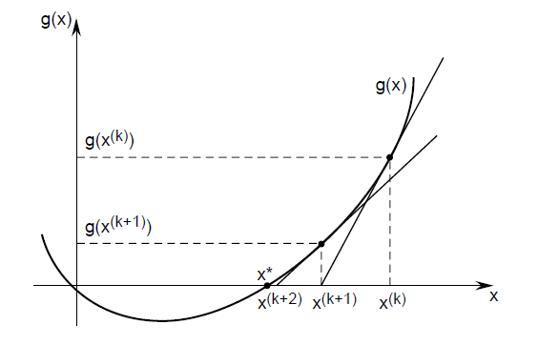
Newton’s method of tangents ...

Slide 37
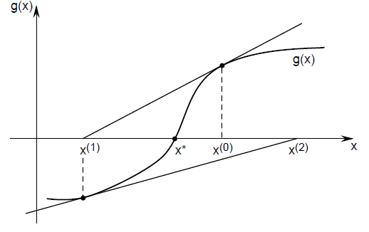
... may fail if we don’t start close enough.

Slide 38
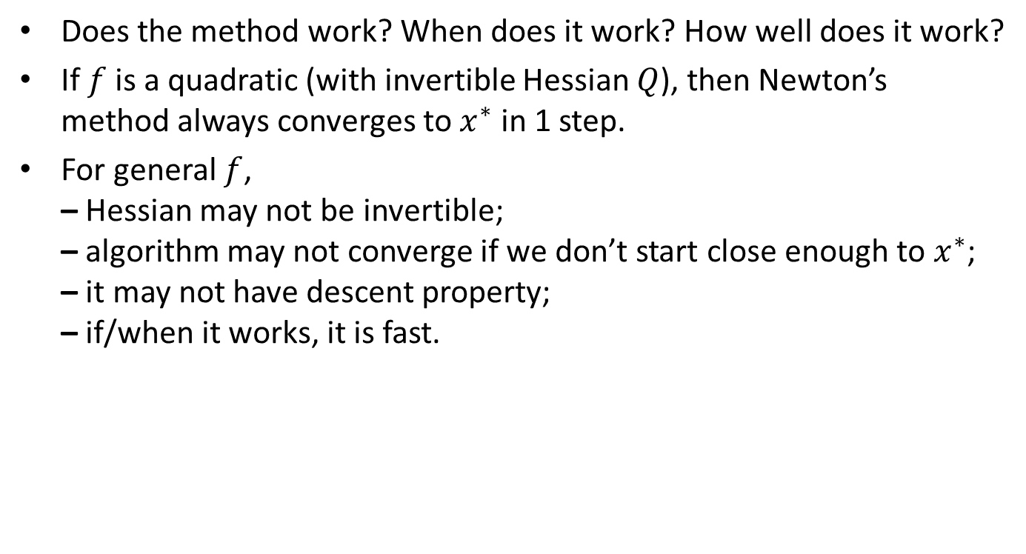
Analysis of Newton’s method
Does the method work? When does it work? How well does it work?
If $f$ is a quadratic (with invertible Hessian $Q$), then Newton’s method always converges to $x^{∗}$ in 1 step.
For general $f$, – Hessian may not be invertible; – algorithm may not converge if we don’t start close enough to $x^{∗}$; – it may not have descent property; – if/when it works, it is fast.

Slide 39
Summary
Newton’s method performs well if we start close enough.
We can incorporate a step size to ensure descent.
For a quadratic, converges in one step.
Is there some way of using only gradients, but still only converge in one or a finite number of steps for quadratics?
Yes ... conjugate direction method.

Slide 40
Multi-variable
Gradient
Hessian matrix

Slide 41
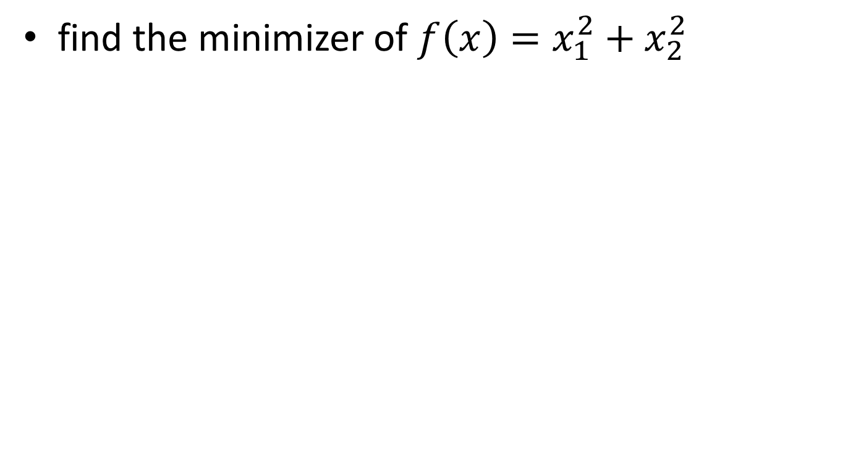
Example
find the minimizer of $f\left(x\right)=x_{1}^{2}+x_{2}^{2}$

Slide 42
Example-quadratic case
假設 且反矩陣存在，則 且H=Q。因此，給定任意初始值x⁽⁰⁾ ，以牛頓法搜尋此二次函數最小值，則：
也就是

Slide 43
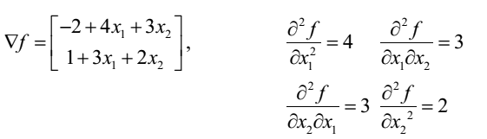


Newton Method In Optimization
Example : Hessian Matrix
Find the Hessian matrix for the function , $f\left(x\right)=6 −2x_{1}+x_{2}+2x_{1}^{2}+3x_{1}x_{2}+x_{2}^{2}$
Hessian is :

Slide 44






Newton Method In Optimization
Taylor series
Taking the gradient
Setting $∇f^{k+1}=0, we have,$
Solving for $∆x$
☆Hessian need be positive definite to assure a global minimum
$$x_{k+1} − x_{k}= − H_{f}^{−1}(x_{k})∇f(x_{k})$$

Slide 45


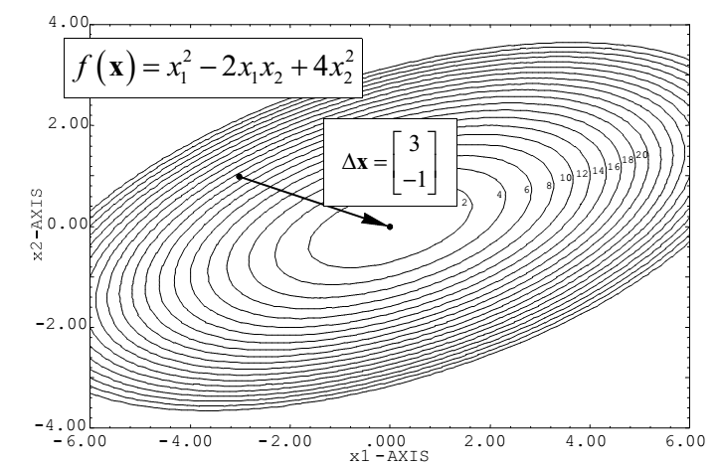




Newton Method In Optimization
Example : Newton’s Method
We wish to optimize the function, $f\left(x\right)= x_{1}^{2}−2x_{1}x_{2}+4x_{2}^{2}$ , from the point
$x^{0}=\left[\begin{matrix}−3 \\ 1\end{matrix}\right]$
At this point , Hessian is
The Hessian inverse is
Thus,
So,

Slide 46
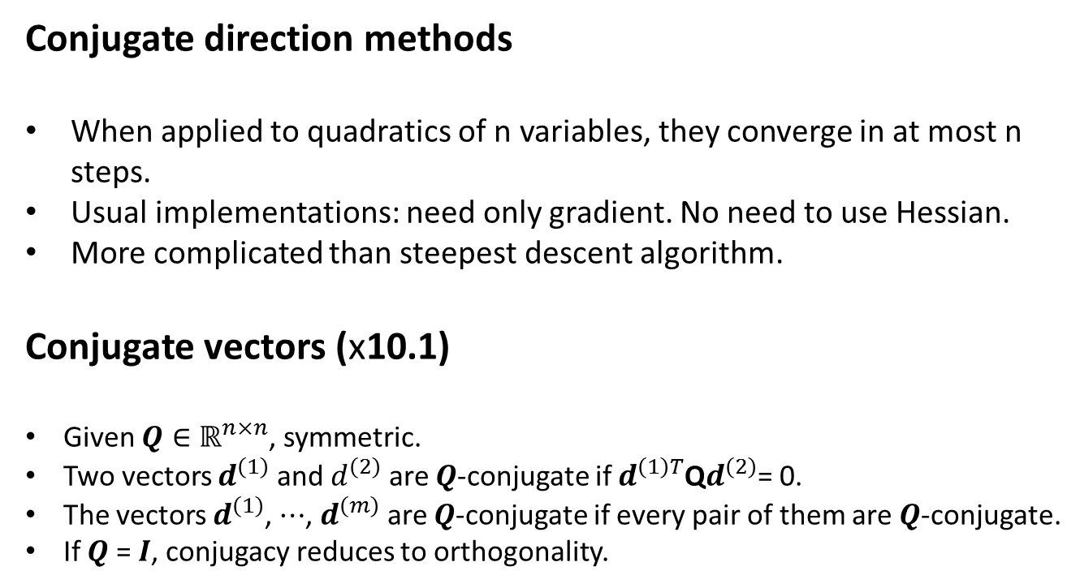
Conjugate direction methods
Conjugate direction methods
When applied to quadratics of n variables, they converge in at most n steps.
Usual implementations: need only gradient. No need to use Hessian.
More complicated than steepest descent algorithm.
Conjugate vectors (x10.1)
Given $Q∈ℝ^{n×n}$, symmetric.
Two vectors $d^{\left(1\right)}$ and $d^{\left(2\right)}$ are $Q$-conjugate if $d^{\left(1\right)T}$Q$d^{\left(2\right)}$= 0.
The vectors $d^{\left(1\right)}$, $⋯$, $d^{\left(m\right)}$ are $Q$-conjugate if every pair of them are $Q$-conjugate.
If $Q$ = $I$, conjugacy reduces to orthogonality.

Slide 47
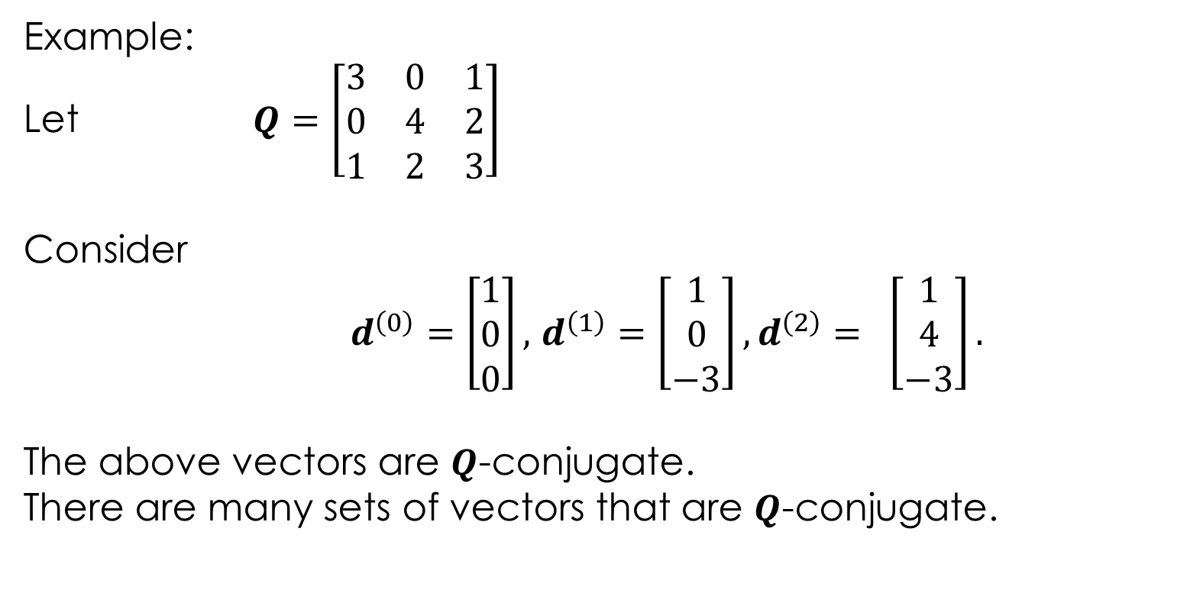
Example:
Let $Q$ $=\left[\begin{matrix}3 & 0 & 1 \\ 0 & 4 & 2 \\ 1 & 2 & 3\end{matrix}\right]$
Consider
$d^{\left(0\right)}=$ $\left[\begin{matrix}1 \\ 0 \\ 0\end{matrix}\right],$ $d^{\left(1\right)}=$ $\left[\begin{matrix}1 \\ 0 \\ −3\end{matrix}\right],d^{\left(2\right)}= \left[\begin{matrix}1 \\ 4 \\ −3\end{matrix}\right].$
The above vectors are $Q$-conjugate.
There are many sets of vectors that are $Q$-conjugate.

Slide 48
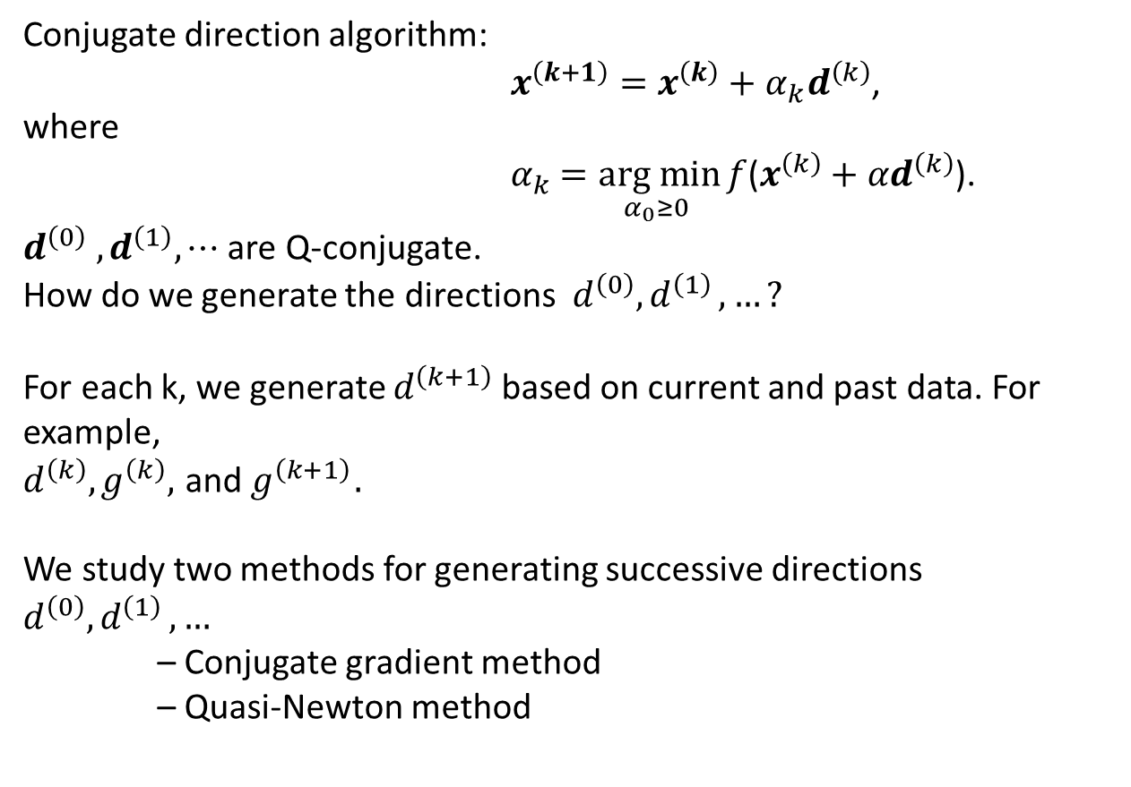
Generating conjugate directions
Conjugate direction algorithm:
$x^{\left(k+1\right)}=x^{\left(k\right)}+{α_{k}d}^{\left(k\right)}$,
where
$α_{k}$ $=\underset{α_{0}≥0 }{arg min}{f}$($x^{\left(k\right)}+{αd}^{\left(k\right)}$).
$d^{\left(0\right)} ,d^{\left(1\right)},⋯$ are Q-conjugate.
How do we generate the directions $d^{\left(0\right)}{,d}^{\left(1\right)},…?$
For each k, we generate $d^{\left(k+1\right)}$based on current and past data. For example,
$$d^{\left(k\right)},g^{\left(k\right)},{ \text{and} g}^{\left(k+1\right)}.$$
We study two methods for generating successive directions $d^{\left(0\right)}{,d}^{\left(1\right)},…$
– Conjugate gradient method
– Quasi-Newton method

Slide 49
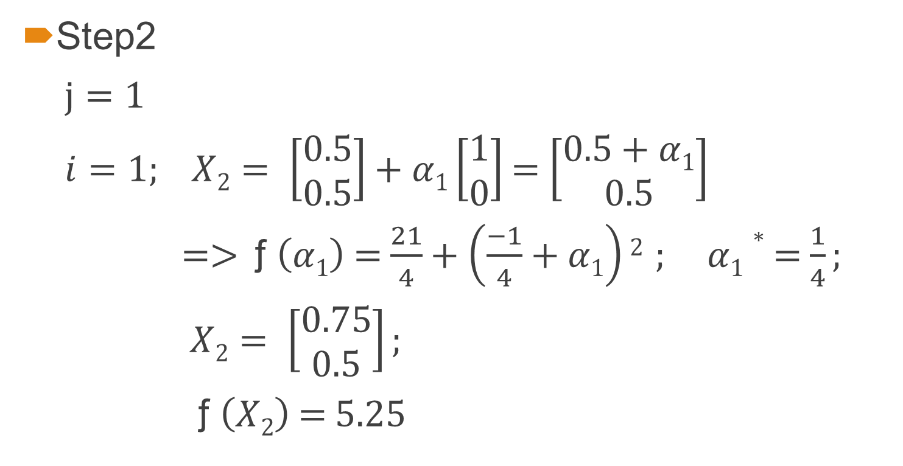
Conjugate gradient algorithm (x10.3)
Algorithm:
$$x^{\left(k+1\right)}=x^{\left(k\right)}+{α_{k}d}^{\left(k\right)}$$
where
$α_{k}$ $=\underset{α_{0}≥0 }{arg min}{f}$($x^{\left(k\right)}+{αd}^{\left(k\right)}$)
We need a way to generate the${ d}^{\left(k\right)}$ such that for a quadratic, they are Q-conjugate.
Conjugate gradient method: use gradient to generate$d^{\left(k\right)}$.
Start with ${ d}^{\left(0\right)}$ = ${ −g}^{\left(0\right)}$ .
Update ${ d}^{\left(k\right)}$ according to formula:
$$d^{\left(k+1\right)}={−g}^{\left(k+1\right)}+{β_{k}d}^{\left(k\right)}.$$
The scalar k is computed using a formula involving ${ g}^{\left(k\right)}$, ${ g}^{\left(k+1\right)}$, and ${ d}^{\left(k\right)}$.

Slide 50
Easy way to compute $β_{k}$
We need $d^{\left(k\right)T}Qd^{\left(k+1\right)}$= 0.
Hence,
0 = $d^{\left(k\right)T}Qd^{\left(k+1\right)}$ ${=−d}^{\left(k\right)T}Qg^{\left(k+1\right)}$+ ${β_{k}^{}d}^{\left(k\right)T}Qd^{\left(k\right)}.$
We obtain
$β_{k}$= $\frac{d^{\left(k\right)T}Qg^{\left(k+1\right)}}{d^{\left(k\right)T}Qd^{\left(k\right)}}$
The above formula not immediately useful because it involves Q. (How to apply to nonquadratics?)

Slide 51
Useful formulas for $β_{k}$:
Hestenes-Stiefel formula:
${ β}_{k}$= $\frac{g^{\left(k+1\right)T}\left[g^{\left(k+1\right)}−g^{\left(k\right)}\right]}{d^{\left(k\right)T}\left[g^{\left(k+1\right)}−g^{\left(k\right)}\right]}$
Polak-Ribiere formula:
${ β}_{k}$= $\frac{g^{\left(k+1\right)T}\left[g^{\left(k+1\right)}−g^{\left(k\right)}\right]}{g^{\left(k\right)T}g^{\left(k\right)}}$
Fletcher-Reeves formula:
${ β}_{k}$= $\frac{g^{\left(k+1\right)T}g^{\left(k+1\right)}}{g^{\left(k\right)T}g^{\left(k\right)}}$

Slide 52
The previous three formulas all lead to conjugate direction algorithms (i.e., the resulting directions are $Q$-conjugate when applied to a quadratic with Hessian $Q$). See book for proof.
The conjugate gradient algorithm using the above formulas for $k$ can be applied to any function $f$.
If $f$ is a quadratic, all the three formulas are equivalent.
If $f$is not a quadratic, the algorithm will not usually reach the solution in n steps.

Slide 53
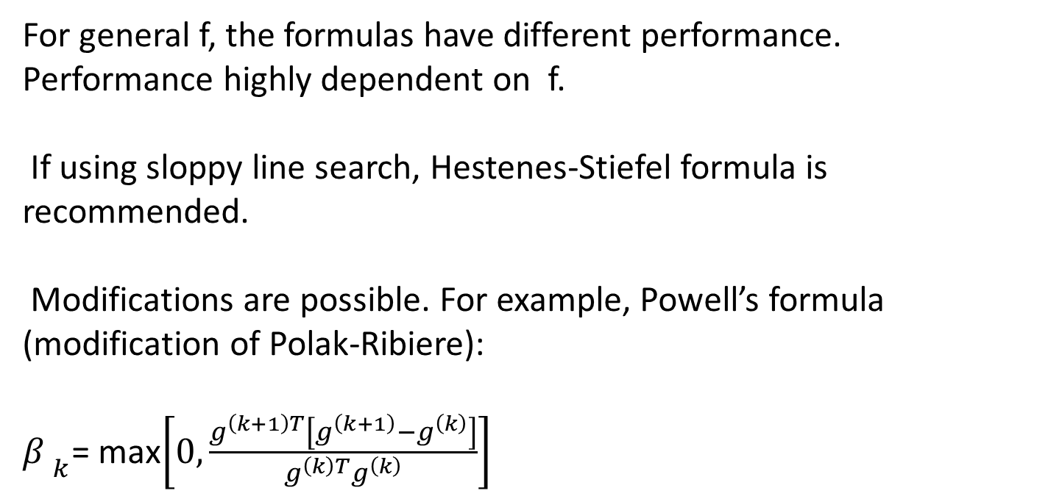
For general f, the formulas have different performance. Performance highly dependent on f.
If using sloppy line search, Hestenes-Stiefel formula is recommended.
Modifications are possible. For example, Powell’s formula (modification of Polak-Ribiere):
${β }_{k}$= max$\left[0,\frac{g^{\left(k+1\right)T}\left[g^{\left(k+1\right)}−g^{\left(k\right)}\right]}{g^{\left(k\right)T}g^{\left(k\right)}}\right]$

Slide 54
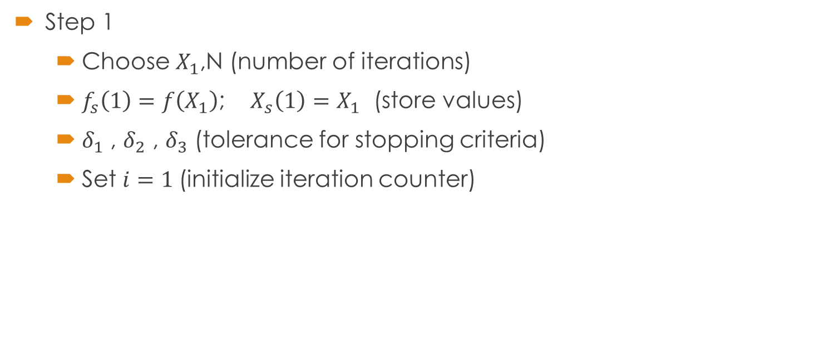
Algorithm
Step 1
Choose $X_{1}$,N (number of iterations)
$f_{s}\left(1\right)=f\left(X_{1}\right)$; $X_{s}\left(1\right)=X_{1}$ (store values)
$δ_{1}$ , $δ_{2}$ , $δ_{3}$ (tolerance for stopping criteria)
Set $i=1$(initialize iteration counter)

Slide 55

Algorithm
Step 2
If $i=1$ $S_{i}=−∇f\left(X_{i}\right)$
Else $β=\frac{∇f{\left(X_{i}\right)}^{T}∇f\left(X_{i}\right)}{∇f{\left(X_{i−1}\right)}^{T}∇f\left(X_{i−1}\right)}$ $S_{i}=−∇f\left(X_{i}\right)+ βS_{i−1}$
End If $X_{i+1}=X_{i}+α_{i}{ S}_{i} ; α_{i}$ is determined by Minimizing $f\left(X_{i+1}\right)$ $X_{s}\left(i+1\right)←X_{i+1}$ ; $f_{s}\left(i+1\right)=f\left(X_{i+1}\right)$ store values

Slide 56
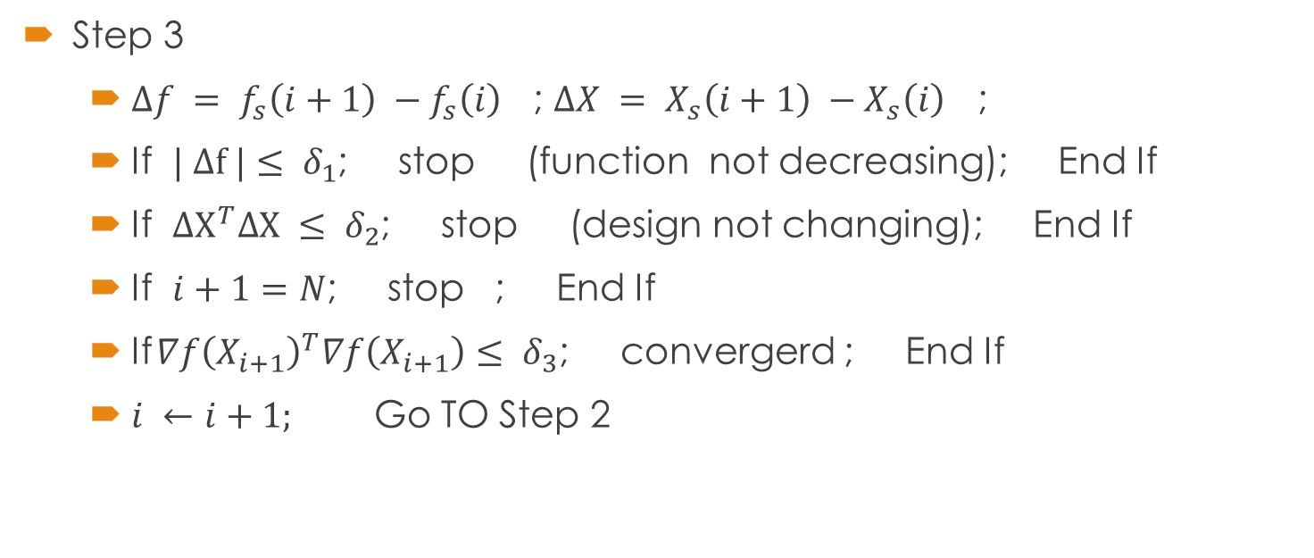
Algorithm
Step 3
$∆f = f_{s}\left(i+1\right) −f_{s}\left(i\right)$ ; $∆X = X_{s}\left(i+1\right) −X_{s}\left(i\right)$ ;
If $| ∆f |≤ δ_{1}$; stop (function not decreasing); End If
If ${∆X}^{T}∆X ≤ δ_{2}$; stop (design not changing); End If
If $i+1=N$; stop ; End If
If $∇f{\left(X_{i+1}\right)}^{T}∇f\left(X_{i+1}\right)≤ δ_{3}$; convergerd ; End If
$i ←i+1;$ Go TO Step 2

Slide 57
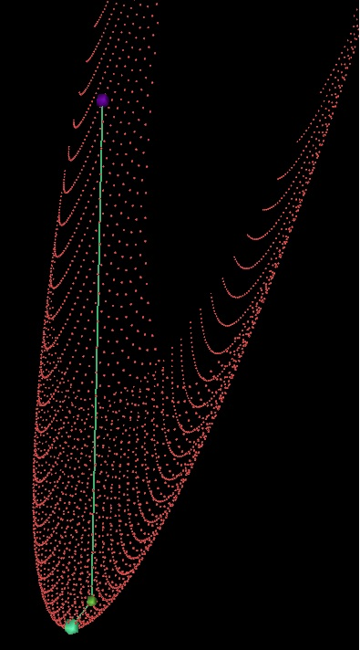
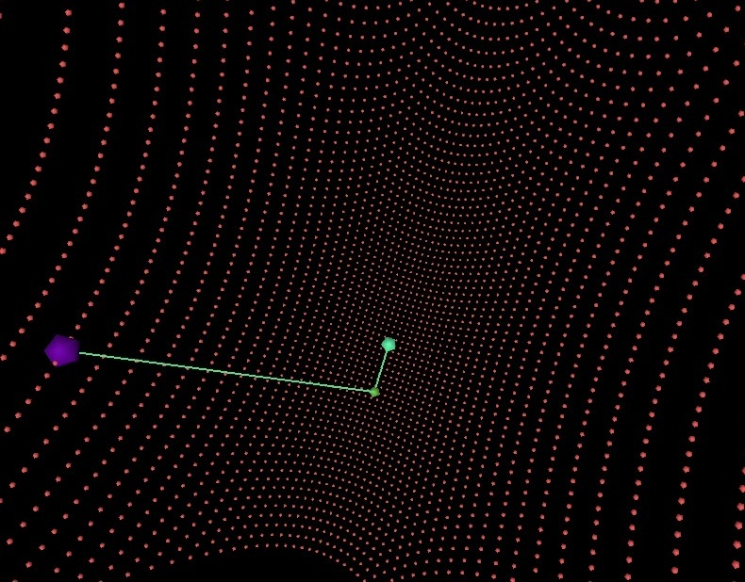
Conjugate Gradient Methods in Multidimensions
Initial point : (50,30)
The minimum value of f is -1.6 at point (6,10)

Slide 58
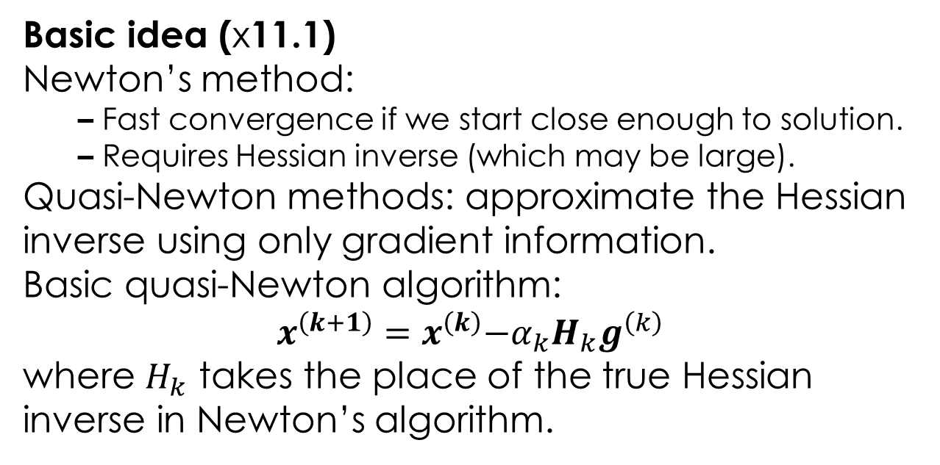
Quasi-Newton methods
Basic idea (x11.1)
Newton’s method:
– Fast convergence if we start close enough to solution.
– Requires Hessian inverse (which may be large).
Quasi-Newton methods: approximate the Hessian inverse using only gradient information.
Basic quasi-Newton algorithm:
$$x^{\left(k+1\right)}=x^{\left(k\right)}{{−α}_{k}H_{k}g}^{\left(k\right)}$$
where $H_{k}$ takes the place of the true Hessian inverse in Newton’s algorithm.

Slide 59
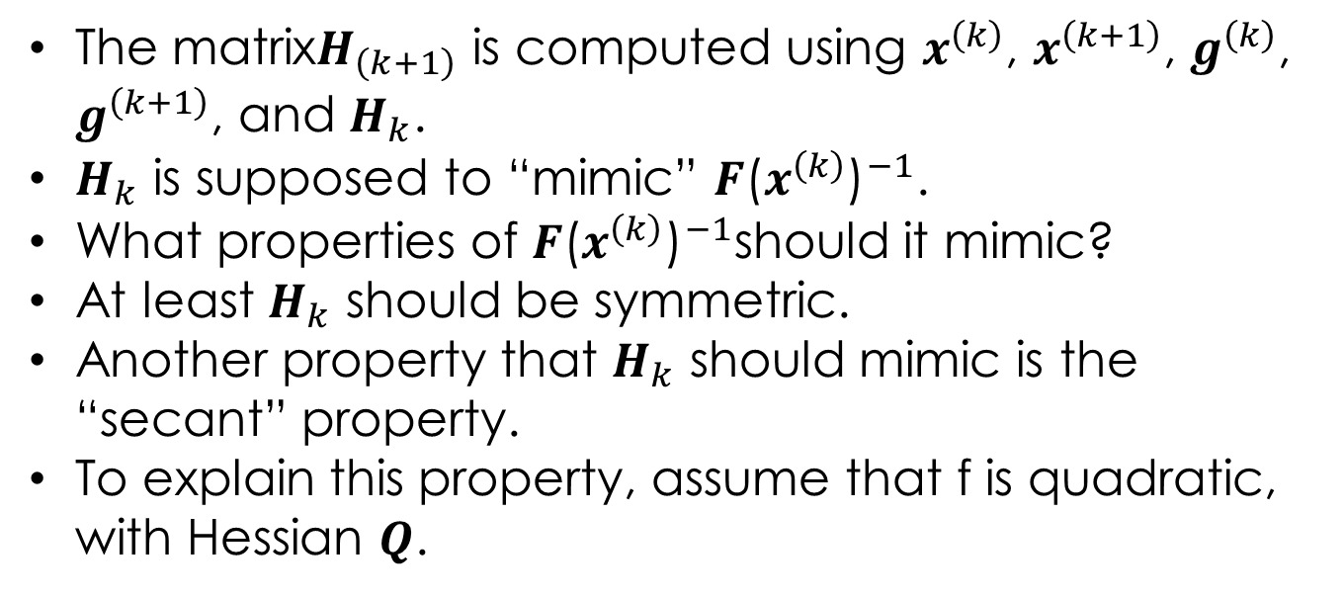
The matrix$H_{\left(k+1\right)}$ is computed using $x^{\left(k\right)}$, $x^{\left(k+1\right)}$, $g^{\left(k\right)}$, $g^{\left(k+1\right)}$, and $H_{k}$.
$H_{k}$ is supposed to “mimic” ${F\text{(}x^{\left(k\right)}\text{)}}^{−1}$.
What properties of ${F\text{(}x^{\left(k\right)}\text{)}}^{−1}$should it mimic?
At least $H_{k}$ should be symmetric.
Another property that $H_{k}$ should mimic is the “secant” property.
To explain this property, assume that f is quadratic, with Hessian $Q$.

Slide 60
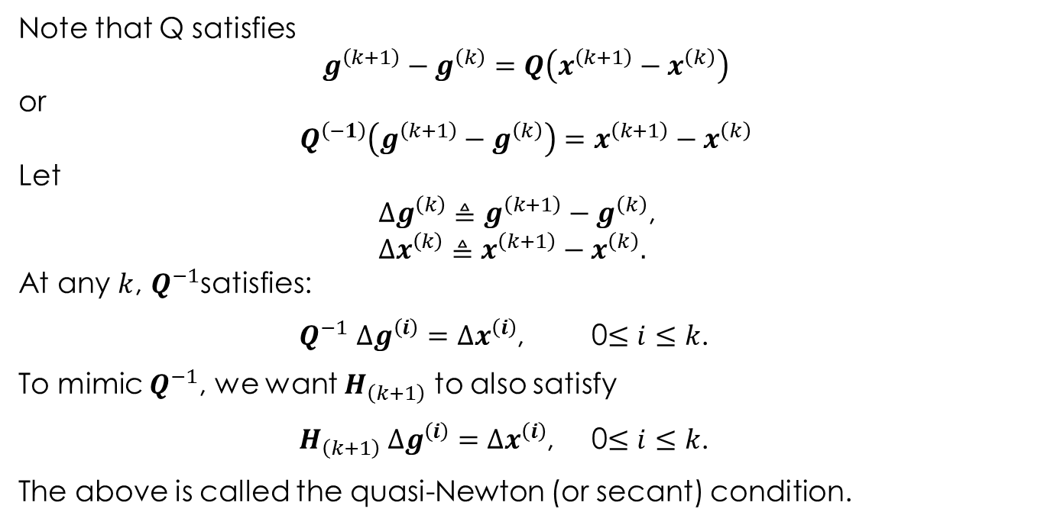
Note that Q satisfies
$$g^{\left(k+1\right)}−g^{\left(k\right)}=Q\left(x^{\left(k+1\right)}−x^{\left(k\right)}\right)$$
or
$$Q^{\left(−1\right)}\left(g^{\left(k+1\right)}−g^{\left(k\right)}\right)=x^{\left(k+1\right)}−x^{\left(k\right)}$$
Let
$∆g^{\left(k\right)}≜g^{\left(k+1\right)}−g^{\left(k\right)}$,
$$∆x^{\left(k\right)}≜x^{\left(k+1\right)}−x^{\left(k\right)}.$$
At any $k$, $Q^{−1}$satisfies:
$Q^{−1}$ $∆g^{\left(i\right)}=$ $∆x^{\left(i\right)}$, 0$≤i≤k$.
To mimic $Q^{−1}$, we want $H_{\left(k+1\right)}$ to also satisfy
$H_{\left(k+1\right)} ∆g^{\left(i\right)}=$ $∆x^{\left(i\right)}$, 0$≤i≤k$.
The above is called the quasi-Newton (or secant) condition.

Slide 61
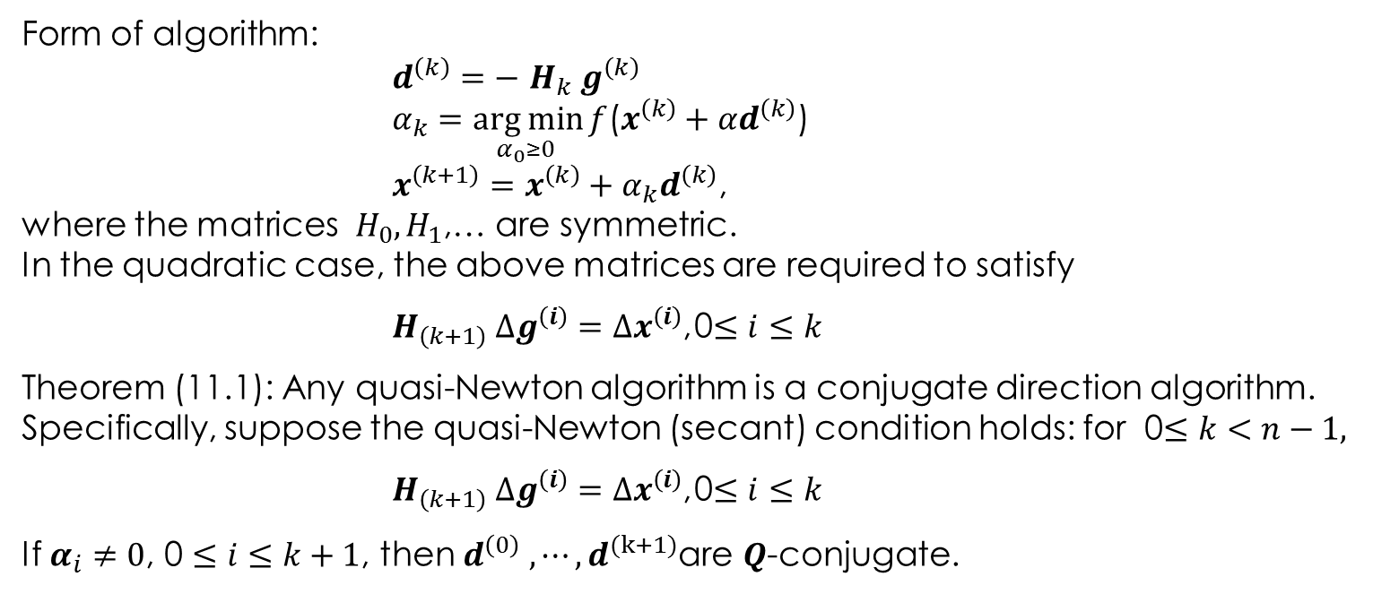
Summary of quasi-Newton algorithm
Form of algorithm:
$d^{\left(k\right)}=−$ $H_{k} g^{\left(k\right)}$
$α_{k}$ $=\underset{α_{0}≥0 }{arg min}{f}$($x^{\left(k\right)}+{αd}^{\left(k\right)}$)
$x^{\left(k+1\right)}=x^{\left(k\right)}+{α_{k}d}^{\left(k\right)}$,
where the matrices $H_{0},H_{1}$,… are symmetric.
In the quadratic case, the above matrices are required to satisfy
$H_{\left(k+1\right)} ∆g^{\left(i\right)}=$ $∆x^{\left(i\right)}$, 0$≤i≤k$
Theorem (11.1): Any quasi-Newton algorithm is a conjugate direction algorithm.
Specifically, suppose the quasi-Newton (secant) condition holds: for 0$≤k<n−1,$
$H_{\left(k+1\right)} ∆g^{\left(i\right)}=$ $∆x^{\left(i\right)}$, 0$≤i≤k$
If $α_{i}≠0$, 0 $≤i≤k+1$, then $d^{\left(0\right)} {,⋯,d}^{(k+1)}$are $Q$-conjugate.

Slide 62
Quasi-Newton Method
A new estimate of the Hessian matrix using information from previous iterates
The idea behind quasi-Newton methods
start with a positive definite, symmetric approximation to A
build up the approximating Hi’s in such a way that the matrix Hi remains positive definite and symmetric
Two Schemes
Davidon-Fletcher-Powell(DFP) algorithm
Broyden-Fletcher-Glodfarb-Shanno(BFGS) algorithm

Slide 63

牛頓法有個計算上的缺點，就是需要計算Hessian矩陣H( x^{(k)} )而且還需解方程式 H( x^{(k)} ) d= －g^{(k)} ；
→擬牛頓法使用數值近似來取代反矩陣 H( x^{(k)} ) ^{－1} 的計算
DFP演算法：
步驟1：設定k=0、初始點為x⁽⁰⁾及實數對稱正定矩陣 F₀=I
步驟2：若g^{(k)} =0 即停止，否則d^{(k)} = －F_{k} g^{(k)}
步驟3：計算
步驟4：計算
步驟5：設定k＝k+1；回到步驟2。

Slide 64
BFGS演算法：
此演算法計算步驟與DFP演算法幾乎相同，唯一的差異在步驟4 計算 F_{k}的式子需要改變
步驟4：計算

