Slide 1
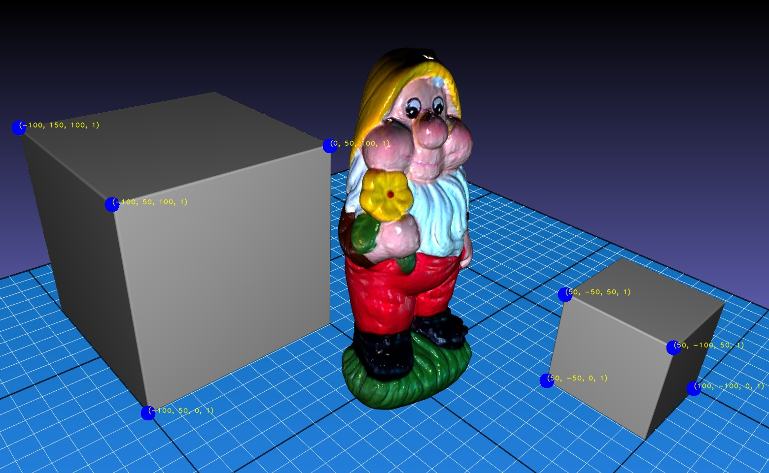
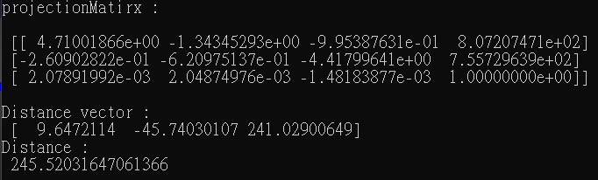
Homework#3：Calculate the distance between an object and your camera
results of projection matrix and distance vector
selected 8 points (blue point for 2d, yellow words for 3d coordinate)

