Slide 1
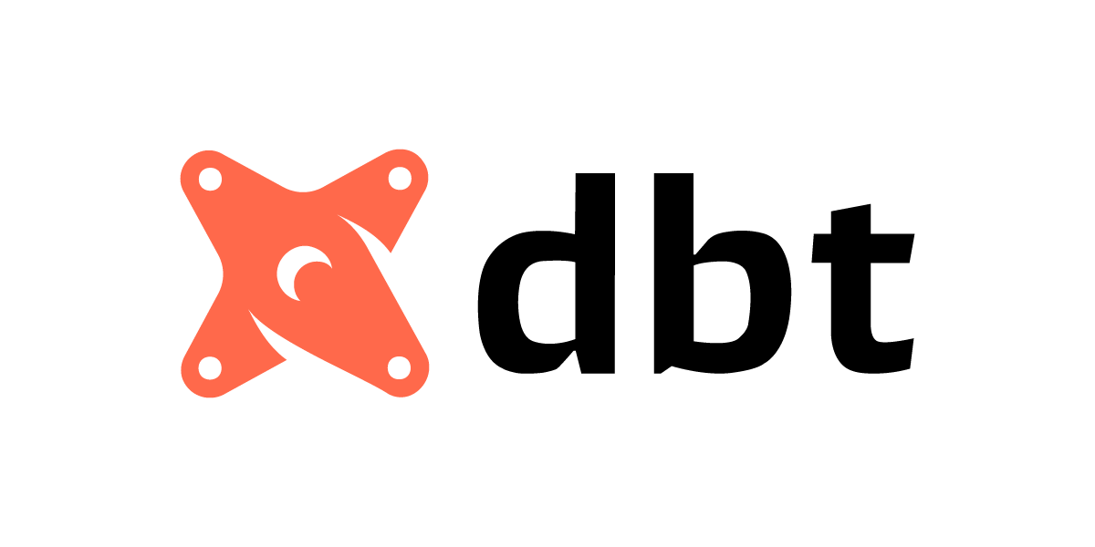
Workshop
From Your First Model to Enterprise-Scale Pipelines

Slide 3
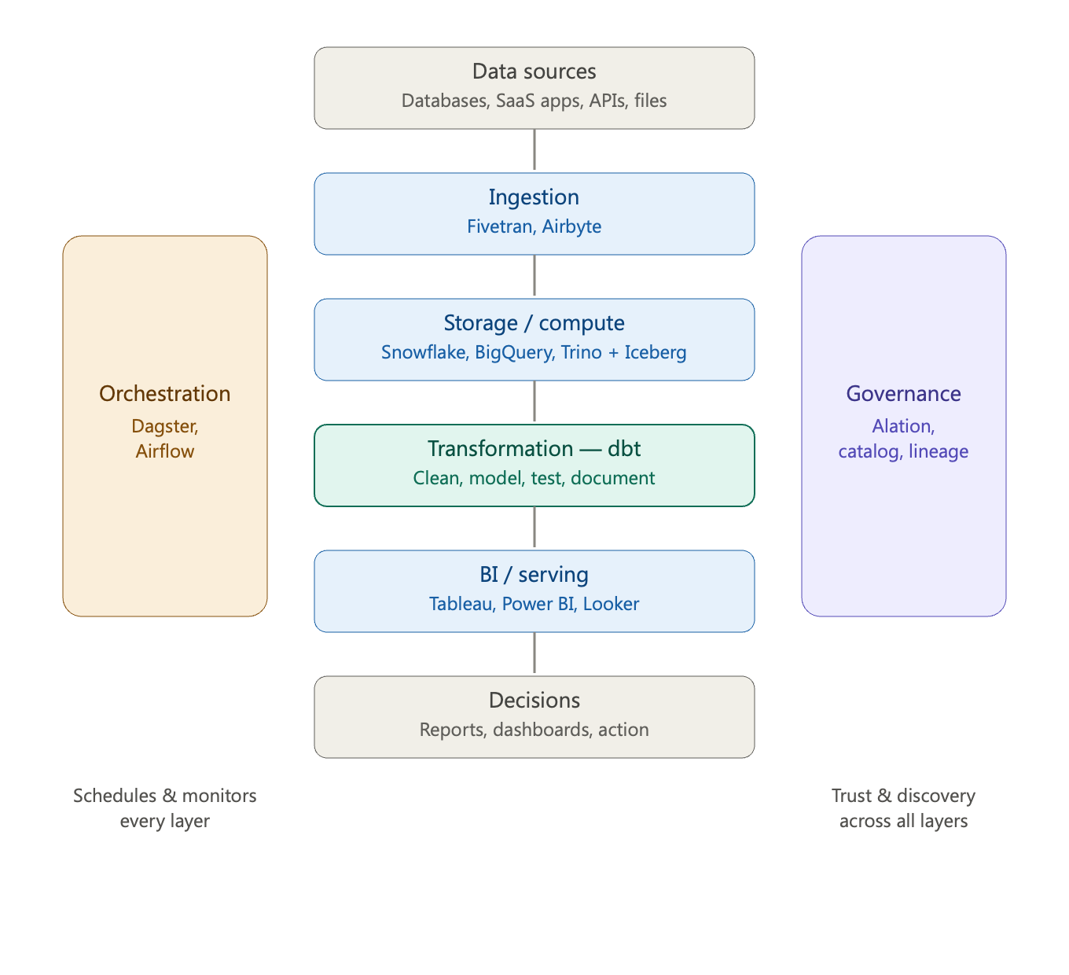
The Modern Data Stack
Architecture — A suite of cloud-native or self-hosted tools, each specialized for one job
ELT, not ETL — Load raw data first, then transform it in place; enabled by cheap, elastic cloud storage and compute
Ingestion — Load source data as-is, without upfront transformation
Storage — Central warehouse or lakehouse where raw and modeled data lives (Iceberg, Snowflake, BigQuery)
Transformation — Model, clean, test, and document data after loading (dbt)
Serving / BI — Deliver analytics-ready data to dashboards and decisions (Tableau, Power BI)
Orchestration — Defines how and in what logical order each layer of the stack runs (Dagster, Airflow)
Governance — Catalog, lineage, and access control that keep data trusted and discoverable across all layers (OpenMetadata, Ataccama)

Slide 4
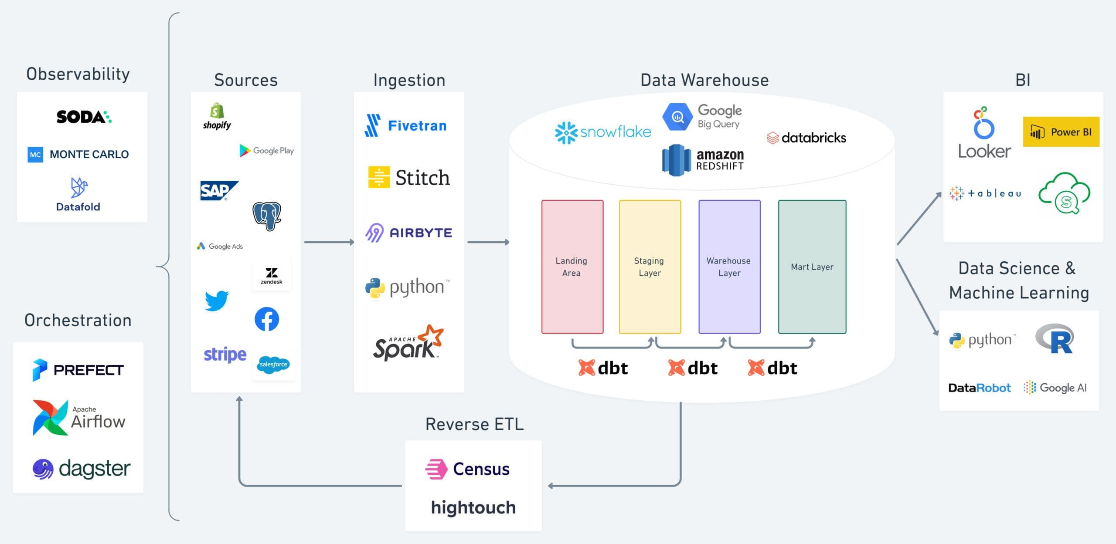

Slide 5
Why this stack emerged
Cloud warehouses made storage cheap and compute elastic
Separation of storage and compute changed the economics
Loading raw data first became viable → transform later
Shift from monolithic platforms to modular "best-of-breed" tools

Slide 6
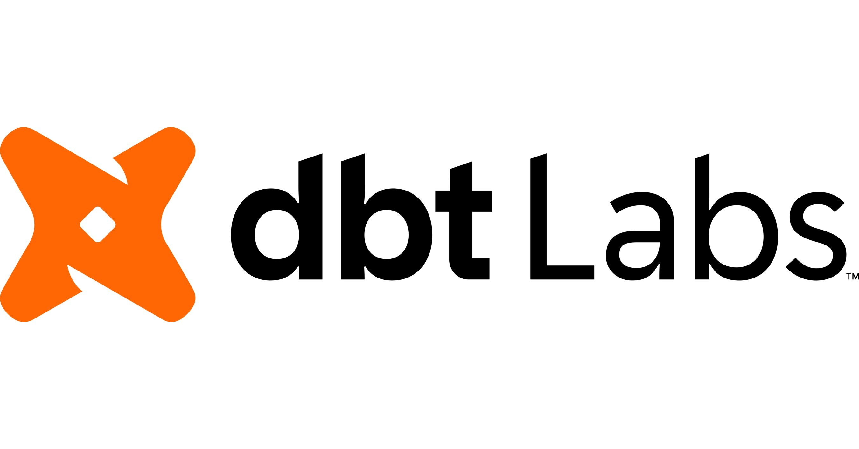

What is dbt
dbt (data build tool) transforms raw data already in your warehouse into clean, analytics-ready tables — using just SQL.
Maintained by dbt labs

Slide 7
The Core Idea
You write SELECT statements. dbt handles the engineering:
Creates tables and views
Figures out dependencies between models
Runs everything in the correct order
SQL SELECT statements
dbt compiles & runs
Tables & views in your warehouse

Slide 8
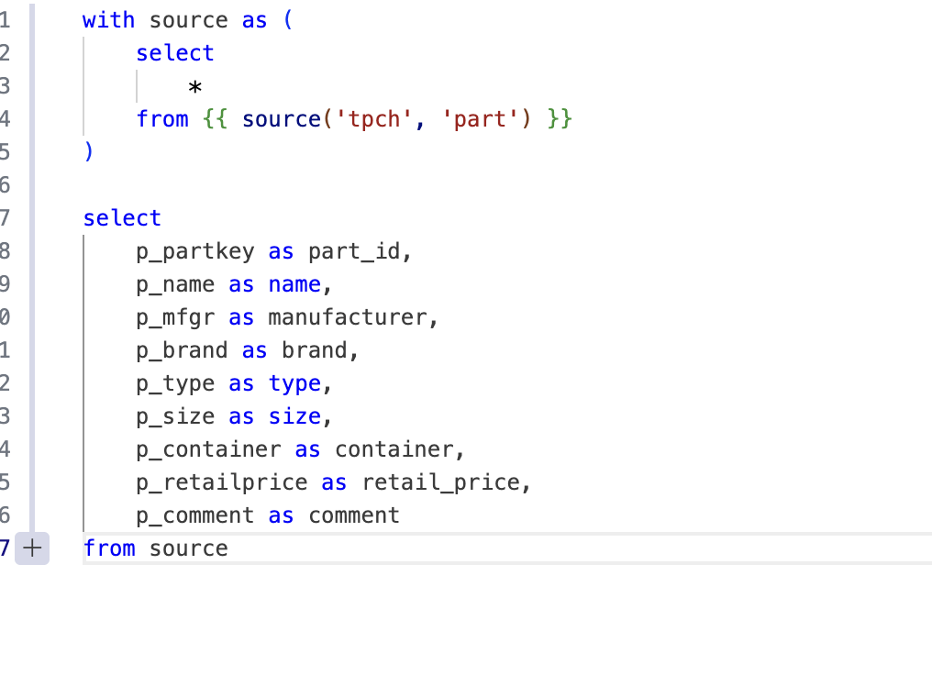
How dbt works
Write models (SQL files)
Link them with ref() and source()
dbt builds a dependency graph (DAG)
Runs, tests, and documents automatically

Slide 9




What dbt brings
Modularity — reusable, layered models (staging → marts)
Testing — catch bad data before it reaches dashboards
Documentation — auto-generated docs and lineage
Version control — Git-based, like real software

Slide 10

dbt Core
The free, open-source engine at the core of every dbt project
Installed locally via pip — no dbt Labs account needed
You write and run models from the command line
You bring your own scheduler, hosting, and CI/CD
Best for teams who want full control and are comfortable self-managing infrastructure

Slide 11

dbt Cloud
dbt Labs' managed, browser-based platform built on top of dbt
Cloud IDE, job scheduler, and hosted docs — no local setup
Built-in CI/CD, alerting, and role-based access control
Adds the Semantic Layer, dbt Explorer, and an AI copilot (dbt Wizard)
Recently renamed the dbt platform — plans start free, with paid tiers

Slide 12

dbt Fusion
dbt’s next-generation engine — a ground-up rewrite in Rust
Understands SQL natively — validates queries before they hit the warehouse
Up to 30x faster parsing than dbt Core, plus column-level lineage
Powers both local development (CLI, VS Code) and the dbt platform
Launched in public beta May 2025 — designed to fully replace dbt Core's execution engine over time

