Slide 1

ЭЕШ-2018 он
Математик
А-хувилбар

Slide 2







$1. 2∙3∙5∙7 тооны хуваагч аль нь бэ?.$ /1оноо/
$$A. 22 B.12 C.21 D.25 E.18$$
$$=2∙11$$
$$=3∙4$$
$$=3∙7$$
$$=5∙5$$
$$=2∙9$$
$$c$$
$$Бодолт$$

Slide 3


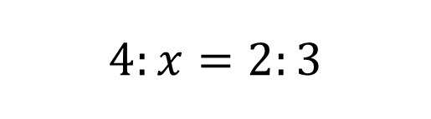

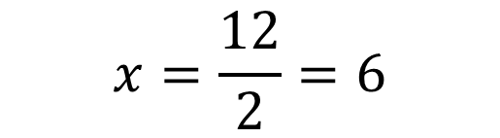
$$Бодолт$$
$$4:x=2:3$$
$$2x=12$$
$$x=\frac{12}{2}=6$$
$$D$$

Slide 4
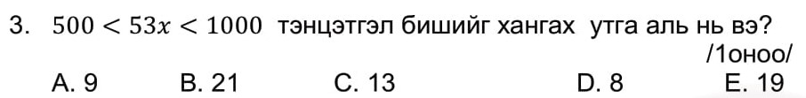
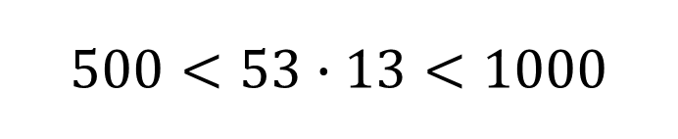
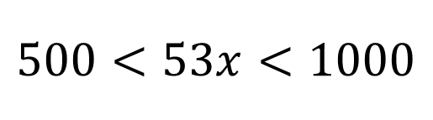

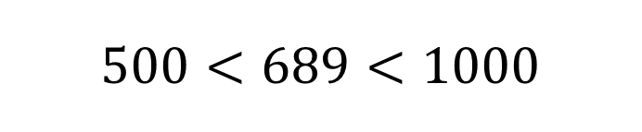
$$Бодолт$$
$$500<53x<1000$$
$$500<53∙13<1000$$
$$500<689<1000$$
$$C$$

Slide 5


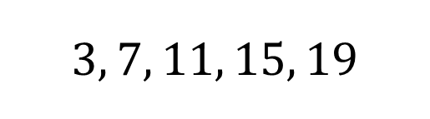

$$Бодолт$$
$$3, 7, 11, 15, 19$$
$$A$$

Slide 6
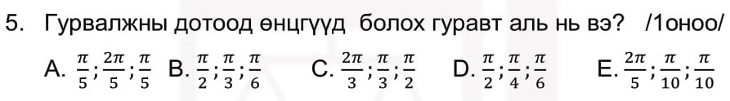
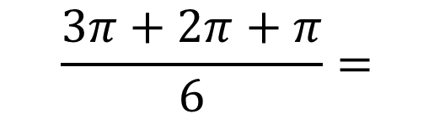
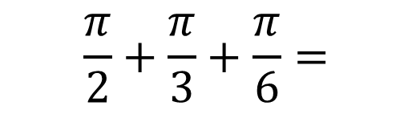


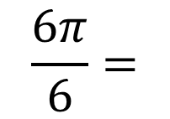
$$Бодолт$$
$$\frac{3π+2π+π}{6}=$$
$$\frac{6π}{6}=$$
$$\frac{π}{2}+\frac{π}{3}+\frac{π}{6}=$$
$$π$$
$$B$$

Slide 7
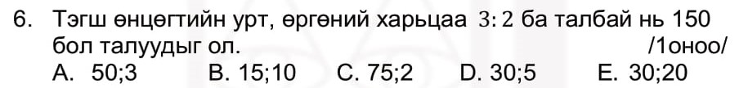
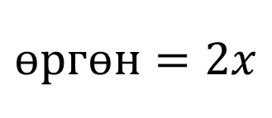
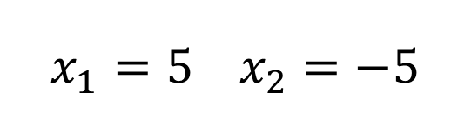
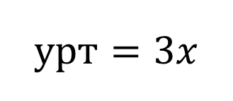
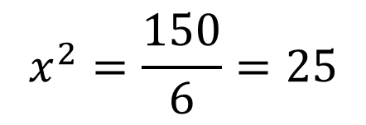
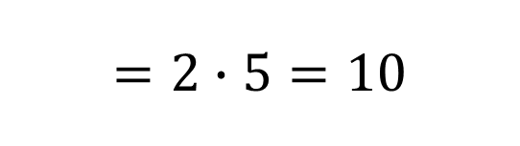


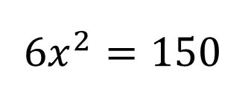

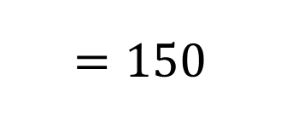
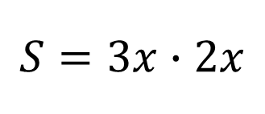
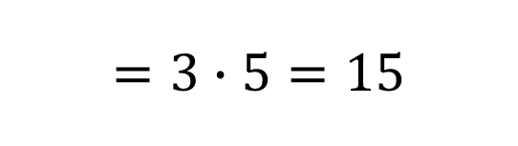
$$Бодолт$$
$$S=3x∙2x$$
$$=150$$
$$6x^{2}=150$$
$$=2∙5=10$$
$$өргөн=2x$$
$$x^{2}=\frac{150}{6}=25$$
$$x_{1}=5 x_{2}=−5$$
$$15; 10$$
$$B$$
$$урт=3x$$
$$=3∙5=15$$

Slide 8

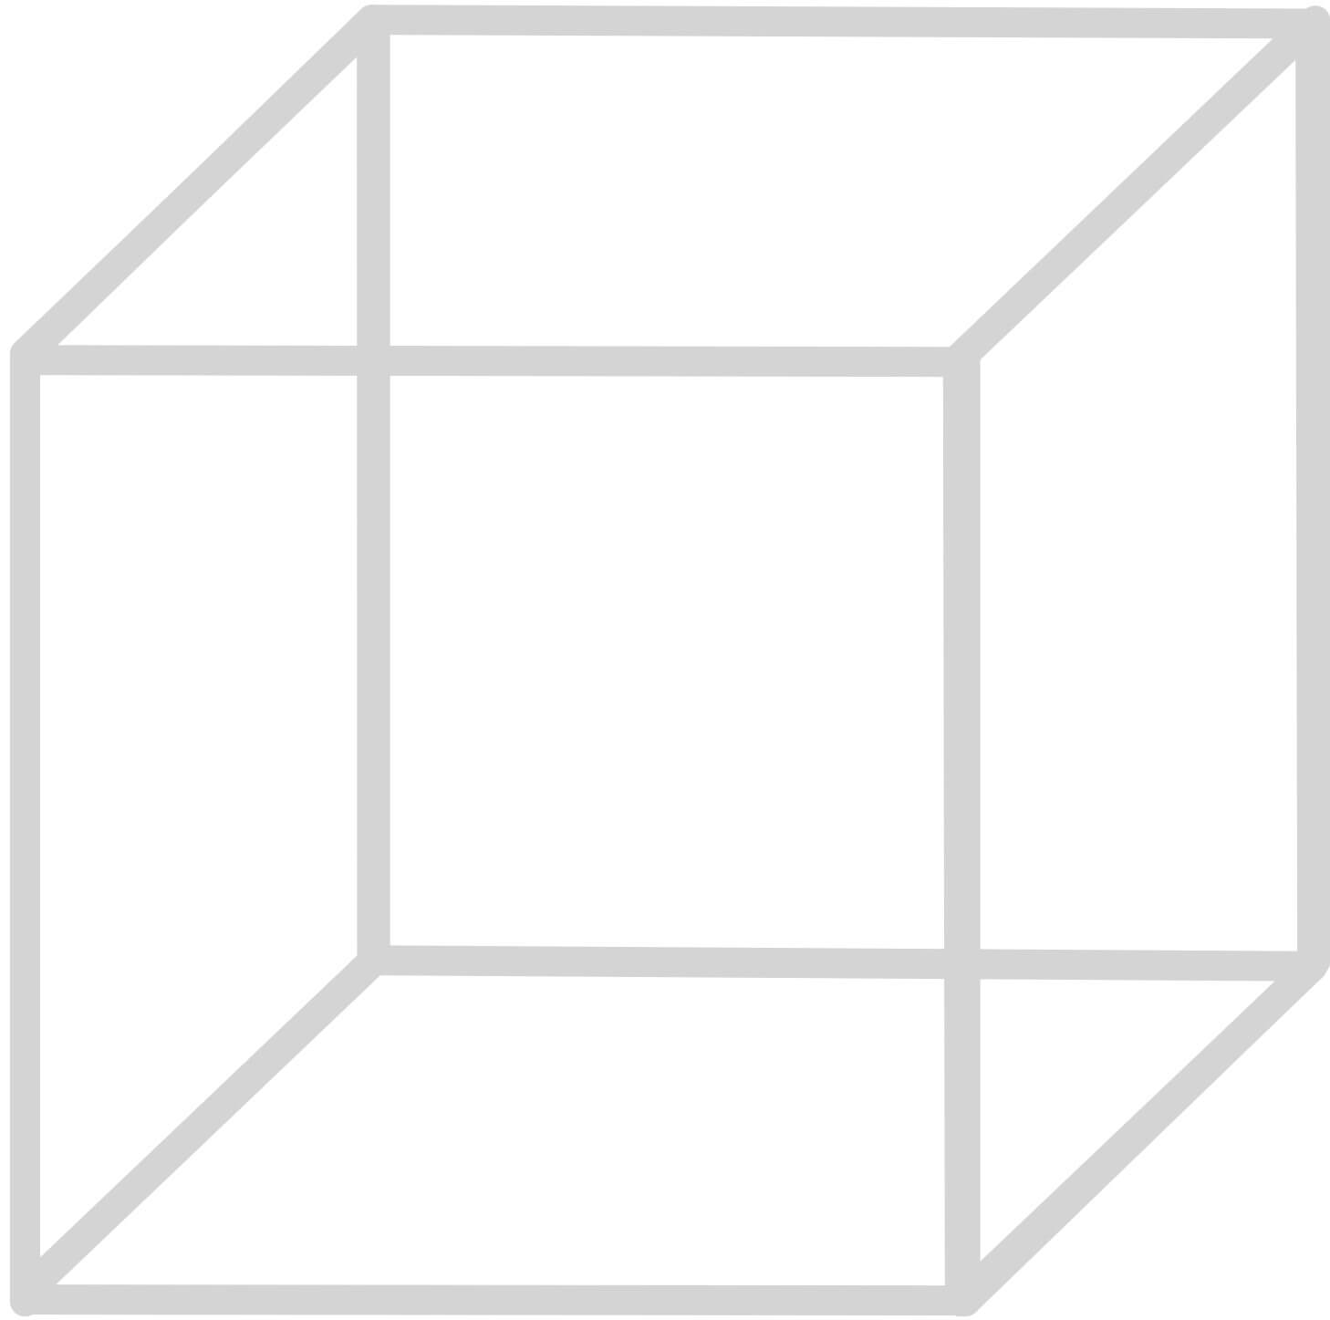

$$Бодолт$$
$$D$$

Slide 9
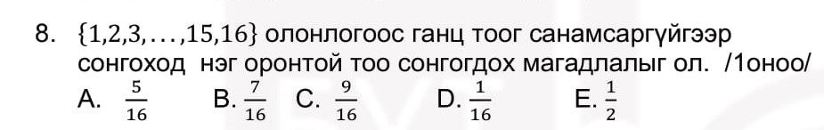
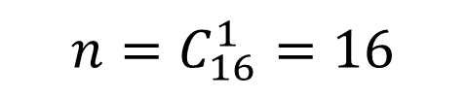
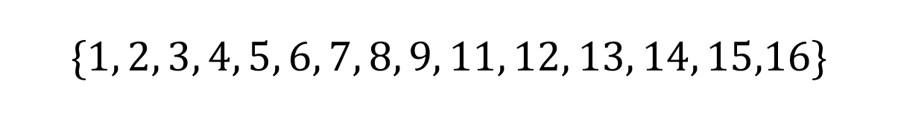

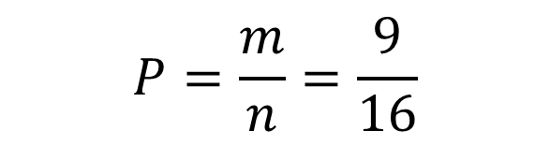
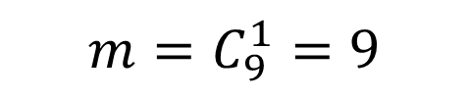
$$\{1, 2, 3, 4, 5, 6, 7, 8, 9, 11, 12, 13, 14, 15,16\}$$
$$n=C_{16}^{1}=16$$
$$m=C_{9}^{1}=9$$
$$P=\frac{m}{n}=\frac{9}{16}$$
$$C$$

Slide 10
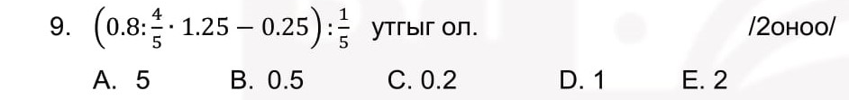
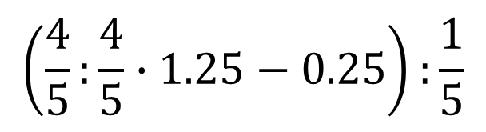
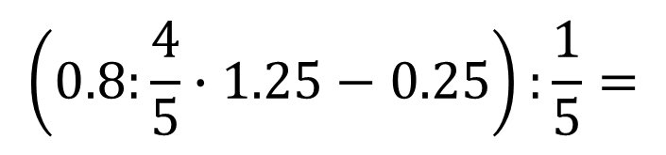



$$\left(0.8:\frac{4}{5}∙1.25−0.25\right):\frac{1}{5}=$$
$$\left(\frac{4}{5}:\frac{4}{5}∙1.25−0.25\right):\frac{1}{5}$$
$$=5$$
$$A$$
$$1$$

Slide 11
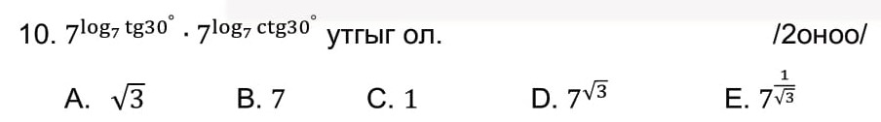
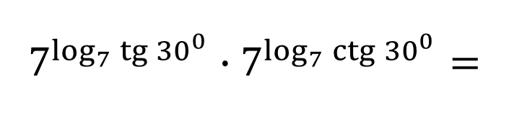



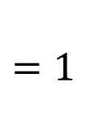
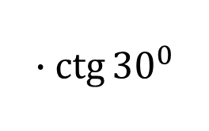
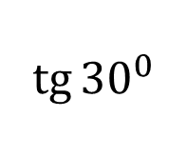

$$a^{\log_{a}{b}}=b$$
$$7^{\log_{7}{\operatorname{tg}{{30}^{0}}}}∙7^{\log_{7}{\operatorname{ctg}{{30}^{0}}}}=$$
$$\operatorname{tg}{α∙\operatorname{ctg}{α=1}}$$
$$\operatorname{tg}{{30}^{0}}$$
$$∙\operatorname{ctg}{{30}^{0}}$$
$$=1$$
$$C$$
$$\frac{sinα}{\cos{α}}∙\frac{\cos{α}}{sinα}=1$$

Slide 12
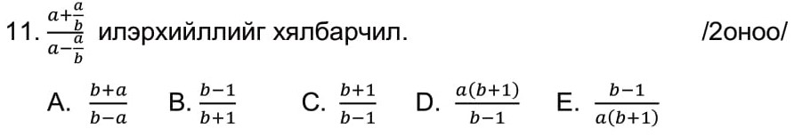
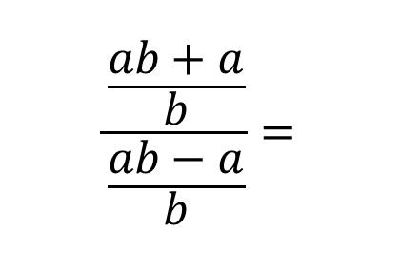
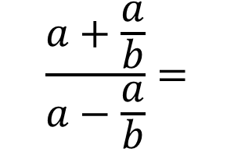

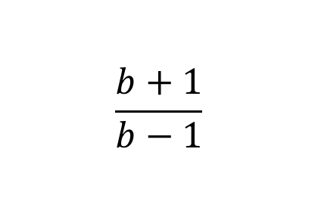
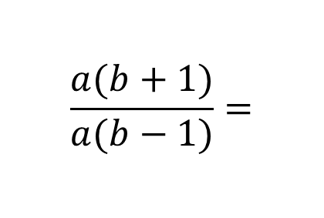
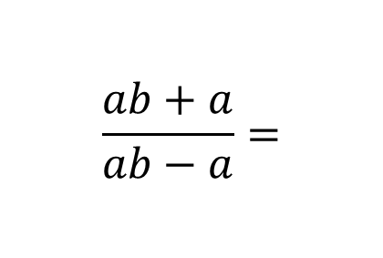
$$\frac{\frac{ab+a}{b}}{\frac{ab−a}{b}}=$$
$$\frac{ab+a}{ab−a}=$$
$$\frac{a(b+1)}{a(b−1)}=$$
$$\frac{b+1}{b−1}$$
$$\frac{a+\frac{a}{b}}{a−\frac{a}{b}}=$$
$$C$$

Slide 13


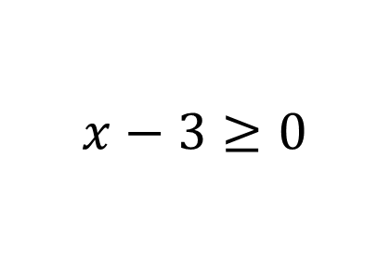

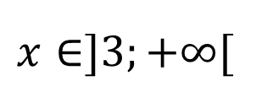
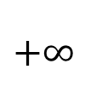

$$x−3≥0$$
$$x≥3$$
$$+∞$$
$$3$$
$$x∈]3;+∞[$$
$$D$$

Slide 14
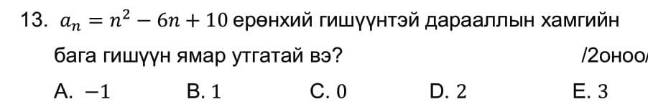
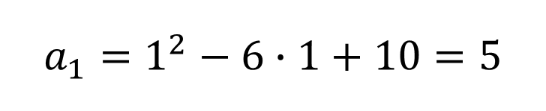

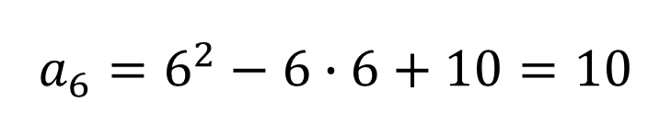

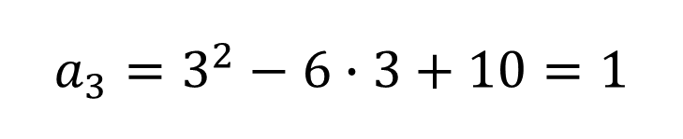

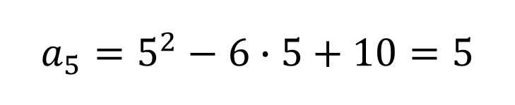


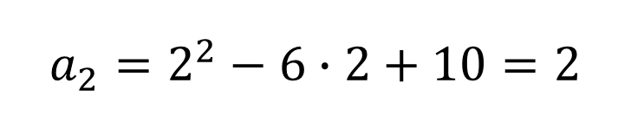



$$a_{1}=1^{2}−6∙1+10=5$$
$$n=1 үед$$
$$a_{2}=2^{2}−6∙2+10=2$$
$$n=2 үед$$
$$a_{3}=3^{2}−6∙3+10=1$$
$$n=3 үед$$
$$B$$
$$a_{4}=4^{2}−6∙4+10=2$$
$$n=4 үед$$
$$a_{5}=5^{2}−6∙5+10=5$$
$$n=5 үед$$
$$a_{6}=6^{2}−6∙6+10=10$$
$$n=6 үед$$

Slide 15




$$5\sin{\frac{π}{6}−\operatorname{ctg}{\frac{π}{4}}}$$
$$=5∙\frac{1}{2}−1=\frac{5}{2}−1=\frac{3}{2}=1 .5$$
$$D$$

Slide 16






















$$\sin\left(−x\right)=−\sin{x}$$
$$сондгой$$
$$f\left(−x\right)=−f\left(x\right) сондгой$$
$$\cos\left(−x\right)=\cos{x}$$
$$тэгш$$
$$\operatorname{tg}\left(−x\right)=−tg{x}$$
$$сондгой$$
$$f\left(−x\right)=f\left(x\right) тэгш$$
$$\operatorname{ctg}\left(−x\right)=−ctg{x}$$
$$сондгой$$
$$A. y=\frac{\sin{2x}}{3tg⁡(x)}=\frac{\sin{(−2x)}}{3tg{(−x)}}=\frac{\sin{2x}}{3tg⁡(x)}$$
$$тэгш$$
$$A$$
$$E. y=\cos\left(3x−\frac{π}{6}\right)$$
$$B. y=\frac{\cos{2x}}{tg⁡(x)}=\frac{\cos{(−2x)}}{\operatorname{tg}{(−x)}}=−\frac{\cos{2x}}{tg⁡(x)}$$
$$сондгой$$
$$тэгш биш сондгой ч биш$$
$$C. y=\sin\left(2x+\frac{π}{3}\right)$$
$$тэгш биш сондгой ч биш$$
$$D. y=\operatorname{xcos}{x=\left(−x\right)\cos\left(−x\right)=−xcosx}$$
$$сондгой$$

Slide 17







$$\lim_{x→−1}{\frac{x^{2}−x−2}{x^{2}−1}}$$
$$=\lim_{x→−1}{\frac{(x+1)(x−2)}{(x−1)(x+1)}}$$
$$=\lim_{x→−1}{\frac{(x−2)}{(x−1)}}$$
$$={−\frac{3}{−2}=\frac{3}{2}}$$
$$={\frac{(−1−2)}{(−1−1)}}$$
$$C$$

Slide 18












$$B$$
$${50}^{0}$$
$$M$$
$${50}^{0}$$
$${65}^{0}$$
$${15}^{0}$$
$${65}^{0}$$
$${∡MAC=15}^{0}$$
$$D$$
$$A$$
$$C$$

Slide 19










$$3x$$
$$x+2x+3x={360}^{0}$$
$$6x={360}^{0}$$
$$x$$
$$={60}^{0}$$
$${60}^{0}$$
$$x={60}^{0}$$
$$E$$
$$2x$$

Slide 20











$$2\vec{a}=(2,−6)$$
$$2\vec{a}−3\vec{b}=$$
$$(−4, −9)$$
$$3\vec{b}=(6, 3)$$
$$\vec{a}+\vec{b}=$$
$$(3, −2)$$
$$(2\vec{a}−3\vec{b})∙(\vec{a}+\vec{b})=$$
$$\left(\left(−4\right)∙3+\left(−9\right)∙\left(−2\right)\right)$$
$$=6$$
$$E$$

Slide 21


$$A$$

Slide 22













$$\frac{x}{2}+\frac{y}{3}=\frac{2y}{3}$$
$$Жигмэд−x$$
$$−\frac{x}{2}=\frac{x}{2}$$
$$+\frac{y}{3}$$
$$\frac{3x}{6}+\frac{2y}{6}=\frac{4y}{6}$$
$$Тогмод−y$$
$$3x+2y=4y$$
$$−\frac{y}{3}=\frac{2y}{3}$$
$$3x=2y$$
$$y=\frac{3}{2}x$$
$$\frac{3}{2}=1.5$$
$$B$$

Slide 23










$${\left(a−b\right)}^{2}=a^{2}−2ab+b^{2}$$
$${\left(\sqrt{2+\sqrt{3}}−\sqrt{2−\sqrt{3}}\right)}^{2}=$$
$${\left(\sqrt{2+\sqrt{3}}\right)}^{2}−2\sqrt{\left(2+\sqrt{3}\right)\left(2−\sqrt{3}\right)}+{\left(\sqrt{2−\sqrt{3}}\right)}^{2}=$$
$$a$$
$$b$$
$$2^{2}−{\left(\sqrt{3}\right)}^{2}$$
$$=4−3=1$$
$$2+\sqrt{3}−2\sqrt{1}+2−\sqrt{3}=$$
$$C$$
$$4−2∙1=2$$

Slide 24









$$\frac{2a+6}{a}=$$
$$\frac{2a}{a}+\frac{6}{a}=$$
$$2+\frac{6}{a}$$
$$1;2;3;6$$
$$−1;−2;−3;−6$$
$$8 ширхэг$$
$$D$$

Slide 25














$$\frac{9a}{20}=\frac{1}{5a}$$
$$\frac{a45\%}{100\%}$$
$$=\frac{9a}{20}$$
$$a$$
$$45a^{2}=20$$
$$\frac{1}{a}$$
$$=\frac{1}{5a}$$
$$\frac{1}{a}∙\frac{20\%}{100\%}$$
$$a^{2}=\frac{20}{45}$$
$$a^{2}=\frac{4}{9}$$
$$a_{1}=\frac{2}{3}$$
$$a_{2}=−\frac{2}{3}$$
$$E$$

Slide 26






















$$\log_{5}\left(6−5^{x}\right)=1−x$$
$$t^{2}−6t+5=0$$
$$\log_{5}\left(6−5^{x}\right)=\log_{5}{5^{1−x}}$$
$$\left(t−1\right)\left(t−5\right)=0$$
$$t_{1}=1 t_{2}=5$$
$$\left(6−5^{x}\right)=5^{1−x}$$
$$\left(6−5^{x}\right)=\frac{5}{5^{x}}$$
$$5^{x}=t гэвэл$$
$$t_{1}=1 үед$$
$$t_{2}=5 үед$$
$$5^{x}=1$$
$$5^{x}=5$$
$$\left(6−t\right)=\frac{5}{t}$$
$$5^{x}=5^{0}$$
$$5^{x}=5^{1}$$
$$6t−t^{2}=5$$
$$x_{1}=0$$
$$x_{2}=1$$
$$−t^{2}+6t−5=0$$
$${x_{1}+x}_{2}=0+1=1$$
$$D$$

Slide 27









$$y$$
$$II мөч$$
$$I мөч$$
$$x$$
$$III мөч$$
$$IV мөч$$
$$E$$

Slide 28












$$\operatorname{ctg}{α=\frac{1}{\operatorname{tg}{α}}}$$
$$\sin^{2}{α}+\cos^{2}{α}=1$$
$$\sqrt{2\operatorname{ctg}{α}+\frac{1}{\sin^{2}{α}}}$$
$$=\sqrt{2\operatorname{ctg}{α}+\frac{cos^{2}{α}+\sin^{2}{α}}{\sin^{2}{α}}}$$
$$=\sqrt{2\operatorname{ctg}{α}+\frac{cos^{2}{α}}{\sin^{2}{α}}+\frac{\sin^{2}{α}}{\sin^{2}{α}}}$$
$$=\sqrt{2\operatorname{ctg}{α}+{ctg}^{2}{α}+1}$$
$$=\sqrt{\frac{2}{\operatorname{tg}{α}}+\frac{1}{{tg}^{2}{α}}+1}$$
$$=\sqrt{\frac{2}{2}+\frac{1}{2^{2}}+1}$$
$$=\sqrt{\frac{9}{4}}$$
$$=\frac{3}{2}=1.5$$
$$B$$

Slide 29








$$x\left(t\right)=3t^{2}+\frac{2}{t}+2t−8$$
$$x(t)=3t^{2}+2t^{−1}+2t−8$$
$$x^{′}\left(t\right)=6t−2t^{−2}+2$$
$$x^{′}\left(t\right)=6t−\frac{2}{t^{2}}+2$$
$$x^{′}\left(1\right)=6∙1−\frac{2}{1^{2}}+2$$
$$x^{′}\left(1\right)=6$$
$$C$$

Slide 30














$$\left(\frac{b}{3}−\frac{{ b}^{2}}{3}\right)−\left(\frac{b}{6}−\frac{b^{2}}{12}\right)=−\frac{4}{3}$$
$$\int_{\frac{b}{2}}^{b}{\frac{1−2x}{3}dx=−\frac{4}{3}}$$
$$\frac{b−b^{2}}{3}−\frac{2b−b^{2}}{12}=−\frac{4}{3}$$
$$4b−4b^{2}−2b+b^{2}=−16$$
$$\int_{\frac{b}{2}}^{b}{\left(\frac{1}{3}−\frac{2}{3}x\right)dx=−\frac{4}{3}}$$
$$−3b^{2}+2b+16=0$$
$$3b^{2}−2b−16=0$$
$$\left(\frac{1}{3}x−\frac{{ 2x}^{2}}{3∙2}\right){\left.​\right|}_{\frac{b}{2}}^{b}=−\frac{4}{3}$$
$$\left(3b−8\right)\left(b+2\right)=0$$
$$\left(\frac{1}{3}b−\frac{{ b}^{2}}{3}\right)−\left(\frac{1}{3}\left(\frac{b}{2}\right)−\frac{{ \left(\frac{b}{2}\right)}^{2}}{3}\right)=−\frac{4}{3}$$
$$b_{1}=\frac{8}{3}$$
$$b_{2}=−2$$
$$D$$

Slide 31

















$$h=5$$
$$a\sqrt{2}$$
$${45}^{0}$$
$$a$$
$$r=\frac{5}{2}$$
$${45}^{0}$$
$$S_{хг}=2πrh$$
$${90}^{0}$$
$$d=5\sqrt{2}$$
$$5$$
$$a$$
$$S_{хг}=2π∙5∙\frac{5}{2}$$
$$S_{хг}=25π$$
$$C$$
$$5$$

Slide 32


















$$\frac{20\%}{100\%}=\frac{1}{5}$$
$$a−\frac{1}{5}a=\frac{4a}{5}$$
$$b−\frac{1}{5}b=\frac{4b}{5}$$
$$c−\frac{1}{5}c=\frac{4c}{5}$$
$$өндөр=c$$
$$S_{БГ}^{′}=2\left(\frac{4a}{5}∙\frac{4b}{5}+\frac{4c}{5}∙\frac{4b}{5}+\frac{4a}{5}∙\frac{4c}{5}\right)$$
$$өргөн=b$$
$$урт=a$$
$$\frac{4c}{5}$$
$$S_{БГ}=2(ab+bc+ac)$$
$$S_{БГ}^{′}=2∙\frac{16}{25}\left(ab+bc+ac\right)$$
$$\frac{4b}{5}$$
$$\frac{4a}{5}$$
$$1−\frac{16}{25}=\frac{9}{25}$$
$$\frac{9}{25}∙100\%=36\%$$
$$B$$

Slide 33





$$9^{0}, 9^{0} {,9}^{0}, {12}^{0}, {12}^{0}, {13}^{0}, { 14}^{0}, {15}^{0}, {16}^{0}, {16}^{0}$$
$$M_{0}=9^{0}$$
$$M=\frac{{12}^{0}+{13}^{0}}{2}={12.5}^{0}$$
$$D$$

Slide 34









$$5^{\sqrt[3]{5}} 5^{\sqrt[4]{7}} 5^{\sqrt{3}}$$
$$5^{\sqrt{3}};5^{\sqrt[3]{5}};5^{\sqrt[4]{7}}$$
$$A$$
$${\left(5^{\sqrt[3]{5}}\right)}^{12 }{\left(5^{\sqrt[4]{7}}\right)}^{12}{ \left(5^{\sqrt{3}}\right)}^{12}$$
$$5^{5^{4}} 5^{7^{3}}{ 5}^{3^{6}}$$
$$5^{625} 5^{343}{ 5}^{729}$$
$$5^{343} < 5^{625}{ < 5}^{729}$$
$$5^{\sqrt[4]{7}}<5^{\sqrt[3]{5}}{< 5}^{\sqrt{3}}$$

Slide 35













$$\log_{14}{28=}$$
$$\log_{14}{2}+\log_{14}{14}=$$
$$\frac{1}{\log_{2}{14}}+1=$$
$$\frac{1}{\log_{2}{2}+\log_{2}{7}}+1=$$
$$\frac{a+a+1}{a+1}=$$
$$\frac{a}{a+1}+1=$$
$$\frac{2a+1}{a+1}$$
$$\frac{1}{1+\frac{1}{a}}+1=$$
$$\frac{1}{\frac{a+1}{a}}+1=$$
$$\frac{1}{1+\frac{1}{\log_{2}{7}}}+1=$$
$$E$$

Slide 36

















$$ус$$
$$99\%=99кг$$
$$ус$$
$$98\%$$
$$Хатна$$
$$=50кг$$
$$шинэ мөөг$$
$$100кг$$
$$хатсан мөөг$$
$$x кг$$
$$мөөг$$
$$1\%=1кг$$
$$Хатхад мөөгний хэмжээ өөрчлөгдөхгүй$$
$$мөөг$$
$$2\%$$
$$2\% нь 1кг$$
$$\frac{1кг}{2\%}$$
$$=50кг$$
$$∙100\%$$
$$хатсан мөөг$$
$$D$$

Slide 37













$$f\left(x\right)=\int{\frac{1}{x^{2}−5x+6}dx}$$
$$=\int{\frac{1}{\left(x−2\right)\left(x−3\right)}dx=}$$
$$\int{\left(\frac{1}{x−3}−\frac{1}{x−2}\right)dx=}$$
$$f(x)=ln{\frac{|x−3|}{|x−2|}+C}$$
$$=ln{|x−3|−\ln{|x−2|+C}}$$
$$=ln{\frac{|x−3|}{|x−2|}+C}$$
$$f(4)=ln{\frac{|4−3|}{|4−2|}+C}=−\ln{2}$$
$$f(x)=ln{\frac{|x−3|}{|x−2|}}$$
$$D$$
$$\ln{\frac{1}{2}+C}=−\ln{2}$$
$$\ln{2^{−1}+}C=−\ln{2}$$
$$C=0$$

Slide 38




















$\cos{\frac{5π}{3}}+$ $\left|\sin{\frac{α}{4}}\right|>1$
$$B$$
$$a=1$$
$$\cos{\frac{5π}{3}}=\cos\left({300}^{0}\right)=\cos\left({270}^{0}+{30}^{0}\right)=\sin{{30}^{0}=\frac{1}{2}}$$
$$1$$
$$\cos{\frac{5π}{3}}$$
$\frac{1}{2}+$ $\left|\sin{\frac{α}{4}}\right|>1$
$$\frac{1}{2}<sin{\frac{α}{4}}<−\frac{1}{2}$$
$$A$$
$$C$$
$$\frac{π}{6}+πk<{\frac{α}{4}}<\frac{5π}{6}+πk$$
$$\left|\sin{\frac{α}{4}}\right|$$
$$∙4$$
$$\frac{1}{2}<\sin{\frac{α}{4}}$$
$$b=1$$
$$\left|\sin{\frac{α}{4}}\right|>\frac{1}{2}$$
$$\frac{2π}{3}+4πk<{α}<\frac{10π}{3}+4πk$$
$$\sin{\frac{α}{4}}<−\frac{1}{2}$$
$$d=2; e=3;f=4; g=0;$$
$$c=1$$

Slide 39






















$$b c$$
$$x_{1} y_{1}$$
$$x_{2} y_{2}$$
$$y={a\left(x−b\right)}^{2}+c$$
$$1. y={\left(x−2\right)}^{2}−2$$
$$y=x^{2}−4x+4−2$$
$$y=x^{2}−4x+2$$
$$y=2x−6$$
$$y=x^{2}−4x+2$$
$$a=4$$
$$b=2$$
$$2$$
$$2. k=\frac{y_{2}−y_{1}}{x_{2}−x_{1}}$$
$$=\frac{2−\left(−6\right)}{4−0}=\frac{8}{4}=2$$
$$4$$
$$y−y_{1}=k(x−x_{1})$$
$$y−(−6)=2(x−0)$$
$$y=2x−6$$
$$c=2$$
$$d=6$$

Slide 40









$$S=\int_{2}^{4}{\left(\left(2x−6\right)−\left(x^{2}−4x+2\right)\right)dx}$$
$$=\int_{2}^{4}{\left(−x^{2}+6x−8\right)dx}$$
$$=\left(−\frac{x^{3}}{3}+\frac{6x^{2}}{2}−8x\right){\left.​\right|}_{2}^{4}$$
$$=\left(−\frac{{\left(4\right)}^{3}}{3}+3∙4^{2}−8∙4\right)−\left(−\frac{{\left(2\right)}^{3}}{3}+3∙2^{2}−8∙2\right)$$
$$=\left(−\frac{64}{3}+48−32\right)−\left(−\frac{8}{3}+12−16\right)$$
$$=−\frac{64}{3}+16+\frac{8}{3}+4=$$
$$−\frac{56}{3}+20=\frac{4}{3}$$
$$=1\frac{1}{3}$$
$$e=1;f=1; g=3;$$

Slide 41





















$$Орос хэл −100\%$$
$$Англи хэл −100\%$$
$$Франц хэл −100\%$$
$$мэддэг асуулт−45\%$$
$$мэддэг асуулт−60\%$$
$$мэддэг асуулт−80\%$$
$$P=\frac{m}{n}=\frac{1}{3}$$
$$1. Франц хэлний дугтуй авах магадлал −$$
$$a=3$$
$$нийт гурван дугтуй байна. n=3$$
$$Франц хэлний дугтуй 1 ширхэг. m=1$$
$$P=\frac{m}{n}=\frac{80\%}{100\%}=\frac{4}{5}$$
$$b=4$$
$$2. Франц хэлний дугтуйнаас мэддэг асуулт сугалах магадлал −$$
$$=\frac{37}{60}$$
$$3. мэддэг асуулт сугалах магадлал −$$
$$P=\frac{m}{n}=\frac{185\%}{300\%}$$
$$c=3$$
$$d=0$$
$$=\frac{16}{37}$$
$$p=\frac{80\%}{185\%}$$
$$4. мэддэг асуулт Франц хэлнийх байх магадлал −$$
$$e=6;f=3; g=7$$

Slide 42









































$$h=2; R=\frac{d}{2}=\frac{5}{2}$$
$$S$$
$$\frac{1}{3}πR^{2}∙h$$
$$=\frac{1}{3}π{\left(\frac{5}{2}\right)}^{2}∙2$$
$$1. V=\frac{1}{3}S_{c}h=$$
$$=\frac{25π}{6}$$
$$a=5$$
$$b=6$$
$$≅∆SO^{′}N$$
$$2−h$$
$${60}^{0}$$
$$∆SOM$$
$$2$$
$$\frac{x}{\sqrt{3}}$$
$$N$$
$$\frac{\frac{5}{2}}{\frac{x}{\sqrt{3}}}=\frac{2}{2−h}$$
$$\frac{2}{2−h}=\frac{5\sqrt{3}}{2x}$$
$$x$$
$$O^{′}$$
$$x$$
$$\frac{x}{\sqrt{3}}$$
$$2−h=\frac{4x}{5\sqrt{3}}$$
$$h$$
$$\frac{x}{2\sqrt{3}}$$
$$∙\frac{\sqrt{3}}{\sqrt{3}}$$
$$M$$
$${60}^{0}$$
$${60}^{0}$$
$$O$$
$$\frac{5}{2}$$
$${90}^{0}$$
$${30}^{0}$$
$$h=2−\frac{4x\sqrt{3}}{15}$$
$$\frac{x}{2}$$
$$\frac{x}{2}$$
$$2−h=\frac{4x\sqrt{3}}{15}$$
$$h=\frac{30−4x\sqrt{3}}{15}$$
$$x$$
$$c=0$$
$$d=4$$

Slide 43
























$$h=\frac{30−4x\sqrt{3}}{15}$$
$$S_{c}=\frac{x^{2}\sqrt{3}}{4}$$
$$x$$
$$x$$
$$x$$
$$V_{пр}=S_{c}h$$
$$=\frac{x^{2}\sqrt{3}}{4}∙\frac{(30−4x\sqrt{3})}{15}$$
$$=\frac{x^{2}30\sqrt{3}−12x^{3}}{60}$$
$$=\frac{x^{2}30\sqrt{3}}{60}−\frac{12x^{3}}{60}$$
$$=\frac{x^{2}\sqrt{3}}{2}−\frac{x^{3}}{5}$$
$$\frac{x^{2}\sqrt{3}}{2}−\frac{x^{3}}{5}$$
$$x\left(\sqrt{3}−\frac{3}{5}x\right)=0$$
$$V_{пр}=$$
$$x_{1}=0$$
$$x_{2}=\frac{5\sqrt{3}}{3}$$
$$V_{пр}^{′}=\frac{2x\sqrt{3}}{2}−\frac{3x^{2}}{5}$$
$$V_{пр}=\frac{x^{2}\sqrt{3}}{2}−\frac{x^{3}}{5}$$
$$=\frac{{\left(\frac{5\sqrt{3}}{3}\right)}^{2}\sqrt{3}}{2}−\frac{{\left(\frac{5\sqrt{3}}{3}\right)}^{3}}{5}$$
$$={\left(\frac{5\sqrt{3}}{3}\right)}^{2}\left(\frac{\sqrt{3}}{2}−\frac{\sqrt{3}}{3}\right)$$
$$x\sqrt{3}−\frac{3x^{2}}{5}=0$$
$$=\frac{25\sqrt{3}}{18}$$
$$=\frac{25∙3}{9}∙\frac{\sqrt{3}}{6}$$
$$e=5;f=1; g=8$$

