Slide 1
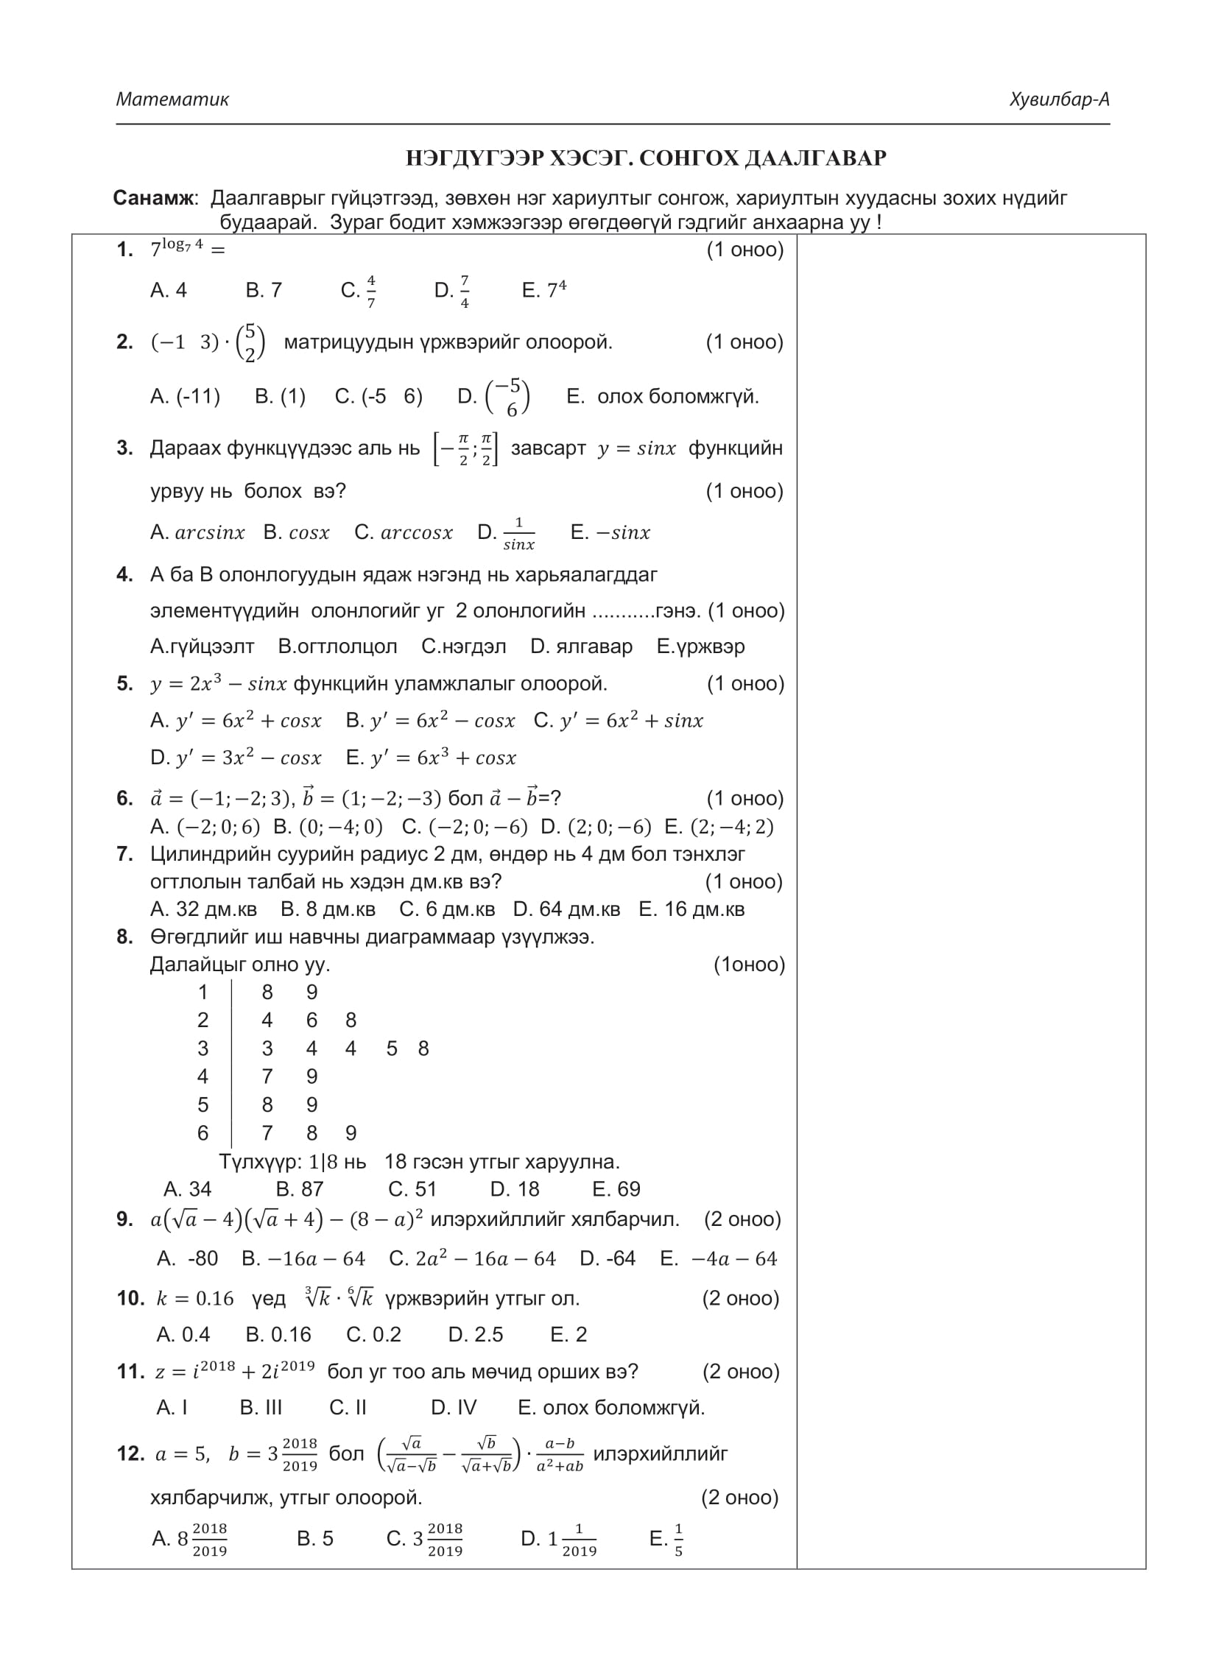
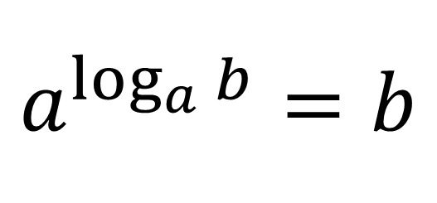



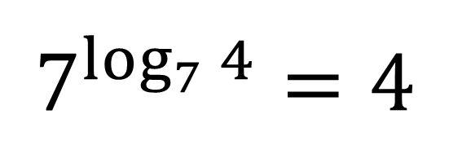
$$2019 оны ЭЕШ−ын А хувилбар$$
Ашиглах томьёо
$$Бодолт$$
$$7^{\log_{7}{4}}=4$$
$$a^{\log_{a}{b}}=b$$
$$A$$

Slide 2
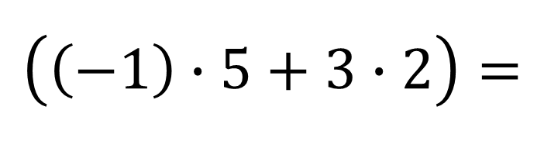
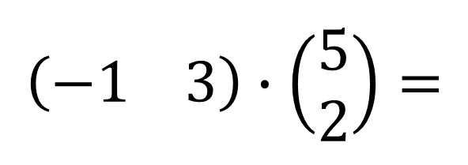


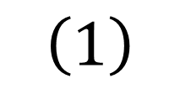
$$Бодолт$$
$$\left(−1 3\right)∙\left(\begin{aligned}5 \\ 2\end{aligned}\right)=$$
$$\left(\left(−1\right)∙5+3∙2\right)=$$
$$\left(1\right)$$
$$B$$

Slide 3

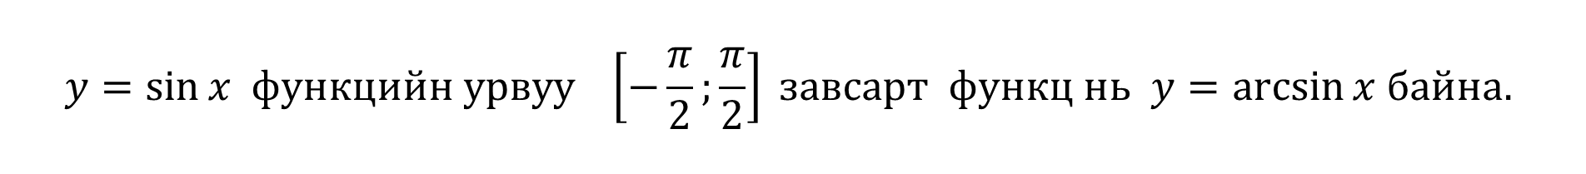

$$Бодолт$$
$$y=\sin{x функцийн урвуу \left[−\frac{π}{2};\frac{π}{2}\right] завсарт функц нь y=\arcsin{x байна. }}$$
$$A$$

Slide 4



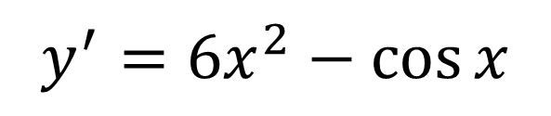
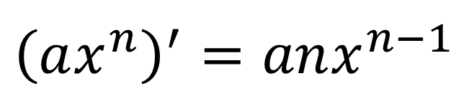
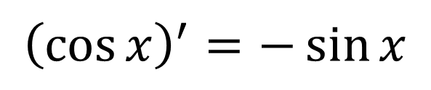
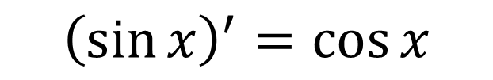
$$Бодолт$$
Ашиглах томьёо
$$y=2x^{3}−\sin{x}$$
$${\left(\sin{x}\right)}^{′}=\cos{x}$$
$$y^{′}=6x^{2}−\cos{x}$$
$$B$$
$${\left(\cos{x}\right)}^{′}=−\sin{x}$$
$${\left(ax^{n}\right)}^{′}=anx^{n−1}$$

Slide 5
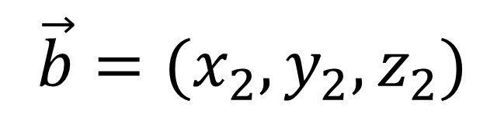

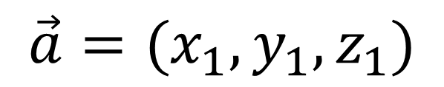
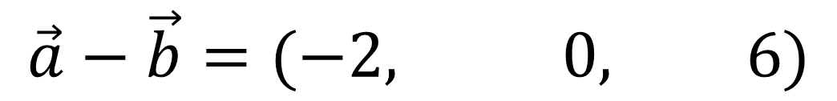
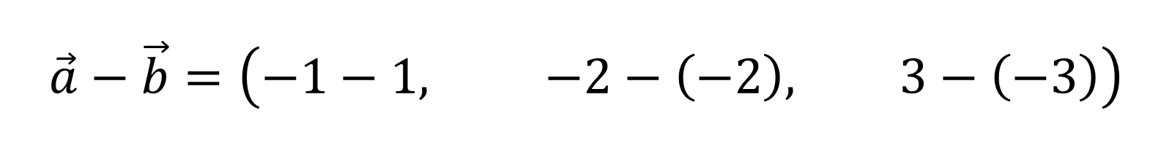

Ашиглах томьёо
$$\vec{a}=(x_{1},y_{1},z_{1})$$
$$\vec{b}=(x_{2},y_{2},z_{2})$$
$$\vec{a}−\vec{b}=(x_{1}−x_{2},{ y}_{1}−y_{2},{ z}_{1}−z_{2})$$
$$Бодолт$$
$$\vec{a}−\vec{b}=\left(−1−1, −2−\left(−2\right), 3−\left(−3\right)\right)$$
$$\vec{a}−\vec{b}=(−2, 0, 6)$$
$$A$$

Slide 6
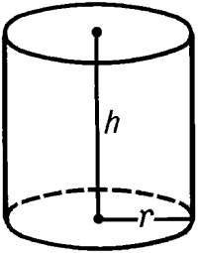
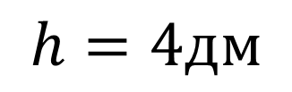



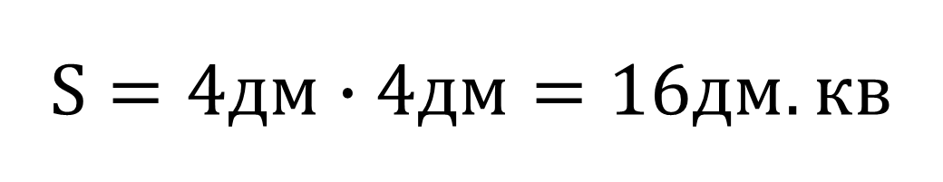
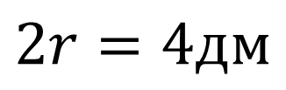
$$Бодолт$$
$$S=4дм∙4дм=16дм.кв$$
$$E$$
$$h=4дм$$
$$2r=4дм$$

Slide 7


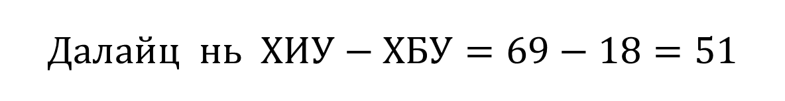
$$Бодолт$$
$$Далайц нь ХИУ−ХБУ=69−18=51$$
$$C$$

Slide 8


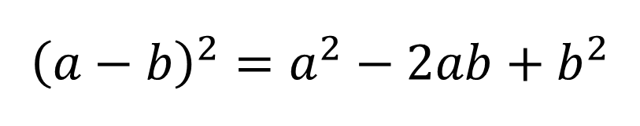

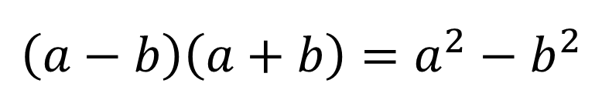
Ашиглах томьёо
$$\left(a−b\right)\left(a+b\right)=a^{2}−b^{2}$$
$${\left(a−b\right)}^{2}=a^{2}−{2ab+b}^{2}$$
$$Бодолт$$
$$a\left(\sqrt{a}−4\right)\left(\sqrt{a}+4\right)−{\left(8−a\right)}^{2}=$$
$$a\left(a−16\right)−\left(64−16a+a^{2}\right)=$$
$$−64$$
$$a^{2}−16a−64+16a−a^{2}=$$
$$D$$

Slide 9

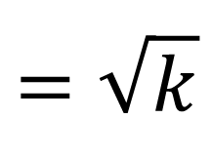
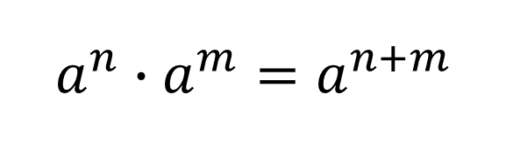
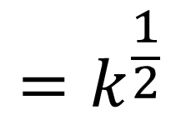

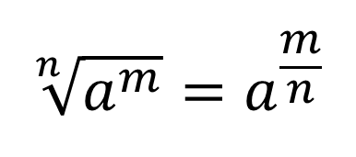
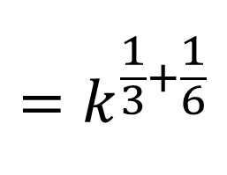
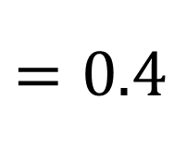
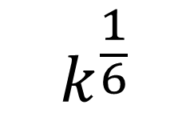

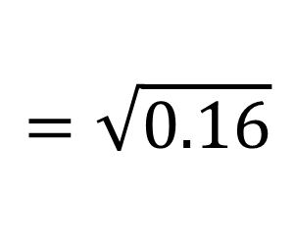
Ашиглах томьёо
$$\sqrt[n]{a^{m}}=a^{\frac{m}{n}}$$
$$a^{n}∙a^{m}=a^{n+m}$$
$$Бодолт$$
$${=k}^{\frac{1}{3}+\frac{1}{6}}$$
$$=\sqrt{0.16}$$
$$\sqrt[3]{k}∙\sqrt[6]{k}=k^{\frac{1}{3}}∙$$
$${=k}^{\frac{1}{2}}$$
$$k^{\frac{1}{6}}$$
$$=\sqrt{k}$$
$$=0.4$$
$$A$$

Slide 10
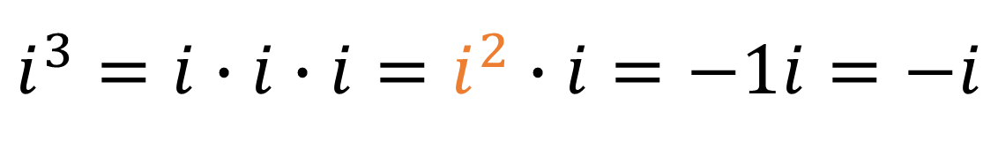
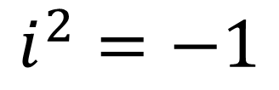
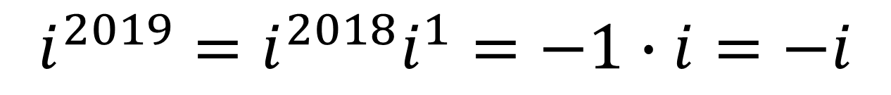


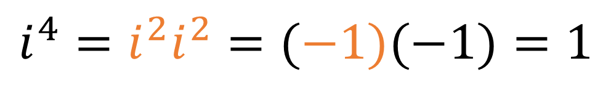
Комплекс тоо
$$i$$
$$i^{2}=−1$$
$$i^{3}=i∙i∙i=i^{2}∙i=−1i=−i$$
$$i^{4}=i^{2}i^{2}=(−1)(−1)=1$$
$$i^{5}=i^{4}i=1i=i$$
$$i^{2018}=i^{2016}i^{2}=1∙\left(−1\right)=−1$$
$$i^{2019}=i^{2018}i^{1}=−1∙i=−i$$

Slide 11
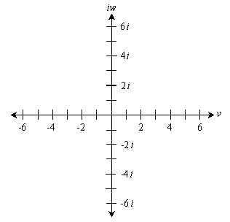

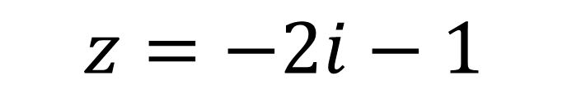
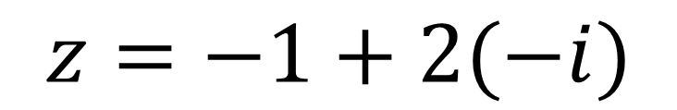
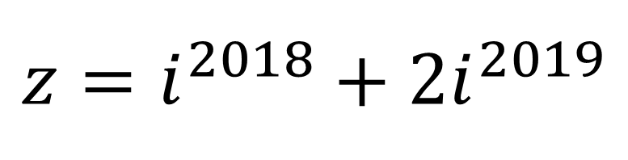


$$z=i^{2018}+2i^{2019}$$
$$z=−1+2(−i)$$
$$z=−2i−1$$
$$III мөч$$
$$B$$

Slide 12
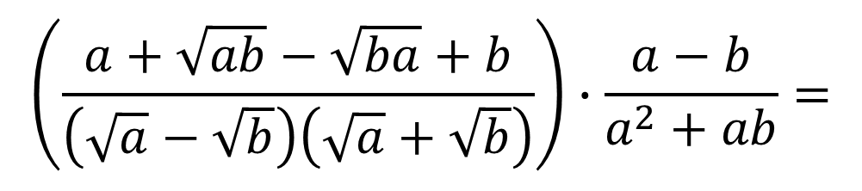
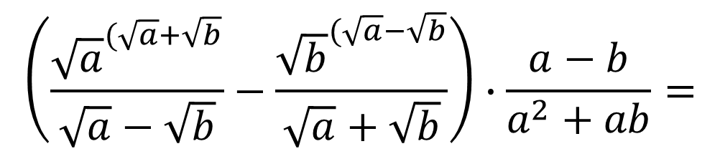



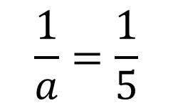
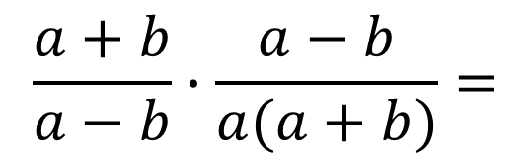
$$Бодолт$$
$$\left(\frac{{\sqrt{a}}^{(\sqrt{a}+\sqrt{b}}}{\sqrt{a}−\sqrt{b}}−\frac{{\sqrt{b}}^{(\sqrt{a}−\sqrt{b}}}{\sqrt{a}+\sqrt{b}}\right)∙\frac{a−b}{a^{2}+ab}=$$
$$\left(\frac{a+\sqrt{ab}−\sqrt{ba}+b}{\left(\sqrt{a}−\sqrt{b}\right)\left(\sqrt{a}+\sqrt{b}\right)}\right)∙\frac{a−b}{a^{2}+ab}=$$
$$\frac{a+b}{a−b}∙\frac{a−b}{a(a+b)}=$$
$$\frac{1}{a}=\frac{1}{5}$$
$$E$$

Slide 13
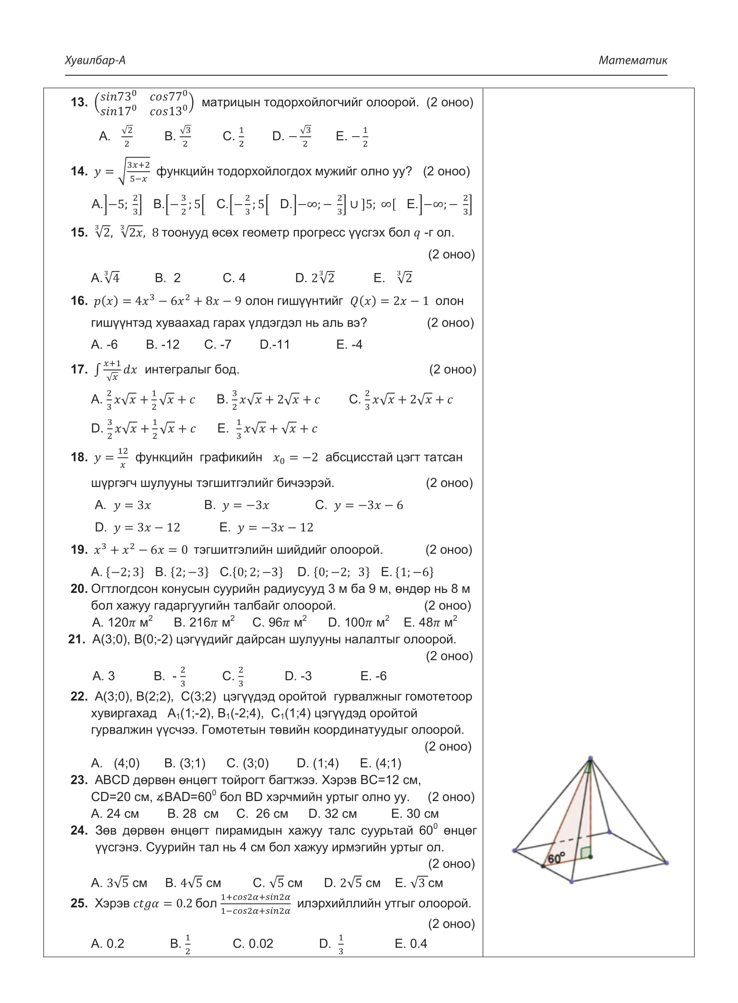
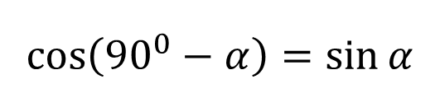
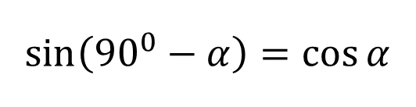

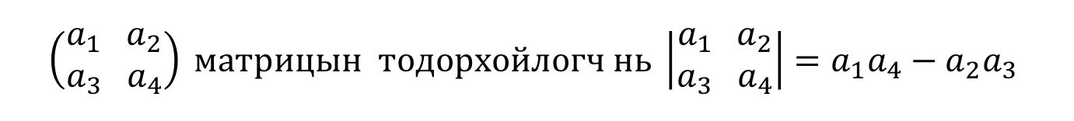
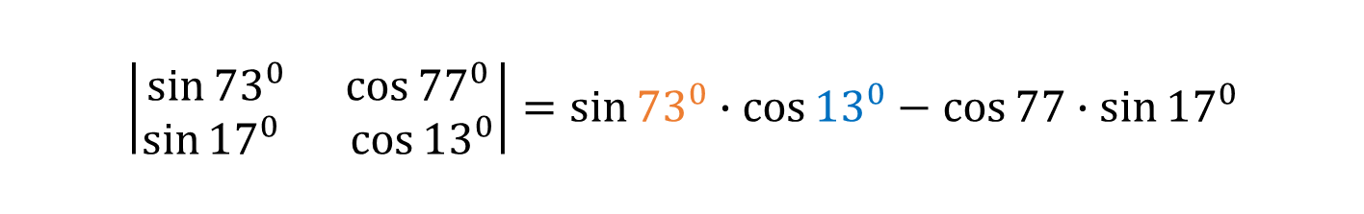
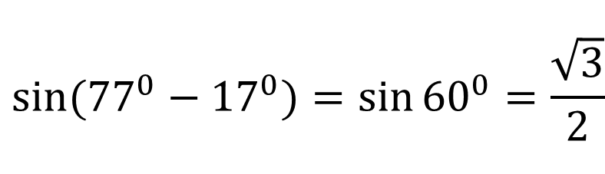

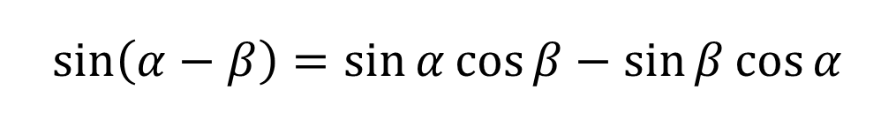
$$\left(\begin{aligned}a_{1} a_{2} \\ a_{3} a_{4}\end{aligned}\right) матрицын тодорхойлогч нь \left|\begin{aligned}a_{1} a_{2} \\ a_{3} a_{4}\end{aligned}\right|=a_{1}a_{4}−a_{2}a_{3}$$
Ашиглах томьёо
$$\sin\left({90}^{0}−α\right)=\cos{α}$$
$$\sin\left(α−β\right)=\sin{α}\cos{β}−\sin{β}\cos{α}$$
$$\cos\left({90}^{0}−α\right)=\sin{α}$$
$$\left|\begin{aligned}\sin{{73}^{0} }\cos{{77}^{0}} \\ \sin{{17}^{0} }\cos{{13}^{0}}\end{aligned}\right|=sin{{73}^{0}∙\cos{{13}^{0}−\cos{77∙\sin{{17}^{0}}}}}$$
$$Бодолт$$
$$\sin{({90}^{0}−{17}^{0})∙\cos{({90}^{0}−{77}^{0})−\cos{77∙\sin{{17}^{0}}}}}$$
$$\cos{{17}^{0}∙\sin{{77}^{0}−\cos{77∙\sin{{17}^{0}}}}}$$
$$sin({77}^{0}−{17}^{0})=cos{{17}^{0}∙\sin{{77}^{0}−\cos{77∙\sin{{17}^{0}}}}}$$
$$sin({77}^{0}−{17}^{0})=sin{{60}^{0}=\frac{\sqrt{3}}{2}}$$
$$B$$

Slide 14



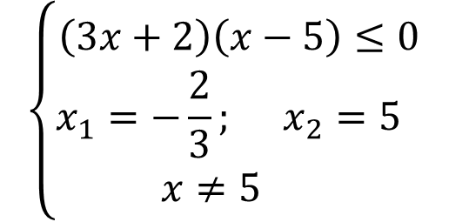






$$Бодолт$$
$y=\sqrt{\frac{3x+2}{5−x} }$ квадрат язгуураас ямагт эерэг тоо гарна.
$$\frac{3x+2}{5−x}≥0$$
$$\left\{\begin{aligned}\left(3x+2\right)\left(x−5\right)≤0 \\ x_{1}=−\frac{2}{3}; x_{2}=5 \\ x≠5 \end{aligned}\right.$$
$$\left\{\begin{aligned}\left(3x+2\right)\left(5−x\right)≤0 \\ 5−x≠0\end{aligned}\right.$$
+
-
+
$$−∞$$
$$−\frac{2}{3}$$
$$5$$
$$+∞$$
$$x ε[−\frac{2}{3};5[$$
$$B$$

Slide 15






















$$\sqrt[3]{2}, \sqrt[ 3]{2x}, \sqrt[3]{8^{3}}$$
$$геометр прогрессийн чанар:$$
$$b_{2}=\sqrt{b_{1}b_{3}}$$
$$Бодолт$$
$$b_{1}$$
$$b_{2}$$
$$b_{3}$$
$$x=\frac{2^{5}}{2}$$
$$q=\sqrt[3]{2^{4}}$$
$$=\sqrt[3]{2^{3}∙2}$$
$$2x=\sqrt{2∙8^{3}}$$
$$=2\sqrt[3]{2}$$
$$2x=\sqrt{2∙2^{9}}$$
$$x=2^{4}$$
$$D$$
$$2x=\sqrt{2^{10}}$$
$$q=\frac{b_{2}}{b_{1}}$$
$$=\frac{2x}{2}$$
$$=\frac{2∙2^{4}}{2}$$
$$=2^{4}$$
$$2x=2^{5}$$

Slide 16











$$Бодолт$$
$$2x−1=0$$
$$p\left(x\right)=4x^{3}−6x^{2}+8x−9$$
$$2x=1$$
$$x=\frac{1}{2}$$
$$p\left(\frac{1}{2}\right)=4∙{\left(\frac{1}{2}\right)}^{3}−6∙{\left(\frac{1}{2}\right)}^{2}+8∙\left(\frac{1}{2}\right)−9$$
$$p\left(\frac{1}{2}\right)=4∙\frac{1}{8}−6∙\frac{1}{4}+8∙\frac{1}{2}−9$$
$$p\left(\frac{1}{2}\right)=0.5−1.5+4−9$$
$$p\left(\frac{1}{2}\right)=−6$$
$$үлдэгдэлтэй$$
$$A$$

Slide 17











$$Бодолт$$
$$\int{\left(\frac{ x}{\sqrt{x}}+\frac{1}{\sqrt{x}}\right)dx}=$$
$$\int{\left(\frac{ x}{x^{\frac{1}{2}}}+\frac{1}{x^{\frac{1}{2}}}\right)dx}=$$
$$\int{\left(x^{\frac{1}{2}}+x^{−\frac{1}{2}}\right)dx}=$$
$$\int{\frac{x+1}{\sqrt{x}}dx}=$$
$$\frac{2\sqrt{x^{3}}}{3}+\frac{2\sqrt{x}}{1}+c=$$
$$\frac{2}{3}x\sqrt{x}+2\sqrt{x}+c$$
$$\frac{x^{\frac{1}{2}+1}}{\frac{1}{2}+1}+\frac{x^{−\frac{1}{2}+1}}{x^{−\frac{1}{2}+1}}+c=$$
$$\frac{x^{\frac{3}{2}}}{\frac{3}{2}}+\frac{x^{\frac{1}{2}}}{\frac{1}{2}}+c=$$
$$C$$
$$\sqrt{x^{3}}=\sqrt{x^{2}∙x}=x\sqrt{x}$$

Slide 18




















$$Бодолт$$
$$y_{0}=f(x_{0})=\frac{12}{−2}=−6$$
$k=f^{′}(x_{0})$ шулууны налалт
$$f^{′}\left(x\right)={\left(\frac{12}{x}\right)}^{′}$$
$${=\left(12x^{−1}\right)}^{′}$$
$$=−12x^{−1−1}$$
$$=−\frac{12}{x^{2}}$$
$$=−12x^{−2}$$
$$k=f^{′}\left(x_{0}\right)=−\frac{12}{{\left(−2\right)}^{2}}=\frac{12}{−4}=−3$$
$$x_{0}=−2$$
$$y_{0}=−6$$
$$k=−3$$
$$y−y_{0}=k(x−x_{0})$$
$$Шүргэгч шулууны тэгшитгэл$$
$$y−\left(−6\right)=−3(x−(−2))$$
$$y+6=−3(x+2)$$
$$y+6=−3x−6$$
$$y=−3x−6−6$$
$$y=−3x−12$$
$$E$$

Slide 19








$$Бодолт$$
$$x^{3}+x^{2}−6x=0$$
$$x\left(x^{2}+x−6\right)=0$$
$$x(x+3)(x−2)=0$$
$$x_{1}=0$$
$$x_{1}=−3$$
$$x_{3}=2$$
$$\{−3; 0; 2\}$$
$$C$$

Slide 20


















$$өгсөн нь:$$
$$Бодолт$$
$$R=9м$$
$$l^{2}={\left(8м\right)}^{2}+{\left(6м\right)}^{2}$$
$$r=3м$$
$$l^{2}=64м^{2}+36м^{2}$$
$$h=8м$$
$$олох нь:$$
$$l^{2}=100м^{2}$$
$$h=8м$$
$$S_{хг}=?$$
$$l=10м$$
$$S_{хг}=(R+r)πl$$
$$R−r=6м$$
$$S_{хг}=(9м+6м)π10м$$
$$S_{хг}=120πм^{2}$$
$$A$$

Slide 21






$$x_{1};y_{1}$$
$$x_{2};y_{2}$$
$$Бодолт$$
$$k=\frac{y_{2}−y_{1}}{x_{2}−x_{1}}\text{шулууны налалт}$$
$$k=\frac{−2−0}{0−3}=−\frac{2}{−3}=\frac{2}{3}$$
$$C$$

Slide 22










$$Бодолт$$
$$B_{1}$$
$$C_{1}$$
$$B$$
$$c$$
$$(4;1)$$
$$A$$
$$E$$
$$A_{1}$$

Slide 23















$$Бодолт$$
$$B$$
$$A$$
$${60}^{0}$$
$$BD=?$$
$$BC=12см$$
$${120}^{0}$$
$$D$$
$$C$$
$$CD=20см$$
$$∆BDC хувьд косинусын теорем бичвэл$$
$$BD^{2}={\left(12см\right)}^{2}+{\left(20см\right)}^{2}−2∙12см∙20см∙\cos{{120}^{0}}$$
$$BD^{2}={144см}^{2}+{400cм}^{2}−2∙12см∙20см∙\left(−\frac{1}{2}\right)$$
$BD^{2}={544см}^{2}$+ ${240см}^{2}$
$$BD^{2}={784см}^{2}$$
$$BD=28см$$
$$B$$

Slide 24




















$$Бодолт$$
$$l^{2}={\left(2\sqrt{3}см\right)}^{2}+{\left(2\sqrt{2}см\right)}^{2}$$
$$l^{2}={12см}^{2}+{8см}^{2}$$
$${30}^{0}$$
$$l$$
$$l^{2}={20см}^{2}$$
$$4см$$
$$2\sqrt{3}см$$
$$l=\sqrt{{20см}^{2}}$$
$$4\sqrt{2}см$$
$$a=4см$$
$$l=2\sqrt{5}см$$
$$D$$
$$2\sqrt{2}см$$
$$2см$$
$$2см$$
$$a=4см$$
$$a=4см$$

Slide 25












$$\cos{2α}=\cos^{2}{α}−\sin^{2}{α}$$
$$Бодолт$$
$$\cos{2α}=1−2\sin^{2}{α}$$
$$\cos{2α}={2cos}^{2}{α}−1$$
$$\sin{2α}=2cos{α}\sin{α}$$
$$\frac{1+\cos{2α+\sin{2α}}}{1−\cos{2α+\sin{2α}}}$$
$$=\frac{1+\left({2cos}^{2}{α}−1\right)+2cos{α}\sin{α}}{1−\left(1−2\sin^{2}{α}\right)+2cos{α}\sin{α}}$$
$$=\frac{{2cos}^{2}{α}+2cos{α}\sin{α}}{2\sin^{2}{α}+2cos{α}\sin{α}}$$
$$=\operatorname{ctg}{α}=0.2$$
$$=\frac{2\cos{α}(\cos{α+\sin{α}})}{2\sin{α}(\sin{α+\cos{α}})}$$
$$=\frac{\cos{α}}{\sin{α}}$$
$$A$$

Slide 26




$$Бодолт$$
Бодлогын тоо | $$0≤x<3$$ | $$3≤x<6$$ | $$6≤x<9$$ | Нийт
С$урагчдын тоо$ $$f$$ | $$8$$ | $$23$$ | $$9$$ | $$40$$
$$<x>$$ | $$\frac{0+3}{2}=1.5$$ | $$\frac{3+6}{2}=4.5$$ | $$\frac{6+9}{2}=7.5$$
$$f∙<x>$$ | $$1.5∙8=12$$ | $$4.5∙23=103.5$$ | $$7.5∙9=67.5$$ | 183
$$\frac{183}{40}=4.575≈4.6$$
$$E$$

Slide 27













$$Бодолт$$
$$C_{n}^{m}=C_{n}^{n−m}$$
$$A_{n}^{m}=\frac{n!}{{\left(n−m\right)}^{!}}$$
$$P_{n}=n!$$
Хэсэглэл
Сэлгэмэл
Гүйлгэмэл
$$C_{x}^{7}=C_{x}^{5}$$
$$C_{x}^{7}=C_{x}^{x−5}$$
$$x−5=7$$
$$x=12$$
$$\frac{P_{x}}{A_{x}^{2}}=\frac{P_{12}}{A_{12}^{2}}$$
$$=\left(12−10\right)!=10!$$
$$=\frac{12!}{\frac{12!}{(12−2)!}}$$
$$B$$

Slide 28




$$Бодолт$$
$$E\left(x\right)=p_{1}x_{1}+p_{2}x_{2}+p_{3}x_{3}+p_{4}x_{4}$$
$$E\left(x\right)=2∙0.4+5∙0.2+3∙0.3+1∙0.1=2.8$$
$$C$$

Slide 29

















$$Бодолт$$
$$2y−x−2=0$$
$$y+2x−6=0$$
$$2y=x+2/:2$$
$$y=−2x+6$$
$$−2x+6=0$$
$$y=\frac{x}{2}+1$$
$$−2x=−6$$
$$x=3$$
$$2$$
$$\frac{x}{2}+1=0$$
$$y=0$$
$$\frac{x}{2}=−1$$
$$5$$
$$x=−2$$
$$S=\frac{5∙2}{2}=5$$
$$D$$

Slide 30














$$x^{4}−23x^{2}+1=(x^{2}+px+1)(x^{2}−qx+1)$$
$$Бодолт$$
$${=x}^{4}−qx^{3}+x^{2}+px^{3}−pqx^{2}+px+x^{2}−qx+1$$
$${=x}^{4}+x^{3}\left(p−q\right)+x^{2}\left(2−pq\right)+x\left(p−q\right)+1$$
$$p>0 тул$$
$$\left\{\begin{aligned}p−q=0 \\ 2−pq=−23 \\ p−q=0 \end{aligned}\right.$$
$$\left\{\begin{aligned}p=q \\ 2−pq=−23\end{aligned}\right.$$
$$p=5$$
$$2−p^{2}=−23$$
$$q=p=5$$
$$p^{2}=25$$
$$p+q=10$$
$$p=±5$$
$$C$$

Slide 31







$$Бодолт$$
$$δ=\sqrt{Var\left(x\right)} стандарт хазайлт$$
$$Var\left(x\right)=\frac{\sum{{\left(x−\overline{x}\right)}^{2}}}{n} Дисперс$$
$$\overline{x}=\frac{1+1+2+4+7}{5}=\frac{15}{5}=3$$
$δ=\sqrt{Var\left(x\right)}=$ $\sqrt{\frac{\sum{{\left(x−\overline{x}\right)}^{2}}}{n}}$
=$\sqrt{\frac{{\left(1−3\right)}^{2}+{\left(1−3\right)}^{2}+{\left(2−3\right)}^{2}+{\left(4−3\right)}^{2}+{\left(7−3\right)}^{2}}{5}}=\sqrt{\frac{26}{5}}≈2.28$
$$A$$

Slide 32


















$$x_{1}; y_{1}{; z}_{1}$$
$$x_{2}; y_{2}{; z}_{2}$$
$$Бодолт$$
$$\vec{a}∙\vec{b}$$
$$\cos{α}=\frac{\vec{a}∙\vec{b}}{|\vec{a}|∙|\vec{b}|}$$
$$=\frac{x_{1}x_{2}+y_{1}y_{2}+z_{1}z_{2}}{\sqrt{x_{1}^{2}+y_{1}^{2}+z_{1}^{2}}∙\sqrt{x_{2}^{2}+y_{2}^{2}+z_{2}^{2}}}$$
$$\left|\vec{a}\right|$$
$$\left|\vec{b}\right|$$
$$=\frac{0∙1+\left(−1\right)∙\left(−1\right)+(−1)∙(−2)}{\sqrt{0^{2}+{\left(−1\right)}^{2}+{\left(−1\right)}^{2}}∙\sqrt{1^{2}+{\left(−1\right)}^{2}+{\left(−2\right)}^{2}}}$$
$$=\frac{3}{\sqrt{2}∙\sqrt{6}}$$
$$=\frac{3}{\sqrt{2}∙\sqrt{2}∙\sqrt{3}}$$
$$\cos{α}=\frac{\sqrt{3}}{2}$$
$$=\frac{3}{2\sqrt{3}}∙\frac{\sqrt{3}}{\sqrt{3}}$$
$$=\frac{3\sqrt{3}}{2∙3}$$
$$=\frac{\sqrt{3}}{2}$$
$$α={30}^{0}$$
$$D$$

Slide 33























$${\left(\frac{1}{2}\right)}^{x^{2}−7}<2^{3|x−1|}$$
$$\left\{\begin{aligned}x≥1 \\ x^{2}+3x−10>0\end{aligned}\right.$$
$$буюу$$
$$\left\{\begin{aligned}x<1 \\ x^{2}−3x−4>0\end{aligned}\right.$$
$$Бодолт$$
$$\left(x+5\right)\left(x−2\right)>0$$
$$\left(x−4\right)\left(x+1\right)>0$$
$$x_{1}=−5; x_{2}=2$$
$$x_{1}=−1; x_{2}=4$$
$${\left(2^{−1}\right)}^{x^{2}−7}<2^{3|x−1|}$$
$$2^{−x^{2}+7}<2^{3|x−1|}$$
+
-
+
+
-
+
$$−x^{2}+7<3|x−1|$$
$$−1 4$$
$$−5 2$$
$$1$$
$$]−∞;−1[$$
$$]2; +∞[$$
$$\left\{\begin{aligned}x−1≥0 \\ −x^{2}+7<3(x−1) \end{aligned}\right.$$
$$буюу$$
$$\left\{\begin{aligned}x−1<0 \\ −x^{2}+7<−3(x−1) \end{aligned}\right.$$
$$E$$
$$xε]−∞;−1[∪]2; +∞[$$
$$\left\{\begin{aligned}x≥1 \\ −x^{2}−3x+10<0\end{aligned}\right.$$
$$буюу$$
$$\left\{\begin{aligned}x−1<0 \\ −x^{2}+3x+4<0\end{aligned}\right.$$

Slide 34






























$$y=x^{2}+4$$
$$Бодолт$$
$$B$$
$$D$$
$$y=8$$
$$S_{1}=\int_{−2}^{2}{\left(8−\left(x^{2}+4\right)\right)dx}$$
$$=\int_{−2}^{2}{\left(4−x^{2}\right)dx}$$
$$4$$
$$=\frac{32}{3}$$
$$S_{1}$$
$$=\left(4∙2−\frac{2^{3}}{3}\right)$$
$$−\left(4∙(−2)−\frac{{(−2)}^{3}}{3}\right)$$
$$=\left(4x−\frac{x^{3}}{3}\right){\left.​\right|}_{−2}^{2}$$
$$8$$
$$S_{2}$$
$$S_{ABCD}=$$
$$\frac{8+4}{2}∙8$$
$$=48$$
$$=\frac{112}{3}$$
$$8$$
$$S_{2}=S_{ABCD}−S_{1}$$
$$=48−\frac{32}{3}$$
$$\frac{32}{112}=$$
$$A$$
$$C$$
$$\frac{2}{7}=$$
$$\frac{S_{1}}{S_{2}}=$$
$$\frac{\frac{32}{3}}{\frac{112}{3}}=$$
$$2:7$$
$$E$$

Slide 35






$$Бодолт$$
$$E\left(x\right)=3∙0.5+2∙0.5=2.5$$
$$Var\left(x\right)={\left(x_{1}−E\left(x\right)\right)}^{2}P_{1}+{\left(x_{2}−E\left(x\right)\right)}^{2}P_{1}$$
$$Var\left(x\right)={(3−2.5)}^{2}∙0.5+{\left(2−2.5\right)}^{2}∙0.5$$
$$Var\left(x\right)=\frac{1}{4}∙\frac{1}{2}+\frac{1}{4}∙\frac{1}{2}=\frac{1}{4}$$
$$D$$

Slide 36



















$$4$$
$$Бодолт$$
$$\sin{2x}=2\sin{x}\cos{x}$$
$$\cos^{2}{x}+\sin^{2}{x}=1$$
$$3\sin{2x}−7\cos^{2}{x}=1$$
$$3(2\sin{x}\cos{x})−7\cos^{2}{x}=\cos^{2}{x}+\sin^{2}{x}$$
$$2$$
$$6sin{x}\cos{x}−8\cos^{2}{x}−\sin^{2}{x}=0$$
$$:\cos^{2}{x}$$
$$\frac{6sin{x}\cos{x}}{\cos^{2}{x}}−\frac{8\cos^{2}{x}}{\cos^{2}{x}}−\frac{\sin^{2}{x}}{\cos^{2}{x}}=0$$
$$6\operatorname{tg}{x}−8−{tg}^{2}{x}=0$$
$$π$$
$${tg}^{2}{x}−6tg{x+8}=0$$
$$−π$$
$$(\operatorname{tg}{x}−2)(\operatorname{tg}{x}−4)=0$$
$$\operatorname{tg}{x_{1}=}2$$
$$\operatorname{tg}{x_{2}=}4$$
$$A$$

Slide 37













































$$2019 оны ЭЕШ−ын А хувилбар нөхөх даалгавар$$
$$Бодолт$$
$$f\left(x\right)=x^{2}−4x+6$$
$$f\left(x\right)=x^{2}−4x+6$$
$$f^{−1}\left(x\right)=2+\sqrt{x−2}$$
$$y=x^{2}−4x+6$$
$$f\left(x\right)={\left(x−2\right)}^{2}+2$$
$$\left(x−2\right)({\left(x−2\right)}^{3}−1)=0$$
$$y=x^{2}−4x+4−4+6$$
$$f\left(x\right)=f^{−1}(x)$$
$$x−2=0$$
$${\left(x−2\right)}^{3}−1=0$$
$$y={\left(x−2\right)}^{2}+2$$
$$x_{1}=2$$
$${\left(x−2\right)}^{2}+2=2+\sqrt{x−2}$$
$${\left(x−2\right)}^{3}=1$$
$${\left(x−2\right)}^{2}=y−2$$
$$x−2=1$$
$${\left(x−2\right)}^{2}=\sqrt{x−2}$$
$$x−2=\sqrt{y−2}$$
$$x_{2}=3$$
$${\left({\left(x−2\right)}^{2}\right)}^{2} ={\left(\sqrt{x−2}\right)}^{2}$$
$$x=\sqrt{y−2}+2$$
$x_{1}=2$ үед
$$y={\left(x−2\right)}^{2}+2$$
$${\left(x−2\right)}^{4} =\left|x−2\right|$$
$$y={\left(2−2\right)}^{2}+2=2$$
$$y=\sqrt{x−2}+2$$
$${\left(x−2\right)}^{4} =\left|x−2\right|$$
$$x≥2 тул$$
$$A(2; 2)$$
$$f^{−1}(x)=\sqrt{x−2}+2$$
$${\left(x−2\right)}^{4} =(x−2)$$
$$c$$
$$d$$
$x_{2}=3$ үед
$$y={\left(x−2\right)}^{2}+2$$
$$f^{−1}\left(x\right)=2+\sqrt{x−2}$$
$${\left(x−2\right)}^{4} −\left(x−2\right)=0$$
$$a$$
$$b$$
$$B(3; 3)$$
$$y={\left(3−2\right)}^{2}+2=3$$
$$e$$
$$f$$

Slide 38












$$A(2; 2)$$
$$B(3; 3)$$
$$x_{1}, y_{1}$$
$$x_{2}, y_{2}$$
$$\left|AB\right|=\sqrt{{\left(x_{2}−x_{1}\right)}^{2}+{\left(y_{2}−y_{1}\right)}^{2}}$$
$$\left|AB\right|=\sqrt{{\left(3−2\right)}^{2}+{\left(3−2\right)}^{2}}=\sqrt{2}$$
$$g$$
$$f\left(x\right)=x^{2}−4x+6$$
$$f^{−1}\left(x\right)=2+\sqrt{x−2}$$
$$B$$
$$A$$

Slide 39
























$$f\left(x\right)=x^{2}−4x+6$$
$$y=x^{2}$$
$$1) Oy тэнхлэг огтлох цэг$$
$$x=0 байна.$$
$$f\left(x\right)=x^{2}−4x+6$$
$$y=x^{2}−4x+6$$
$$y={\left(x−2\right)}^{2}+2$$
$$6$$
$$y=0^{2}−4∙0+6$$
$$y=6$$
$$2) Ox тэнхлэг огтлох цэг$$
$$y=0 байна.$$
$$O(2;2)$$
$$x^{2}−4x+6=0$$
$$D=4^{2}−4∙6=−8$$
$$f^{−1}\left(x\right)=2+\sqrt{x−2}$$
$$3) Парболын оройн цэг$$
$$y=\sqrt{x}$$
$$f\left(x\right)=x^{2}−4x+6$$
$$y=x^{2}−4x+6$$
$$y=x^{2}−4x+4−4+6$$
$$y={\left(x−2\right)}^{2}+2$$
$$O(2;2)$$

Slide 40





















$$a=1;b=4$$
$$c=2;d=7$$
$$AB=\sqrt{{\left(x−14\right)}^{2}+{\left(\sqrt{x} −0\right)}^{2}}$$
$$AB=\sqrt{{\left(x−14\right)}^{2}+{\left(\sqrt{x} −0\right)}^{2}}$$
$$\sqrt{x^{2}−27x+{14}^{2}}$$
$$AB=\sqrt{x^{2}−28x+{14}^{2}+x}$$
$$AB=\sqrt{x^{2}−27x+{14}^{2}}$$
$$y=\sqrt{x^{2}−27x+{14}^{2}}$$
$$x=\frac{27}{2}$$
$$y^{′}=\frac{2x−27}{2\sqrt{x^{2}−27x+{14}^{2}}}$$
$$\sqrt{x}$$
$$B(x, y)$$
$$\frac{2x−27}{2\sqrt{x^{2}−27x+{14}^{2}}}=0$$
$$e=5;f=5;g=2$$
$$|AB|=\frac{\sqrt{55}}{2}$$
$$2x−27=0$$
$$(14, 0)$$
$$\left|AB\right|=\sqrt{x^{2}−27x+{14}^{2}}$$
$$x=\frac{27}{2}$$
$$\left|AB\right|=\sqrt{{\left(\frac{27}{2}\right)}^{2}−27∙\frac{27}{2}+{14}^{2}}$$
$$=\sqrt{\frac{729}{4}−\frac{729}{2}+196}=\frac{\sqrt{55}}{2}$$

Slide 41

































$$Бодолт$$
$$I сурагч$$
$$II сурагч$$
$$Тэнцэх$$
$$магадлал$$
$$Тэнцэх$$
$$магадлал$$
$$Тэнцэхгүй$$
$$байх магадлал$$
$$Тэнцэхгүй$$
$$байх магадлал$$
$$0.85=\frac{85}{100}=\frac{17}{20}$$
$$1−\frac{17}{20}=\frac{3}{20}$$
$$0.9=\frac{9}{10}$$
$$1−\frac{9}{10}=\frac{1}{10}$$
$$a) Хоёулаа тэнцэх магадлал нь \frac{\boxed{1ab}}{200}$$
$$∙\frac{17}{20}$$
$$a=5;b=3$$
$$=\frac{9}{10}$$
$$=\frac{153}{200}$$
$$c=1;d=1$$
$$=\frac{9}{10}$$
$$∙\frac{3}{20}$$
$$\frac{1}{10}$$
$$=\frac{27}{200}+\frac{17}{200}$$
$$=\frac{44}{200}$$
$$=\frac{11}{50}$$
$$b) Яг нэг сурагч тэнцэх магадлал нь \frac{\boxed{cd}}{50}$$
$$+$$
$$∙\frac{17}{20}$$
$$e=1;f=9;g=7$$
$$+\frac{11}{50}$$
$$=\frac{153}{200}+\frac{44}{200}$$
$$=\frac{197}{200}$$
$$c) Ядаж нэг сурагч тэнцэх магадлал нь \frac{\boxed{efg}}{50}=$$
$$\frac{153}{200}$$

Slide 42

























$$A_{1}\left(−1;1\right)$$
$$B_{1}\left(−4;1\right)$$
$$C_{1}\left(−1;3\right)$$
$$a=1$$
$$b=4$$
$$c=3$$
$${Координатын эх дээр төвтэй цагийн зүүний эсрэг 90}^{0} өнцгөөр эргүүлэхэд хувиргалтын матриц$$
$$\left({0 −1 \atop 1 0}\right)$$
$$d=0 e=1;f=1;g=0$$
$$Бодолт$$
$$A\left(1;1\right)$$
$$\left({0 −1 \atop 1 0}\right)$$
$$\left({1 \atop 1}\right)$$
$$=\left({0∙1+(−1)∙1 \atop 1∙1+0∙1 }\right)$$
$$=\left({−1 \atop 1}\right)$$
$$B\left(1;4\right)$$
$$\left({0 −1 \atop 1 0}\right)$$
$$\left({1 \atop 4}\right)$$
$$=\left({0∙1+(−1)∙4 \atop 1∙1+0∙4 }\right)$$
$$=\left({−4 \atop 1}\right)$$
$$C\left(3;1\right)$$
$$\left({0 −1 \atop 1 0}\right)$$
$$\left({3 \atop 1}\right)$$
$$=\left({0∙3+(−1)∙1 \atop 1∙3+0∙1 }\right)$$
$$=\left({−1 \atop 3}\right)$$

