Slide 1

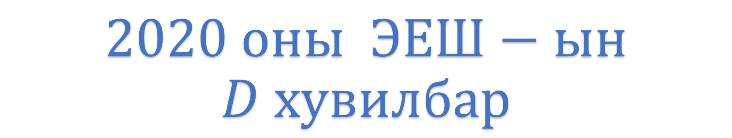
$$2020 оны ЭЕШ−ын$$
$$D хувилбар$$

Slide 2
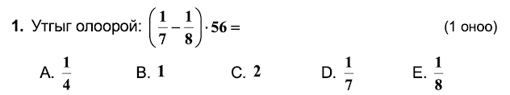
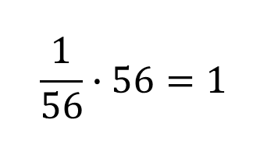
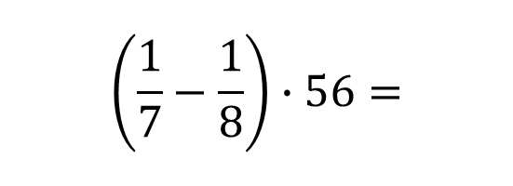

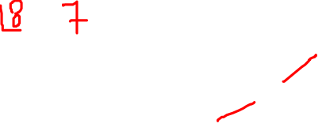

$$\left(\frac{1}{7}−\frac{1}{8}\right)∙56=$$
$$\frac{1}{56}∙56=1$$
$$Бодолт$$
$$B$$

Slide 3
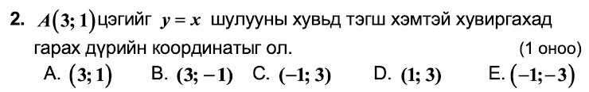
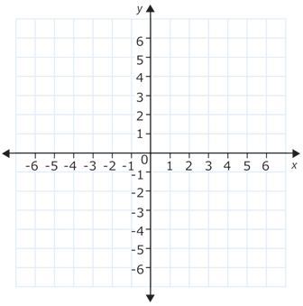




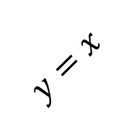

$$Бодолт$$
$$y=x$$
$$A^{′}(1;3)$$
$$D$$
$$A(3;1)$$

Slide 4
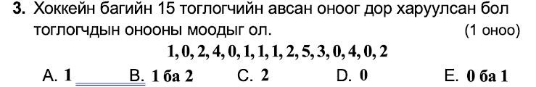



$$Бодолт$$
$$Хамгийн их давтагдсан цифрийг моод гэнэ.$$
$$моод⇒0 ба 1$$
$$E$$

Slide 5
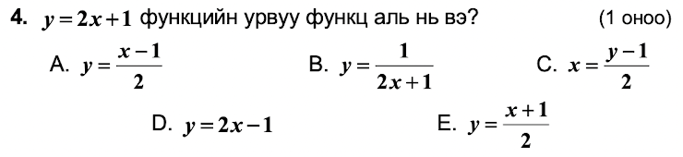
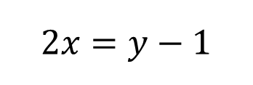
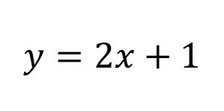
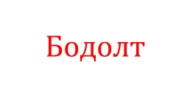

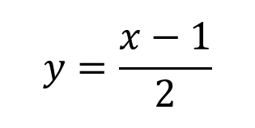
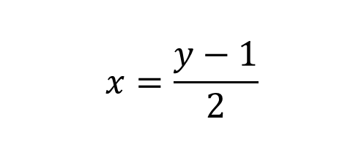
$$Бодолт$$
$$y=2x+1$$
$$2x=y−1$$
$$x=\frac{y−1}{2}$$
$$y=\frac{x−1}{2}$$
$$A$$

Slide 6
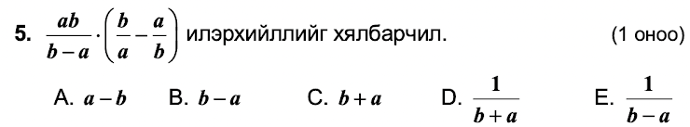
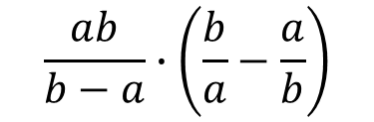

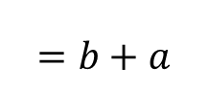

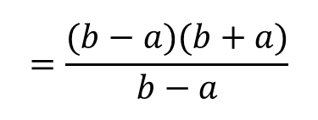
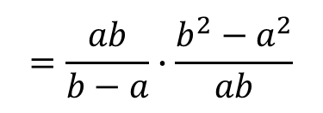
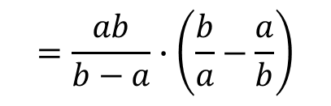
$$Бодолт$$
$$=\frac{ab}{b−a}∙\left(\frac{b}{a}−\frac{a}{b}\right)$$
$$=\frac{ab}{b−a}∙\frac{b^{2}−a^{2}}{ab}$$
$$=\frac{(b−a)(b+a)}{b−a}$$
$$=b+a$$
$$\frac{ab}{b−a}∙\left(\frac{b}{a}−\frac{a}{b}\right)$$
$$C$$

Slide 7
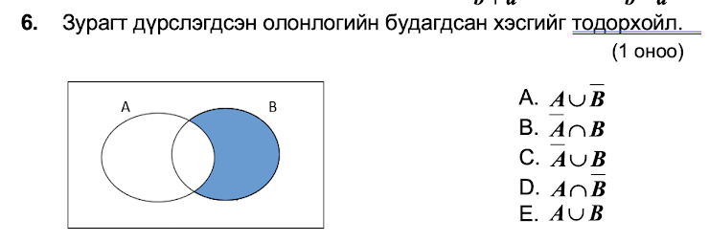

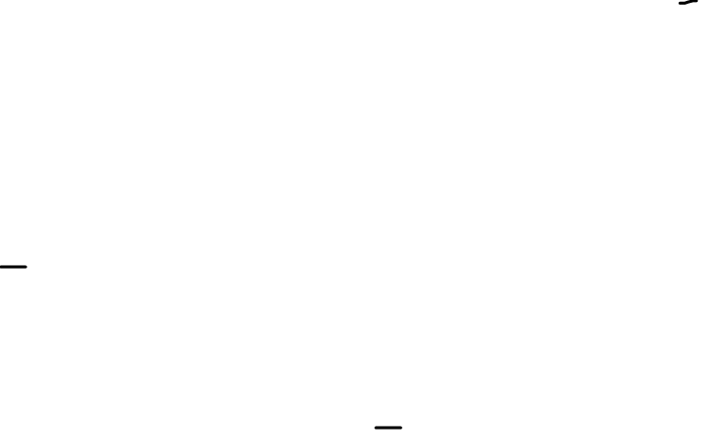





$$A∪B$$
$$B$$
$$A∩B$$
$$\overline{A}$$
$$\overline{A}∩B$$
$$B$$

Slide 8

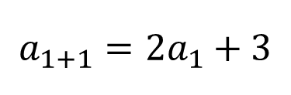

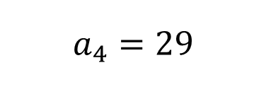
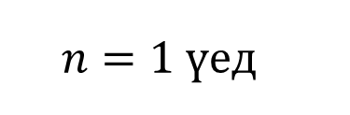
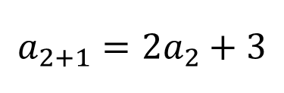

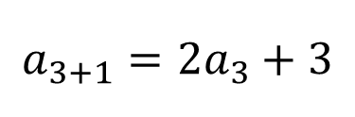

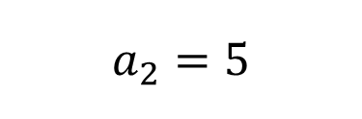
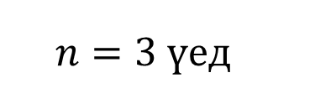
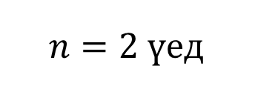


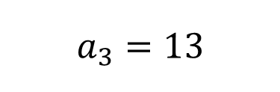
$$Бодолт$$
$$n=1 үед$$
$$a_{1+1}=2a_{1}+3$$
$$=2∙1+3=5$$
$$a_{2}=5$$
$$n=2 үед$$
$$a_{2+1}=2a_{2}+3$$
$$a_{3}=13$$
$$=2∙5+3=13$$
$$n=3 үед$$
$$a_{3+1}=2a_{3}+3$$
$$=2∙13+3=29$$
$$a_{4}=29$$
$$D$$

Slide 9
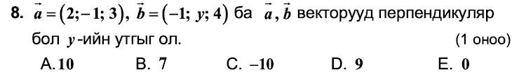
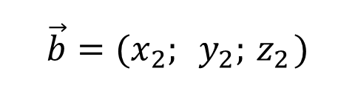
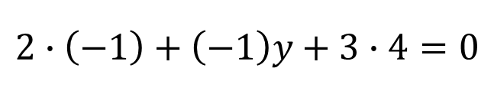
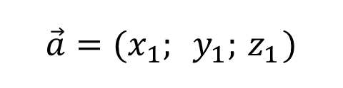
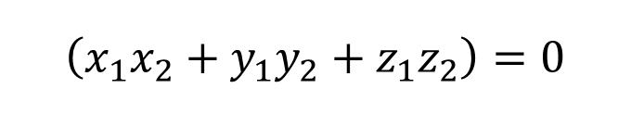


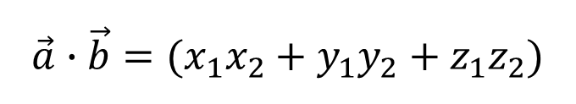

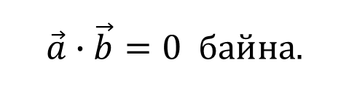


$$Бодолт$$
$$\vec{a}=(x_{1}; y_{1};{ z}_{1})$$
$$\vec{b}=(x_{2}; y_{2};{ z}_{2})$$
$$\vec{a}⊥\vec{b} бол$$
$$\vec{a}∙\vec{b}=0 байна.$$
$$\vec{a}∙\vec{b}=(x_{1}x_{2}+y_{1}y_{2}+z_{1}z_{2})$$
$$\left(x_{1}x_{2}+y_{1}y_{2}+z_{1}z_{2}\right)=0$$
$$2∙\left(−1\right)+\left(−1\right)y+3∙4=0$$
$$−2−y+12=0$$
$$y=−10$$
$$C$$

Slide 10
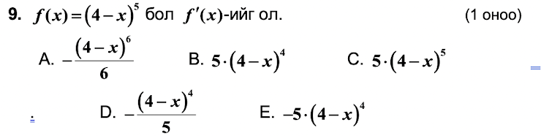
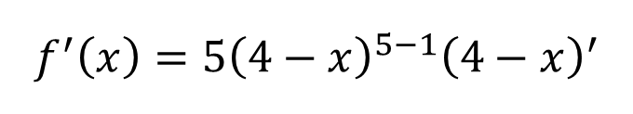
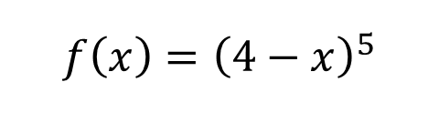



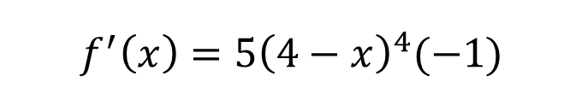
$$f\left(x\right)={\left(4−x\right)}^{5}$$
$$Бодолт$$
$$f^{′}\left(x\right)={5\left(4−x\right)}^{5−1}{\left(4−x\right)}^{′}$$
$$f^{′}\left(x\right)={5\left(4−x\right)}^{4}(−1)$$
$$f^{′}\left(x\right)={−5\left(4−x\right)}^{4}$$
$$E$$

Slide 11
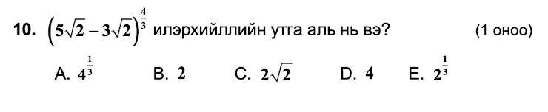
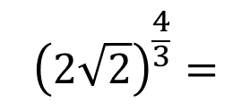

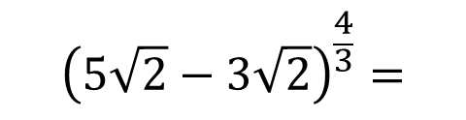
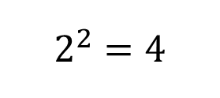

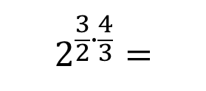
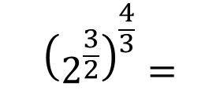
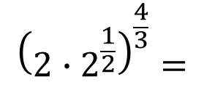
$$Бодолт$$
$${\left(5\sqrt{2}−3\sqrt{2}\right)}^{\frac{4}{3}}=$$
$${\left(2\sqrt{2}\right)}^{\frac{4}{3}}=$$
$${\left(2∙2^{\frac{1}{2}}\right)}^{\frac{4}{3}}=$$
$${\left(2^{\frac{3}{2}}\right)}^{\frac{4}{3}}=$$
$$2^{\frac{3}{2}∙\frac{4}{3}}=$$
$$2^{2}=4$$
$$D$$

Slide 12








$$a=−\frac{1}{2}$$
$$b=\frac{1}{2}$$
$$Бодолт$$
$$\frac{1}{a}=−2$$
$$<$$
$$−b=−\frac{1}{2}$$
$$C$$

Slide 13






$$Бодолт$$
$$\frac{1}{2}x^{2}=\frac{1}{2}∙0^{2}=0$$
$$\frac{1}{2}x+1=\frac{1}{2}∙6+1=4$$
$$[0;4]$$
$$B$$

Slide 14














$$Бодолт$$
+$\left\{\begin{aligned}2^{x}+3^{y}=19 \\ 2^{x}−3^{y}=13\end{aligned}\right.$
$$2^{x}+3^{y}=19$$
$${2∙2}^{x}=32$$
$$2^{4}+3^{y}=19$$
$$2^{x+1}=2^{5}$$
$$16+3^{y}=19$$
$$x+1=5$$
$$3^{y}=3$$
$$x=4$$
$$y=1$$
$$x∙y=4∙1=4$$
$$D$$

Slide 15







$$\sqrt{b\left(\sqrt{a}+\sqrt{a−b}\right)\left(\sqrt{a}−\sqrt{a−b}\right)}=$$
$$Бодолт$$
$$=\sqrt{b\left({\left(\sqrt{a}\right)}^{2}−{\left(\sqrt{a−b}\right)}^{2}\right)}$$
$$=\sqrt{b\left(a−\left(a−b\right)\right)}$$
$$=\sqrt{b^{2}}=b$$
$$C$$

Slide 16

















$$y_{1}=3x+1$$
$$Бодолт$$
$$k_{1}=3$$
$$3x+1=0$$
$$x=−\frac{1}{3}$$
$$y_{1}=3x+1$$
$$Координатын эх (0; 0)$$
$$y_{2}=−\frac{1}{3}x$$
$$(x_{0};y_{0})$$
$$Хоёр шулуун ⊥байх нөхцөл k_{1}∙k_{2}=−1$$
$$3∙k_{2}=−1$$
$y−y_{0}=k\left(x−x_{0}\right) Шулууны тэгшитгэл$
$$k_{2}=−\frac{1}{3}$$
$$y−0=−\frac{1}{3}(x−0)$$
$$y=−\frac{1}{3}x$$
$$D$$

Slide 17























$$Бодолт$$
$$\left|x−2\right|=\left|x−3\right|+2$$
II. $x−2=−(x−3)+2$
$$x−2=0$$
$$x−3=0$$
$$x−2=−x+3+2$$
$$x=2$$
$$x=3$$
$$2x=7$$
$$I$$
$$II$$
$$III$$
$$x=\frac{7}{2}$$
$$C$$
$$2$$
$$3$$
I. $−\left(x−2\right)=−(x−3)+2$
III. $x−2=x−3+2$
$$∅$$
$$−x+2=−x+3+2$$
$$∅$$

Slide 18










$$Бодолт$$
$$\sin{α}$$
$$1$$
$$\sin{α}>cos{α}$$
$$B$$
$$−1$$
$$1$$
$$\cos{α}$$
$$−1$$

Slide 19














$A=\left(\begin{matrix}a & b \\ c & d\end{matrix}\right) 2x2 хэмжээст матрицын урвуу матриц нь$
$$A^{−1}=\frac{1}{|A|}\left(\begin{matrix}d & −b \\ −c & a\end{matrix}\right)$$
$$\left|A\right|=ad−cb$$
$$Бодолт$$
$$+\left(\begin{matrix}4 & 1 \\ 6 & 2\end{matrix}\right)$$
$$=\left(\begin{matrix}8 & −1 \\ −6 & 10\end{matrix}\right)$$
$$\left|A\right|=4∙2−1∙6=2$$
$${4A}^{−1}+A=$$
$$\left(\begin{matrix}4 & −2 \\ −12 & 8\end{matrix}\right)$$
$$A^{−1}=\frac{1}{2}\left(\begin{matrix}2 & −1 \\ −6 & 4\end{matrix}\right)$$
$$D$$
$${4A}^{−1}=4∙\frac{1}{2}\left(\begin{matrix}2 & −1 \\ −6 & 4\end{matrix}\right)$$
$$=\left(\begin{matrix}4 & −2 \\ −12 & 8\end{matrix}\right)$$

Slide 20















$$Бодолт$$
$$ax^{3}+bx^{2}+cx+d=0$$
$$:a$$
$${f\left(x\right)=x}^{3}+mx^{2}−x+3$$
$$x^{3}+\frac{b}{a}x^{2}+\frac{c}{a}x+\frac{d}{a}=0$$
$$x_{1}=3$$
$${f\left(3\right)=3}^{3}+m∙3^{2}−3+3=0$$
$$\left\{\begin{aligned}x_{1}+x_{2}+x_{3}=−\frac{b}{a} \\ x_{1}x_{2}+x_{1}x_{3}+x_{2}x_{3}=\frac{c}{a} \\ x_{1}x_{2}x_{3}=−\frac{d}{a}\end{aligned}\right.$$
$$27+9m=0$$
$$m=−3$$
$$x^{3}−3x^{2}−x+3=0$$
$$x_{1}+x_{2}+x_{3}=3$$
$$B$$
$$Виетийн теорем$$

Slide 21



$$Бодолт$$
$$E$$

Slide 22










$$Бодолт$$
$$\int_{0}^{3}{\left(f\left(x\right)+4x+1\right)dx=}$$
$$\int_{0}^{3}{f\left(x\right)dx+\int_{0}^{3}{(4x+1)dx}=}$$
$$4$$
$$\left(\frac{4x^{2}}{2}+x\right){\left.​\right|}_{0}^{3}$$
$$+$$
$$4+{\left(2x^{2}+x\right) |}_{0}^{3}=$$
$$4+\left(\left(2∙3^{2}+3\right)−\left(2∙0^{2}−0\right)\right)=25$$
$$A$$

Slide 23











$$3,1,5⇒135$$
$$5!=1∙2∙3∙4∙5$$
$$Бодолт$$
$$2,5,1⇒125$$
$$5!=3!∙4∙5$$
$$4,5,3⇒345$$
$$=\frac{4∙5}{1∙2}$$
$$=10$$
$$C_{5}^{3}=\frac{5!}{3!\left(5−3\right)!}$$
$$=\frac{3!∙4∙5}{3!2!}$$
$$E$$

Slide 24
















$$α+γ={180}^{0}$$
$$Бодолт$$
$$\frac{α}{2}+\frac{γ}{2}={90}^{0}$$
$$B$$
$$C$$
$$β$$
$$R=5$$
$$AB=2R=10$$
$$O$$
$$K$$
$$A$$
$$R=5$$
$$α$$
$$A$$
$$D$$

Slide 25




















$$a_{5}=5a_{1}$$
$$Бодолт$$
$$α+4d=5α$$
$$4d=4α$$
$$a_{5}=α+4d$$
$$a_{1}=α$$
$$d=α$$
$$a_{4}=α+3d$$
$$O$$
$$a_{1}+a_{2}+a_{3}+a_{4}+a_{5}={360}^{0}$$
$$a_{2}=α+d$$
$$α+α+d+α+2d+α+3d+α+4d={360}^{0}$$
$$a_{3}=α+2d$$
$$5α+10d={360}^{0}$$
$$5α+10α={360}^{0}$$
$$15α={360}^{0}$$
$$a_{5}={24}^{0}+4∙{24}^{0}$$
$$α={24}^{0}$$
$$a_{5}={120}^{0}$$
$$B$$

Slide 26



















$$S_{1}=S_{AOPB}−S_{2}$$
$$S_{1}=a^{7}−\frac{a^{7}}{7}=\frac{6a^{7}}{7}$$
$$S_{1}$$
$$S_{2}$$
$$a^{6}$$
$$y=0$$
$$\frac{S_{1}}{S_{2}}=\frac{\frac{6a^{7}}{7}}{\frac{a^{7}}{7}}$$
$$(a;0)$$
$$=6:1$$
$$a$$
$$=\frac{6}{1}$$
$$S_{AOBP}=a∙a^{6}=a^{7}$$
$$D$$
$$Бодолт$$
$$S_{2}=$$
$$\frac{x^{7}}{7}{\left.​\right|}_{0}^{a}=$$
$$\int_{0}^{a}{\left(x^{6}−0\right)dx}=$$
$$\left(\frac{a^{7}}{7}−\frac{0^{7}}{7}\right)=\frac{a^{7}}{7}$$

Slide 27




$$Бодолт$$
$$E$$
$${Координатын эх дээр төвтэй цагийн зүүний эсрэг 90}^{0} өнцгөөр эргүүлэхэд хувиргалтын матриц$$
$$\left({0 −1 \atop 1 0}\right)$$

Slide 28








$$x≥m \left\{\begin{aligned}x>m \\ x=m ХБУ \end{aligned}\right.$$
$$Бодолт$$
$$f^{′}\left(x\right)=6x+6$$
$$6x+6=0$$
$$6x=−6$$
$$x=−1$$
$$m=−1$$
$$A$$

Slide 29



















$$Бодолт$$
$$2x^{3}+x^{2}−5x+2$$
$$2x^{2}−3x+1$$
$$−$$
$$x+2$$
$$2x^{3}+4x^{2}$$
$$2x^{2}$$
$$+1$$
$$2+(−3)+1=0$$
$$−3x$$
$$−3x^{2}$$
$$−5x$$
$$A$$
$$−$$
$$−3x^{2}−6x$$
$$x$$
$$+2$$
$$x+2$$

Slide 30









$$y=1+2cos{x}$$
$$y=\cos{x}$$
$$y=2cos{x}$$
$$Бодолт$$
$$y=a+b∙\cos{x}$$
$$y=1+2∙cos{x}$$
$$a∙b=1∙2=2$$
$$C$$

Slide 31



















$$Бодолт$$
$$\frac{3x+2}{x^{2}(x+1)}=$$
$$\frac{A}{x}+\frac{B}{x^{2}}+\frac{C}{x+1}=$$
$$\frac{Ax(x+1)}{x}+\frac{B(x+1)}{x^{2}}+\frac{Cx^{2}}{x+1}=$$
$$0$$
$$3$$
$$2$$
$$=\frac{Ax^{2}+Ax+Bx+B+Cx^{2}}{x^{2}(x+1)}$$
$$=\frac{x^{2}(A+C)+x(A+B)+B}{x^{2}(x+1)}$$
$$B=2$$
$$A+C=0$$
$$A+B=3$$
$$1+C=0$$
$$C=−1$$
$$A+2=3$$
$$A=1$$
$$A+B+C=1+2−1=2$$
$$B$$

Slide 32




















$$(x;y)$$
$$Бодолт$$
$$y=3x+1$$
$$4y=x+15$$
$$y=\frac{x}{4}+\frac{15}{4}$$
$$(1;4)$$
$$3x+1=\frac{x}{4}+\frac{15}{4}$$
$$\frac{x+1}{2}=6.5$$
$$\frac{y+4}{2}=7.5$$
$$12x+4=x+15$$
$$x+1=13$$
$$y+4=15$$
$$11x=11$$
$$x=12$$
$$y=11$$
$$x=1$$
$$y=3x+1=3∙1+1=4$$
$$C(12;11)$$
$$B$$

Slide 33






$$Бодолт$$
$$\overline{x}=\frac{\frac{1+5}{2}∙6+\frac{6+8}{2}∙10+\frac{9+11}{2}∙4}{6+10+4}$$
$$=\frac{18+70+40}{20}$$
$$=\frac{128}{20}=6.4$$
$$A$$

Slide 34






















$$C_{n}^{1}=n$$
$$Бодолт$$
$$A$$
$$2, 5, 7,9$$
$$B$$
1, $3,6,9,9$
$$C$$
$$9,8,9,9,9$$
$n=C_{4}^{1}{∙C}_{5}^{1}$ ${∙C}_{5}^{1}=4∙5∙5=100$
$$C_{4}^{1}=4$$
$$C_{5}^{1}=5$$
$$C_{5}^{1}=5$$
$m=C_{1}^{1}{∙C}_{2}^{1}$ ${∙C}_{1}^{1}$
$+C_{3}^{1}{∙C}_{2}^{1}$ ${∙C}_{4}^{1}$
$+C_{1}^{1}{∙C}_{3}^{1}$ ${∙C}_{4}^{1}$
$$=1∙2∙1+3∙2∙4+1∙3∙4=38$$
$$A B C$$
$$A B C$$
$$A B C$$
$$9 9 a$$
$$a 9 9$$
$$9 a 9$$
$$P=\frac{m}{n}=\frac{38}{100}=\frac{19}{50}$$
$$D$$

Slide 35



















$$:3π$$
$$Бодолт$$
$$r+h=6$$
$$3πr\left(4−r\right)=0$$
$$h=6−r$$
$$r_{2}=4$$
$$r_{1}=0$$
$$V=πr^{2}h$$
$r_{2}=4$ үед
$$h=6−r=6−4=2$$
$$V=πr^{2}(6−r)$$
$$V=6πr^{2}−πr^{3}$$
$$V=π{(4)}^{2}∙2=32π$$
$$C$$
$$V^{′}(r)=12πr−3πr^{2}$$
$$12πr−3πr^{2}=0$$
$$3πr\left(4−r\right)=0$$

Slide 36






















$$MP=x$$
$$\frac{MP}{PO}=\frac{1}{2}$$
$$PO=2x$$
$$Бодолт$$
$$OM=3x$$
$$\vec{\frac{b}{2}}$$
$$\vec{OM}=\vec{AO}+\vec{AM}$$
$${45}^{0}$$
$$MP=x$$
$${45}^{0}$$
$$\vec{OM}=\vec{a}+\vec{\frac{b}{2}}$$
$$\vec{a}+\vec{\frac{b}{2}}=3x$$
$$PO=2x$$
$$x=\frac{\vec{a}}{3}+\vec{\frac{b}{6}}$$
$$∆OAM гурвалжны хувьд AP биссектрис$$
$$x=\frac{2\vec{a}+\vec{b}}{6}$$
$$\frac{MP}{PO}=\frac{AM}{AO}$$
$$=\frac{1}{2}$$
$$=\frac{AM}{2AM}$$
$$MP=\frac{2\vec{a}+\vec{b}}{6}$$
$$D$$

Slide 37

















$$Бодолт$$
$$y=ax^{2}$$
$$y=ax+1$$
$$ax^{2}=ax+1$$
$$ax^{2}−ax−1=0$$
$$D>0 үед 2 язгууртай$$
+
-
+
$$−∞$$
$$−4$$
$$0$$
$$+∞$$
$$a^{2}+4a>0$$
$$a∈]−∞;−4[∪]0; +∞[$$
$$E$$
$$a(a+4)>0$$
$$a_{1}=0$$
$$a_{2}=−4$$

Slide 38

2020 оны ЭЕШ материалын D хувилбар Нөхөх даалгавар

Slide 39































$$S_{2}=xy$$
$$y$$
$$x$$
$$S_{1}=2y∙4x=8xy$$
$$a=8; b=6$$
$$S=12(4x−x^{2})$$
$$Бодолт$$
$$+y$$
$$+3y$$
$$+4x$$
$$S=−12(x^{2}−4x)$$
$$P=2y$$
$$+3x$$
$$+x$$
$$=8x+6y=32$$
$$S=S_{1}+S_{2}=$$
$$8xy+xy=9xy$$
$$8x+6y=32$$
$$S=−12(x^{2}−4x+4−4)$$
$$S=9xy=$$
$$6y=32−8x$$
$$S=−12\left({\left(x−2\right)}^{2}−4\right)$$
$$9x\left(\frac{16}{3}−\frac{4x}{3}\right)$$
$$y=\frac{16}{3}−\frac{4x}{3}$$
$$S=−12{\left(x−2\right)}^{2}+48$$
$$S=48x−12x^{2}$$
$$S=12(4x−x^{2})$$
$$c=4$$
$$S=48−12{\left(2−x\right)}^{2}$$
$$d=4; e=8; f=2$$

Slide 40









$$0$$
$$2−x=0$$
$$x=2$$
$$S_{ХИУ}=48$$
$$S=9xy=48$$
$$9∙2∙y=48$$
$$y=\frac{48}{9∙2}$$
$$y=\frac{8}{3}$$
$$g=8$$

Slide 41


$$Бодолт$$

Slide 42

























$$DM^{2}=x^{2}+3^{2}$$
$$DM=\sqrt{x^{2}+9}$$
$$a=9$$
$$u_{1}=4км/ц$$
$$S_{1}=\sqrt{x^{2}+9}$$
$$t_{1}=\frac{S_{1}}{u_{1}}=\frac{\sqrt{x^{2}+9}}{4}$$
$$t\left(x\right)=\frac{\sqrt{x^{2}+9}}{4}+\frac{5−x}{5}$$
$$u_{2}=5км/ц$$
$$S_{2}=5−x$$
$$t_{2}=\frac{S_{2}}{u_{2}}=\frac{5−x}{5}$$
$$t\left(x\right)=\frac{1}{4}\sqrt{x^{2}+9}+1−\frac{x}{5}$$
$$\frac{5x−4\sqrt{x^{2}+9}}{20\sqrt{x^{2}+9}}=0$$
$$t^{′}\left(x\right)=\frac{2x}{4∙2\sqrt{x^{2}+9}}−\frac{1}{5}$$
$$16(x^{2}+9)={25x}^{2}$$
$$5x−4\sqrt{x^{2}+9}=0$$
$$16x^{2}+16∙9={25x}^{2}$$
$$t^{′}\left(x\right)=\frac{10x−8\sqrt{x^{2}+9}}{40\sqrt{x^{2}+9}}$$
$$4\sqrt{x^{2}+9}=5x$$
$$−9x^{2}=−16∙9$$
$${\left(4\sqrt{x^{2}+9}\right)}^{2}={(5x)}^{2}$$
$$x^{2}=16$$
$$t^{′}\left(x\right)=\frac{5x−4\sqrt{x^{2}+9}}{20\sqrt{x^{2}+9}}$$
$$x_{2}=4$$
$$x_{1}=−4 ∅$$
$$b=5; c=4$$

Slide 43
















$$x=4$$
$$\left[0;5\right] завсар$$
$$d=4$$
$$t\left(x\right)=\frac{\sqrt{x^{2}+9}}{4}+\frac{5−x}{5}$$
$$=1\frac{3}{4}=1.75$$
$$t\left(0\right)=\frac{\sqrt{0^{2}+9}}{4}+\frac{5−0}{5}$$
$$=\frac{3}{4}+1$$
$$f=5$$
$$t\left(4\right)=\frac{\sqrt{4^{2}+9}}{4}+\frac{5−4}{5}$$
$$=\frac{5}{4}+\frac{1}{5}$$
$$=\frac{29}{20}=1.45$$
$$e=5$$
$$t\left(5\right)=\frac{\sqrt{5^{2}+9}}{4}+\frac{5−5}{5}$$
$$=\frac{\sqrt{34}}{4}$$
$$=\frac{1}{4}\sqrt{34}$$
$$g=3$$

Slide 44













$$Бодолт$$
$$56−60=−4$$
$$a=3$$
$$\sum{\left(x−60\right)=}$$
$$−2+\left(−11\right)+\left(−4\right)+\left(−5\right)+8+1+\left(−3\right)+1+\left(−8\right)+3$$
$$=−20$$
$$b=0$$
$$\sum{{\left(x−60\right)}^{2}=}$$
$${\left(−2\right)}^{2}+{\left(−11\right)}^{2}+{\left(−4\right)}^{2}+{\left(−5\right)}^{2}+8^{2}+1^{2}+{\left(−3\right)}^{2}+1^{2}+{\left(−8\right)}^{2}+3^{2}$$
$$c=3$$
$$=314$$
$$\overline{x}=\frac{\sum{\left(x−60\right)+10∙60}}{10}$$
$$=\frac{−20+600}{10}=58$$
$$d=5; e=8$$

Slide 45






$$С.Х=\sqrt{\frac{\sum{y^{2}}}{n}−{\left(\overline{y}\right)}^{2}}=$$
$$\sqrt{\frac{314}{10}−{\left(58−60\right)}^{2}}=$$
$$\sqrt{\frac{314}{10}−4}=$$
$$\sqrt{\frac{274}{10}}$$
$$f=2; g=7$$

Slide 46















$$Бодолт$$
$${30}^{0}$$
$${45}^{0}$$
$$4\sqrt{2}$$
$$4\sqrt{2}$$
$$\frac{AE}{\sin{{45}^{0}}}=2R$$
$$b=6$$
$$S_{ABE}=S_{1}=\frac{4\sqrt{2}∙4\sqrt{2}}{2}=16$$
$$AE=2Rsin{45}^{2}$$
$${∡BDE=90}^{0}$$
$$c=9$$
$$AE=2∙4∙\frac{\sqrt{2}}{2}$$
$$AE=4\sqrt{2}$$
$$a=2$$

Slide 47




























$${120}^{0}$$
$${60}^{0}$$
$$R=4$$
$$2$$
$$BD=4\sqrt{3}$$
$$d=3$$
$$c$$
$$2\sqrt{3}$$
$${60}^{0}$$
$$\frac{c}{2}$$
$$2\sqrt{3}$$
$$ED=4$$
$$e=4$$
$${30}^{0}$$
$${30}^{0}$$
$${45}^{0}$$
$$S_{DBE}=S_{2}=\frac{4∙4\sqrt{3}}{2}=8\sqrt{3}$$
$$\frac{c\sqrt{3}}{2}$$
$$4\sqrt{2}$$
$$8$$
$$4$$
$$d=3$$
$${60}^{0}$$
$$CF=2$$
$$f=2$$
$$4\sqrt{2}$$
$$S_{CBE}=S_{3}=\frac{2∙4\sqrt{3}}{2}=4\sqrt{3}$$
$$g=3$$
$$S={S_{1}+S_{2}+S}_{3}=16+8\sqrt{3}+4\sqrt{3}=16+12\sqrt{3}$$

