Slide 1
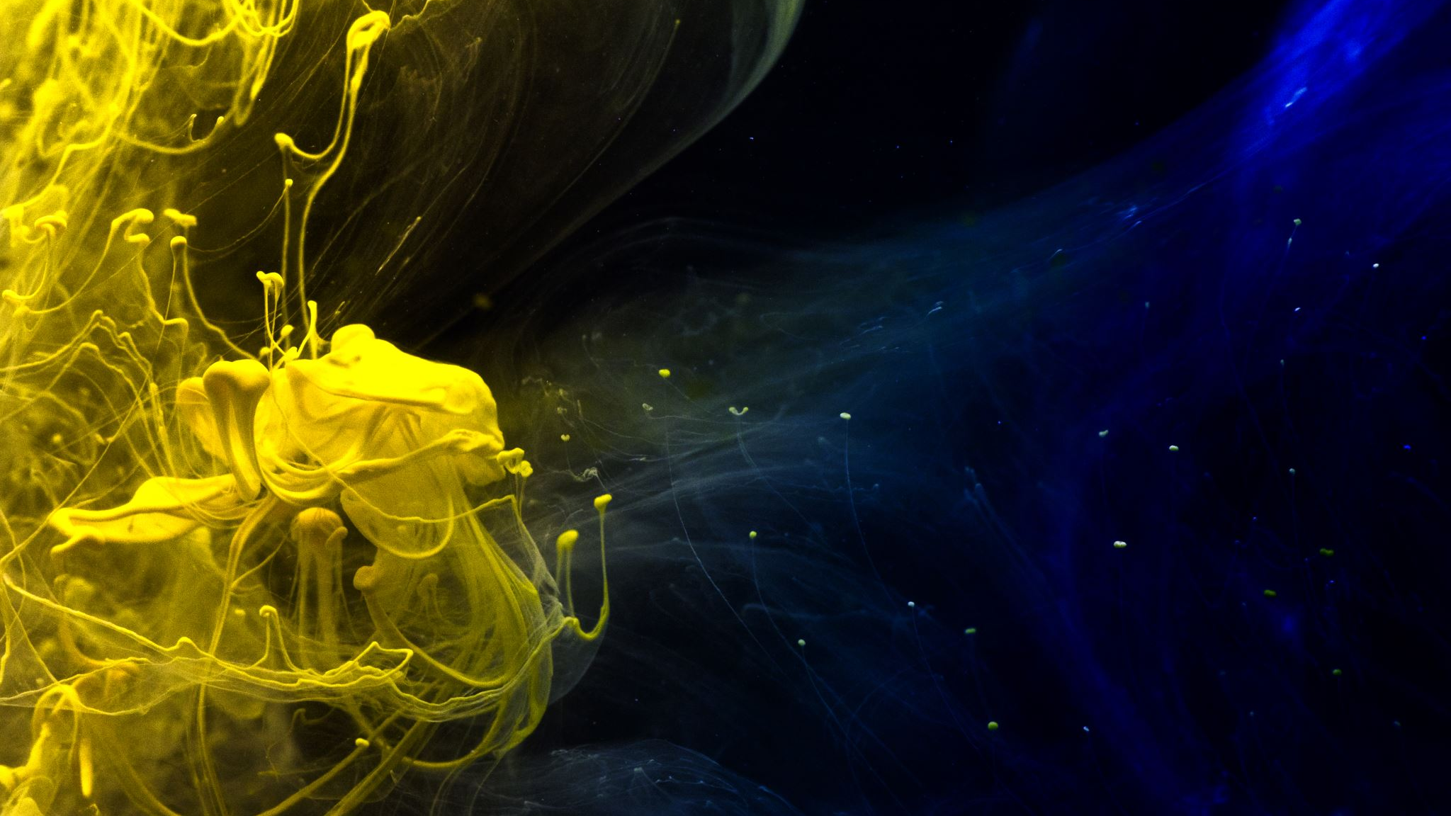
2021 оны ЭЕШ-ын А хувилбар

Slide 2

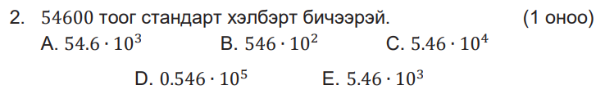








$$Сонгох тест$$
$$Бодолт$$
$$6.7≈7$$
$$A$$
$$Бодолт$$
$$54600=$$
$$5.46∙{10}^{4}$$
$$C$$

Slide 3
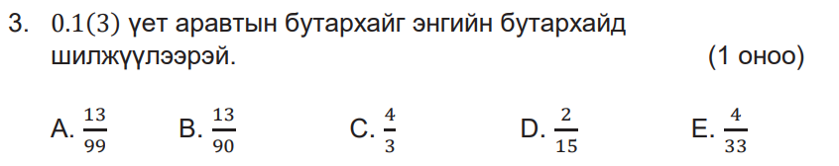


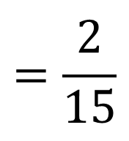





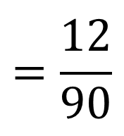
$$Бодолт$$
$$=\frac{12}{90}$$
$$2$$
$$=\frac{2}{15}$$
$$13−1$$
$$0.1\left(3\right)=$$
$$D$$
$$90$$
$$15$$

Slide 4
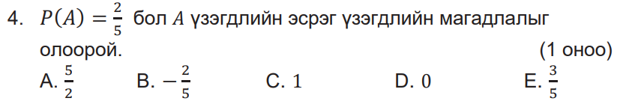

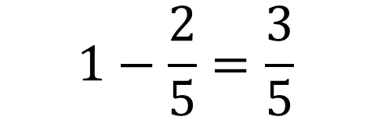

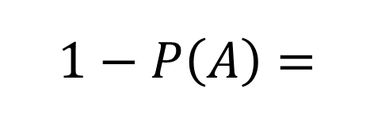
$$Бодолт$$
$$1−P\left(A\right)=$$
$$1−\frac{2}{5}=\frac{3}{5}$$
$$E$$

Slide 5
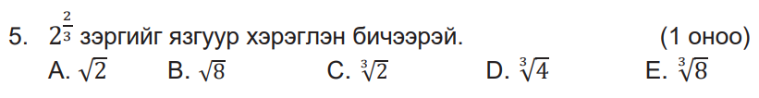


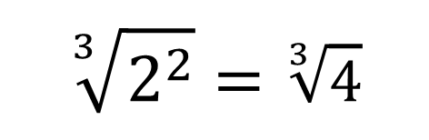


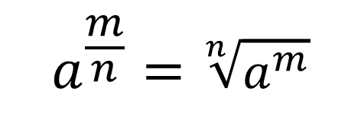
$$Бодолт$$
$$Ашиглах томьёо$$
$$a^{\frac{m}{n}}=\sqrt[n]{a^{m}}$$
$$2^{\frac{2}{3}}=$$
$$\sqrt[3]{2^{2}}=\sqrt[3]{4}$$
$$D$$

Slide 6
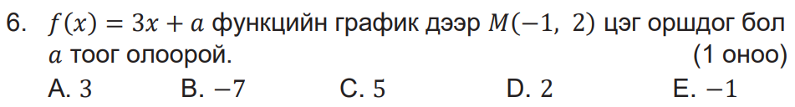
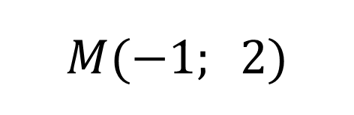


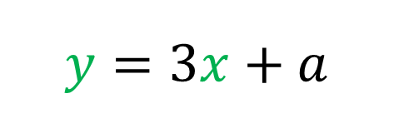
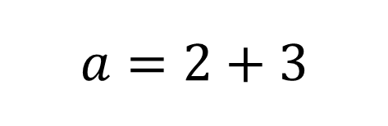
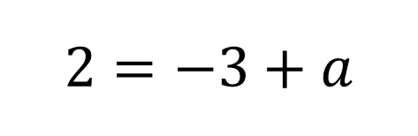

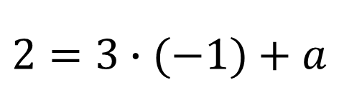
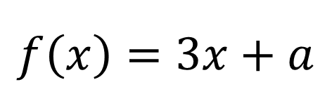

$$f\left(x\right)=3x+a$$
$$Бодолт$$
$$y=3x+a$$
$$(x; y)$$
$$M(−1; 2)$$
$$2=3∙(−1)+a$$
$$2=−3+a$$
$$a=2+3$$
$$a=5$$
$$C$$

Slide 7
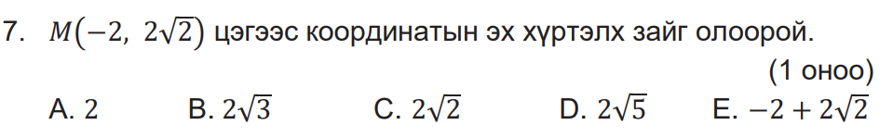
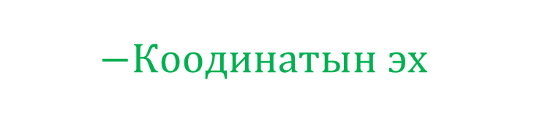
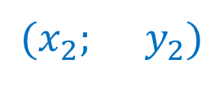
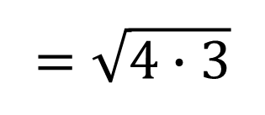

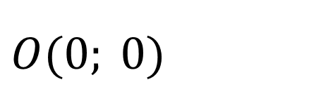

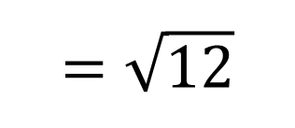
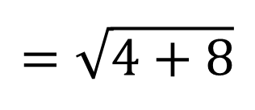
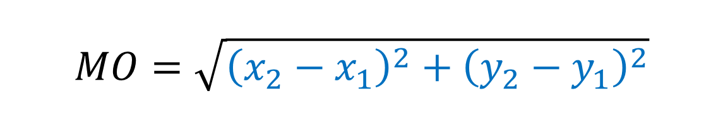
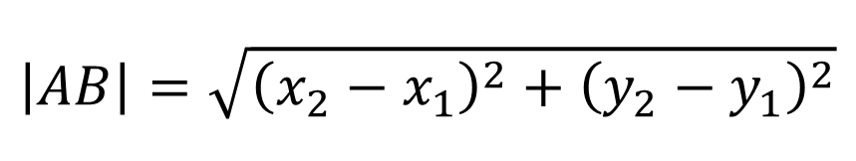
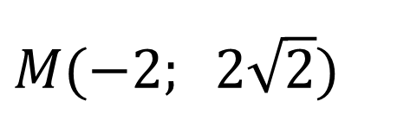
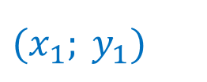

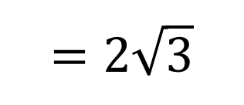


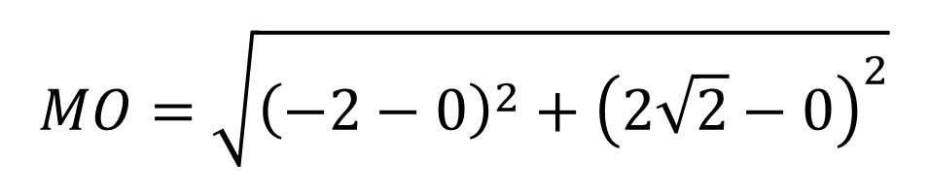
$$Бодолт$$
$(x_{2}; y_{2})$
$M(−2; 2\sqrt{2})$
$$Ашиглах томьёо$$
$$A\left(x_{1}; y_{1}\right) ба B\left(x_{2};y_{2} \right) бол$$
$(x_{1}; y_{1})$
$$−Коодинатын эх$$
$O(0; 0)$
$$\left|AB\right|=\sqrt{{\left(x_{2}−x_{1}\right)}^{2}+{\left(y_{2}−y_{1}\right)}^{2}}$$
$$Хоёр цэгийн хоорондох$$
$$зайг олох томьёо$$
$$MO=\sqrt{{\left(x_{2}−x_{1}\right)}^{2}+{\left(y_{2}−y_{1}\right)}^{2}}$$
$$MO=\sqrt{{\left(−2−0\right)}^{2}+{\left(2\sqrt{2}−0\right)}^{2}}$$
$$=\sqrt{4+8}$$
$$=\sqrt{12}$$
$$=\sqrt{4∙3}$$
$$=2\sqrt{3}$$
$$B$$

Slide 8
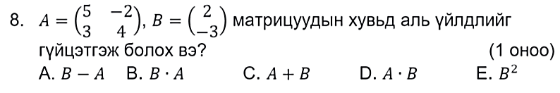
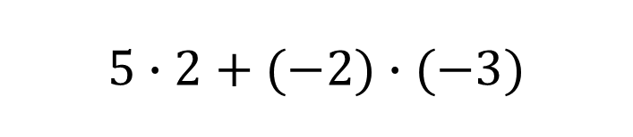
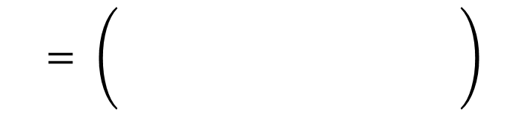

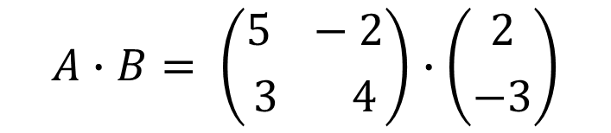
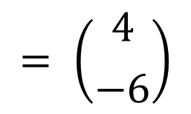


$$Бодолт$$
$$5∙2+(−2)∙(−3)$$
$$A∙B= \left({5 −2 \atop 3 4}\right)∙\left({2 \atop −3}\right)$$
$$= \left(\begin{aligned} \\ \\ \end{aligned}\right)$$
$$= \left({4 \atop −6}\right)$$
$$D$$
$$3∙2+4∙(−3)$$
$$мөр болон багананы тоо тэнцүү бол үржиж болно.$$

Slide 9
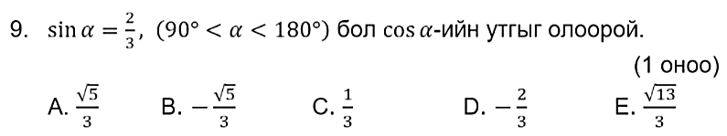
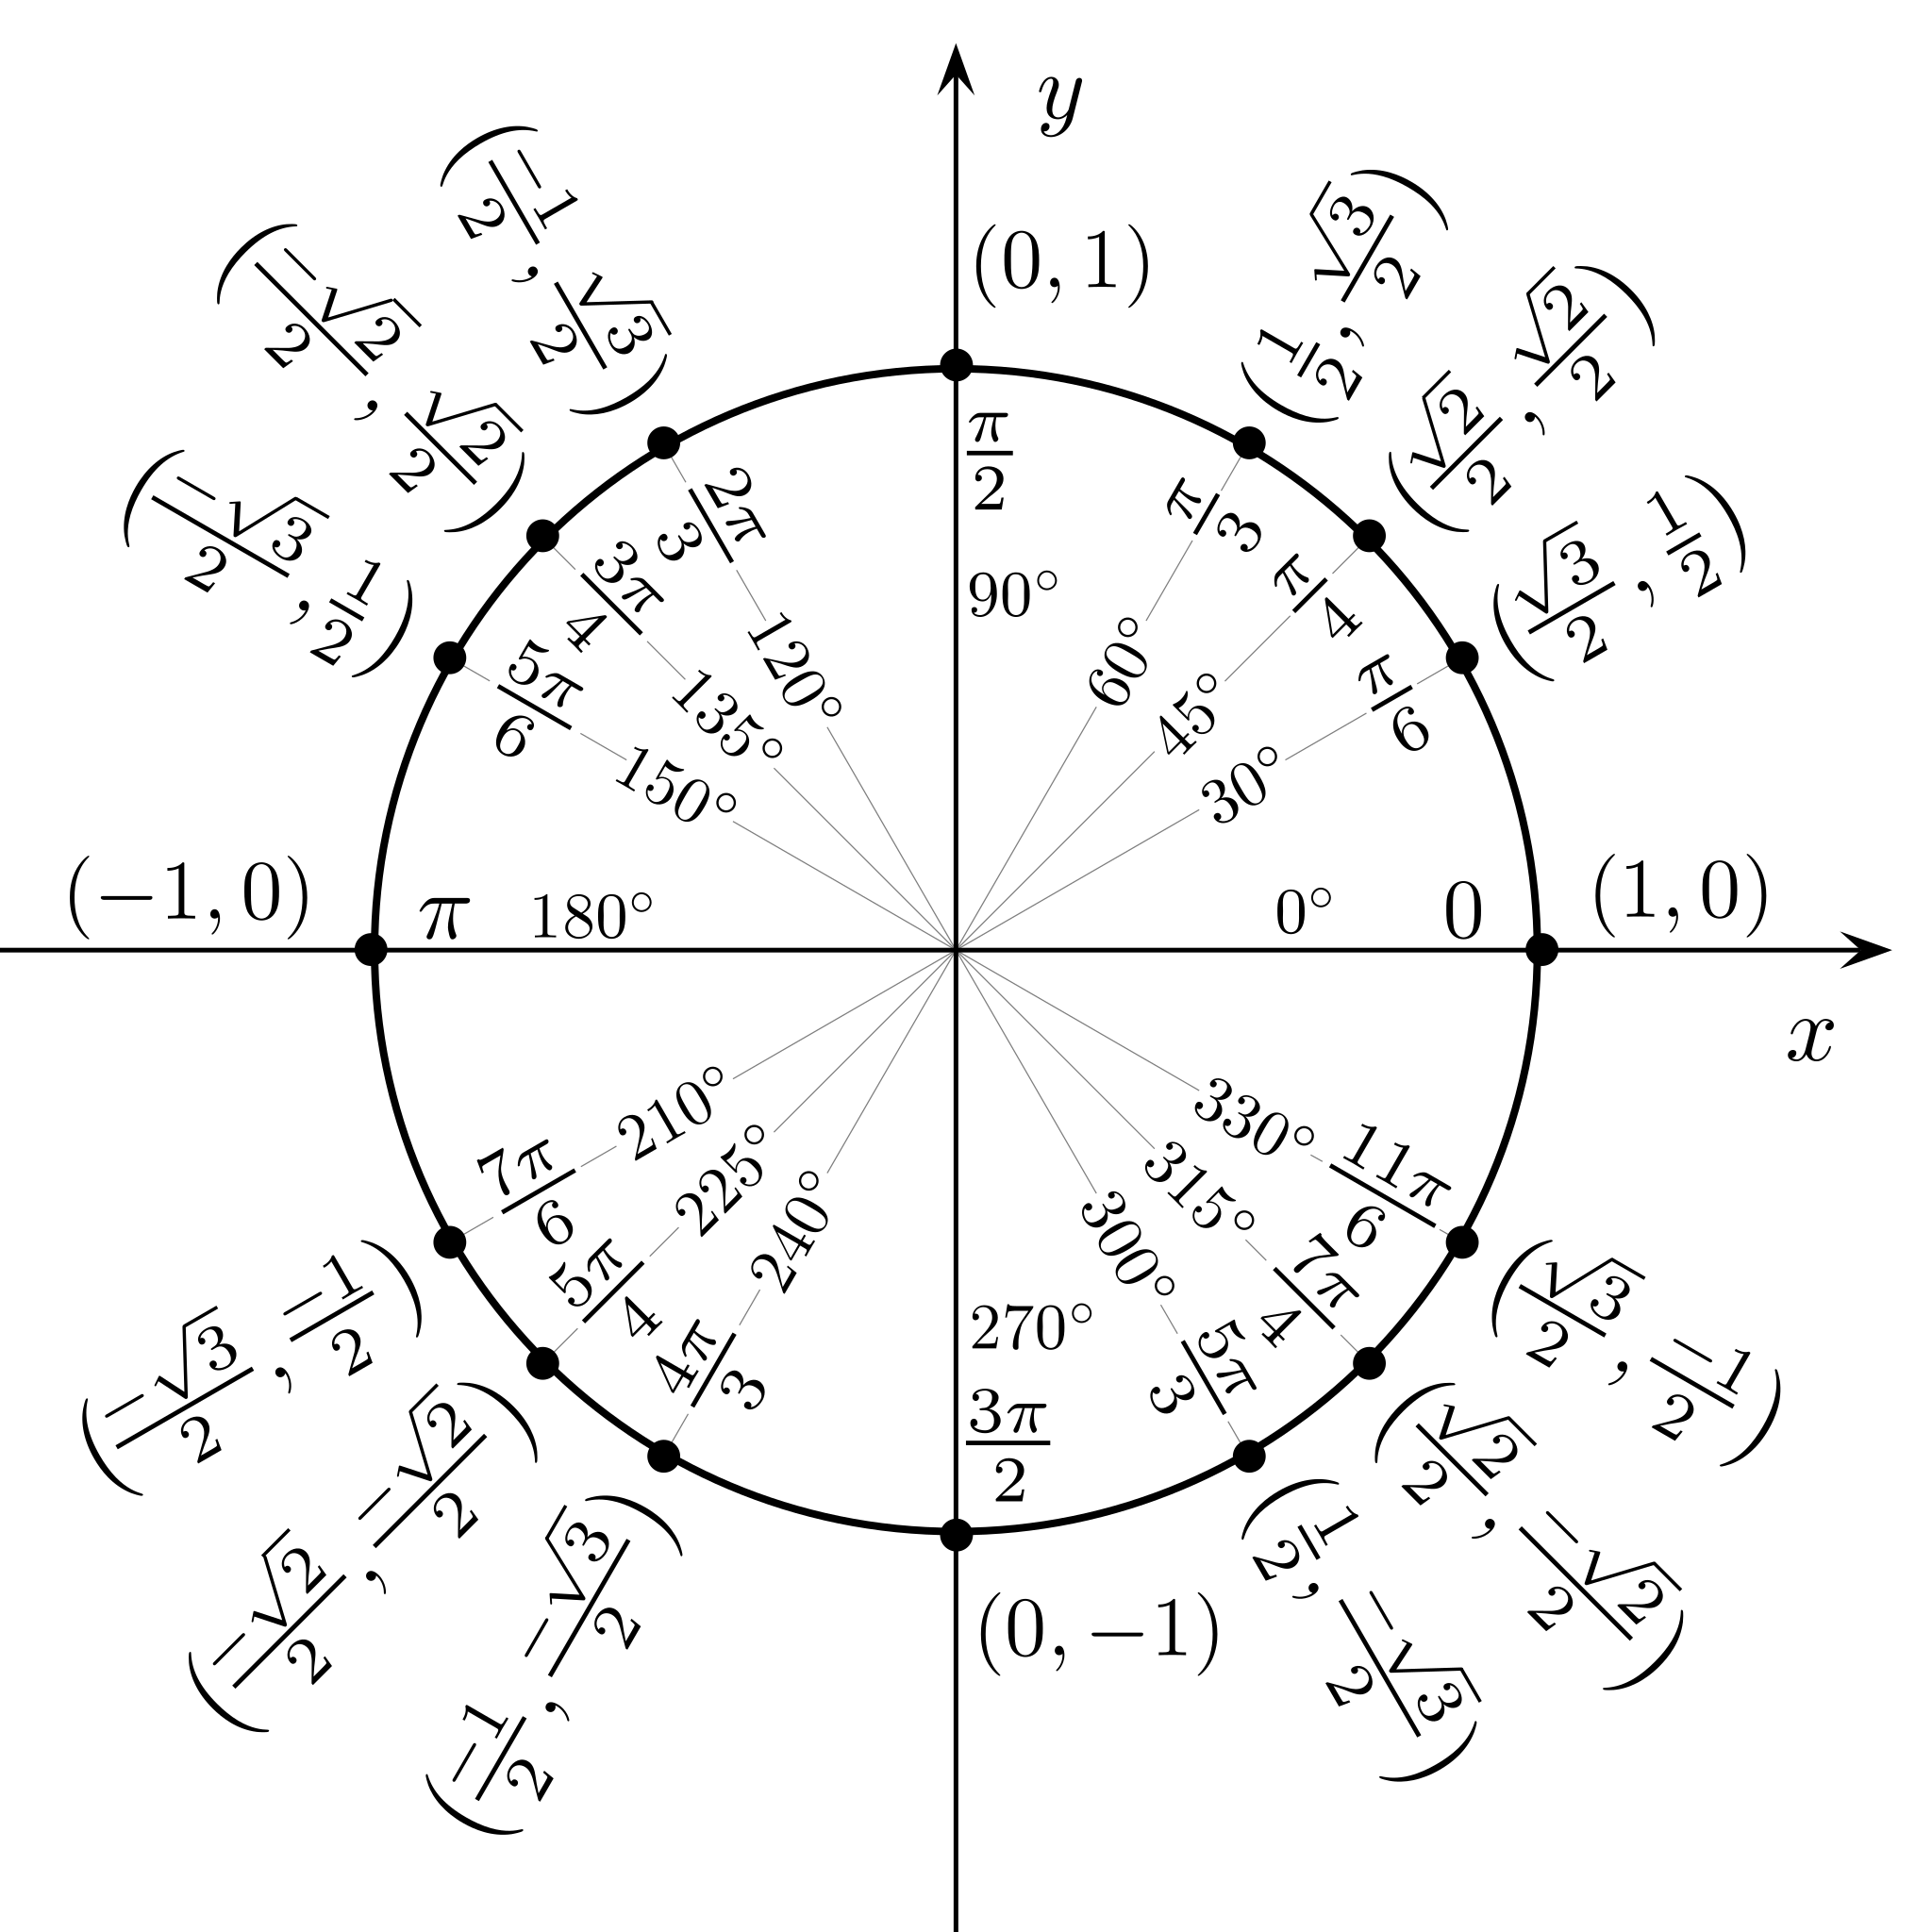
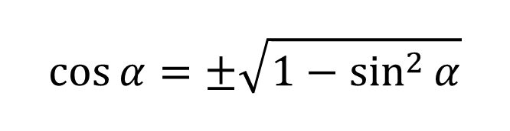
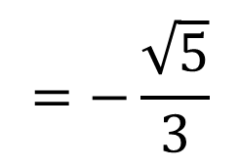
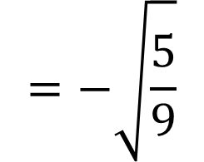

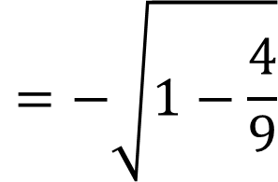

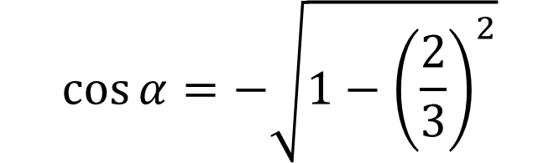


$$II мөч$$
$$Бодолт$$
$$Ашиглах томьёо$$
$$\cos{α=±\sqrt{1−\sin^{2}{α}}}$$
$$\cos{α=−\sqrt{1−{\left(\frac{2}{3}\right)}^{2}}}$$
$$\cos{α}→ −утгатай$$
$$=−\sqrt{1−\frac{4}{9}}$$
$$=−\sqrt{\frac{5}{9}}$$
$$=−\frac{\sqrt{5}}{3}$$
$$B$$

Slide 10
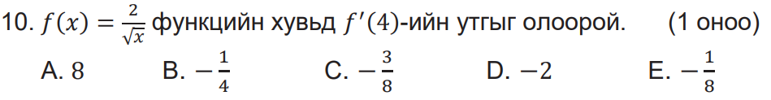
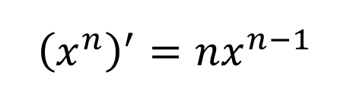
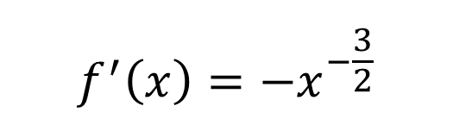
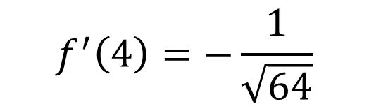

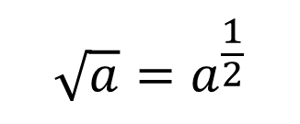
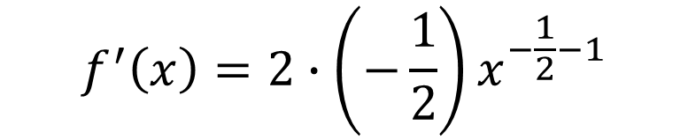
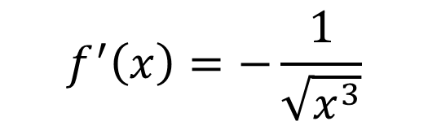











$$Бодолт$$
$$Ашиглах$$
$$томьёо$$
$$f\left(x\right)=\frac{2}{\sqrt{x}}$$
$$=2∙x^{−\frac{1}{2}}$$
$$=\frac{2}{x^{\frac{1}{2}}}$$
$$f^{′}\left(x\right)=−\frac{1}{\sqrt{x^{3}}}$$
$$\frac{1}{a^{n}}=a^{−n}$$
$$f\left(x\right)=2∙x^{−\frac{1}{2}}$$
$$\sqrt{a}=a^{\frac{1}{2}}$$
$$f^{′}\left(4\right)=−\frac{1}{\sqrt{4^{3}}}$$
$${\left(x^{n}\right)}^{′}=nx^{n−1}$$
$$f^{′}\left(x\right)=2∙\left(−\frac{1}{2}\right)x^{−\frac{1}{2}−1}$$
$$f^{′}\left(4\right)=−\frac{1}{\sqrt{64}}$$
$$f^{′}\left(x\right)=−x^{−\frac{3}{2}}$$
$$=−\frac{1}{\sqrt{x^{3}}}$$
$$=−\frac{1}{x^{\frac{3}{2}}}$$
$$f^{′}\left(4\right)=−\frac{1}{8}$$
$$E$$

Slide 11








$$Бодолт$$
$$2$$
$$1.3$$
$$\frac{7}{5}=1.4$$
$$\frac{π}{2}=\frac{3.14}{2}=1.57$$
$$\sqrt{2}≈1.414$$
$$D$$

Slide 12













$$Эхлээд медианыг олно.$$
$$Бодолт$$
$$медианыг квартиль$$
$$хоёр гээд Q_{2 } гэж тэмдэглэнэ.$$
$$Q_{2}=60$$
$$41, 43, 45, 58, 60, 70, 70, 74, 100$$
$$Энэ хэсгийн медианыг квартиль$$
$$нэг гээд Q_{1} гэж тэмдэглэнэ.$$
$$Энэ хэсгийн медианыг квартиль$$
$$гурав гээд Q_{3} гэж тэмдэглэнэ.$$
$$Q_{1}=\frac{43+45}{2}=44$$
$$Q_{3}=\frac{70+74}{2}=72$$
$$Q_{3}−Q_{1}=72−44=28$$
$$квартиль хоорондын далайц$$
$$A$$

Slide 13












$$Бодолт$$
$$\sqrt{{\left(a−1\right)}^{2}}+\sqrt{a^{2}−8a+16}=$$
$$\sqrt{{\left(a−1\right)}^{2}}+\sqrt{{\left(a−4\right)}^{2}}=$$
$$1<a<4 тул$$
$$\sqrt{{\left(a−1\right)}^{2}}+\sqrt{{\left(4−a\right)}^{2}}=$$
$$a=3 гэвэл$$
$$a−1+4−a=$$
$$\sqrt{3−4}=\sqrt{−1} тул$$
$$3$$
$$D$$
$$\sqrt{4−a} болно.$$

Slide 14











$$Бодолт$$
$$Ашиглах томьёо$$
$$M=\left({−4 −3 \atop 6 4}\right)$$
$$A=\left({a b \atop c d}\right)$$
$$\left|A\right|=ad−bc$$
$$\left|M\right|=\left(−4\right)∙4−\left(−3\right)∙6=2$$
$$=\left({ 2 1.5 \atop −3 −2}\right)$$
$$A^{−1}=\frac{1}{|A|}\left({d −b \atop −c a}\right)$$
$$M^{−1}=\frac{1}{2}\left({ 4 3 \atop −6 −4}\right)$$
$$E$$

Slide 15













$$Бодолт$$
$$\left\{\begin{aligned}x−y=−1 \\ 2^{x+1}=4^{y}\end{aligned}\right.$$
$$⇒\left\{\begin{aligned}x−y=−1 \\ 2^{x+1}=2^{2y}\end{aligned}\right.$$
$$⇒\left\{\begin{aligned}x−y=−1 \\ x+1=2y\end{aligned}\right.$$
$$⇒ \left\{\begin{aligned}x−y=−1 \\ x−2y=−1\end{aligned}\right.$$
$$−y−\left(−2y\right)=−1−(−1)$$
$$y=0$$
$$x−y=−1$$
$$x−0=−1$$
$$x=−1$$
$$x+y=−1+0=−1$$
$$C$$

Slide 16











$$Бодолт$$
$$y=x^{2}−4x+3$$
$$y\left(1\right)=1^{2}−4∙1+3=0$$
$$y^{′}=2x−4$$
$$y\left(2\right)=2^{2}−4∙2+3=−1$$
$$2x−4=0$$
$$y\left(4\right)=2^{2}−4∙2+3=3$$
$$x=2$$
$$−1≤y≤3$$
$$B$$

Slide 17









$$Бодолт$$
$$Q\left(x\right)=x+1$$
$$x+1=0$$
$$x=−1$$
$$P\left(x\right)=2x^{3}+x^{2}+x−3$$
$$P\left(−1\right)=2{(−1)}^{3}+{(−1)}^{2}+(−1)−3$$
$$=−5$$
$$D$$

Slide 18
















$$|A∩B|$$
$$Бодолт$$
$$|B|$$
$$|A|$$
$$=x+4$$
$$=6+4=10$$
$$E$$
$$3$$
$$4$$
$$x$$
$$\left|A∪B\right|=13$$
$$\left|A∪B\right|=3+4+x=13$$
$$7+x=13$$
$$x=13−7$$
$$x=6$$

Slide 19














$$Бодолт$$
$$Натурал тоо гэдэг бол аливаа зүйлийг тоолдог эсвэл дугаарладаг тоо$$
$$1 2, 3, 4, 5,6,7,8….. гэх мэт$$
$$x, y, z$$
$$1, 2, 4$$
$$3!=1∙2∙3=6 янз$$
$$2, 3, 2$$
$$3 янз$$
$$Нийт 15 янз$$
$$3, 3, 1$$
$$3 янз$$
$$D$$
$$1, 1, 5$$
$$3 янз$$

Slide 20























$$Бодолт$$
$$Конусын дэлгээс$$
$$S$$
$S_{хг}=S_{сектор}$
$$3$$
$$π∙8∙12=\frac{{ π∙12}^{2}}{{360}^{∘}}∙α$$
$$R=12$$
$$l=12$$
$$2$$
$$α$$
$$1$$
$$R=12$$
$$2=\frac{3}{{360}^{∘}}∙α$$
$$r=8$$
$${120}^{∘}$$
$$S_{cектор}=\frac{{ π∙R}^{2}}{{360}^{∘}}∙α$$
$$2=\frac{1}{{120}^{∘}}∙α$$
$$S_{хг}=π∙r∙l$$
$$S_{хг}=π∙8∙12$$
$$S_{cектор}=\frac{{ π∙12}^{2}}{{360}^{∘}}∙α$$
$$α=2∙{120}^{∘}={240}^{∘}$$
$$C$$

Slide 21

















$$Бодолт$$
$$x=−1$$
$$x=1$$
$$x=3$$
$$(x+1)$$
$$=0$$
$$(x−1)$$
$$=0$$
$$(x−3)$$
$$=0$$
$$=0$$
$${(x}^{2}−1)$$
$$\left(x−3\right)=0$$
$$x^{3}−3x^{2}$$
$$−x+3=0$$
$$B$$

Slide 22






































$$Бодолт$$
$$[−\frac{1}{2};3[$$
$$\left|2x+1\right|+\left|x−3\right|=5$$
$$II завсар$$
$$2x+1=0$$
$$x−3=0$$
$$\left(2x+1\right)−\left(x−3\right)=5$$
$$x=−\frac{1}{2}$$
$$x=3$$
$$2x+1−x+3=5$$
$$I завсар$$
$$x+4=5$$
$$II завсар$$
$$III завсар$$
$$x=1$$
$$−∞$$
$$3$$
$$+∞$$
$$III завсар$$
$$[3;+∞[$$
$$−\frac{1}{2}$$
$$]−∞;−\frac{1}{2}[$$
$$\left(2x+1\right)+\left(x−3\right)=5$$
$$I завсар$$
$$2x+1+x−3=5$$
$$−\left(2x+1\right)−\left(x−3\right)=5$$
$$3x−2=5$$
$$−2x−1−x+3=5$$
$$\left\{−1; 1\right\} гэсэн 2 шийдтэй$$
$$3x=7$$
$$−3x+2=5$$
$$−3x=3$$
$$B$$
$$∅$$
$$x=\frac{7}{3}$$
$$x=−1$$

Slide 23


















$$Бодолт$$
$$x; y$$
$$Ашиглах томьёо$$
$$P\left(−1; 2\right) цэгийг дайрсан тул$$
$$\frac{dy}{dx}=2x−3$$
$$2={\left(−1\right)}^{2}−3∙(−1)+C$$
$$\int{ax^{n}dx=\frac{ax^{n+1}}{n+1}+C}$$
$$dy=\left(2x−3\right)dx$$
$$2=1+3+C$$
$$\int{adx=ax+C}$$
$$C=−2$$
$$y=\frac{2x^{2}}{2}−3x+C$$
$$y=x^{2}−3x+C$$
$$y=x^{2}−3x−2$$
$$D$$

Slide 24

















$$Бодолт$$
$$f\left(x\right)=x^{2}−6x+5$$
$$x_{0}=2$$
$$Ашиглах томьёо$$
$$k=f^{′}(x_{0})$$
$$y_{0}=f\left(x_{0}\right)=2^{2}−6∙2+5=−3$$
$$y−y_{0}=−\frac{1}{k}(x−x_{0})$$
$$f′(x)=2x−6$$
$$k=f^{′}\left(x_{0}\right)=2∙2−6=−2$$
$$y+3=\frac{1}{2}x−1$$
$$Нормаль шулуун$$
$$тэгшитгэл$$
$$y−y_{0}=−\frac{1}{k}(x−x_{0})$$
$$y=\frac{1}{2}x−1−3$$
$$y−(−3)=−\frac{1}{(−2)}(x−2)$$
$$y=\frac{1}{2}x−4$$
$$E$$

Slide 25















$$AC:CB=2:1 тул$$
$$\vec{OC}=\vec{OA}+\vec{AC}$$
$$Бодолт$$
$$\frac{2\vec{AB}}{3}$$
$$\vec{OC}=\vec{OA}+\frac{2\vec{AB}}{3}$$
$$\vec{OC}=\vec{a}+\frac{2(\vec{b}−\vec{a})}{3}$$
$$\vec{AO}=−\vec{a}$$
$$\frac{\vec{AB}}{3}$$
$$\vec{OC}=\frac{3\vec{a}}{3}+\frac{2\vec{b}−2\vec{a}}{3}$$
$$\vec{OC}=\frac{\vec{a}+2\vec{b}}{3}$$
$$\vec{AB}=\vec{AO}+\vec{OB}$$
$$D$$
$$\vec{AB}=−\vec{a}+\vec{b}$$
$$\vec{AB}=\vec{b}−\vec{a}$$

Slide 26














$$Бодолт$$
$$11.5n−10n=27$$
$$\frac{a_{1}+a_{2}+…a_{n}}{n}=11.5$$
$$1.5n=27$$
$$a_{1}+a_{2}+…a_{n}=11.5n$$
$$\frac{3}{2}n=27$$
$$\sum{\left(x−10\right)=27}$$
$$9$$
$$n=\frac{27∙2}{3}$$
$$=18$$
$$\left(a_{1}−10\right)+\left(a_{2}−10\right)+…+(a_{n}−10 )=27$$
$$A$$
$$a_{1}+a_{2}+…a_{n}−10n=27$$

Slide 27













$$Бодолт$$
$$2(x−2)$$
$$\left(x+2\right)$$
$$\left(\frac{2}{x−2}+\frac{x^{2}−6x}{x^{2}−4}\right):\frac{2x−4}{x^{2}−x−6}=$$
$$\left(\frac{2x+4+x^{2}−6x}{(x−2)(x+2)}\right)∙\frac{(x+2)(x−3)}{2\left(x−2\right)}=$$
$$(x−2)(x+2)$$
$$(x+2)(x−3)$$
$${\left(x−2\right)}^{2}$$
$$\frac{x−3}{2}$$
$$\left(\frac{x^{2}−4x+4}{(x−2)(x+2)}\right)∙\frac{(x+2)(x−3)}{2\left(x−2\right)}=$$
$$\left(\frac{{\left(x−2\right)}^{2}}{(x−2)(x+2)}\right)∙\frac{(x+2)(x−3)}{2\left(x−2\right)}=$$
$$D$$

Slide 28

















$$Бодолт$$
$$+15кг$$
$$Зэс+Төмөр =75кг$$
$$Зэс+Төмөр =60кг$$
$$x\%$$
$$x\%−12\%$$
$$=\left(x−12\right)\%$$
$$\frac{60кг ∙x\%}{100\%} =\frac{3}{5}xкг$$
$$\frac{75кг ∙\left(x−12\right)\%}{100\%} =\frac{3}{4}(x−12)кг$$
$$\frac{3}{5}xкг=\frac{3}{4}(x−12)кг$$
$$\frac{3}{5}xкг=\frac{3}{5} ∙60кг=36 кг$$
$$\frac{3}{4}\left(x−12\right)кг=\frac{3}{4}\left(60−12\right)кг=36кг$$
$$4xкг=5(x−12)кг$$
$$E$$
$$4xкг=5xкг−60кг$$
$$x=60\%$$

Slide 29





$$Бодолт$$
$${Координатын эх дээр төвтэй цагийн зүүний эсрэг 90}^{0}$$
$$өнцгөөр эргүүлэхэд хувиргалтын матриц$$
$$\left({0 −1 \atop 1 0}\right)$$
$$C$$

Slide 30





















$$Бодолт$$
$$S_{n}=\frac{a_{1}+a_{n}}{2}∙n$$
$$Ашиглах томьёо$$
$$a_{1}=41$$
$$d=−3$$
$$a_{n}=a_{1}+\left(n−1\right)d$$
$$S_{n}=\frac{41+44−3n}{2}∙n$$
$$a_{n}=a_{1}+\left(n−1\right)d$$
$$S_{n}=\frac{a_{1}+a_{n}}{2}∙n$$
$$a_{n}=41+\left(n−1\right)(−3)$$
$$S_{n}=\frac{85−3n}{2}∙n$$
$$\frac{85}{2}−3n=0$$
$$a_{n}=41−3n+3$$
$$S_{n}=\frac{85}{2}n−\frac{3}{2}n^{2}$$
$$a_{n}=44−3n$$
$$3n=\frac{85}{2}$$
$$S_{n}^{′}=\frac{85}{2}−\frac{3}{2}∙2n$$
$$n=\frac{85}{6}=14\frac{1}{6}≈15$$
$$S_{n}=\frac{85−3n}{2}∙n=\frac{85−3∙15}{2}∙15=300$$
$$B$$

Slide 31























$$Бодолт$$
$$Ашиглах томьёо$$
$$\vec{b}=\left( 6, p+4, 3\right)$$
$$\vec{a}=\left( x, y, z\right)$$
$$\vec{a}=\left( 3, p, −2p\right)$$
$$\vec{b}=\left( x_{1}, y_{2}, z_{2}\right)$$
$$\vec{b}−\vec{a}=\left( 6−3, p+4−b, 3−\left(−2p\right)\right)$$
$$\vec{a} ∥\vec{b} бол$$
$$\vec{b}−\vec{a}=\left( 3, 4, 3+2p\right)$$
$$\frac{x}{x_{1}}=\frac{y}{y_{1}}=\frac{z}{z_{1}}=k$$
$$\vec{c}=\left( p−1, 2, q\right)$$
$$\frac{3}{p−1}=2$$
$$\frac{3+2p}{q}=2$$
$\vec{b}−\vec{a}∥\vec{c} тул$
$$p−1=\frac{3}{2}$$
$$\frac{3+2∙2.5}{q}=2$$
$$2$$
$$p=2.5$$
$$\frac{3}{p−1}=\frac{4}{2}=\frac{3+2p}{q}$$
$$q=4$$
$$p=\frac{3}{2}+1=\frac{5}{2}=2.5$$
$$q=\frac{8}{2}=4$$
$$\frac{8}{q}=2$$
$$E$$

Slide 32






















$$Бодолт$$
$$x−2=0$$
$$−$$
$$+$$
$$−∞$$
$$1$$
$$4$$
$$+∞$$
$$x=2$$
$$2$$
$$\int_{1}^{4}{|x−2|}dx=$$
$$\int_{1}^{2}{−(x−2)}dx+$$
$$\int_{2}^{4}{(x−2)}dx$$
$$=−\frac{x^{2}}{2}+2x{\left.​\right|}_{1}^{2}$$
$$+\frac{x^{2}}{2}−2x{\left.​\right|}_{2}^{4}$$
$$=\left(\left(−\frac{2^{2}}{2}+2∙2\right)−\left(−\frac{1^{2}}{2}+2∙1\right)\right)$$
$$+\left(\left(\frac{4^{2}}{2}−2∙4\right)−\left(\frac{2^{2}}{2}−2∙2\right)\right)$$
$$=\left(\left(−2+4\right)−\left(−\frac{1}{2}+2\right)\right)$$
$$+\left(\left(8−8\right)−\left(2−4\right)\right)$$
$$=\frac{5}{2}$$
$$A$$

Slide 33




















$$P=2+\sqrt{6}$$
$$Пифагорын теорем$$
$$Бодолт$$
$$P=a+b+2$$
$$a^{2}+b^{2}=2^{2}$$
$$a+b+2=2+\sqrt{6}$$
$$a^{2}+b^{2}=4$$
$$R=1$$
$$a+b=\sqrt{6}$$
$${\left(a+b\right)}^{2}={\left(\sqrt{6}\right)}^{2}$$
$$a$$
$$R=1$$
$$a^{2}+2ab+b^{2}=6$$
$$a^{2}+b^{2}+2ab=6$$
$$b$$
$$4+2ab=6$$
$$ab=\frac{6−4}{2}=1$$
$$S=\frac{ab}{2}=\frac{1}{2}$$
$$D$$

Slide 34

















$$Бодолт$$
$$1x$$
$$4x$$
$$V=S_{c}∙h$$
$$V_{A_{1}D_{1}MNAKLD}=5x∙x∙5x=25x^{3}$$
$$1x$$
$$V_{MNC_{1}B_{1}KLBC}=5x∙4x∙5x=100x^{3}$$
$$4x$$
$$V_{MNC_{1}B_{1}BC}=\frac{V_{MNC_{1}B_{1}KLBC}}{2}$$
$$5x$$
$$L$$
$$V_{BB_{1}NCC_{1}M}=\frac{5x∙4x∙5x}{2}=50x^{3}$$
$$5x$$
$$K$$
$$1x$$
$$4x$$
$$V_{ABCDA_{1}D_{1}MN}=V_{A_{1}D_{1}MNAKLD}+\frac{V_{MNC_{1}B_{1}KLBC}}{2}$$

Slide 35










$$2$$
$$=\frac{50x^{3}}{75x^{3}}$$
$$\frac{V_{BB_{1}NCC_{1}M}}{V_{ABNA_{1}DCMD_{1}}}$$
$$=\frac{2}{3}$$
$$=2:3$$
$$C$$
$$V_{ABNA_{1}DCMD_{1}}=V_{A_{1}D_{1}MNAKLD}+\frac{V_{MNC_{1}B_{1}KLBC}}{2}$$
$$3$$
$$V_{ABNA_{1}DCMD_{1}}=25x^{3}+\frac{100x^{3}}{2}=75x^{3}$$

Slide 36







$$Бодолт$$
$$A′(−4; 4)$$
$$M\left(\frac{1}{2}; \frac{5}{2}\right)$$
$$A(5; 1)$$
$$y_{1}=3x+1$$

Slide 37

















$$y_{1}=3x+1$$
$$Бодолт$$
$$y_{1} ба y_{2} шулуунууд ⊥ тул$$
$$k_{1}∙k_{2}=−1 байна.$$
$$k_{1}=3$$
$$A′(a;b)$$
$$3∙k_{2}=−1$$
$$M\left(\frac{a+5}{2} ; \frac{b+1}{2}\right)$$
$$k_{2}=−\frac{1}{3}$$
$$(x_{1};{ y}_{1})$$
$$A(5; 1)$$
$y_{2} шулуун тэгшитгэл$
$$y_{2} шулуун$$
$$y−y_{1}=k_{2}(x−x_{1})$$
$$y−1=−\frac{1}{3}(x−5)$$
$$y=−\frac{1}{3}x+\frac{5}{3}+1$$
$$y_{1}=3x+1$$
$$y=−\frac{1}{3}x+\frac{8}{3}$$

Slide 38
















$$М\left(\frac{1}{2} ; \frac{5}{2}\right)$$
$$y_{2}=−\frac{1}{3}x+\frac{8}{3}{ болон y}_{1}=3x+1$$
$$шулуунуудыг оглтолцолын цэгийг олбол$$
$$3x+1=−\frac{1}{3}x+\frac{8}{3}$$
$$\frac{a+5}{2}=\frac{1}{2}$$
$$9x+3=−x+8$$
$$a+5=1$$
$$10x=5$$
$$a=−4$$
$$x=\frac{5}{10}=\frac{1}{2}$$
$$\frac{b+1}{2}=\frac{5}{2}$$
$$y=3 ∙\frac{1}{2}+1=\frac{5}{2}$$
$$b+1=5$$
$$b=4$$
$$\left(−4;4\right)$$
$$B$$

Slide 39

























$$Ашиглах томьёо$$
$$Бодолт$$
$$x^{2}−2ax+(a+6)>0$$
$$ax^{2}+bx+c=0$$
$$b$$
$$c$$
$$D=b^{2}−4ac$$
$$D<0$$
$${\left(2a\right)}^{2}−4\left(a+6\right)<0$$
$$D>0 үед 2 шийдтэй$$
$$4a^{2}−4a−24<0$$
$$:4$$
$$+$$
$$−$$
$$+$$
$$a^{2}−a−6<0$$
$$−∞$$
$$−2$$
$$3$$
$$+∞$$
$$\left(a−3\right)\left(a+2\right)<0$$
$$−2<a<3$$
$$D$$
$$a_{1}=3$$
$$a_{2}=−2$$

Slide 40
Нөхөх тест

Slide 41


Slide 42




$$Ашиглах томьёо$$

Slide 43












$$Бодолт$$
$$AC^{2}=AB^{2}+BC^{2}−2AB∙BC ∙\cos{{60}^{∘} }$$
$$AC^{2}=3^{2}+8^{2}−2∙3∙8 ∙\cos{{60}^{∘} }$$
$$AC^{2}=9+64−2∙3∙8 ∙\frac{1}{2}$$
$$AC^{2}=49$$
$$\frac{AC}{\sin{{60}^{∘}}}=2R$$
$$a=7$$
$$\frac{7}{\frac{2\sqrt{3}}{2}}=R$$
$$AC=\sqrt{49}=7$$
$$b=7$$
$$\frac{7}{\frac{\sqrt{3}}{2}}=2R$$
$$=\frac{7\sqrt{3}}{3}$$
$$∙\frac{\sqrt{3}}{\sqrt{3}}$$
$$R=\frac{7}{\sqrt{3}}$$

Slide 44














$$Бодолт$$
$$AC=7$$
$$AC^{2}=AD^{2}+DC^{2}−2AD∙DC ∙\cos{{120}^{∘} }$$
$$7^{2}=x^{2}+5^{2}−2x∙5 ∙\cos{{120}^{∘} }$$
$$AD=x$$
$${120}^{∘}$$
$$49=x^{2}+25−2x∙5 ∙\left(−\frac{1}{2}\right)$$
$$49=x^{2}+25+5x$$
$$x^{2}+5x−24=0$$
$$\left(x−3\right)\left(x+8\right)=0$$
$$x_{1}=3$$
$$x_{2}=−8$$
$$∅$$
$$AD=3$$
$$c=3$$

Slide 45















$$Бодолт$$
$$S_{ABC}=\frac{3∙8}{2}∙\sin{{60}^{∘}}$$
$$=\frac{3∙8}{2}∙\frac{\sqrt{3}}{2}$$
$$=6\sqrt{3}$$
$$3$$
$$=\frac{3∙5}{2}∙\frac{\sqrt{3}}{2}$$
$$S_{ADC}=\frac{3∙5}{2}∙\sin{{120}^{∘}}$$
$$=\frac{15\sqrt{3}}{4}$$
$$e=3$$
$$f=9$$
$${{S_{ABCD}=S}_{ABC}+S}_{ADC}$$
$$d=6$$
$$=\frac{39\sqrt{3}}{4}$$
$$=6\sqrt{3}+S_{ADC}$$
$$=6\sqrt{3}+\frac{15\sqrt{3}}{4}$$

Slide 46


Slide 47



























2
3
4
2
3
$$Ашиглах томьёо$$
$$C_{n}^{1}=n$$
${ C}_{2}^{1}∙ C_{2}^{1}$
$$a=4$$
$$C_{n}^{m}=\frac{n!}{m!\left(n−m\right)!}$$
$$Бодолт$$
$$=2∙2=4$$
$$Сэлгэмэл$$
2
2
3
3
$$P=\frac{m}{n}$$
$$Магадлал$$
$$2$$
${n=C}_{5}^{2}$
$$=\frac{5!}{2!\left(5−2\right)!}$$
$$=\frac{5!}{2!3!}$$
$$=\frac{3!∙4∙5}{1∙2∙ 3!}$$
$$Бодолт$$
$$=10$$
$$+$$
$$m=C_{1}^{1}∙C_{2}^{1}=1∙2=2$$
$$C_{1}^{1}∙C_{1}^{1}=1$$
$$=3$$
$$=\frac{3}{10}$$
$$d=3$$
$$P=\frac{n}{m}$$
4
2
4
2
3
3
$$b=3, c=0$$
$$m=3$$

Slide 48



































2
3
4
2
3
${n=C}_{5}^{2}=10$
$$Бодолт$$
$$4 оноо авах боломж$$
$$P_{1}=\frac{1}{10}$$
2
2
$$=1$$
$$5 оноо авах боломж$$
$$P_{2}=\frac{4}{10}$$
$$−4$$
$$өмнө нь тооцоолсон$$
$$6 оноо авах боломж$$
$$P_{3}=\frac{3}{10}$$
$$−3$$
$$өмнө нь тооцоолсон$$
$$7 оноо авах боломж$$
$$P_{4}=\frac{2}{10}$$
4
3
$$+$$
4
3
$$=2$$
$$e=7$$
$$x$$
$$P(X=x)$$
$$4$$
$$5$$
$$6$$
$$7$$
$$\frac{1}{10}$$
$$\frac{4}{10}$$
$$\frac{3}{10}$$
$$\frac{2}{10}$$
$$Математик дундаж нь$$
$$g=2; h=8$$
$$28$$
$$E\left(x\right)=\frac{4}{10}+\frac{20}{10}+\frac{18}{10}+\frac{14}{10}$$
$$=\frac{56}{10}$$
$$=\frac{28}{5}$$
$$f=5$$
$$5$$

Slide 49



Slide 50




















$$y=\frac{1}{3}x^{3}−\frac{5}{2}x^{2}+4x+\frac{7}{6}$$
$$x^{2}−5x+4=0$$
$$Бодолт$$
$$\left(x−4\right)\left(x−1\right)=0$$
$$y′=\frac{1}{3}∙3x^{2}−\frac{5}{2}∙2x+4$$
$$x_{1}=4$$
$$x_{2}=1$$
$$c=4$$
$$d=1$$
$$a=5$$
$$y′=x^{2}−5x+4$$
$$Бодолт$$
$$y(4)=\frac{1}{3}{∙4}^{3}−\frac{5}{2}{∙4}^{2}+4∙4+\frac{7}{6}$$
$$=\frac{64}{3}−40+16+\frac{7}{6}$$
$$=−\frac{3}{2}=−1.5$$
$$y(1)=\frac{1}{3}{∙1}^{3}−\frac{5}{2}{∙1}^{2}+4∙1+\frac{7}{6}$$
$$=\frac{1}{3}−\frac{5}{2}+4+\frac{7}{6}$$
$$=\frac{18}{6}=3$$
$$d=3$$

Slide 51

















$$Бодолт$$
$$y^{′}<0 завсар буурна$$
$$y′=x^{2}−5x+4$$
$$x^{2}−5x+4<0$$
$$\left(x−4\right)\left(x−1\right)<0$$
$$x_{1}=4$$
$$x_{2}=1$$
$$+$$
$$−$$
$$+$$
$$−∞$$
$$1$$
$$4$$
$$+∞$$
$$1<x<4$$
$$e=4$$

Slide 52






$$Бодолт$$
$$3=$$
$$k=3$$
$$g=3$$
$$−\frac{3}{2}<k<3$$

Slide 53


Slide 54




















$$y$$
$$тоог 0−д хувааж болдоггүй тул хуваарь нь x−3≠0$$
$$x−3≠0$$
$$Бодолт$$
$$x≠3$$
$$a=3$$
$$y=\frac{2x−4}{x−3}$$
$$f(x)=\frac{2x−4}{x−3}$$
$$Бодолт$$
$$y(x−3)=2x−4$$
$$f\left(5\right)=\frac{2∙5−4}{5−3}=3$$
$$yx−3y=2x−4$$
$$yx−2x=3y−4$$
$$b=3$$
$$x(y−2)=3y−4$$
$$f^{−1}(x)=\frac{3x−4}{x−2}$$
$$x=\frac{3y−4}{y−2}$$
$$⇒ y=\frac{3x−4}{x−2}$$
$$f^{−1}\left(3\right)=\frac{3∙3−4}{3−2}=5$$
$$f^{−1}(x)=\frac{3x−4}{x−2}$$
$$c=5$$

Slide 55











$$Бодолт$$
$$d=3$$
$$f^{−1}(x)=\frac{3x−4}{x−2}$$
$$тоог 0−д хувааж болдоггүй тул хуваарь нь x−2≠0$$
$$x−2≠0$$
$$x≠2$$
$$−∞$$
$$2$$
$$+∞$$
$$]−∞;2\left[ ∪\right]2;+∞[$$
$$e=2$$

Slide 56













$$Бодолт$$
$$f(x)=\frac{2x−4}{x−3}$$
$$f^{−1}(x)=\frac{3x−4}{x−2}$$
$$\frac{2x−4}{x−3}=\frac{3x−4}{x−2}$$
$$(2x−4)(x−2)=(x−3)(3x−4)$$
$$2x^{2}−8x+8=3x^{2}−13x+12$$
$$3x^{2}−13x+12−2x^{2}+8x−8=0$$
$$x^{2}−5x+4=0$$
$$\left(x−1\right)\left(x−4\right)=0$$
$$x_{1}=1$$
$$x_{2}=4$$
$$f=1$$
$$g=4$$

