Slide 1


CAPSTONE PROJECT
Interactive Web Data Dashboard Built in Python for Banks and Investment Banks
TSERENDORJ TUMENBAYAR

Slide 2



INTRODUCTION
DASHBOARD
HOW IT WORKS
DATA AND METHODOLOGY
CONCLUSION
It is important to note that pertaining to client confidentiality requirements, the client for this project shall be left anonymous.

Slide 3



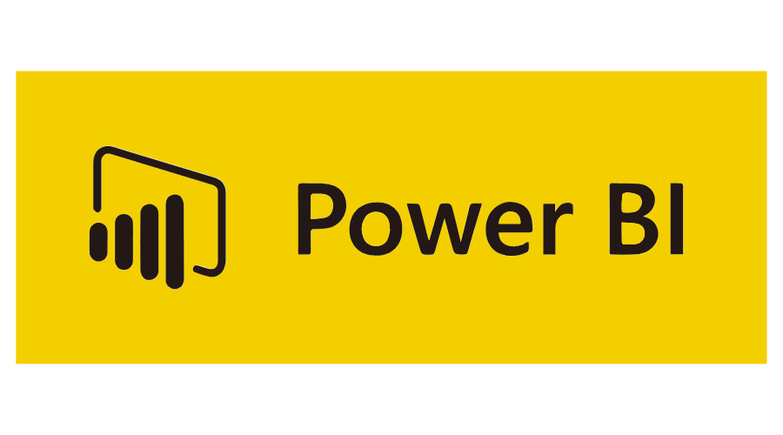
INTRODUCTION
DASHBOARD
Competitive digital economy
Interactive reporting
Business Intelligence
HOW IT WORKS
DATA AND METHODOLOGY
CONCLUSION

Slide 4
INTRODUCTION
DASHBOARD
HOW IT WORKS
DATA AND METHODOLOGY
CONCLUSION

Slide 5
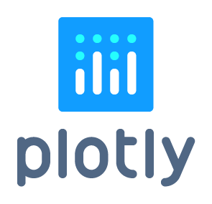

DATA AND METHODOLOGY
Citigroup Inc
Bank of America Corporation
Goldman Sachs Group
JPMorgan Chase & Co
Morgan Stanley
10-K
INTRODUCTION
DASHBOARD
HOW IT WORKS
CONCLUSION
Commonly used Python library for web browsers that makes high quality, interactive graphs.
A productive Python framework for building web applications

Slide 6

INTRODUCTION
DASHBOARD
HOW IT WORKS
DATA AND METHODOLOGY
CONCLUSION

Slide 7
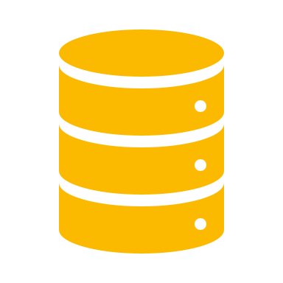
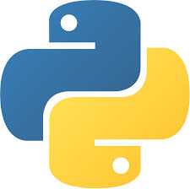
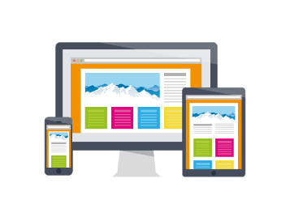
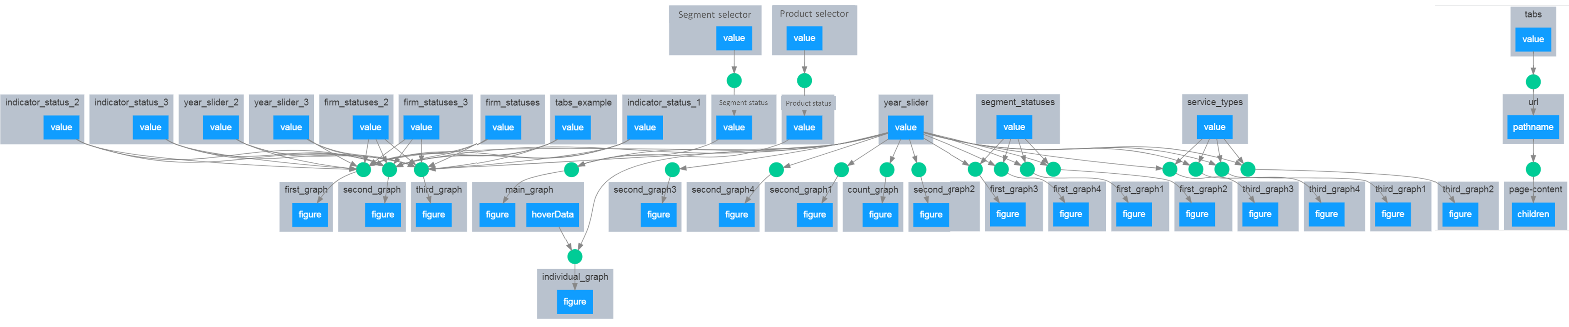
HOW IT WORKS
INTRODUCTION
DASHBOARD
DATA AND METHODOLOGY
CONCLUSION
CSV DATABASE
PYTHON
DASHBOARD

Slide 8
INTRODUCTION
HOW IT WORKS
DASHBOARD
DATA AND METHODOLOGY
CONCLUSION

Slide 9
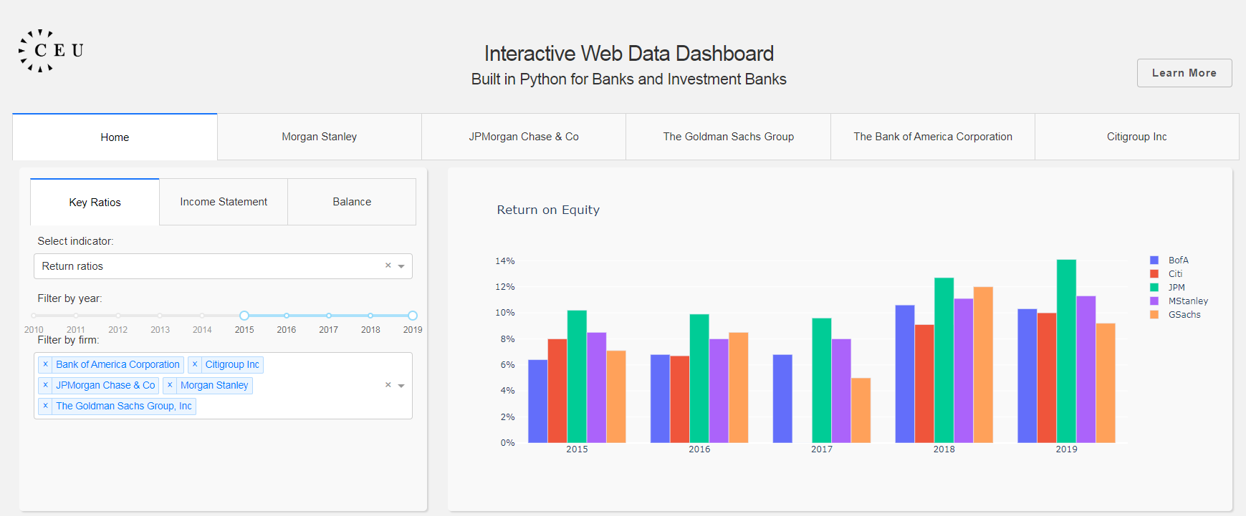
DASHBOARD
The dashboard is available for use and analysis at
http://tserendorj.pythonanywhere.com/home
INTRODUCTION
HOW IT WORKS
DATA AND METHODOLOGY
CONCLUSION

Slide 10
INTRODUCTION
DASHBOARD
HOW IT WORKS
DATA AND METHODOLOGY
CONCLUSION

Slide 11
CONCLUSION
Primary purpose of this project is to provide a free dashboard analysis tool that is based on Python programming language.
INTRODUCTION
АППЛИКАЙШН
HOW IT WORKS
DATA AND METHODOLOGY
Users can assess with other business intelligence tools for comparative reasons.

Slide 12
THANK YOU FOR YOUR ATTENTION

Slide 13
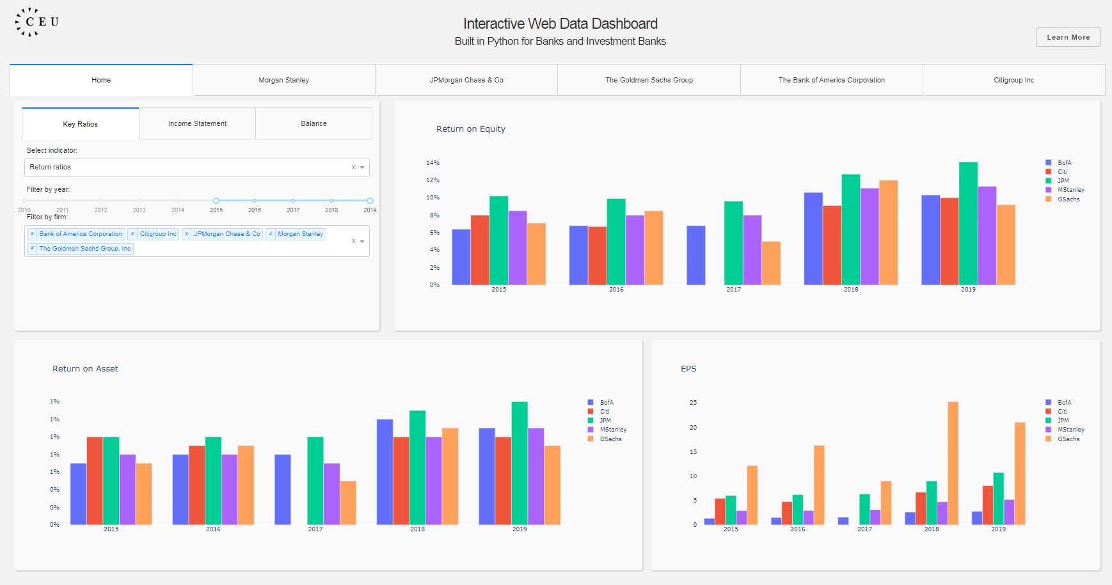
Appendix for Dashboard
If users change these value, all charts’ will change

Slide 14
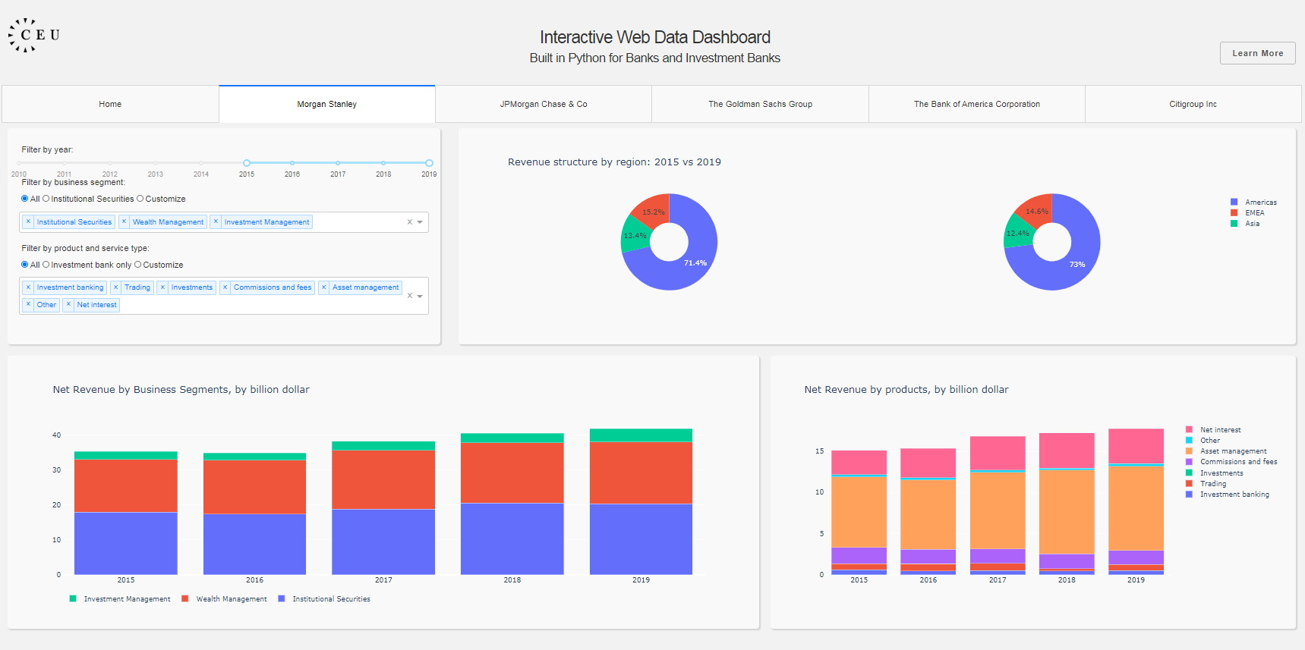
Appendix for Dashboard
If users hover the mouse on this chart, this chart’s value will change

