Slide 1
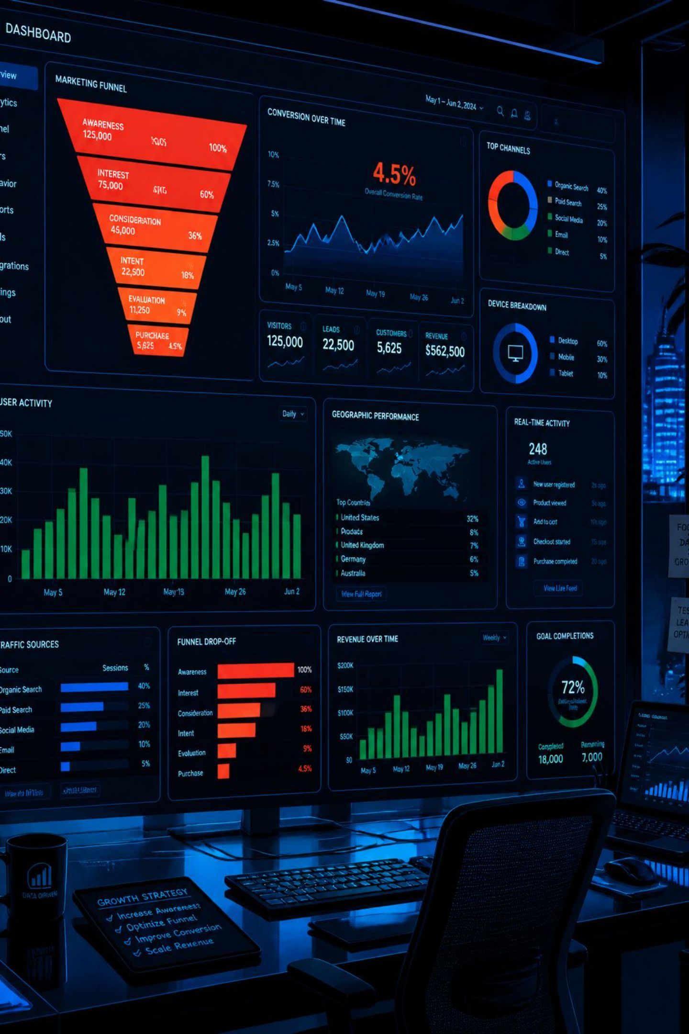
Marketing Funnel & Sales Conversion Analysis
A B2B Seller Acquisition Funnel & Sales Efficiency Study — Olist dataset (Kaggle). Tools: Python (Pandas) · SQL (BigQuery) · Power BI.

Slide 2

PROJECT OVERVIEW
What We're Analyzing
8,000 sellers who filled out Olist's "sell on Olist" form (MQLs), June 2017–June 2018, and the subset converted by the sales team. Two core questions:
Marketing ROI
Which channels and landing pages justify the spend?
Sales Efficiency
How much does rep execution drive conversion vs. lead quality?

Slide 3
DATASET
The Data at a Glance
8,000
841
Total MQLs
Closed Deals
Leads table: 4 columns
After 1 integrity exclusion
10.5%
48.5
Conversion Rate
Avg Days to Close
Overall funnel rate
Across all reps
Two tables joined on lead ID (confirmed unique). Key features: origin, landing page ID, business segment, lead type, and behaviour profile (Eagle / Cat / Wolf / Shark).

Slide 4

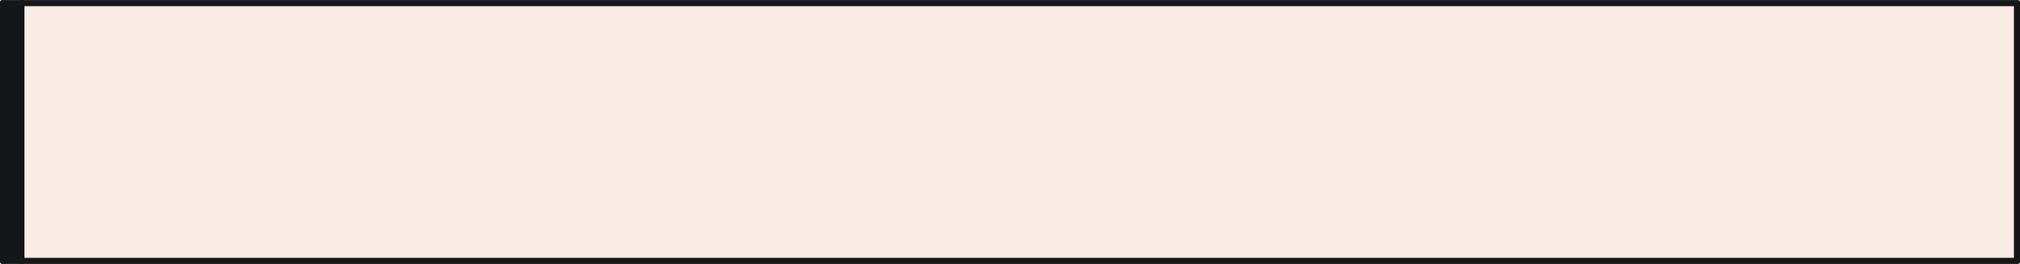

DATA CLEANING
Quality Issues & How We Handled Them
Origin: 1,159 "unknown"
60 blanks merged with 1,099 pre-existing "unknown" — both mean untracked channel.
Revenue: 94.7% zeros → null
797 of 842 rows showed exactly $0 — diagnosed as a system default, not real data.
Multi-label profiles → "mixed"
16 leads tagged with multiple profiles (e.g., "cat, wolf") — kept as a distinct category.
Date anomaly excluded
1 deal had a won date before its first contact — logical impossibility, removed.

Slide 5
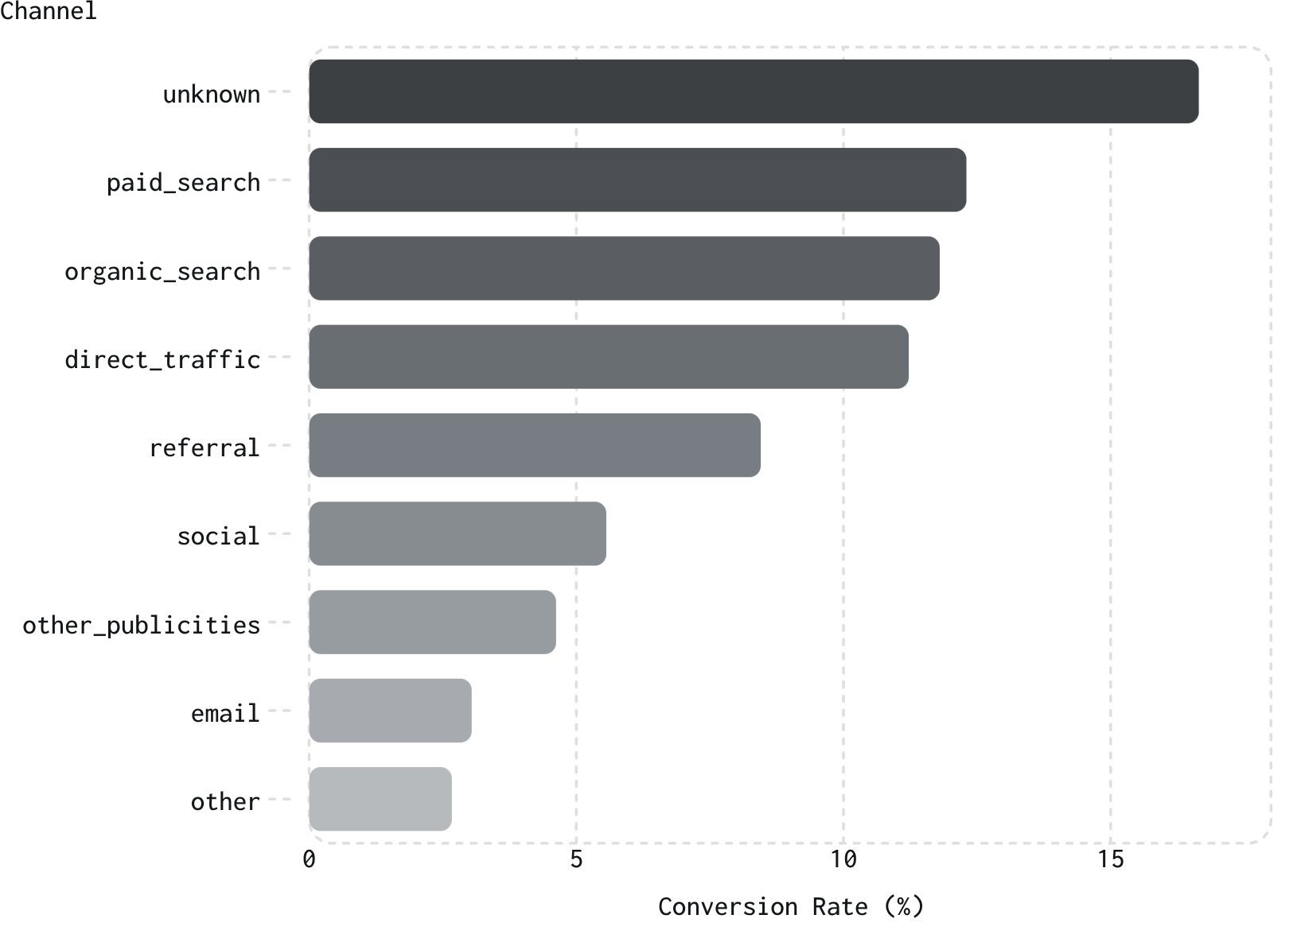
CHANNEL ANALYSIS
Which Channels Convert Best?
Key Findings
Unknown leads convert best at 16.65% — investigate tracking gaps before treating as a high-value source.
Social drives 1,350 leads (3rd-highest volume) but converts at only 5.56% — flagged for budget review.
Email & other are the weakest performers at 3.04% and 2.67%.

Slide 6

LANDING PAGES
Landing Page Performance
495 Unique Pages
0%–25% Conversion Range
Median just 2 leads/page; one page drove 912 leads (~11% of all traffic).
Among pages with 20+ leads. Two pages with identical volume converted at 25% vs. 10% — page design is an independent lever.
15 Zero-Conversion Pages
Each has 20+ leads but zero closed deals — collectively hundreds of leads with no return. Audit or pause.

Slide 7
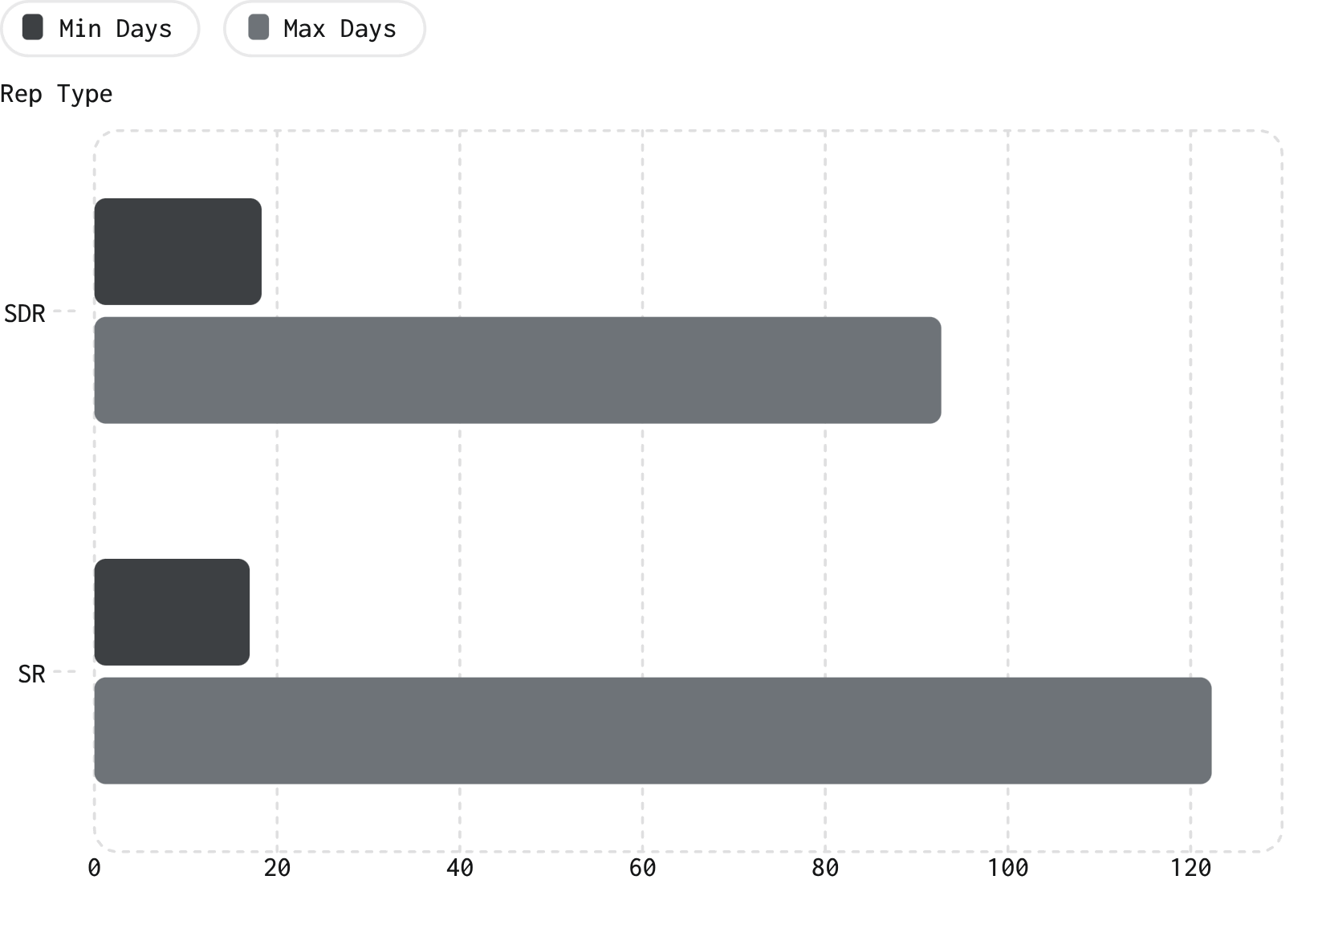

SALES TEAM
Rep Concentration & Time-to-Close
Concentration Risk
Top SDR closed 140 of 841 deals (~16.6%); top SR closed 133 (~15.8%). Sharp drop-off after the top 5–6 reps — a business-continuity risk.
Speed ≠ Volume
Busiest SDR (140 deals) averages 33.6 days to close. A lower-volume SDR closes in under 20 days. Deal volume and deal speed are not the same skill.
Fastest-rep patterns should become a coaching template for slower reps.

Slide 8
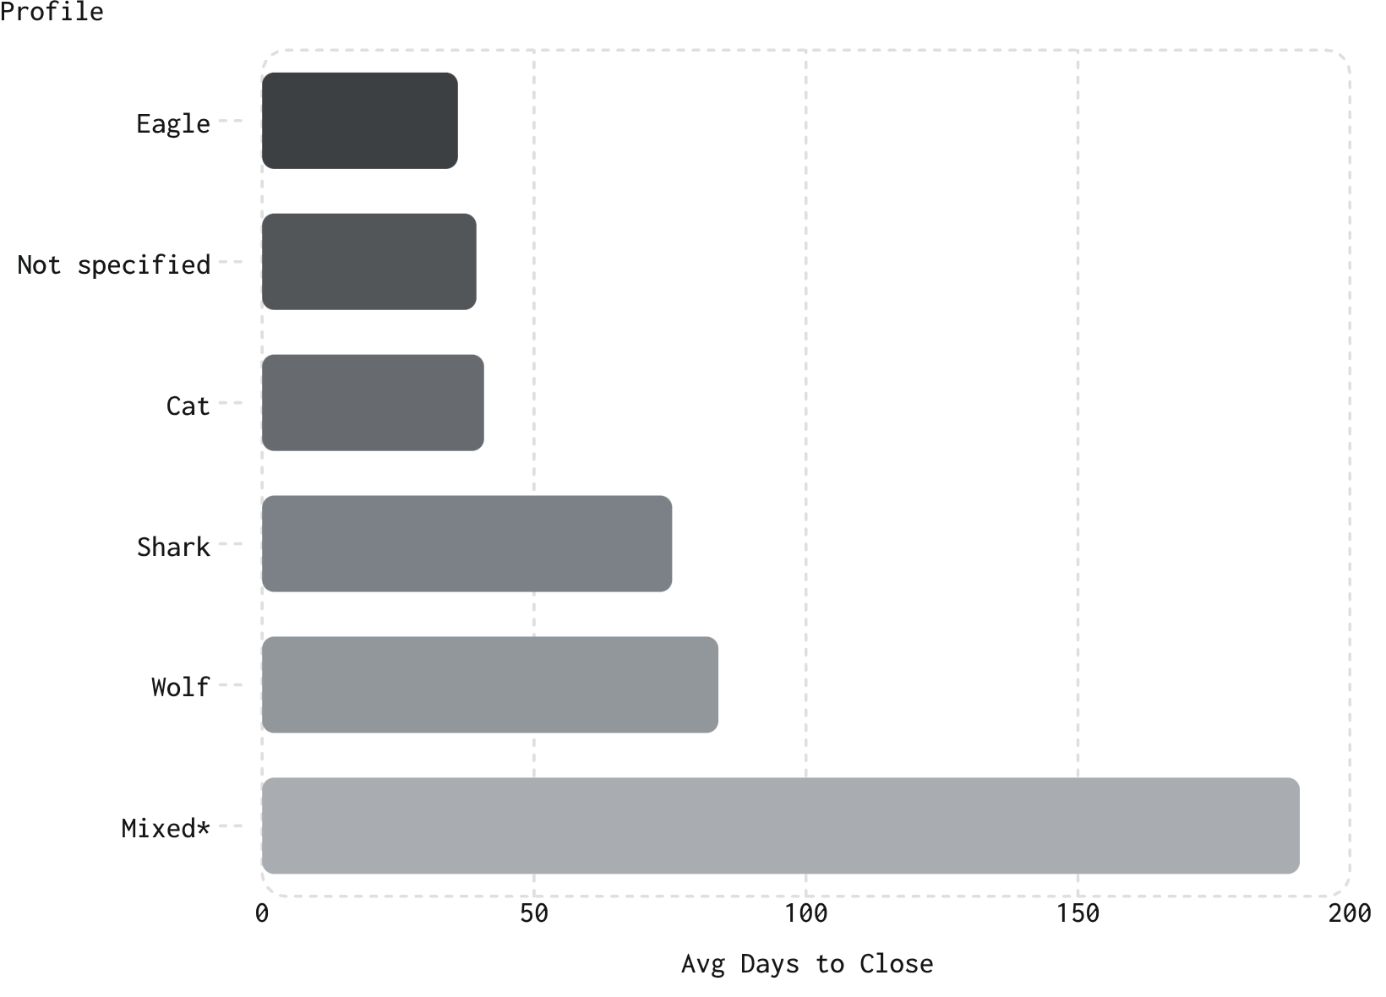
LEAD BEHAVIOR
Behaviour Profile Predicts Deal Speed
2.3× Faster
Eagle leads close in 36 days vs. Wolf's 83.9 days — despite comparable sample sizes (123 vs. 95 deals).
Why It Matters
Eagles are decisive and results-driven; Wolves are relationship-driven and need more touchpoints. Route Eagles to fast-track handling; give Wolves structured follow-up cadences.
*Mixed (16 deals) — treat cautiously due to small sample.

Slide 9
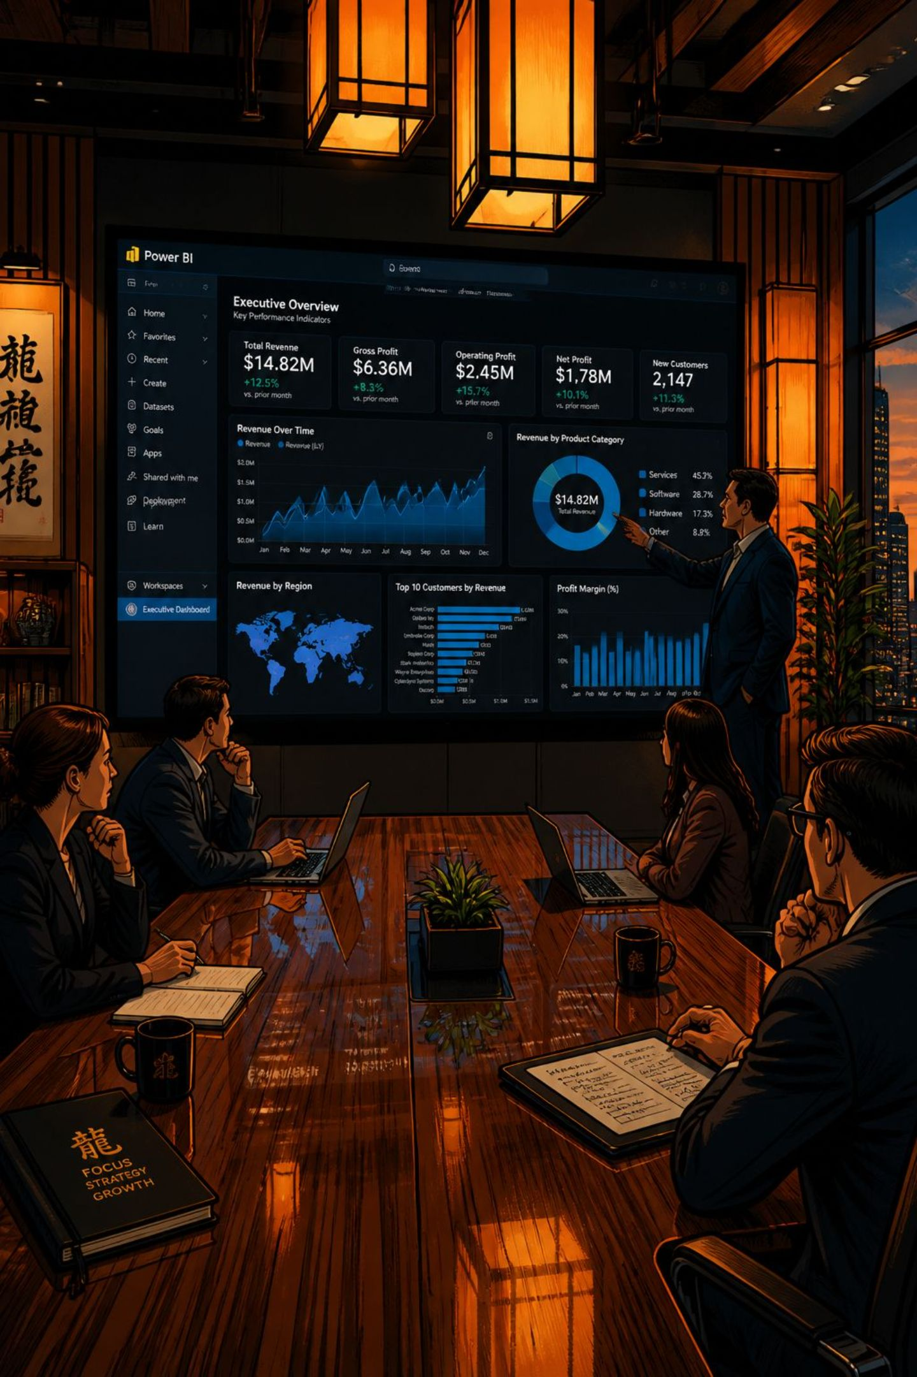
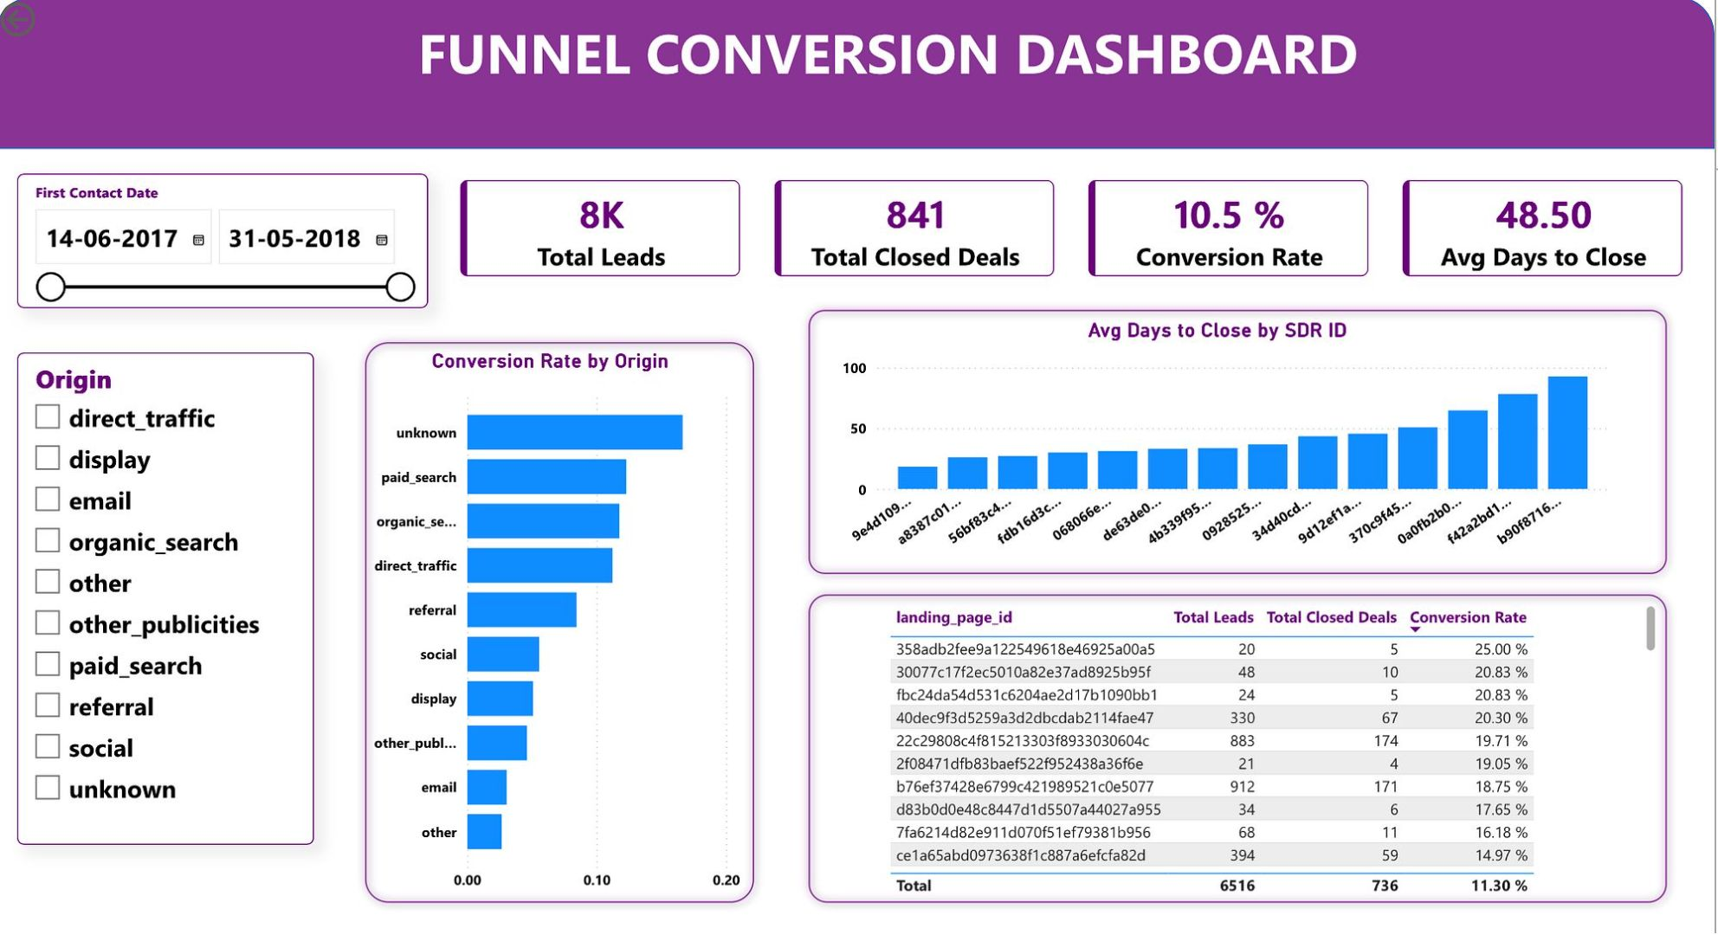
POWER BI DASHBOARD
Interactive Funnel Dashboard
Built on live DAX measures with bidirectional cross-filtering — all visuals update together when viewers filter by date or channel.

Slide 10

KEY TAKEAWAYS
Three Levers, Sequenced Correctly
Weak spots aren't evenly distributed — treating "low conversion" as one problem leads to the wrong fix.
1
Reallocate Social Spend — After Fixing Lead Quality
Social's gap is a lead-quality issue, not rep execution (only a 2-day handling gap vs. unknown). Reassigning reps won't fix it.
2
Replicate Top Landing Page Patterns
Page design is an independent lever — pages with identical traffic differ 2× in conversion.
3
Route Leads by Behaviour Profile
Fast-track Eagles; give Wolves and Sharks structured follow-up cadences.

