Slide 1

Melissa, Tan, Tarika

Slide 2
Company Description
Spotify is a digital music and podcast service that gives you access to millions of songs. Users can discover new music, share and create music playlists. Spotify radio allows users to hear similar songs. It is a freemium service with over 50 million paying customers and over 100 million users total. Spotify is available in most of Europe, Americas, Australia, New Zealand and parts of Asia and is available for most modern devices, including Windows, MacOs and Linux computers as well and Android and iOS devices. Users can browse or search for music based on different parameters, such as album, artist, song, genre, playlist, or record label. They can also create their own playlists and share them with followers. Spotify currently has over 30 million songs available to its users, and as of March 2017, has 50 million subscribers. .

Slide 3
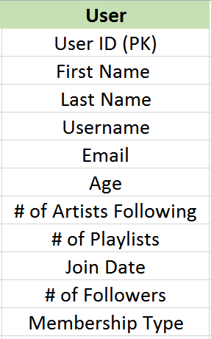
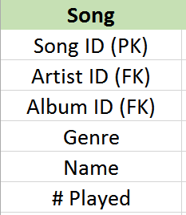
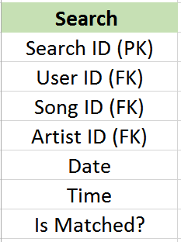
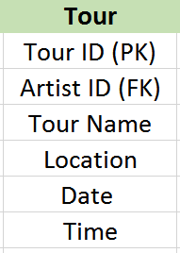
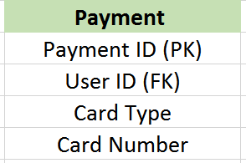
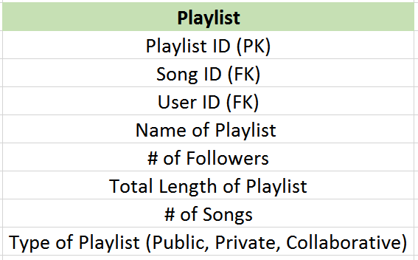
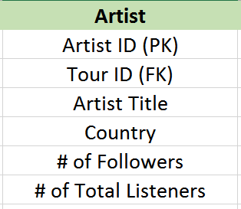
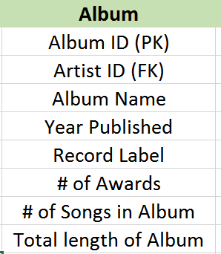
1
1
M
1
M
M
M
M
M
1
1
M
1
1
1
M
Notes:
ASSUMPTION NOTES:
1 to Many for Song to Album: Assuming that there is no various artist albums
Many to 1 for User to Payment: The user can only use one payment method to activate their membership

