Slide 1


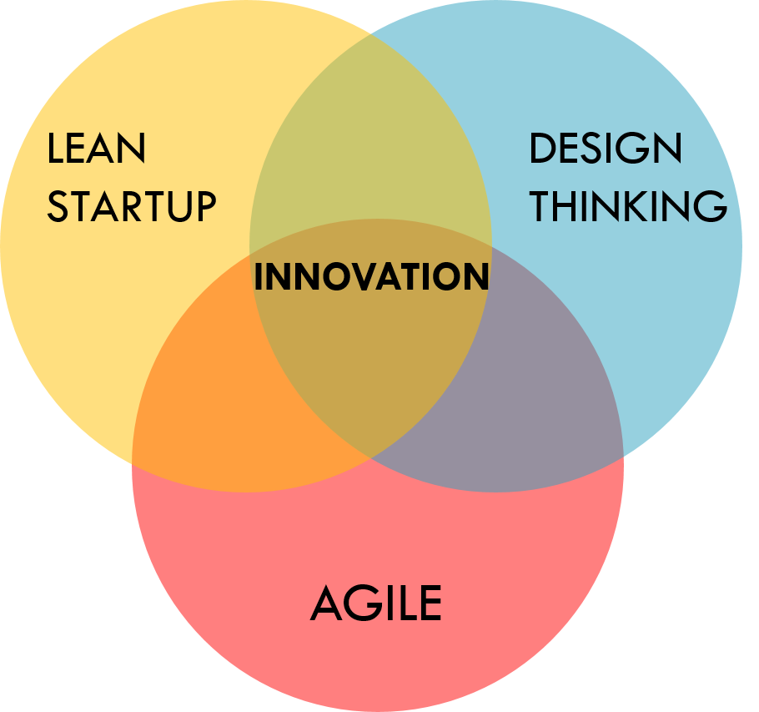
Design
Strategy
PREPARED FOR
Robert Kaufholz
MAY 21, 2021 (updated)
PREPARED FOR
TvEyes
June, 2022

Slide 2
Intro &
Content
DESIGN STRATEGY INTRO
Design Vision
Summary
CJM Scope
LOW-FI
Plan / Roadmap
Ramp-up
Design Phase
Agile & Design Process
Lean + Agile CJM & Backlog
User Story Template
Lean + Agile Ceremonies
Design Story Flow
Team Composition
The Team
Design Kit
MUI
Links & Materials
The primary outcome of this document - provide a Strategy for a solid foundation for further development and growth for product.
All suggestions come from the deep analysis of the requirements and current setup within products and best-fit the short-term, and long-term goals.

Slide 3
Vision
Summary
DESIGN STRATEGY DESIGN VISION
2 USER GROUPS
Regular User, Admin
1 CUSTOMER JOURNEY MAP AS A SCOPE (±30 EPICS) TO COVER
With a steps, actions, problems, needs and Hypotheses to validate
1 SMALLER CJM for MOBILE AS A SCOPE (±12 EPICS) TO COVER
With a steps, actions, problems, needs and Hypotheses to validate
Project Goal: This project aims to design MVP with a new User Experience with the most important functions from the MMS with improved UX, and some functions from the Fusion product. Users must have the possibility to reset/change passwords on their own.
MVP - is a product with enough features to attract early-adopter customers and validate a product idea.
MVP should cover: CJM 30 steps (Desktop), CJM ±12 steps (Mobile)
Target Audience:
PR Communication, Researchers.
Design System (DS) - is a new solution with designed and developed components based on the framework to handle everything consistently.
TECHNOLOGIES
Web Product, MUI
OS TO SUPPORT
Windows, Android, MacOs, IOS
RESOLUTIONS LAPTOPS
1280x720
RESOLUTIONS DESKTOPS
DESKTOPS 1920x1080
DESIGN SYSTEM
Design for TvEyes own library with designed, and developed components based on chosen technologies to handle consistency across applications. Based on MUI design Kit
TEAM: OPTION 1 (±6-9 MONTH)
Lead Designer (time, 100%)
Middle Designer (time, 100%)
Project Manager (part-time, ±20%)
TEAM: OPTION 2 (±6-9 MONTH)
Lead Designer (time, 75%)
1 Senior Designer (time, 100%)
1 Middle Designer (time, 100%)

Slide 4
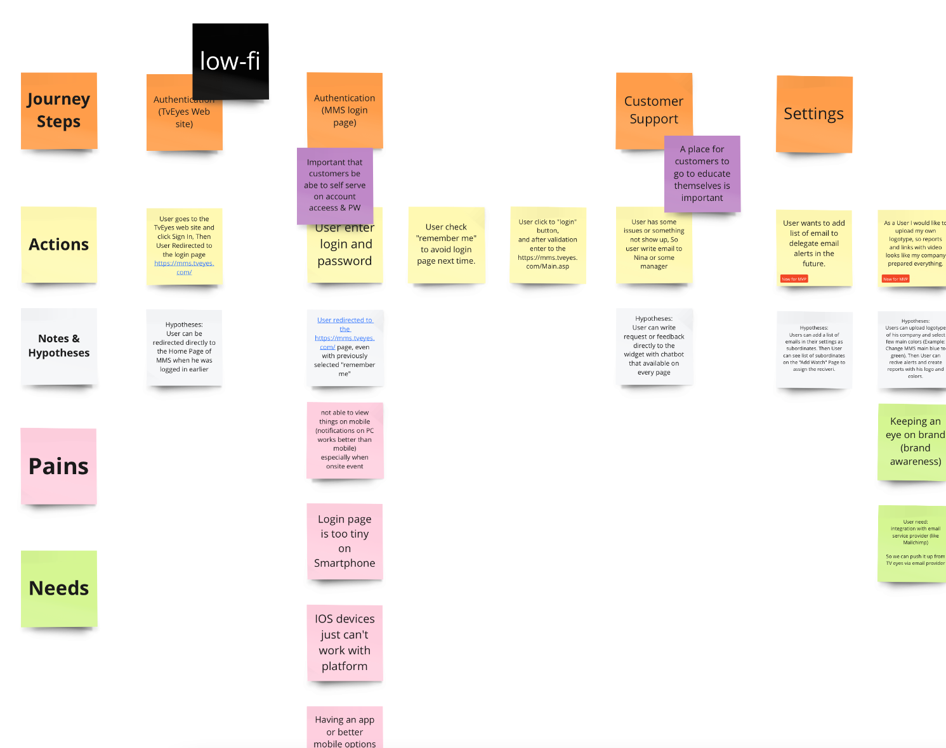
CJM
Scope for MVP
DESIGN STRATEGY SCOPE FOR MVP from CJM
CJM - A Customer Journey Map visually represents a customer's experience with your brand. These visuals tell a story about how a customer moves through each interaction phase and experiences each phase.
Break scenario needs a statement into phases. Inspiration from the current MMS with some features/steps from SCOUT and FUSION with new ideas and information from our users.
We mapped user tasks for each phase/step and wrote down these tasks with pain points and ideas for each phase/step.
Have been shared evidence and ideas: copy/pasting screenshots from all products, possible solutions, and anything that can help.
This is an instrument to understand the important scope for MVP, illustrate all problems, needs, and hypotheses to develop.
Full Diagram with CJM

Slide 5
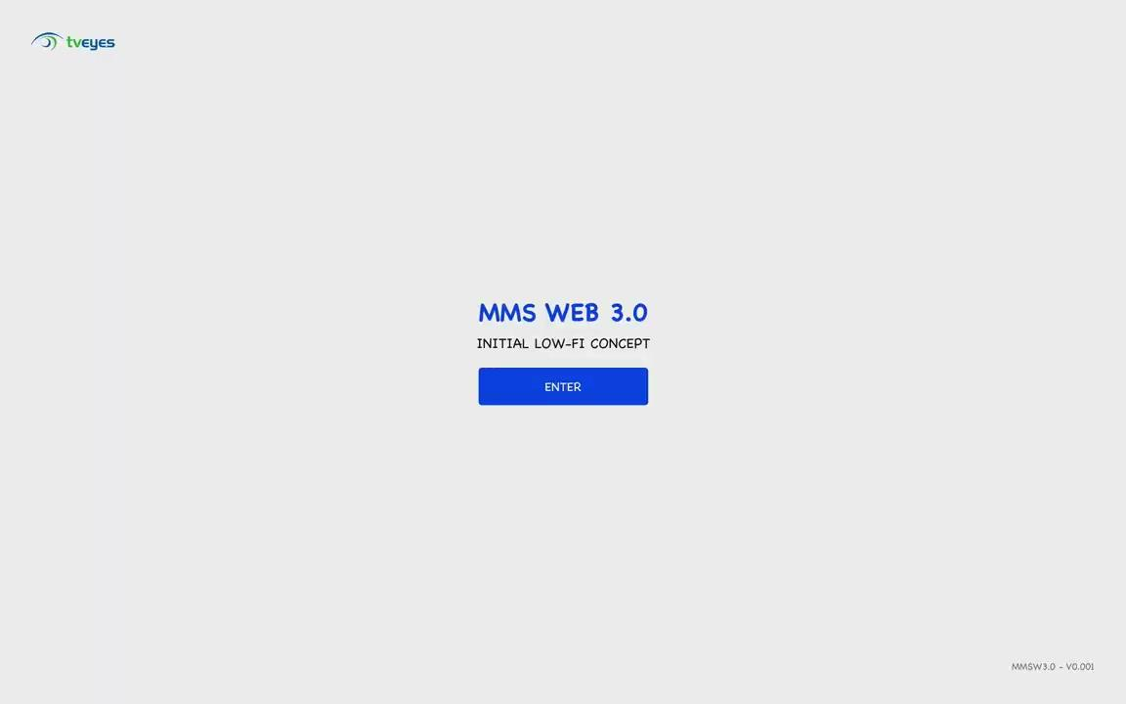
LOW-FI
WIREFRAMES
DESIGN STRATEGY HYPOTHESIS IN LOW-FI WIREFRAMES
MMS WEB 3.0 - It is the initial concept to combine more ideas, feedback for the next iteration with more accurate solutions.
Target Audience:
PR Communication, Researchers.
Problems to Solve:
Complicated Search
User can't change settings or password.
Old design with dated UX patterns.
Not possible avoid authentication even with“remember me” checkmark.
Hard to check alerts, review & share clip from mobile.
Clip Viewer: Not possible to scroll video.
Clip Viewer: Not possible to manage volume.
User should enter login and password too many times.
FIGMA PROTOTYPE

Slide 6
DESIGN STRATEGY PLAN / ROADMAP
Ramp-up
Jul 1 week | Jul 2 week | Jul 3 week | Jul 4 week | Aug 1 week | Aug 2 week
Kick Off
Preparation to Design Phase
Design Phase
Design System (DS) Concept with UI components from the chosen framework
Design Strategy
Development & Presentation Process
Prepare Templates
Setup Environment in Figma, Design System, Branches, Templates. Licenses. Requests for Brand Books and etc.
Design Resources Ramp-Up
Backlog Organisation and Prioritization
Design Spikes to Define Scope and Validate Hypothesis.
Design & Agile
Process Organisation
Backlog in Jira
for CJMs
Initial Backlog and Roadmap

Slide 7
DESIGN STRATEGY PLAN / ROADMAP
Design Phase
MMS WEB 3.0 MVP
It is the initial concept to combine more ideas, feedback for the next iteration with more accurate solutions.
DESIGN SYSTEM (DS)
Design for TvEyes own library with designed, and developed components based on chosen technologies to handle consistency across applications. Based on MUI design Kit
Jul | Aug | Sep | Oct | Nov | Dec
Kick Off
External
Usability Testing
External
Usability Testing
Preparation
to Design Phase
Design Phase Sprint-by-Sprint
Design Hand-off
Design system
Concept
MMS 3.0
Concept
Design System
Backlog in Jira
for CJMs
Create Design for entire application step-by-step
(Iterative process for each step from CJM/ User Task in Backlog)
Design Spikes: Working on Wireframes & Validation ideas with Users and Stakeholders to Cover CJM
High Fidelity Design for Validated Prototypes from Wireframes
Initial Backlog and Roadmap

Slide 8
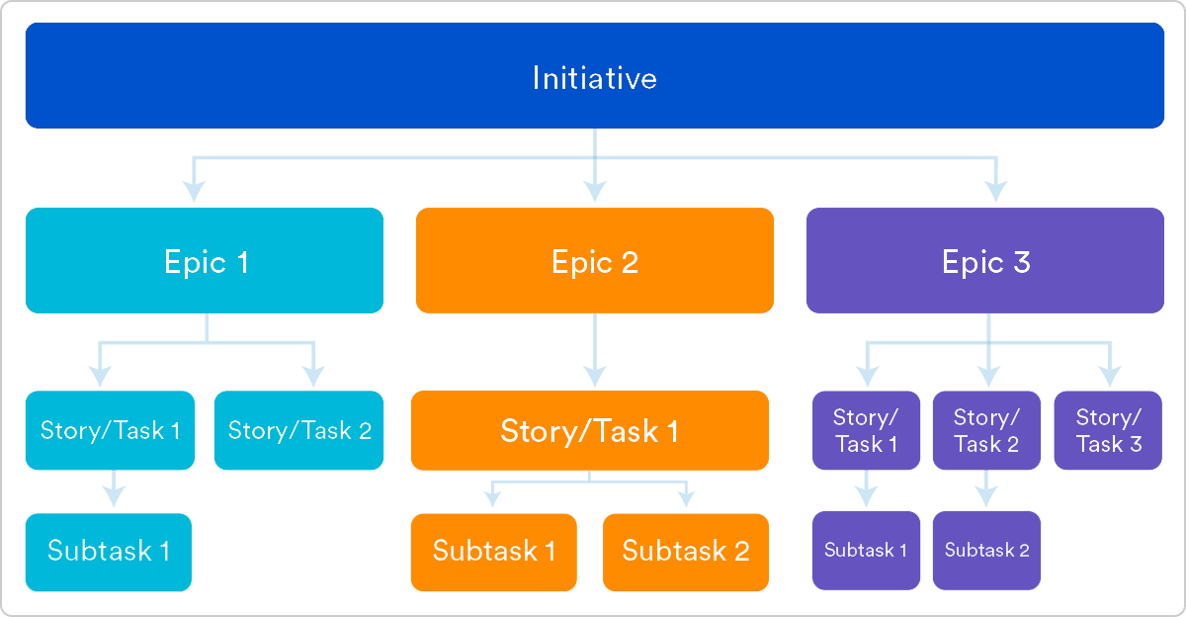
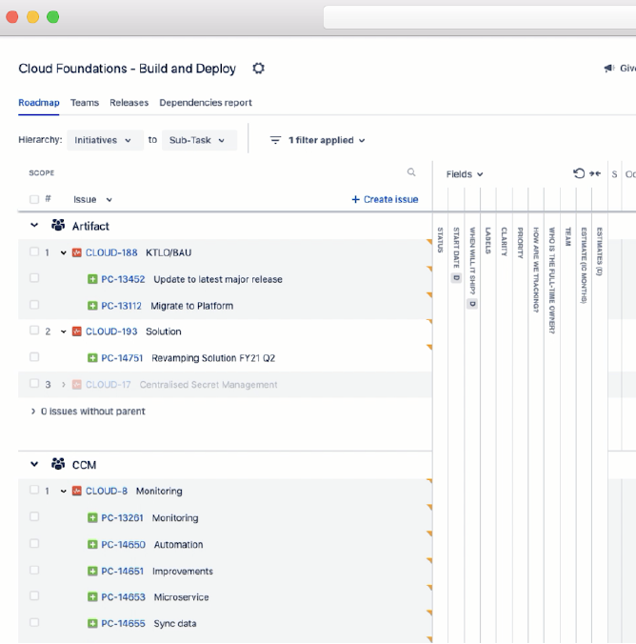
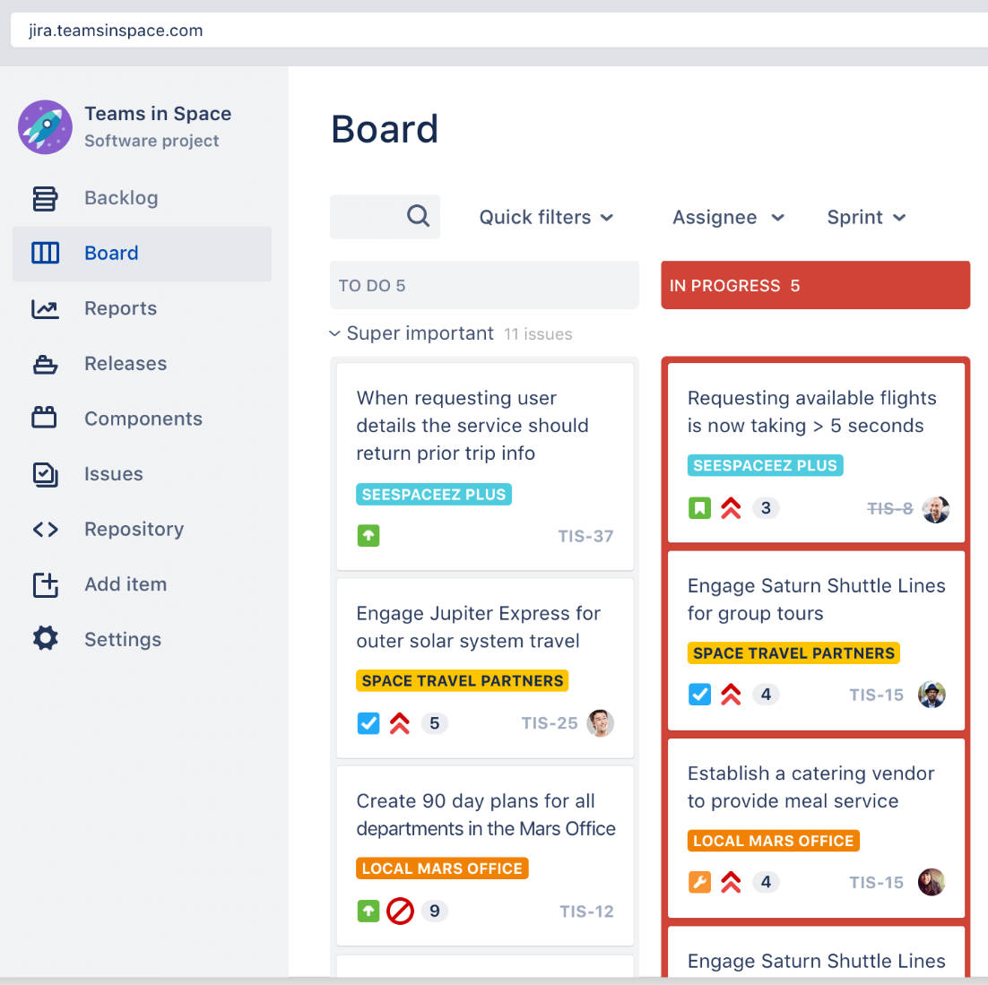
Lean + Agile
CJM & Backlog
DESIGN STRATEGY AGILE & DESIGN PROCESS
A customer journey map is a process the customer follows or workflow steps looking for improvements in the overall experience. The journey map typically reflects several user stories. Video: Customer Journey in Agile
Epics (Customer Journey from Our Discovery)
An agile epic is a body of work that can be broken down into specific tasks (called user stories) based on the needs/requests of customers or end-users.
User Story
User stories are one of the core components of an agile program. They help provide a user-focused framework for daily work — which drives collaboration, creativity, and a better product overall.
More Information about Backlog and User Stories.
Backlog
The Scrum Board

Slide 9
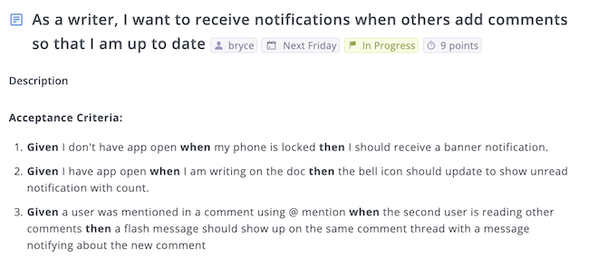
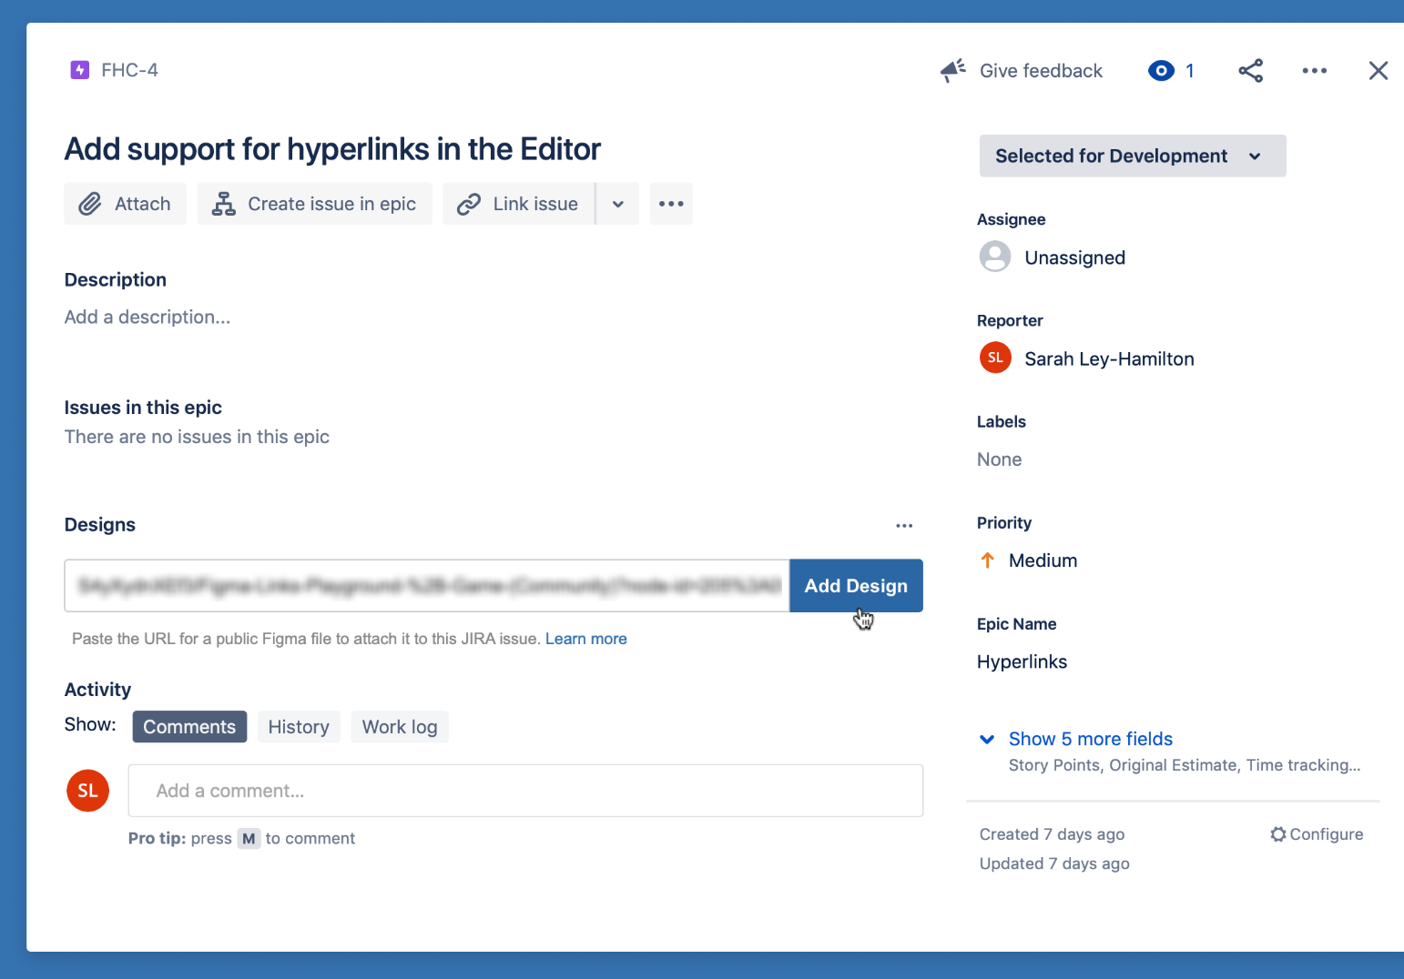
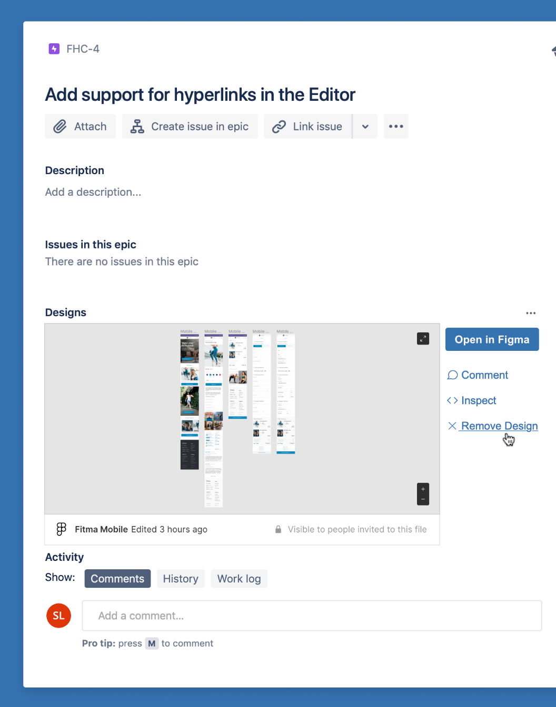
User Story
Template
DESIGN STRATEGY AGILE & DESIGN PROCESS
User Story for Design - it is design requirement at the beginning and after design process with design prototype, and status “Ready for Dev”.
User Story for Development - it is development requirement with prototype from the design story that was done.
Template for Design Story:
Description:
Acceptance Criteria
Requestor (Users, Costumes, Stakeholders)
Attachments
Priority
Input for Figma prototype
Comments
How to integrate Figma into Jira

Slide 10
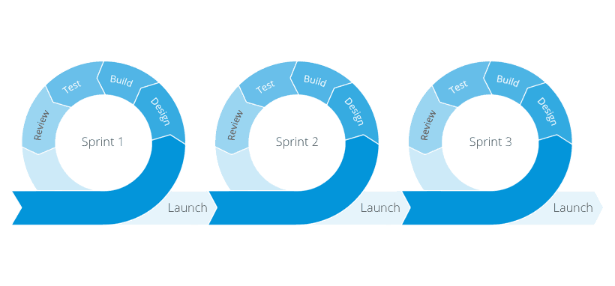
Lean + Agile Ceremonies
DESIGN STRATEGY AGILE & DESIGN PROCESS
External
Usability Testing
External
Usability Testing
Sprint Planning
A team planning meeting that determines what to complete
in the coming 2 weeks sprint.
Sprint Demo
A sharing meeting where the team shows what they've
Shipped in that sprint.
Daily Standup
Also known as a stand-up, a 15-minute mini-meeting
for the software team to sync.
Retrospective
A review of what did and didn't go well with actions
to make the next sprint better. More Information with details.
2 Weeks
2 Weeks
2 Weeks
Demo
Demo
Demo

Slide 11
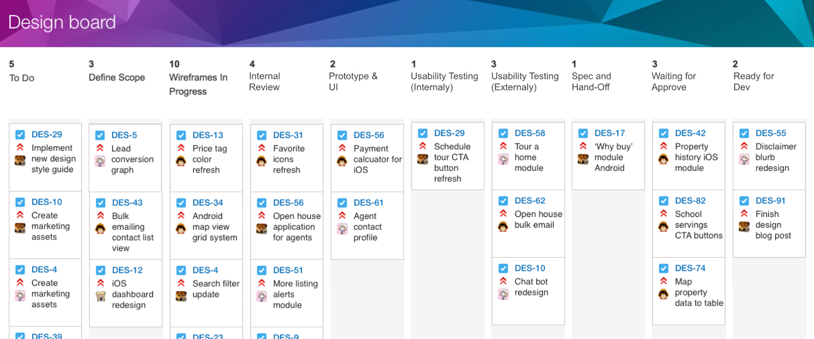
Design Story Flow
DESIGN STRATEGY AGILE & DESIGN PROCESS
The main outcome of this document - provide a Strategy for a solid foundation for further development and growth for ToolsGroup product.
All suggestions come out from the deep analysis of the requirements and current set up within ToolsGroup products and are chosen to best-fit the ToolsGroup short-term and long-term goals.

Slide 12
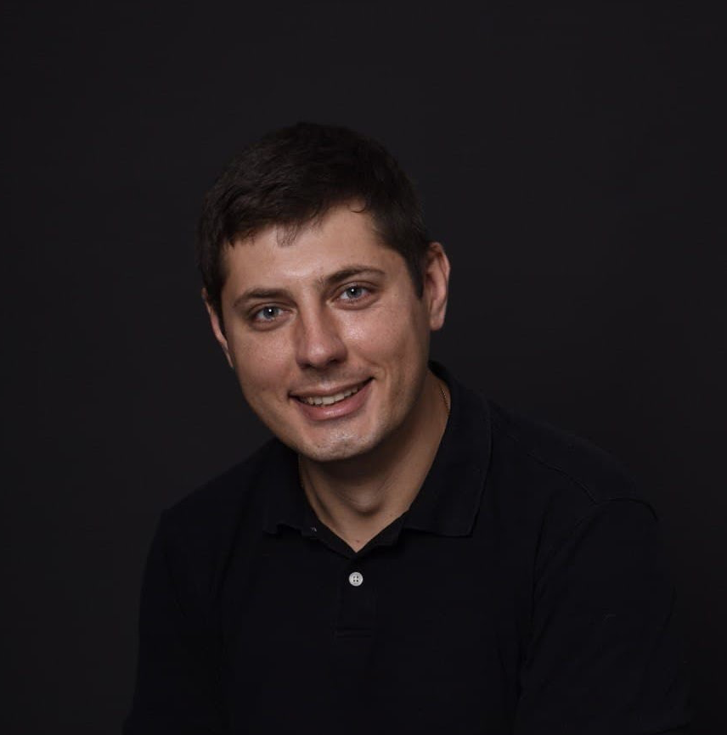
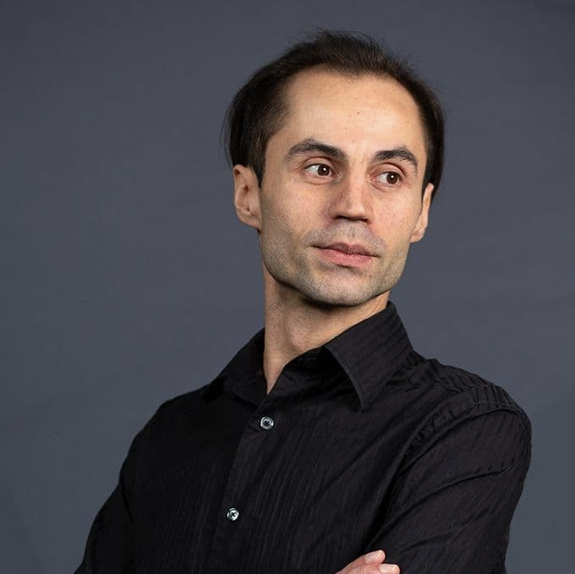
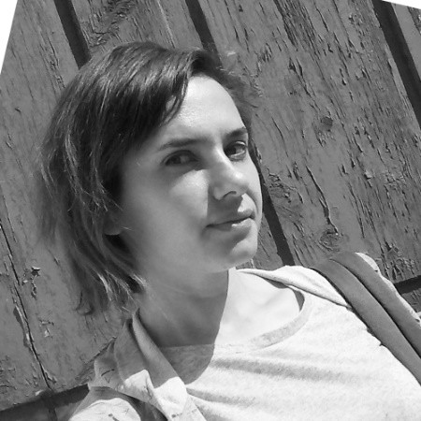
The
Team
DESIGN STRATEGY TEAM COMPOSITION
Oleksii Kush
Project Manager
Alexey Tsesliuk
Lead UI/UX
Oleksii Kush
Project Manager
Lead UI/UX (75%)
Working with the business to understand what it needs from the design team; Responsible for the Quality, Design Review, Facilitating Workshops, Usability Testing.
Project Manager (part-time, ±20-25%)
Responsible for planning, Burndown plan, SDLS
Senior Designer (full-time, 100%)
Responsible for collecting and translating business and user requirements for MVP features into clickable prototype.
Middle Designer (full-time, 100%)
Translating requirements into style guides, design system components, design patterns and attractive user interfaces.
Working on Mobile Application Part
TBD
Senior UI/UX Designer
Olena Korolova
Senior UI/UX Designer
TBD
UI/UX Designer

Slide 13
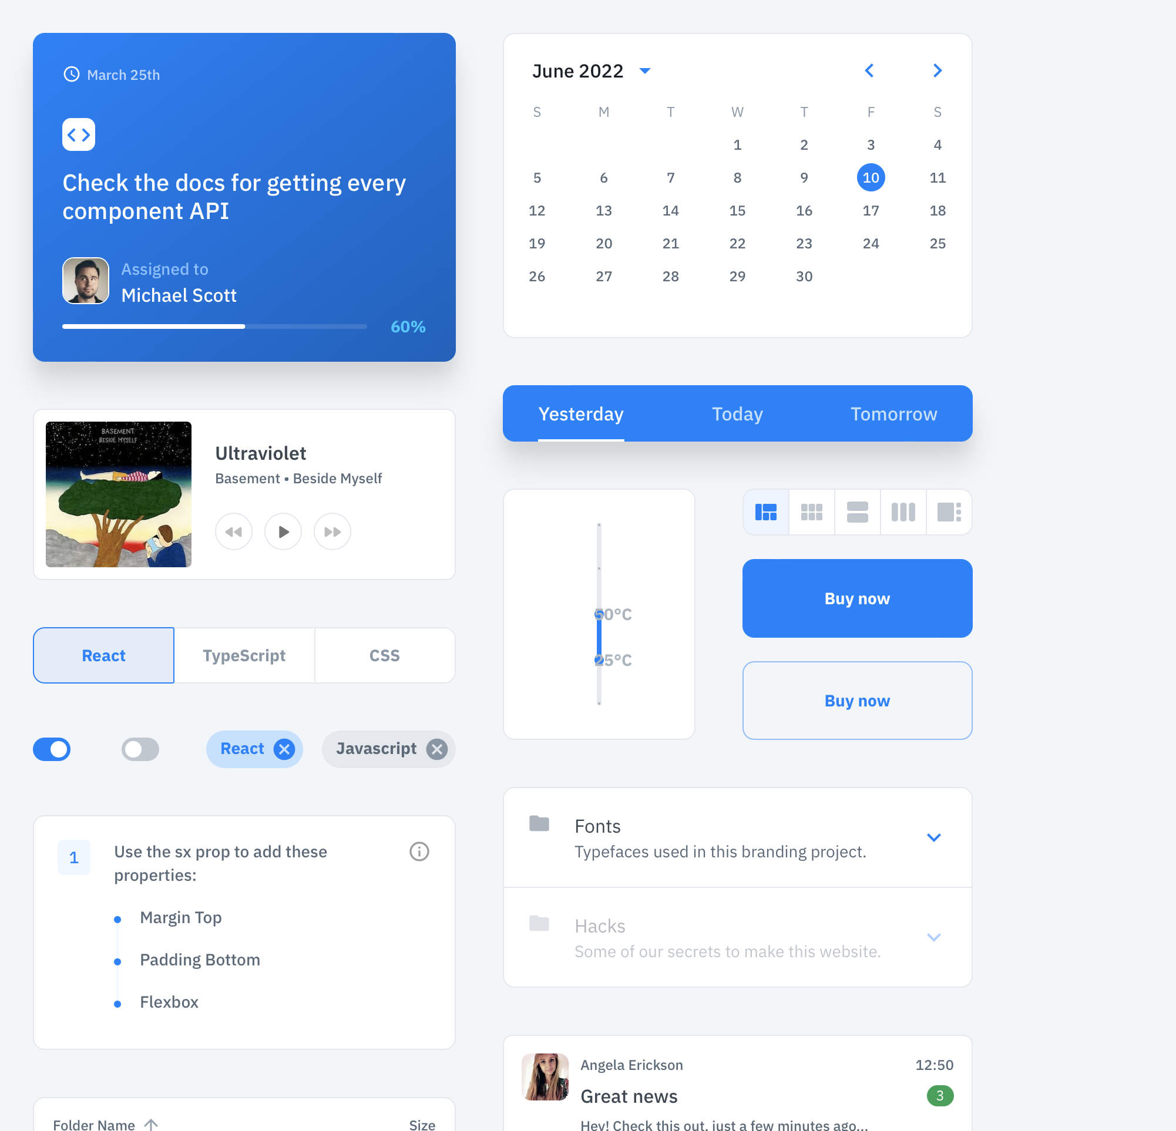
Material Design
MUI
DESIGN STRATEGY DESIGN KIT | OPTION 1
This library is a Design System with perfectly shaped UI kit for Figma with reusable templates for desktop
& mobile apps.
We have experience in using this UI Kit with icons, menu, dashboards and everything inside. It is a good solution to apply TvEyes styles, and adapt for our needs.
More Details

Slide 14
Links
& Materials
DESIGN STRATEGY LINKS
Links | What is it
Google Drive | Shared documents with presentations & everything
Design Board | Miro Board for all design activities and finding where we collaborate and store all outcomes
Design Strategy | This is separated presentation with Design Strategy for MVP
We would like to use this slide for sharing links with Miro, Reports, Plans and shared folders (any other received resources).
So, everyone can use this presentation as a reminder for future purpose.

Slide 15
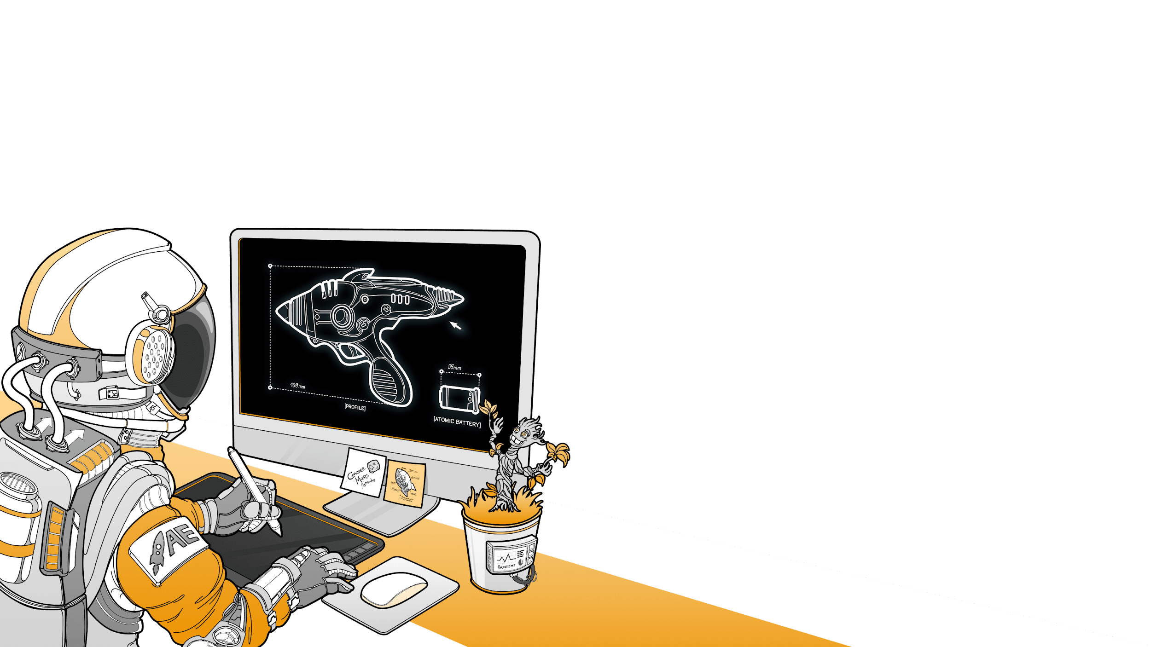
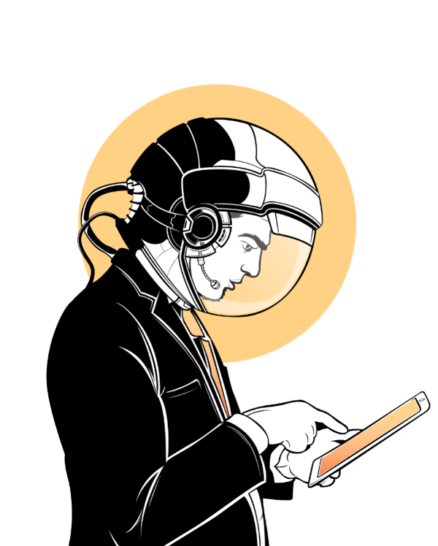
Design proposal
for ToolsGroup
Let’s build something great
Together!
PREPARED FOR
Robert Kaufholz
MAY 21, 2021 (updated)
PREPARED FOR
TvEyes
Jun, 2022

