Slide 1
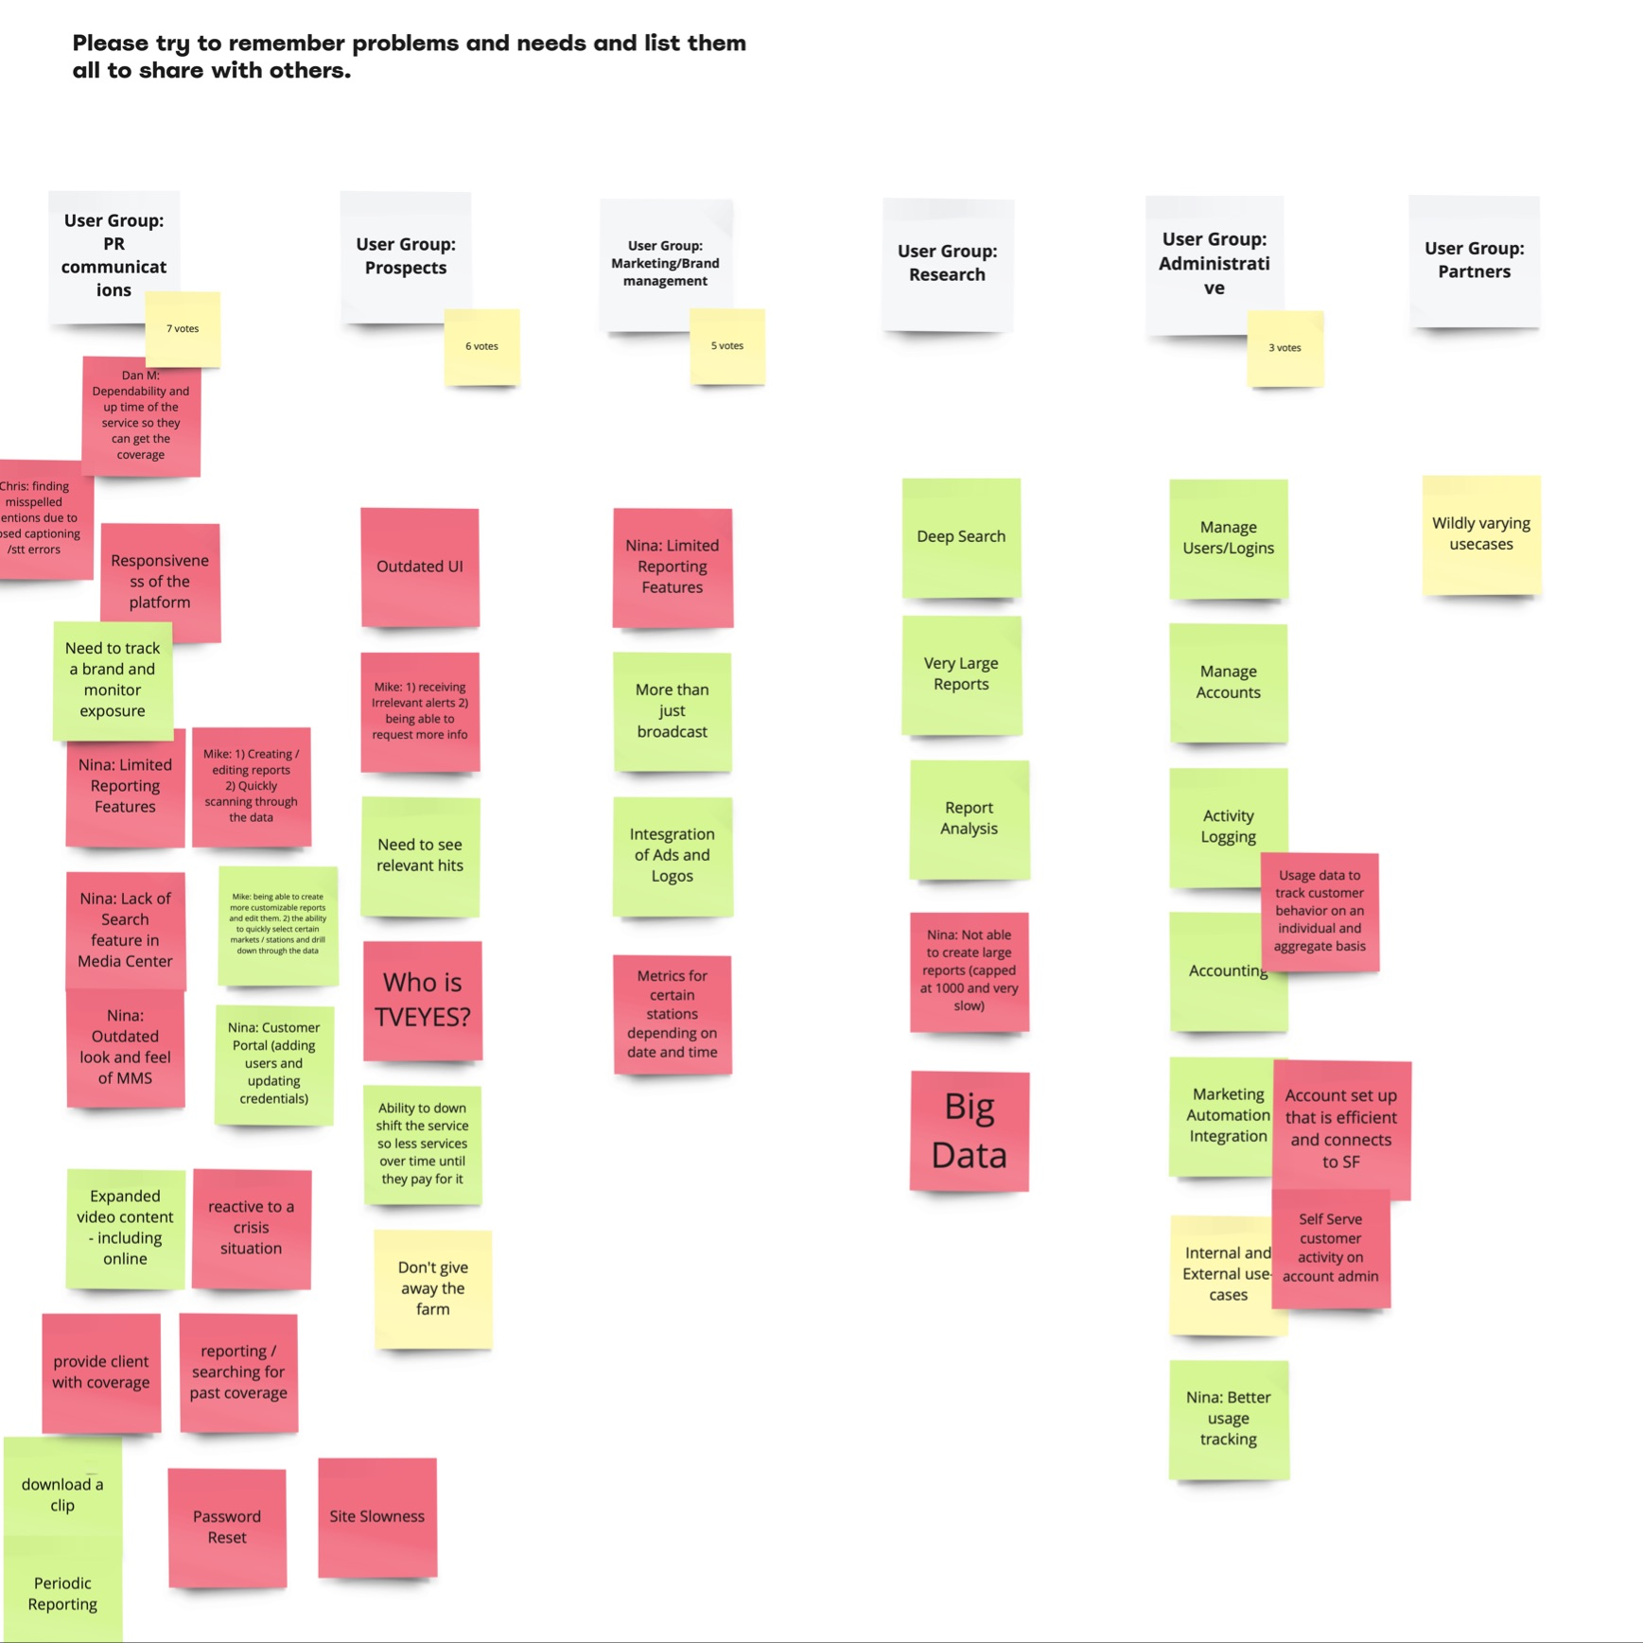


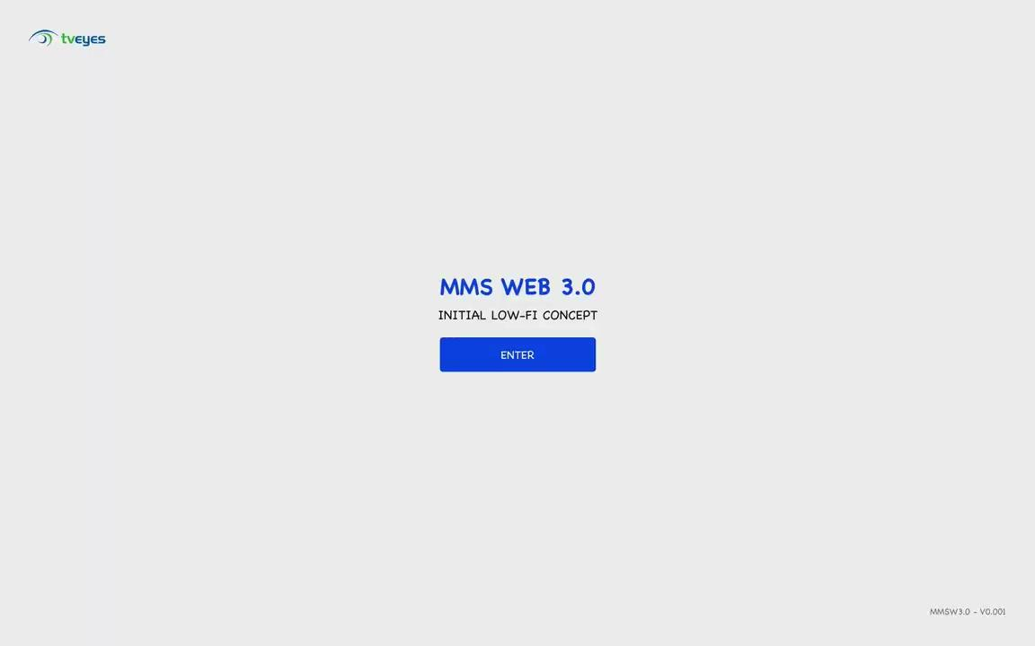
Discovery
Results
PREPARED FOR
Robert Kaufholz
MAY 21, 2021 (updated)
PREPARED FOR
TvEyes
June, 2022

Slide 2
Intro &
Content
DISCOVERY RESULTS INTRO
Executive Summary
Problem
Solution
End-Users’ Input
Findings
Pain Points
Needs
Stakeholders Input
Findings
MVP Scope
CJM
LOW-FI Wireframes
Next Steps
Links & Materials
The primary outcome of this document - share
the results of the Discovery Phase.
This document contains links, material, and understanding from the different points of view collected during the Discovery Phase.
As a result of all these findings, there are a scope of work and a Design Vision for further development and growth for the product.
Design strategy with a roadmap presented as a next separate document.

Slide 3
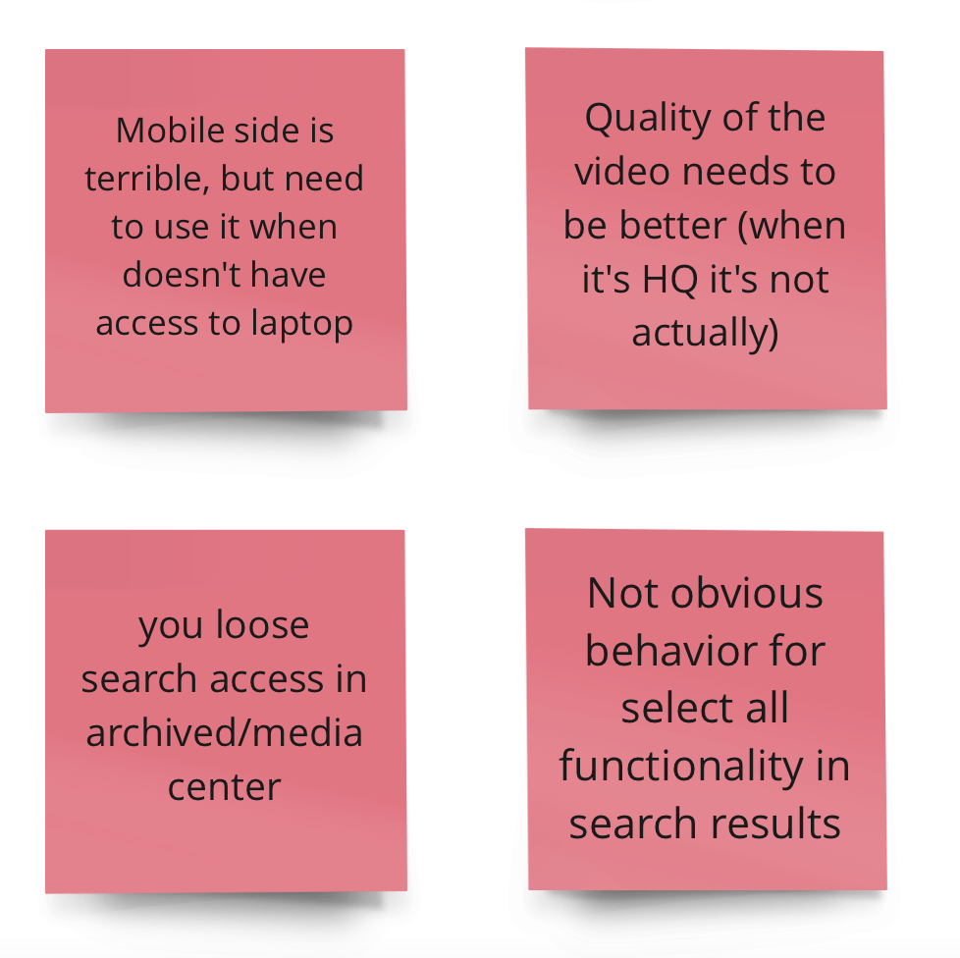
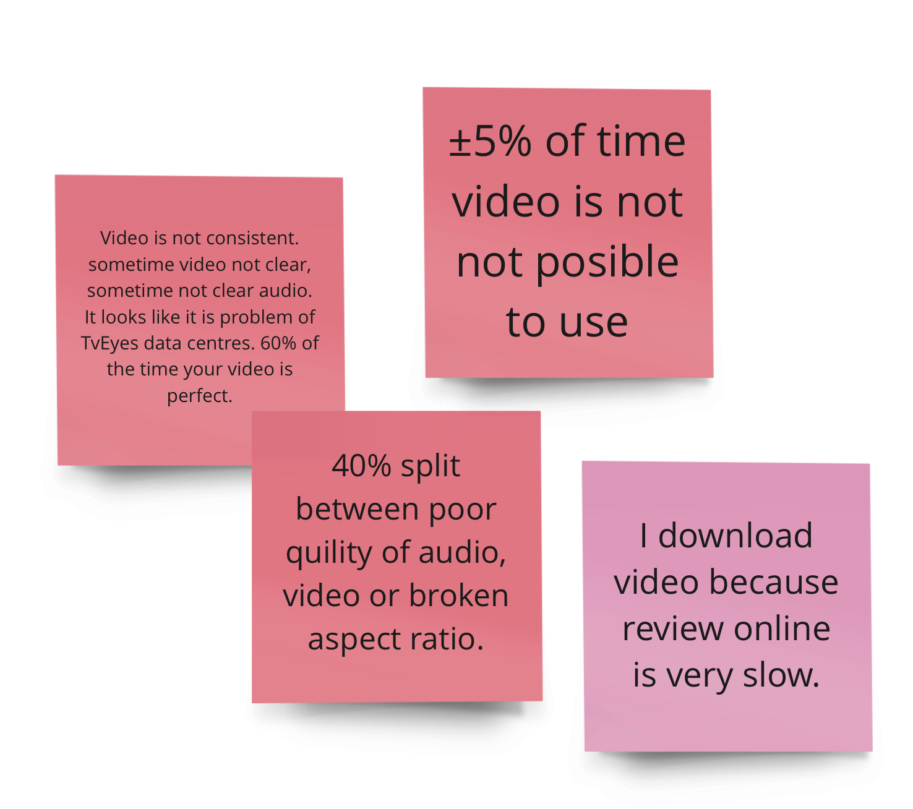
Problem Summary
DISCOVERY RESULTS EXECUTIVE SUMMARY
SUCCESSFUL PRODUCTS
1 of 3
STAKEHOLDERS INTERVIEWED
8
USER INTERVIEWS
13
ANALYZED FEATURES/ALL PRODUCTS
±45
TvEyes has the first very successful product MMS with a dated design and limited functionality. Now - it is very hard to support existing customers and sell it to new clients.
Also, TvEyes company losing a ton of time when changing passwords for users and other trivial tasks that can be done with simple functionality.
Most parts of the users require Improvements in search capabilities to search specific markets or individual stations. New design (look and Feel) to have improved Ux patterns and Mobile version for check-in and sharing alerts and clips.
WORKSHOPS
4
PROBLEM STATEMENTS
±9
PROBLEMS TO SOLVE IN MVP
±3
DEFINED PAIN POINTS
±50

Slide 4
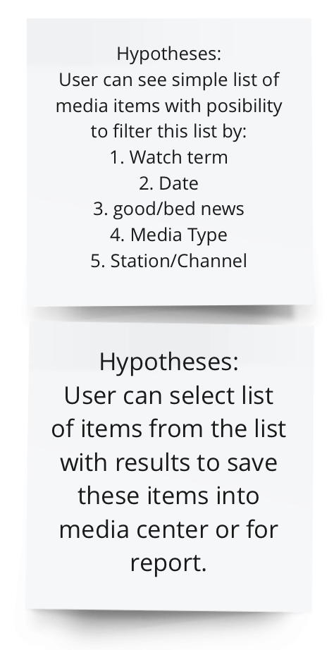
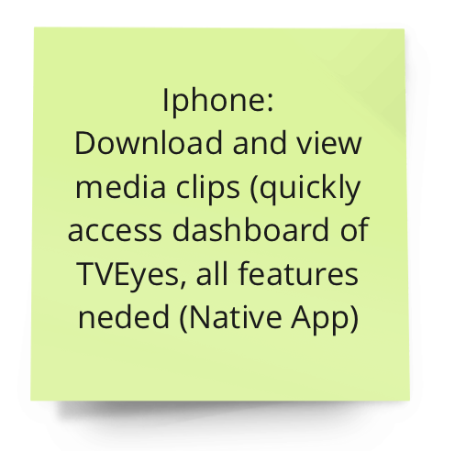

Solution Summary
DISCOVERY RESULTS EXECUTIVE SUMMARY
DESKTOP PRODUCT
1
MOBILE PRODUCT
1
DESIGN SYSTEM
1
REAL USER GROUPS IN MVP
2
This project aims to design a new User Experience with the most important functions from the MMS with improved UX, and some functions from the Fusion product. Users must have the possibility to reset/change passwords on their own.
MVP - is a product with enough features to attract early-adopter customers and validate a product idea created based on CJM (±30 steps) garnered during Discovery Phase.
MVP should cover: CJM 30 steps (Desktop), CJM ±12 steps (Mobile)
Design System (DS) - is a new solution with designed and developed components based on the framework to handle everything consistently.
Technologies: Web Product, Angular Material, Laptops 1280x720 - Desktop 1920x1080
CUSTOMER JOURNEYS
±2
CUSTOMER JOURNEYS STEPS
±30
DESKTOP OS
WINDOWS, MACOS,
RESOLUTIONS LAPTOPS
1280x720
MOBILE OS
IOS, ANDROID
RESOLUTIONS DESKTOP DESKTOPS 1920x1080
IDEAS & SOLUTIONS
±80
DESIGNERS
2 for ±6 Months

Slide 5
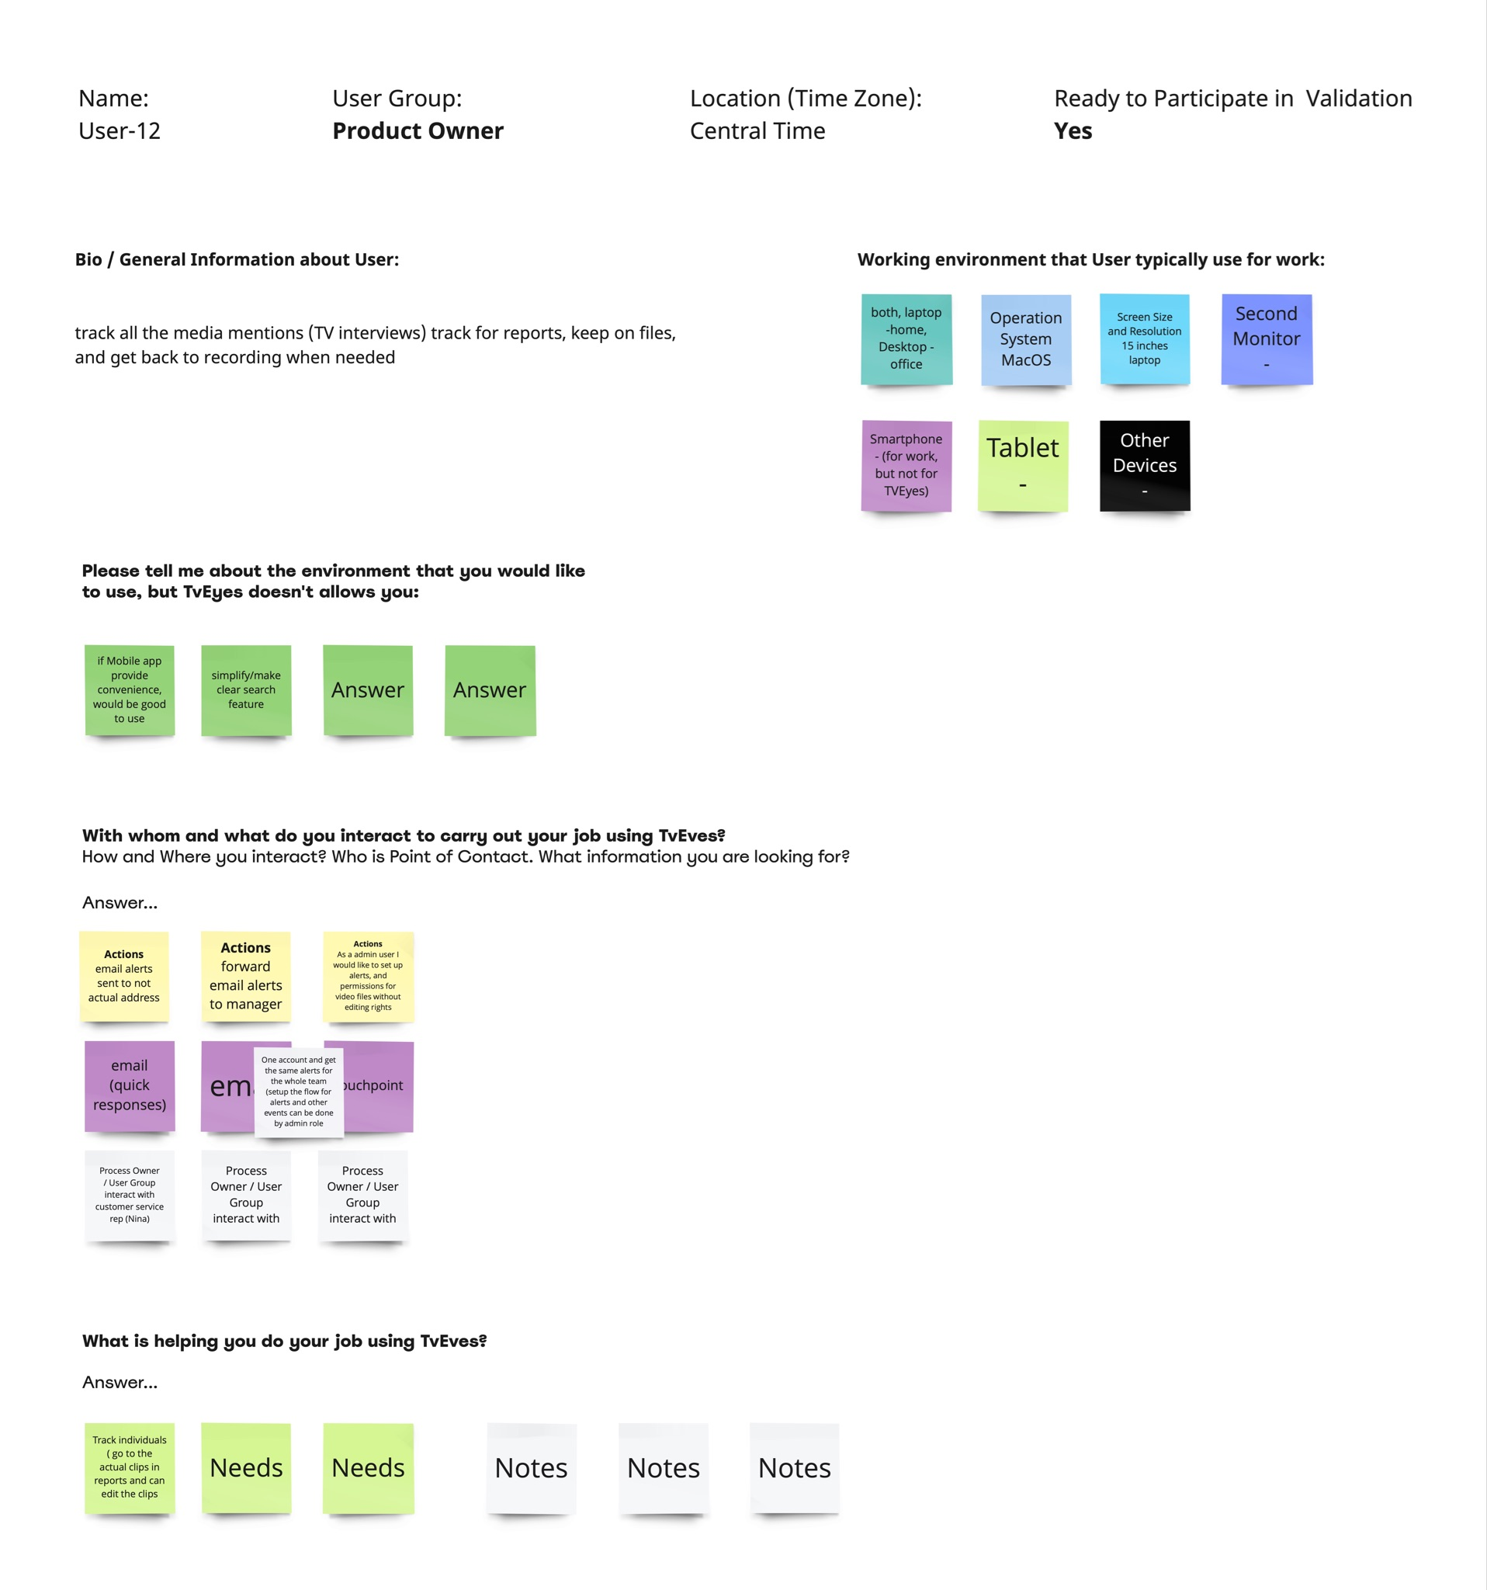
End-Users’
Findings
DISCOVERY END-USERS’ INPUT
We have done interviews with users. The most critical part of these sessions was listening to and observing how users interact with MMS application.
Videos from Interviews
Notes

Slide 6
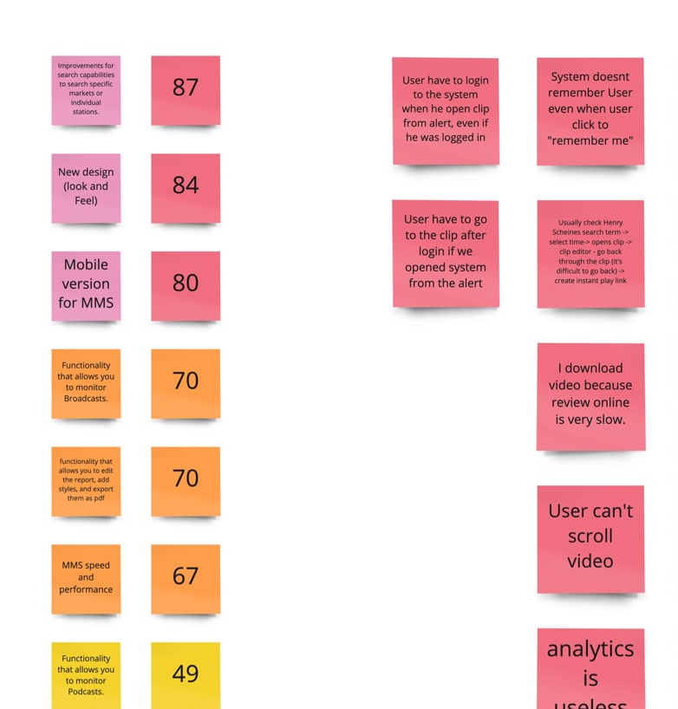
End-Users’
Pain Points
DISCOVERY END-USERS’ INPUT
We have done interviews with users. The most critical part of these sessions was listening to and observing how users interact with MMS application. Users shared some requests and pain points listed here. Also, all these pains you can find on CJM assigned to specific places in application.
Pain Points - Document
Pain Points - MIRO

Slide 7
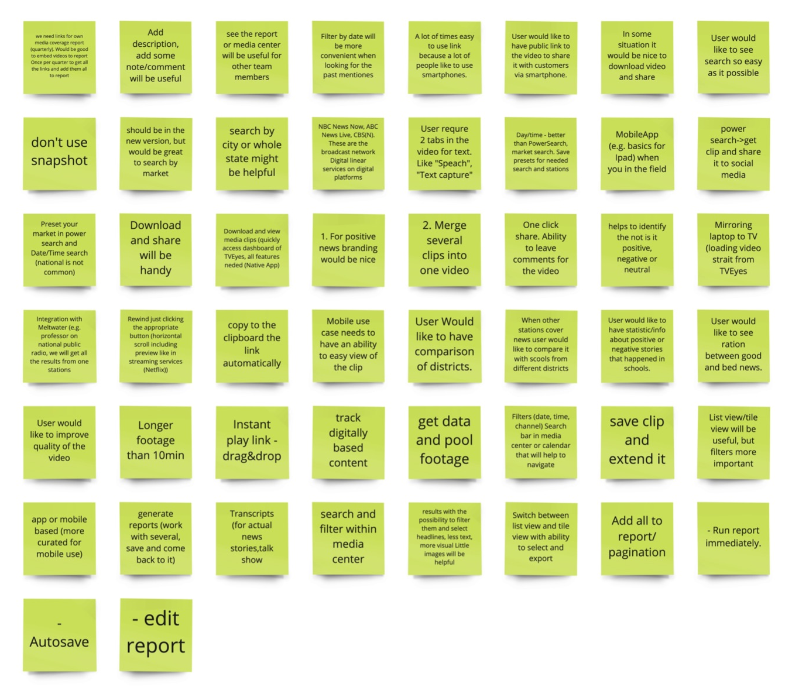
End-Users’ Needs
DISCOVERY END-USERS’ INPUT
We have done interviews with users. The most critical part of these sessions was listening to and observing how users interact with MMS application. User shared some request and needs listed here. Also, all these needs you can find on CJM assigned to specific places in application.
Needs - Document
Needs - MIRO

Slide 8
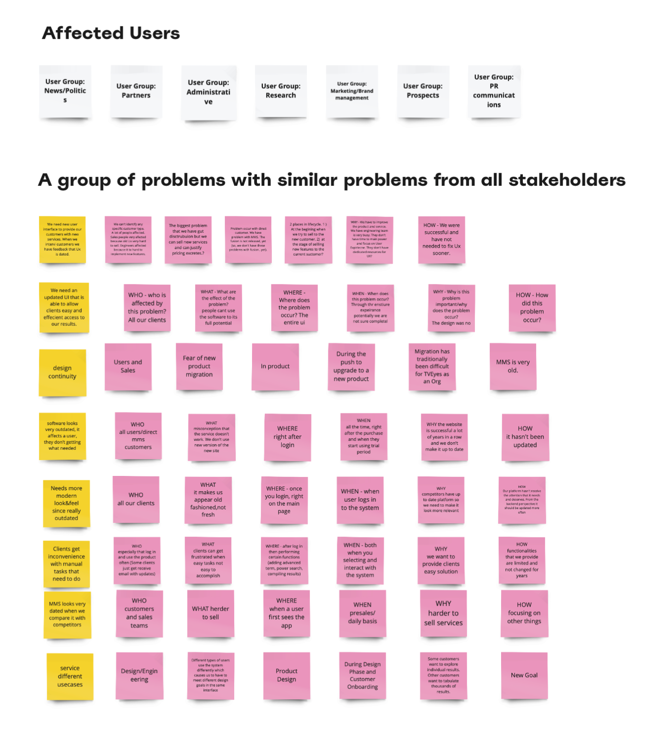
Stakeholders
Findings
DISCOVERY STAKEHOLDERS INPUT
We interviewed managers and developers to understand how MMS, SCOUT, and FUSION products work. Also, to figure out the potential problems your company already faced to avoid these problems.
Problems Statement
Stakeholders Interview

Slide 9
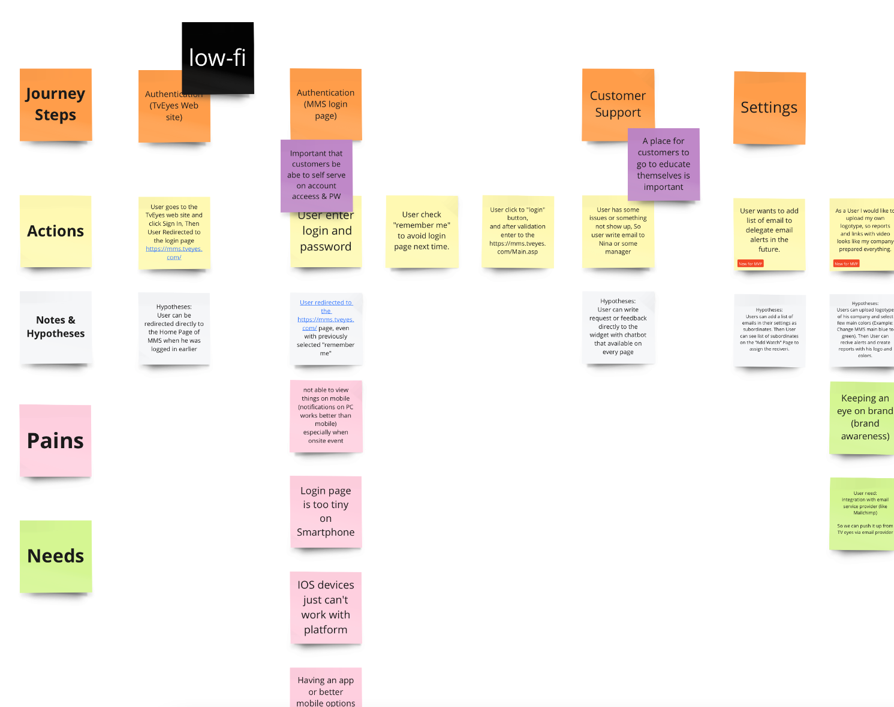
CJM
Methodology
DISCOVERY SCOPE FOR MVP from CJM
CJM - A Customer Journey Map visually represents a customer's experience with your brand. These visuals tell a story about how a customer moves through each interaction phase and experiences each phase.
Break scenario needs a statement into phases. Inspiration from the current MMS with some features/steps from SCOUT and FUSION with new ideas and information from our users.
We mapped user tasks for each phase/step and wrote down these tasks with pain points and ideas for each phase/step.
Have been shared evidence and ideas: gathered screenshots from all products, possible solutions, and anything that can help.
This is an instrument to understand the important scope for MVP, illustrate all problems, needs, and hypotheses to develop.
Full Diagram with CJM

Slide 10
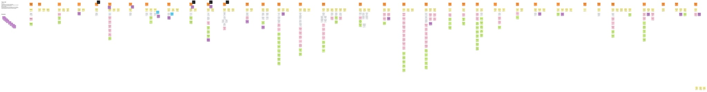

DISCOVERY CJM for MVP
Zoom In

Slide 11
LOW-FI
WIREFRAMES
DISCOVERY HYPOTHESIS IN LOW-FI WIREFRAMES
MMS WEB 3.0 - It is the initial concept to combine more ideas, feedback for the next iteration with more accurate solutions.
Target Audience:
PR Communication, Researchers.
Problems to Solve:
Complicated Search
User can't change settings or password.
Old design with dated UX patterns.
Not possible avoid authentication even with “remember me” checkmark.
Hard to check alerts, review & share clip from mobile.
Clip Viewer: Not possible to scroll video.
Clip Viewer: Not possible to manage volume.
User should enter login and password too many times.
FIGMA PROTOTYPE

Slide 12
The Next
Step is
Design Strategy
DISCOVERY RESULTS NEXT STEP

Slide 13
Links
& Materials
DISCOVERY LINKS
Links | What is it
Google Drive | Shared documents with presentations & everything
Design Board | Miro Board for all design activities and finding where we collaborate and store all outcomes
Design Strategy | This is separated presentation with Design Strategy for MVP
We would like to use this slide for sharing links with Miro, Reports, Plans and shared folders (any other received resources).
So, everyone can use this presentation as a reminder for future purpose.

Slide 14
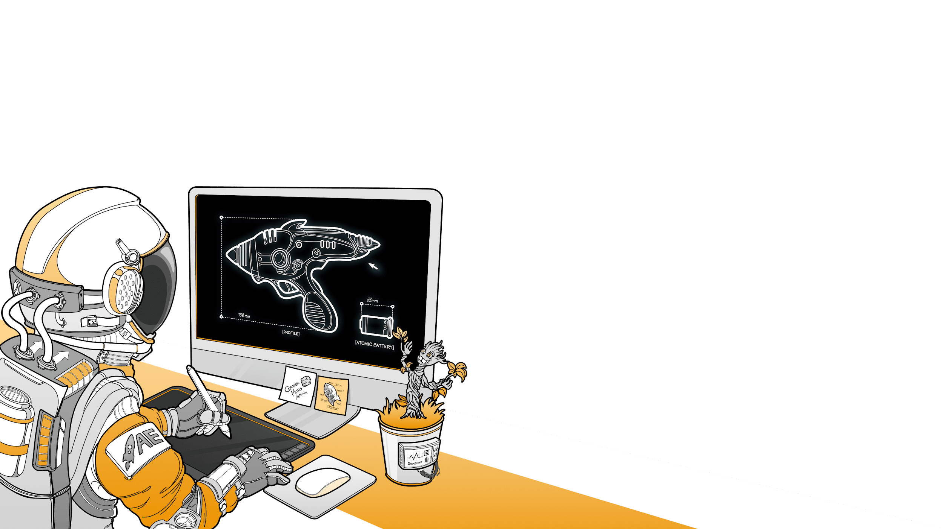

Design proposal
for ToolsGroup
Let’s build something great
Together!
PREPARED FOR
Robert Kaufholz
MAY 21, 2021 (updated)
PREPARED FOR
TvEyes
June, 2022

