Slide 1
Uganda NDC Data Explorer
Decision-support cockpit · powered by Climate TRACE API v7
Climate TRACE API → 3D GIS map → NDC AI chatbot → policy decisions
Stack: React · Express (Node) · Climate TRACE API v7 · OpenAI · MapLibre GL · Vercel
Date: 17 June 2026 Presented by: Tseten Sherpa

Slide 2
The problem
From static NDCs to operational delivery
Today: ministries assemble answers manually
NDC PDFs
Spreadsheets
Email / MRV
Weeks of work
Targets & pledges
Sector data silos
Fragmented evidence
Before any briefing
Five operational questions — unanswered in real time
Where are we today?
What moves the needle?
Policy impact?
Gaps vs target?
What to prioritise?
Our answer: link Uganda's NDC layer to live observed emissions via the Climate TRACE API — not another static report.
Uganda NDC Data Explorer · Demo 17 June 2026 · Data: Climate TRACE API v7
02

Slide 3
Cockpit architecture
Five linked columns — one decision workspace
1 · Targets
2 · Activities
3 · Observed
4 · Progress
5 · Options
NDC pledges Sector filters
Measures & owners Implementation catalog
Climate TRACE API Live MtCO₂e
On-track scoring Gap vs 2030
Mitigation paths Finance scenarios
Uganda NDC catalog
Climate TRACE v7
3D GIS map tab
NDC AI chatbot
Curated targets & strategies
api.climatetrace.org
Satellite terrain Emission bubbles
Grounded briefing OpenAI + citations
Observed column + Emissions Map + NDC AI share one Climate TRACE pipeline — charts, 3D GIS bubbles, and chat answers cite the same live API data.
Uganda NDC Data Explorer · Demo 17 June 2026 · Data: Climate TRACE API v7
03

Slide 4
What you can do here
Six modules for planners, MRV teams and partners — Climate TRACE + Uganda's Updated NDC
Explore NDCs
Data Ingestion
AI Predictions
Planners · sector ministries · focal points
MRV teams · GIS · ministry statistics
Strategy planners · finance · gap screening
Browse sector targets, Climate TRACE progress, mitigation options, and finance links in one cockpit. Useful when you need to see which sectors are on or off track before BTR reporting.
Quick-scan unknown files or map columns to indicators and publish trusted observations. Useful when ministry spreadsheets must sit beside satellite data — triage without committing bad rows.
Forecast 2030 trajectories from observed emissions history; gap cards flag emerging shortfalls. Useful for prioritisation conversations — spot problems early, not at the 2030 deadline.
Policy documents
Policy Impact
My Work
Policy analysts · legal · delegation prep
Socio-economic planners · adaptation teams
Field officers · delivery units · validators
National corpus, CPR passage search on key laws, and intervention pathway diagrams. Useful to find evidence in NDC, NDPIV, and regulations — trace interventions to intended outcomes.
Model policy choices with international case-study analogies and TEF intervention picker. Useful to stress-test options before committing resources — deep-link to finance screening.
Log delivery activities, manage approvals queue, and track pending verifications. Useful to keep evidence organized before it counts toward national reporting.
Each tile maps to a live route in the app — same home screen users see at ndc-data-explorer-e051f914.vercel.app
Uganda NDC Data Explorer · Demo 17 June 2026 · Data: Climate TRACE API v7
04

Slide 5
System architecture
Browser → API → live data — same code local and on Vercel
Presentation
Dashboard
Emissions Map
Policy / Finance
NDC AI
React SPA
Targets · observed · progress
3D GIS bubbles
Pathways · MAC
Grounded chat
same-origin /api/v1 · React Query cache
API layer
emissions
documents
policyImpact
ingest
dashboardAi
Express · Node
TRACE aggregation
CPR corpus
KCI matching
Mapped import
OpenAI proxy
Data sources
Climate TRACE v7
NDC catalog
Postgres
OpenAI
live + versioned
Live emissions API
Repo-versioned
Optional ingest
gpt-4o-mini
Uganda NDC Data Explorer · Demo 17 June 2026 · Data: Climate TRACE API v7
05

Slide 6
Climate TRACE data pipeline
Live observed emissions — API v7 (CC BY 4.0)
EMISSIONS SOURCES
Satellite EO
Climate TRACE API v7
Express API
Land & power
Node.js backend Cache & provenance
• GET /v7/sources/emissions — sector timeseries • GET /v7/sources — asset-level map points • GET /v7/rankings/countries — national totals • GADM2 districts — Uganda disaggregation
Facility data
Power & industry
Postgres / seed
MtCO₂e store /api/v1/provenance
Transport
Road & aviation
React cockpit
https://api.climatetrace.org/v7
Dashboard · 3D GIS NDC AI chatbot
AFOLU models
Land use
In the app: every observed chart shows Climate TRACE provenance — click a bar to trace the source. Not a national inventory replacement; open observed layer for briefing.
Uganda NDC Data Explorer · Demo 17 June 2026 · Data: Climate TRACE API v7
06

Slide 7
Three layers of truth
What is official, what is observed, what is indicative
1 · Official pledges
BUNDLED
Uganda Updated NDC 2022 targets + curated activity catalogue — versioned in the repo.
2 · Observed emissions
LIVE
Climate TRACE API v7 — live MtCO₂e on Dashboard & 3D GIS Map; national 2015+, district 2021+.
3 · Evidence & screening
INDICATIVE
Policy docs (CPR export), indicative finance (MAC), Policy Impact (KCI analogies), pathway diagrams.
4 · Ministry uploads
OPTIONAL
Mapped ingest observations on indicator targets — provenance badge shown when Postgres is configured.
Intended outcomes (targets, pathways) stay visually distinct from measured outcomes (Climate TRACE).
Uganda NDC Data Explorer · Demo 17 June 2026 · Data: Climate TRACE API v7
07

Slide 8
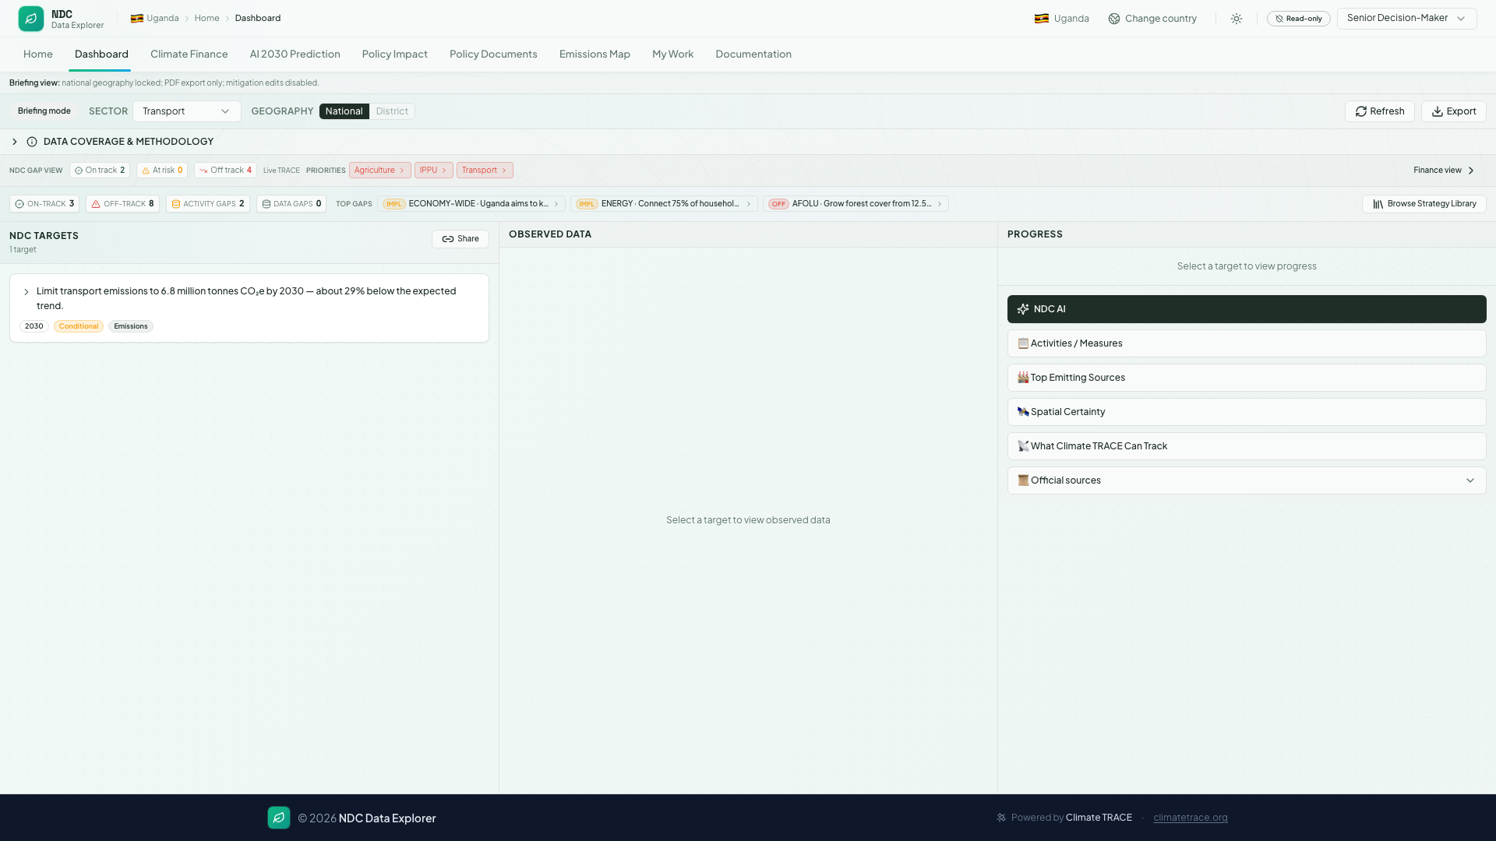
Live product — NDC Dashboard
Observed emissions linked to NDC targets
On screen
Targets
Uganda NDC 2022 pledges by sector
Observed
Live Climate TRACE MtCO₂e timeseries
Progress
On-track status vs 2030 ceiling
NDC AI
Ask a grounded question in plain language
Provenance
Click any bar to trace the source
Uganda NDC Data Explorer · Demo 17 June 2026 · Data: Climate TRACE API v7
08

Slide 9
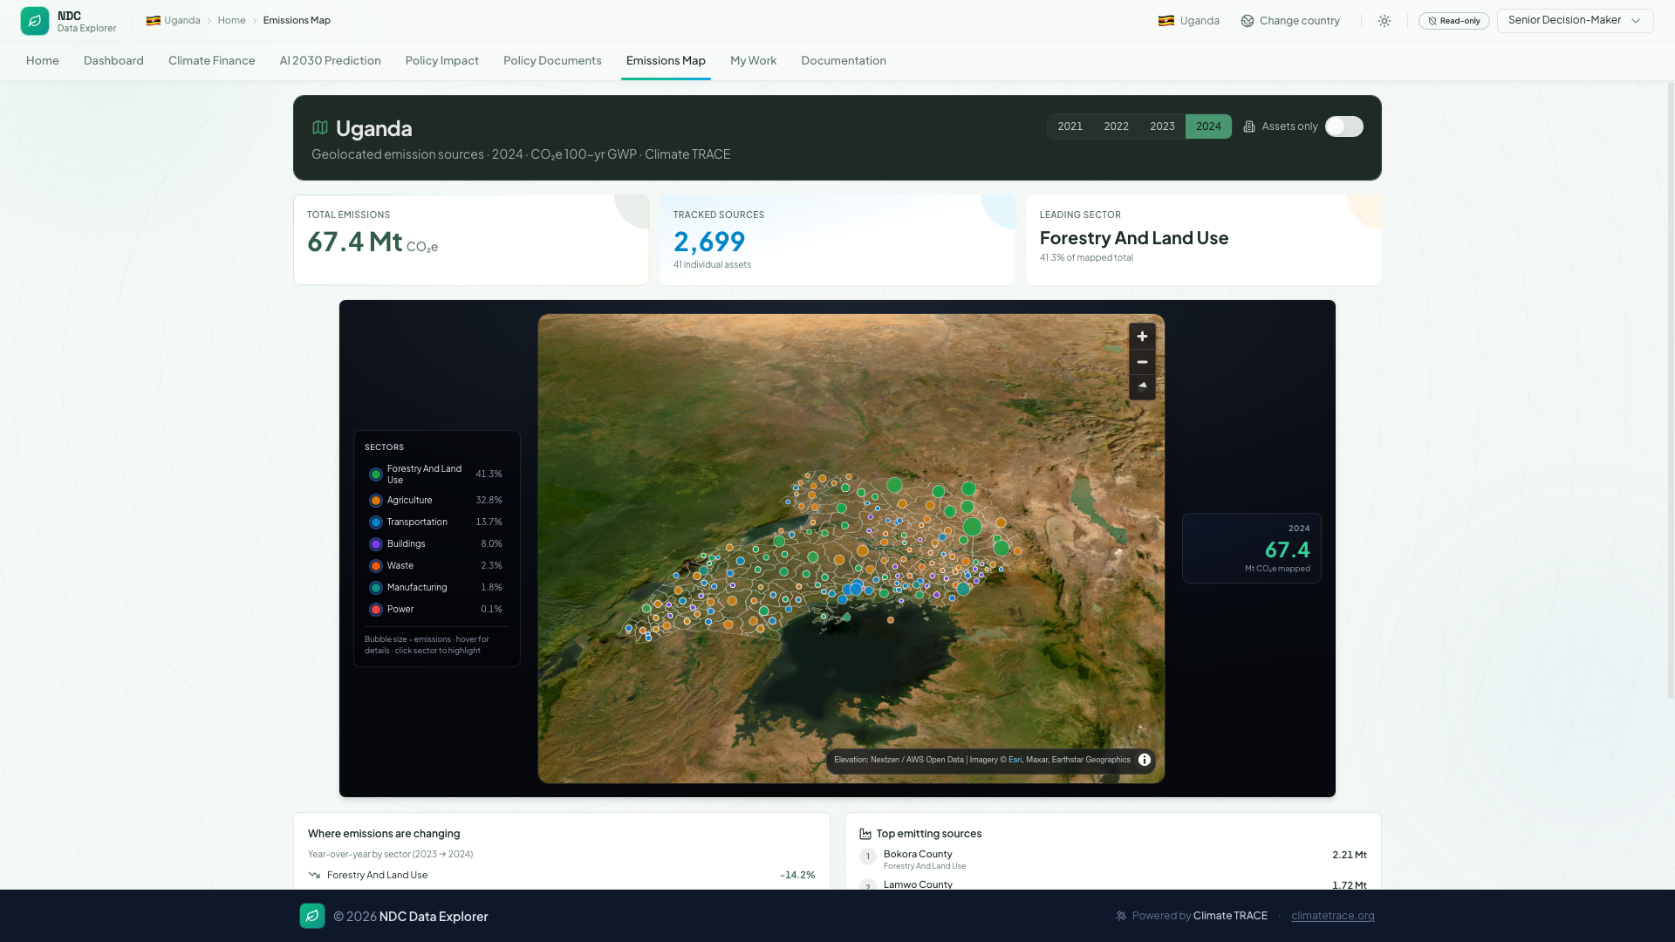
NDC AI & 3D GIS
Intelligence and spatial views on Climate TRACE data
3D GIS representation — Emissions Map
NDC AI chatbot — dashboard sidebar
Climate TRACE /v7/sources
MapLibre GL
GIS bubbles
User question
Context pack
OpenAI API
Asset geo-points per sector
Satellite imagery Terrain DEM 3D
Size ∝ MtCO₂e District overlay
Plain language 'Transport on track?'
Sector · target TRACE progress
Grounded answer With citations
▸ Opens from Progress column → NDC AI button ▸ Tab key fills an example question ▸ Answers cite Climate TRACE + NDC panels ▸ Senior Decision-Maker briefing mode ▸ Not a generic chatbot — country-specific context
Both modules sit on the same Climate TRACE API v7 feed — spatial GIS for where emissions occur, NDC AI for why it matters against Uganda's pledges.
Uganda NDC Data Explorer · Demo 17 June 2026 · Data: Climate TRACE API v7
09

Slide 10
From satellite to decision
How observed data reaches the dashboard
Climate TRACE ingests signals
API v7 serves Uganda sectors
App reconciles vs NDC targets
Decision-maker briefing
Monthly updates 100+ countries
Transport · Energy AFOLU · Waste…
Progress % · gaps District views
Dashboard · Map NDC AI · Finance
What users see
▸ Live Climate TRACE banner on dashboard ▸ Sector timeseries charts (MtCO₂e) ▸ 3D GIS map — satellite terrain + emission bubbles ▸ NDC AI chatbot — grounded briefing with citations ▸ Progress ring vs 2030 NDC pledge
Uganda NDC Data Explorer · Demo 17 June 2026 · Data: Climate TRACE API v7
10

Slide 11
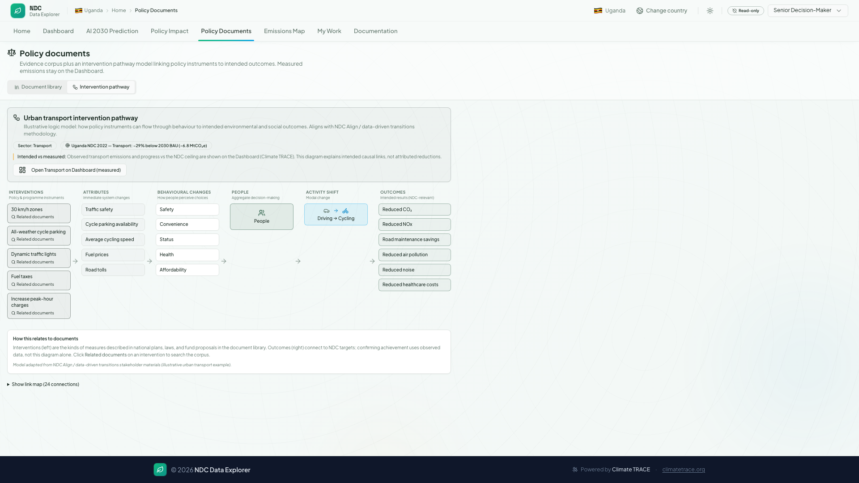
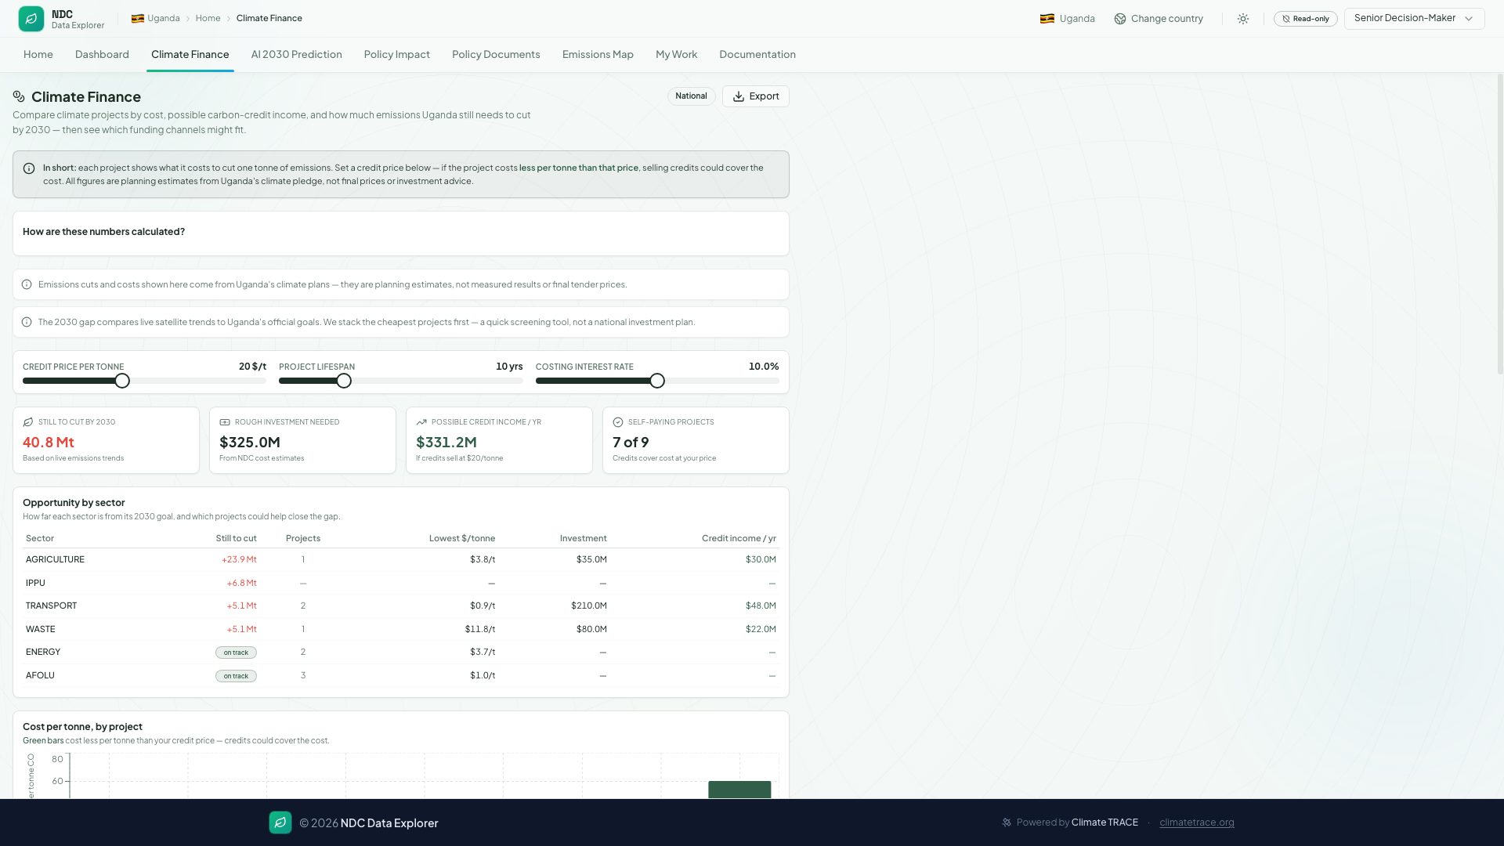
Policy & finance modules
From observed gaps to investment scenarios
Interventions → outcomes, traced to NDC targets (TEF logic model).
Indicative MAC — abatement cost vs potential; fund + MCF hints.
Climate TRACE
Policy docs
Finance MAC
Observed gaps
Intervention map
Abatement cost
Uganda NDC Data Explorer · Demo 17 June 2026 · Data: Climate TRACE API v7
11

Slide 12
5-minute live walkthrough
Suggested flow — Uganda · Transport sector
0:00
0:45
1:15
1:45
2:15
2:45
Explore NDCs
Data Ingestion
AI Predictions
Policy docs
Policy Impact
My Work
Dashboard · Transport Climate TRACE progress
Quick scan file Mapped publish
2030 trajectory Gap cards
CPR passages Intervention path
KCI analogies Finance link
Activities queue Verifications
Punchline: all six home modules — from observed emissions to policy evidence and delivery workflow.
Also in app
Challenges
Live URL
3D GIS map · NDC AI chatbot Finance & MAC screening
Mixed sources · API warm-up Not UNFCCC submission
ndc-data-explorer-e051f914.vercel.app
Uganda NDC Data Explorer · Demo 17 June 2026 · Data: Climate TRACE API v7
12

Slide 13
Challenges & mitigations
Honest limits of a prototype
Climate TRACE ≠ inventory
Open observed layer; label provenance clearly
API cold starts
Pre-warm dashboard, 3D GIS map, and NDC AI before stage
NDC AI availability
Requires OPENAI_API_KEY on API server
Mixed data sources
Curated NDC catalog + live API panels
Official reporting
Briefing tool — not UNFCCC submission
Uganda NDC Data Explorer · Demo 17 June 2026 · Data: Climate TRACE API v7
13

Slide 14
Future roadmap
Scaling beyond Uganda
Policy paper database
Mobile application
Multi-country scale
Searchable national policy corpus per country. Full-text search linked to NDC targets and Climate TRACE sectors.
Field MRV capture and district briefings. Offline views when API is unavailable.
Replicate cockpit for other NDCs. Shared Climate TRACE v7 pipeline; country strategy layers.
Questions? · https://ndc-data-explorer-e051f914.vercel.app
Uganda NDC Data Explorer · Demo 17 June 2026 · Data: Climate TRACE API v7
14

