Slide 1
Uganda NDC Data Explorer
Decision-support cockpit · powered by Climate TRACE API v7
Climate TRACE API → 3D GIS map → NDC AI chatbot → policy decisions
Date: 17 June 2026 Presented by: Tseten Sherpa

Slide 2
The problem
From static NDCs to operational delivery
Today: ministries assemble answers manually
NDC PDFs
Spreadsheets
Email / MRV
Weeks of work
Targets & pledges
Sector data silos
Fragmented evidence
Before any briefing
Five operational questions — unanswered in real time
Where are we today?
What moves the needle?
Policy impact?
Gaps vs target?
What to prioritise?
Our answer: link Uganda's NDC layer to live observed emissions via the Climate TRACE API — not another static report.
Uganda NDC Data Explorer · Demo 17 June 2026 · Data: Climate TRACE API v7
02

Slide 3
Cockpit architecture
Five linked columns — one decision workspace
1 · Targets
2 · Activities
3 · Observed
4 · Progress
5 · Options
NDC pledges Sector filters
Measures & owners Implementation catalog
Climate TRACE API Live MtCO₂e
On-track scoring Gap vs 2030
Mitigation paths Finance scenarios
Uganda NDC catalog
Climate TRACE v7
3D GIS map tab
NDC AI chatbot
Curated targets & strategies
api.climatetrace.org
Satellite terrain Emission bubbles
Grounded briefing OpenAI + citations
Observed column + Emissions Map + NDC AI share one Climate TRACE pipeline — charts, 3D GIS bubbles, and chat answers cite the same live API data.
Uganda NDC Data Explorer · Demo 17 June 2026 · Data: Climate TRACE API v7
03

Slide 4
Climate TRACE data pipeline
Live observed emissions — API v7 (CC BY 4.0)
EMISSIONS SOURCES
Satellite EO
Climate TRACE API v7
Express API
Land & power
Node.js backend Cache & provenance
• GET /v7/sources/emissions — sector timeseries • GET /v7/sources — asset-level map points • GET /v7/rankings/countries — national totals • GADM2 districts — Uganda disaggregation
Facility data
Power & industry
Postgres / seed
MtCO₂e store /api/v1/provenance
Transport
Road & aviation
React cockpit
https://api.climatetrace.org/v7
Dashboard · 3D GIS NDC AI chatbot
AFOLU models
Land use
In the app: every observed chart shows Climate TRACE provenance — click a bar to trace the source. Not a national inventory replacement; open observed layer for briefing.
Uganda NDC Data Explorer · Demo 17 June 2026 · Data: Climate TRACE API v7
04

Slide 5
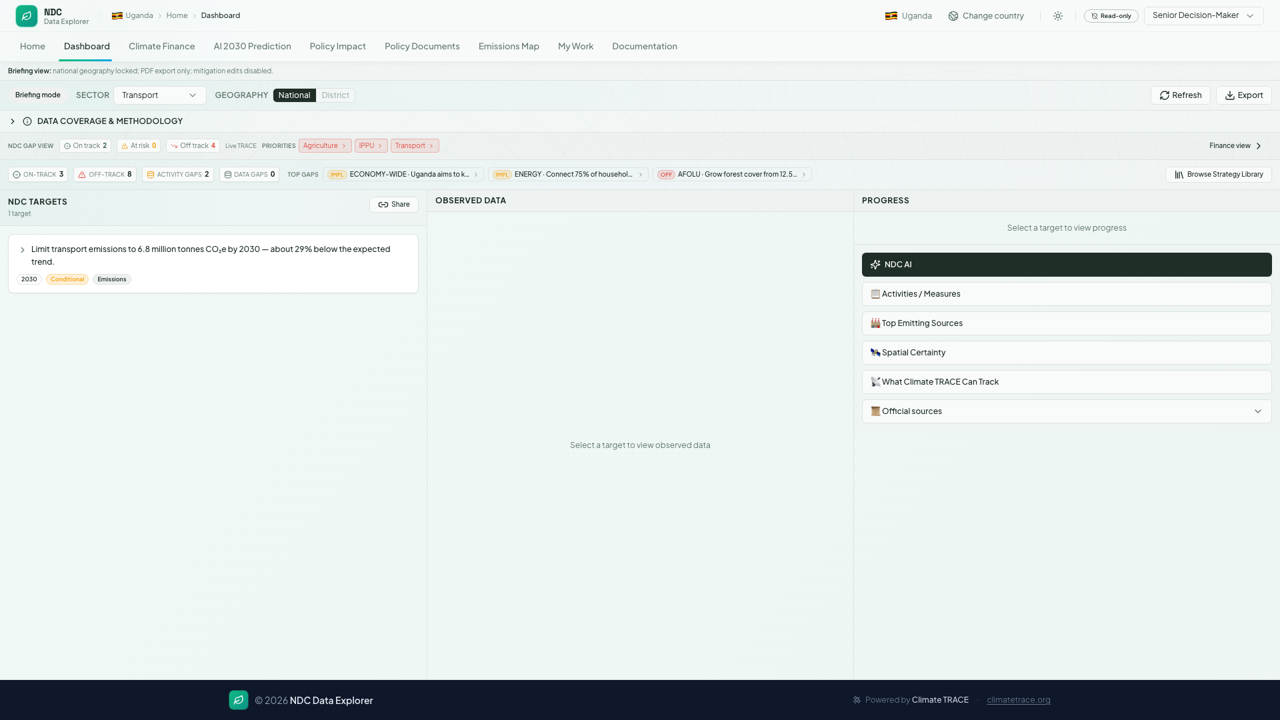
Live product
NDC Dashboard — observed emissions linked to targets
Uganda NDC Data Explorer · Demo 17 June 2026 · Data: Climate TRACE API v7
05

Slide 6
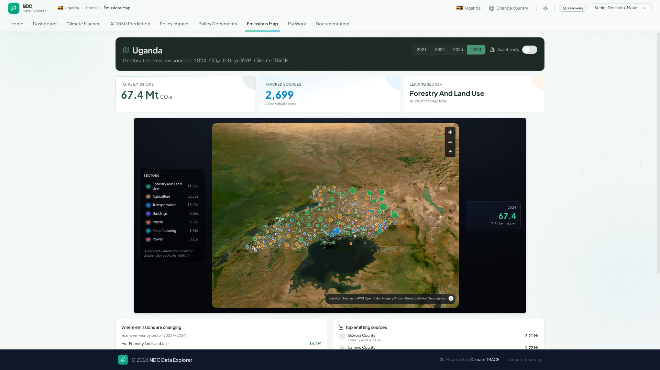
NDC AI & 3D GIS
Intelligence and spatial views on Climate TRACE data
3D GIS representation — Emissions Map
NDC AI chatbot — dashboard sidebar
Climate TRACE /v7/sources
MapLibre GL
GIS bubbles
User question
Context pack
OpenAI API
Asset geo-points per sector
Satellite imagery Terrain DEM 3D
Size ∝ MtCO₂e District overlay
Plain language 'Transport on track?'
Sector · target TRACE progress
Grounded answer With citations
▸ Opens from Progress column → NDC AI button ▸ Tab key fills an example question ▸ Answers cite Climate TRACE + NDC panels ▸ Senior Decision-Maker briefing mode ▸ Not a generic chatbot — country-specific context
Both modules sit on the same Climate TRACE API v7 feed — spatial GIS for where emissions occur, NDC AI for why it matters against Uganda's pledges.
Uganda NDC Data Explorer · Demo 17 June 2026 · Data: Climate TRACE API v7
06

Slide 7
From satellite to decision
How observed data reaches the dashboard
Climate TRACE ingests signals
API v7 serves Uganda sectors
App reconciles vs NDC targets
Decision-maker briefing
Monthly updates 100+ countries
Transport · Energy AFOLU · Waste…
Progress % · gaps District views
Dashboard · Map NDC AI · Finance
What users see
▸ Live Climate TRACE banner on dashboard ▸ Sector timeseries charts (MtCO₂e) ▸ 3D GIS map — satellite terrain + emission bubbles ▸ NDC AI chatbot — grounded briefing with citations ▸ Progress ring vs 2030 NDC pledge
Uganda NDC Data Explorer · Demo 17 June 2026 · Data: Climate TRACE API v7
07

Slide 8
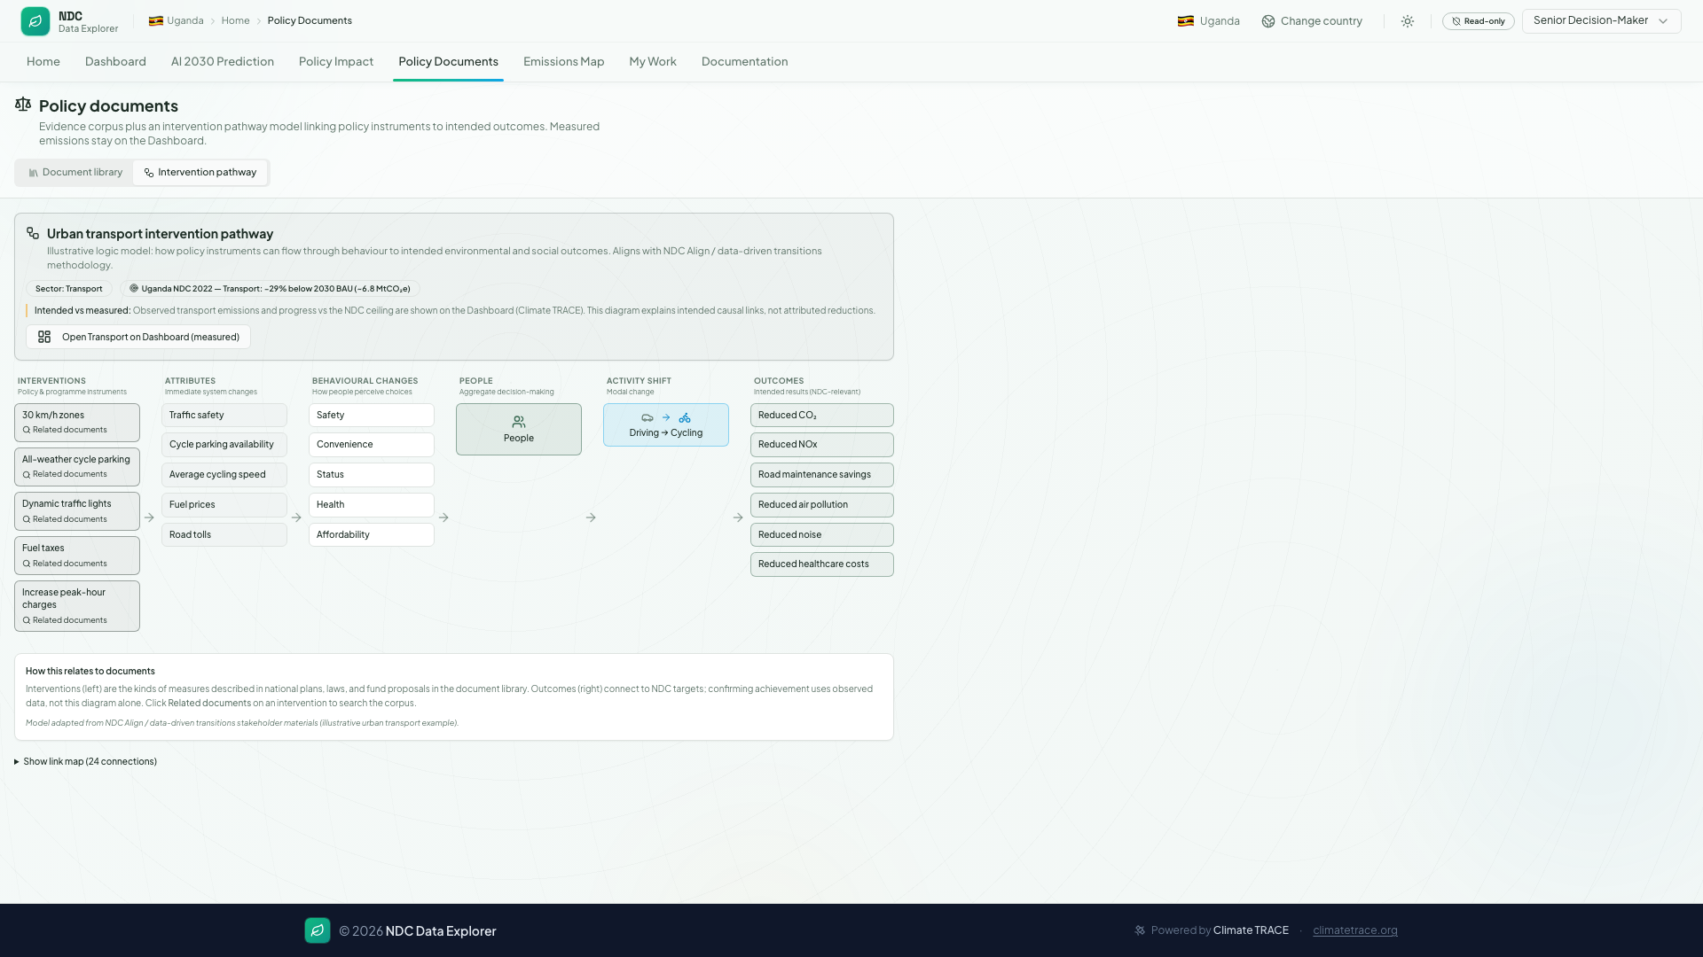
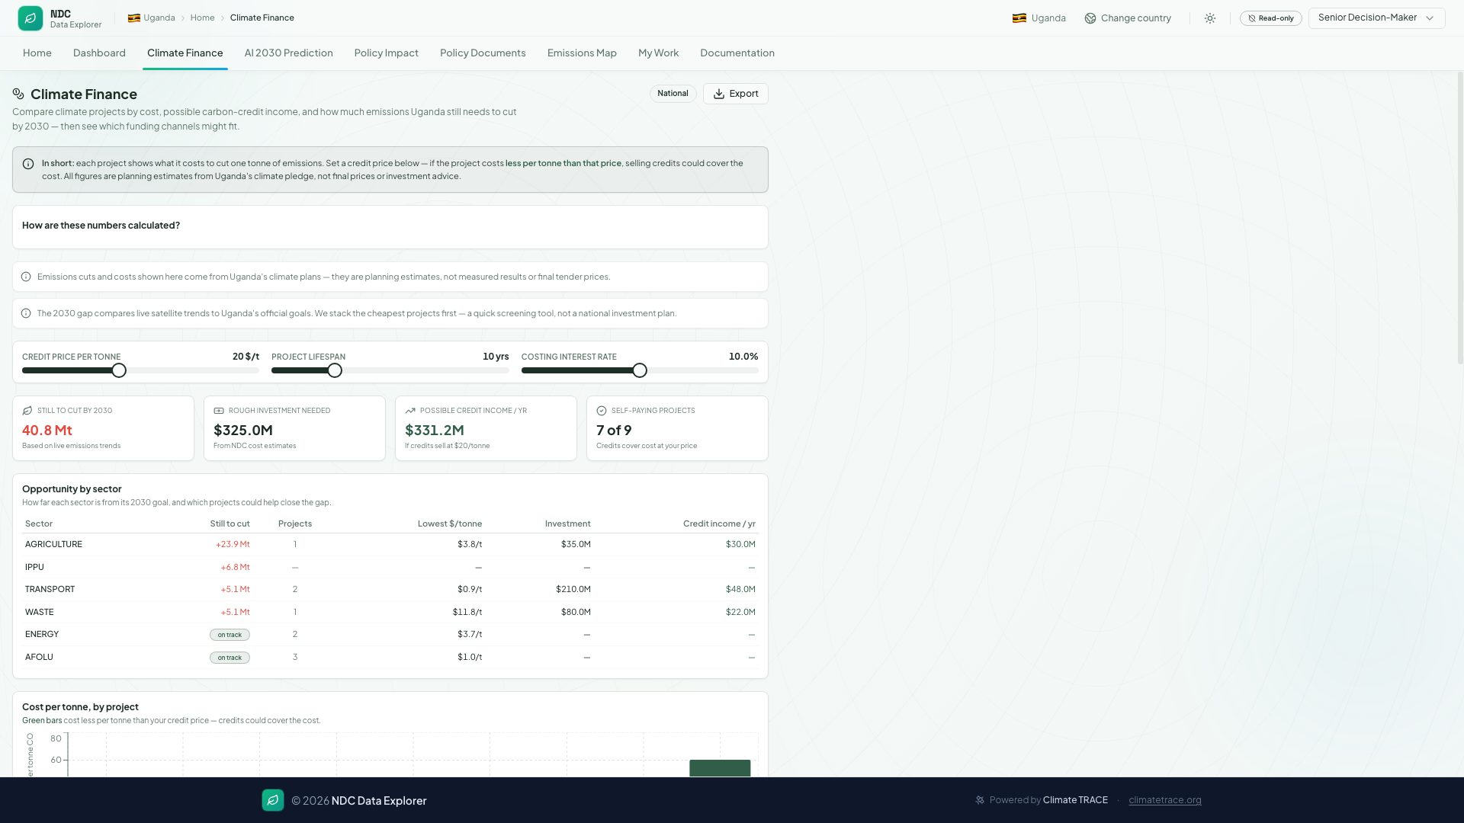
Policy & finance modules
From evidence to investment scenarios
Climate TRACE
Policy docs
Finance MAC
Observed gaps
Intervention map
Abatement cost
Uganda NDC Data Explorer · Demo 17 June 2026 · Data: Climate TRACE API v7
08

Slide 9
5-minute demo journey
Presenter flow — Uganda · Transport sector
0:00
1:00
1:45
2:10
2:40
Dashboard
3D GIS map
Documents
Finance
NDC AI
Transport sector Climate TRACE data
Emissions Map tab Satellite · bubbles
Policy pathway NDC linkage
Cost & abatement MAC chart
Chatbot briefing Tab → ask
Punchline: from reporting to decision support — one operational system for NDC delivery.
Challenges
Future
Live URL
Mixed sources · API warm-up Not UNFCCC submission
Policy corpus per country Mobile MRV app
ndc-data-explorer-e051f914.vercel.app
Uganda NDC Data Explorer · Demo 17 June 2026 · Data: Climate TRACE API v7
09

Slide 10
Challenges & mitigations
Honest limits of a prototype
Climate TRACE ≠ inventory
Open observed layer; label provenance clearly
API cold starts
Pre-warm dashboard, 3D GIS map, and NDC AI before stage
NDC AI availability
Requires OPENAI_API_KEY on API server
Mixed data sources
Curated NDC catalog + live API panels
Official reporting
Briefing tool — not UNFCCC submission
Uganda NDC Data Explorer · Demo 17 June 2026 · Data: Climate TRACE API v7
10

Slide 11
Future roadmap
Scaling beyond Uganda
Policy paper database
Mobile application
Multi-country scale
Searchable national policy corpus per country. Full-text search linked to NDC targets and Climate TRACE sectors.
Field MRV capture and district briefings. Offline views when API is unavailable.
Replicate cockpit for other NDCs. Shared Climate TRACE v7 pipeline; country strategy layers.
Questions? · https://ndc-data-explorer-e051f914.vercel.app
Uganda NDC Data Explorer · Demo 17 June 2026 · Data: Climate TRACE API v7
11

