Slide 1
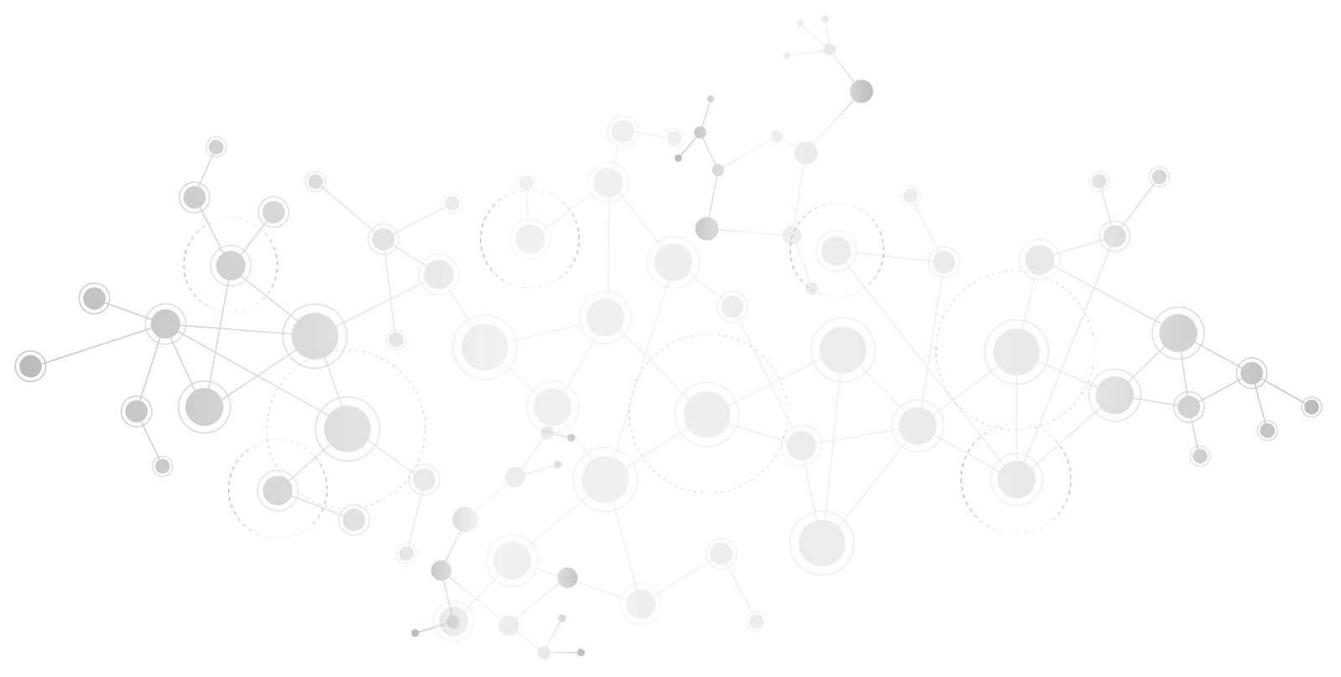
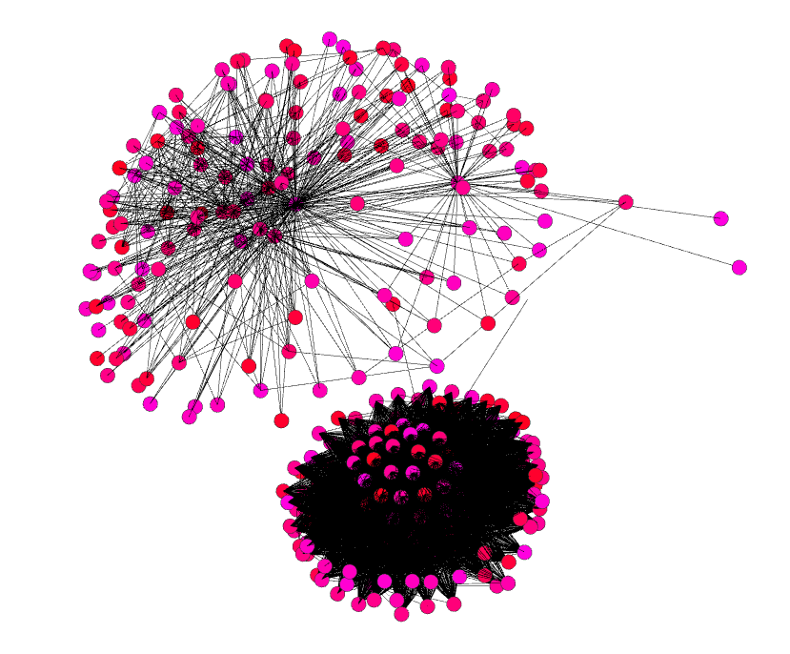
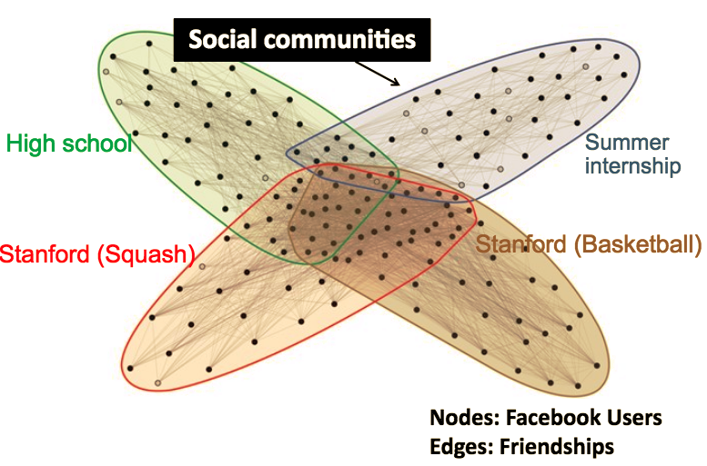
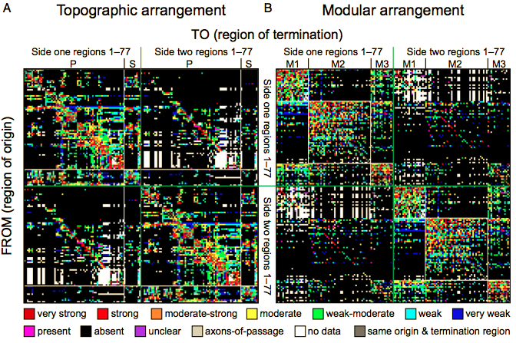
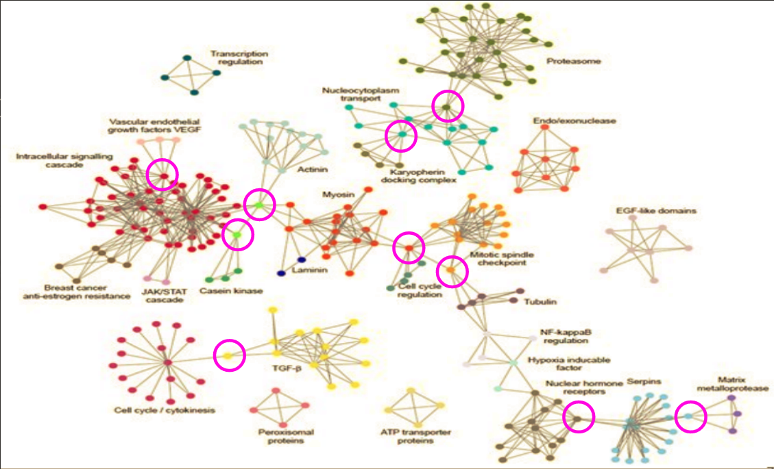
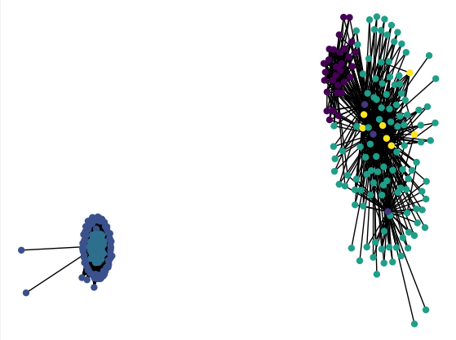
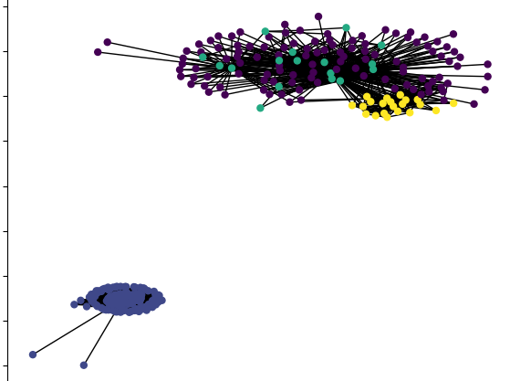
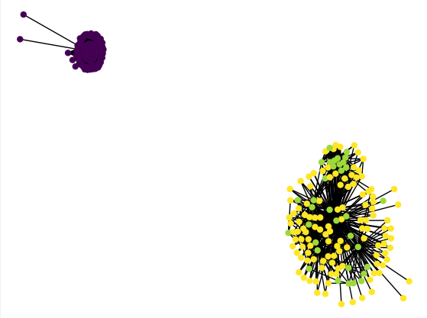
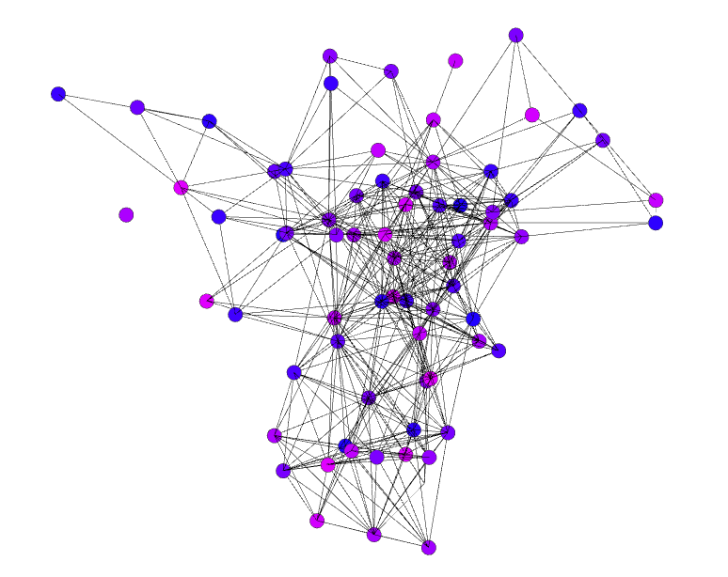
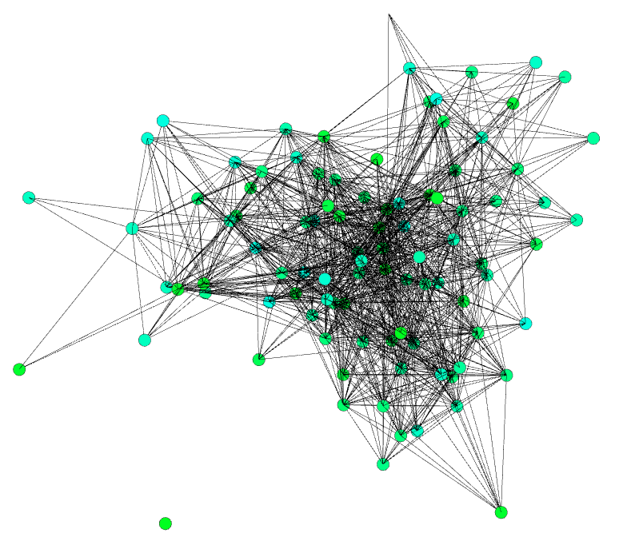

`
Analysis of Mammal Connectomes for Detection of
Overlapping Module Structure
Tom Evans, Kavin Aravind, Rishi Pulluri
Advisor: T. M. Murali
BACKGROUND
3-D Mouse Cortex
EVALUATION
Nodes in a network often have properties which allow them to be classified into community-like structures called modules. Theoretical network models are often structured with disjoint modules, but modules in real world networks tend to overlap due to nodes which belong to multiple modules at once.
Visualizations of the mammal connectomes reveal modular properties of the networks. The mouse cortex has three distinct modules, two of which clearly overlap in three-dimensional space. The COPRA algorithm is used to detect overlapping modules in large-scale networks and takes a single parameter V to indicate the degree by which modules may overlap. Running the COPRA algorithm on the mouse connectome with suggested parameters V=2, V=4, and V=6 results in a smaller number of modules with a greater amount of overlap.
Overlapping modules in brain networks serve the purpose of linking various regions and hemispheres by a small amount of neurons so that they may work in conjunction. In the macaque cortex, modules representing the visual cortex and memory regions overlap to train the species for survival. In the mouse connectome, heavy overlap was found between modules concerned with sensory function (sight, smell, sound) and production of emotion (amygdala region), suggesting there exists a relationship between the two.
Proteins which simultaneously belong to more than one complex cause overlap and allow for physical interactions between regions of the brain.
308 Nodes
11,858 Edges
V = 2
V = 4
V = 6
SOURCES
3-D Macaque Cortex
3-D Cat Cortex
Swanson, Larry W., et al. “Organizing Principles for the Cerebral Cortex Network of Commissural and Association Connections.” PNAS, National Academy of Sciences, 2 Nov. 2017,
www.pnas.org/content/early/2017/11/01/1712928114.Sporns, Olaf & Zwi, Jonathan. (2004). The Small World of the Cerebral Cortex. Neuroinformatics. 2. 145-62. 10.1385/NI:2:2:145.
J.W. Scannell, G.A.P.C. Burns, C.C. Hilgetag, M.A. O'Neil, M.P. Young; The Connectional Organization of the Cortico-thalamic System of the Cat, Cerebral Cortex, Volume 9, Issue 3, 1 April 1999, Pages 277–299, https://doi.org/10.1093/cercor/9.3.277
Felleman DJ, Van Essen DC. Distributed hierarchical processing in the primate cerebral cortex. Cereb Cortex. 1991 Jan-Feb;1(1) 1-47. doi:10.1093/cercor/1.1.1. PMID: 1822724.
Steve Gregory (2010). Finding overlapping communities in networks by label propagation. New Journal of Physics, 12, 103018.
METHOD
We will analyze various mammal connectomes using the COPRA Algorithm (Gregory, 2010) to detect overlapping module structure in large-scale networks. This extends on the label propagation technique to assign module identifiers to nodes in a network. The networks we will focus on come from well-researched mammal cortices including the macaque, cat, and most recently, the mouse.

