Slide 1
Beginning with FreeSurfer
and getting ready for ExploreDTI
They are both in versacea@10.145.65.122:/data/Phillips2/projects/dtistudy/BIOS/script

Slide 2
ExploreDTI in command line
http://sites.cardiff.ac.uk/cubric/cubric-users/user-documentation/mri-resources/mri-how-to/using-exploredti-via-the-command-line/

Slide 3
Analytic Flow
Resampling T1 image into DWI voxel size (2mm^3).
Generating the DWI.mat file with customized parameters (not sure how you can enter these?)
Getting to set the parameters before starting with correcting procedures. Automated Masking
SM/EC/EPI correction
Correcting the DWIs for Subject Motion (SM), Eddy Current (EC) and EPI distortions. I attached a txt file with all these settings to be entered in the command line of SM_EC_EPI_correction.
Extracting the DWIs.nii and DWIs.bvec from the SM_EC_EPI_DWI.mat file to reconstruct the fibers (TRACULA).
Whole-brain tractography (DTI)
Create Connectivity Matrices

Slide 4
Resampling T1 image (${BFS}/${SUBJECT}/mri/brain.mgz) into DWI voxel size (2mm^3).
# First change LIA to RAS.
${MRI_CONVERT} ${BFS}/${SUBJECT}/mri/brain.mgz ${EXPLOREDTI}/T1_1mm_RAS/${SUBJECT}_T1_masked_RAS.nii --out_orientation RAS
# To enable parallel computation to use ExploreDTI
matlabpool(n_workers) (??8??);
# To disable: matlabpool close
-------------------------------------------------------------------------------------------------------------------
#From now on use ExploreDTI in : the most of the scripts are in /data/Phillips2/projects/dtistudy/ExploreDTI/Source/Plugins/
### I don’t want the software ExploreDTI to be in the dtistudy folder, please move it where you think is more convenient####.
---
# Resample the T1 image.
script: E_DTI_Resample_nii.p (or ??? E_DTI_Resample_nii_ex.p or E_DTI_Resample_nii_ex_me.p or E_DTI_resample_nii_file.p ??? NOT SURE WHICH ONE IS THE CORRECT ONE)
input: ${EXPLOREDTI}/T1_1mm_RAS/${SUBJECT}_T1_masked_RAS.nii
destination/output: ${EXPLOREDTI}/REORDERED/${SUBJECT}_T1.nii
voxel size: [2 2 2]

Slide 5
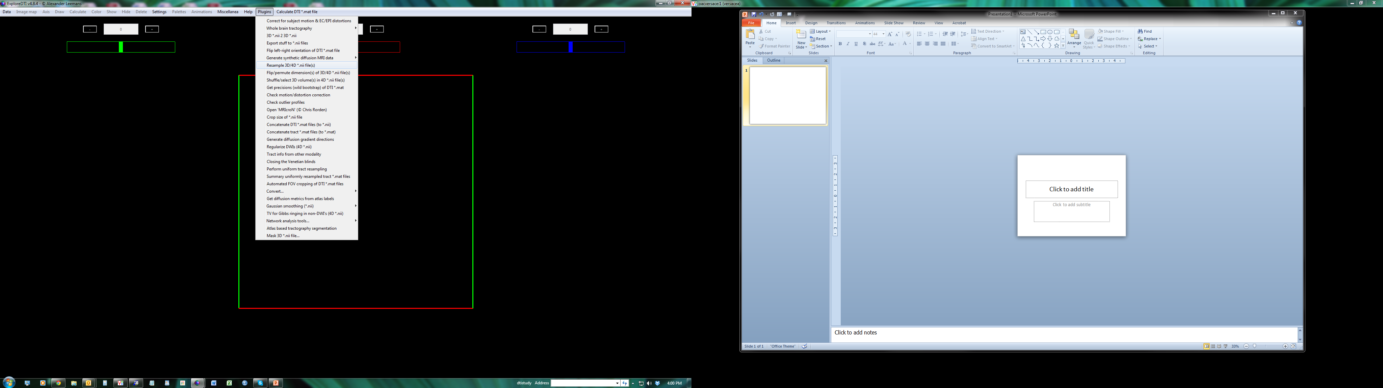
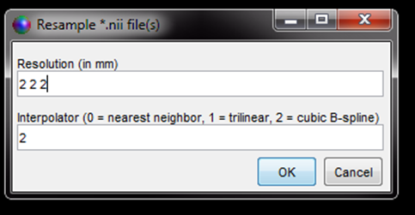
GUI: Resampling T1 image (${BFS}/${SUBJECT}/mri/brain.mgz) into DWI voxel size (2mm^3).

Slide 6
Generating the DWI.mat file with customized parameters
# script: E_DTI_convert_nii_dic_2_txt.p
# input and output destination folder: ${EXPLOREDTI}/REORDERED/.
?? Script to Convert folder of DICOMs to an ExploreDTI .mat file:
script syntax: E_DTI_Script_Get_DTI_folders(source_dir,target_dir)
source_dir = /data/Phillips2/projects/dtistudy/BIOS/data/exploreDTI/REORDERED
target_dir = /data/Phillips2/projects/dtistudy/BIOS/data/exploreDTI/REORDERED
NOT SURE HOW YOU CAN ENTER THE FOLLOWING PARAMETERS (NEXT SLIDE)?

Slide 7
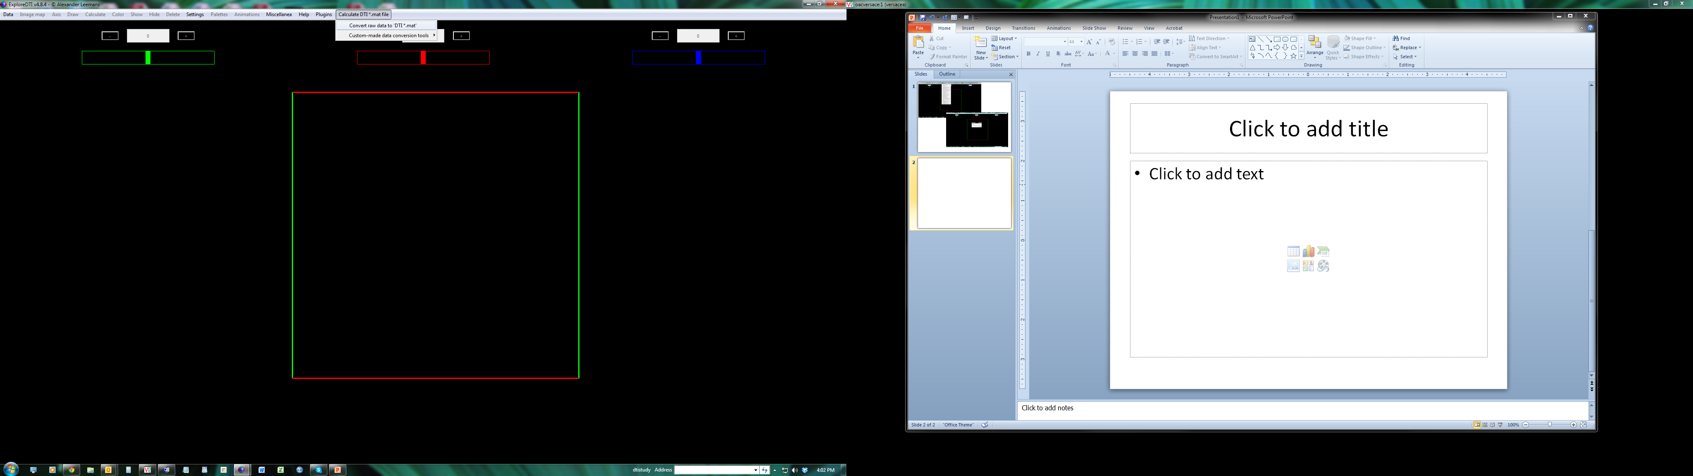
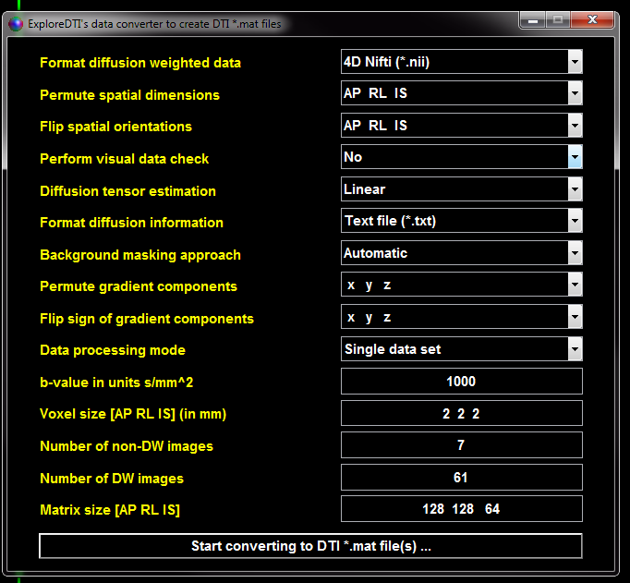

Slide 8
Setting the parameters/ Correcting the DWIs for Subject Motion (SM), Eddy Current (EC) and EPI distortions
script: E_DTI_SMECEPI_Main(parameter_filename);
destination folder: /data/Phillips2/projects/dtistudy/BIOS/data/exploreDTI/MC_D_EPI/
mv /data/Phillips2/projects/dtistudy/BIOS/data/exploreDTI/MC_D_EPI/*trafo.mat /data/Phillips2/projects/dtistudy/BIOS/data/exploreDTI/MC_D_EPI/trafo/.
mv /data/Phillips2/projects/dtistudy/BIOS/data/exploreDTI/MC_D_EPI/*native.mat /data/Phillips2/projects/dtistudy/BIOS/data/exploreDTI/MC_D_EPI/native/.

Slide 9
GUI to set the parameters before starting with correcting procedures. These will probably be defined all at once in the command line.
Automated Masking
SM/EC/EPI correction

Slide 10
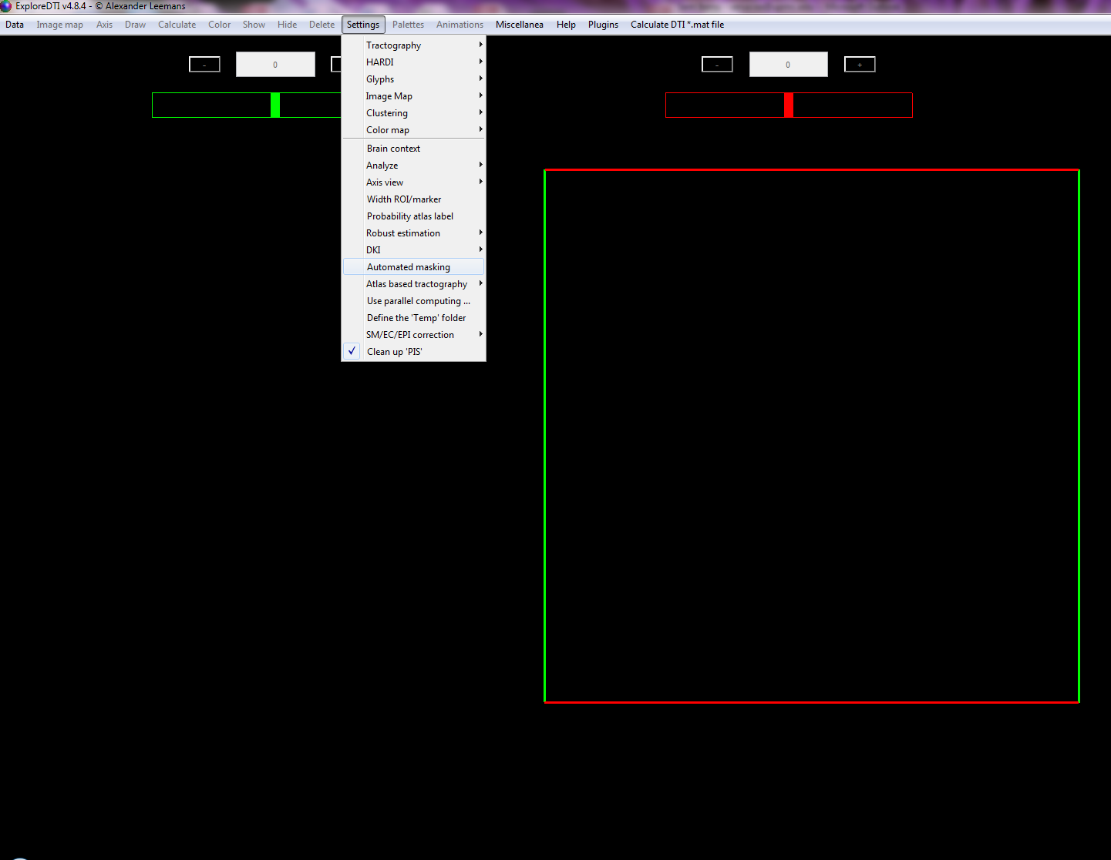
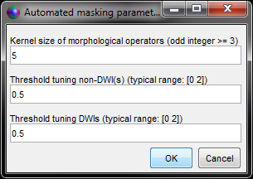

Slide 11
GUI to set the parameters before starting with correcting procedures. These will probably be defined all at once in the command line.
Automated Masking
SM/EC/EPI correction

Slide 12
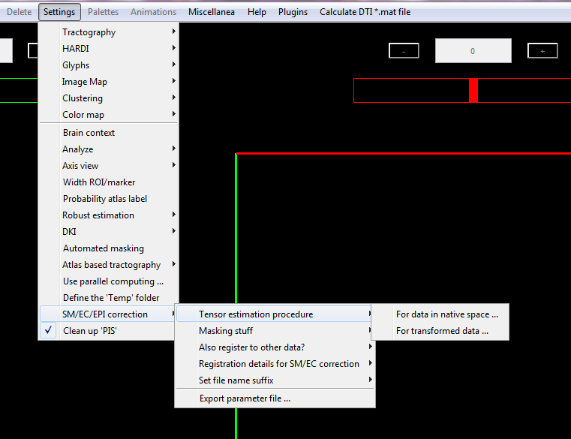
For native space=4
For transformed data=4

Slide 13
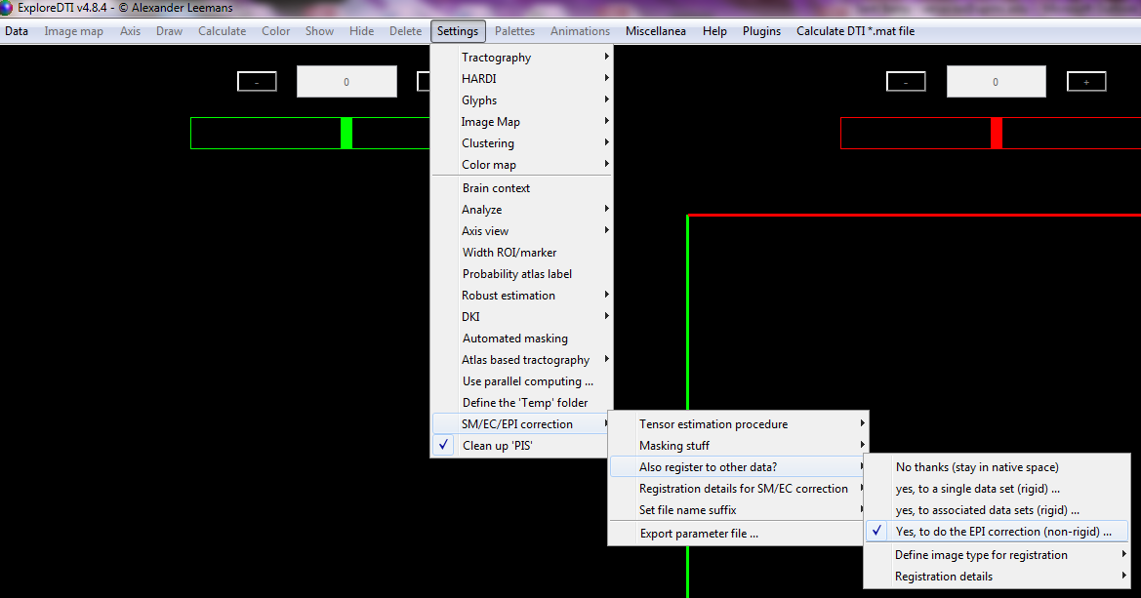
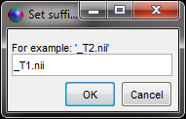

Slide 14
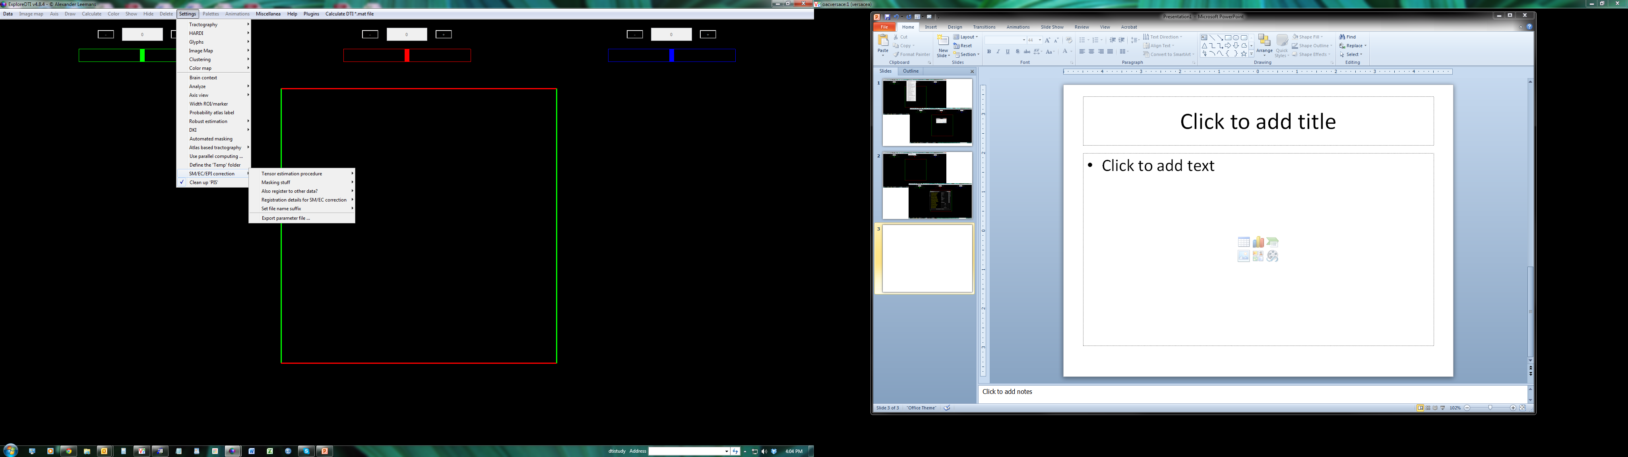
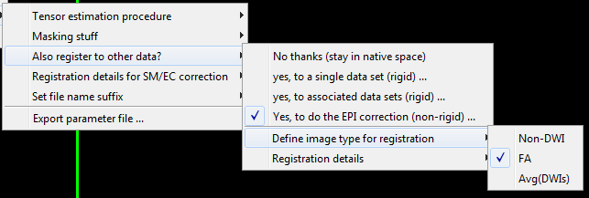

Slide 15
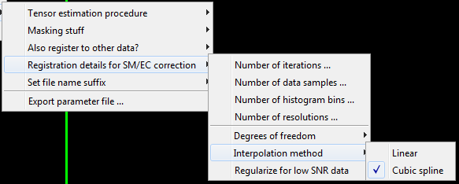

Slide 16
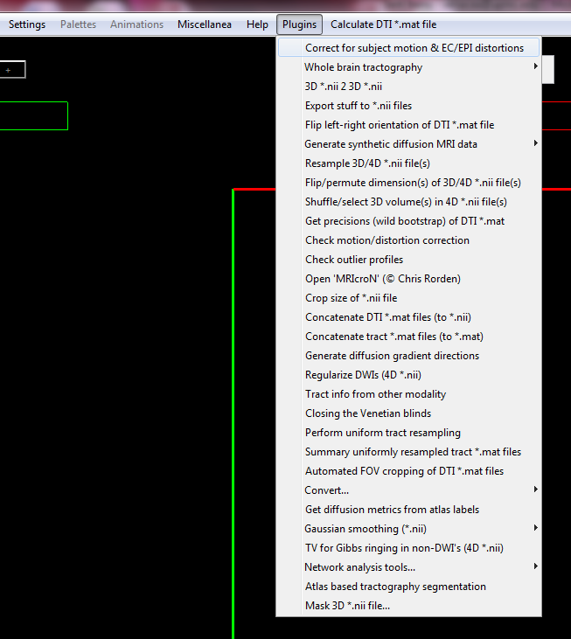

Slide 17
Extracting the DWIs.nii and DWIs.bvec from the SM_EC_EPI_DWI.mat file to reconstruct the fibers (TRACULA).
Script??
Source folder: /data/Phillips2/projects/dtistudy/BIOS/data/exploreDTI/MD_C_EPI/trafo/.
Destination folder: /data/Phillips2/projects/dtistudy/BIOS/data/exploreDTI/DWIs/.
------
mv /data/Phillips2/projects/dtistudy/BIOS/data/exploreDTI/DWIs/${SUBJECT}_MD_C_trafo_grads.txt /data/Phillips2/projects/dtistudy/BIOS/data/exploreDTI/DWIs/61directions/.
/data/Phillips2/projects/dtistudy/BIOS/data/exploreDTI/DWIs/61directions/convertGrads.sh . ..
# now *_MD_C_trafo_grads68.txt should look like this:
mkdir /data/Phillips2/projects/dtistudy/BIOS/data/tracula/${SUBJECT}/orig
mv /data/Phillips2/projects/dtistudy/BIOS/data/exploreDTI/DWIs/${SUBJECT}_MD_C_trafo_DWIs.nii /data/Phillips2/projects/dtistudy/BIOS/data/tracula/ ${SUBJECT}/orig /.
mv /data/Phillips2/projects/dtistudy/BIOS/data/exploreDTI/DWIs/${SUBJECT}_MD_C_trafo_grads68.txt /data/Phillips2/projects/dtistudy/BIOS/data/tracula/ ${SUBJECT}/orig /.

Slide 18
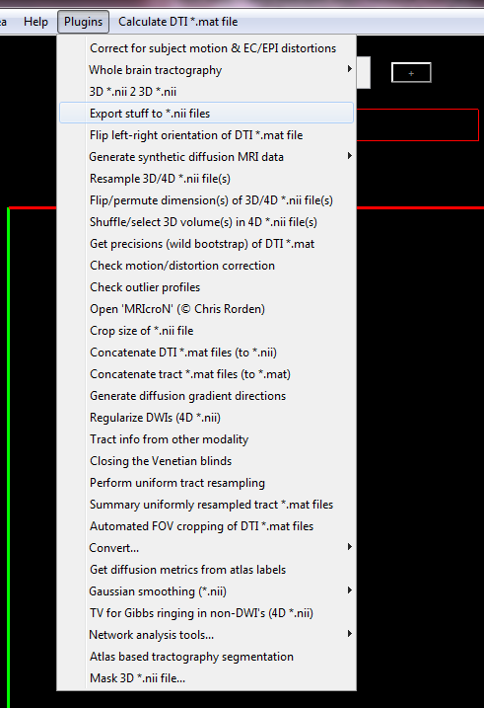
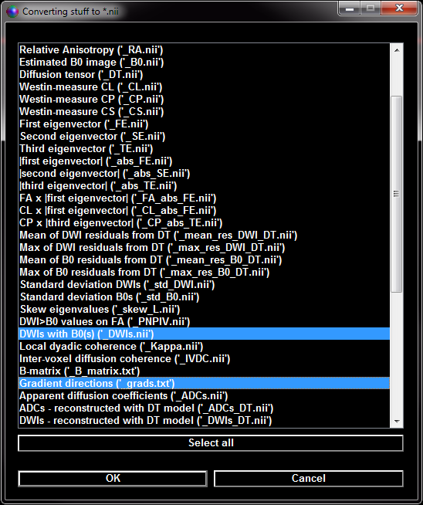

Slide 19
Other example
bval211

Slide 20
Now with TRACULA, run trac-all
trac-all –c /data/Phillips2/projects/dtistudy/BIOS/data/tracula/scripts/dmrirc.${SUBEJCT} –prep
trac-all –c /data/Phillips2/projects/dtistudy/BIOS/data/tracula/scripts/dmrirc.${SUBEJCT} –bedp
trac-all –c /data/Phillips2/projects/dtistudy/BIOS/data/tracula/scripts/dmrirc.${SUBEJCT} –path
# Here is an example of the script needed for each subject:
# All the subjects will need a dmrirc file.
# I usually, just sed ‘s/20120303.1953/${SUBEJECT}/g’

Slide 21
Going back to ExploreDTI (in parallel) run whole-brain tractography (DTI)
WholeBrainTrackingDTI(filename_in, filename_out, parameters);
With the following parameters: paramaters.SeedPointRes = [3 3 3] paramaters.StepSize = 1 paramaters.FAThresh = 0.2000 paramaters.AngleThresh = 45 paramaters.FiberLengthRange = [50 500]
Source & Destination folder: /data/Phillips2/projects/dtistudy/BIOS/data/exploreDTI/MD_C_EPI/trafo/.

Slide 22
And Create Connectivity Matrices
E_DTI_Network_analysis_exe(dti_filename,tracts_filename,img_filename,A_T,A_L,L,VDims_A,mat_dir,img_suffix,selected_labels,ACh);
dti_filename = name of the DTI .mat file
#/data/Phillips2/projects/dtistudy/BIOS/data/exploreDTI/MD_C_EPI/trafo/*MD_C_trafo.mat tracts_filename = name of the DTI tracts .mat file
#/data/Phillips2/projects/dtistudy/BIOS/data/exploreDTI/MD_C_EPI/trafo/*MD_C_trafo_Tracts_DTI.mat img_filename = [] # for now A_T = 3D volume of the atlas (e.g. AAL) reference template. Note this volume must be read into MATLAB using the command:A_T=E_DTI_load_nii(‘template_filename’)
#/data/Phillips2/projects/dtistudy/ExploreDTI/Templates/AAL_Template.nii A_L = 3D volume of the atlas (e.g. AAL) labels. As above, the volume need to be loaded into MATLABA_L=E_DTI_load_nii(‘labels_filename’) #/data/Phillips2/projects/dtistudy/ExploreDTI/Templates/AAL_Labels.nii L = cell array of label names for each region in A_L.
#/data/Phillips2/projects/dtistudy/ExploreDTI/Templates/AAL_Label_Names.txt mat_dir = Directory to save the connectivity matrices
#/data/Phillips2/projects/dtistudy/BIOS/data/exploreDTI/CMs img_suffix = [] # for now. selected_labels = a n_labelsx2 matrix of pairs of label indices to create an individual tract .mat file for that pair of labels. Use [] to disable. Use nchoosek(1:n_atlas_labels,2) to output for every pair of labels # for now. ACh = 3

