Slide 1
Measuring Diversity with R
ECES 450 Tutorial #4
Dan Dunkers, Toshika Fegade, Anthony Knesis

Slide 2
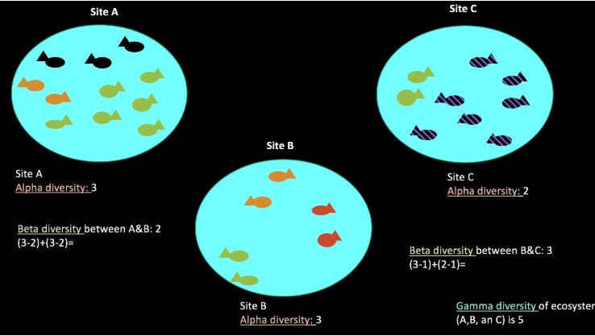
Diversity – how many species?
Alpha diversity refers to the average species diversity in a habitat or specific area. Alpha diversity is a local measure.
Beta diversity refers to the ratio between local or alpha diversity and regional diversity. This is the diversity of species between two habitats or regions.
Gamma diversity is the total diversity of a landscape and is a combination of both alpha and beta diversity.

Slide 3
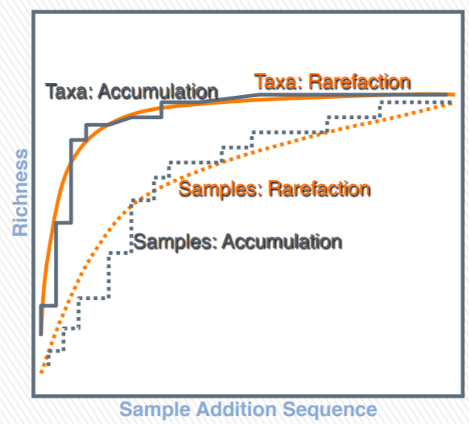
Alpha Diversity - Rarefaction
Estimators of Alpha diversity reveal that there might be some rare species that have not been effectively observed. The purpose of an alpha diversity estimator is to extrapolate from the available observations to the total number of species existing in the community.
Rarefaction is one of the important incidents associated with Alpha diversity to get adequate observations to achieve a successful measurement of an Alpha diversity metric. This is undertaken by drawing a rarefaction curve that depicts the changes in a metric in the form of several observations that keeps on increasing. If the curve converges into horizontal asymptote then it depicts that more observations or more reads will show little or no impact on the metric.

Slide 4
Indicators in Microbiome Package - R
All indicators from the richness, diversity, evenness, dominance, and rarity functions are available.
Richness | Observed, Chao1
Diversity | Inverse Simpson, gini Simpson, Shannon, Fisher, Coverage
Evenness | Camargo, pielou, Simpson, Evar, Bulla
Dominance | Dbp, dmn, relative, absolute, simpson, core abundance, gini
Rarity | Log modulo skewness, low abundance, rare abundance

Slide 5
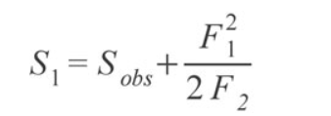



Diversity Measures in R
Richness – estimate of how many species appear in sample.
Observed Species – simple count of unique OTUs in each sample
Chao1 index – estimate diversity from abundance data; stresses importance of rare OTUs (assumes Poisson distribution)
Diversity – weights the number and abundances of species.
Inverse Simpson - Alpha diversity with alpha=2, i.e. weighted arithmetic mean of squared proportional abundance of types in the dataset of interest.
Shannon - Logarithmic measure of entropy.
Coverage - Number of species needed to cover 50% of the ecosystem.
Evenness – measures species count against relative abundance of each OTU. As species richness and evenness increase, so diversity increases.
Dominance - gives abundance of the most abundant species.
Rarity – concentration of species at low abundance
Notes:
Here Sobs is the number of species in the sample, F1 is the number of singletons (i.e., the number of species with only a single occurrence in the sample) and F2 is the number of doubletons (the number of species with exactly two occurrences in the sample).
The idea behind the estimator is that if a community is being sampled, and rare species (singletons) are still being discovered, there is likely still more rare species not found; as soon as all species have been recovered at least twice (doubletons), there is likely no more species to be found.
Inverse simpson - The greater the biodiversity in an area, the higher the value of D. The lowest possible defined value of D is 1 and would occur if the community contained only one species. The maximum value would occur if there was perfect evenness and would be equal to the number of species.
Shannon - The idea is that the more different letters there are, and the more equal their proportional abundances in the string of interest, the more difficult it is to correctly predict which letter will be the next one in the string. The Shannon entropy quantifies the uncertainty (entropy or degree of surprise) associated with this prediction.

Slide 6
Alpha Diversity - Demo
dietswap data - The diet swap data set represents a study with African and African American groups undergoing a two-week diet swap.
https://www.nature.com/articles/ncomms7342
Libraries/Commands used –
install.packages("BiocManager")
library(BiocManager)
BiocManager::install("microbiome")
BiocManager::install("openxlsx")
BiocManager::install("knitr")
BiocManager::install("ggpubr")
More info - https://bioconductor.org/packages/devel/bioc/manuals/microbiome/man/microbiome.pdf

Slide 7
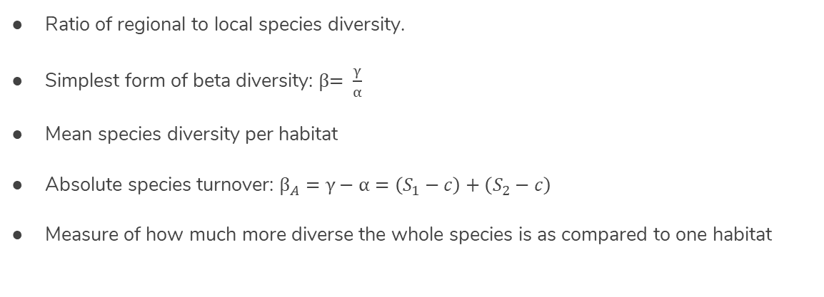
Beta Diversity
Ratio of regional to local species diversity.
Simplest form of beta diversity: β$= \frac{γ}{α}$
Mean species diversity per habitat
Absolute species turnover: ${\text{β}}_{A}=γ−α=\left(S_{1}−c\right)+\left(S_{2}−c\right)$
Measure of how much more diverse the whole species is as compared to one habitat

Slide 8
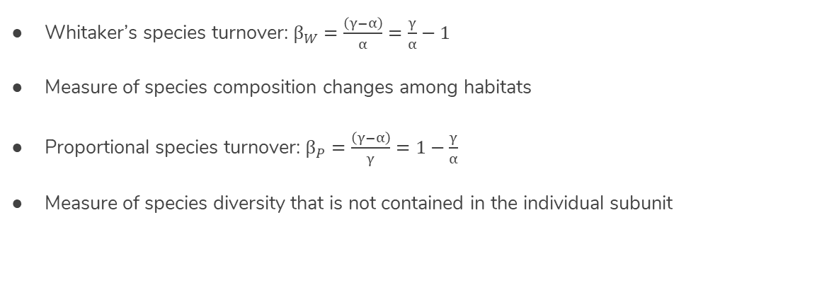
Beta Diversity cont.
Whitaker’s species turnover: ${\text{β}}_{W}=\frac{\left(γ−α\right)}{α}=\frac{γ}{α}−1$
Measure of species composition changes among habitats
Proportional species turnover: ${\text{β}}_{P}=\frac{\left(γ−α\right)}{γ}=1−\frac{γ}{α}$
Measure of species diversity that is not contained in the individual subunit

Slide 9
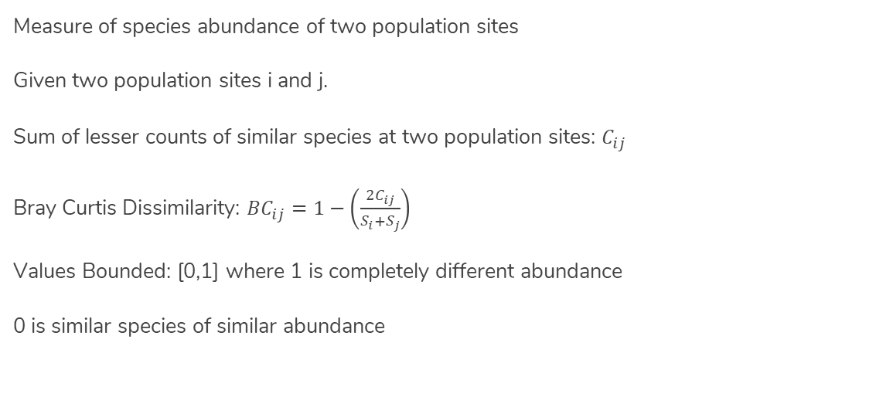
Beta Diversity - Bray Curtis Dissimilarity
Measure of species abundance of two population sites
Given two population sites i and j.
Sum of lesser counts of similar species at two population sites: $C_{ij}$
Bray Curtis Dissimilarity: ${BC}_{ij}=1−\left(\frac{2C_{ij}}{S_{i}+S_{j}}\right)$
Values Bounded: [0,1] where 1 is completely different abundance
0 is similar species of similar abundance

Slide 10
PERMANOVA
PERmutational
Validates significance through random sampling
Multivariate
Assess influence of multiple factors (e.g. individual taxa)
ANalysis Of
VAriance
Is data best explained with several clusters or single group?

Slide 11
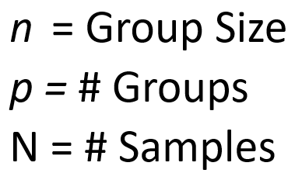
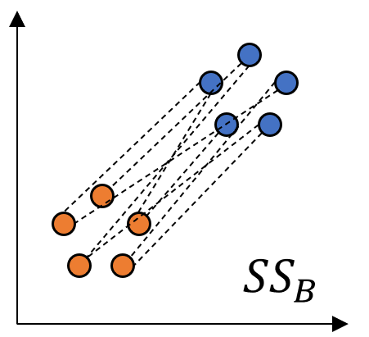
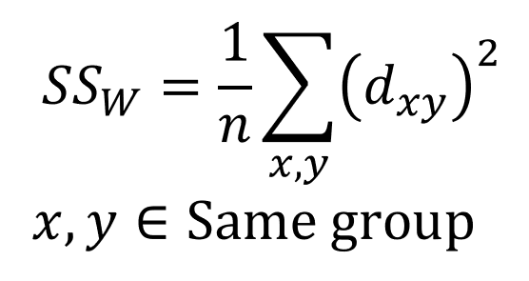
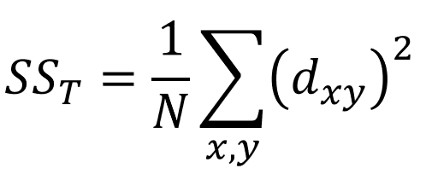

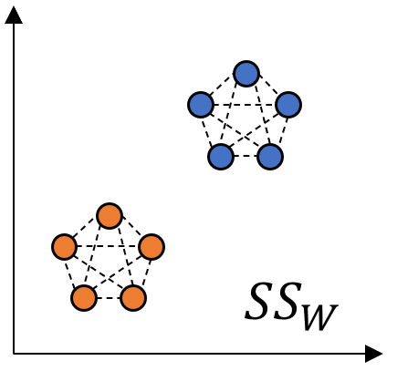
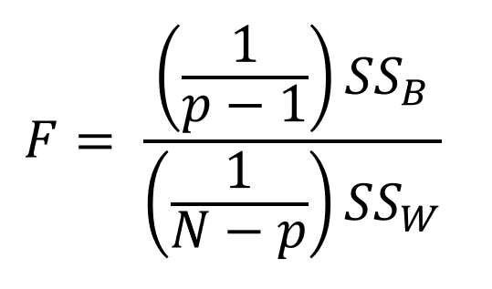
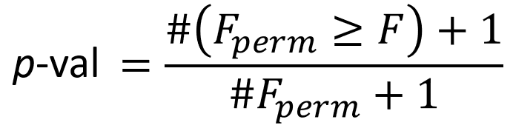
Statistical Basis
Flexible choice of pairwise distance d_{xy}
Within-Group
Between-Group
Likelihood of this result
Test Statistic
Permutations shuffle group labelings

Slide 12
Hypothesis Test Comparison
 | t-Test | ANOVA | PERMANOVA
Number of Groups | 2 | 2 or more | 2 or more
Number of Variables | Single Variable (Mean) | Single (ANOVA) Multiple (MANOVA) | Multiple Variables
Test Statistic | Diff. of Means | Ratio of Variances | Any Distance Matrix
Statistic Distribution | t-Distribution (~Gaussian) | F-distribution | Non-Parametric
Advantages | Generalizable for data with unequal variances | Very high power (confident about alt. hypotheses) | Allows for fewer samples, sparser data
Notes:
Anderson, M.J. (2017). Permutational Multivariate Analysis of Variance (PERMANOVA). In Wiley StatsRef: Statistics Reference Online (eds N. Balakrishnan, T. Colton, B. Everitt, W. Piegorsch, F. Ruggeri and J.L. Teugels).

Slide 13
Microbiome Community Variation
Groups - Metadata (location, time, etc.)
Variables - OTUs, species abundances, etc.
Demo
Hypothesis Do these groups of bacteria
come from multiple communities?
Hypothesis -
Permutations - Compare with bootstrapping

Slide 14
Thank you!

