Slide 1
Taxonomic Classification of Sequences from WGS - Kraken 2
ECES 450/650 Tutorial 7
Toshika S Fegade, Neha Cherian, Wenhan Tan
Notes:
WGS - Whole genomic sequencing
- classifying groups of biological organisms on the basis of shared characteristics.
- hierarchical model

Slide 2
Metagenomics
Metagenomics, the study of genomic sequence obtained directly from the environment , has become an increasingly popular field of study
For many metagenomic samples, the species, genera and even phyla present in the sample are largely unknown at the time of sequencing and the goal of sequencing is to determine this microbial composition as precisely as possible.
Most well know algorithm BLAST (classify a sequence by finding the best alignment to a large database of genomic sequence). Other methods like MEGAN, NBC ,etc. are slower than BLAST
For faster approach to metagenomics -> Abundance estimation (creates database smaller than the collection of all genomes . Allows them to perform classification much faster than methods that attempt to identify every read in a data set.)
- drawback: cannot help with analyses that require more details
We describe new sequence classification tool => KRAKEN
- Accuracy => comparable to the best sequence classification tool
- Speed => exceeds both classifiers and abundance estimation programs
Notes:
Wood, D.E., Salzberg, S.L. Kraken: ultrafast metagenomic sequence classification using exact alignments. Genome Biol 15, R46 (2014). https://doi.org/10.1186/gb-2014-15-3-r46
Genera- genus is a taxonomic category ranking used in biological classification that is below family and above species.

Slide 3
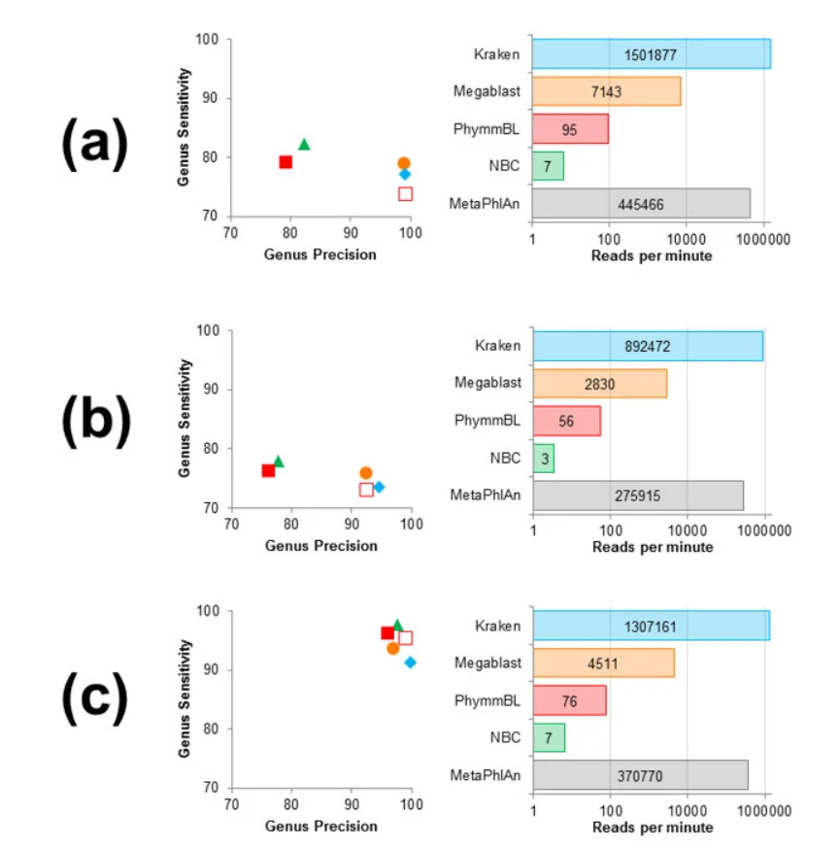
Classification accuracy and speed comparison of classification programs for three simulated metagenomes
Notes:
Classification accuracy and speed comparison of classification programs for three simulated metagenomes. For each metagenome, genus precision and sensitivity are shown for five classifiers, and speed is shown for five programs (PhymmBL65 is simply a confidence-filtered version of PhymmBL’s results, and MetaPhlAn only classifies a subset of reads that map to one of its marker genes, as it is an abundance estimation program). Results shown are for: (a) the HiSeq metagenome, consisting of HiSeq reads (mean length μ = 92 bp) in equal proportion from ten bacterial sequencing projects; (b) the MiSeq metagenome, consisting of MiSeq reads (μ = 156 bp) in equal proportion from ten bacterial projects; and (c) the simBA-5 metagenome, consisting of simulated 100-bp reads with a high error rate from 1,967 bacterial and archaeal taxa. Note that the horizontal axes in all speed graphs have a logarithmic scale.

Slide 4
Kraken 2 - Introduction
Kraken is a taxonomic sequence classifier that assigns taxonomic labels to DNA sequences.
Kraken examines the k-mers within a query sequence and uses the information within those k-mers to query a database. That database maps k-mers to the lowest common ancestor (LCA) of all genomes known to contain a given k-mer.
Need - Previous programs designed for this task have been relatively slow and computationally expensive, forcing researchers to use faster abundance estimation programs, which only classify small subsets of metagenomic data.
Kraken 1 VS Kraken 2 - The first version of Kraken used a large indexed and sorted list of k-mer/LCA pairs as its database. While fast, the large memory requirements posed some problems for users, and so Kraken 2 was created to provide a solution to those problems.
- Kraken 2 uses a compact hash table that is a probabilistic data structure.
- Kraken 2 utilizes spaced seeds in the storage and querying of minimizers to improve classification accuracy.
- Kraken 2 provides support for "special" databases that are not based on NCBI's taxonomy. These are currently limited to three popular 16S databases.
Notes:
Kraken 2 uses a compact hash table that is a probabilistic data structure. Kraken 2 has the ability to build a database from amino acid sequences and perform a translated search of the query sequences against that database.
This means that occasionally, database queries will fail by either returning the wrong LCA, or by not resulting in a search failure when a queried minimizer was never actually stored in the database. By incurring the risk of these false positives in the data structure, Kraken 2 is able to achieve faster speeds and lower memory requirements. Users should be aware that database false positive errors occur in less than 1% of queries and can be compensated for by use of confidence scoring thresholds.
Kraken 2 utilizes spaced seeds in the storage and querying of minimizers to improve classification accuracy.
Kraken 2 provides support for "special" databases that are not based on NCBI's taxonomy. These are currently limited to three popular 16S databases.

Slide 5
Kraken 2 - Requirements
Disk space: Construction of standard database requires approximately 100 GB of disk space.
Memory: To run efficiently, Kraken 2 requires enough free memory to hold the database (primarily the hash table) in RAM. Kraken 2 will by default load the database into process-local RAM
Dependencies: Kraken 2 currently makes extensive use of Linux utilities.
Network connectivity: Kraken 2's standard database build and download commands expect unfettered FTP and rsync access to the NCBI FTP server.
MiniKraken: At present, users with low-memory computing environments can replicate the "MiniKraken" functionality of Kraken 1 in two ways:
- by increasing the value of k with respect to ℓ (using the --kmer-len and --minimizer-len options to kraken2-build);
- through downsampling of minimizers (from both the database and query sequences) using a hash function. This second option is performed if the --max-db-size option to kraken2-build is used.
Notes:
1. A trial on 01 Jan 2018 of the default installation showed 42 GB of disk space was used to store the genomic library files, 26 GB was used to store the taxonomy information from NCBI, and 29 GB was used to store the Kraken 2 compact hash table.
2. The default database size is 29 GB (as of Jan. 2018), and you will need slightly more than that in RAM if you want to build the default database.
3. Many scripts are written using the Bash shell, and the main scripts are written using Perl. Core programs needed to build the database and run the classifier are written in C++11, and need to be compiled using a somewhat recent version of g++ that will support C++11. Multithreading is handled using OpenMP. Most Linux systems will have all of the above listed programs and development libraries available either by default or via package download.
4. If you're working behind a proxy, you may need to set certain environment variables (such as ftp_proxy or RSYNC_PROXY) in order to get these commands to work properly. Kraken 2's scripts default to using rsync for most downloads; however, you may find that your network situation prevents use of rsync. In such cases, you can try the --use-ftp option to kraken2-build to force the downloads to occur via FTP.
5. however, the two options are not mutually exclusive. In a difference from Kraken 1, Kraken 2 does not require building a full database and then shrinking it to obtain a reduced database.

Slide 6
KRAKEN 2 – Input Format
FASTQ input: Input is normally expected to be in FASTA format, but you can classify FASTQ data using the --fastq-input switch.
Compressed input: Kraken 2 can handle gzip and bzip2 compressed files as input by specifying the proper switch of --gzip-compressed or --bzip2-compressed.
Input format auto-detection: If regular files are specified on the command line as input, Kraken 2 will attempt to determine the format of your input prior to classification. You can disable this by explicitly specifying --fasta-input, --fastq-input, --gzip-compressed, and/or --bzip2-compressed as appropriate. Note that use of the character device file /dev/fd/0 to read from standard input (aka stdin) will not allow auto-detection.
Paired reads: Kraken 2 can process the mates individually while still recognizing the pairing information. Using the --paired option to kraken2 will indicate that the input files provided are paired read data, and data will be read from the pairs of files concurrently.
Usage of --paired also affects the --classified-out and --unclassified-out options; users should provide a # character in the filenames provided to those options, which will be replaced by kraken2 with "_1" and "_2" with mates spread across the two files appropriately.
For example: kraken2 --paired --classified-out cseqs#.fq seqs_1.fq seqs_2.fq will put the first reads from classified pairs in cseqs_1.fq, and the second reads from those pairs in cseqs_2.fq.
Notes:
FASTA just stores the name of a sequence and the sequence. FASTQ was invented to store both sequence and associated quality values.
Paired reads: Kraken 2 provides an enhancement over Kraken 1 in its handling of paired read data. Rather than needing to concatenate the pairs together with an N character between the reads,

Slide 7
KRAKEN 2 - Output Formats
Each sequence (or sequence pair, in the case of paired reads) classified by Kraken 2 results in a single line of output.
Kraken 2's output lines contain five tab-delimited fields; from left to right, they are:
1. "C"/"U": a one letter code indicating that the sequence was either classified or unclassified.
2. The sequence ID, obtained from the FASTA/FASTQ header.
3. The taxonomy ID Kraken 2 used to label the sequence; this is 0 if the sequence is unclassified.
4. The length of the sequence in bp. In the case of paired read data, this will be a string containing the lengths of the two sequences in bp, separated by a pipe character, e.g. "98|94".
5. A space-delimited list indicating the LCA mapping of each k-mer in the sequence(s).
For example, "562:13 561:4 A:31 0:1 562:3"
With kraken2 --use-names, Kraken 2 will replace the taxonomy ID column with the scientific name and the taxonomy ID in parenthesis (e.g., "Bacteria (taxid 2)" instead of "2"). The sample report functionality now exists as part of the kraken2 script, with the use of the --report option.
Notes:
the first 13 k-mers mapped to taxonomy ID #562
the next 4 k-mers mapped to taxonomy ID #561
the next 31 k-mers contained an ambiguous nucleotide
the next k-mer was not in the database
the last 3 k-mers mapped to taxonomy ID #562

Slide 8
KRAKEN 2 – Report Output Formats
Kraken 2's standard sample report format is tab-delimited with one line per taxon.
The fields of the output, from left-to-right, are as follows:
1. Percentage of fragments covered by the clade rooted at this taxon 2. Number of fragments covered by the clade rooted at this taxon 3. Number of fragments assigned directly to this taxon 4. A rank code, indicating (U)nclassified, (R)oot, (D)omain, (K)ingdom, (P)hylum, (C)lass, (O)rder, (F)amily, (G)enus, or (S)pecies. Taxa that are not at any of these 10 ranks have a rank code that is formed by using the rank code of the closest ancestor rank with a number indicating the distance from that rank. E.g., "G2" is a rank code indicating a taxon is between genus and species and the grandparent taxon is at the genus rank. 5. NCBI taxonomic ID number 6. Indented scientific name
The scientific names are indented using space, according to the tree structure specified by the taxonomy.
Notes:
By default, taxa with no reads assigned to (or under) them will not have any output produced. However, if you wish to have all taxa displayed, you can use the --report-zero-counts switch to do so. This can be useful if you are looking to do further downstream analysis of the reports, and want to compare samples. Sorting by the taxonomy ID (using sort -k5,5n) can provide a consistent line ordering between reports.
In addition, we also provide the option --use-mpa-style that can be used in conjunction with --report. This option provides output in a format similar to MetaPhlAn's output. The output with this option provides one taxon per line, with a lowercase version of the rank codes in Kraken 2's standard sample report format (except for 'U' and 'R'), two underscores, and the scientific name of the taxon (e.g., "d__Viruses"). The full taxonomy of each taxon (at the eight ranks considered) is given, with each rank's name separated by a pipe character (e.g., "d__Viruses|o_Caudovirales"). Following this version of the taxon's scientific name is a tab and the number of fragments assigned to the clade rooted at that taxon.

Slide 9
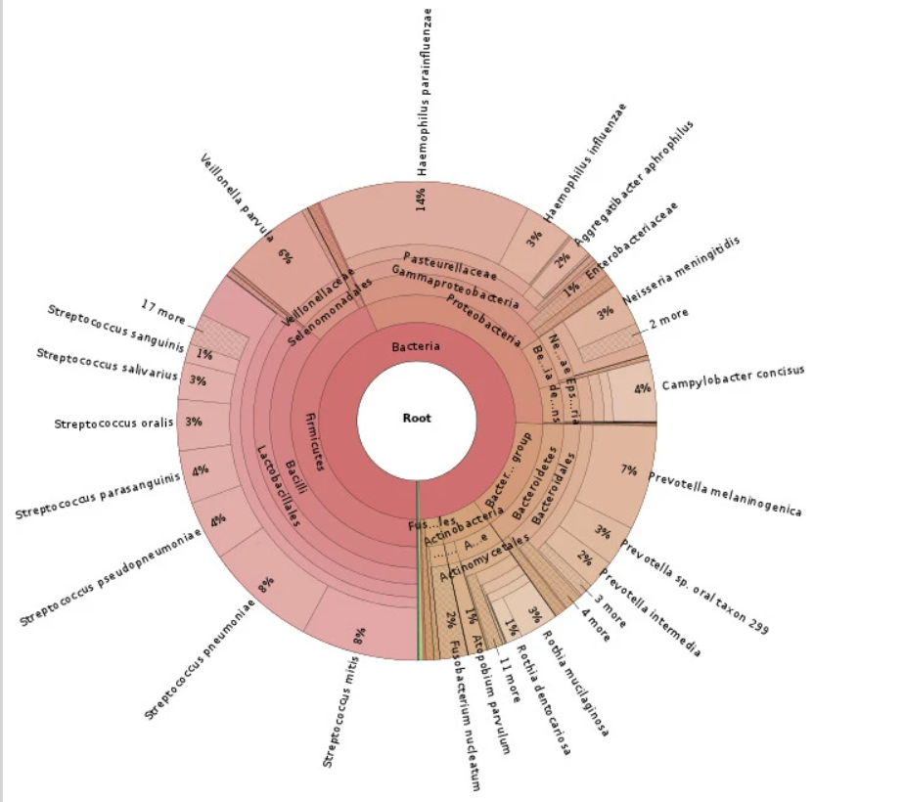
Taxonomic distribution of saliva microbiome reads classified by Kraken

Slide 10
Kraken- Algorithm
Core of kraken is a database that contains all the records consisting of a k-mer and LCA of all organisms whose genome contains that k-mers. By default, kraken builds the database with k = 31.
Sequences classified by querying the database for each k-mer in a sequence and using resulting set of LCA taxa to determine appropriate label for the sequence
- Allows quick lookup of the most specific node in the taxonomic tree associated with given k-mer
Sequence with no k-mers in database = unclassified.
Need to classify DNA sequence S. collect all k-mers within that sequence into a set --> K(S)
Map each k-mer in K(S) to LCA taxon of all genomes that contain that k-mer
LCA taxa + their ancestor in the taxonomy tree = classification tree --> pruned subtree used to classify S
Each node of tree weight = number of k-mers in K(S) mapped to the taxon associated with that node
Each root-to-leaf (RTL) path score = sum of all node weight along that path
Maximum scoring RTL path --> Classification path (if multiple, LCA of all paths selected)

Slide 11
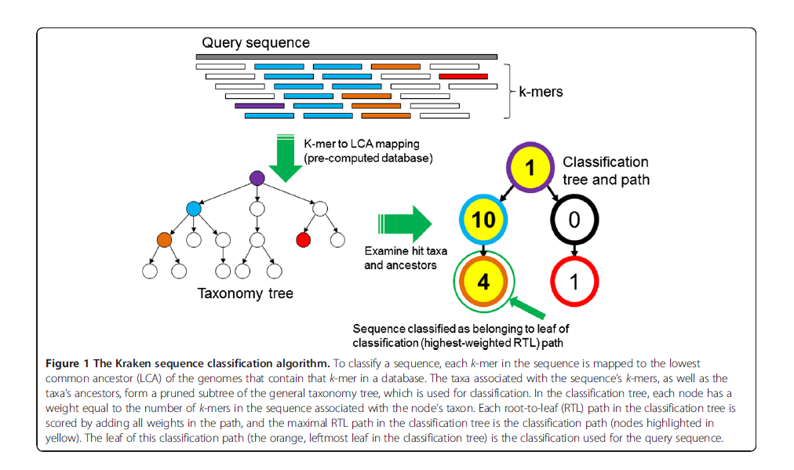
Kraken- Algorithm continued

Slide 12
Kraken 2 Databases
A Kraken 2 database is a directory containing at least 3 files -
- hash.k2d: Contains the minimizer to taxon mappings
- opts.k2d: Contains information about the options used to build the database
- taxo.k2d: Contains taxonomy information used to build the database
To create the standard Kraken 2 database, you can use the following command: kraken2-build --standard --db $DBNAME
This will download NCBI taxonomic information, as well as the complete genomes in RefSeq for the bacterial, archaeal, and viral domains, along with the human genome and a collection of known vectors (UniVec_Core). After downloading all this data, the build process begins; this can be the most time-consuming step. If you have multiple processing cores, you can run this process with multiple threads, e.g.: kraken2-build --standard --threads 24 --db $DBNAME
The build process itself has two main steps, each of which requires passing over the contents of the reference library:
1. Estimation of the capacity needed in the Kraken 2 compact hash table. This uses a low-memory method to reliably estimate the number of minimizers present in the reference library given the selected parameters k and ℓ.
2. Population of the hash table (and conversion of the taxonomy to an internal format). This step is a second pass over the reference library to find minimizers and then place them in the database.
(There is one other preliminary step where sequence IDs are mapped to taxonomy IDs, but this is usually a rather quick process and is mostly handled during library downloading.)
Notes:
2. None of these three files are in a human-readable format. Other files may also be present as part of the database build process, and can, if desired, be removed after a successful build of the database. In interacting with Kraken 2, you should not have to directly reference any of these files, but rather simply provide the name of the directory in which they are stored. Kraken 2 allows both the use of a standard database as well as custom databases.
3.Replace "$DBNAME" above with your preferred database name/location. Please note that the database will use approximately 100 GB of disk space during creation, with the majority of that being reference sequences or taxonomy mapping information that can be removed after the build.
4.Using 32 threads on an AWS EC2 r4.8xlarge instance with 16 dual-core hyperthreaded 2.30 GHz CPUs and 244 GB of RAM, the build process took approximately 35 minutes in Jan. 2018.
5. Unlike Kraken 1's build process, Kraken 2 does not perform checkpointing after the estimation step. This is because the estimation step is dependent on the selected k and ℓ values, and if the population step fails, it is likely because k needs to be increased (reducing the overall memory requirements).

Slide 13
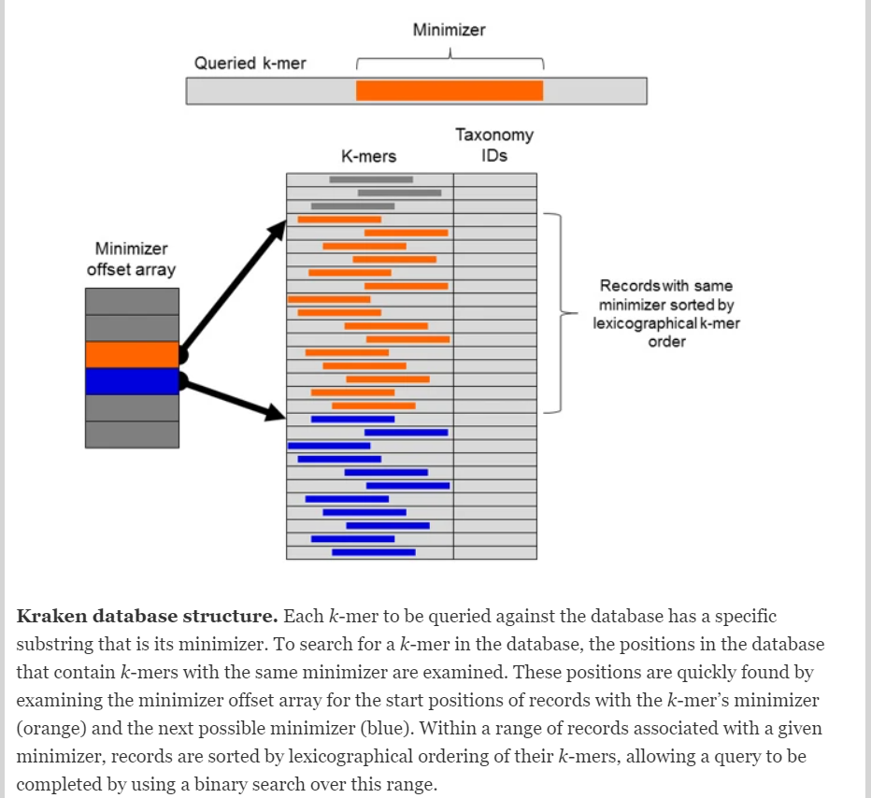

Slide 14
Kraken- Search Algorithm
Because Kraken frequently uses a k-mer as a database a query immediately after querying adjacent k-mer, and because adjacent k-mer share a substantial amount of sequence ----> utilize minimizer concept to group similar k-mers together.
To determine a k-mer minimizer of length M, we consider the canonical representation of all M-mers in the k-mer and select the lexicographically smallest of those M-mers as the k-mer's minimizer
In practice, adjacent k-mers will often have the same minimizer .
In Kraken's database , all k-mers with the same minimizer are stores consecutive and are sorted in lexicographical order of their canonical representation .
A query for a k-mer R can then be processed by looking up in an index the position in the database where the k-mers with R's minimizer would be stored , and then perform a binary search within that region
Because k-mers often have the same minimizer, the search range is often the same between two consecutive queries, and the search in the first query can often bring data into the CPU cache that will be used in the second query.
By allowing memory accesses in subsequent queries to access data in the CPU cache instead of RAM, this strategy makes subsequent queries much faster than they would otherwise be.
The index containing the offsets of each group of k-mers in the database requires 8×4M bytes.
By default Kraken uses 15-bp minimizers, but the user can modify this value

Slide 15
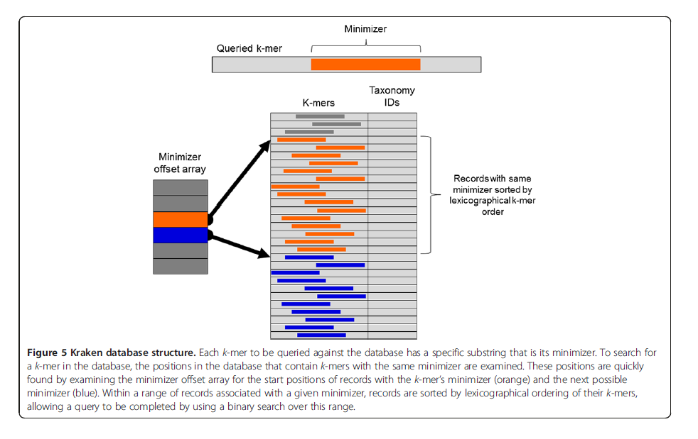
Kraken- Search Algorithm continued

Slide 16
KRAKEN 2 – installation info, commands, demo
Run on your local user space
1. Installation (./install_kraken2.sh $KRAKEN2_DIR)
2. Optional: Export environment variables (PATH to your $KRAKEN2_DIR) (Into your .bashrc file)
3. Download Kraken2 Database (kraken2-build --standard --db $DBNAME)
4. Optional: Export environment variables (PATH to your $KRAKEN2_DB_PATH) (Into your .bashrc file)
6. Use job script to run Kraken2 with your dataset (kraken2 ….)
7. Extract Krona input file from Kraken2 output file (cut ….)
8. Generate html file to visualize (ktImportTaxonomy ….)
Run on Proteus
1. Add to your .bashrc file (module use –append /mnt/HA/groups/rosenclassGrp/opt/modulefiles)
2. Add to your job script file (module load rosenclassGrp-kraken2)
3. Perform the same steps 6 to 8 from above

