Slide 1
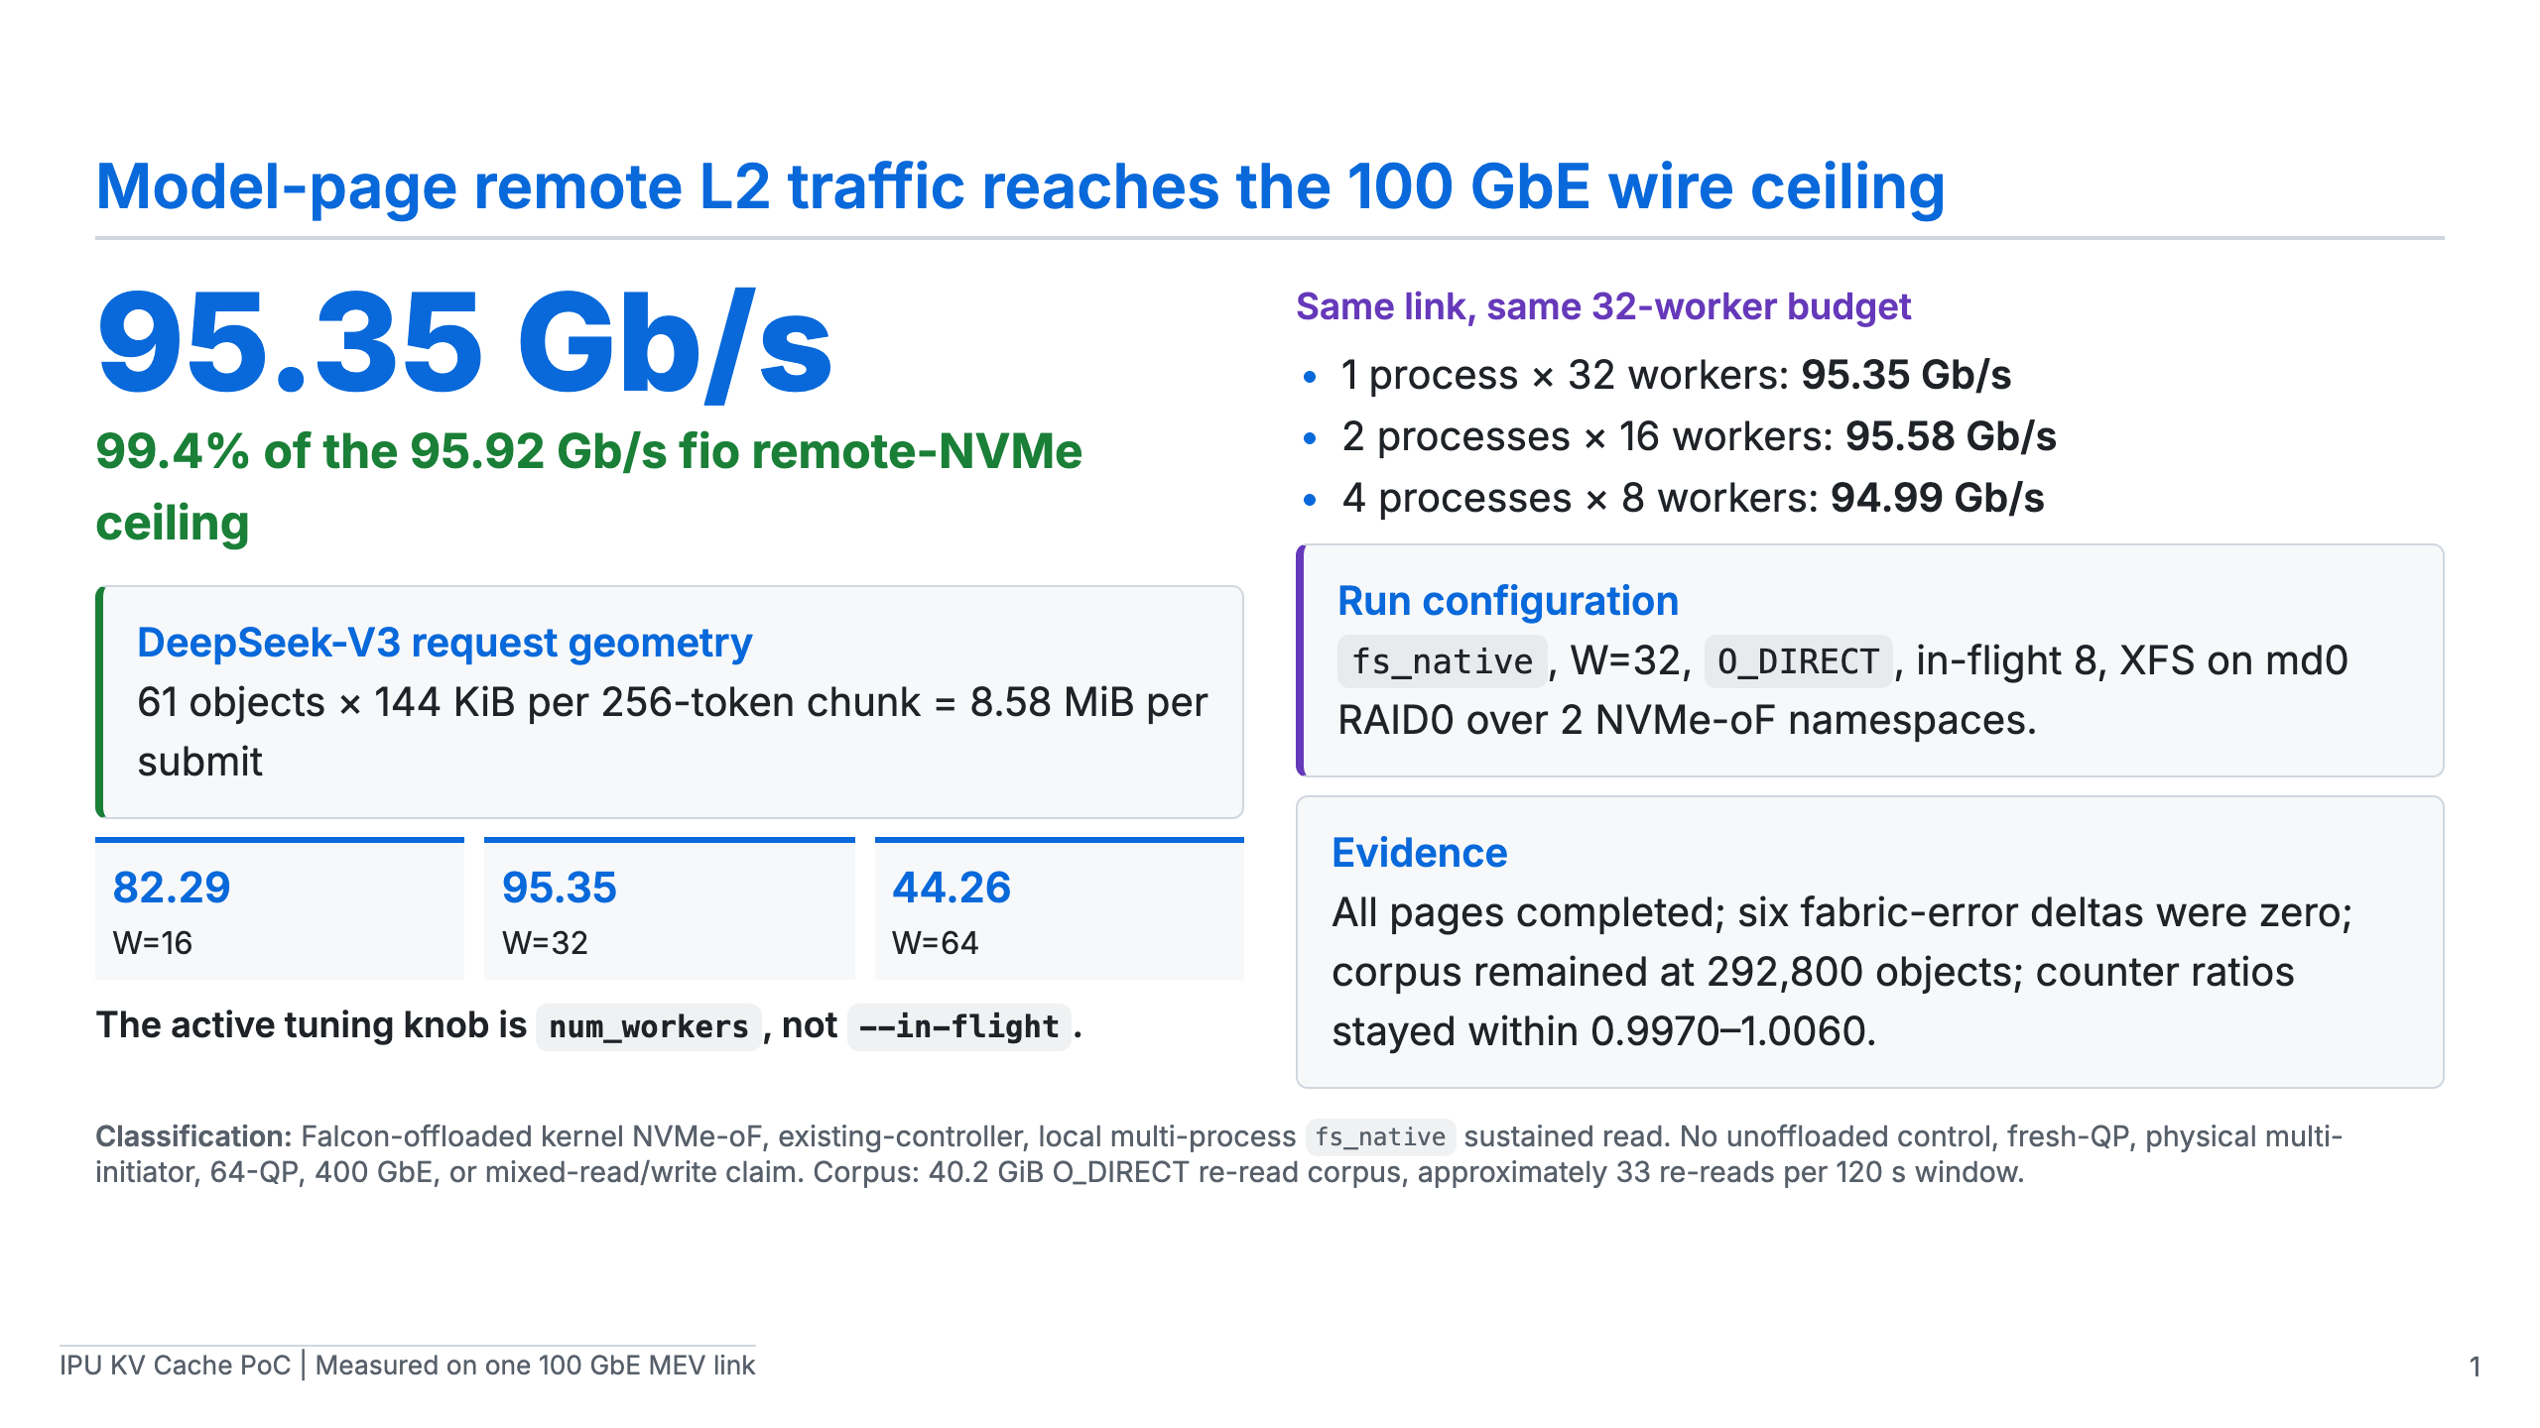
Notes:
[Sources] - scripts/ipu-poc/README-model-geometry.md: DeepSeek geometry, measured W=32, fan-in, integrity, and corpus-caveat data. - fio raw remote-NVMe baseline in the same result record.

Slide 2
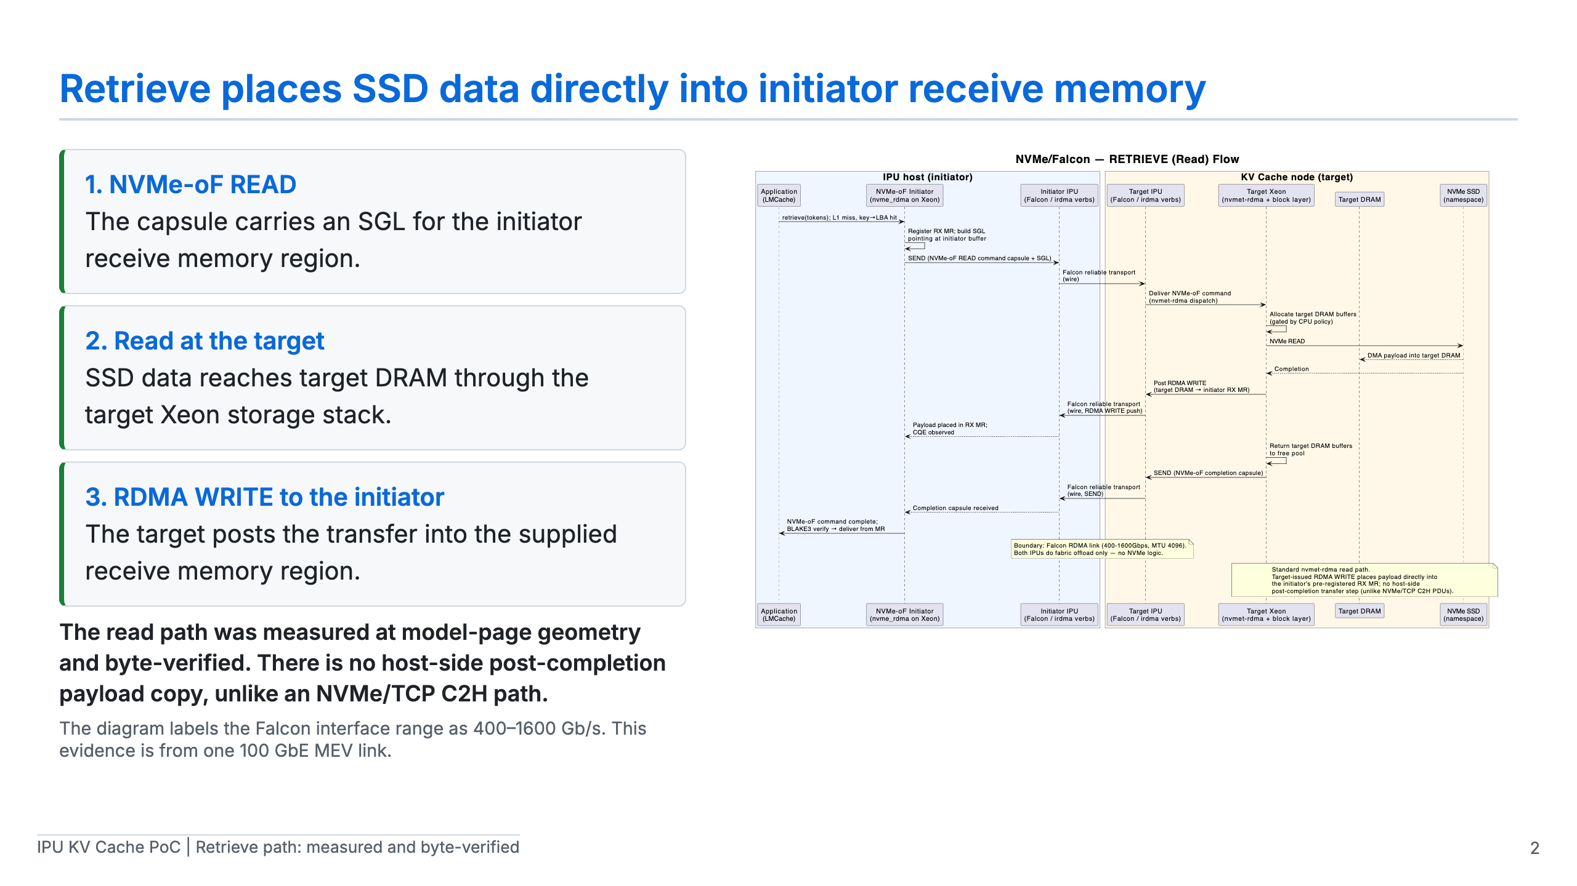
Notes:
[Sources] - diagrams/architecture-a-nvmeof-falcon-retrieve-flow.puml and .svg: Architecture A retrieve sequence. - scripts/ipu-poc/README-model-geometry.md: measured and byte-verified read-path evidence.

Slide 3
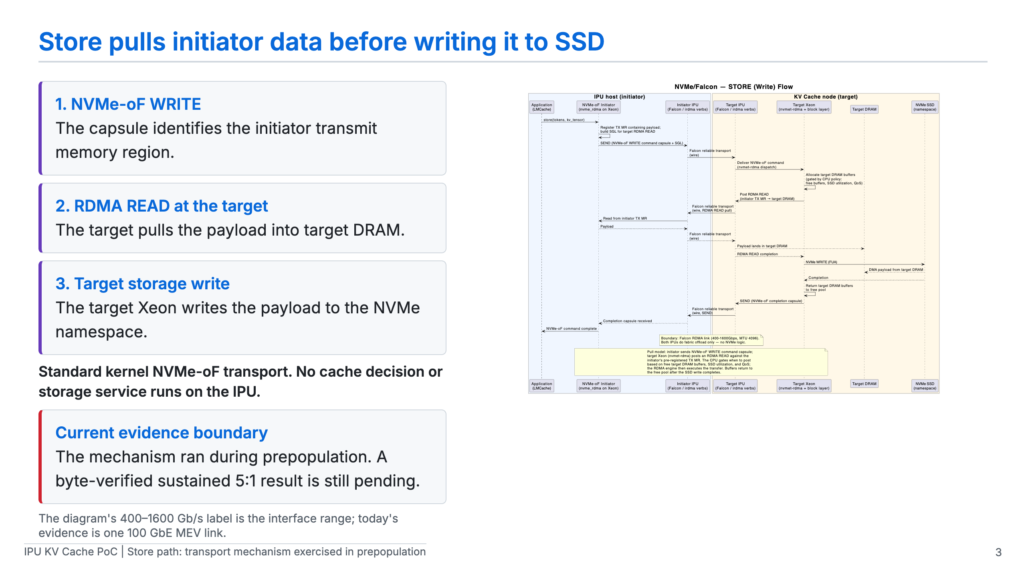
Notes:
[Sources] - diagrams/architecture-a-nvmeof-falcon-store-flow.puml and .svg: Architecture A store sequence. - scripts/ipu-poc/README-model-geometry.md: sustained mixed verification boundary.

Slide 4
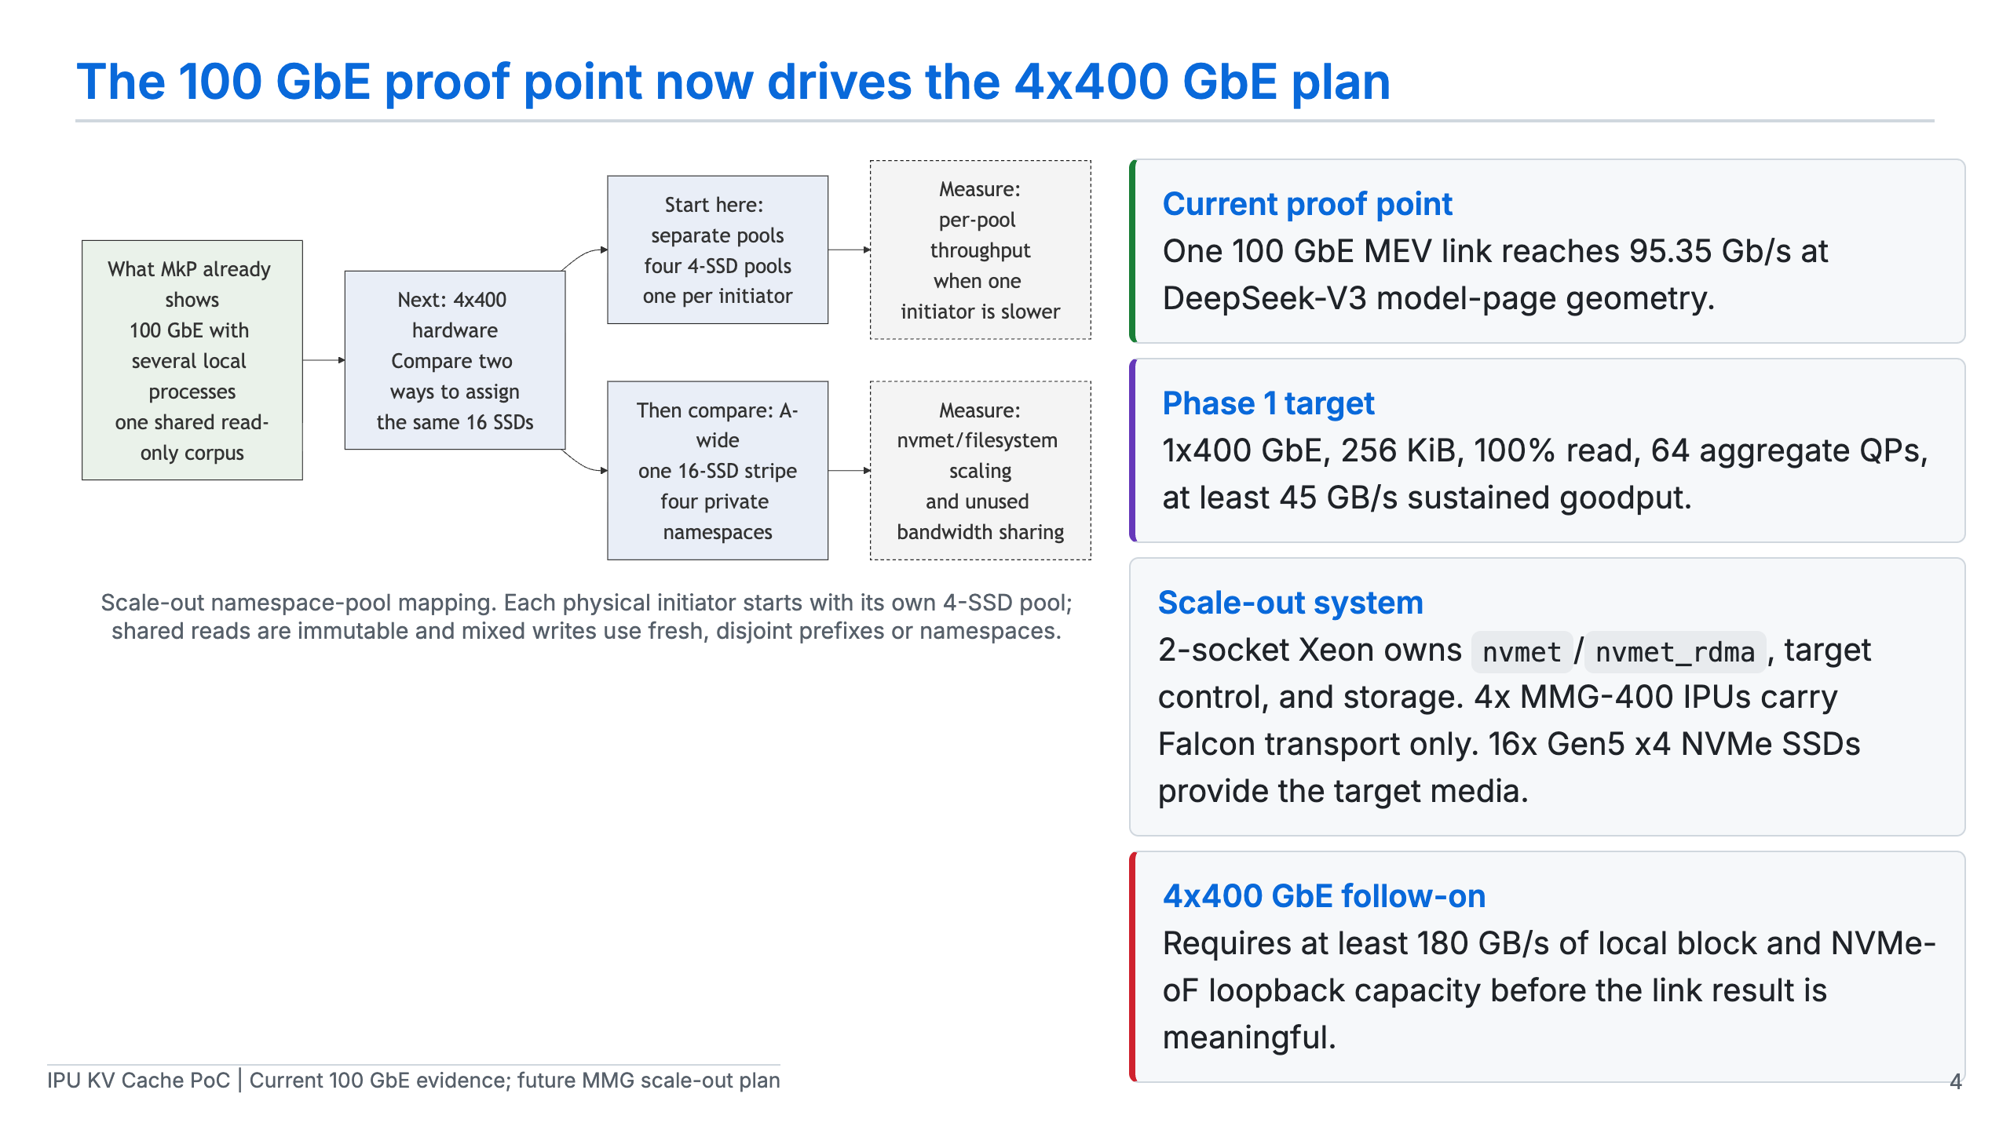
Notes:
[Sources] - diagrams/mkp-fsnative-4x400-test-architecture.mmd and .svg: multi-initiator namespace-pool mapping. - Anthropic NVMe-oF PoC plan: future 1x400 and 4x400 scope, hardware, 64-QP headline cell, and scale-out capacity gate.

