Slide 1
Assignment 4 – Texture Mapping
Submitted by:
Tianshuang Gao
Geethanjali Jeevanatham
HsinMiao Lee

Slide 2
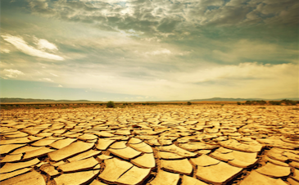
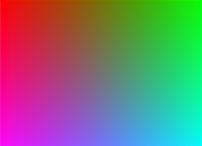
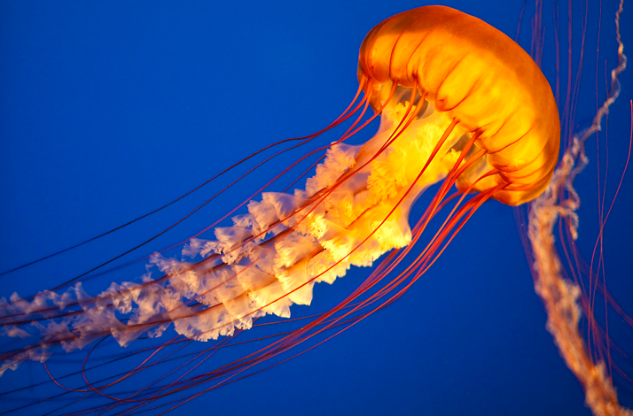
Problem I:
Using three different images as textures to combine a single plane.
Landscape
Color Gradient
Animal / Person

Slide 3
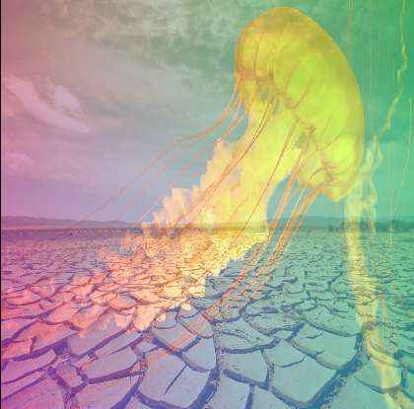
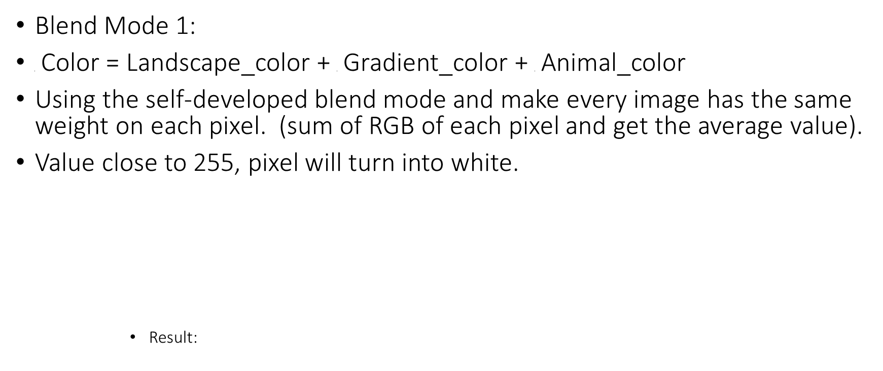
Different Blend, Different Result
Blend Mode 1:
$\frac{1}{3}$ Color = Landscape_color + $\frac{1}{3}$ Gradient_color + $\frac{1}{3}$ Animal_color
Using the self-developed blend mode and make every image has the same weight on each pixel. (sum of RGB of each pixel and get the average value).
Value close to 255, pixel will turn into white.
Result:

Slide 4
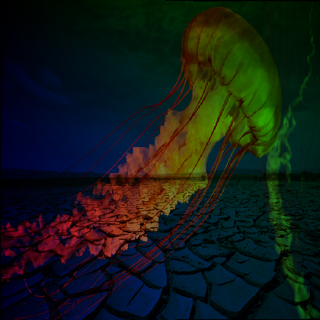
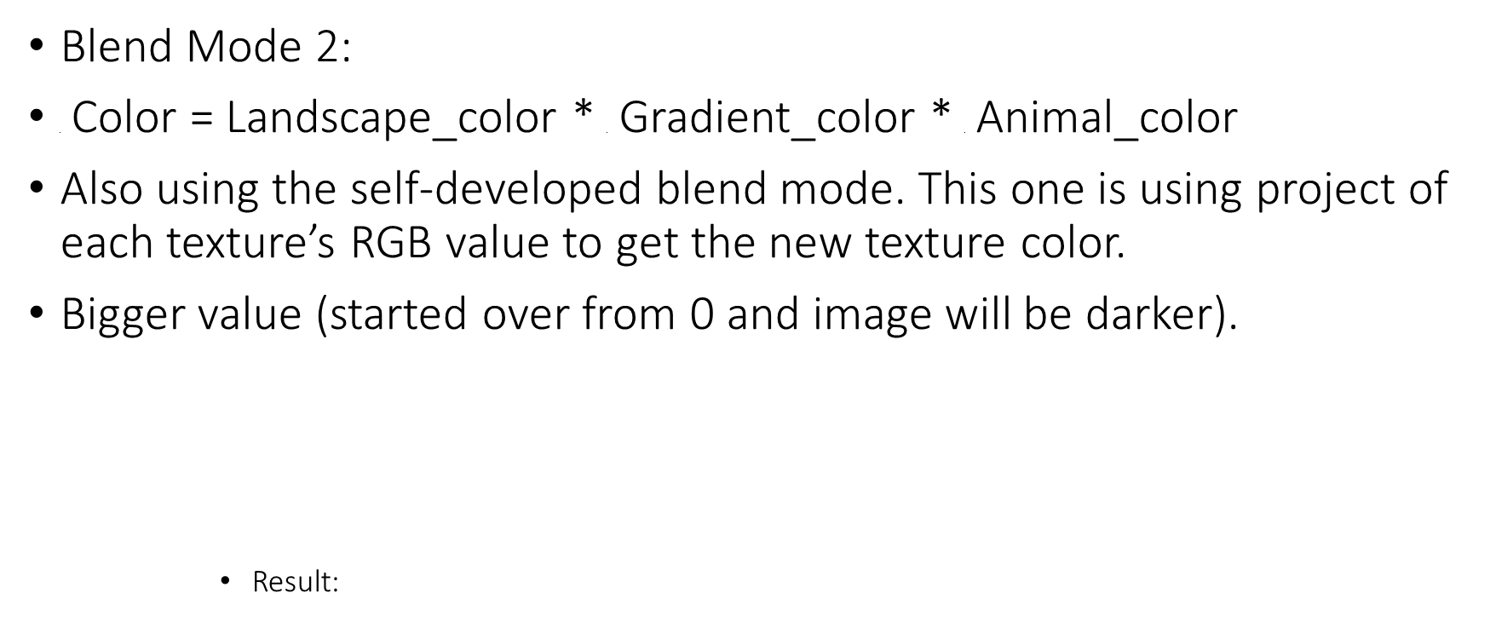
Different Blend, Different Result
Blend Mode 2:
$\frac{1}{3}$ Color = Landscape_color * $\frac{1}{3}$ Gradient_color * $\frac{1}{3}$ Animal_color
Also using the self-developed blend mode. This one is using project of each texture’s RGB value to get the new texture color.
Bigger value (started over from 0 and image will be darker).
Result:

Slide 5
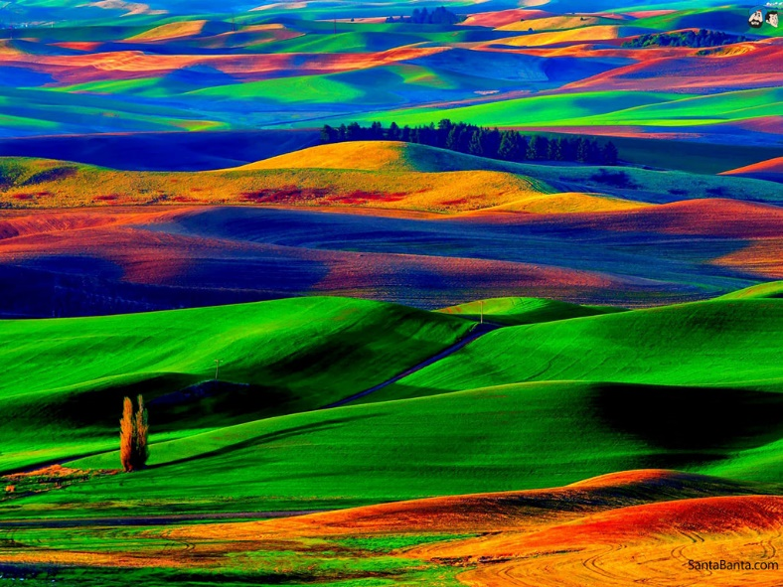
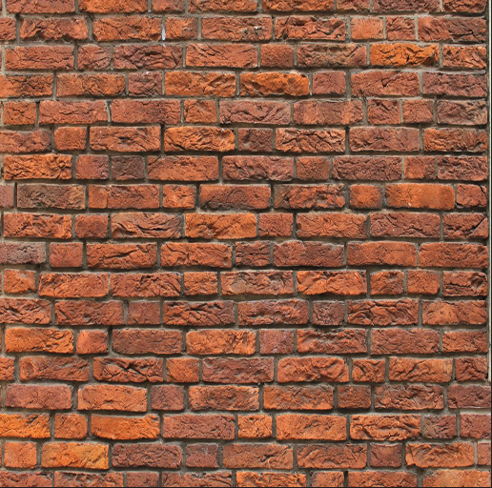
Problem II:
Working with noise maps and using texture as a information source for color information.
- Use the color information from the noise map and interpret as displacement vectors and change the texture location from our color information.
Landscape
Noise Image

Slide 6
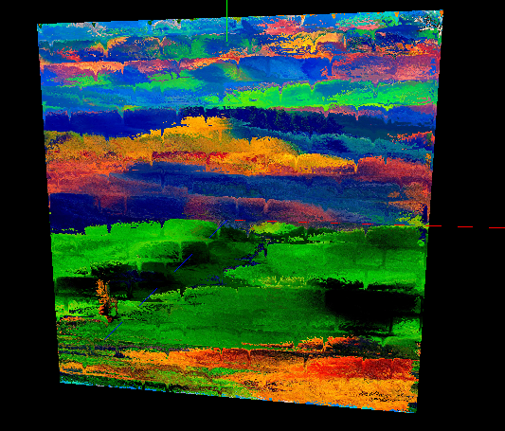
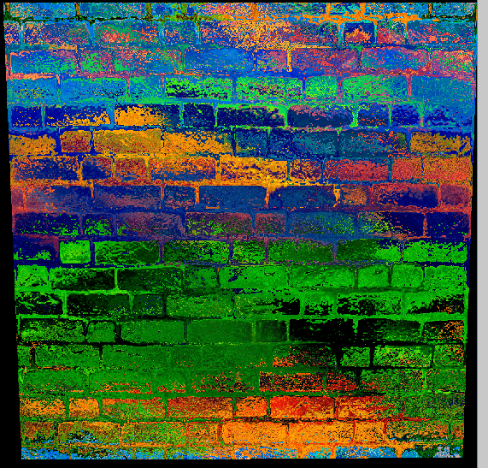
Result:
We are using the formula which shown below:
The image on the left is using 0.035 as a value to times vector in noiseVec.
The image on the right is using 0.55
The greater value, the greater displacement shown in image.
vec3 noiseVec = normalize(texture(texture_foreground, pass_TexCoord.xy).xyz);
noiseVec = (noiseVec * 2.0 - 1.0) * 0.55;
color = texture(texture_background, pass_TexCoord.xy + noiseVec.xy)
0.035
0.55

Slide 7
Difficulty
Finding the correct formula to combine the two images.
Program crash
Nothing render with noise map
Hard to define the correct result

