Slide 1

An Initial Investigation of Protocol Customization
David Ke Hong, Qi Alfred Chen, Z. Morley Mao
University of Michigan
Notes:
Good afternoon! I am David.
Today, I will present our workshop paper “An initial investigation of protocol customization”.
This work is done with my colleague Alfred Chen, and my advisor Prof. Morley Mao from the University of Michigan.

Slide 2



Today’s protocols are feature-rich
Widely-used protocols contain a rich set of features and extensions
Around 15 extensions for the functionality provided by the TLS protocol message formats
Different usage scenarios
TCP extensions
Performance consideration
Various HTTP/2 features
Implemented as a one-size-fits-all library
Notes:
We see that today’s widely used protocols contain a rich set of features.
For example, in TLS, we find around 15 extensions for extending the functionality provided by the TLS protocol message formats.
The rich set of features are usually for different purposes.
To fit for various usage scenarios, different TCP extensions are added specifically for wireless network, high-speed network and space communication network.
For performance concerns, various HTTP/2 features, such as stream multiplexing, header compression, are added to HTTP recently.
One commonality of these feature-rich protocols is that they are usually implemented as a one-size-fits-all library.

Slide 3


Vulnerabilities caused by unnecessary features
Not all features are desirable in a particular deployment scenario, and unused features enlarge attack surface
HeartBleed attack caused by an implementation flaw in TLS/DTLS heartbeat extension
Optional in many deployment scenarios
FREAK attack exploiting weak RSA_EXPORT cipher suites
Stronger cipher suites already available
Notes:
So, in a particular deployment scenario, not all features are needed.
But due to the current protocol implementation, all features are generally deployed as a whole.
These unused but deployed features potentially enlarge the attack surface of a protocol.
In fact, they have already caused severe vulnerability exposures in the real world.
The HeartBleed attack is caused by an implementation flaw in heartbeat extension, which is not a desirable feature in many deployment scenarios.
The FREAK RSA downgrade attack exploits the availability of weak cipher suites in TLS.
But stronger cipher suites are already available and implemented in its protocol software like OpenSSL.

Slide 4
Protocol Customization
Modify and specialize a standard protocol to enable only desirable features
Compile-time disabling
97 OpenSSL_NO* compiler flags
Runtime disabling or parameter tuning
mod_* parameters for module disabling
Notes:
In this work, we explore protocol customization as an approach to enable only desirable features for mitigating attack surface from unnecessary features in a standard protocol.
And we start by surveying existing customization practices in popular protocol software in the real world.
One common practice is to disable certain features in compile-time such that they are not built into the executable. For example, OpenSSL contains around 97 compiler flags for disabling various cipher suites, protocol extensions or features.
In particular, the HeartBeat extension can be disabled by one of these flags.
Another common practice is to disable or restrict the use of a feature by configuring some parameters in runtime.
This mechanism has been broadly used in the Apache HTTP server software, where a typical module can be enabled or disabled by setting some pre-defined parameter.

Slide 5

Existing customization practices
Existing customization practices are ad-hoc
Often relying on configurations offered by the protocol implementation
Case study
Per-feature disabling on HTTP/2 features is not supported in Apache HTTP server
HPACK bomb vulnerability (CVE-2016-1544, CVE-2016-6581)
Developer failed to cover this customization option
Notes:
However, we find these existing customization practices are usually very ad-hoc.
They often rely on configurations offered by the implementation.
These configurations, like compiler flags or runtime parameters, are usually manually defined by developers, which can be inefficient and error-prone.
As human efforts are needed, it is possible that some potentially vulnerable features are not covered by the configurations.
It is also difficult to provide sufficiently fine-grained features for customization at the code design time.
For example, our case study shows that the runtime parameters of Apache HTTP server do not cover the control of HTTP/2 features.
We can only disable the whole HTTP/2 module rather than feature-by-feature, if we want to mitigate a vulnerability related to a particular HTTP/2 feature.
One HTTP/2-related real-world vulnerability is the HPACK bomb.
It is caused by the header compression feature for HTTP/2. It can be mitigated by limiting the size of HTTP header, but developer did not include this parameter check in its runtime configuration.
As a result, to mitigate this vuln without patching, we can only disable the HTTP/2 module as a whole and thus cannot harness the performance benefit from HTTP/2.

Slide 6
Systematic way of protocol customization is needed
Call for a systematic approach to overcome existing limitations
Minimizing human efforts and errors
Covering customization on important features
Supporting customization of fine-grained features
Question: can we systematically customize a standard protocol to reduce its attack surface with sufficient automation?
Notes:
So these limitations, as summarized here, call for a more systematic approach to support existing customization practices.
In this work, we aim to address this research question: can we develop a systematic approach for customizing a standard protocol to reduce the attack surface caused by features that are not desirable in a particular deployment scenario?
In the remaining time of this talk, I will discuss our preliminary methodology to address this question.

Slide 7

Solution direction
Protocol feature access control
A systematic framework to unify common protocol customization practices
Access control resource: protocol feature
Two types of access control policy
Feature disabling policy
Feature tuning policy
Validation: 17 out of 20 CVE patches can be expressed by feature disabling or tuning policy
Notes:
To meet our systematic goal, we propose an access control mechanism as our main solution direction.
In particular, we design a protocol feature access control framework to systematically support common protocol customization practices.
Here, the access control resource is a protocol feature.
To support flexible customization and maintain good protocol usability, we define two types of access control policy, feature disabling and feature tuning policy.
We validate our policy design on the patches of 20 high-profile CVEs, and find that 17 of them can be expressed by these two types of policies.

Slide 8

Access control example: HeartBeat
To prevent HeartBleed vulnerability
OpenSSL protocol entry
Feature access control policy configuration
Execution permitted
Feature 1
Feature 1
Access policy: allowed
Execution permitted when len(RequestEchoBytes) < 1500
Feature 2
T
Feature 2
Access policy: tuning
Tuning policy: Length of requested echo bytes < 1500
Execution denied
Feature 3
X
Feature 3
Access policy: disabling
Notes:
So let me give an example to illustrate our feature access control idea.
Suppose we are trying to customize OpenSSL to prevent HeartBleed vulnerability, our framework will grant access control to the SSL features one by one.
First, Feature 1 has been checked to be safe and can be used unconditionally.
So we generate a normal access policy with “allowed” action.
Feature 2, that is the HeartBeat extension, is enforced by our feature tuning policy.
In feature tuning policy, the feature can be used only when some conditions with tuning parameters are met.
Here, the condition for HeartBeat is if the length of requested heartbeat echo bytes are smaller than the size of a packet.
If yes, HeartBeat can be used. Otherwise, it is blocked.
Feature 3, which is an unnecessary features in our use case, is enforced by our feature disabling policy.
In other words, it is unconditionally blocked and will never be used.

Slide 9


Research challenges
How to systematically identify features and locate its code-level implementation
Bridging the gap between user-level and code-level features
Natural language processing
Deep neural networks
Systematically locating code-level feature-related implementation
Control and data flow analysis
Notes:
To achieve our feature access control idea in real protocol software, we identify several key challenges. Due to the time limit I will discuss two of them today.
As the first step, we need to extract a set of features, and then analyze the protocol code base to locate the code-level implementation for each feature.
In this step, one major challenge is to bridge the gap between the protocol features from the user’s perspective and related code chunks in the actual implementation.
We plan to leverage natural language processing techniques to learn user expected features from protocol descriptions, and apply deep learning methods to analyze multiple vulnerability data sources, such as CVE reports and code patches, to map an identified user-level feature to its related code pieces
Another challenge is to systematically locate all code pieces that are related to a feature.
We propose to use control and data flow analysis to analyze the dependencies across the code base for the code pieces mapped from user-level features, and include all dependent code pieces to form a complete code chunk for a feature.

Slide 10
Research challenges
How to effectively support diverse types of protocol customization with minimized manual efforts
Enforcing policies without assuming that the code base structure is ready for customization by design
Control and data flow analysis
Supporting feature disabling and tuning policy
Control and data flow analysis
Symbolic execution
Notes:
Given the features with their code-level implementation are identified, the next step is to perform customization through policy enforcement.
Since we aim to automate the process with minimized manual efforts from developers, we face a challenging task of performing customization without assuming that the code base structure is ready for customization by design.
That means we need to analyze the dependencies among different features in the code-level implementation.
Control and data flow analysis is a good fit here.
Also, we want to support diverse types of customization to ensure protocol usability, including the two types of policies in our feature access control solution.
To support feature tuning policy, we propose to use control and data flow analysis to identify the parameters related to the functionality of a feature, and explore the possibility of applying symbolic execution to systematically identify their legitimate value range to generate tuning parameters.

Slide 11
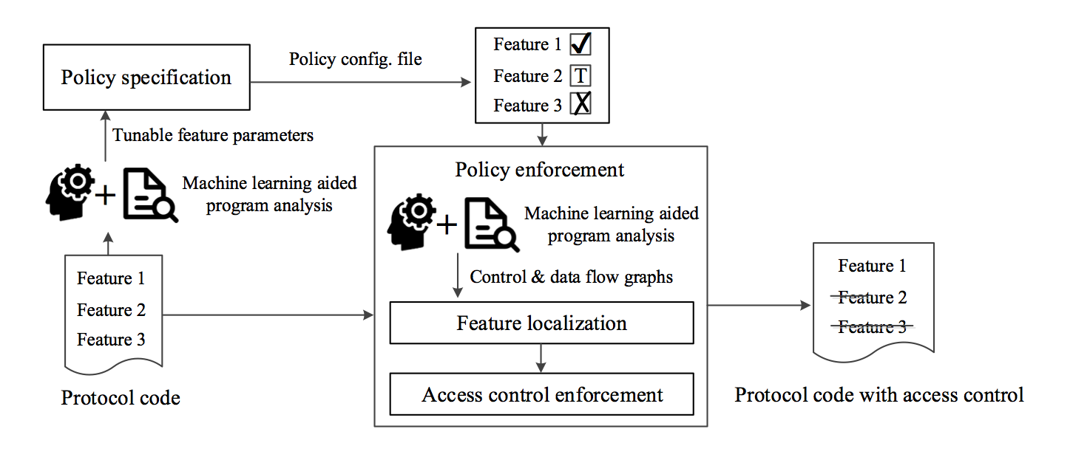
Preliminary system design
Input: features to be customized, protocol software
Notes:
To summarize our solutions proposed, we present a preliminary design of a feature access control system.
The input here is a set of user-level features to be customized and the protocol software.
It first analyzes the customization requirements to generate access control policy for each feature.

Slide 12
Preliminary system design
Input: features to be customized, protocol software
Notes:
The policy enforcement component will take thes policy config files with the protocol software as input, and localize the code-level implementation for each feature, and finally perform the customization through access control policy enforcement.

Slide 13
Limitation
Protocol customization alone is insufficient in addressing some vulnerability cases
Vulnerability related to core functionality that requires significant change to the details of a protocol feature
TLS vulnerability caused by the weakness in key generation
Notes:
I want to point out a limitation with the protocol customization approach.
If a vulnerability is related to some core functionality of the protocol, which requires significant changes to the detailed logic of the protocol feature, it cannot be completely addressed by protocol customization alone.
For example, the recently found TLS vulns caused by the weakness of random key generation cannot be fixed solely by protocol customization.

Slide 14
Summary
Perform an initial investigation of protocol customization for reducing attack surface of a standard protocol
Identify key research challenges for systematic and sufficiently automated protocol customization
Propose an access control mechanism to unify existing protocol customization practices
Future work
Feature identification using NLP techniques
Feature access control: more detailed design and impl.
Notes:
As a summary, we perform an initial investigation of protocol customization for reducing attack surface of a standard protocol.
We identify key challenges for achieving protocol customization in a systematic way.
We also propose an access control mechanism as a systematic solution to unify existing protocol customization practices.
As future works, we plan to develop a practical protocol customization system that can perform feature identification and feature access control in a systematic way with low perofmrance overhead.

Slide 15
Thank you!
Questions?
Notes:
Q: Is there a prototype? What protocols can it support?
No, but we are working towards building a prototype. As mentioned in the future works, we are studying popular protocols to evaluate the design choices and flesh the details of key components in our feature access control system, policy specification and enforcement.
Q: Besides HPACK bomb, what other cases to motivate the need of systematic?
We studied other cases that support the need of systematic protocol customization. The CVE study section in the paper discuss other cases like HTTP proxy DoS, which does not limit the number of forwarded interim responses and allows remote HTTP servers to cause a denial of service (memory consumption) via a large number of interim responses.
Q: How is protocol customization different from software customization?
There exist some domain-specific challenges in protocol customization. For example, domain-specific features in protocols are considered here. Access control policy are also domain-specific. To localize features and enforce policy, we can borrow software customization techniques like binary rewriting or program slicing techniques. They are definitely useful.
Q: Is your system online or offline? Work on source code or binary?
Feature localization and genearation of policy specification is performed before the protocol software, can be seen as offline. In the paper, we discuss a runtime monitoring mechanism on protocol usage to adjust the access control policy and update the specification for enforcement. This is a post-deployment online process. Can work on both. If source code is available, we will add access control logic around the related code chunks. If not, we can use binary rewriting to add the access control check.
Q: The effectiveness is dependent on features and policy?
Right, a good point. We considered that. In the paper, we propose to monitor the protocol usage in runtime. We can modify the access control policy, by reconfiguring the tuning parameters to prevent new features with vuln.
Q: NLP on unstrucutured texts
Sematic interpretation to extract semantic-level meanings
Autocog: Measuring the Description-to-permission Fidelity in Android Applications
WHYPER: Towards Automating Risk Assessment of Mobile Applications

