Slide 1
Vertx: Automated Validation of Binary Transformations
Denis Gopan, David Melski
GrammaTech, Inc.
Peter Ohmann
Xavier University

Slide 2
Why do we care about validation?
Transformation of binaries provides many benefits
Adapt COTS and legacy software
Patch, harden, optimize, de-bloat, ...
Often preferable to source-level or compile-time transformation
Support many compilers/languages
Prevent compiler from removing or messing up instrumentation
Yet many users are cautious to adopt
Transformations may break software, introduce vulnerabilities
Critical software needs to be recertified (significant effort)
Many users opt to stick with the “original” binaries

Slide 3
Vertx: Tool for Validating Transformations
Small, stand-alone tool
Compares transformed binary to the original
Rigorously checks whether the transformation succeeded
Vertx can be deployed:
As TCB for binary transformation framework
During transformation tool development:
Continuous integration: daily / weekly runs to detect regressions
Debugging: help diagnose bugs in transform implementations
Catch: comparing arbitrary binaries is non-trivial
Vertx leans on transformation tool to provide necessary insights

Slide 4
Vertx: Concept of Operations
Adapt Translation Validation:
Check transform applications
Easier to scale
Tolerate latent bugs in transformation tools
Contributions:
Allow changes in semantics
Work on binaries, rather than IR
Original
Binary
Vertx
Transformed
Binary

Slide 5
Vertx: Concept of Operations
Adapt Translation Validation:
Check transform applications
Easier to scale
Tolerate latent bugs in transformation tools
Differences:
Allow changes in semantics
Work on binaries, rather than IR
Original
Binary
Vertx
Transformed
Binary
What did the transform change?
Currently: binary hardening
Elimination of “bad” behaviors
Transform
Spec

Slide 6
Vertx: Concept of Operations
Adapt Translation Validation:
Check transform applications
Easier to scale
Tolerate latent bugs in transformation tools
Differences:
Allow changes in semantics
Work on binaries, rather than IR
Original
Binary
Vertx
Transformed
Binary
What did the transform change?
Currently: binary hardening
Elimination of “bad” behaviors
Transform
Spec
How was the transform applied?
Generated by the transform
Conveys global, hard-to-infer info
Transform
Hints

Slide 7
Vertx: Concept of Operations
Adapt Translation Validation:
Check transform applications
Easier to scale
Tolerate latent bugs in transformation tools
Differences:
Allow changes in semantics
Work on binaries, rather than IR
Original
Binary
Vertx
Transformed
Binary
What did the transform change?
Currently: binary hardening
Elimination of “bad” behaviors
Transform
Spec
Validation:
Check that all desired functionality is preserved
Check that all “bad” behaviors are eliminated
I.e., control is redirected to a designated error handler
How was the transform applied?
Generated by the transform
Conveys global, hard-to-infer info
Transform
Hints

Slide 8
Vertx: Concept of Operations
Adapt Translation Validation:
Check transform applications
Easier to scale
Tolerate latent bugs in transformation tools
Differences:
Allow changes in semantics
Work on binaries, rather than IR
Original
Binary
Transformation is correct
Yes
Vertx
No go:
Transformation is buggy
Hints are insufficient
Timeout
Detailed report
Help users diagnose
Transformed
Binary
No
What did the transform change?
Currently: binary hardening
Elimination of “bad” behaviors
Transform
Spec
Validation:
Check that all desired functionality is preserved
Check that all “bad” behaviors are eliminated
I.e., control is redirected to a designated error handler
How was the transform applied?
Generated by the transform
Conveys global, hard-to-infer info
Transform
Hints

Slide 9

Vertx: TCB for Binary Transformation Ecosystem
Original
Binary
Binary Transformation Tool
Transformed
Binary
Transform
Hints
Transform
Spec
Validated
Transformed
Binary
Yes
Vertx
No
Untrusted: buggy, unknown provenance, malicious intent
Trusted: must be correct to ensure overall transformation correctness

Slide 10
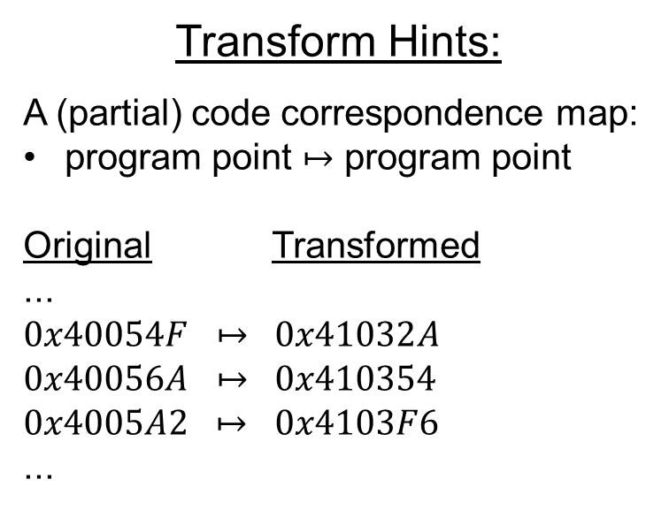
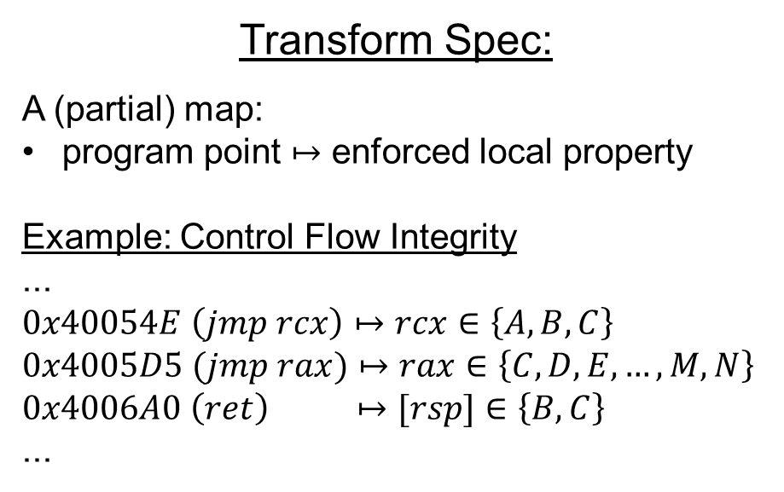
Initial Focus: Local Transformations
Scalable validation for a limited class of transformations
No “global” changes to program semantics; Data is preserved intact
But scale validation to real-world software (e.g. Apache httpd)
Transform Spec:
A (partial) map:
program point $↦$ enforced local property
Example: Control Flow Integrity
...
$$0x40054E \left(jmp rcx\right)↦rcx∈\left\{A, B, C\right\}$$
$$0x4005D5 (jmp rax)↦rax∈\left\{C,D,E,…, M, N\right\}$$
$$0x4006A0 \left(ret\right) ↦[rsp]∈\left\{B, C\right\}$$
...
Transform Hints:
A (partial) code correspondence map:
program point $↦$ program point
Original Transformed
...
$$0x40054F ↦ 0x41032A$$
$$0x40056A ↦ 0x410354$$
$$0x4005A2 ↦ 0x4103F6$$
...

Slide 11
Transformation Validation Mechanism
Partition both binaries into sets of acyclic transformation regions
Single entry, multiple exit; control flow may split and rejoin
Transform Hints: specify correspondence between orig/trx-ed regions
Validate transformation of each region independently
Transformed region must adhere to the Transform Spec
Violations are redirected to a designated error handler
Behaviors of orig/trx-ed regions must be equivalent modulo the transformation
Inductive correctness argument: program states are comparable at region boundaries
Observable events (e.g., syscalls, shared-lib calls) must appear on region boundaries
Local analysis – key to scalability

Slide 12
Transformation Region Extraction
Extract from “raw” binary (no IR)
Independently for original and transformed binaries
Start from the entry point (EA)
Decode and symbolically execute instructions along all paths
Stop when entry points of other regions are reached
Loops: cannot handle – report and stop
Indirect control-flow transfers: enumerate targets (up to a limit)
End result: logical characterization of orig / trx-ed region behaviors
Bit-level precise (use QF_ABV logic)
Memory: flat byte-addressable array

Slide 13
Transformation Region Validation
Program States
Region Entry
Program States
Region Exit
Logical characterization of region’s behavior:
Maps program states at region entry to program states at region exit
Solid arrows: original region

Slide 14
Transformation Region Validation
Program States
Region Entry
Program States
Region Exit
Transform Spec: separates desired and unwanted behaviors
Formally states properties of desired behaviors at block level

Slide 15

Transformation Region Validation
Program States
Region Entry
Program States
Region Exit
Designated
Error Handler
Spec adherence check:
Use SMT to check that unwanted behaviors end up at an error handler
Dashed arrows: transformed region

Slide 16
Transformation Region Validation
Program States
Region Entry
Program States
Region Exit
Designated
Error Handler
Desired behavior equivalence check:
Separate SMT queries for each register, flag, memory

Slide 17
Challenges: Explicit Code Addresses
Transformations perturb code layout
Code addresses are stored in registers, memory
Equivalence check detects/reports address changes
Extreme case: same instruction at different locations
Return addresses on TOS will differ
Our approach: symbolize transformation region entry addresses
Encode 0x40054E and 0x4005D9 as free vars “orig_40054E” and “tx_4005D9”
Assume constraint: “orig_40054E == tx_4005D9” for SMT queries
0x400549: callq 400526
0x40054E: ...
0x4005D4: callq 400526
0x4005D9: ...

Slide 18
Challenges: Code Coverage
Validation must check all reachable code
No easy way to ensure coverage due to indirect control-flow transfers
Hard to disambiguate at region level
Ideal Solution: Enforce CFI as part of transformation
Ensure that all legal targets are specified as region entry points
Additional level of protection
No CFI -> Weaker guarantees
Proper validation only for explicitly specified regions
May still be ok if the user is confident about coverage

Slide 19
Case Study: Dynamic Translation of Code Addresses
...
jmp [rcx] ;; can go to { A, B, C }
...
Sieve: explicitly translate control-flow targets
Borrowed from dynamic translation community
Two benefits:
No need to transform code-address computations
CFI enforcement
Benchmarks:
CGC challenge binaries, Apache httpd
Vertx successfully validates correct implementation
Caught bugs in x86 -> x64 transform port
Validation time: minutes (small) to hours (large)
Linear in the # of regions
Code Layout Changes:
[..., A → A’, B → B’, C → C’, ...]
...
if rcx == A
jmp A’
elseif rcx == B
jmp B’
elseif rcx == C
jmp C’
else
jmp error
...
error: ;; designated handler
report
abort

Slide 20
Going Forward
Support wider range of transformations:
Transforms that impose global semantics changes, perturb data
Emit more sophisticated hints from transformation tools (e.g., invariants)
Improve validation performance:
More efficient logical encoding, SMT solver use
Parallelization
Further reduce TCB:
Vertx relies on decoding, ISA semantics spec, SMT solver, etc.
Ongoing work with CVC4 team: use proof checkers to move SMT out of TCB

Slide 21
Conclusions
Vertx: a stand-alone tool for validation of binary transformations
Successfully validates a class of hardening transforms
Scales to real-world software
Increases users’ trust in binary transformation tools
Helps with debugging / diagnosing bugs in transforms
Lays groundwork for validation of more general transformations
E.g., memory safety, policy monitoring, de-bloating

Slide 22
Questions?
GrammaTech, Inc.:
Cutting edge research in software analysis and transformation
Binaries and source
We are hiring!
Check us out: www.grammatech.com
Apply: careers.grammatech.com
recruiting@grammatech.com

