Slide 1

Computer Science and Robotics in the SixthGrade
Some Lessons and a Curriculum
Tom Sgouros
Brown University
Computer Science Department
Mike McGuigan
The Learning Community
Central Falls, RI

Slide 2
Two Problems
The existing technology curricula treat computers and software like magic boxes never to be opened.
Increasing numbers of sixth-graders already have the skills these classes are designed to teach.

Slide 3
Possible Solution
Subvert the existing technology curriculum by inserting computer science concepts where possible.
Teach HTML and Javascript, not just Word and Excel.

Slide 4
The Learning Community
Our sample school, in Central Falls, RI
K-8 charter school, with a dedication to providing teacher professional development to other schools.
81% Latino, 13% Black, 86% eligible for free or reduced price lunches, 39% ELL.
Pedagogical emphasis on learning by doing.

Slide 5
The Plan
Build a 3-year middle-school curriculum to introduce basic CS concepts to sixth, seventh, and eighth grade students.
Curriculum will “spiral,” re-introducing the same concepts each year, with increasing levels of sophistication.
Start with sixth graders this year.

Slide 6
Activities
Theory games
Web programming using jsfiddle.net
Working toward building familiarity with programming and robotics concepts
Robot programming, maybe

Slide 7

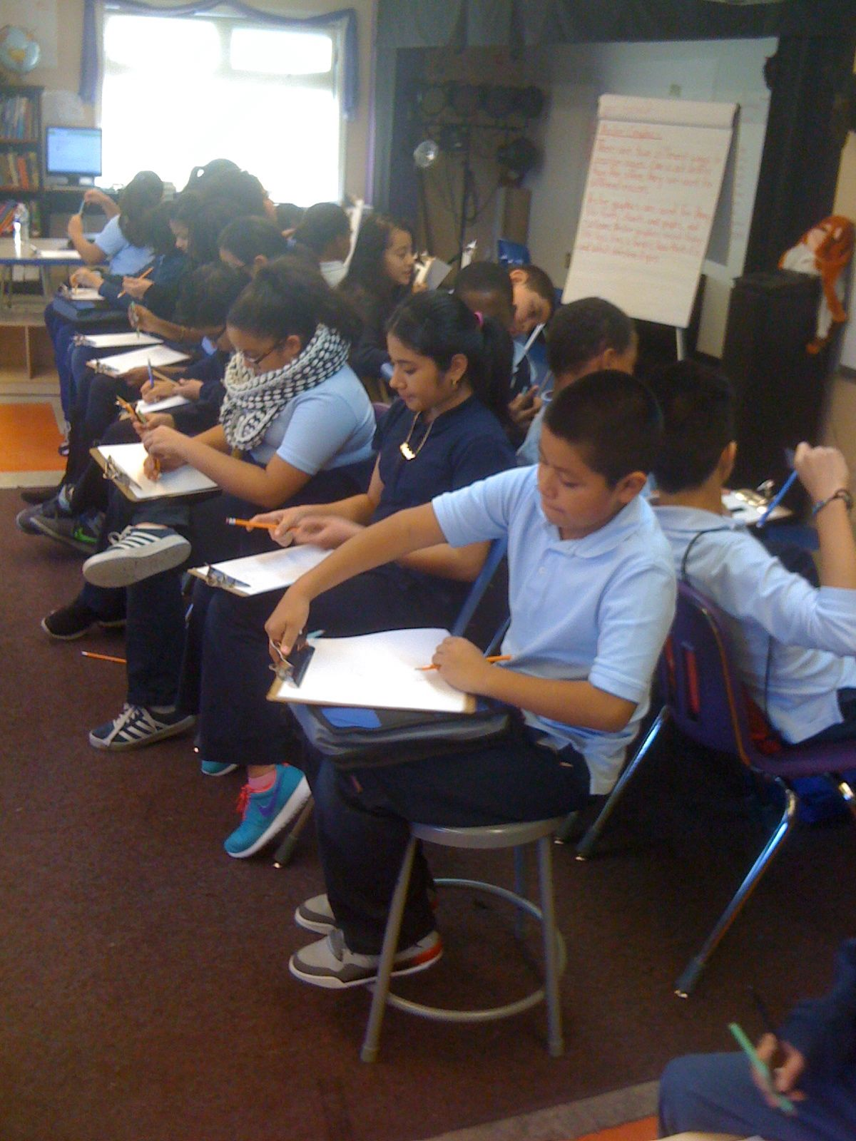
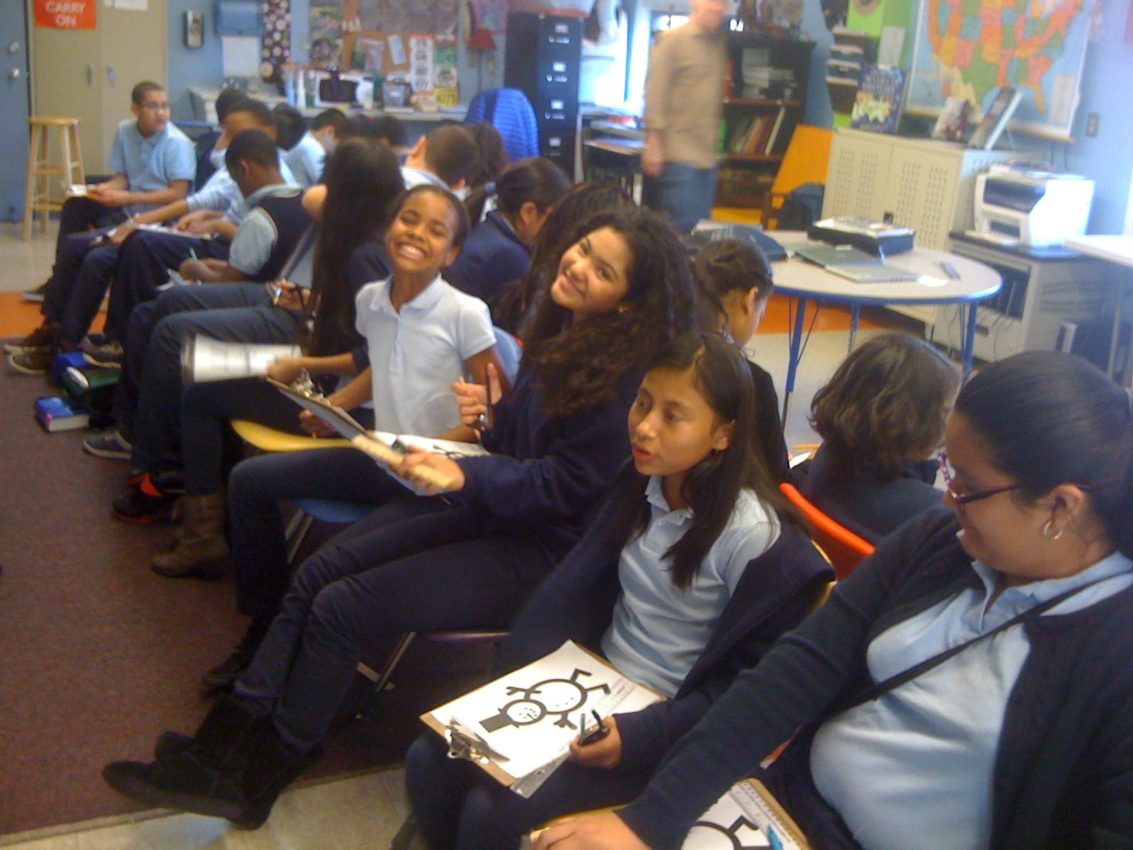
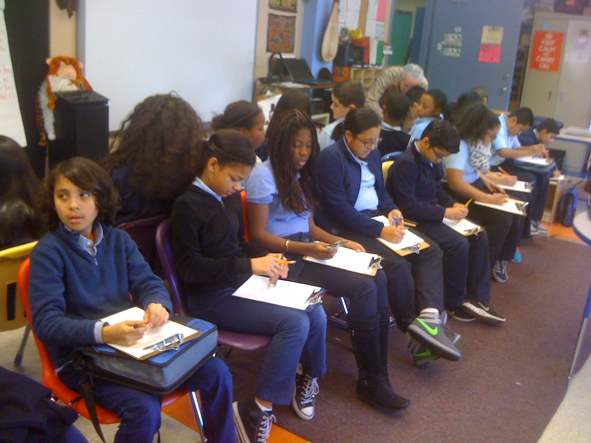
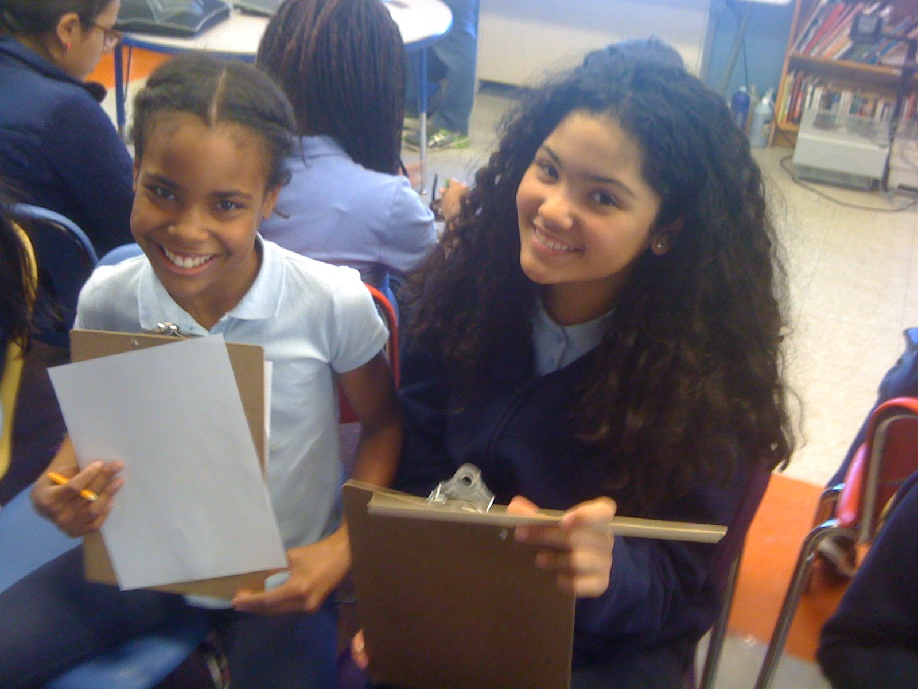
Theory games

Slide 8
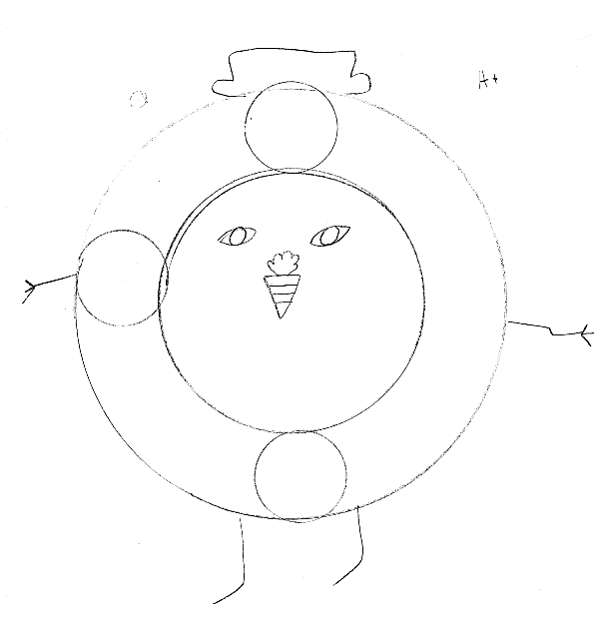
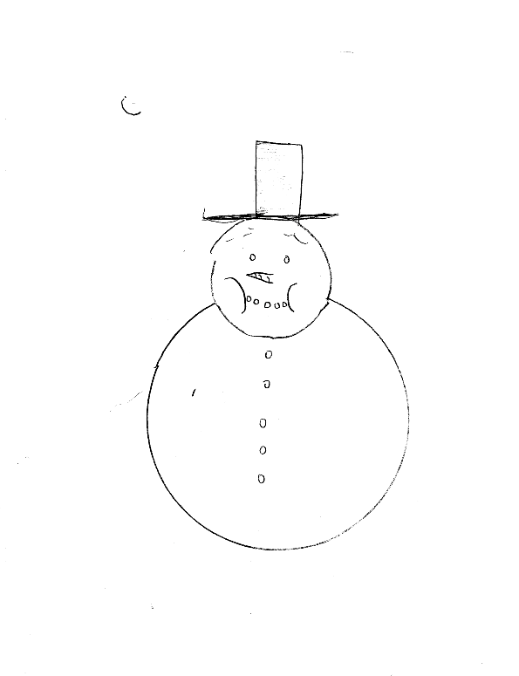
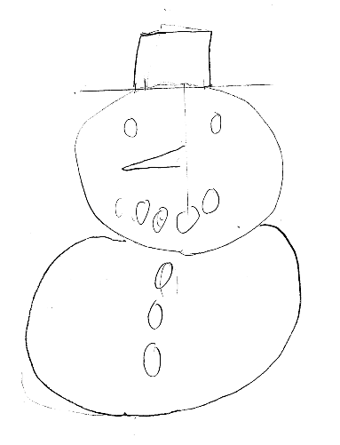
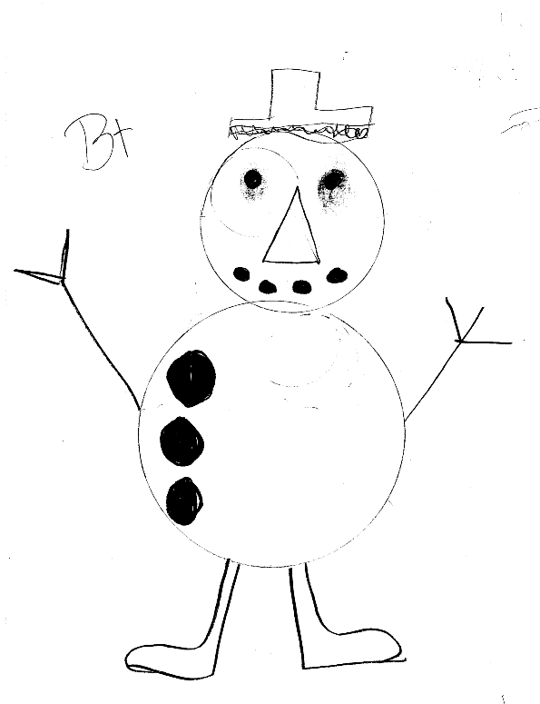
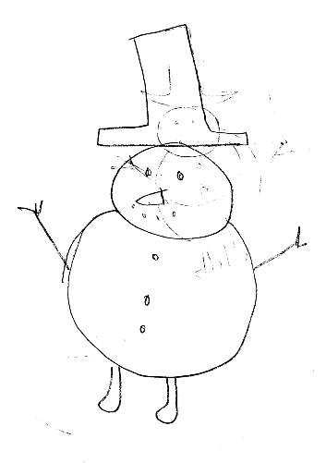
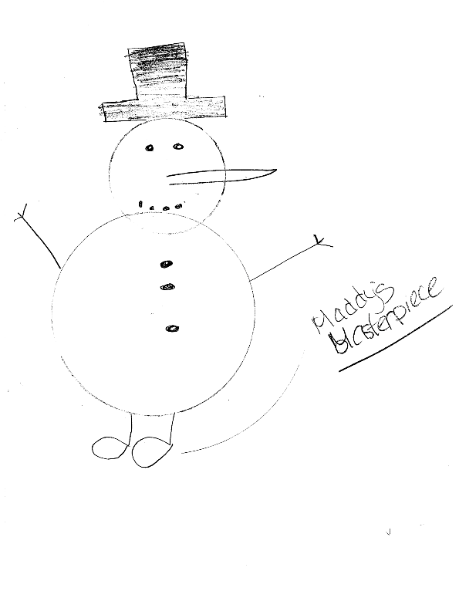
Theory games

Slide 9
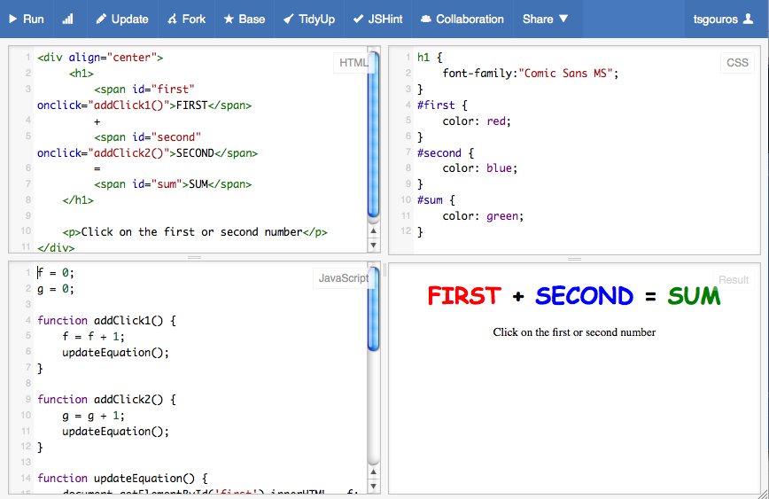
jsfiddle.net

Slide 10
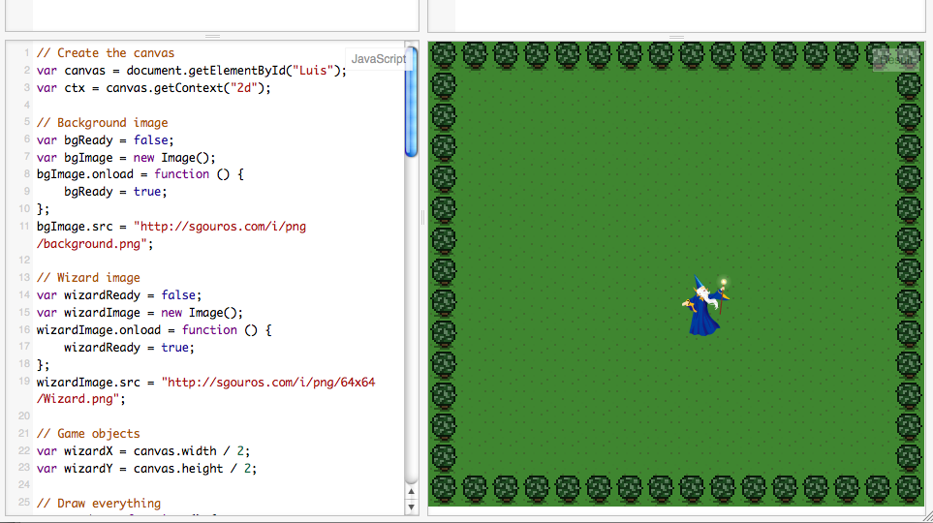
Assignment – fiddle with it

Slide 11
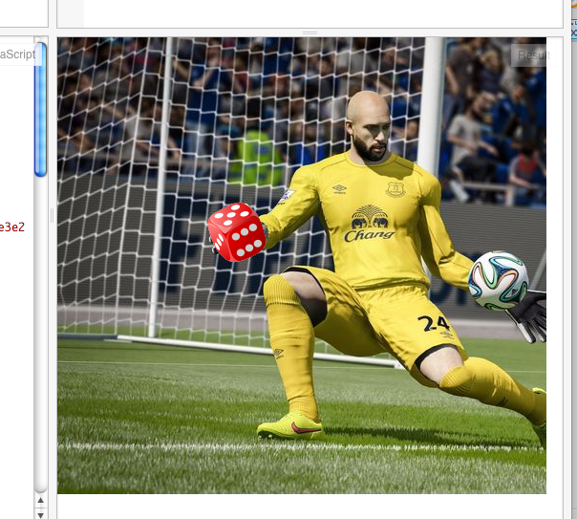
Assignment – fiddle with it

Slide 12
Findings
jsfiddle is a great tool. Panes for what it is, what it looks like and what it does. Except for the hashes.
Students able to see the concepts well enough to fiddle with the code.
Mastery will wait until the second or third time around.
Real assessment not appropriate yet.

Slide 13
Other Findings
Other people have also noticed that the tech curriculum isn't very good or compelling.
i.e. the class was not allocated much time, and is often displaced or canceled.
Existing teachers, at the sample school, are not prepared to teach much more than Excel and Word.

Slide 14
Cautions
N=1
3 classes, 60 students, one teacher, one curriculum guy.

Slide 15
Lessons
jsfiddle has some shortcomings in this context. Hashes, accounts, forking.
Laptop keyboards may be too sensitive for many students.
Hard to direct the fiddling. Substituting images is more fun than adjusting logic.
One hour a week, frequently canceled, is probably not enough to do real robotics work.

Slide 16
Outcomes
Space grant funding was leveraged into a grant from Verizon to set up an “I-lab” with tech equipment for programming and building stuff.
This grant alone will not have much effect, but the total investment it precipitated will.
LC is committed to proselytization, so these lessons will be exported to other schools, and would not have happened without RISG.

