Slide 1
Requirements
Sync issues must be solved
Checklist pages should be rebuild and redesigned
Download should be with a progress bar / download in the background
Make sure there are no upload issues
Categories and other variables must be synced correctly
Optional – static page for checklist that will create an ad-hoc inspection
Remove the “loading line” on the top
Add new job without the photo
“New Job screen” – delete should be replaced with “save”
Old checklist – view all checklists (not just current user). View the marks filled in the previous checklist (currently impossible).
The checklist should be synced to the mobile app once marked as “completed” in the office side

Slide 2
Requirements
Create the ability to add 2 – tier answers (a question that has 2 level of answers)
Add the ability of the system to digest different type of data:
Dates
Open text
Auto feed from the vessel information (link specific question to the DB i.e. IMO number
Add an option to mark answers as “Good” “Bad” or natural, with color coding. Bad answers can require mandatory observation / defficency

Slide 3



Slide 4

Username
Password
Login
Forgot Password?

Slide 5



Vessels List
Aida
2 MB
להוריד את הכמות של המידע
לוודא שההורדה ממשיכה תמיד ברקע
פרןגרס בר
יכול להוריד כמה במקביל
Endurance
Last Downloaded: 19 Jan 2017 18:09
2 MB
Freedom
70%
2 MB
Honor
להוריד את הכמות של המידע
לוודא שההורדה ממשיכה תמיד ברקע
פרןגרס בר
יכול להוריד כמה במקביל
Last Downloaded: 19 Jan 2017 18:09
0.1 MB
Independence
3 MB
Integrity
Last Downloaded: 19 Jan 2017 18:09
0.7 MB

Slide 6
Vessels List
Aida
2.1 MB
Endurance
Last Downloaded: 19-Jan-2017 18:09
2.1 MB
Freedom
2.1 MB
Honor
Last Downloaded: 19-Jan-2017 18:09
2.1 MB
Independence
Loading…
2.1 MB
Integrity
Last Downloaded: 19-Jan-2017 18:09
2.1 MB

Slide 7




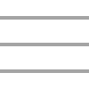
[Vessel] Inspections
Pending
Completed
All
Internal Audit
P
11 Oct
2016
Cargo Hold Inspection – PCTC
Internal Audit
P
11 Apr
2017
Cargo Hold Inspection – PCTC
Cargo Hold Inspection – PCTC
Internal Audit
P
11 Apr
2017
Cargo Hold Inspection – PCTC
Internal Audit
P
11 Apr
2017
Cargo Hold Inspection – PCTC
Internal Audit
C
Cargo Hold Inspection – PCTC
11 Apr
2017
Cargo Hold Inspection – PCTC
Cargo Hold Inspection – PCTC
Internal Audit
C
11 Apr
2017
PSC On Board Inspection
Inspections
Jobs
Crew List
Menu

Slide 8

[Inspection Type]
Upload
Checklist
Inspection’s Jobs
2 / 8
2 / 26
13
Cargo Hold Inspection – PCTC
2 / 8
2 / 26
13
Cargo Hold Inspection – PCTC
Inspections
Jobs
Crew List
Menu

Slide 9

[Inspection Type]
Upload
Checklist
Inspection’s Jobs
Cargo Hold Inspection – PCTC
2 / 8
2 / 26
13
Group 1
7/10
Group 2
3/15
Group 3
10/10
Cargo Hold Inspection – PCTC
2 / 8
2 / 26
13
Inspections
Jobs
Crew List
Menu

Slide 10


[Inspection Type]
Upload
Checklist
Inspection’s Jobs
Group Name
2 / 8
2 / 26
13
7/10
By default, all locations will be expanded. The user can collapse and expand each location by clicking on it
Location 1
Location 2
3
Location 3
5
Inspections
Jobs
Crew List
Menu

Slide 11



[Inspection Type]
Upload
Checklist
Inspection’s Jobs
Group Name
2 / 8
2 / 26
13
7/10
Add separation between this part to the lower part
Bridge
: Checked
Question 2
: 0
Date of previous inspection
Both the grading and the comments will be opened as a popup
: 0
Question 2
: 0
Question that was not answered
: 0
Question with long answer after pressin..
: 0
Location 2
Location 3
5
Inspections
Jobs
Crew List
Menu

Slide 12
[Inspection Type]
Upload
Checklist
Inspection’s Jobs
Group Name
2 / 8
2 / 26
13
7/10
Add separation between this part to the lower part
Location 1
: Checked
Question 2
: 2
Answer text goes here until no se …
See More..
Date of previous inspection
Both the grading and the comments will be opened as a popup
: 0
13 Sep 2017
Question 2
: 1
Satisfactory
Question that was not answered
: 0
Question with long answer after pressin..
: 2
24 Jan 2012
There was no follow up inspection after the latest inspection, should be done ASAP
See Less..
Location 2
: Checked
Location 3
Inspections
Jobs
Crew List
Menu

Slide 13
הוספת כוכב עם פירוט הדירוג של הלוקיישן
הוספת מסך לדירוג הלוקיישן, שיכלול גם את הדירוג וגם את הקומנטס
לשלוח את כל האייקונים

Slide 14

[Inspection Type]
Upload
Checklist
Inspection’s Jobs
Location Name goes here
Question 3 / 10
Group 1
2 / 8
2 / 26
13
2 / 8
2 / 26
13
Checklist: Checklist Name Goes Hers
15ppm alarm arrangement: Automatic stopping device for 15ppm alarm arrangement working satisfactory (MARPOL, Annex I)
Location 1
7/10
Question 2
: 2
Answer text goes here until no space …
See More..
Date of previous inspection
1 tier question.
If the user clicks to move between jobs his answers will be saved.
If he clicks “cancel” only his latest question will not be saved.
Once a job was added, ith will come bac to the same screen (this screen)
: 0
13 Sep 2017
Bad
Below Average
Question 2
Average
: 1
Satisfactory
Good
Excellent
Question that was not answered
: 0
Question with long answer after pressin..
: 2
24 Jan 2012
There was no follow up inspection after the latest inspection, should be done ASAP
See Less..
Location 2
3
7/10
Cancel
Done
Location 3
5
7/10
Inspections
Jobs
Crew List
Menu

Slide 15
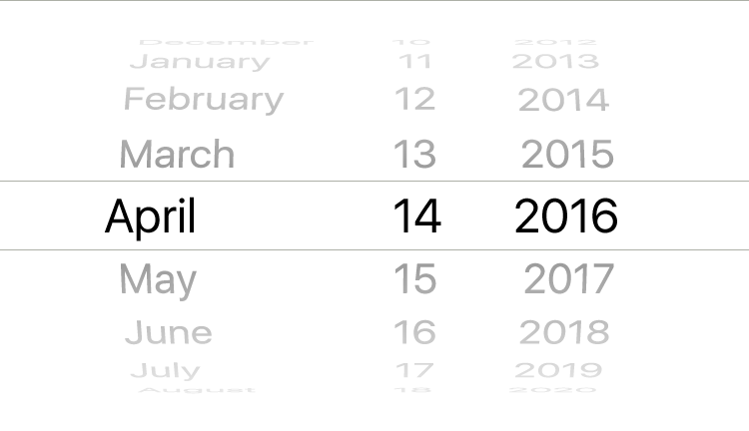
[Inspection Type]
Upload
Checklist
Inspection’s Jobs
Location Name goes here
Question 3 / 10
Group 1
2 / 8
2 / 26
13
2 / 8
2 / 26
13
Checklist: Checklist Name Goes Hers
Date of latest vetting inspection
Enter the date:
Location 1
7/10
Question 2
: 2
Answer text goes here until no space …
See More..
Date of previous inspection
1 tier question.
If the user clicks to move between jobs his answers will be saved.
If he clicks “cancel” only his latest question will not be saved.
Once a job was added, ith will come bac to the same screen (this screen)
: 0
13 Sep 2017
Question 2
: 1
Satisfactory
Question that was not answered
: 0
Add comments to the date
Question with long answer after pressin..
Enter text here..
: 2
24 Jan 2012
There was no follow up inspection after the latest inspection, should be done ASAP
See Less..
Location 2
3
7/10
Cancel
Done
Location 3
5
7/10
Inspections
Jobs
Crew List
Menu

Slide 16
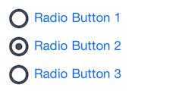
[Inspection Type]
Upload
Checklist
Inspection’s Jobs
Bridge
Group 1
2 / 8
2 / 26
13
2 / 8
2 / 26
13
Checklist: Checklist Name Goes Hers
Add Review to [Location Name gGoes Here]:
Location 1
7/10
Question 2
: 2
Answer text goes here until no space …
See More..
Date of previous inspection
1 tier question.
If the user clicks to move between jobs his answers will be saved.
If he clicks “cancel” only his latest question will not be saved.
Once a job was added, ith will come bac to the same screen (this screen)
: 0
13 Sep 2017
Question 2
: 1
Satisfactory
Question that was not answered
: 0
Comments:
Question with long answer after pressin..
Enter text here..
: 2
24 Jan 2012
There was no follow up inspection after the latest inspection, should be done ASAP
See Less..
Location 2
3
7/10
Cancel
Done
Location 3
5
7/10
Inspections
Jobs
Crew List
Menu

Slide 17



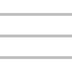
[Inspection Type]
Upload
Checklist
Inspection’s Jobs
Rethink of the search and check all actions.
Maybe add a new line
Mooring rope in poor condition
P
Defect
The spares of AEs Fuel injector valve should be inspection & overhaul
P
Defect
AE#3 LT Cooling pump found water leaks should be inspection
C
Defect
Embarkation Ladders for Life Boats ,Life Rafts: Unusable
P
Defect
Steering gear system leakage .
P
Defect
First Aid Kit to be placed in the Forecastle store
C
Defect
Paint all walkways (main decks, cross walkways, access to cranes) with anti skid
V
Defect
Engine Room Workshop Warning Sign of PPE is mandatory should be posted.
V
Defect
Inspections
Jobs
Crew List
Menu

Slide 18


Job Details
Save
Job Title:
Job’s Description
Job Description:
Can have either text or voice recordings
Change the number format
Job Type:
NCR
Due Date:
25-Jan-2017
Status:
Pending
PSC / Deficiency Code
Numeric Value

Slide 19
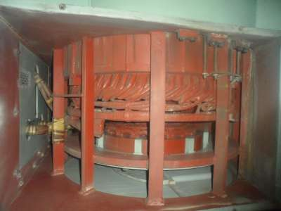

Job Details
Save
Vessel Dept.
Engine
Office Dept.
Technical
Location:
AUX BOILER#0 > GENERAL#0
Photos:
Delete
Save

Slide 20
Job Details
Save
Select Equipment
Function –> System –> Sub System
Job Title:
Job’s Description
Air Con & Ref
Job Description:
Boilers
Open as Modal (popup that covers half the page).
Change the icon “back” to “close”
Can have either text or voice recordings
Boilers
Bridge Equipment
Due Date:
25-Jan-2017
Compressed Air System
Deck
Status:
Pending
Air Con & Ref
Vessel Dept.
Engine
Boilers
Office Dept.
Technical
Boilers
Bridge Equipment
Job Type:
NCR
Compressed Air System
Location:
AUX BOILER#0 > GENERAL#0
Photos:

Slide 21
Job Details
Save
Select Equipment
Function –> System –> Sub System
Job Title:
Job’s Description
Air Con & Ref
Job Description:
System Location 1
Can have either text or voice recordings
System Location 2
System Location 3
Boilers
25-Jan-2017
Due Date:
System Location 1
Sub System Location 1
Sub System Location 1
Sub System Location 1
Vessel Dept.
Pending
System Location 2
Status:
Technical
System Location 3
Office Dept.
Engine
Boilers
NCR
Job Type:
Bridge Equipment
AUX BOILER#0 > GENERAL#0
Location:
Compressed Air System
Deck
Photos:

Slide 22


Manatee Jobs
Upload
Pending
Completed
Verified
All
Mooring rope in poor condition
P
Defect
The spares of AEs Fuel injector valve should be inspection & overhaul
P
Defect
AE#3 LT Cooling pump found water leaks should be inspection
C
Defect
Embarkation Ladders for Life Boats ,Life Rafts: Unusable
P
Defect
Steering gear system leakage .
P
Defect
First Aid Kit to be placed in the Forecastle store
C
Defect
Paint all walkways (main decks, cross walkways, access to cranes) with anti skid
V
Defect
Engine Room Workshop Warning Sign of PPE is mandatory should be posted.
V
Defect
Inspections
Jobs
Crew List
Menu

Slide 23
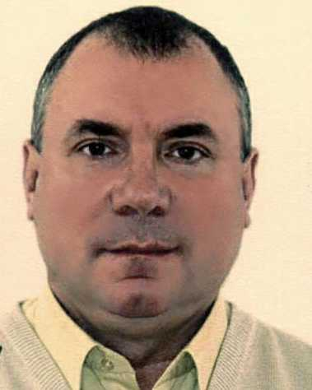




Crew List
Upload
Crew List
 | MST | IGOR BRASLAVSKYI
 | C/OFF | SUMEDHA WICKRAMASINGHA BOMBUWALA DEVAGE
 | 2/OFF | THANT SIN WIN
 | C/E | SUTOMO ADI
1
2
Inspections
Jobs
Crew List
Menu

Slide 24
Crew Details
Upload
IGOR BRASLAVSKYI
Rank: | MST
Nationality: | Sri-Lanka
Date Of Birth : | 22-Jun-1956
11645
Company Seniority | 8 years
 | 14 contract
Rank Seniority | 2 years
 | 3 contracts
Average Evaluation | 85
Last Evaluation | 92
Approved Card | Yellow
Card Remarks | Suspecting he making fake marriage cert…
Add Feedback

Slide 25

Crew Feedback
Upload
IGOR BRASLAVSKYI
Type your feedback or record a voice note
Save
Feedbacks pending to be uploaded
MST | IGOR BRASLAVSKYI | Test Describe the added feedback here
C/OFF | SUMEDHA BOMBUWALA DEVAGE
2/OFF | THANT SIN WIN | Different feedback added on a different time
C/E | SUTOMO ADI

Slide 26




Notification Center
Username Surname
Vessels List
Notifications Feed
Pending Tasks
Aida
Endurance
Freedom
Honor
Inspections
Jobs
Crew List
Independence II
Integrity
Help
Logout
Ver 1.1.1
Created by JiBe ERP

Slide 27
Tryouts

Slide 28
[Inspection Type]
Upload
Checklist
Inspection’s Jobs
Group Name
2 / 8
2 / 26
13
7/10
Add separation between this part to the lower part
Location 1
Question 2
: 0
Date of previous inspection
Both the grading and the comments will be opened as a popup
: 0
Question 2
: 0
Question that was not answered
: 0
Question with long answer after pressin..
: 0
3
Location 2
Location 3
5
Inspections
Jobs
Crew List
Menu

Slide 29
[Inspection Type]
Upload
Checklist
Inspection’s Jobs
Group Name
2 / 8
2 / 26
13
7/10
Add separation between this part to the lower part
Location 1
Question 2
: 2
Answer text goes here until no space …
See More..
Date of previous inspection
Both the grading and the comments will be opened as a popup
: 0
13 Sep 2017
Question 2
: 1
Satisfactory
Question that was not answered
: 0
Question with long answer after pressin..
: 2
24 Jan 2012
There was no follow up inspection after the latest inspection, should be done ASAP
See Less..
Location 2
3
Location 3
5
Inspections
Jobs
Crew List
Menu

Slide 30
[Inspection Type]
Upload
Checklist
Inspection’s Jobs
Group 1
2 / 8
2 / 26
13
2 / 8
2 / 26
13
Location Name goes here
Question 3 / 10
Question 2
15ppm alarm arrangement: Automatic stopping device for 15ppm alarm arrangement working satisfactory (MARPOL, Annex I)
Date of previous inspection
Checklist: Checklist Name Goes Hers
Location 1
Question 2
7/10
: 2
Bad
See More..
1 tier question.
If the user clicks to move between jobs his answers will be saved.
If he clicks “cancel” only his latest question will not be saved.
Answer text goes here until no space …
Question that was not answered
Below Average
Average
: 0
13 Sep 2017
Good
Question with long answer after pressin..
Excellent
: 1
Satisfactory
Cancel
Done
Location 2
7/10
Location 3
5
7/10
Inspections
Jobs
Crew List
Menu

Slide 31
[Inspection Type]
Upload
Checklist
Inspection’s Jobs
Group 1
2 / 8
2 / 26
13
2 / 8
2 / 26
13
Question 2
15ppm alarm arrangement: Automatic stopping device for 15ppm alarm arrangement working satisfactory (MARPOL, Annex I)
Date of previous inspection
Checklist: Checklist Name Goes Hers
Location 1
Question 2
7/10
: 2
Bad
See More..
1 tier question
Answer text goes here until no space …
Question that was not answered
Below Average
Average
: 0
13 Sep 2017
Good
Question with long answer after pressin..
Excellent
: 1
Satisfactory
Cancel
Done
Location 2
7/10
Location 3
5
7/10
Inspections
Jobs
Crew List
Menu

Slide 32
[Inspection Type]
Upload
Checklist
Inspection’s Jobs
Group 1
2 / 8
2 / 26
13
2 / 8
2 / 26
13
Location Name goes here
Question 3 / 10
Checklist: Checklist Name Goes Hers
2 tier question
Location 1
7/10
Date of latest vetting inspection
Enter the date:
Question 2
: 2
Answer text goes here until no space …
See More..
Date of previous inspection
: 0
13 Sep 2017
Question 2
: 1
Satisfactory
Question that was not answered
: 0
Question with long answer after pressin..
Add comments to the date
: 2
24 Jan 2012
There was no follow up inspection after the latest inspection, should be done ASAP
Enter text here..
See Less..
Location 2
3
7/10
Location 3
5
7/10
Cancel
Done
Inspections
Jobs
Crew List
Menu

Slide 33
[Inspection Type]
Upload
Checklist
Inspection’s Jobs
Group Name
2 / 8
2 / 26
13
7/10
Add separation between this part to the lower part
Location 1
Question 2
: 2
Answer text goes here until no space …
See More..
Date of previous inspection
Both the grading and the comments will be opened as a popup
: 0
13 Sep 2017
Question 2
: 1
Satisfactory
Question that was not answered
: 0
Question with long answer after pressin..
: 2
24 Jan 2012
There was no follow up inspection after the latest inspection, should be done ASAP
See Less..
Location 2
3
Location 3
5
Inspections
Jobs
Crew List
Menu

Slide 34
[Inspection Type]
Upload
Checklist
Inspection’s Jobs
Group Name
2 / 8
2 / 26
13
7/10
Location 1
Question 2
: 2
Answer text goes here until no space …
See More..
Date of previous inspection
: 0
13 Sep 2017
Question 2
: 1
Satisfactory
Question that was not answered
: 0
Question with long answer after pressin..
: 2
24 Jan 2012
There was no follow up inspection after the latest inspection, should be done ASAP
See Less..
Location 2
3
Location 3
5
Inspections
Jobs
Crew List
Menu

