Slide 1

Third-1 2025 Analysis of Tshabron Operations
Cost, Sales, Business Plan, and Recommendations by Chukwuebuka Tshally-Okeke

Slide 2
Introduction
This analysis aims to achieve three things
Identify key pain points in the business
Calculate and reduce pain points in the business
Define clear sales targets
Improve revenue growth

Slide 3
What are the key pain points?
High running costs: Expenses above budget
Purchases + Expenses outweigh Revenue
Fragmented Data or incomplete data.
Sales targets have never been met.

Slide 4
Data Visualisation

Slide 5
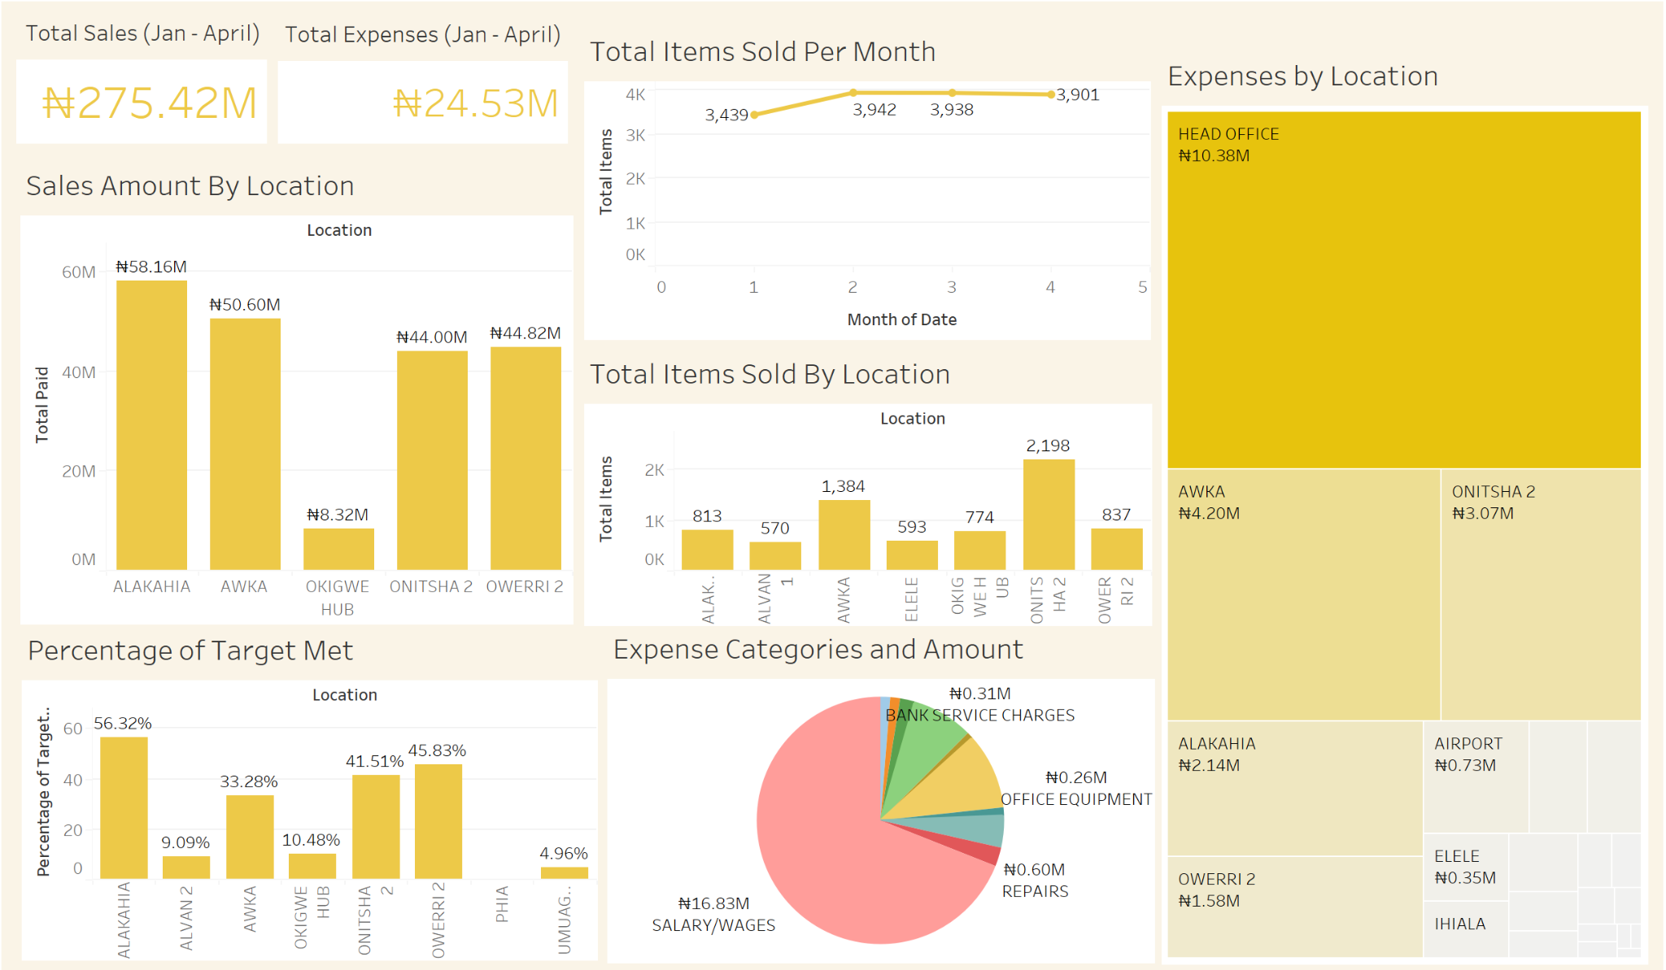
Tableau Dashboard

Slide 6
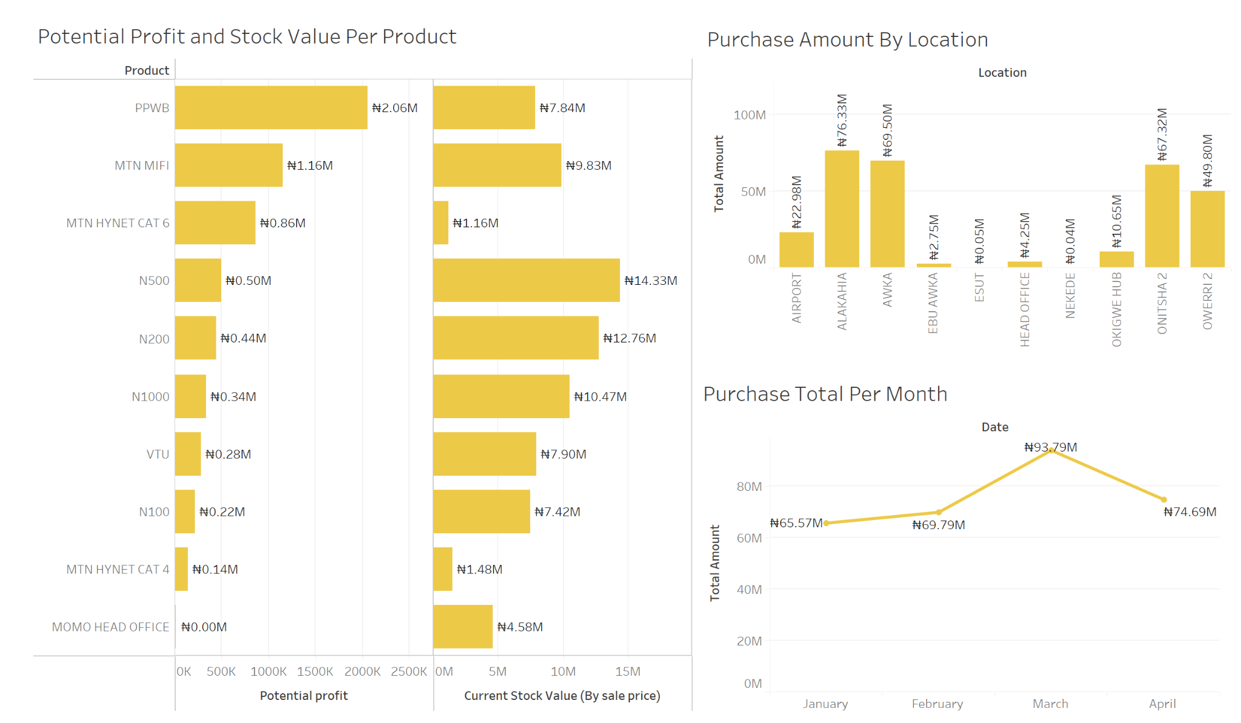

Slide 7
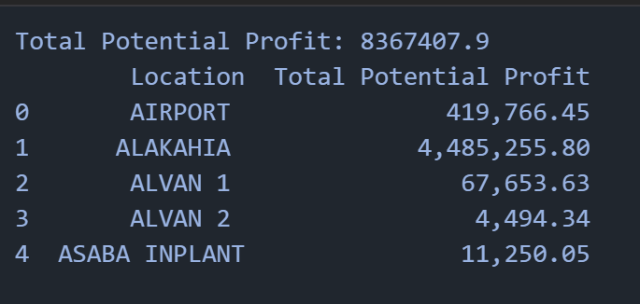
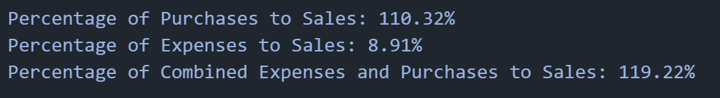


Other Metrics

Slide 8
What do you think should happen?
Suggested Solutions
All included in a 9-paged business plan…

Slide 9
Data Strategy
Standardised data entry via Google Forms
Centralised Google Sheets Forms
Monthly Tableau Dashboards by accounting team for quick insights

Slide 10
Financial Management
Set monthly targets for each branch based on product supply.
Set aside profit allocation for supply of products and asset acquisition.
Data-Driven budgeting and forecasting.

Slide 11
Staff Role Optimisation
20% salary increase to any branch that exceeds 90% of sales target including MoMo.
Branch managers would be involved in accounting processes.
Query low-performing shops or replace staff.

Slide 12
MoMo: How to Recruit More Agents and Improve MoMo Operations.
Target unemployed youths, petty traders, and POS operators.
Regular agent support visits and quick payout systems.
Support top agents with additional float funding.
Use google sheets to track agent performance regularly.
Quickly replace or retrain slow-performing agents.

Slide 13
Expected Results
Higher revenue
Reduced costs
Faster business scaling
Win-Win situation for staff and management.

Slide 14
Expansion Recommendation
Agency Banking
Partner with banks to open banking agent centres at your shops/kiosks.
Offer account opening, deposits, withdrawals, and even loan applications.
E-commerce and Logistics
Local e-commerce dropshipping: Sell phones, gadgets, SIMs online.
Courier services: Start last-mile delivery services between towns or states.
Education and Certification Centre
Certification centre: Register people for online exams (like JAMB centres).

Slide 15
Any Questions?

