Slide 1

MrDelievery
Project Outline
By
Tshepo Maema

Slide 2
Table Of Contents
Introduction 3
Problem Statement 4
Use Case Diagram 5
Class Diagram 6
Sequence Diagram 7
Entity Relationship Diagram 8
Data Flow Diagram 9
Architecture Diagram 10
UI Diagram 11
Technologies 12

Slide 3
Introduction
MrDelivery is a food delivering franchise which offers the ability of food ordering for delivery or for self-collection.
Delivery
they charge a simple flat fee of R35 per delivery, and they also have regular free delivery specials in the app!
for an order to be delivered it must be worth a minimum of- R65 for delivery orders and depending on how long it takes the restaurant to finish with your order their delivery time is 15 minutes after the food has been collected from the restaurant
Self-collection
a customer has collection option if they'd like to pick up their order themselves and they'll still be able to track it from confirmation and will receive a pick-up time. And for fully paid self-collection orders the customer doesn’t have to queue to get their order.

Slide 4
Problem Statement
MrDelivery wants all their users to :
be able to place orders and get their items delivered to them wherever they are
have the option to be able to pay for their ordered items online or by cash upon delivery.
Have the ability to order and fully pay for self-collection and avoid queues.
Register as drivers and make money and
Register as partners and get their orders delivered

Slide 5
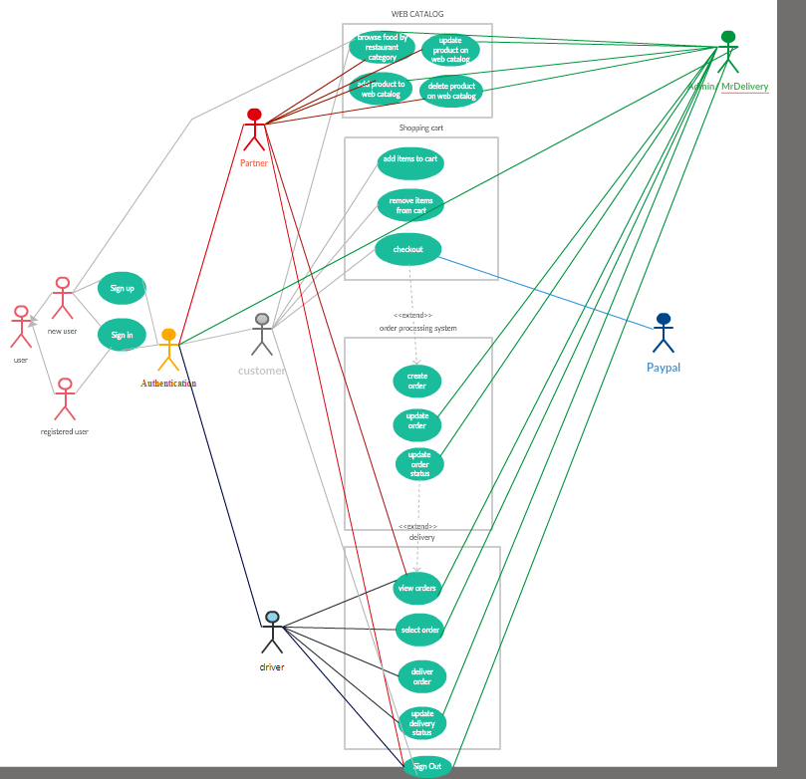
Use case

Slide 6
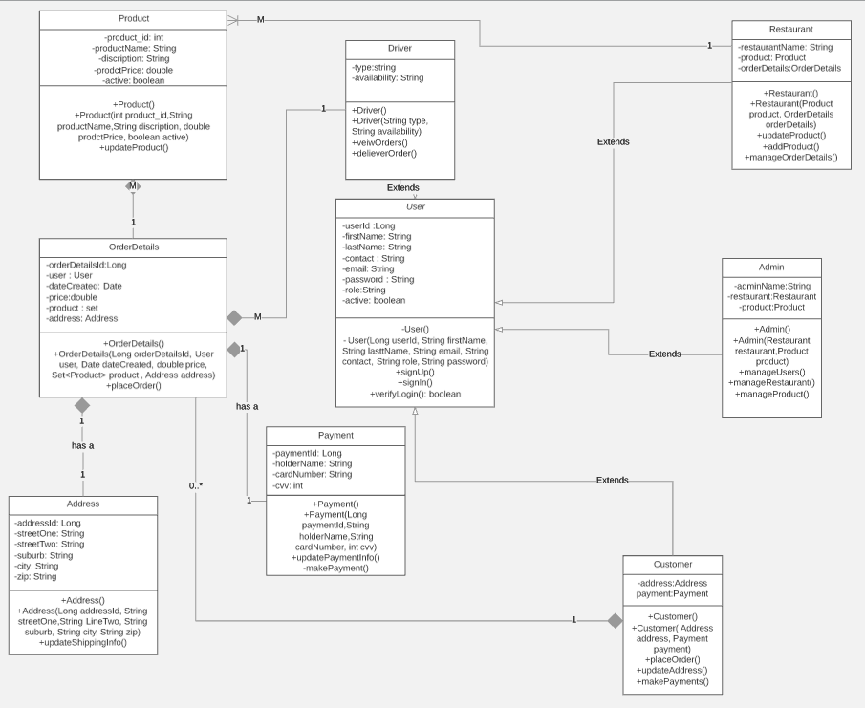
Class Diagram

Slide 7
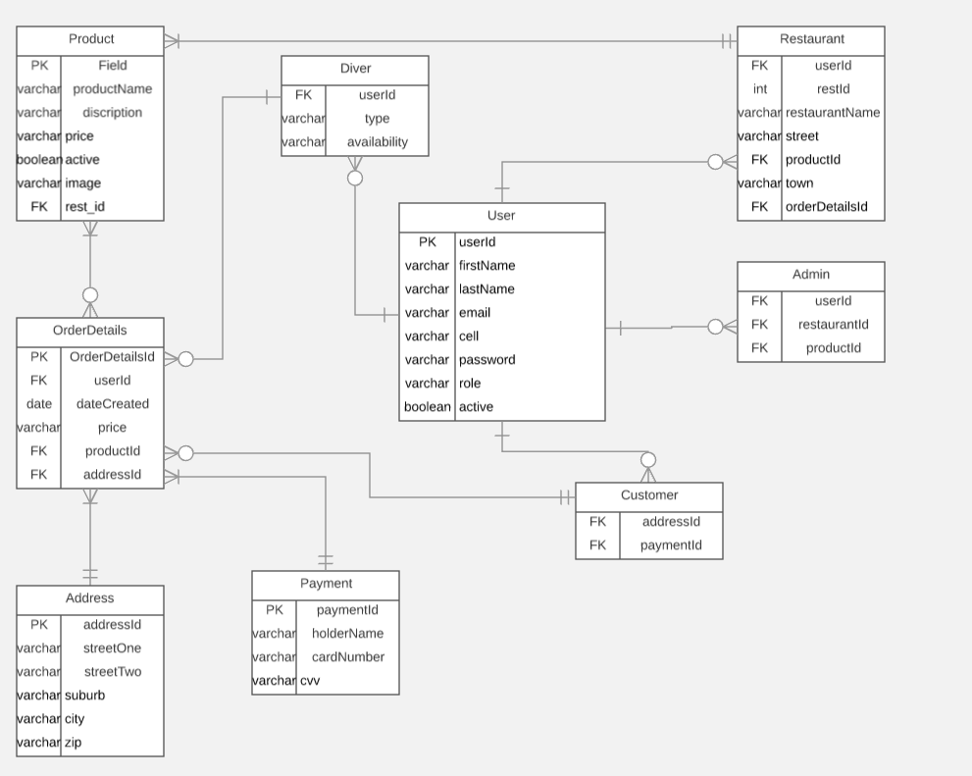
Entity Relationship Diagram

Slide 8
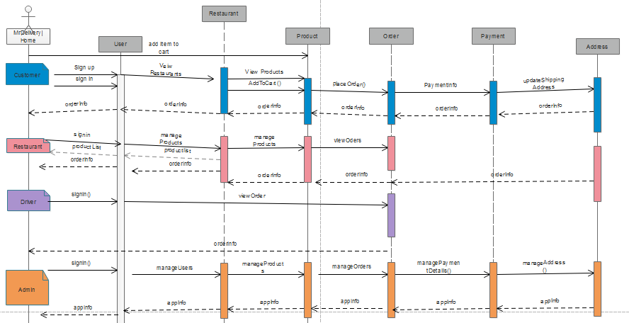
Sequence diagram

Slide 9
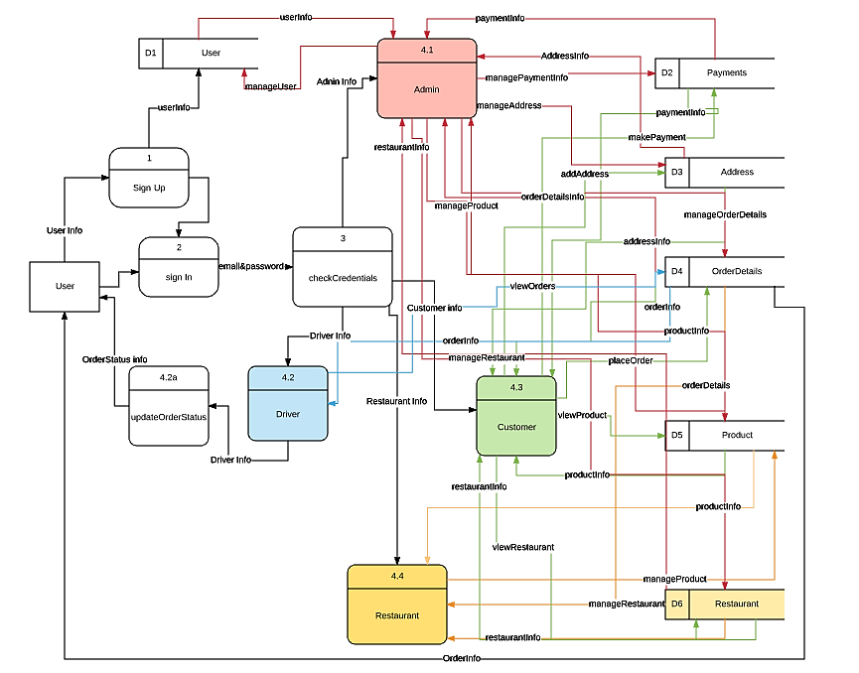
Data flow Diagram

Slide 10
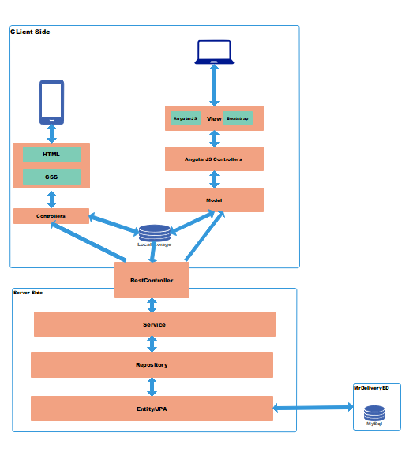
Architecture

Slide 11
Technologies Used
IDE’s
Netbeans
Application Server
Tomcat
Database
Mysql
Back-end
Spring boot
JPA
Restful services
Front end
HTML
CSS
Bootstrap
AngularJs

Slide 12
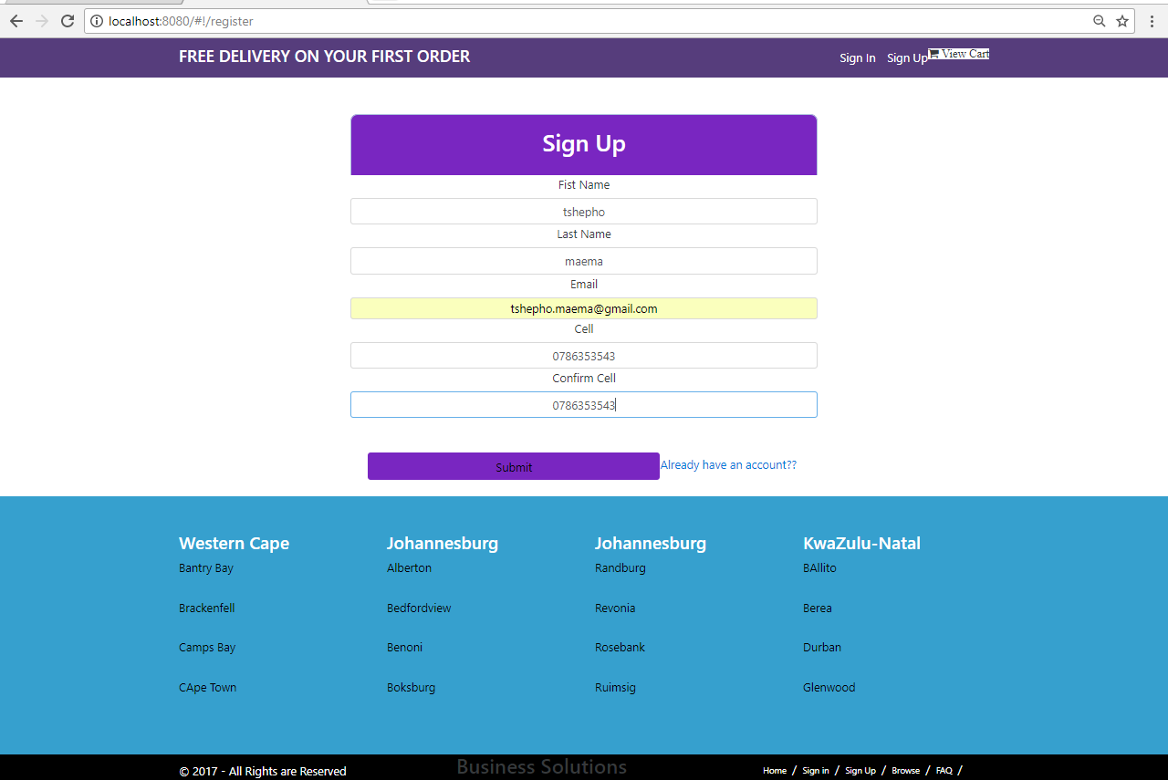
Sign Up

Slide 13
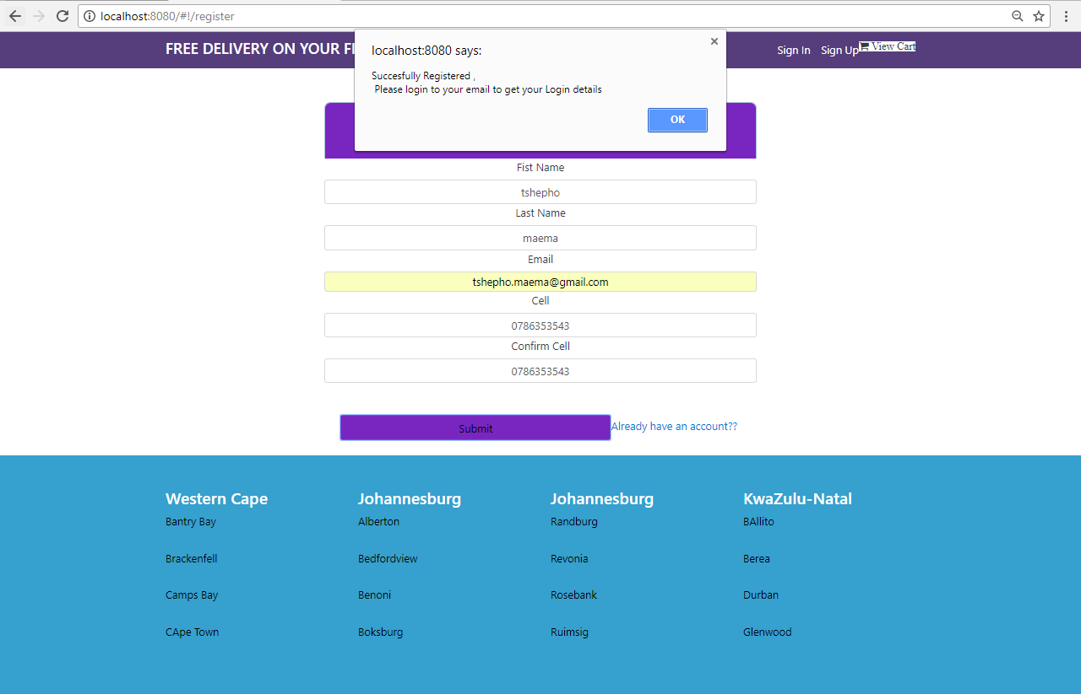
Register Success

Slide 14
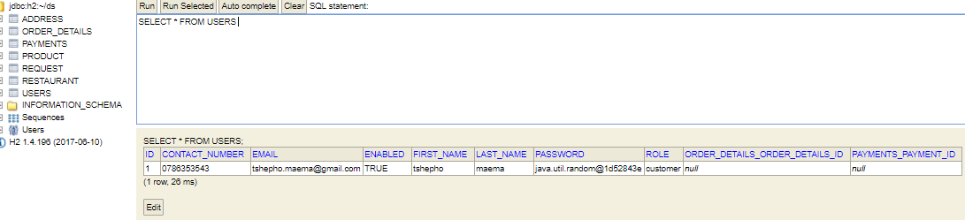
Screenshots

Slide 15
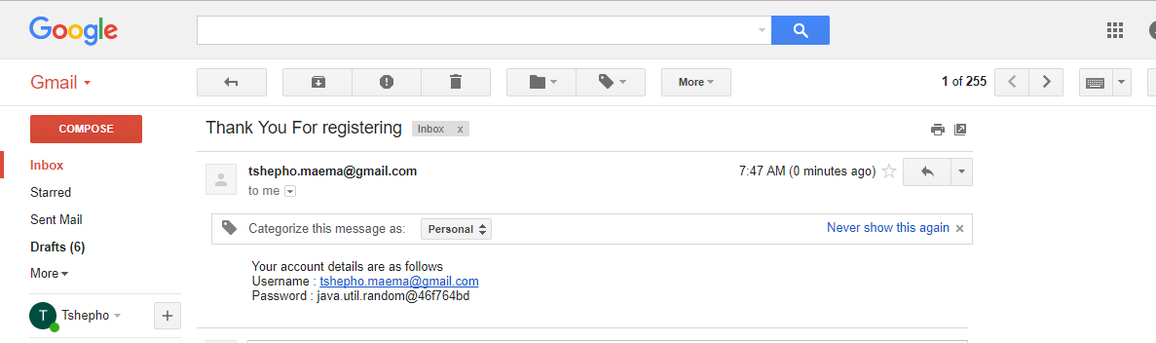
Email Received

Slide 16
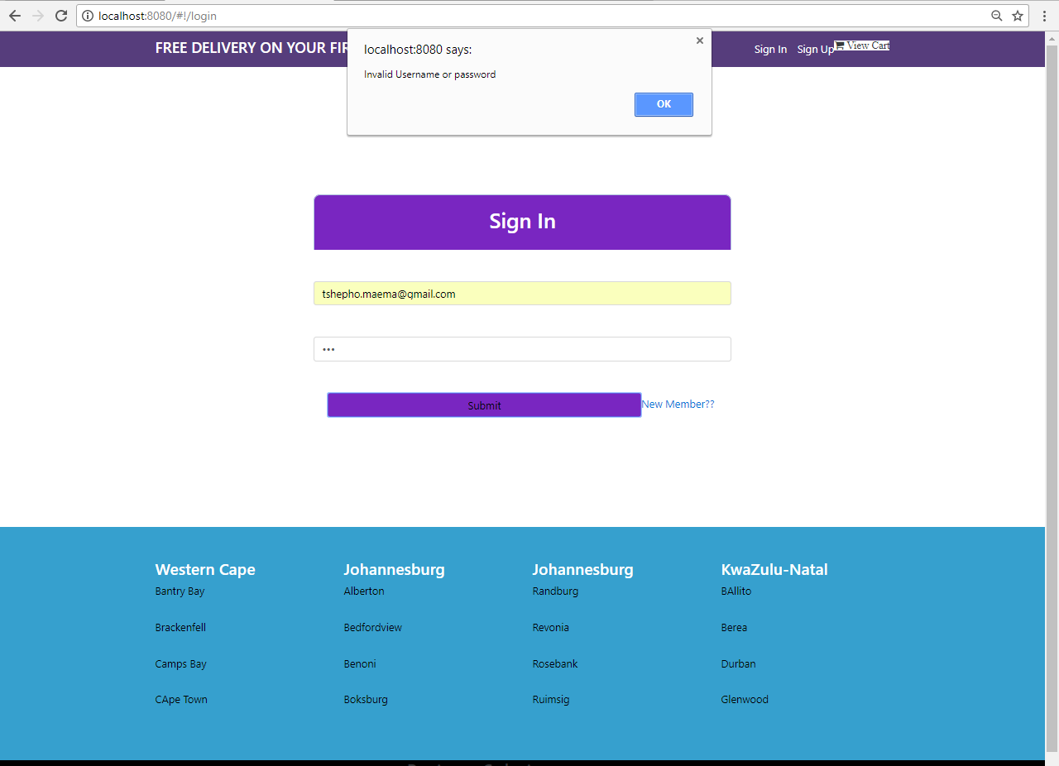
Login invalid

Slide 17
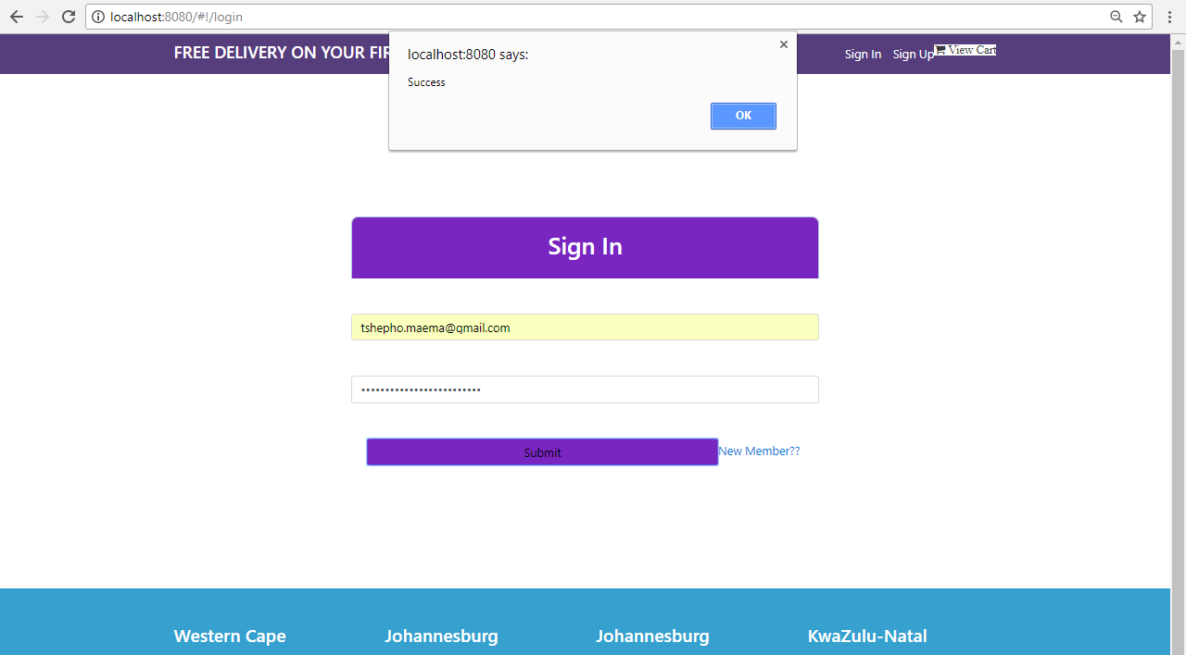
Login Success

Slide 18
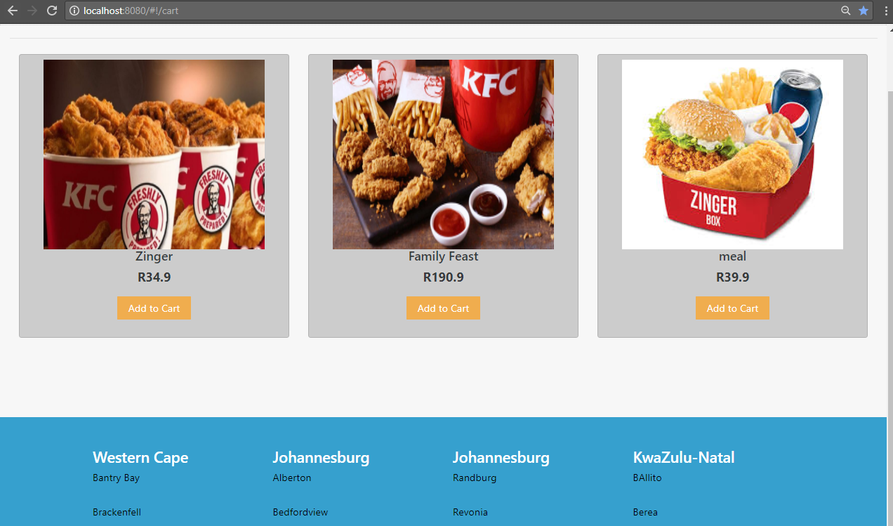
Items products

Slide 19
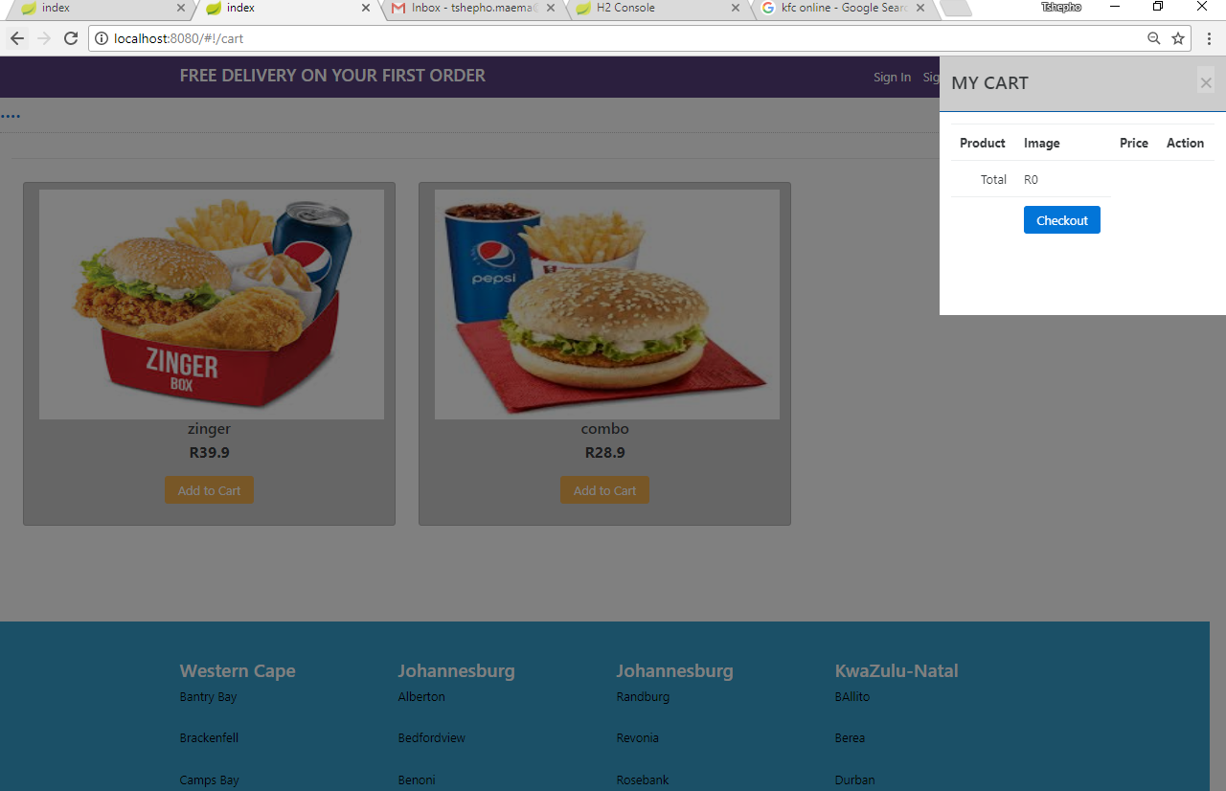
Cart Empty

Slide 20
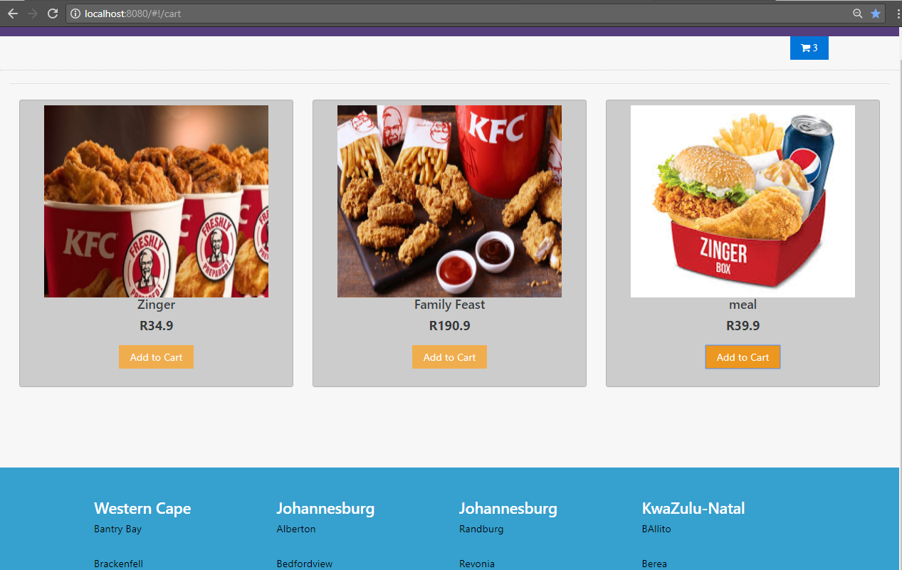
Items Added To Cart

Slide 21
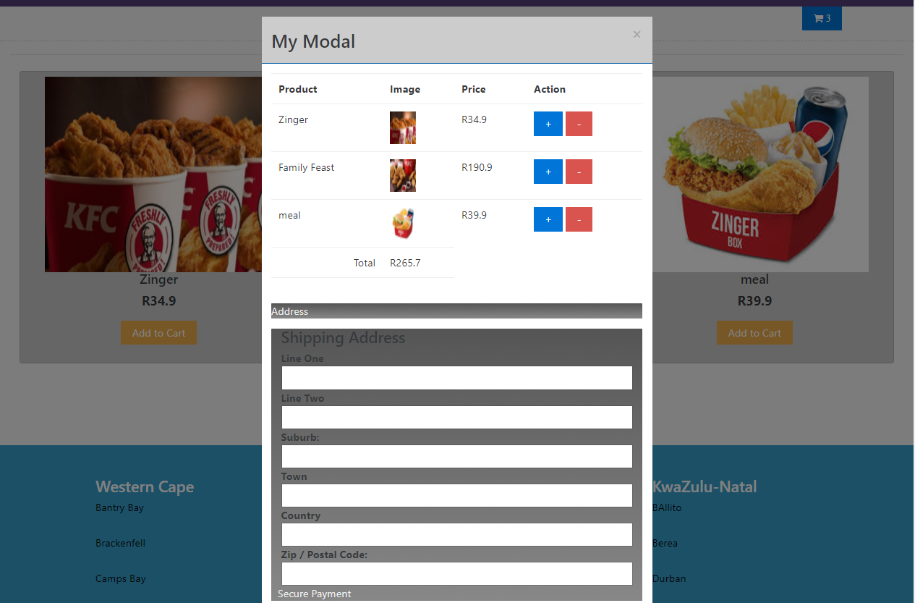
Items Added To Cart

Slide 22
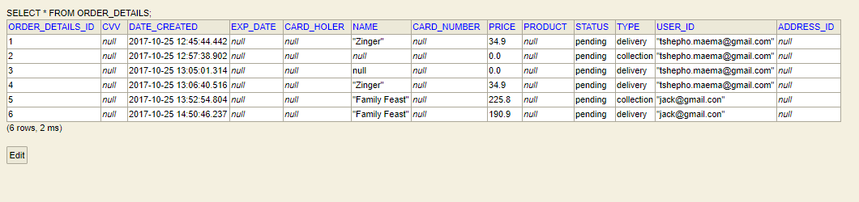
Order

Slide 23
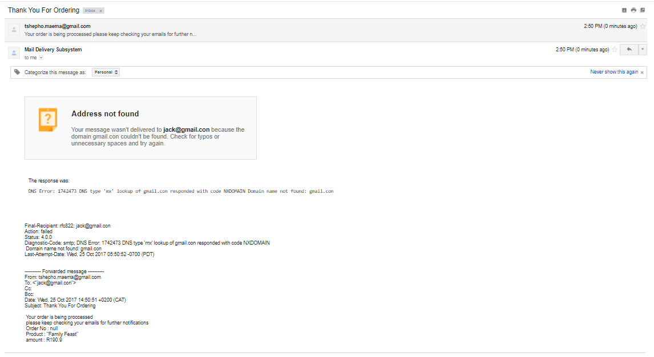
Order Sent To Email

Slide 24
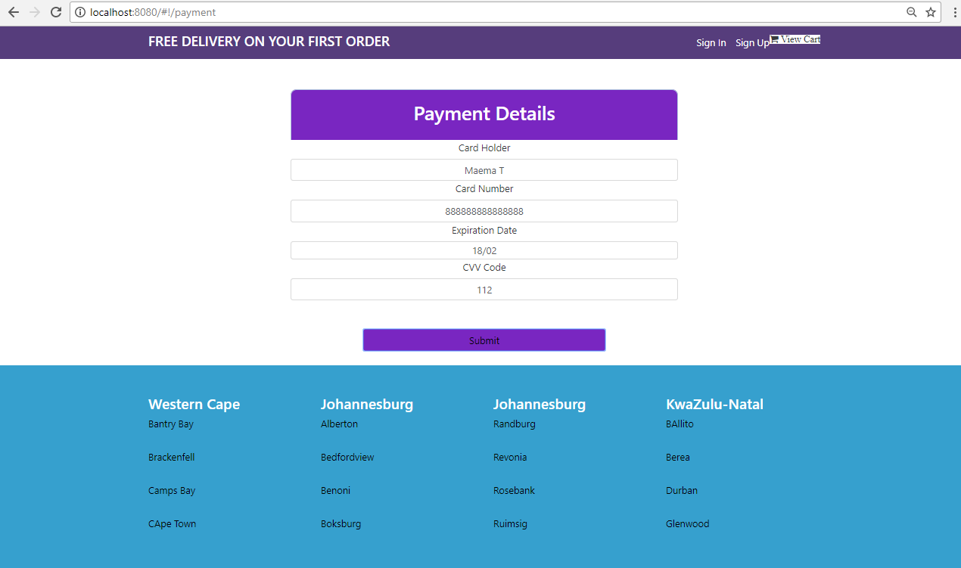
Payment

Slide 25
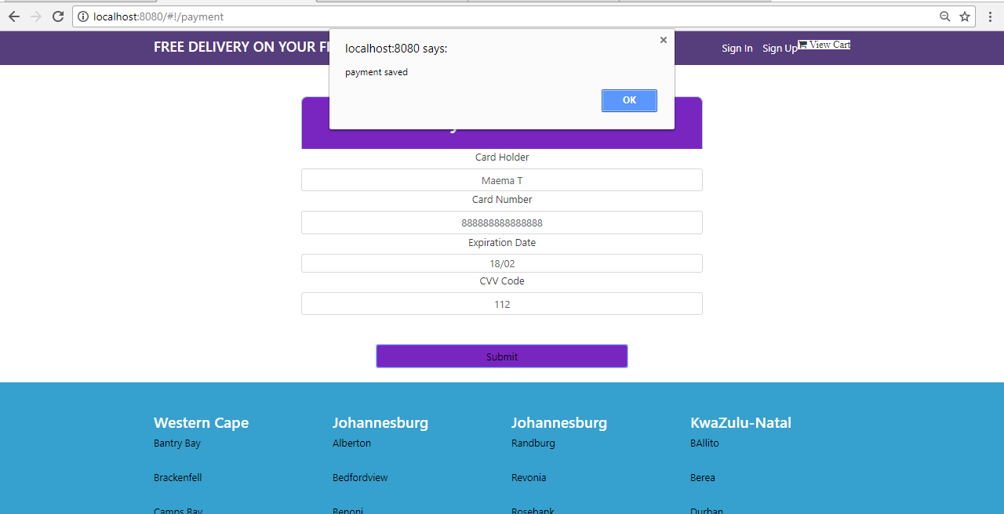
Payment

Slide 26
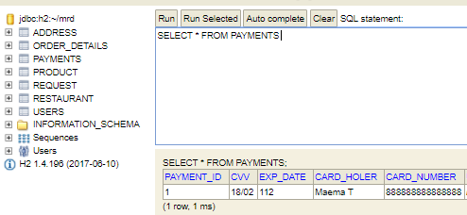
Screenshots

Slide 27
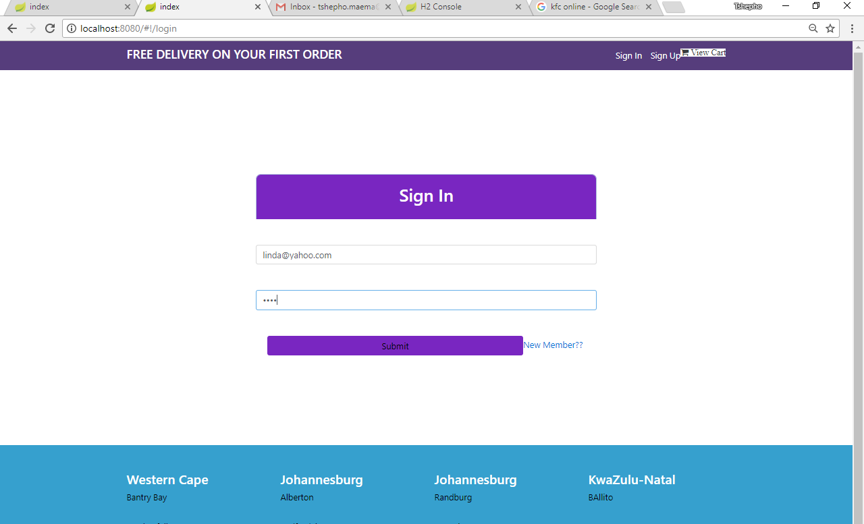
Admin Sign In

Slide 28
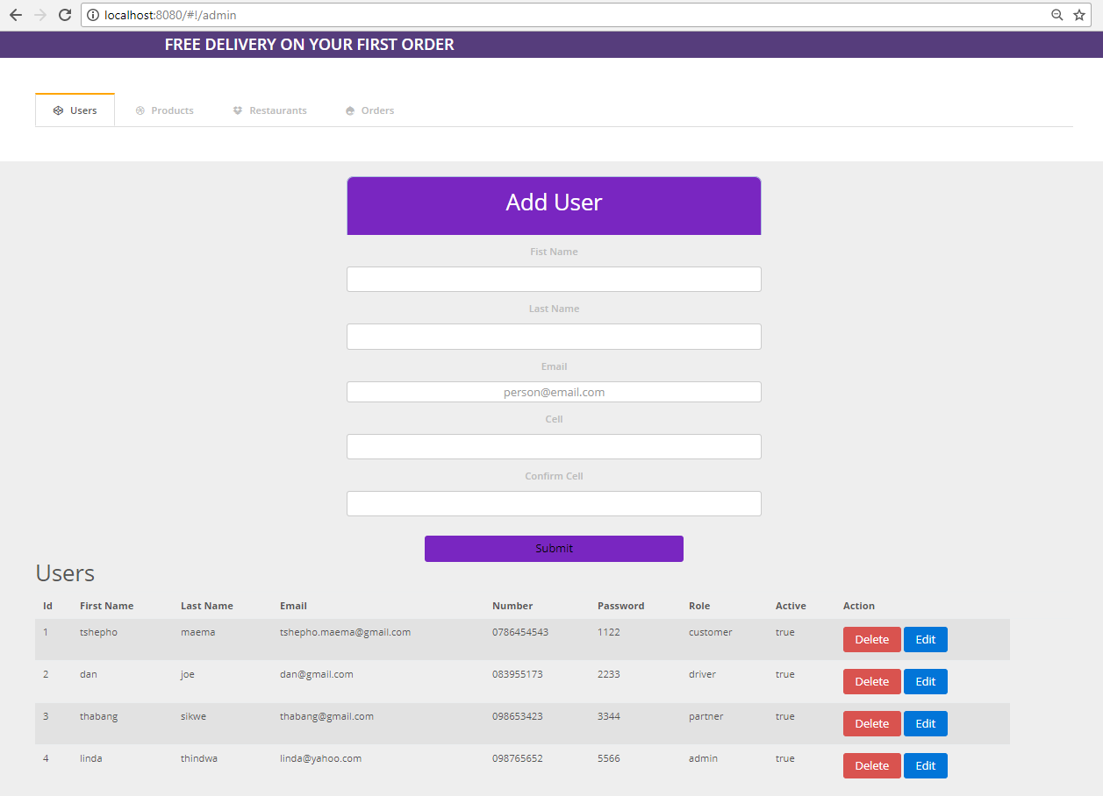
Admin Add User

Slide 29
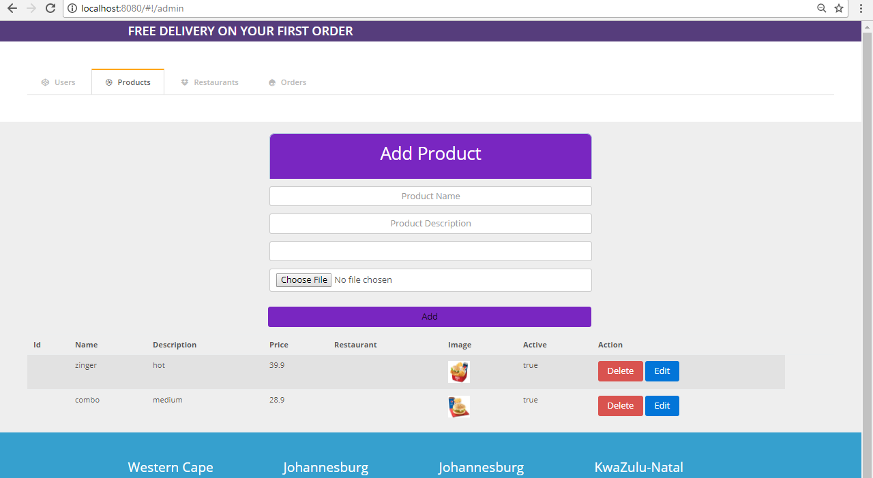
Admin Add product

Slide 30
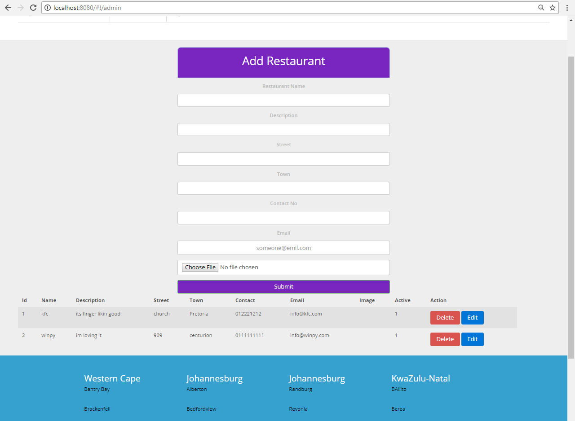
Admin View Restaurants

Slide 31
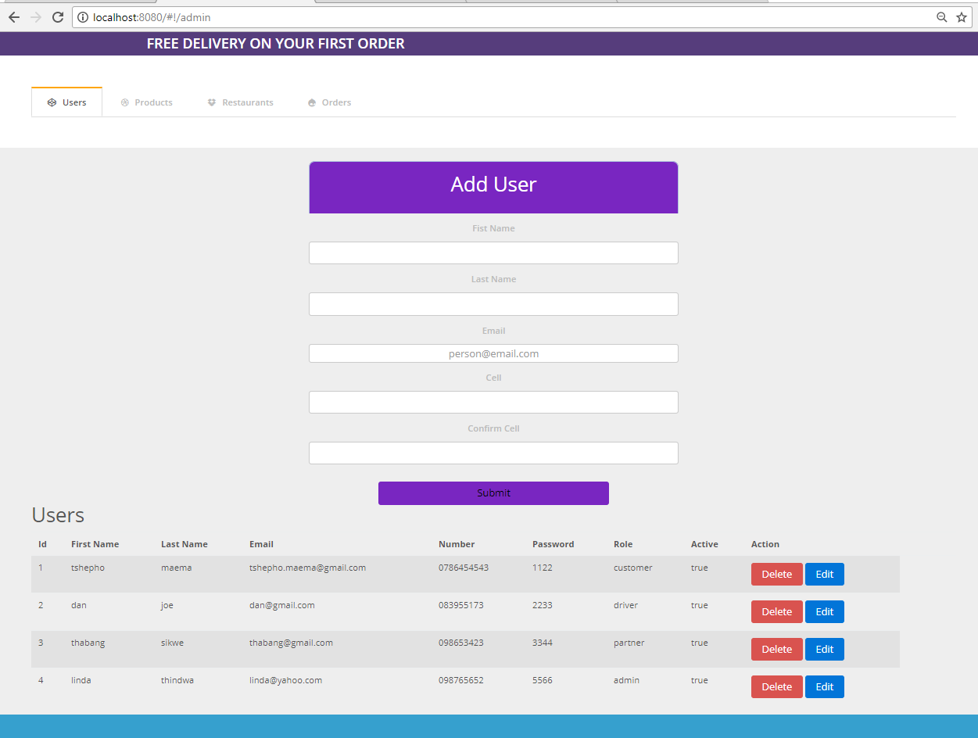
Admin View Users

Slide 32
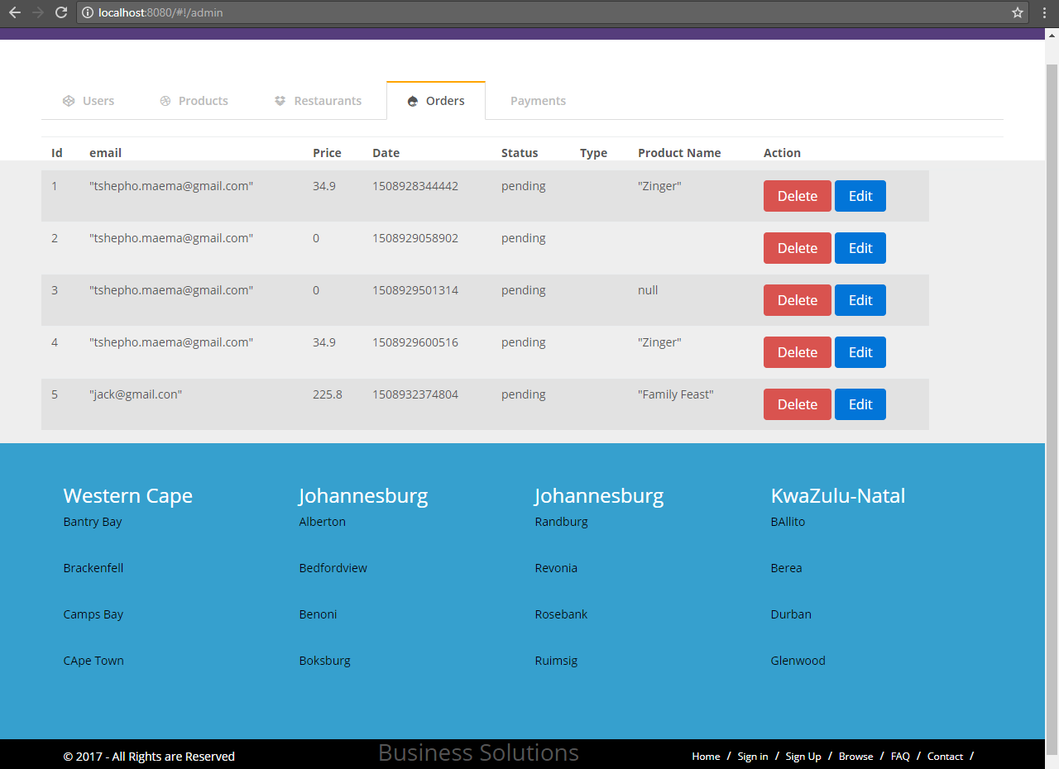
Admin View Orders

Slide 33
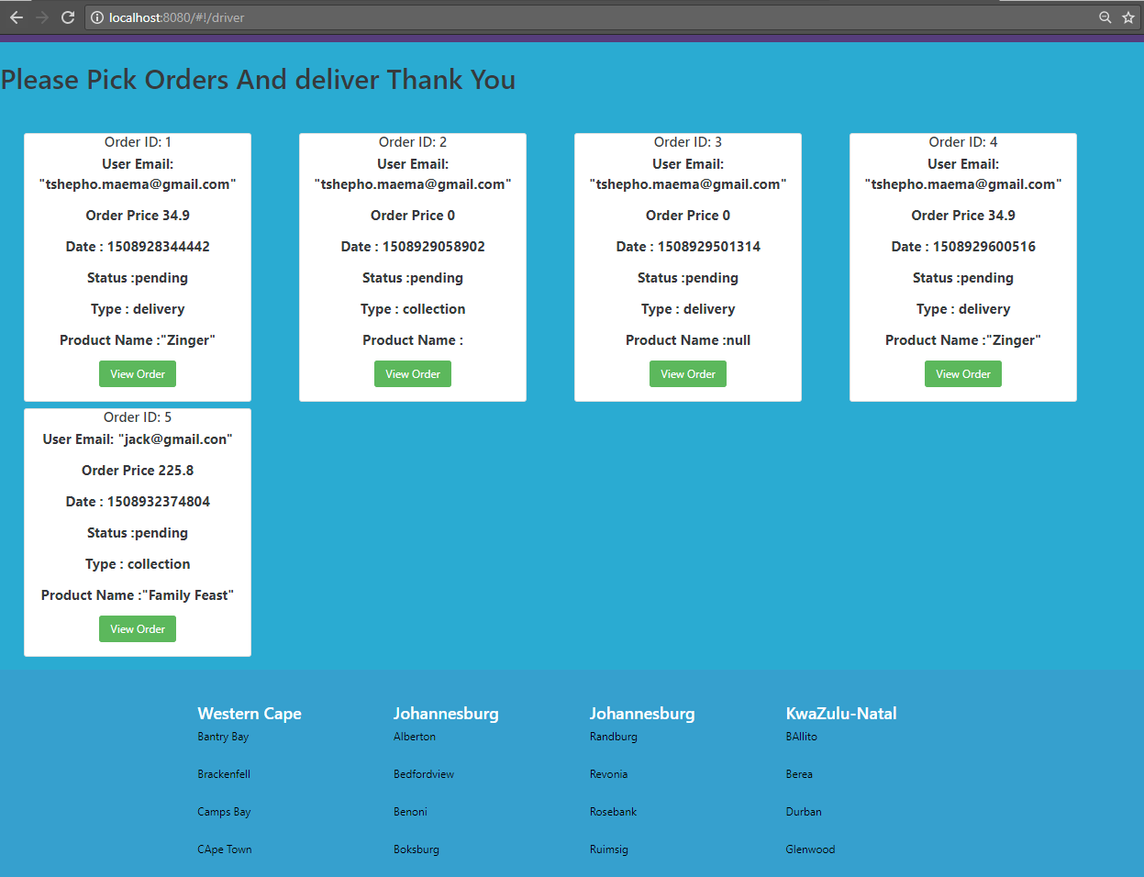
Driver Screenshots

Slide 34
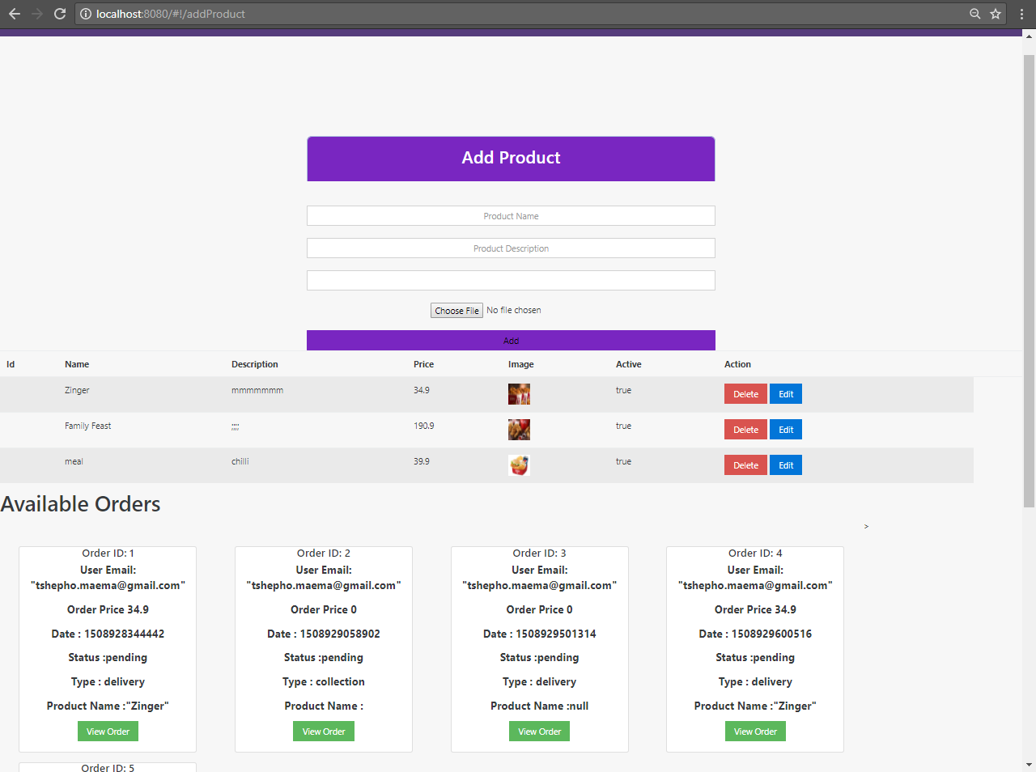
Partner Home

Slide 35
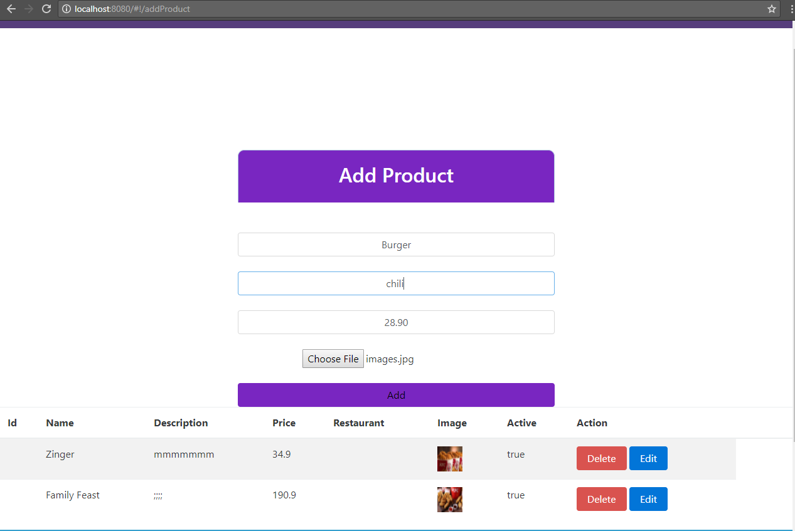
Partner AddProduct

Slide 36
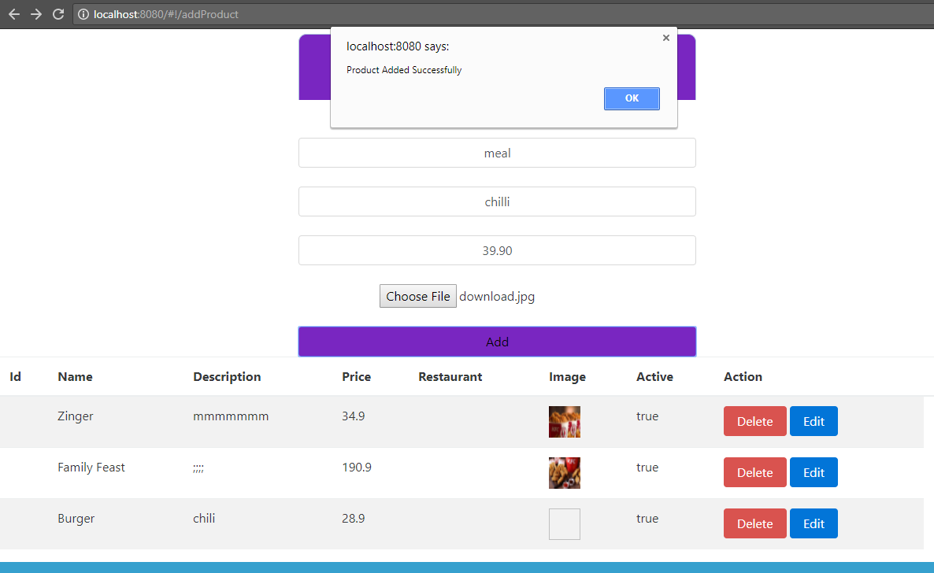
Partner Add Product

Slide 37
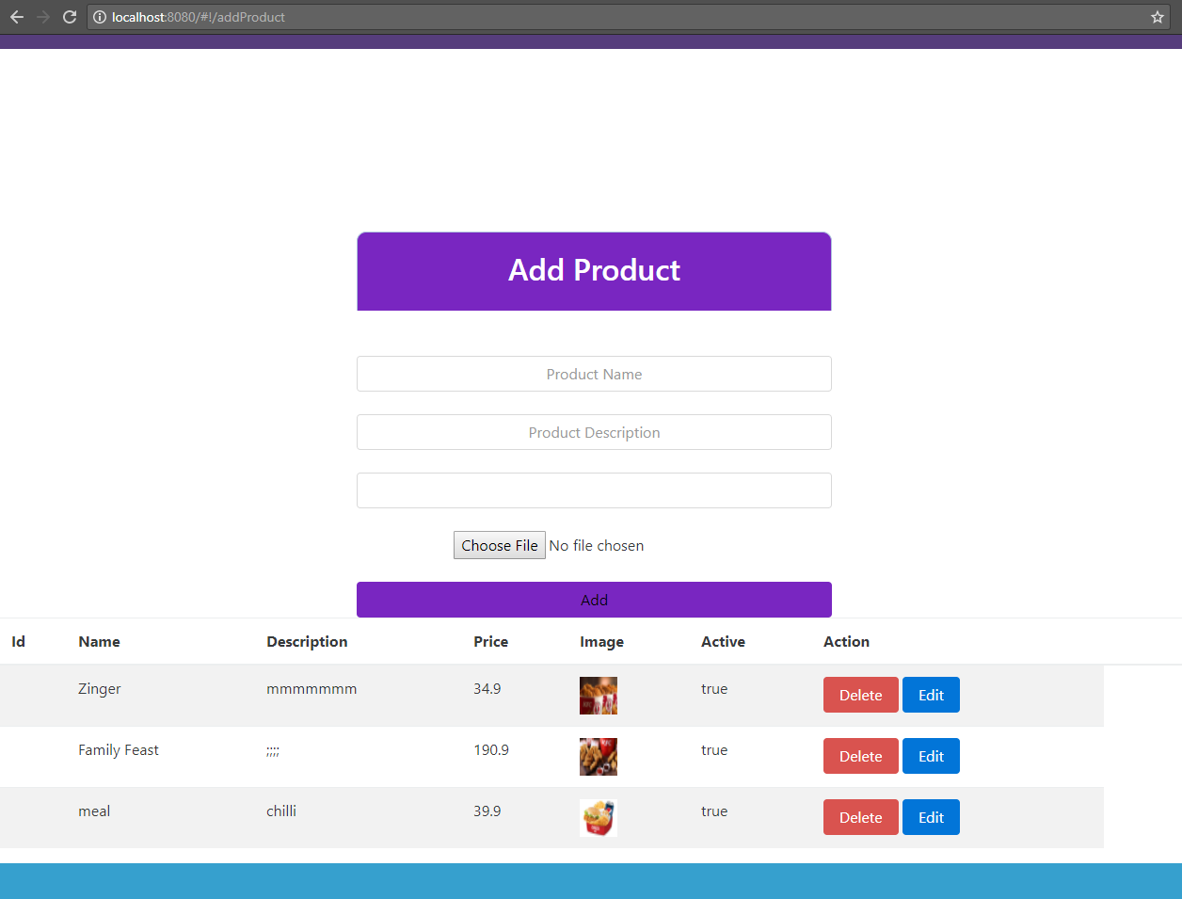
Partner AddProduct

Slide 38
Thank You

