Slide 1
TELECOM CUSTOMER CARE · CAPACITI WEEK 3
ChurnSignal
Most angry customers stay.
Find the ones who won't.
Tshepiso Freddy Thosago
tshepisofrominnostation.github.io/churnsignal
Notes:
Good morning. Care teams get thousands of messages a week: WhatsApp, X, Hellopeter. Most come from people who are annoyed but staying. A few come from people who are quietly leaving. Those few get answered in arrival order, which is the worst possible order. ChurnSignal fixes the order.

Slide 2
THE PROBLEM
Unhappy is not
the same as leaving.
So the inbox is answered in arrival order.
The people about to leave are buried in the middle.
Notes:
Sentiment analysis tells you a message is negative. That is not useful on its own, because most messages are negative. What matters is intent. 'This is unacceptable' is anger. 'This is my last month with you' is a departure. My earlier project scored the first and missed the second.

Slide 3
WHAT IT DOES
Read. Rank. Reply.
READ
RANK
REPLY
every message
risk, not volume
in the right order
Four queues: Respond Now · Today · This Week · Monitor
Notes:
You paste a message, and it answers three things: is this person leaving, how fast must you reply, and what is it about. Then it places the message in one of four queues, so the agent working that queue knows who to phone first.

Slide 4
MEASURED, ON 819 UNSEEN MESSAGES
90%
74%
96%
spots a leaver
of leavers reached
sarcasm read right
keyword rule: 50%
answering top 20% only
word lists: 6%
Answering top to bottom reaches only 18%.
Notes:
These are not guesses. On 819 messages the model never saw, it spots a leaver with 90% F1, against 50% for a keyword rule. The number a manager cares about: if you can only answer the top fifth of your inbox, this reaches 74% of the people who were really leaving, against 18% working top to bottom.

Slide 5
HOW, IN PLAIN WORDS
01
Clean the text
02
Weigh the words
03
Four classifiers
04
One priority score
Churn 62% · urgency 28% · negativity 10%
Notes:
Four steps, no magic. Clean the text, weigh which words are distinctive, run four small classifiers for churn, urgency, topic and sentiment, then combine them into one score. The score is arithmetic a person can follow, and every message shows the words that moved it.

Slide 6
WHAT THIS IS NOT
Honest about the limits.
—
Synthetic data, not real customers
—
A triage aid, not a verdict
—
English first, other languages next
Notes:
I want to be straight about three things. The data is synthetic, so these numbers show the method works, not that it will hit 90% on real customers. It prioritises, it never decides anything about a customer. And it is English first, with South African languages as the next step.

Slide 7
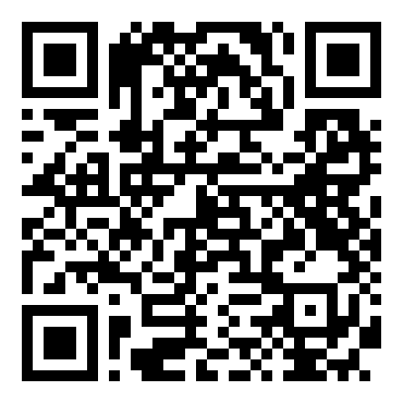
LIVE NOW
Open it on
your phone.
Paste a message. See who to answer first.
SCAN
tshepisofrominnostation.github.io/churnsignal
Notes:
The link is live and it runs in the browser, so nothing is uploaded and there is nothing to install. Scan it now and paste one of your own messages. That is the whole pitch: the queue finally knows who to answer first.

