Slide 1
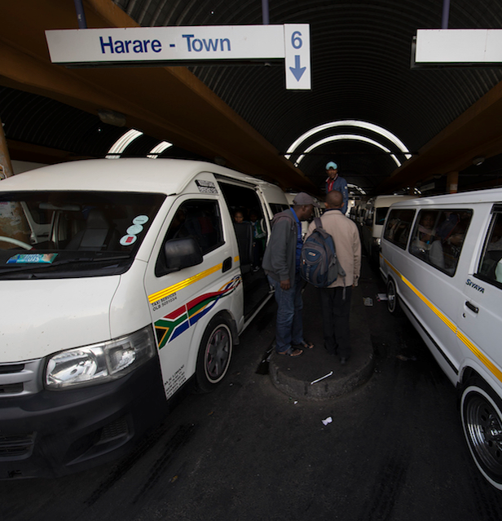
Access CPT Hackathon:
Map My Fleet
Xolani Masuku, Christian Alexander, Sean Cooke, Karabo Makgabo, Tshepo Morailane

Slide 2


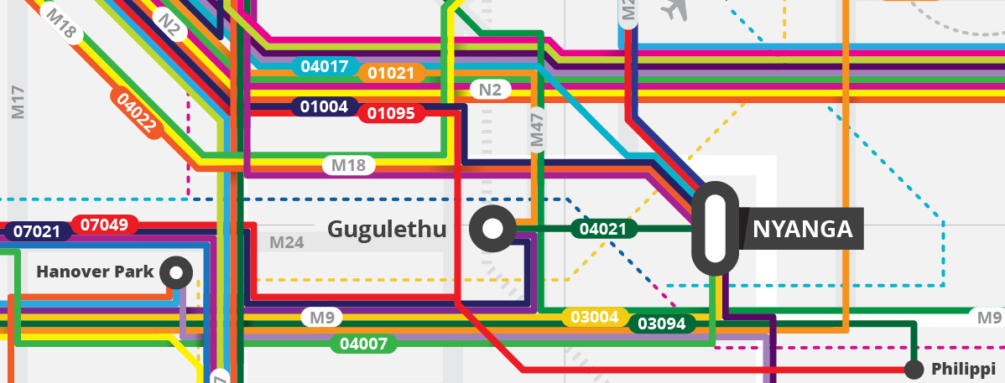
SA Minibus taxi industry
300,000 vehicles
~40,000 owners
15 million passengers
600,000 employees
SANTACO 2016

Slide 3
Minibus challenges
Passengers
Government
√
√
√
When will I
get picked up?
How do we regulate
and integrate
minibus taxis?
Owners
Associations
$$$
How efficient
is my operation?
How do we allocate resources and coordinate amongst members?

Slide 4
Future with minibuses
Passengers
Government
√
√
√
When will I
get picked up?
How do we regulate
and integrate
minibus taxis?
Owners
Associations
Map My Fleet
$$$
Real-time tracking
Driver
Owner
How efficient
is my operation?
How do we allocate resources and coordinate amongst members?
Notes:
Due to scarce empirical data on South African land use characteristics and public transport operating costs, simulation research was necessary to study public transport-urban form relationships. A public transport corridor operating cost model was therefore developed to simulate the effects of varying land use environments on the viability of public transport systems. The model consists of separate land use, transport and costing models, wherein the output of one becomes the input of the next.

Slide 5
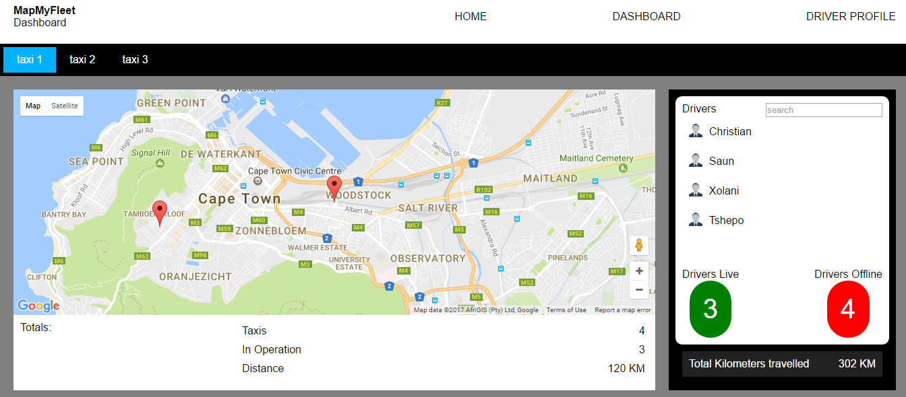
Map My Fleet

Slide 6
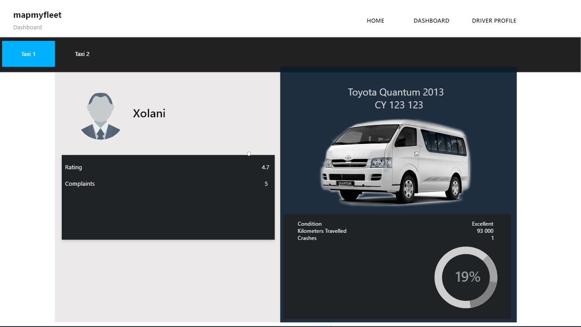
Map My Fleet: Driver profiles

Slide 7







Next steps……..
Continue the app development
Pilot the vehicle tracking app
(1 association)
Pilot the fleet management app
(1 association)
Passenger-facing trip planner roll-out
City-wide MapMyFleet roll-out
Better integrated minibus taxis

Slide 8




Business proposition
$$$
Better informed business decisions
More control over vehicle operations
Better maintenance plans
Better employee management
Incentivise safer driving habits
Better vehicle availability
Notes:
Owners can incentivise safer driving, to prevent crashes and damage to the vehicle.

Slide 9

Long-term benefits
Passengers
Government
√
√
√
Improved timing
Trip planning
Manageable wait times
Regulation enforcement
Modal integration
Owners
Associations
$$$
Better performance
More efficiency
Better coordination
Efficient allocation of routes

Slide 10




Thank you
Xolani Masuku, Christian Alexander, Sean Cooke, Karabo Makgabo, Tshepo Morailane
Notes:
Thank you for your time, and welcome any questions you may have.

