Slide 1
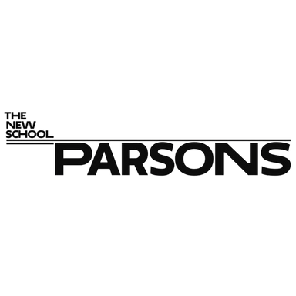
Human Agency Index
ECONOMIC DESIGN PROJECT
Layoon Kim
Tim Sheppel

Slide 2
AGENDA
The Problem
① Job Security Threatened by AI Automation
② Companies began replacing human with AI.
③ Work culture: Profit and efficiency prioritized over People
④ Labor Automation Trend: 20 years of curve shifts to AI
⑤ AI Adoption Gap: Trend-Driven AI Adoption Fails
Guiding Questions
Solution proposal: Human Agency Index
Concept
Survey Questions
Incentive Design
Why it matters

Slide 3
THE PROBLEM
Human Job Security
is threatened by
AI Automation right now.

Slide 4
THE PROBLEM
① Job Security Threatened by AI Automation
66.7%
40%
of U.S. existing jobs threatened by AI
of Low-income Countries jobs threatened by AI
Goldman Sachs report
International Monetary Fund
Generative AI could raise global GDP by 7%, Goldman Sachs Report (Apr 5, 2023)
AI Will Transform the Global Economy. Let’s Make Sure It Benefits Humanity, IMF Blog (Jan 14, 2024)

Slide 5


THE PROBLEM
② Companies began replacing human with AI.
4,000
roles out of 9,000 in Customer Service replaced
Salesforce
14,000
roles out of 30,000 jobs lost were Ops, HR, AWS
Amazon
AI continues to drive job cut in big tech as automation push intensifies in Q3 2025 (Nov 13, 2025)

Slide 6
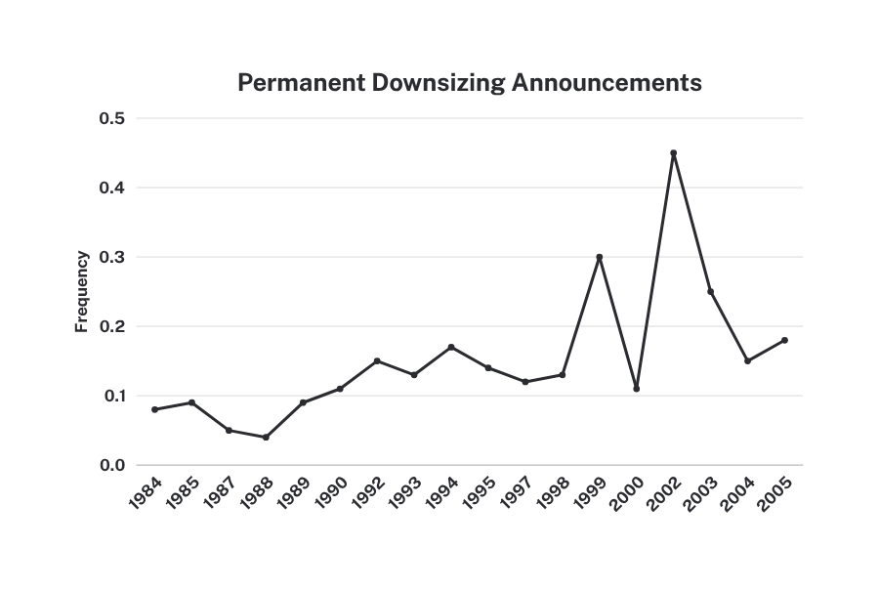
THE PROBLEM
③ Work culture: Profit and efficiency prioritized over People
Despite resistance
from labor unions,
the largest firms downsize when they miss their projected earnings.
Financialization and corporate downsizing as a shareholder value strategy, Oxford Academic (Jul 19, 2021)

Slide 7
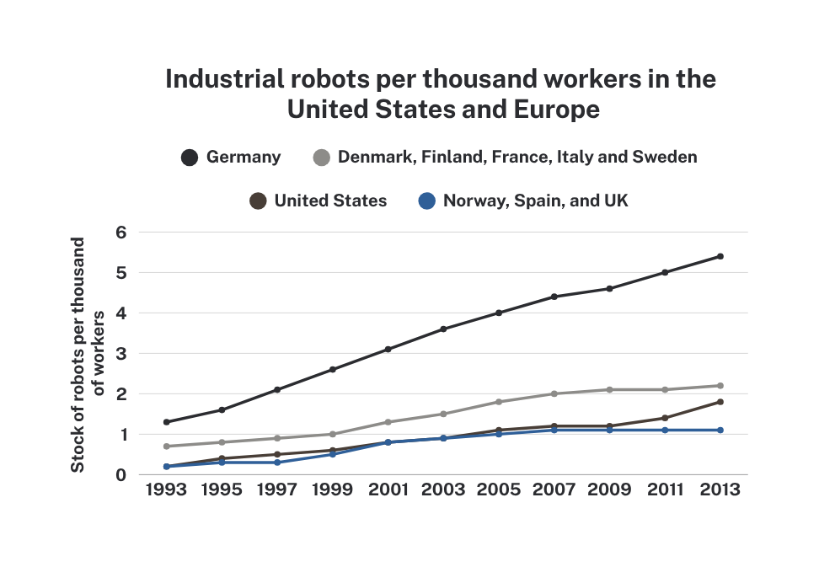
THE PROBLEM
④ Labor Automation Trend: 20 years of curve shifts to AI
“There is renewed concern that advances in robotics and artificial intelligence will lead to massive job losses.”
—Brynjolfsson & McAfee, 2014; Ford, 2015
Robots and Jobs: Evidence from US Labor Markets, The University of Chicago Press Journal (Jun, 2020)

Slide 8

THE PROBLEM
⑤ AI Adoption Gap: Trend-Driven AI Adoption Fails
More than half of companies
that laid off employees for AI
reported regretting their decision.
—Techrepublic.com (May 19, 2025)
55%
regret
‘We Acted Too Quickly’: Over Half of Companies Regret AI-Driven Layoffs, Report Finds, TechRepublic (May 19, 2025)

Slide 9
GUIDING QUESTIONS 1
How can we re-humanize
the AI adoption process itself?
How can we rebalance power
between AI and humans?

Slide 10
SOLUTION PROPOSAL
Human Agency Redesign
Human Agency Index

Slide 11
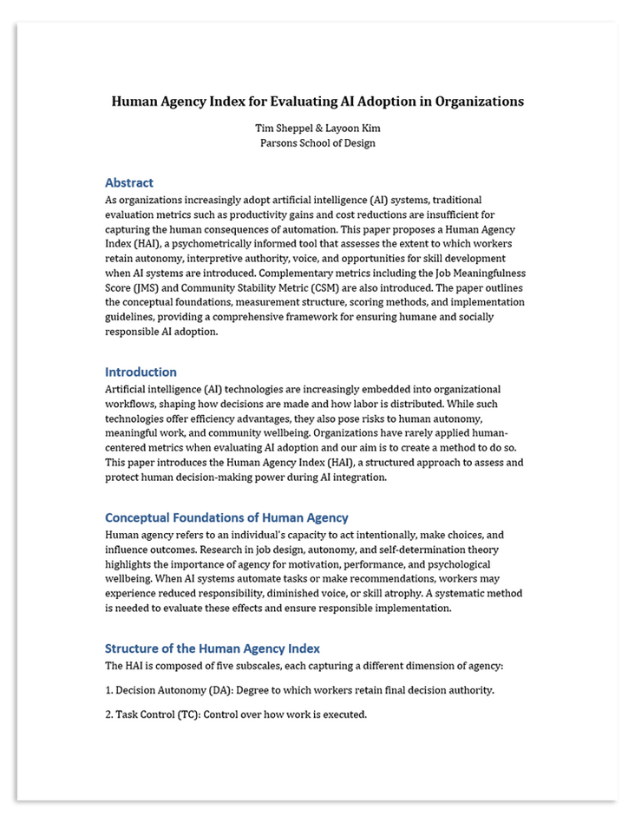
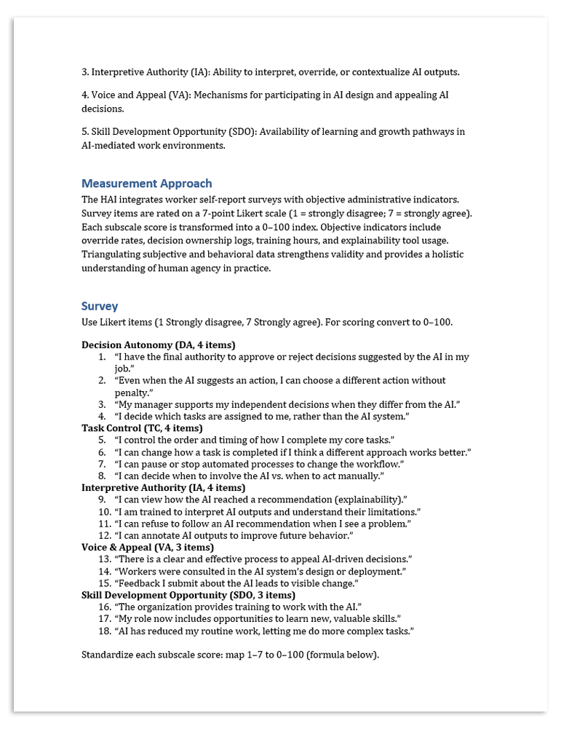
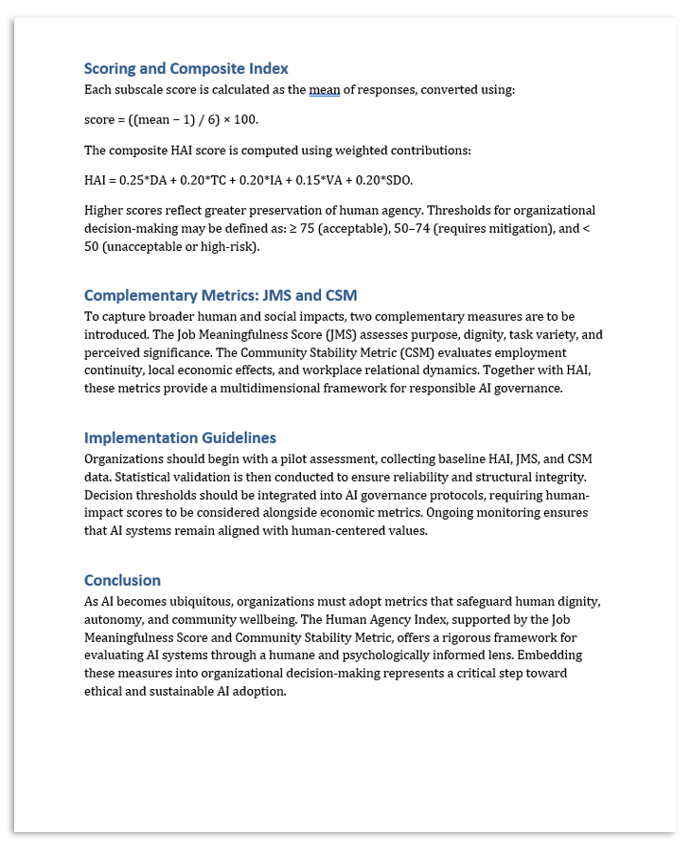
HUMAN AGENCY INDEX(HAI): CONCEPT
We designed the Human Agency Index (metrics organizations can use when deciding whether and how to adopt AI). Instead of relying solely on productivity gains or cost-reduction calculations, companies must evaluate AI implementation through a new set of humane, human-impact performance indicators.
For a copy of this document, please email us at:
shept306@newschool.edu
kiml948@newschool.edu

Slide 12
HAI: SURVEY CATEGORIES
1
2
3
4
5
Decision Autonomy
Task
Control
Interpretive Authority
Voice and Appeal
Skill Development Opportunity
4 items
4 items
4 items
3 items
3 items
Degree to which
workers retain final decision authority.
Control over how
work is executed.
Ability to interpret, override, or
contextualize AI outputs.
Mechanisms for participating in AI
design and appealing
AI decisions.
Availability of learning
and growth pathways in AI-mediated work environments.

Slide 13
HAI: SURVEY QUESTIONS
Category 1:
Decision Autonomy
(4 items)
Degree to which workers retain final decision authority.
Question #1.
I have the final authority to approve or reject decisions
suggested by the AI in my job.
Question #2.
Even when the AI suggests an action, I can choose a different action
without penalty.
Question #3.
My manager supports my independent decisions when they differ from the AI.
Question #4.
I decide which tasks are assigned to me, rather than the AI system.

Slide 14
HAI: SURVEY QUESTIONS
Category 2:
Task Control
(4 items)
Control over
how work is executed.
Question #5.
I control the order and timing of how I complete my core tasks.
Question #6.
I can change how a task is completed if I think a different approach
works better.
Question #7.
I can pause or stop automated processes to change the workflow.
Question #8.
I can decide when to involve the AI vs. when to act manually.

Slide 15
HAI: SURVEY QUESTIONS
Category 3:
Interpretive Authority
(4 items)
Ability to interpret, override, or contextualize AI outputs.
Question #9.
I can view how the AI reached a recommendation (explainability).
Question #10.
I am trained to interpret AI outputs and understand their limitations.
Question #11.
I can refuse to follow an AI recommendation when I see a problem.
Question #12.
I can annotate AI outputs to improve future behavior.

Slide 16
HAI: SURVEY QUESTIONS
Category 4:
Voice & Appeal
(3 items)
Mechanisms for participating in AI design and appealing
AI decisions.
Question #13.
There is a clear and effective process to appeal AI-driven decisions.
Question #14.
Workers were consulted in the AI system’s design or deployment.
Question #15.
Feedback I submit about the AI leads to visible change.

Slide 17
HAI: SURVEY QUESTIONS
Category 5:
Skill Development Opportunity
(3 items)
Availability of learning and growth pathways
in AI-mediated work environments.
Question #16.
The organization provides training to work with the AI.
Question #17.
My role now includes opportunities to learn new, valuable skills.
Question #18.
AI has reduced my routine work, letting me do more complex tasks.

Slide 18
GUIDING QUESTIONS 2
How do we create incentives
so strong that companies want or need
to use these Human Agency Index?

Slide 19

HAI: INCENTIVE DESIGN
1. Market Incentives
Boosting the Human Agency Index functions as an HSG (Human Social Governance) indicator, much like how the ESG Index (Environmental Social Governance) transformed corporate accountability.
1) Consumer Trust Premium
A strong Human Agency Score can generate a trust premium from both consumers and investors.
For example, organizational decision-making thresholds could be defined as follows: A company scoring 92% on the Human Agency Index would signal a “warranted trust premium.”
≥ 75: Acceptable
50–74: Requires mitigation
< 50: Unacceptable or high-risk
2) Investor Attraction
Companies with low-risk, human-centered AI practices are more likely to attract investors, helping strengthen corporate resilience and long-term value creation.

Slide 20

HAI: INCENTIVE DESIGN
2. Financial Incentives
By integrating the Human Agency Index into their operations, companies can reduce the Cost of AI Failure and lower overall management risk.
Organizations that adopt the Human Agency Index can significantly decrease the likelihood of:
AI-related liability stemming from economic damage or negligence
Worker resistance or strikes triggered by poorly implemented automation
Reputational harm and loss of public trust caused by misaligned AI decisions

Slide 21
By embedding Human Agency Index into organizational workflows,
AI adoption can no longer be justified purely on efficiency or profit.

Slide 22
WHY IT MATTERS
Targets the root cause
Scalable and structural
It directly challenges the “profit over human” mindset driving harmful AI substitution
Once adopted, these metrics shape future behavior across teams and decisions, not just one project.
System-level intervention
Restores human dignity
Instead of changing the technology, HAI shifts the economic logic guiding decisions.
Shifting these KPIs reorients organizations to value human wellbeing—not just output.

Slide 23

If AI is the tide we can’t outrun,
then human agency
must be the anchor.

Slide 24
Thank you!
Layoon Kim
Tim Sheppel

