Slide 1



Thimphu HomeFinder
CI/CD implementation
GitHub Actions and Docker
Deployment to an Ubuntu ARM64 VM
CTE412 Integrated Systems Technology
Notes:
Introduce the application briefly, then focus on how a code change becomes a deployed version. This presentation covers the implemented Docker Compose pipeline. The deployment is manually triggered, so describe it as continuous delivery. Allow roughly 12 minutes plus questions.
Sources: https://github.com/tsherabs/House_Rental_Project/blob/main/.github/workflows/verify.yml
https://github.com/tsherabs/House_Rental_Project/blob/main/.github/workflows/deploy.yml

Slide 2
Application and deployment target
A rental platform for seekers, landlords and administrators
Search homes, publish listings and arrange viewings.
Browser
Laptop or phone
Caddy + Angular
Web container
Express API
Backend
PostgreSQL
Database
Ubuntu ARM64 VM: web, API and database run in Docker
Browser address: http://VM_IP:8080. Access depends on VM network reachability.
Notes:
Keep application features to about 40 seconds. The frontend runs in the browser, with its compiled files served by Caddy. Caddy forwards /api requests to Express, which accesses PostgreSQL. All server containers run inside the Ubuntu VM on the laptop. The URL is on the local network, not a public hosting service.
Sources: https://github.com/tsherabs/House_Rental_Project/blob/main/compose.yaml
https://github.com/tsherabs/House_Rental_Project/blob/main/deployment/Caddyfile

Slide 3
The CI/CD pipeline
GitHub-hosted runners
Push to main
Verify
Tests and builds
Publish
ARM64 + AMD64
GHCR
Image storage
If verification fails, publishing stops.
Verify release
Caddy + API
Compose
Update app
VM runner
Pull and migrate
Manual trigger
Run deploy.yml
Self-hosted runner inside the VM
Continuous integration + continuous delivery with a manual release step
Notes:
Read the top row from left to right, then the bottom row from right to left. Publishing does not update the website. After CI and publish succeed for the selected main commit, a person triggers deployment. Tests failing prevent publication. The VM runner receives the job and executes commands locally.
Sources: https://github.com/tsherabs/House_Rental_Project/blob/main/.github/workflows/verify.yml
https://github.com/tsherabs/House_Rental_Project/blob/main/.github/workflows/deploy.yml

Slide 4
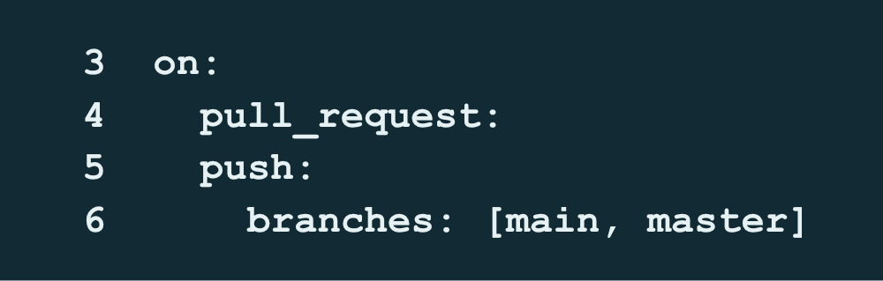

Workflow triggers and responsibilities
verify.yml
deploy.yml
Runs manually on main, using
the VM’s registered runner.
Checks pull requests and pushes
to main or master.
Wait for the selected commit’s
images to finish publishing.
Publishes only after a successful
push-to-main verification.
Notes:
Explain workflow as a YAML automation, job as a set of steps, and runner as the machine executing them. The verify workflow has verify and publish jobs. Deployment is a separate workflow, so needs: verify does not connect the two files. Run deploy only after the selected main commit has published. Source screenshots preserve original line numbers.
Sources: https://github.com/tsherabs/House_Rental_Project/blob/main/.github/workflows/verify.yml
https://github.com/tsherabs/House_Rental_Project/blob/main/.github/workflows/deploy.yml

Slide 5
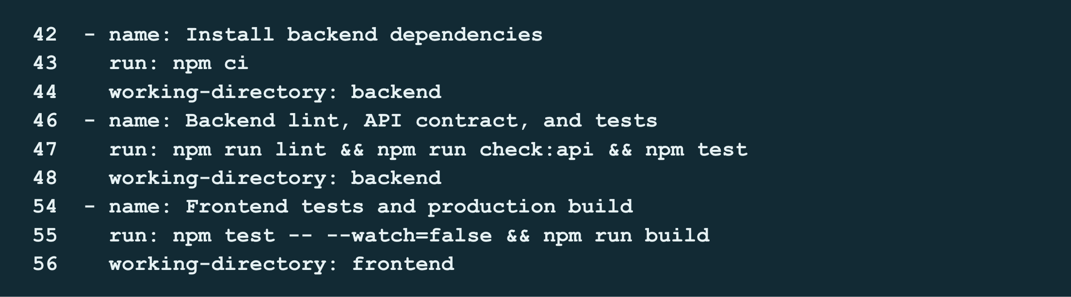
CI checks in verify.yml
A temporary PostgreSQL database supports backend integration tests.
Docker builds then check that both applications can be packaged.
Notes:
The GitHub runner checks out the commit, installs Node 24 and runs npm ci from lockfiles. Backend checks cover ESLint, the API contract script and tests. Frontend checks cover automated tests and the production build. Separate Docker build steps catch broken packaging. The homefinder_test database is temporary and does not contain VM demo data. Passing tests proves only the implemented checks passed.
Sources: https://github.com/tsherabs/House_Rental_Project/blob/main/.github/workflows/verify.yml
https://github.com/tsherabs/House_Rental_Project/blob/main/backend/package.json
https://github.com/tsherabs/House_Rental_Project/blob/main/frontend/package.json

Slide 6
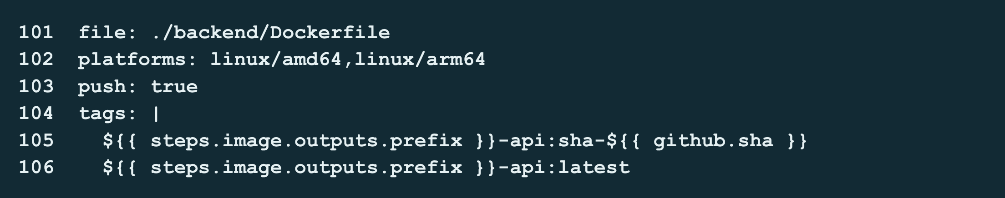
Publishing images to GHCR
needs: verify gates publishing. A push to main supplies the release images.
sha-<commit>
The deployment selects the image for a specific source commit.
AMD64 + ARM64
Buildx and QEMU produce an image variant for the ARM VM.
Notes:
GHCR is GitHub Container Registry. Both backend and web images receive a commit-specific tag and latest. Deployment uses the SHA tag, not latest. Tags are identifiers by convention, not immutable digests. Publish runs on a fresh GitHub runner and rebuilds images for both platforms rather than transferring the earlier CI images. GITHUB_TOKEN has packages:write here. The test suite runs on the CI runner, not independently on every architecture.
Sources: https://github.com/tsherabs/House_Rental_Project/blob/main/.github/workflows/verify.yml

Slide 7
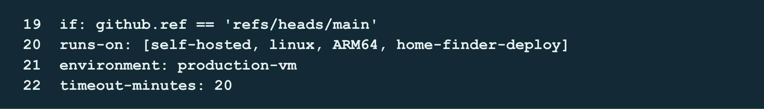
Deployment on the Ubuntu VM
Self-hosted runner
Docker containers
Receives the deployment job and runs Docker commands inside the VM.
Keep serving the application after the deployment job finishes.
Prerequisites: Docker access, Compose, a running runner and the VM-local .env file
Notes:
The matching labels select the existing ARM64 runner with home-finder-deploy. It connects outward to GitHub, so GitHub-hosted runners do not need inbound SSH access to the private VM. The production-vm environment name does not make this public or enable HTTPS. Deployment uses packages:read and a temporary registry login. Concurrency prevents simultaneous Compose deployments. The runner can stop after deployment while Docker continues serving.
Sources: https://github.com/tsherabs/House_Rental_Project/blob/main/.github/workflows/deploy.yml

Slide 8
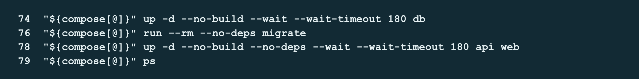
Deployment order and migrations
Pull images
Database ready
Run migrations
Update app
Commands from deploy.yml
Migration failure stops the application update. Database rollback is not automatic.
Notes:
The workflow copies compose.yaml and the image overlay into the persistent deployment directory, sets IMAGE_BASE and IMAGE_TAG, validates configuration, then pulls images. The Bash compose array holds the common command options. It waits for PostgreSQL, runs a one-off migration container, then updates API and web. --no-build prevents compilation on the VM. --rm removes the migration container, not database data. A failed migration prevents the app update, but completed schema changes are not automatically reversed.
Sources: https://github.com/tsherabs/House_Rental_Project/blob/main/.github/workflows/deploy.yml
https://github.com/tsherabs/House_Rental_Project/blob/main/deployment/compose.prod.yaml

Slide 9
Data and configuration across releases
Application containers
Compose recreates them when images or configuration change.
Persistent volumes
Database records and uploaded photos survive container replacement.
VM-local configuration
~/house-rental/.env supplies secrets and APP_ORIGIN.
The workflow leaves this file outside the code checkout.
Changing .env requires container recreation to apply the new environment.
Notes:
Compose uses the stable homefinder project name, so it reuses the named database and uploads volumes. Code is packaged in images. Secrets stay in the VM environment file. Do not show secret values during the presentation. An IP change requires APP_ORIGIN to match the new browser origin and redeployment to recreate the API container. Storage persistence is not a backup. Deleting volumes or losing the VM disk can lose data.
Sources: https://github.com/tsherabs/House_Rental_Project/blob/main/compose.yaml
https://github.com/tsherabs/House_Rental_Project/blob/main/.github/workflows/deploy.yml

Slide 10
Verification after deployment
Smoke check
Inside API container
Caddy
http://web/
API + database
/api/v1/ready
Frontend response
Backend readiness
HTTP 200 and an Angular
<app-root> element
HTTP 200 from the database-backed
readiness endpoint through Caddy
Follow with a browser check: log in, create a property and confirm it persists.
Notes:
The workflow retries its smoke check up to ten times. It confirms the frontend HTML and API routing through Caddy inside the Docker network. It does not execute frontend JavaScript or prove laptop/browser reachability. The API Docker health check targets readiness. After successful checks, the workflow writes commit and image tags into the GitHub run summary. No numeric test count is claimed here.
Sources: https://github.com/tsherabs/House_Rental_Project/blob/main/.github/workflows/deploy.yml
https://github.com/tsherabs/House_Rental_Project/blob/main/backend/Dockerfile
https://github.com/tsherabs/House_Rental_Project/blob/main/backend/src/app.js

Slide 11
Deployment problems and diagnosis
Docker socket permission denied
The runner user needed Docker access and a restarted session.
Website bound to 127.0.0.1
BIND_HOST=0.0.0.0 exposed port 8080 on the VM’s interfaces.
VM IP changed, then writes returned 403
Check the running APP_ORIGIN against the browser address.
The same 403 message can also indicate account or permission problems.
Notes:
These examples come from the project deployment conversation. The user reported that Docker access and the port binding issues were fixed. For the later 403, an origin mismatch is a hypothesis, not a confirmed root cause. Diagnose it with docker exec homefinder-api-1 printenv APP_ORIGIN and the failed request details. A separate Firefox access issue occurred even though curl worked. These examples show why pipeline checks and external browser checks are different. Sources: user-provided deployment logs and network outputs; backend/src/middleware/csrf.js; frontend/src/app/core/api.ts.
Sources: https://github.com/tsherabs/House_Rental_Project/blob/main/backend/src/middleware/csrf.js
https://github.com/tsherabs/House_Rental_Project/blob/main/frontend/src/app/core/api.ts

Slide 12
Live CI/CD demonstration
1
A visible change
Edit a heading and push the commit to main.
2
CI and publication
Show the checks and the matching SHA image tag in GHCR.
3
Manual deployment
Run deploy.yml and show migrations and readiness checks.
4
Browser verification
Refresh the VM site, then confirm login and a saved property.
Notes:
Prepare one small visible change before presenting. If build time exceeds the demo slot, show a completed run for that exact commit and demonstrate deployment/browser behaviour, clearly stating what was run earlier. Do not fabricate a green workflow screenshot. Show the commit SHA in the source, registry tag and deployment summary. Keep credentials hidden. All team members should understand their handover.
Sources: https://github.com/tsherabs/House_Rental_Project/blob/main/.github/workflows/verify.yml
https://github.com/tsherabs/House_Rental_Project/blob/main/.github/workflows/deploy.yml

Slide 13
Outcome and current limits
Implemented
Current limits
Automated checks before publishing
Commit-tagged images for the ARM VM
Repeatable deployment with migrations
Readiness checks and release records
A person starts deployment
The laptop and VM must stay available
Compose updates may interrupt requests
No automatic database rollback
The project demonstrates continuous delivery to a local-network environment.
Notes:
Conclude with what the implementation demonstrates rather than claiming measured productivity or coverage improvements. The user reported a successful Compose CD run and successful browser access, but this deck does not claim a new test run or public production deployment. The current main workflows do not contain an explicit dependency/image vulnerability scan. That is a useful future addition for the module security outcome. Kubernetes is outside this presentation’s implemented Compose scope.
Sources: https://github.com/tsherabs/House_Rental_Project/blob/main/.github/workflows/verify.yml
https://github.com/tsherabs/House_Rental_Project/blob/main/.github/workflows/deploy.yml

Slide 14
References and questions
Project implementation
github.com/tsherabs/House_Rental_Project
.github/workflows/verify.yml
.github/workflows/deploy.yml
compose.yaml and deployment/Caddyfile
Tool documentation
GitHub Actions: docs.github.com/actions
Docker Compose: docs.docker.com/compose
Caddy: caddyserver.com/docs
Notes:
Questions to prepare for: Why separate publishing and deployment? Why use a self-hosted runner? What happens if a migration fails? Why does updating a container not erase data? Why did the smoke check pass when Firefox could not connect? Explain that local hosting is compatible with a CI/CD demonstration. Primary evidence is the repository implementation. Tool documentation links are provided for further reading.
Sources:

