Slide 1
Trusted AI Challenge Stage-1: Summer 2024 Trusted AI Challenge Stage-1: Summer 2024
Submitted By Nishat Ara Nipa Graduate Research Assistant Old Dominion University Email: nishataranipa@gmail.com
Dr. Sachin Shetty Professor Old Dominion University Email: sshetty@odu.edu

Slide 2


Content:
Key Research Objective
Our Approach
Analysis Techniques
Key Findings of Stage1
Research Direction for Stage 2

Slide 3

Key Research Objective (Stage 1)
Develop an understanding of Human/AI performance variations with metadata.
Identify conditions requiring human intervention.
Future research directions to enhance model reliability and interpretability.
Questions we like to address:
Should the system rely only on AI predictions ?
If a human operator should assess the imagery instead ?
To what extent humans and AI should share responsibilities within the system

Slide 4
Our Approach
Analysis Techniques:
Comparative analysis between AI and human performance.
Correlation analysis.
Uncertainty estimation techniques (to be implemented in future stages).

Slide 5
Key Findings from stage 1

Slide 6
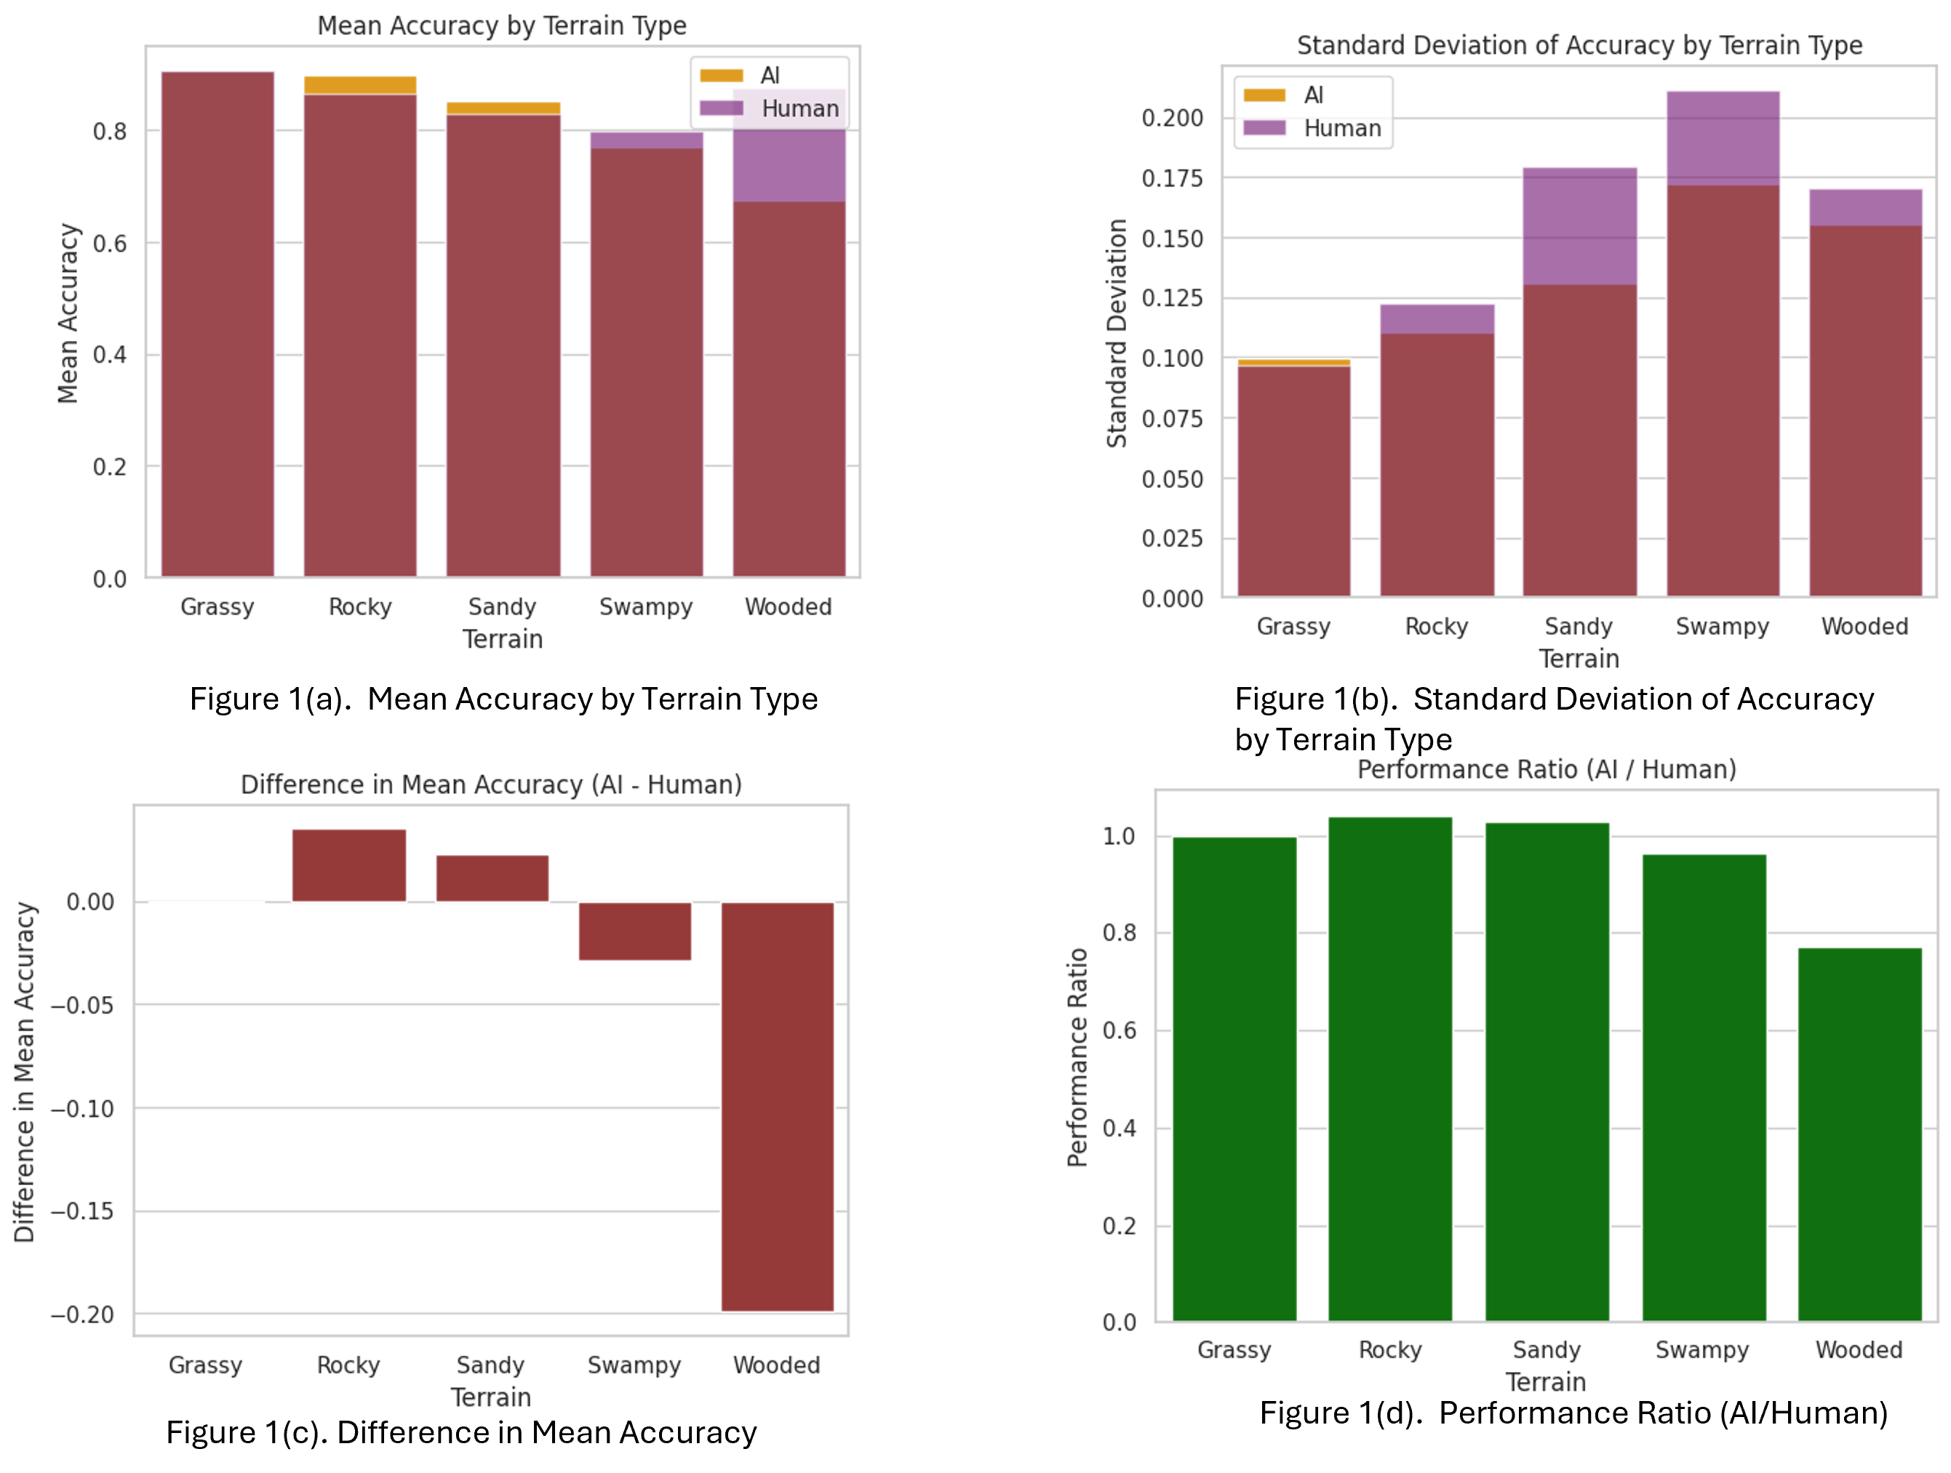
AI vs. Human Performance Analysis:
Mean accuracy by terrain type.
Standard deviation of accuracy by terrain type.
Difference in mean accuracy (AI vs. Human).
Performance ratio (AI/Human).

Slide 7
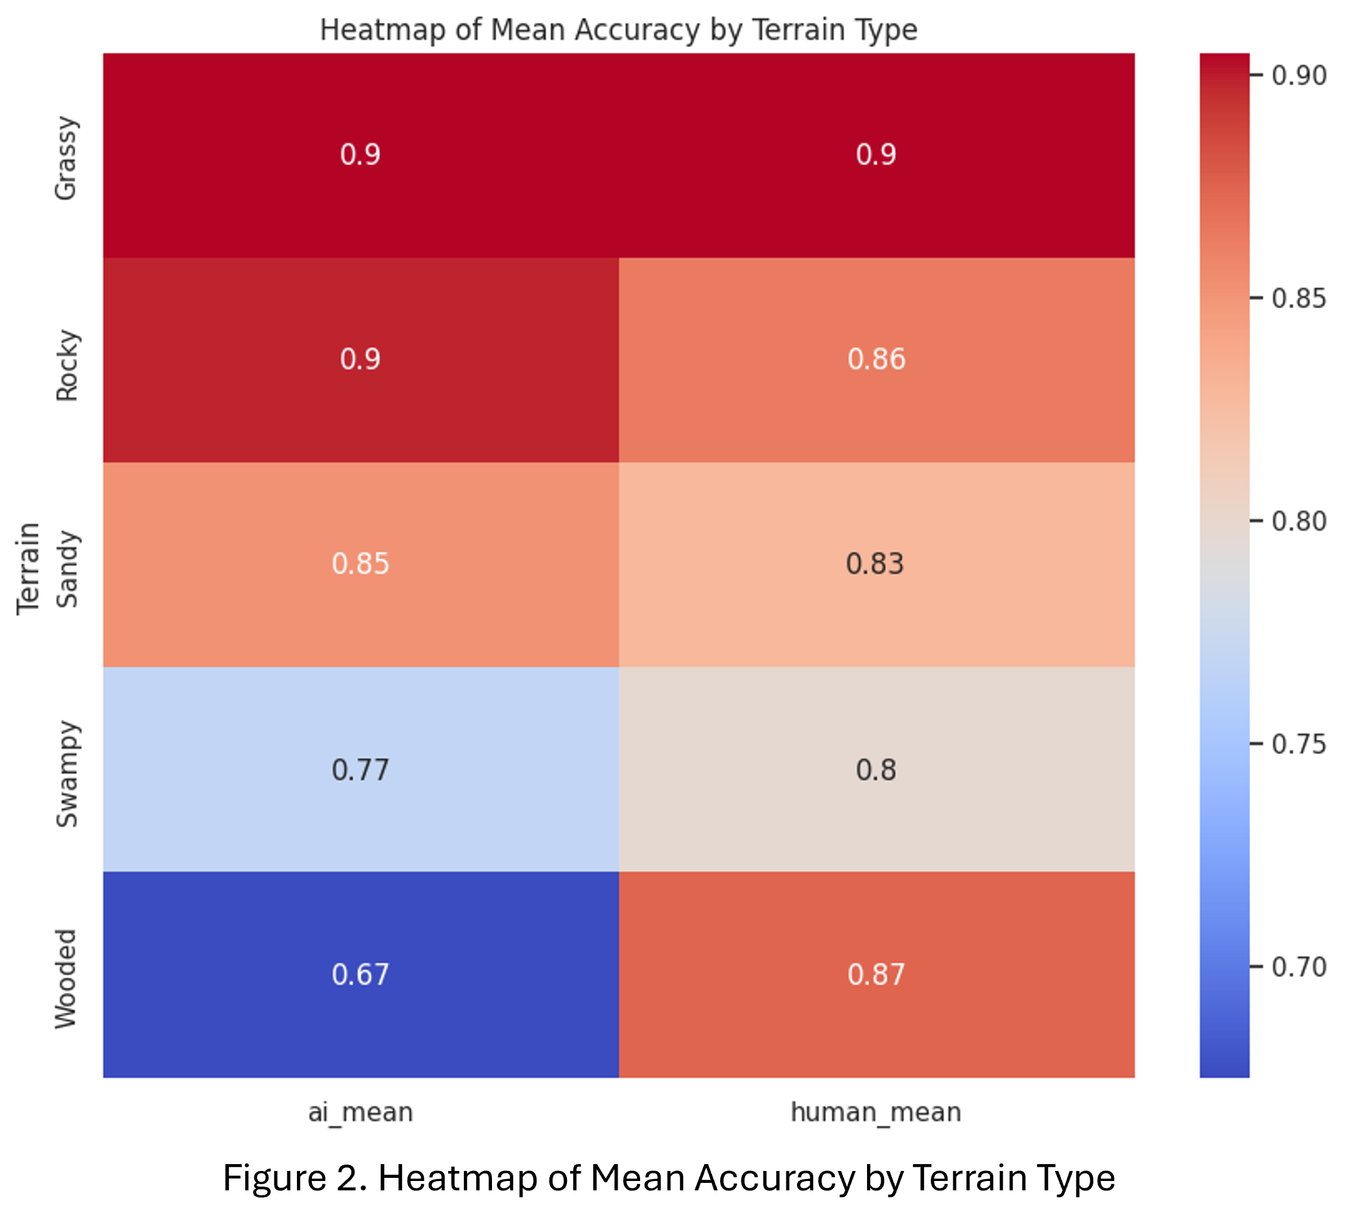
We averaged the condition values for each terrain type.
AI Performance Across Terrains:
High mean accuracy (> 0.8) in grassy, rocky, and sandy terrains.
Significant drop in AI accuracy in wooded terrain, where human performance is notably higher.
Variability in AI Performance:
Consistent performance in grassy and rocky terrains (low standard deviation).
Increased variability in sandy, swampy, and wooded terrains, with wooded terrain showing the highest variability.
Implications:
The higher variability in wooded and swampy terrains indicates AI's unreliability in these conditions.
Reinforces the need for human oversight in those environments.

Slide 8
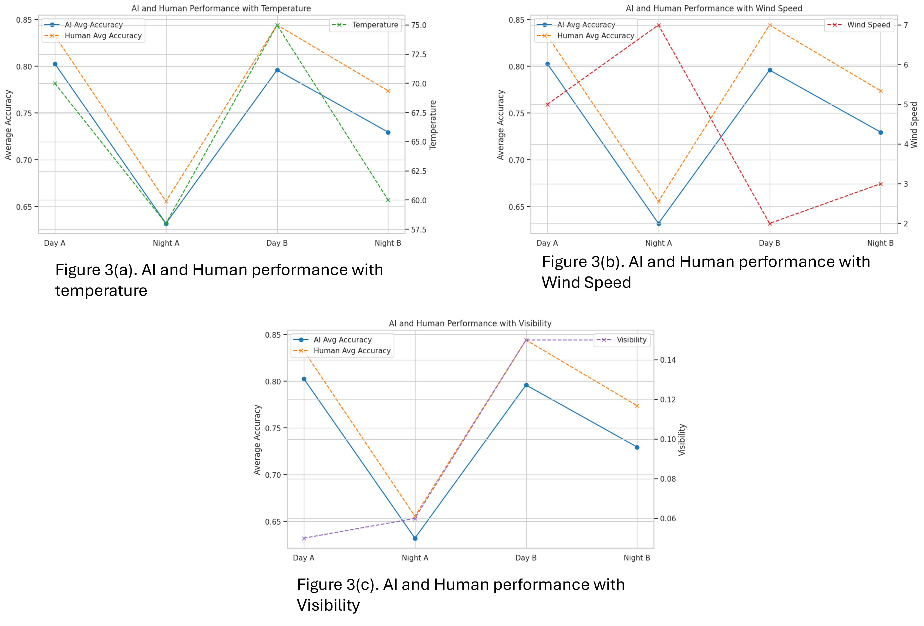
Impact of Environmental Conditions on AI Performance
Temperature Impact:
AI performance is highly sensitive to temperature changes.
Sharp decline in AI accuracy at lower temperatures (Night A).
Peak AI accuracy during highest temperatures (Day B).
Human performance remains stable across temperature variations.
Wind Speed Impact:
AI accuracy decreases significantly at high wind speeds (Night A).
Improvement observed when wind speeds are moderate (Day B).
Human performance slightly increases during high wind speeds, showing less sensitivity compared to AI.
Visibility Impact:
AI performance drastically drops during low visibility (Night A).
Significant improvement in AI accuracy with higher visibility (Day B).
Human performance is relatively stable, indicating AI's greater dependence on clear visibility.

Slide 9
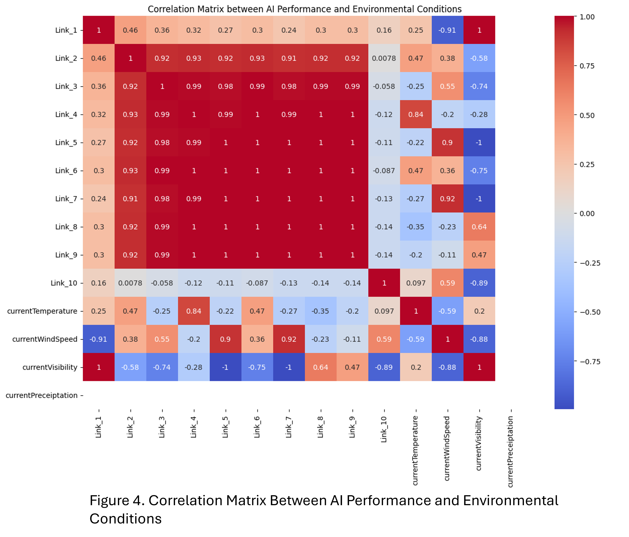
Correlation Analysis for AI:
High positive correlations observed across most AI performance links
Temperature Impact: Varied correlations with temperature; notable positive correlations with Link_8 (0.84) and Link_2 (0.47). Suggests increased performance with rising temperatures.
Wind Speed Impact: Strong positive correlation with Link_7 (0.92). Negative correlation with Link_1 (-0.91), indicating wind speed's differing impact on performance across links.
Visibility Impact: Generally negative correlations with most links, indicating visibility typically hampers performance. Exceptions include Link_9 (0.64) and Link_1 (1), where visibility positively influences performance.

Slide 10
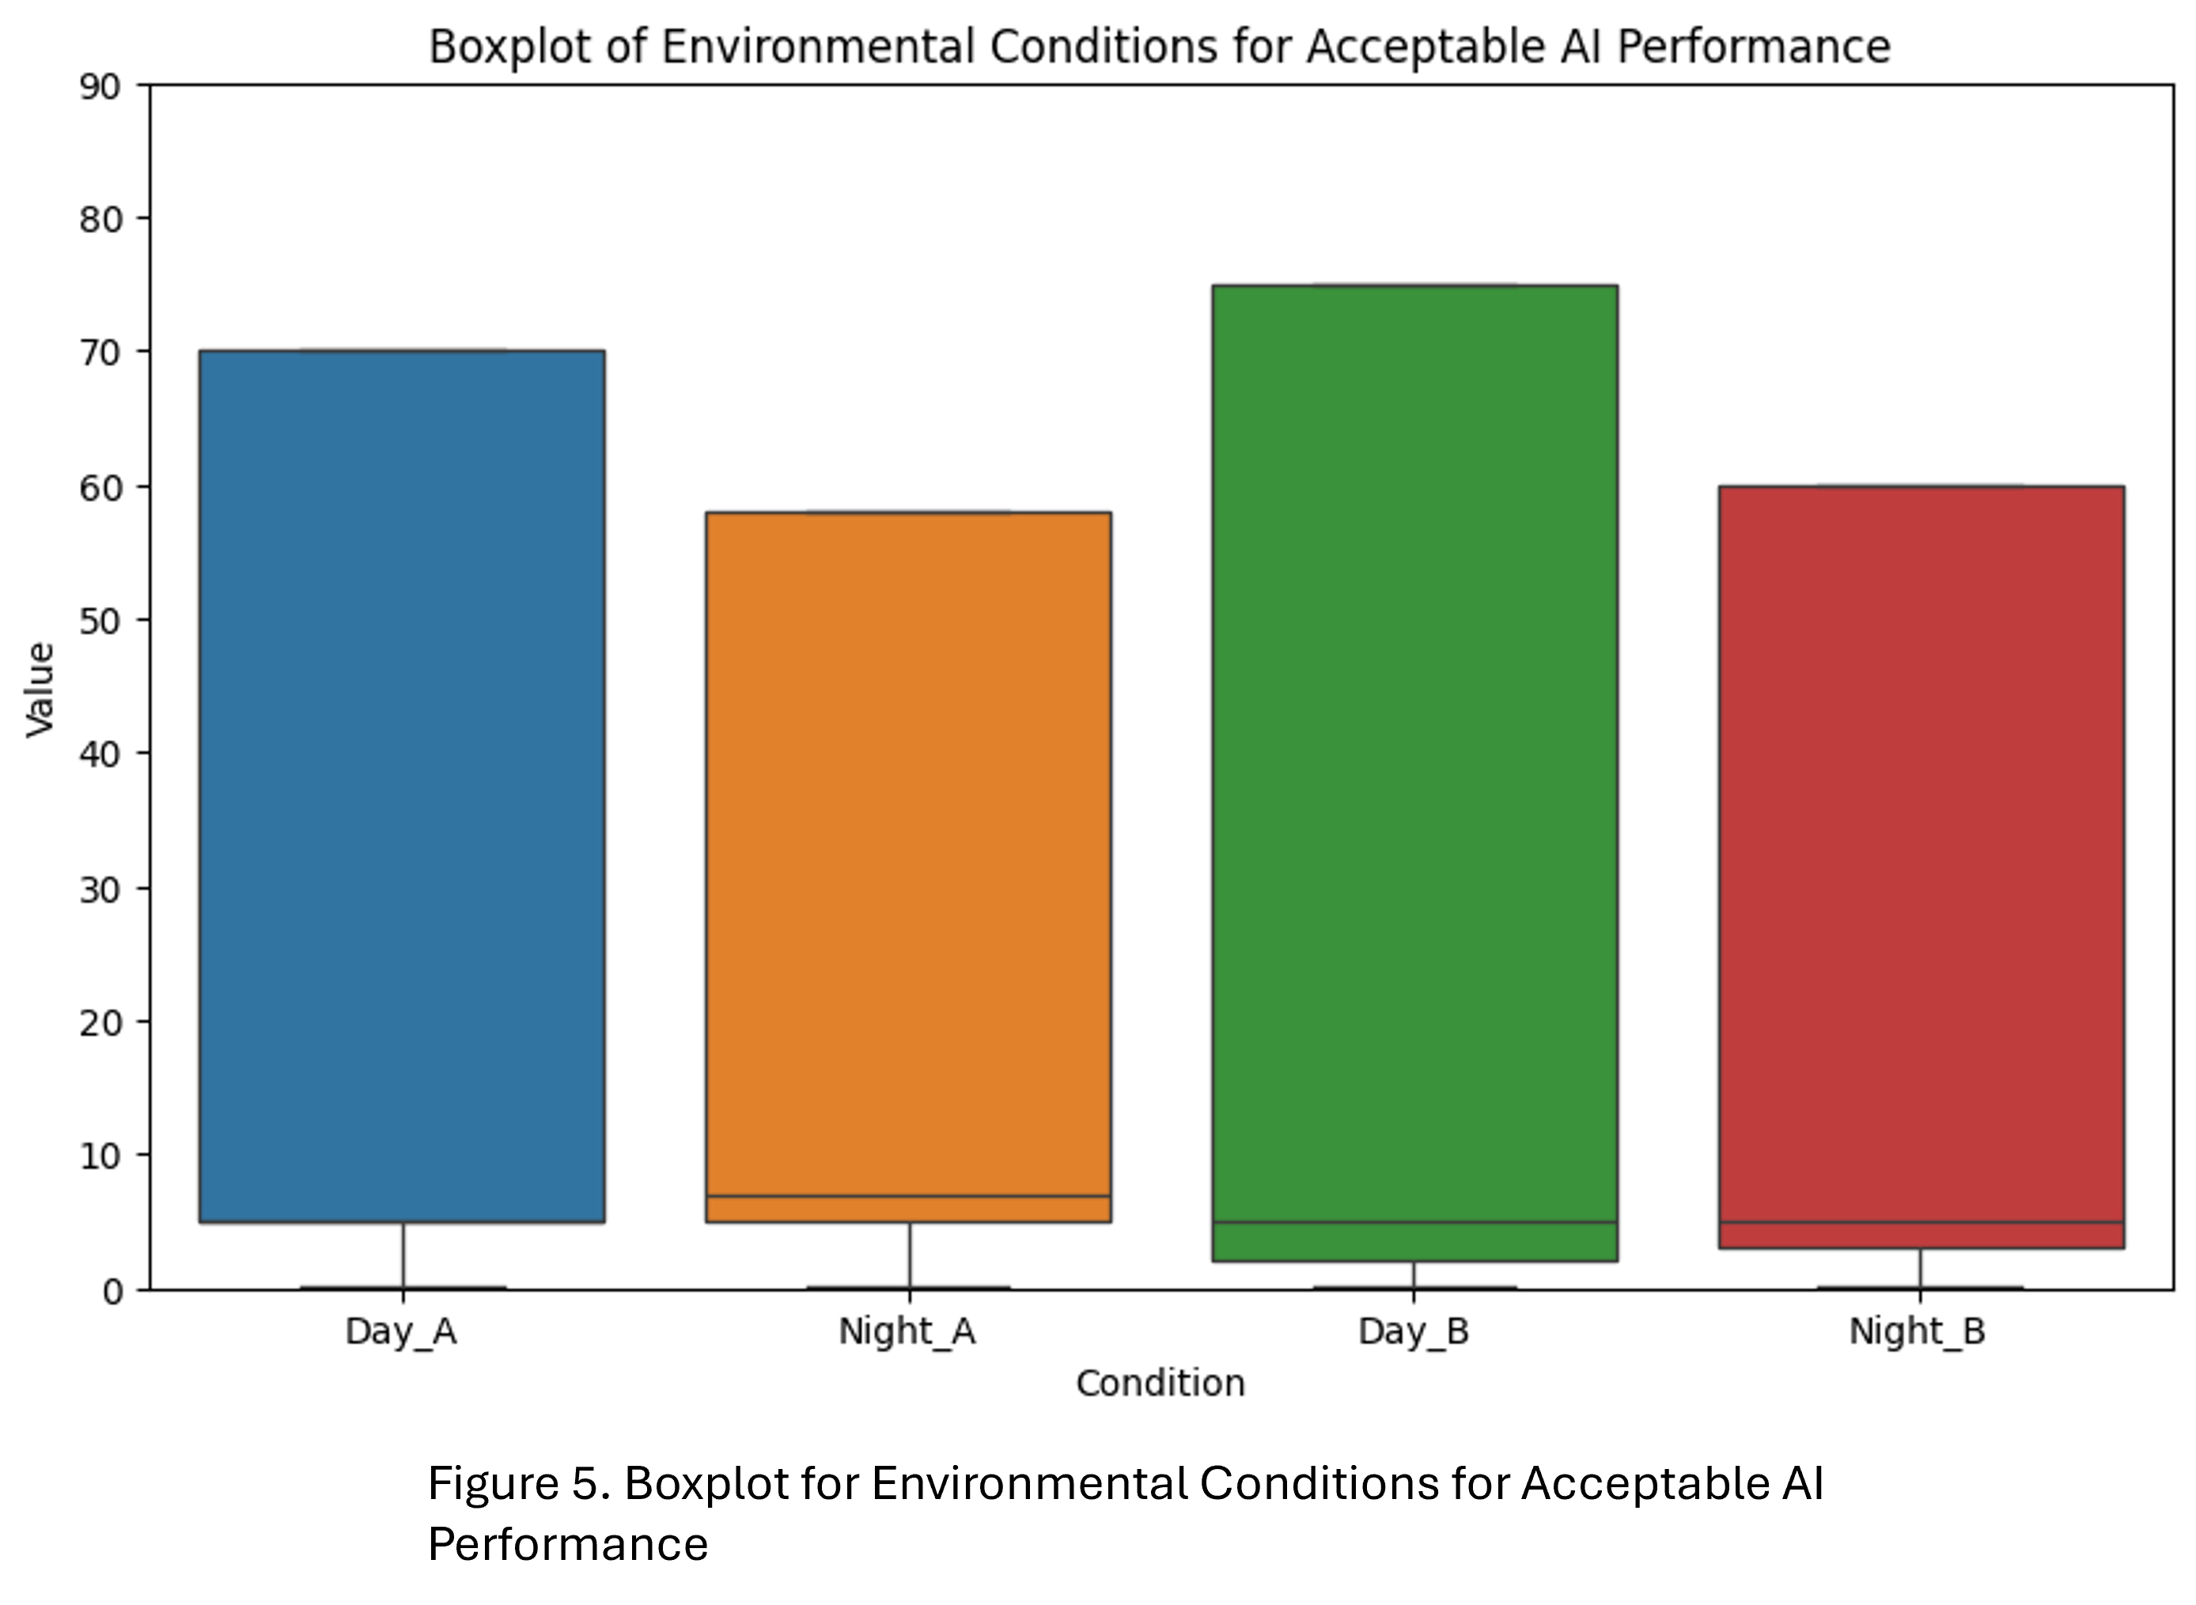
Optimal Environmental Conditions for AI

Slide 11
Research Direction for stage 2

Slide 12
Integration of Metadata-Driven Insights:
Tailor AI models to operate optimally under favorable conditions identified from metadata analysis.
Improve AI algorithms based on correlations, e.g., enhancing computer vision for low-visibility scenarios.
Optimization of Operational Environments:
Fine-tune AI systems to adapt to environmental conditions (temperature, wind speed, visibility).
Implement real-time monitoring for dynamic adjustment of AI parameters.
Enhancement of Model Reliability:
Employ uncertainty estimation techniques like Bayesian Inference and Deep Ensembles.
Quantify confidence levels in AI predictions to reduce decision-making errors and increase trust in AI systems.

Slide 13
Thank you

