Slide 1
AI Challenge for Armaments Systems Engineering – A Preliminary Perspective on Human System Integration
Nathan Lau, Virginia Tech
David Du, Virginia Tech
David Du
Ph.D. student, Department of Industrial and Systems Engineering, Virginia Tech
8/20/24

Slide 2

Perspective on Trust
What is trust and why is it important?
Trust is commonly defined as reliance or confidence in the dependability of a someone or something (APA Dictionary of Psychology).
It is essential for efficient cooperations, especially in high-stakes environments like military operations.
Facilitates decision-making under time pressure
Reduces need for exhaustive communication in critical situations

Slide 3
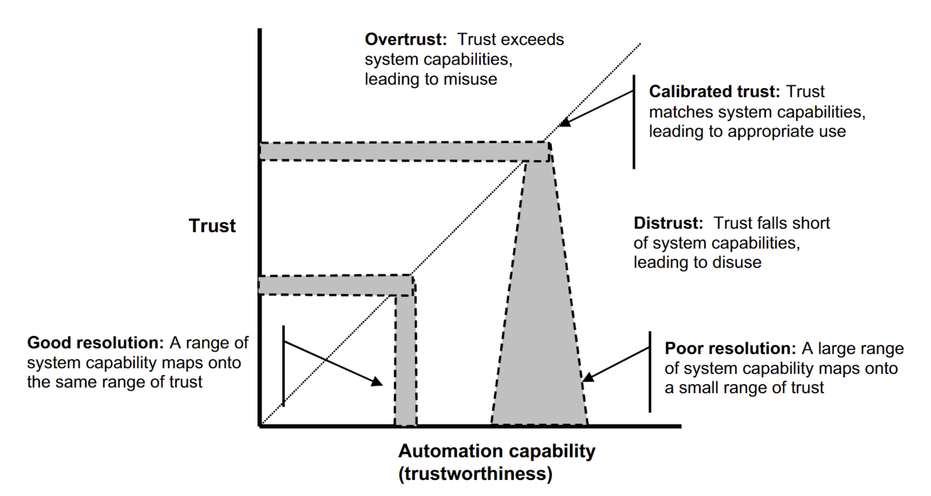
Perspective on Trust
How to develop and support trust?
Trust is refined in accuracy, precision, and specificity over repeated interactions across different situations.
Why it can be challenging?
Takes great amount of time and effort to build and maintain.
Mis-calibrated trust (over-/under-trust) can lead to negative outcomes.
Lee, J. D., & See, K. A. (2004). Trust in automation: Designing for appropriate reliance.

Slide 4
Premise for Trust in AI
In the context of the Rapid Safe Passage (RSP) mission,
Trust…
is essential for cooperation in adaptive problem-solving.
is an emergent property from the interactions between human and AI.
Can be accelerated within the system from design characteristics of AI (and traits of human).
Are dependent on quantity and quality of interactions between human and AI.
Optimal calibration, resolution, and specificity can be achieved through interaction mechanisms between human and AI.

Slide 5
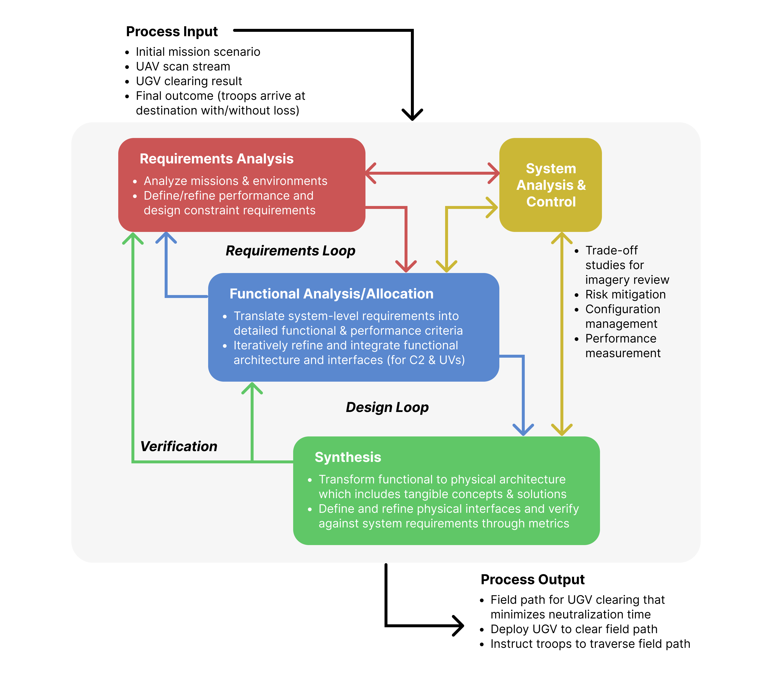
Provisioning Human-AI Interactions

Slide 6
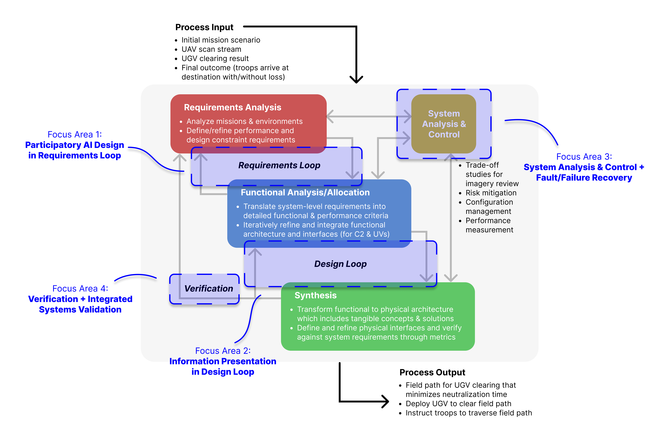
Provisioning Human-AI Interactions

Slide 7
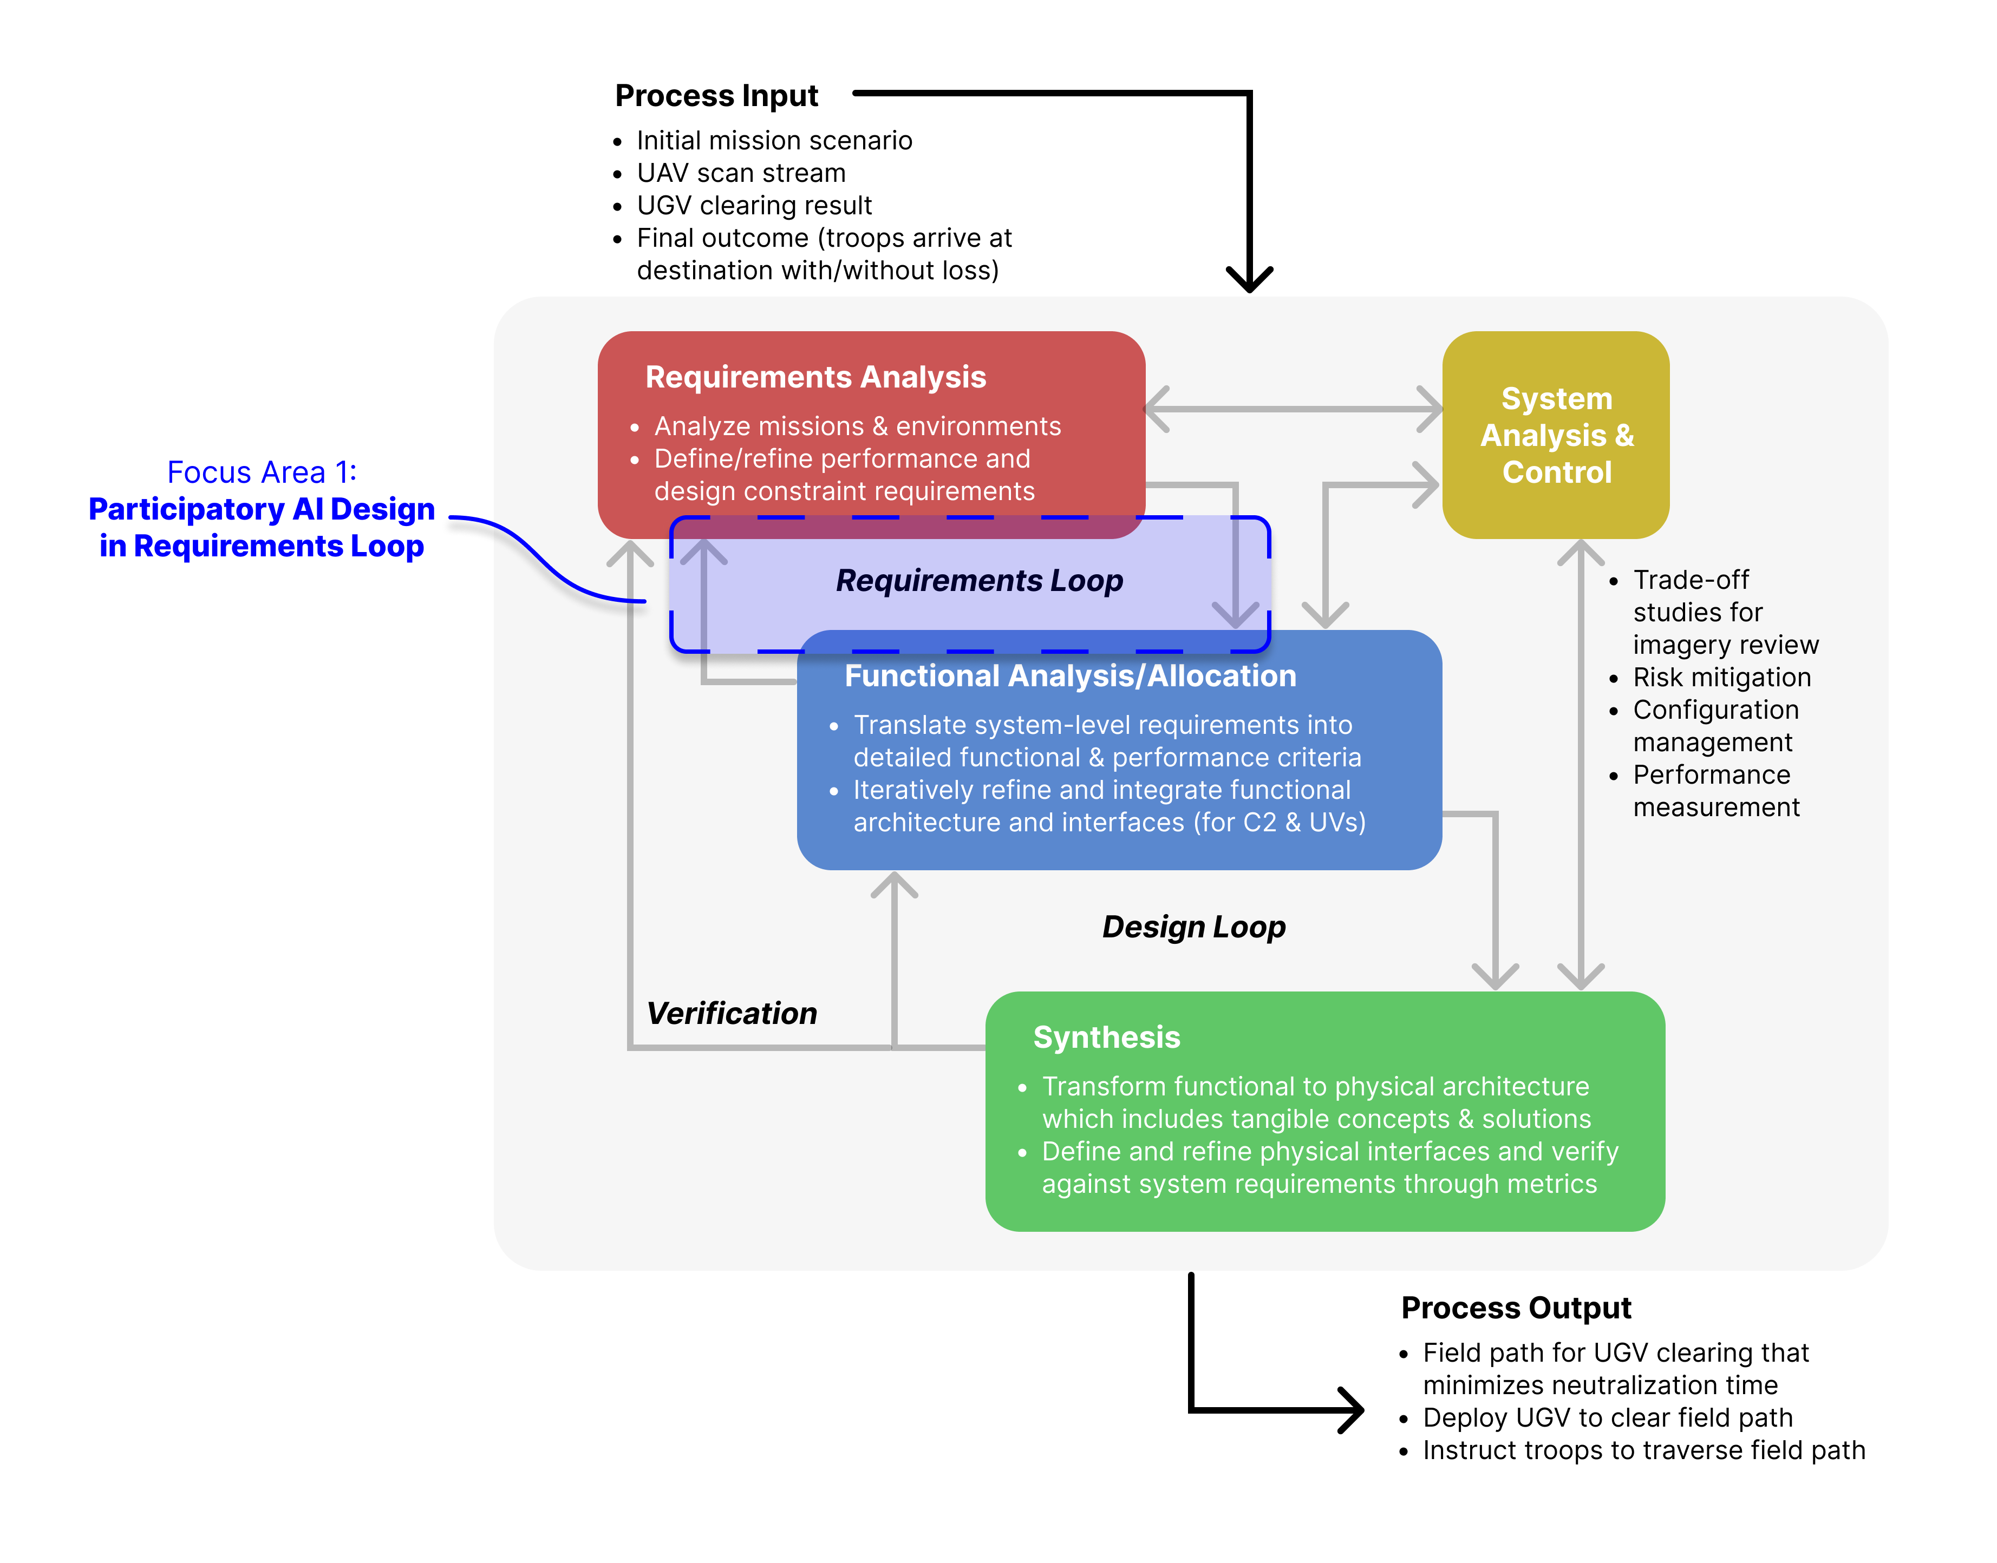
1. Participatory AI Design in Requirements Loop
Role in the SE Process:
Integrate operator input early to shape AI system requirements.
Why is it important?
Provides early insights into AI’s competence, limitations, and edge cases.
Fosters more accurate “priors”, reducing reliance on rumors. (Bayesian perspective)

Slide 8
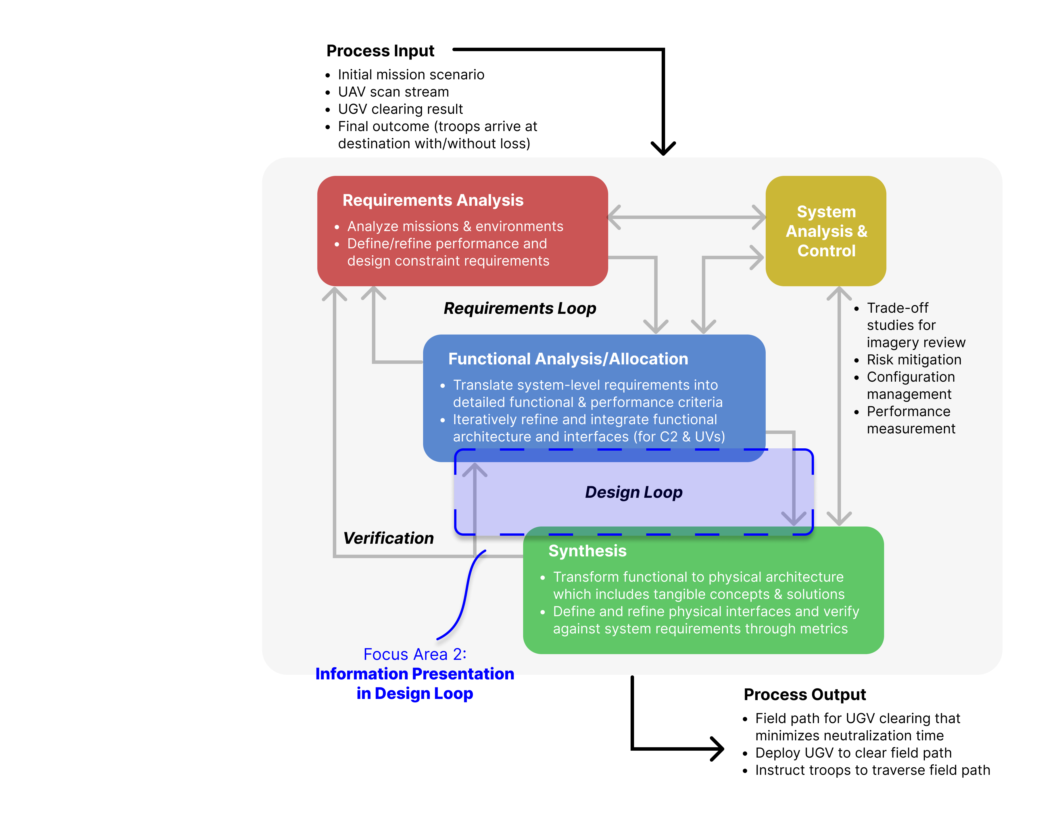
2. Information Presentation in Design Loop
Role in the SE Process:
User interfaces to support direct interactions between the human operator and AI.
Why is it important?
Dictates how trust will emerge in the system.
Influences the levels of resolution and specificity of trust.

Slide 9
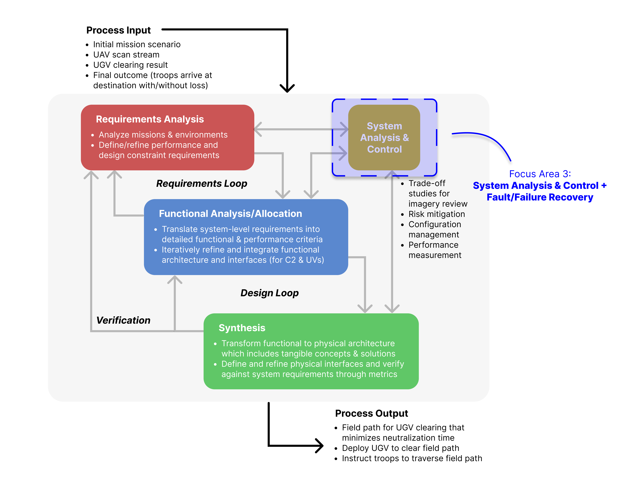
3. Failure Recovery in Systems Analysis & Control
Role in the SE Process:
Reactive measures of fault and failure recovery to maintain human-AI trust.
Why is it important?
Promotes system resilience and reliability.
Failure to do so could significantly erode trust.

Slide 10
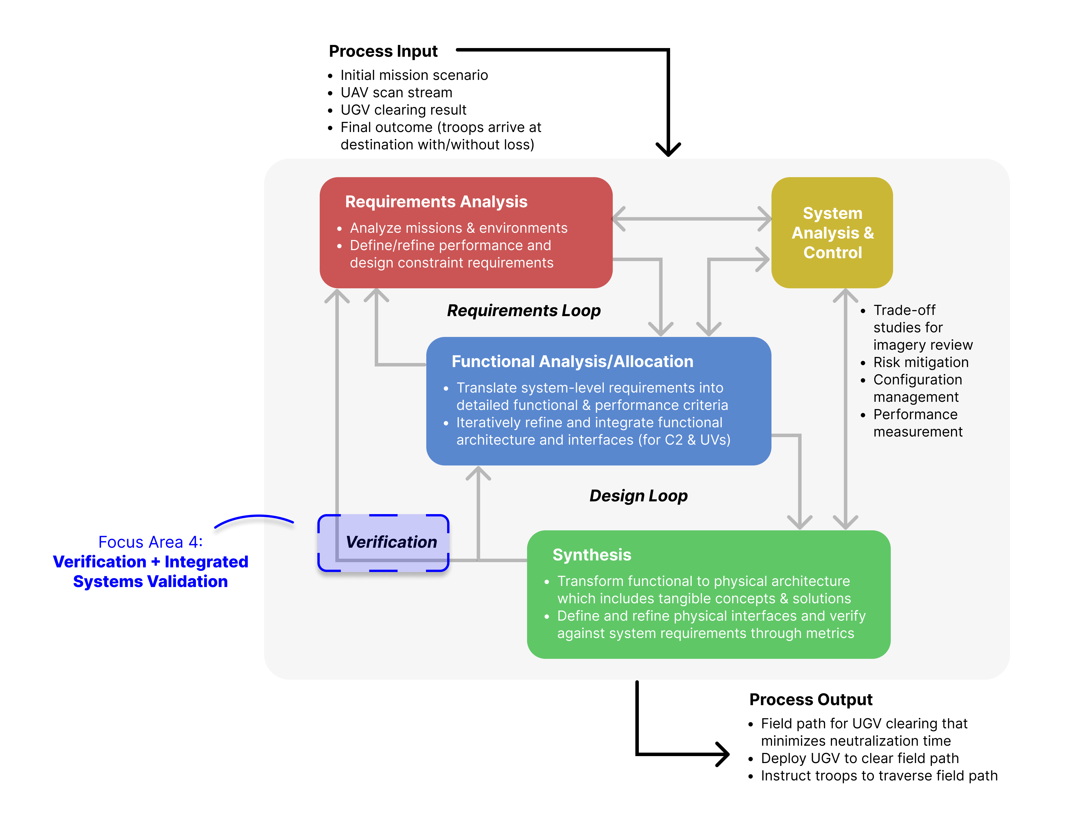
4. Integrated Systems Validation at Verification
Role in the SE Process:
Embed validation & verification (V&V) to integrate operators in testing and evaluation.
Why is it important?
Historical accidents demonstrate the need for rigorous validation in human-machine systems.
Determine the known/unknown interaction risks for operations that dictate levels of trust.

Slide 11
Summary
Key Takeaways:
Trust is an emergent property of human-AI interactions.
The SE process should strategically provision user interactions with AI throughout the system life cycle.
The proposed focus areas highlight critical points where human-AI collaboration can enhance SE for a more reliable and trustworthy system.

Slide 12
Thank you!
David Du
Department of Industrial & Systems Engineering, Virginia Tech
daviddu@vt.edu

