Slide 1


SE Approaches to Human-AI System Development & Assurance
Aditya Singh, Zoe Szajnfarber
December 11, 2024

Slide 2
Introduction & Research Goals
Understand how humans and AI can be partnered together
Develop heuristics to understand which human-AI system architectures are best suited for various operating conditions
Understand which systems engineering practices can help create trust & assurance in AI-enabled systems

Slide 3
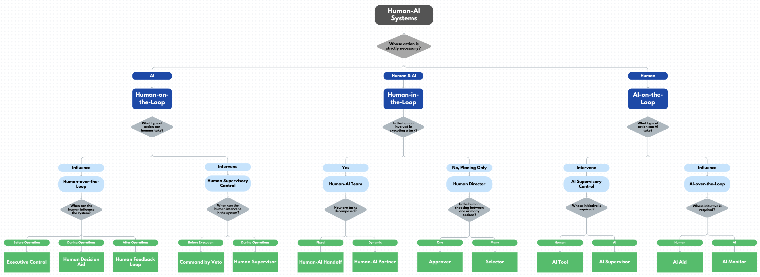
Recap: Framework
Created a framework that specifies 12 architectures that govern how humans and AI collaborate and have oversight over each other

Slide 4
Modeling Approach
Map
Simulation Environment
Track KPIs: mines hit, traversal time
Flexibly interchange maps, architectures, etc.
Multiple sim runs
Simulation Settings
Architecture

Slide 5
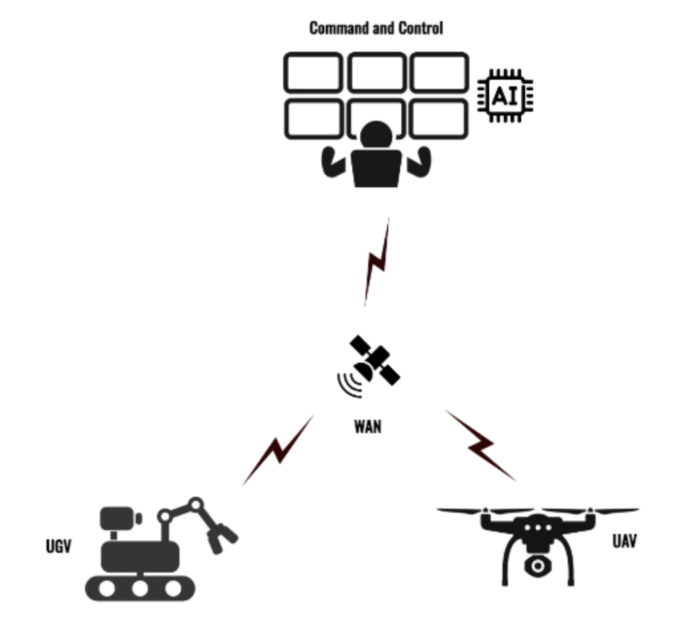
Modeling Architectures
UAV Data for Every Link At Current Node
Okay with classification at given p?
Analysis
Assume unless otherwise stated that initially, AI always does classification
Image Classification
Options Analysis
{C/NC,…}
{p,…}
Confidence Assessment
Y
{C/NC,…}
{p,…}
Human (30min) / AI (5 min)
N
Link A: Clear, High Confidence, AI
Link B: Clear, Low Confidence, AI
Link C: Not Clear, High Confidence, AI
Re-assign analysis
Ranked Links
Re-assign analysis
Request New Recommendation
N
Decision Analysis
Command to UGV
Command
Y
Recommendation
Final Decision
Agree with recommendation?
Decide

Slide 6
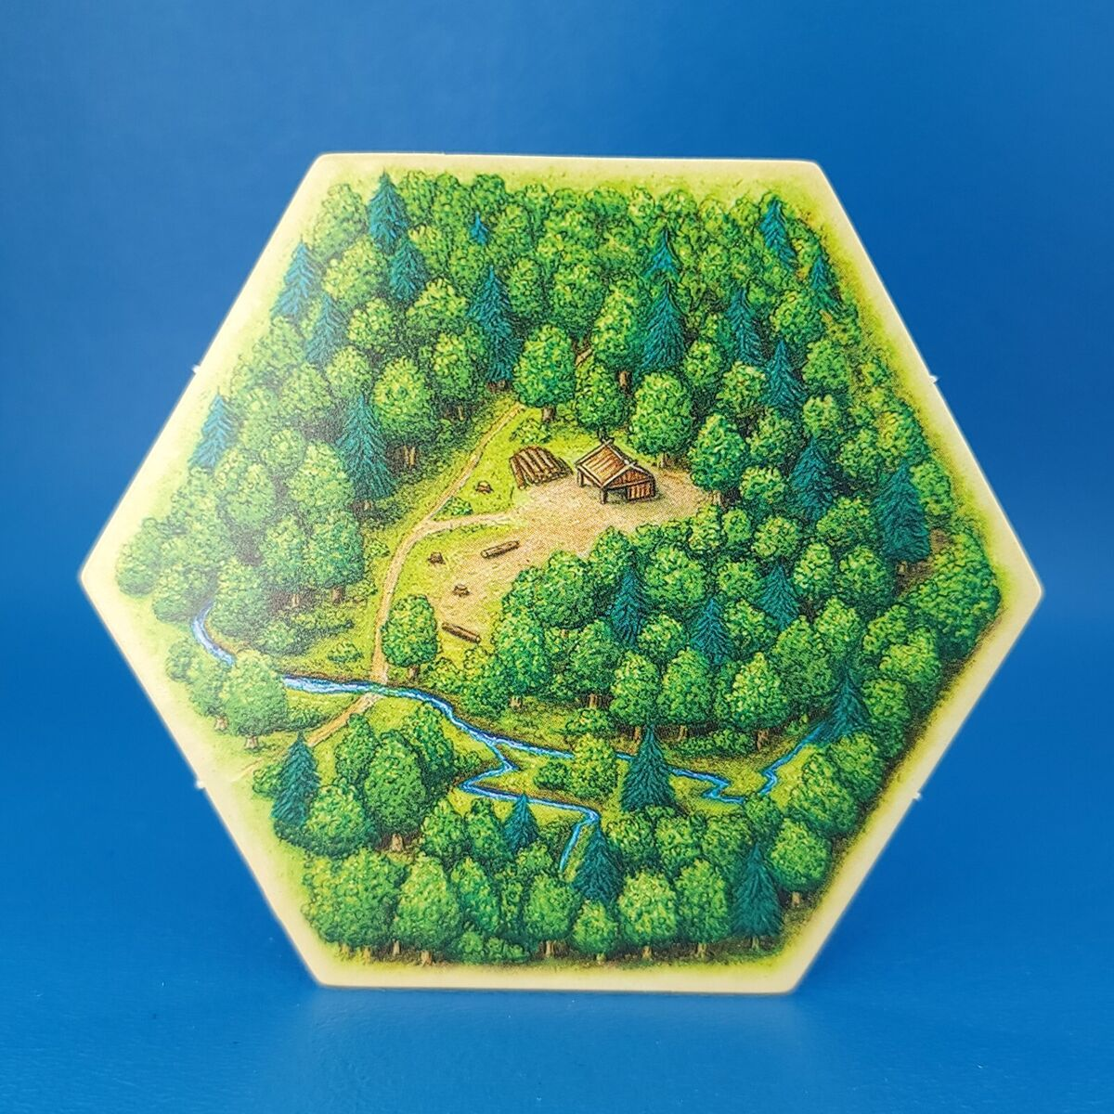
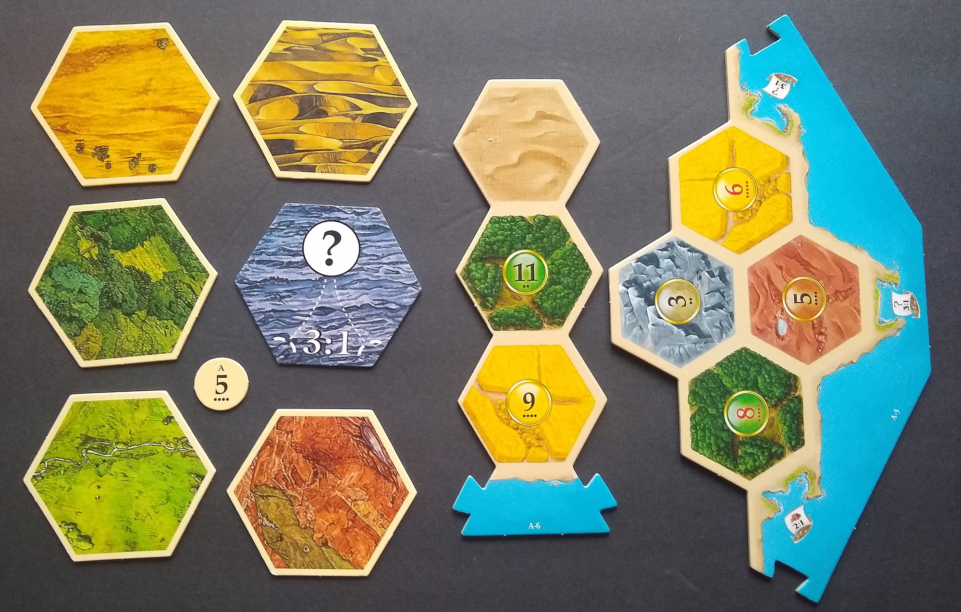
SilverFish Map
Wooded
Sandy, Rocky
Grassy
A
D
Start
B
E
End
C
F

Slide 7
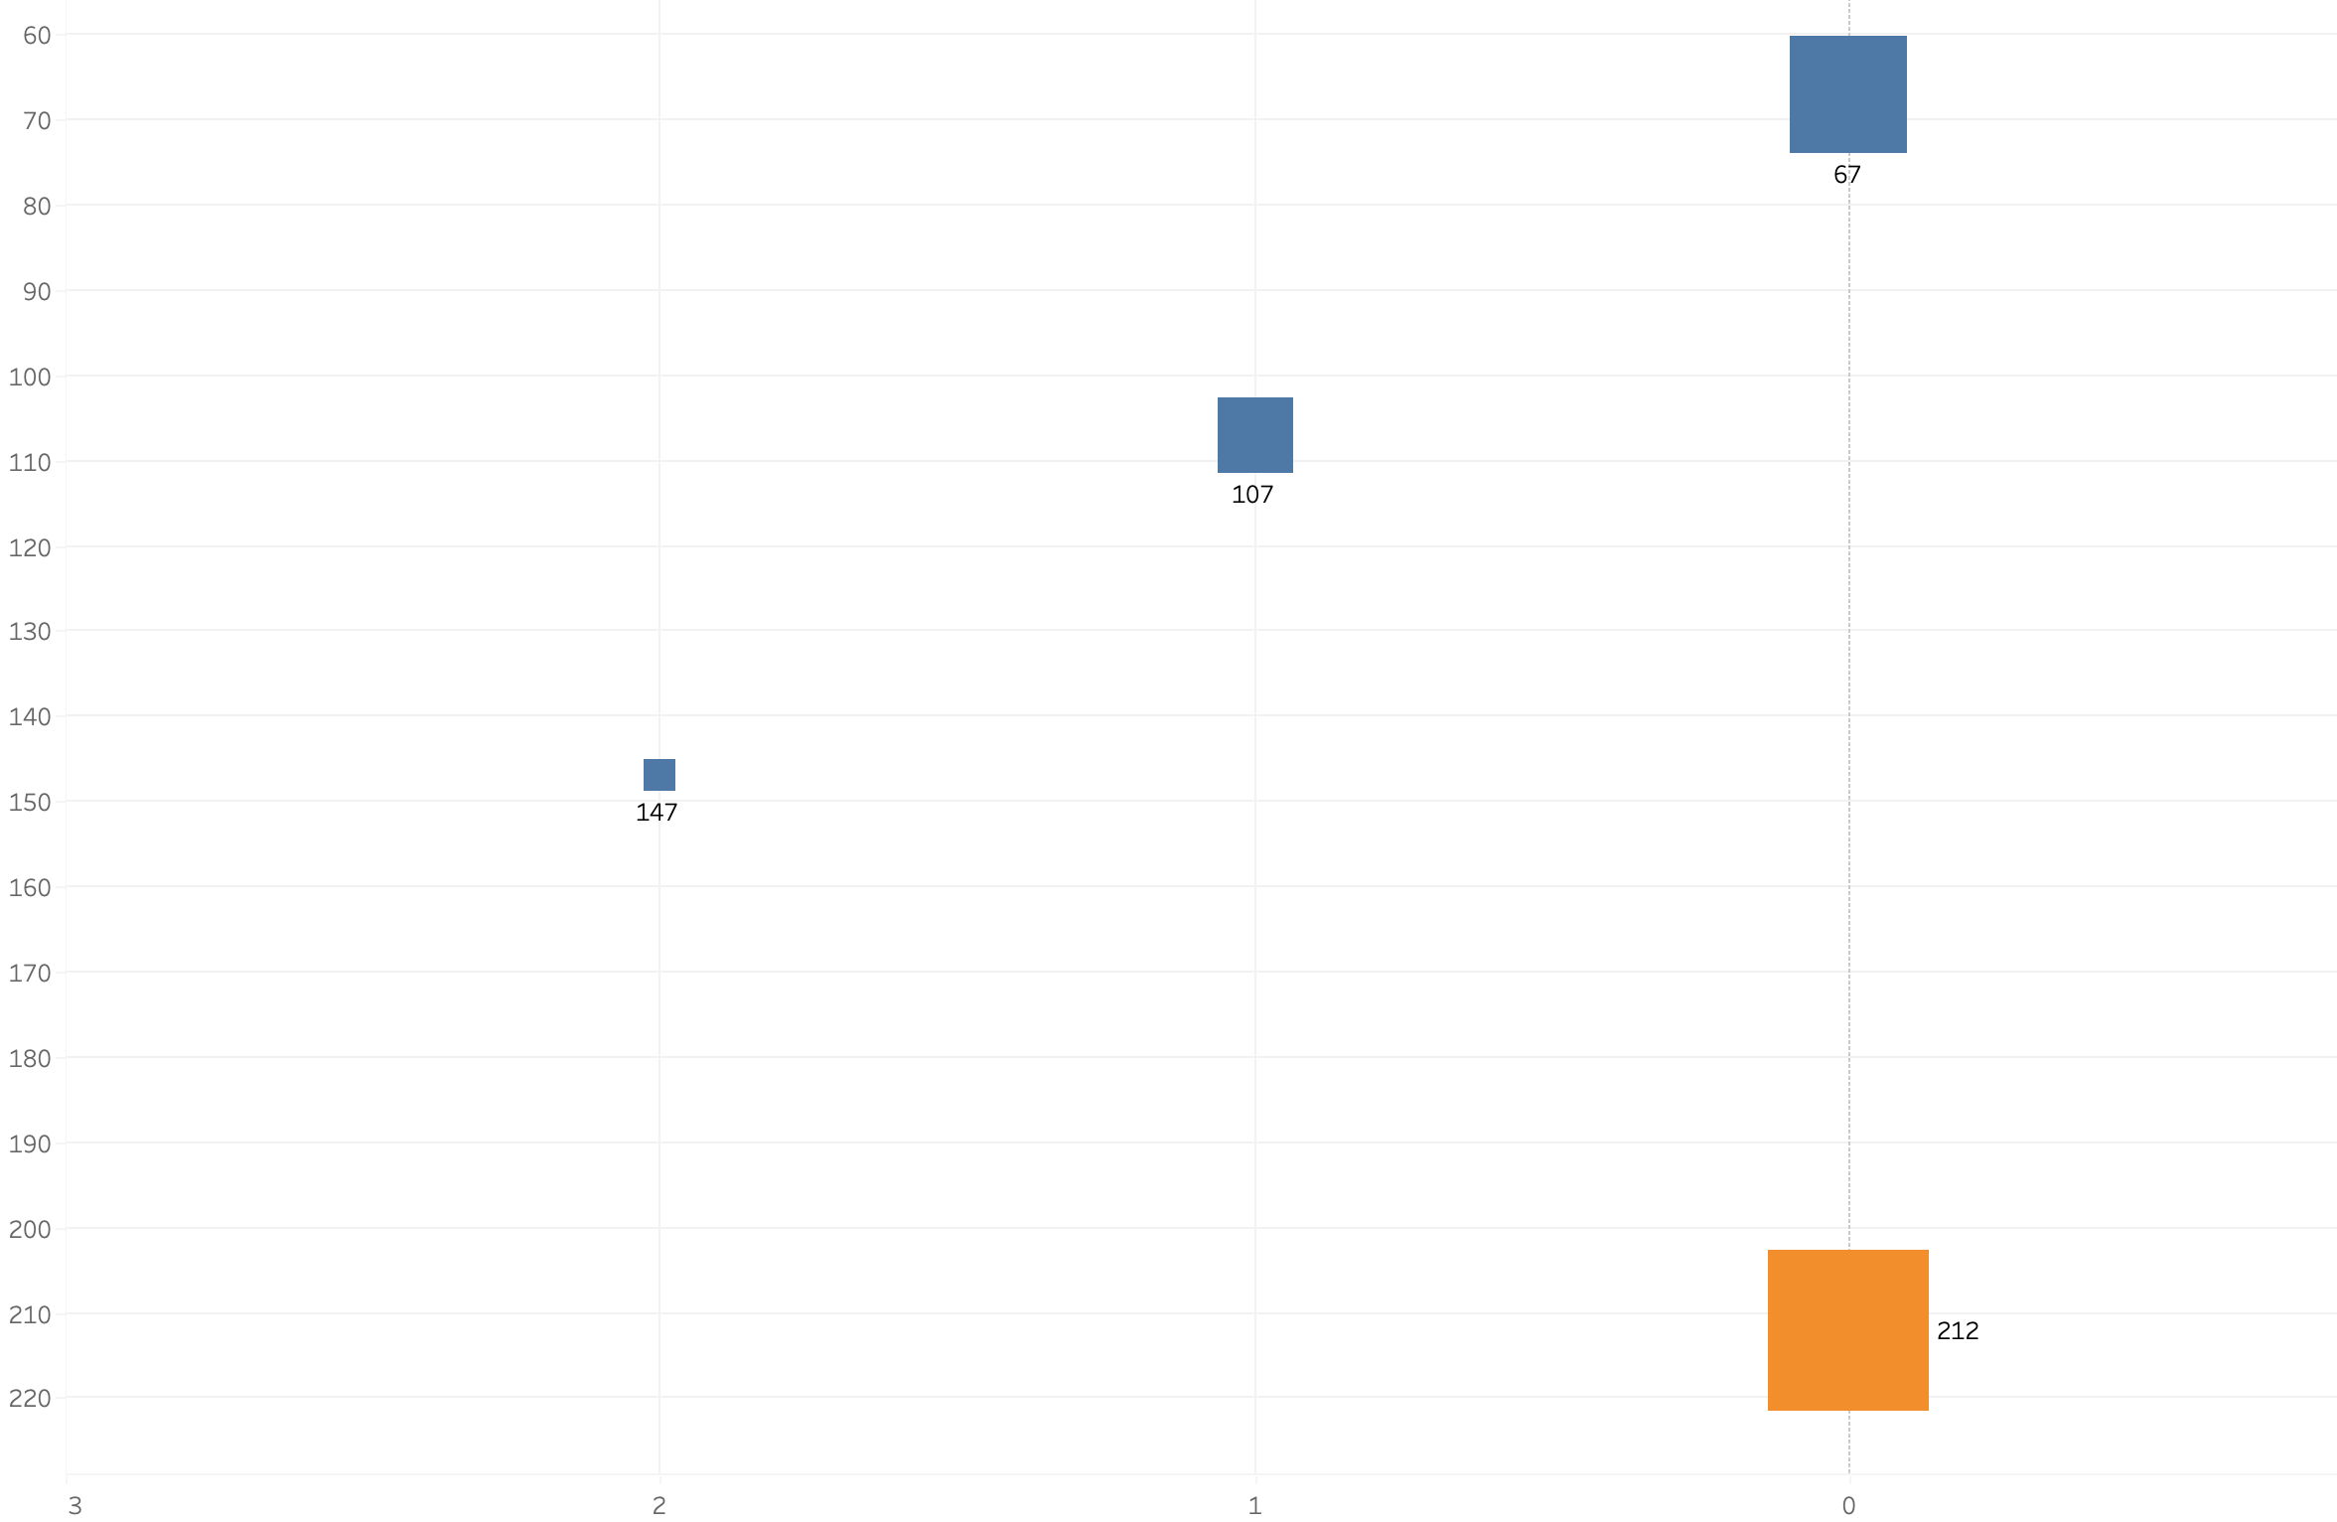
Baseline Human & AI Performance
AI alone avoids all mines in 80% of runs, taking only 67 min to traverse the map
Faster Traversal
AI alone hits 1 mine in 18.4% of runs
Performance Time to Traverse Map)
AI alone hits 2 mines in 1.6% of runs
Humans alone always avoid all mines, but take 212 min to traverse
Block size corresponds to % of runs
Slower Traversal
More Mines Hit
Risk (# of Mines Hit)
Fewer Mines Hit

Slide 8
Human Approver
UAV Data for Every Link At Current Node
Is human okay with confidence levels? 5 min to decide Reassign if 50/50 or worse
Analysis
Image Classification
Options Analysis
{C/NC,…}
{p,…}
Confidence Assessment
Y
{C/NC,…}
{p,…}
Human (30min) / AI (1 min)
N
Re-assign analysis
Link A: Clear, High Confidence, AI
Link B: Clear, Low Confidence, AI
Link C: Not Clear, High Confidence, AI
Ranked Links
Command to UGV
Decision Analysis
Human
Selected Route
AI

Slide 9
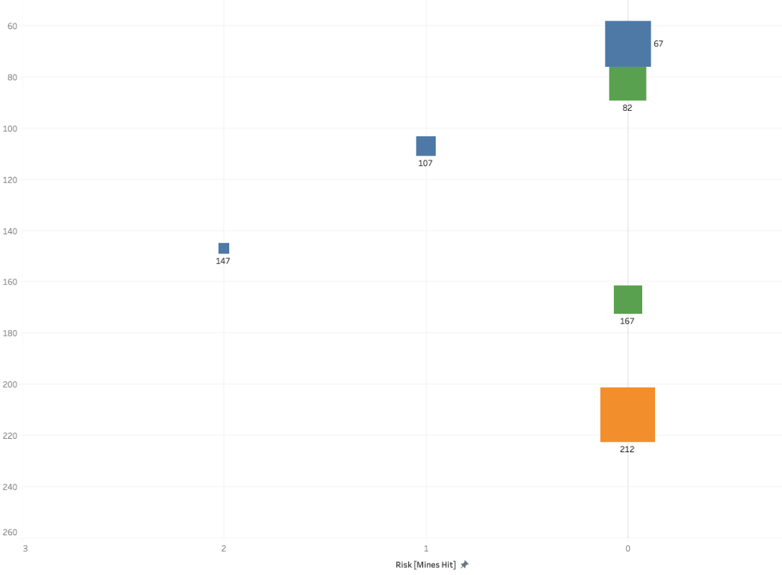
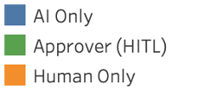
Human Approver Results
Human approver can provide better performance than human only with a better risk profile than AI-only
Performance Time to Traverse Map)
Risk (# of Mines Hit)

Slide 10
Human-AI Handoff
UAV Data for Every Link At Current Node
Analysis
Image Classification
Options Analysis
Analysis Assessment
{C/NC,…}
{p,…}
Human (30min) / AI (1 min)
If rocky terrain, human does classification;
else AI alone classifies
Ranked Links
Link A: C/NC, Confidence Level
Link B: C/NC, Confidence Level
…
Command to UGV
Decision Analysis
Selected Route

Slide 11
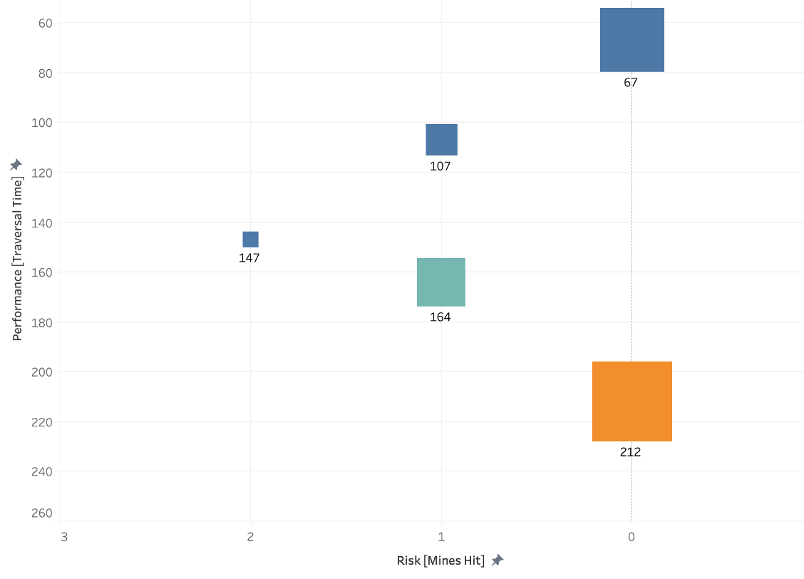

Human-AI Handoff Results
Human-AI Relay & AI Only performance is equal in 80% of runs
Performance Time to Traverse Map)
But in 20% of runs, 1 mine is hit with significantly worse performance than AI Only
Risk (# of Mines Hit)

Slide 12
Preliminary Results Summary
 | AI Alone | Human Approver | Human-AI Relay | Human Only
Avg Time | 75.6 min | 101.8 min | 84.4 min | 212 min
Avg Mines Hit | 0.26 | 0.0 | 0.2 | 0.0
AI performance is superior but at the cost of higher risk; inverse for humans
Human-AI collaboration can leverage AI performance with human judgement

Slide 13
Discussion: Non Linearity of Tradeoffs
P
E
R
F
O
R
M
A
N
C
E
?
AI
Alone
?
AI performance is superior but at the cost of higher risk; inverse for humans
Human-AI Systems
Humans
Alone
Tradeoffs are not linear
?
?
RISK

Slide 14
Discussion: Systems Engineering Implications
Systems engineers need to understand how humans interact with AI to ensure humans are able to perform as expected
Modeling human-AI system architecture needs to be a core practice in system development, design, and testing
Need to consider human/AI task allocation as a key function of system architecting and T&E

Slide 15
Conclusions & Next Steps
The goal is to create trust and assurance in the whole system, not just the algorithm
Preliminary results show complex tradeoffs of different human-AI system architectures
Continue to model architectures across different operating conditions, including degraded AI and human performance

Slide 16




