Slide 1
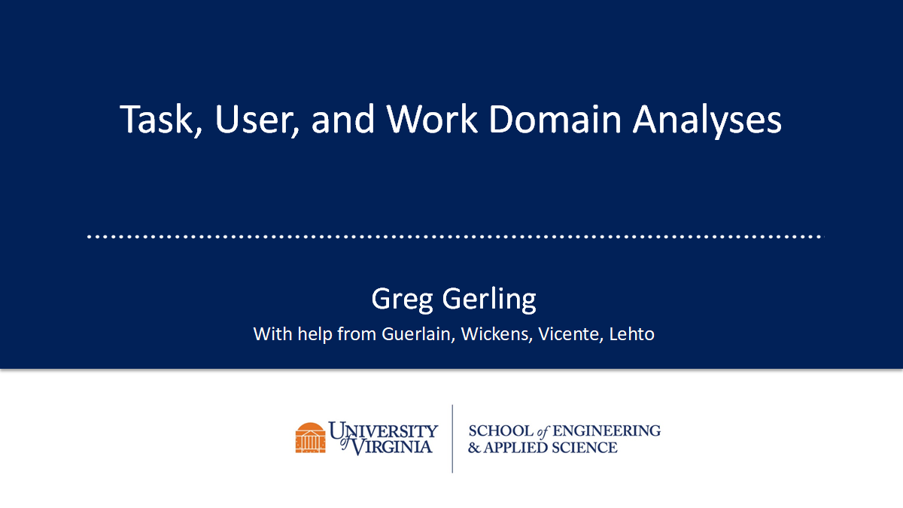
Trusted Artificial Intelligence for Armaments in Uncertain Environments
Justin Abel, Stephen Durham, Andrew Evans, Hannah Palmer, Sami Saliba
Mentored by Hunter Moore and William Scherer
University of Virginia Department of Systems and Information Engineering
December 6th, 2024

Slide 2
Agenda
1
Executive Summary
2
Mission Context
3
Methodology
4
Experimental Design and Results
5
Discussion
Notes:
Introduction of the Agency and its current uses of AI
What the Agencies administrative tasks are
How AI can be applied to these mentioned administrative task
The benefits and impacts of these AI applications
Potential risks and how to mitigate them
Lastly a conclusion also exploring future step

Slide 3
Trust in AI-enabled models can be established through the integration of explainable statistical models as data inputs.
Problem Context
Approach
Safely and efficiently traverse a minefield while minimizing number of mines hit and traversal time.
Explainable Statistics
Risk Monitoring
Goal
Simulation Modularity
Reinforcement Learning
Establish trust in uncertain environments and systems despite the black box nature of artificial intelligence (AI).

Slide 4
Mission Context

Slide 5
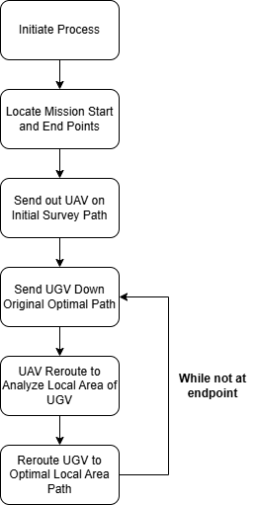
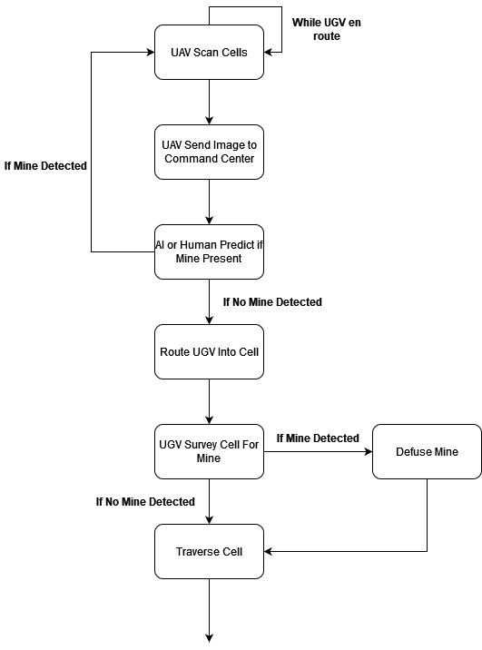
The mission context involves coordination between UAVs, UGVs, AI, and humans to dynamically detect, analyze, and navigate optimal paths through a minefield.
Simulation Modeling Process
Network Traversal and Mine Removal Process
Notes:
Jenna

Slide 6
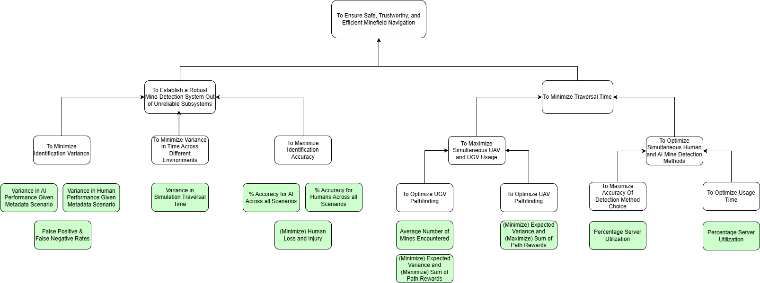
Employing a top-down approach ensures system goals are met and quantifies trust through clear success metrics.
Objectives Tree for Mission Context
These metrics are calculated in real time to ensure optimal system performance. By tying each sub objective to quantifiable metrics, the system will improve its reliability, minimize risks, and strengthen trust.

Slide 7
We frame trust in AI through the definition: “reliance upon others, confidence in their abilities, and consistency in behavior.”
Confidence in Capabilities
Consistent & Reliable Performance
Trust in AI
Reliance in the system’s function comes naturally in high-stakes scenarios.
Transparent and auditable models integrated into system design
Metrics monitored over time
Design systems that foster positive and reliable user experiences
Trust “involves a willingness to be vulnerable based on positive expectations of another’s behavior.”
Rousseau et. al., 1998
Clear reporting of system functions and decision-making process
Past performance data used to make evidence-based decisions
Risk is inevitable
Prioritize robustness

Slide 8
Methodology

Slide 9
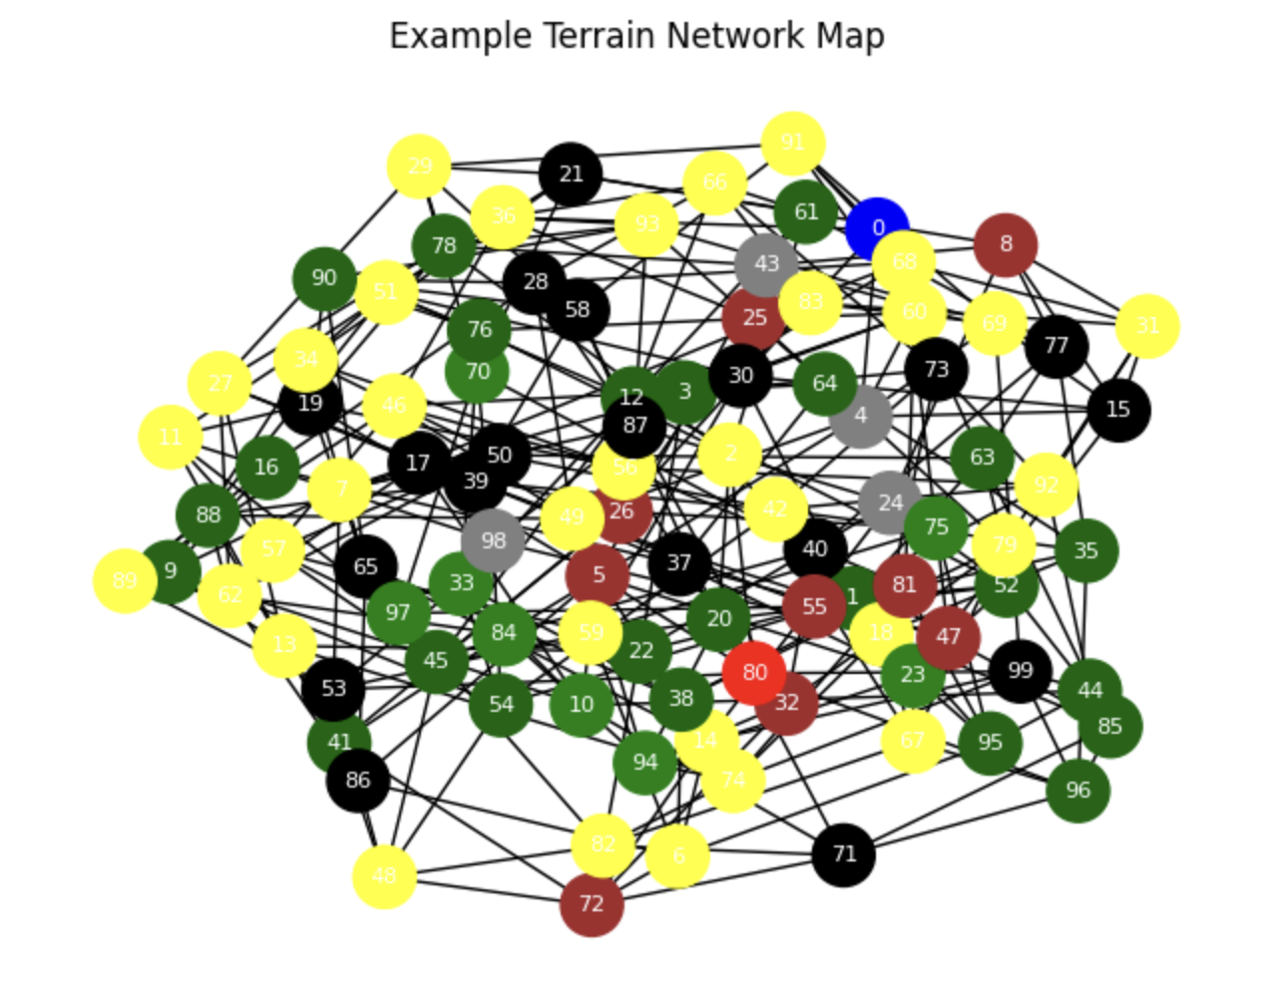
Building Accuracy Into the Simulation
Example Terrain Network Map
Map Generation
Configurable network with metadata, prediction estimates, accuracy, and mines
Accuracy Methodology
Logistic regression to model environment and detection reliability
Prediction Estimation
Translates the system accuracy and ground truth into a confidence score
Relates environment to accuracy
Logistic regression
Accuracy and knowing when a system is inaccurate is critical in trust
Notes:
Map generation
Accuracy methodology
Prediciton estimation
Simulation design
Simulation setup and base parameters

Slide 10
Simulation Design and Setup
Design
Base Environment Parameters
Our simulation is a mission wrapper built on the provided base to extend functionality
Allows for parallel processing to accommodate simultaneous events
More complex map generation and metadata capabilities
Tracked information includes
Scan status
Traversal status
Directional information for UGV/UAV
Distance of UGV/UAV to goal
Distance between UGV and UAV
Terrain transition matrix
Precipitation
Temperature
Wind
Visibility
Notes:
Map generation
Accuracy methodology
Prediciton estimation
Simulation design
Simulation setup and base parameters

Slide 11
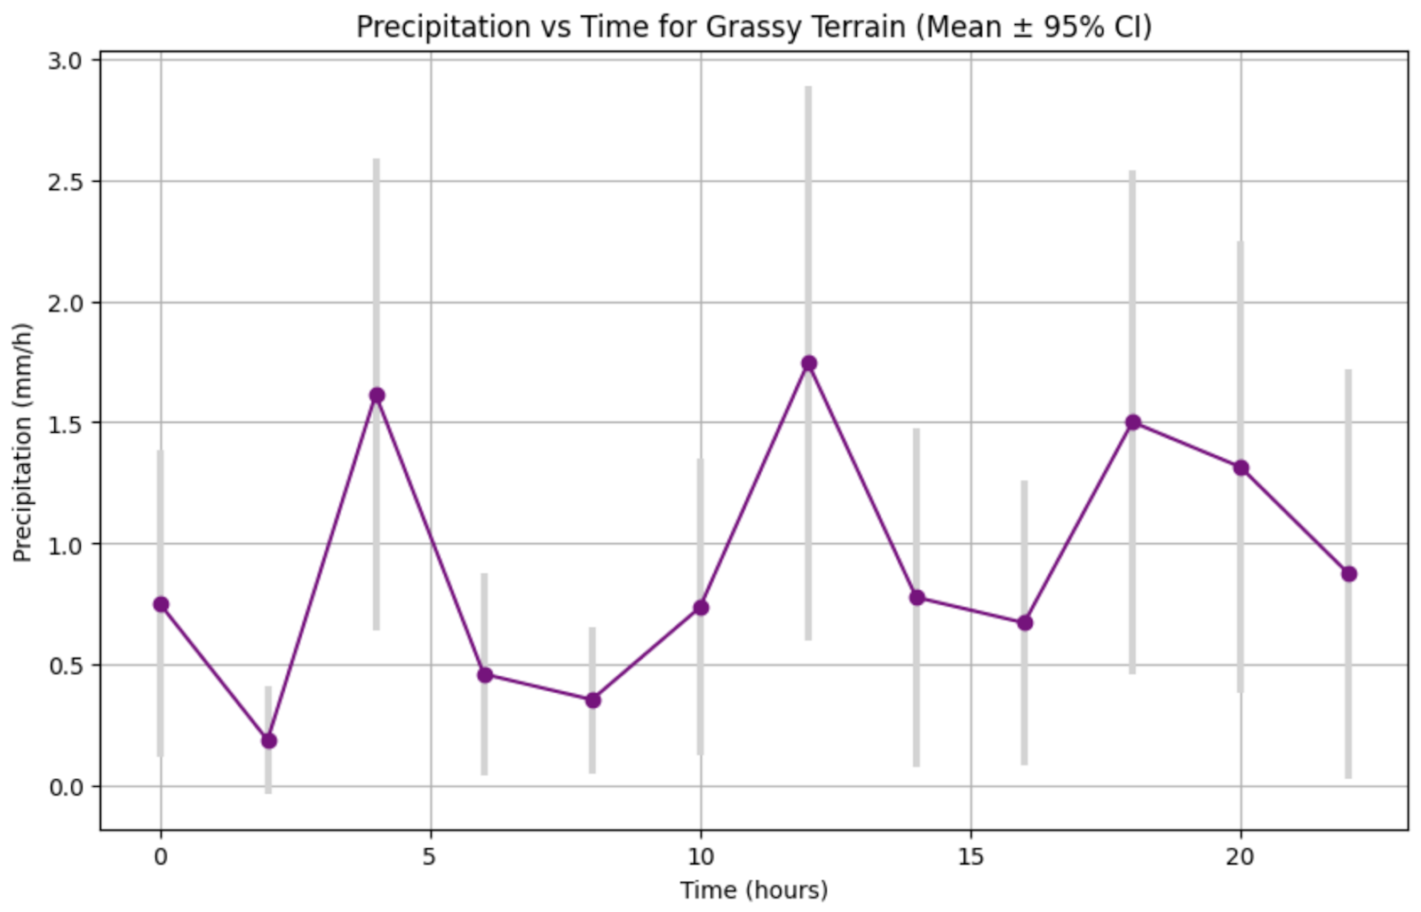
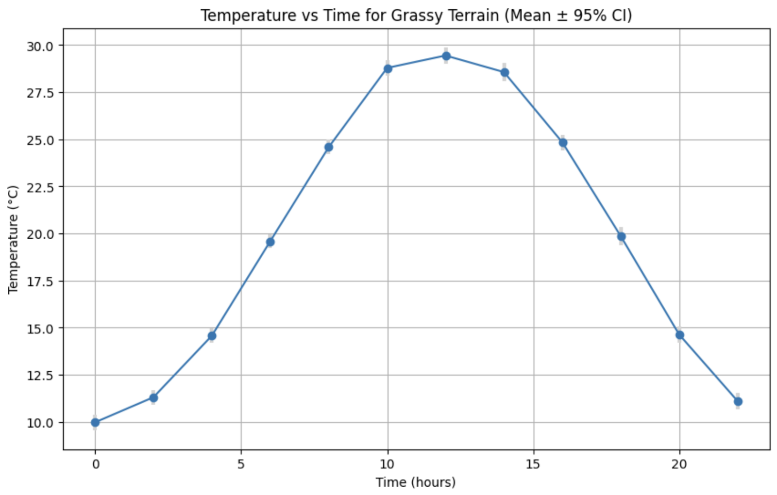
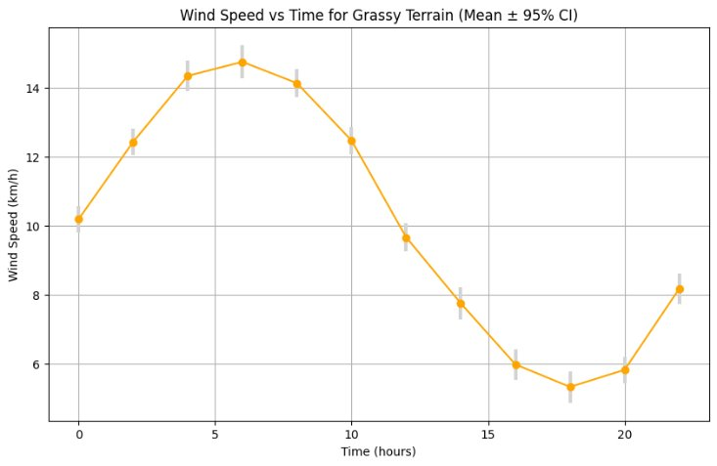
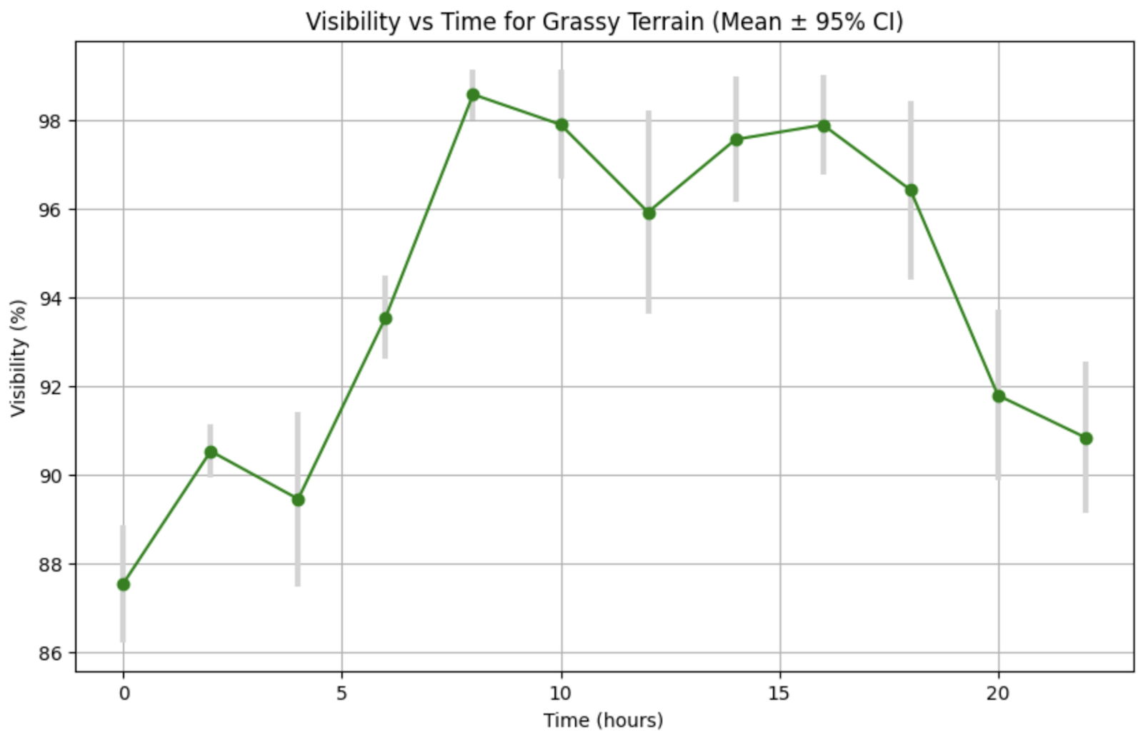
Generated metadata varies with terrain and time, used as base parameters in our simulation.
Metadata is time dependent to model daily and diurnal variation in factors such as in visibility, temperature, precipitation, and wind speed.

Slide 12
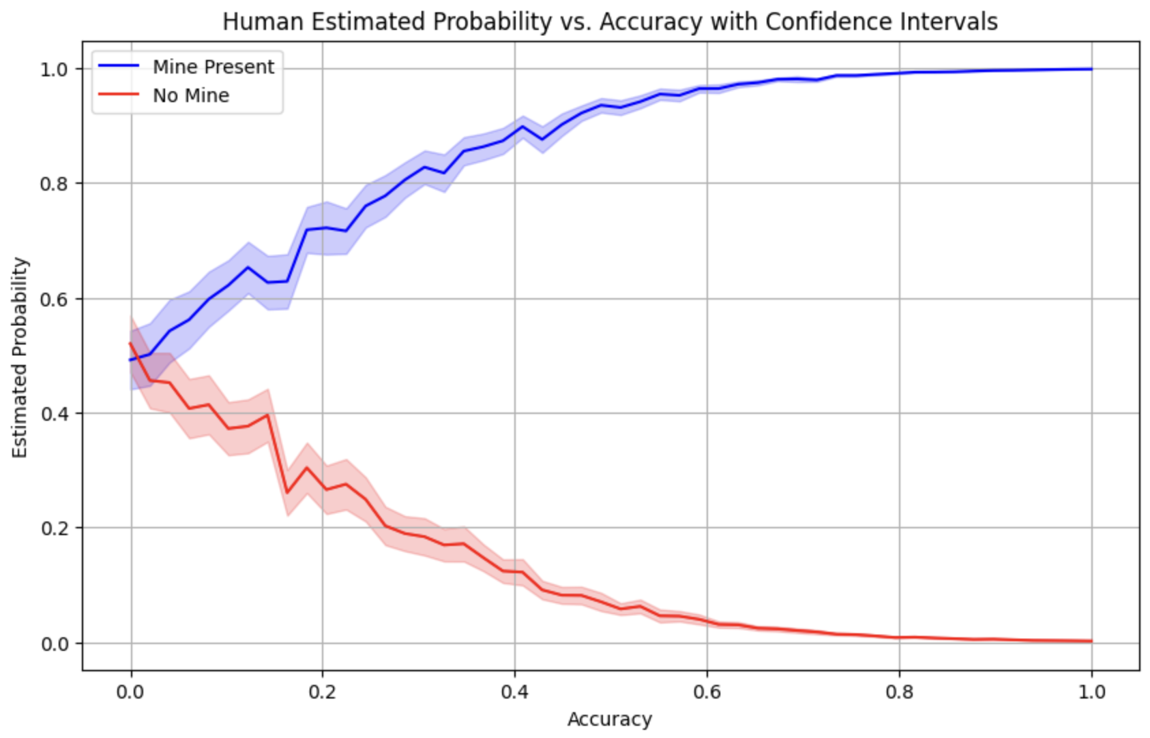
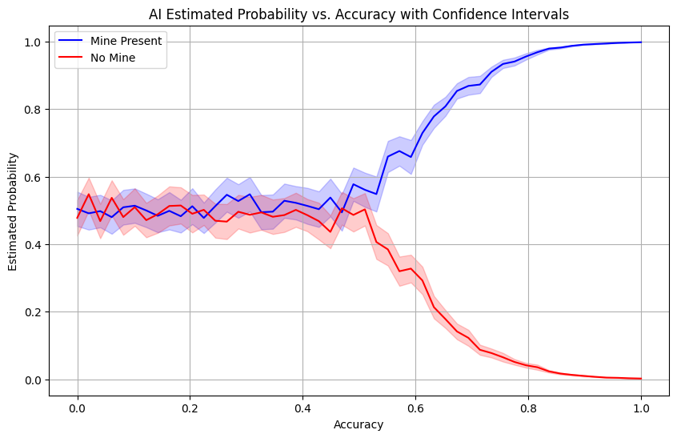
Estimated mine probability and system accuracy depend on true mine presence and evaluation method.
Representation of the system's confidence that a mine is present and the actual truth of mine presence. The human is given stronger prediction power at lower accuracy instances than the AI.

Slide 13
The Learning Agent is guided toward efficient, accurate, and mission-focused behavior.
Application of Reinforcement Learning (RL)
Setup as a Markov Decision Process (MDP)
States, actions, rewards, environment, policy
Multi-layer perceptron network architecture, proximal policy algorithm for training
Reward Function Components
Distance to Goal
Scans Performed
Mine Encounters
Action Efficiency

Slide 14
Experimental Design and Results

Slide 15
The system combines reinforcement learning, explainable statistics, and risk monitoring for safe, efficient, and trustworthy minefield navigation.
UGV Design
UAV Design
UAV determines which cells to scan, influencing UGV’s path selection
Utilizes the A* algorithm for efficient pathfinding
Integrates mine probability data to avoid high-risk areas
Recalculates UGV paths as UAV provides updated scans and probability estimates
Reinforcement Learning (RL): Employs a multi-layer perceptron (MLP) neural network with Proximal Policy Optimization (PPO) for training
RL framework adapts to new scenarios and optimizes performance through rewards and penalties
Explainable Statistics
Risk Based Monitoring
Uses linear regression to estimate prediction accuracy and verify system decisions
Analyzes metadata (e.g., terrain, weather) to evaluate mine detection confidence
UAV Metrics: Accuracy Avoidance Ratio (AAR) tracks UAV’s avoidance of low-accuracy cells
UGV Metrics: Surrounding Scan Confidence (SSC) measures the quality of nearby cell scans weighted by accuracy
Integrated Risk Monitoring: Links UAV scanning to UGV traversal confidence

Slide 16
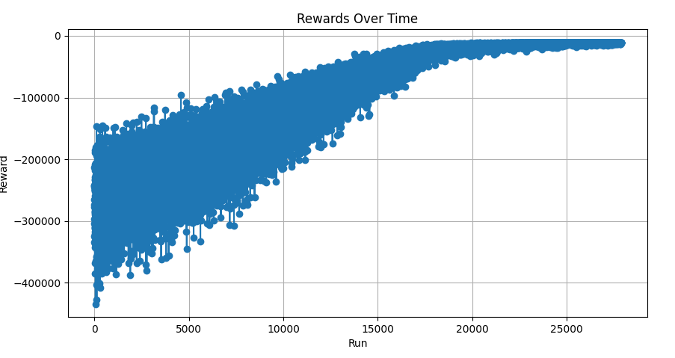
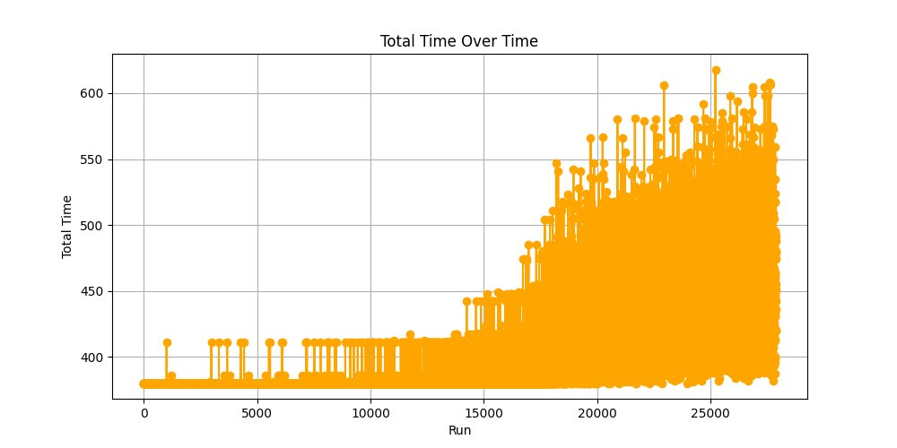
Results From Experimentation
Performance Over Training
Key Findings
Over ~25,000 episodes, the agent reaches a local maxima in cumulative rewards
Agent was beginning to use the AI and human scanning methods to reduce the UGV distance cost to the goal
Training ended prematurely before the agent was able to learn a mine avoidance policy
Rand
Notes:
Map generation
Accuracy methodology
Prediciton estimation
Simulation design
Simulation setup and base parameters

Slide 17
Discussion

Slide 18
This research discusses embedding trust and accountability into adaptable AI systems.
Relevance of this Work
Adoption of Work
Addresses challenge of embedding trust within the integration of AI systems as development rapidly increases
Uses explainable statistics to verify decision-making and assumptions
Optimizes reinforcement learning for minefield traversal via a custom reward system
Enhances understanding of trust and AI interaction
Explores ethical trade-offs between minimizing casualties and mission speed
Establishing a general framework for building trust in AI architecture
Systems engineering approach ensures clarity, and adaptability for replicating findings
Structured methodology includes mission process flows, objectives, and metrics discussion
Coding processes and frameworks offer a template for replication and validation
Modular simulation design allows customization of parameters (e.g., metadata, traversal rules, accuracies)
Black-box intelligent agent design supports integration with reinforcement learning platforms
Notes:
Addresses challenge of embedding trust within the integration of AI systems
This issueis magnified by the rapid development of AI technologies
We use explainable statistics from cited literature and relevant statistical models to verify decision making and assumptions
Use a custom reward system to optimize reinforcement learning for minefield traversal
Contributes to the understanding of the interplay between trust and AI systems
Address broader discourse on the ethics of mission success, particularly in weighing the trade-offs between minimizing casualties and optimizing mission speed

Slide 19
A multidisciplinary workforce is required to facilitate trust in AI-enabled systems.
Human Subject Matter Experts
AI Technicians + AI Software Engineers
Cyber Workforce
Risk Analysis Workforce
Operators
AI-ML Engineers
Analyze UAV & UGV imagery
Able to replicate similar work to that performed in this study
Support, maintain, and develop AI models
Employ firewalls, VPNs, secure local networks
Monitor, mitigate, and analyze risks and failures
Interpret AI recommendations, assess validity, integrate with human judgment
Notes:
Human Subject Matter Experts
Analyze UAV & UGV imagery
UAV & UGV Technicians/Operators
AI-ML Engineers
Able to replicate similar work to that performed in this study
AI Technicians + AI Software Engineers
Cyber Workforce
Employ firewalls, VPNs, secure local networks
Risk Analysis Workforce
Monitor, mitigate, and analyze risks and failures
Operators
Interpret AI recommendations, assess validity, integrate with human judgment

Slide 20
Planned Future Work
Simulation Enhancements
Adjusting parameters to account for more real world-conditions
Add parameters for number of UAVs and UGVs
Explore Defined Metrics
Minimizing human loss and injury
Account for time (server utilization)
Expanded Literature Review
Focus on trade off between time and human safety
Accuracy and variance stats for performance in different weather conditions
False positive and false negative rates
Further Experiments
More complex reward structures
Longer training sessions
Adding tactical placements of mines
Notes:
Testing under a wider range of scenarios
Explain further on this?
Adjust to handle situations where reliability is not guaranteed
UGV doesn't consistently disarm mines
UAV has limited battery life
Adjust current parameters to handle these situations
Such as # of nodes, UAV & UGV depths, # of edges, accuries, predictions
Maximize cumulative awards
Expanded literature review
Account for time
Server utilization metric

